Slide 1
Simple Spirometry
Dr Reema Altaweraqi

Slide 2
Objectives
1. Describe how a bell-type spirometer is used to measure lung volumes and capacities. 2. List and Define the different lung volumes and capacities. 3. State the normal values of each lung volume and capacity. 4. Discuss the physiological and pathological factors that may affect the different lung volumes and capacities.

Slide 3
Simple Spirometry
Is a pulmonary function test that measure lung volumes and capacities Why do we perform spirometer test? - Cause of SOB - Rule out obstructive or restrictive lung disease - Diagnose and monitor lung problems. - Monitor how well medications are working.

Slide 4
Equipment
Simple spirometer ( many types are available, Bell-type spirometer or water-gauge spirometer )
Nose clip.
Disposable mouth piece.

Slide 5
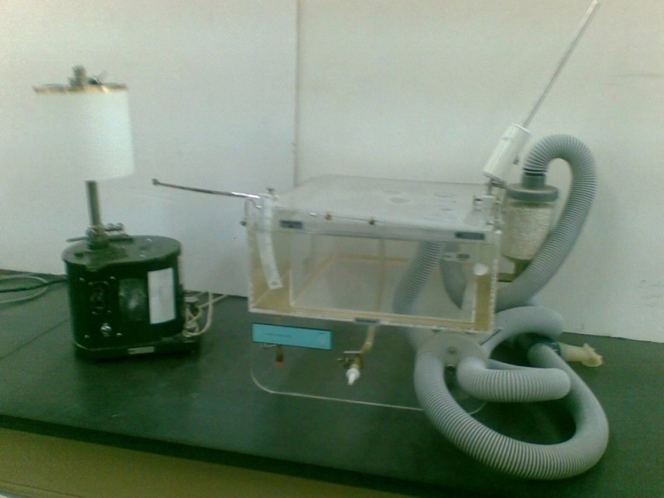
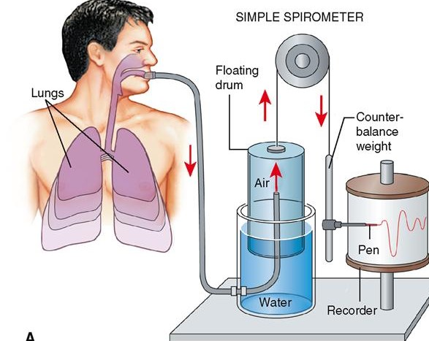
Simple spirometer

Slide 6
Procedure
1. Insert the mouthpiece in the subject’s mouth.
2. Place the nose clip on the subject’s nose.
3. Ask the subject to take normal breaths through the mouthpiece for a short while.
4. After recording few normal breaths, ask the subject to take a deep forceful inspiration filling their lungs to their maximum ability, then exhale gently and follow it with few normal breaths.
5. Than ask the subject to expire quickly, forcibly and as completely as possible. Followed by inhalation and normal breathing.
6. Finally, ask the subject to take a deep forceful inspiration and to follow it immediately with maximum quick and forceful expiration. Once this is complete, ask the subject to breath normally for a short time.
7. The spirogram is recorded on a moving drum.

Slide 7
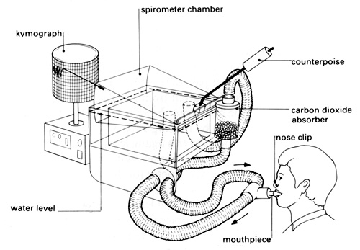
The subject breaths through a mouthpiece while a nose clip is placed on the nose to avoid air escaping through the nose. While breathing, air moves in and out of the spirometer chamber causing displacement in the pen attached to its surface. The moving pen draws the spirometry graph on kymograph. The degree of displacement is proportional to the volume of air moving in and out of the lungs. With proper calibration, the volume of air moving in and out of the lungs can be calculated.

Slide 8
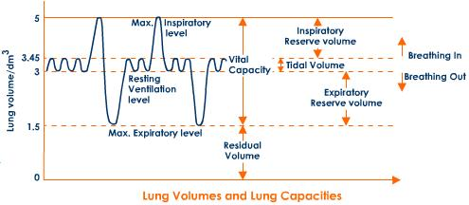
Lung volumes and Capacities

Slide 9
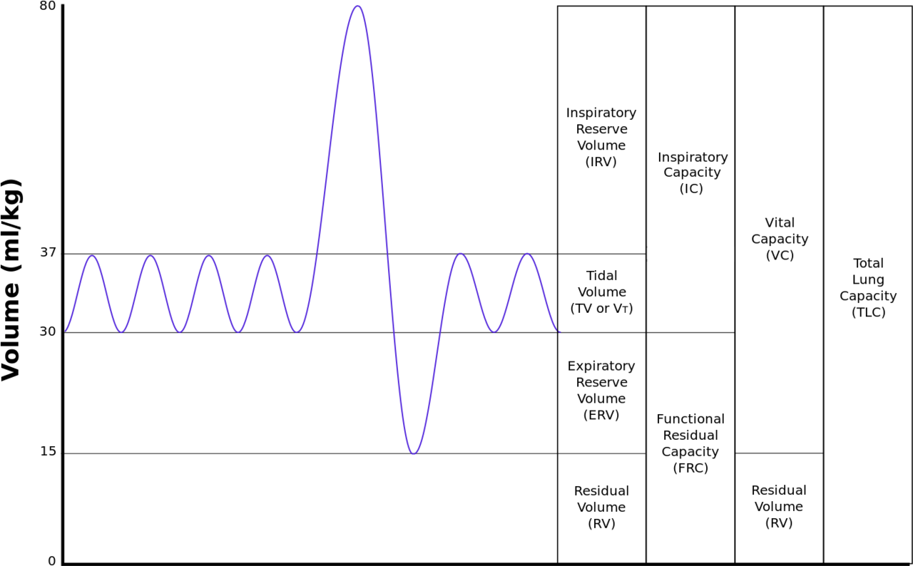
Lung volumes and Capacities

Slide 10
Lung volumes and Capacities
1. TIDAL VOLUME (TV) - Volume of air inspired or expired during normal (quit) breathing. - N = 500 ml or 0.5 L ( male and female )
2. INSPIRATORY RESERVE VOLUME (IRV) - The extra volume of air that can be inspired by a maximal inspiratory effort after normal inspiration.
- Average : 3000 ml or 3 L - Male : 3.3 L Female : 1.9 L

Slide 11
Lung volumes and Capacities
3. EXPIRATORY RESERVE VOLUME (ERV) - The extra volume of air that can be expired by forceful expiration after the end of a normal tidal expiration.
- Average : 1100 ml or 1.1 L - Male : 1 L Female : 700 ml

Slide 12
Lung volumes and Capacities
4. RESIDUAL VOLUME (RV) - The volume of air remaining in the lungs after the most forceful expiration. - Average : 1.2 L ( RV and FRC can not be measured directly by Spirometry but measured by Helium dilution method )

Slide 13
Lung volumes and Capacities
5. INSPIRATORY CAPACITY (IC) - Volume of air inspired by a maximal inspiratory effort after normal expiration. - IC = TV + IRV - Average : 3.5 L - Male : 3.8 L Female : 2.4 L

Slide 14
Lung volumes and Capacities
6. FUNCTIONAL RESIDUAL CAPACITY (FRC) - The amount of air that remains in the lungs at the end of normal expiration. - FRC = ERV + RV - Average : 2.3 L
7. VITAL CAPACITY (VC) - The volume of air that can be maximally expired after maximum inspiration. - VC = TV + IRV + ERV - Average : 4600 ml or 4.6 L - Male : 4.8 L Female : 3.1 L

Slide 15
Lung volumes and Capacities
8. TOTAL LUNG CAPACITY (TLC) - Is the maximum volume to which the lungs can be expanded with the greatest possible inspiratory effort. - TLC = VC + RV - Average: 5800 ml or 5.8 L

Slide 16
Physiological factors affecting lung volumes and capacities
1. Age - ↑ RV, ↑ FRC with ↑ age - ↓ VC with age (muscle weakness) 2. Sex - females have 20 – 25% less values in all pulmonary volume and capacities than males. 3. Body size - Obese : ↓ VC , ↓ FRC because there is ↑ elastic recoil of the lungs. 4. Athletes - ↑ VC

Slide 17
Pathological conditions affecting lung volumes and capacities
Restrictive Lung diseases ( e.g. Alveolar Fibrosis) - Reduce the compliance of the lungs ( restrict expansion) compressed lung volumes - ↓ VC, ↓ IRV, ↓ ERV, ↓RV, ↓ TV - ↑ breathing frequency

Slide 18
Pathological conditions affecting lung volumes and capacities
Obstructive Lung diseases ( e.g. Emphysema ) - ↑ Resistance to airflow ( small airway closure during expiration) air trapping ( pulmonary hyperinflation)
- ↑ TLC, ↑ FRC, ↑ RV, ↑ TV - ↓ VC, ↓ ERV

Slide 19
Thank You

