Slide 1
Infective Endocarditis
ALI SOMILY , MD, FRCP(C)
ali.somily@gmail.com
FAWZIA ALOTAIBI, MD
ofawzia@ksu.edu.sa

Slide 2
Objectives
Define infective endocarditis
Recognize the bacteria such as staphylococcus aureus and streptococcus viridans as the most common etiologies of IE
Know the different clinical presentation of acute and sub-acute IE
To recognize the different clinical presentation of IE; fever as the most common cause of pyerixia of unknown origin (P.U.O).
TO the bacterial and host factors affecting the severity and outcome of the disease.
Recognize the sources of bacteria causing bacteremia preceding IE.
To know the pathogenesis of IE and the formation and importance of vegetations.
To know the predisposing factors such as RHD, CHD, prosthetic valves and IVDU.
To the common bacterial causes of IE associated with different sources and clinical conditions.
To realize the infection as a diagnostic challenge and to know the different diagnostic methods of IE including;
Clinical presentation (signs & symptoms)
Laboratory tests mainly multiple blood cultures.
Echocardiogram for the presence of vegetations
To know the different regimens used to treat different types of organisms.
To know possible complications of IE.
.

Slide 3
Outlines
Definition
Pathogenesis
Risk factors
Clinical presentation
Diagnosis
Culture negative endocarditis
Management
Prophylaxis

Slide 4
Definition
Infectious Endocarditis (IE): an infection of the heart’s endocardial surface
Classified into four groups:
Native Valve IE
Prosthetic Valve IE
Intravenous drug abuse (IVDA) IE
Nosocomial IE

Slide 5
Further Classification
Acute:
Affects normal heart valves
Rapidly destructive
If not treated, usually fatal within 6 weeks
Commonly Staph→ Metastatic foci
Subacute:
Often affects damaged heart valves
Indolent nature
If not treated, usually fatal by one year
Commonly viridans Streptococci

Slide 6
Pathophysiology
Turbulent blood flow disrupts the endocardium making it “sticky”
Bacteremia delivers the organisms to the endocardial surface
Adherence of the organisms to the endocardial surface
Eventual invasion of the valvular leaflets

Slide 7
Epidemiology
Incidence: 1.7— 6.2 / 100, 000 person years
M:F 1.7
Becoming a disease of the elderly
Median age
PreABx era —35y
Now —58y
Due to two factors
The decline of rheumatic heart disease
The increasing proportion of elderly

Slide 8
Prosthetic Valve
7 -25 % of cases of infective endocarditis
Early <12mons
Late >12 mons
0.94 per 100,000 bioprosthetic
Initially mechanical valves at greater risk for first 3 mo, then risk same at 5y
1-3.1% risk at 1 yr
2-5.7% at 5 yr

Slide 9
Risk Factors
Injection drug use
100X risk in young
Staphylococcus aureus
Other risks:
Poor dental hygiene
Hemodialysis
DM
HIV
IVDU
Rates 150- 2000/ 100 000
person years
Higher among patients with known valvular heart disease
Structural cardiac abnormality
75% of pts will have a preexisting structural cardiac abnormality
10-20% have congenital heart disease

Slide 10
Risk Factors ; Cardiac Abnormality
High risk ● Moderate risk
Previous IE 4.5(2.5 to 9)%
Aortic valve disease12 to 30%
Rheumatic valve disease
Prosthetic valve
Coarctation
Complex cyanotic congenital
MVP w/ MR/thickened leaflets- 5 to 8 times (100/100 000 person years)
Mitral Stenosis
tricuspid valve
Pulmonary Stenosis
Hypertrophic Obstructive Cardiomyopathy (HOCM)
Low/no risk
ASD (secundum)
CABG

Slide 11
Risk Factors
HIV infection:
A number of cases of IE have been reported in patients with HIV infection
It has been suggested that HIV infection is an independent risk factor for IE in IDU
Rheumatic valve disease:
Predisposition for young in some countries 37%-76% of cases
Mitral 85%, Aortic 50%
Degenerative valvular lesions
MV Prolapse and associated mitral regurgitation - 5 to 8 times higher IE risk
Aortic valve disease (stenosis or/and regurgitation) is present in 12 to 30 % of cases

Slide 12
Diagnostic approach
History of prior cardiac lesions
A recent source of bacteremia

Slide 13
Symptoms
Acute
Subacute
High grade fever and chills
SOB
Arthralgias/ myalgias
Abdominal pain
Pleuritic chest pain
Back pain
Low grade fever
Anorexia
Weight loss
Fatigue
Arthralgias/ myalgias
Abdominal pain
N/V
The onset of symptoms is usually ~2 weeks or less from the initiating bacteremia

Slide 14
Physical examination
Look for small and large emboli with special attention to the fundi, conjunctivae, skin, and digits
Cardiac examination may reveal signs of new regurgitation murmurs and signs of CHF
Neurologic evaluation may detect evidence of focal neurologic impairment
Signs
Fever
Heart murmur
Nonspecific signs – petechiae, subungal or “splinter” hemorrhages, clubbing, splenomegaly, neurologic changes
More specific signs - Osler’s Nodes, Janeway lesions, and Roth Spots

Slide 15
Other aspects clinical diagnosis
WHICH VALVE? R or L heart where would emboli go?
HEART FUNCTION?
Pump, acute valve dysfunction conduction
Look for evidence emboli
Bleed (intracranial, elsewhere mycotic aneurysm )

Slide 16
Diagnostic approach
Positive blood culture results
A minimum of three blood cultures should be obtained over a time period based upon the severity of the illness
Additional laboratory Nonspecific test
An elevated ESR and/or an elevated level of CRP is usually present
Most patients quickly develop a normochromic normocytic anemia
The WBC count may be normal or elevated

Slide 17
Additional laboratory tests
abnormal urinalysis
The combination of RBC casts on urinalysis and a low serum complement level may be an indicator of immune-mediated glomerular disease
ECG:
New AV, fascicular, or bundle branch block...
.?PERIVALVULAR INVAVSION­ monitoring,
??pacing

Slide 18
Native Valve IE
Strep. (55%), mostly S. viridans
Staph. (30%), mostly S. aureus
Enterococci (5-10%),
GNB=HACEK (5%),
Fungi
Prosthetic Valve IE
Early (0-2 mo) 1 - 3.1%
50% Staphylococci S. epi.> S. aureus, gnb, enterococci
Late (>12 mo) 2 - 5.7%
IE in IV drug abusers
Staph. aureus(50-60%)

Slide 19
Case Definition: IE
Duke criteria
In 1994 investigators from Duke University modified the previous criteria to include
The role of echocardiography in diagnosis
They also expanded the category of predisposing heart conditions to include intravenous drug use

Slide 20
Modified Duke criteria
Proposed: 2000, Addresses TEE, Broad “possible categories.
S. aureus risks (13-25% S. aureus bacteremia have IE )
Definite IE
Microorganism (via culture or histology) in a valvular
vegetation, embolized vegetation, or intracardiac abscess
Histologic evidence of vegetation or intracardiac abscess
Possible IE
2 major
1 major and 3 minor
5 minor
Rejected IE
Resolution of illness with four days or less of antibiotics

Slide 21
Major criteria
Minor criteria
Predisposition (heart condition or IV drug use)
Fever >/= 38ºC
Vascular phenomenon (excludes petechiae, splinter hemorrhage) 3.major arterial emboli,
1.MICROBIOLOGY
Typical organism from 2 separate cultures OR
Microorganism from persistently positive BC OR Single BC + for Coxiella burnetii, or titer >1:800
○
○
2.ENDOCARDIAL INVOLVEMEMT
New (not changed) murmur of regurgitation
3.POSITIVE ECHO
Mycotic aneurysm, intracranial or conjunctival hemorrhages. Janeway lesions
Immunologic phenomena
RF,.Roth’s spots glomerulonephritis, Osler’s nodes
Microbiologic evidence
Not meeting major criteria single BC not CNS, serology
○
•
(TEE if prosthetic valve, complicated, or pretest probability possible IE

Slide 22
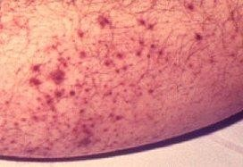
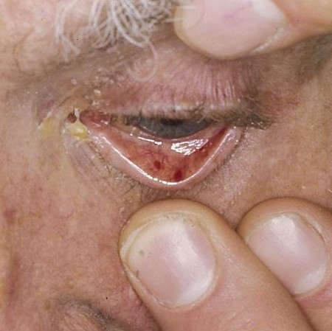
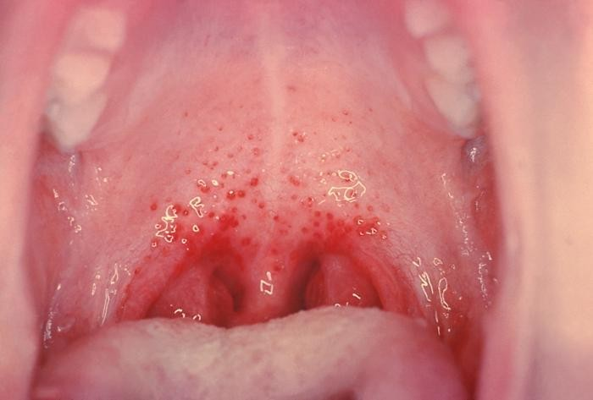
Petechiae
Nonspecific
Often located on extremities or mucous membranes
Harden Library for the Health Sciences
Photo credit, Josh Fierer, M.D.

Slide 23
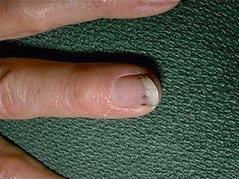
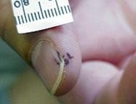
Splinter Hemorrhages
Nonspecific
Nonblanching
Linear reddish-brown lesions found under the nail bed
Usually do NOT extend the entire length of the nail

Slide 24
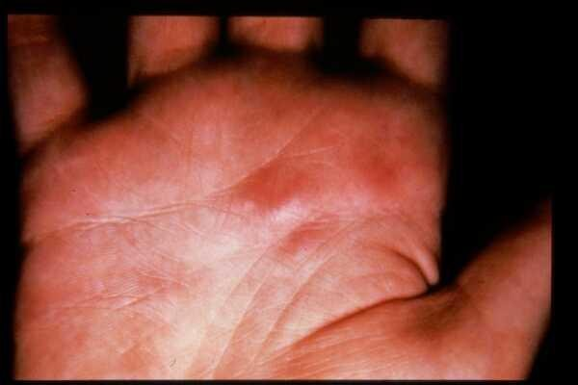
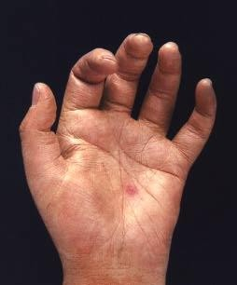
Osler’s Nodes
American College of Rheumatology
More specific
Painful and erythematous nodules
Located on pulp of fingers and toes
More common in subacute IE

Slide 25
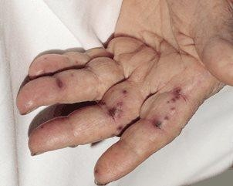
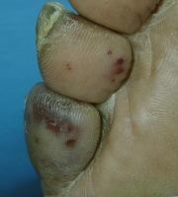
Janeway Lesions
More specific
Erythematous, blanching macules
Nonpainful
Located on palms and soles

Slide 26
Complications
Four etiologies
Embolic
Local spread of infection
Metastatic spread of infection
Formation of immune complexes – glomerulonephritis and arthritis

Slide 27
Embolic Complications
Occur in up to 40% of patients with IE
Predictors of embolization
Size of vegetation
Left-sided vegetations
Fungal pathogens, S. aureus, and Strep. Bovis
Incidence decreases significantly after initiation of effective antibiotics
Stroke
Myocardial Infarction
Fragments of valvular vegetation or
vegetation-induced stenosis
of coronary ostia
Ischemic limbs
Hypoxia from pulmonary emboli
Abdominal pain (splenic or renal infarction)

Slide 28
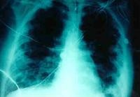
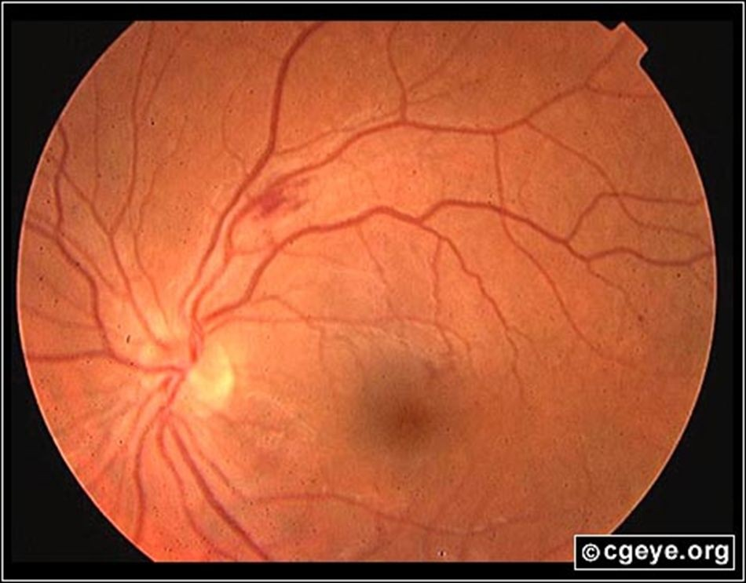
Septic Pulmonary Emboli Septic Retinal embolus
http://www.emedicine.com/emerg/topic164.htm

Slide 29
Local Spread of Infection
Heart failure
Extensive valvular damage
Paravalvular abscess (30-40%)
Most common in aortic valve, IVDU, and S. aureus
May extend into adjacent conduction tissue causing arrythmias
Higher rates of embolization and mortality
Pericarditis
Fistulous intracardiac connections

Slide 30
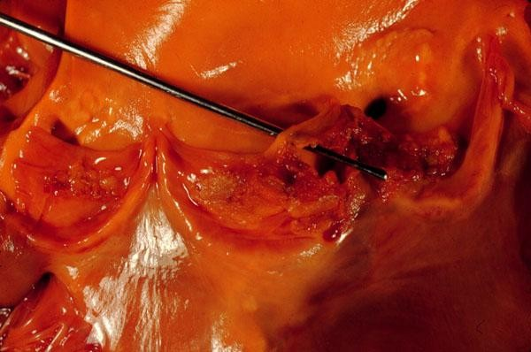
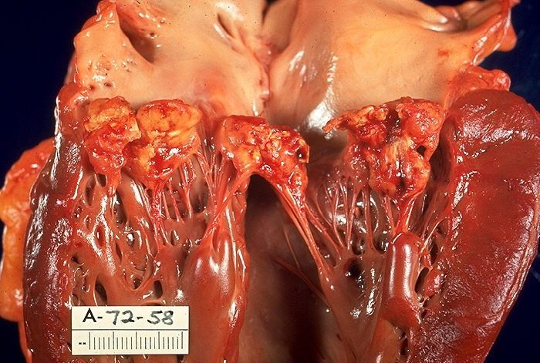
Local Spread of Infection
Acute S. aureus IE with perforation of the aortic valve and aortic valve vegetations.
Acute S. aureus IE with mitral valve ring abscess extending into myocardium.

Slide 31
Metastatic Spread of Infection
Metastatic abscess
Kidneys, spleen, brain, soft tissues
Meningitis and/or encephalitis
Vertebral osteomyelitis
Septic arthritis

Slide 32
Poor Prognostic Factors
Female
S. aureus
Vegetation size
Aortic valve
Prosthetic valve
Older age
Diabetes mellitus
Low serum albumen
Apache II score
Heart failure
Paravalvular abscess
Embolic events

Slide 33
Echocardiographic findings
1. Oscillating intracardiac mass
o On valve or supporting structure,
In the path of regurgitation jets,
On implanted material, in the absence of an altenate anatomic explanation
abscess
New partial dehiscence of prosthetic valve
New valvular regurgitation (increase or change in pre-existing murmur not sufficient)

Slide 34
Improved diagnostic value of echocardiography in patients with infective endocarditis by transoesophageal approach A prospective study
Eur Heart J, 1988 Jan;9(i):43.5396 patients were studied consecutively with TEE and TTE
TEE sensitivity 100 percent for vegetations as compared to 63 percent with TTE
Both TTE and TEE had specificity of 98%
25% of vegetations less than 5 mm,
69% of vegetations 6-10 mm, and
100% of vegetations greater than 11 mm detected by TEE were also observed with TTE

Slide 35
Culture Negative” IE
How hard did you look?
(50% culture neg are d/t previous antibiotics)
HACEK: - 2-3 wk incubation, subculturing,
Tend to see subacute w/ valve destruction/CHF
Hemophilus paraphrophilus, aphrophilus. Parainfluenzae
Aggregatibacter(Actinob acillus) actinomycetemcomitans
Cardiobacterium hominis
Eikenella corrodens
Kingella spp.

Slide 36
Lab Diagnosis! Etiologies“Culture Negative” IE Based on clinical setting
PCR of vegetation/emboli:
Tropheryma whippelei, bartonella
Histology/stain /culture of vegetation/emboli:
Fungus
Prolonged, enriched cultures:
HACEK
Lysis centrifugation system (Isolator):
Bartonella, legionella (BCYE),fungal
Serology:
Endemic fungi, bartonella, Q fever, brucella, legionella, chiamydia
Thioglycolate or cysteine supplemented media.
S.aureus satellitism: Abiotrophia (NVS)

Slide 37
endocarditis
GENERAL CONSIDERATIONS
Antimicrobial therapy should be administered in a dose designed to give sustained bactericidal serum concentrations throughout much or all of the dosing interval.
In vitro determination of the minimum inhibitory concentration of the etiologic cause of the endocarditis should be performed in all patients.

Slide 38
The duration of therapy has to be sufficient to eradicate microorganisms growing within the valvular vegetations.
The need for prolonged therapy in treating endocarditis has stimulated interest in using combination therapy to treat endocarditis.

Slide 39
Indications for surgery in IE
Combined therapy generally advised with
Refractory CHF (mortality 56-86% w/o surgery vs 11-35% w/surgery)
Perivalvualr invasive disease
Uncontrolled infection on maximal medical therapy
Recurrent systemic emboli, particularly in the presence of large vegetations
SOME pathogens: Pseudomonas, brucella, coxiella, fungi, enterococci

Slide 40
Prosthetic same as native valve endocarditis
Perivalvular infection valve
Dehiscence
Excessively mobile prosthesis on echo results in hemodynamic instability

Slide 41
Prosthetic valve endocarditis that one may attempt medical treatment alone:
>l2mo post surgical
VGS or HACEK or enterococci
No perivalvular extension
Recurrence after surgery about 7% / 6 years
Relapse,
S. aureus usually means surgery
S. aureus- RR death 0.18 in surgery plus AB vs ABx alone

Slide 42
VGS, NVS, sreptococcus MIC (ug/mI) | Native valve | prosthetic valve
<0.1 | PenG or Ceph3 4wk | PenG 6wk plus Gent 2wk
>0.1 —0.5 | PenG 4wk plus Gent 2wk | PenG 6wk Plus Gent 4wk
>0.5 | PenG or Amp plus Gent for 4-6 wk | total 6 wk
MSSA/ MRSA: Most common org | Cloxacillin / Vancomycin 4-6 wk +/- gent X 3-5d | cloxacillin / vancomycin 6wk, gentamicin 2wk, rifampin 6 wk
IDU w/ R sided IE | Clox plus gent 2 wk, (not if complicated or febrile >lwk, large vegetations)
HACEK | Ceph3 for 4wk | 6wk
Bartonella | Aminoglycoside and flouroquinolones(or B-Lactam)
Q-fever | Doxycycline +or-hydroxychloroquine 26 months untill the titer below1:400 | 35% surgical

Slide 43
Prophylaxis
For High or Mod. cardiac risk conditions (previous list)
For Dental, rigid bronchoscopy, esophageal procedures, G I mucosal procedures, cystoscopy, prostate surgery
Antibiotic Prophraxis (American Heart Assoc. JAMA
Timing
One hour prior to procedure:
2gm Amoxicillin oraly or
600 mg Clindamycin orally or
2gm Cephalexin orally or
500mg Clarithromycin orally or
2 gm Ampicillin intramusculariy

Slide 44
Dental procedures where endocarditic prophylaxis indicated:
Dental procedures where endocarditic prophylaxis NOT indicated:
Filling cavity or local anesthetic
Placement of rubber dam 3.Suture removal 4.Orthodontic removal 5.Orthodontic adjustments 6.Dental X-rays
7.Shedding of primary teeth
1.Extraction 2.Periodontal procedures 3.Implants
4.Root canal 5.Subgingival antibiotics fiber/strips
Initial orthodontic bands (not brackets)
Intraligamentary local anesthetic
Cleaning of teeth/implants if bleeding anticipated

Slide 45
Male tutor Female tutor
ALI SOMILY , MD, FRCP(C)
ali.somily@gmail.com
FAWZIA ALOTAIBI, MD
ofawzia@ksu.edu.sa

