Slide 1
Cardiovascular physiology
Asma Alyahya, MBBS, PhD

Slide 2
Contractile mechanism in cardiac muscle
Objectives
Define cardiac muscle contractility & types of its contraction
Understand the physiology of cardiac muscle
Understand the phases of cardiac action potential and the ionic bases
Identify the refractory period of cardiac muscle
Discuss the role of ca++ in the regulation of cardiac muscle function
Describe the mechanism of excitation contraction coupling
Discuss factors affecting cardiac contractility
Ref: Guyton and Hall

Slide 3
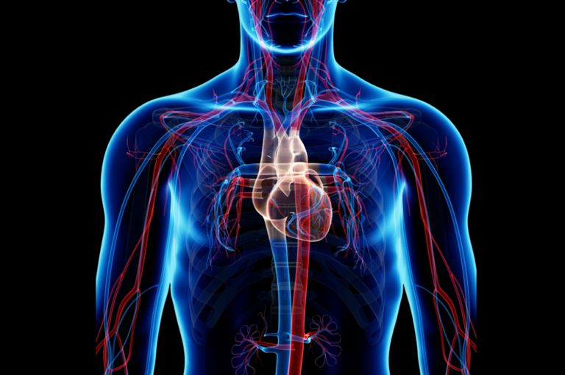
Cardiovascular Physiology functions of the CVS
Primary function of cardiovascular system:
Deliver blood to tissues
Providing essential nutrients to cells for metabolism
Removing waste products.

Slide 4
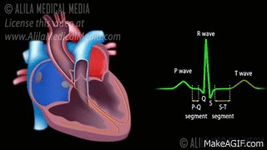
The heart muscle is remarkable. At an average heart rate of 70 beats/min , the heart needs to contract and relax more than 100 000 times a day without stopping or tiring.

Slide 5
Physiology of Cardiac Muscle
Heart has 3 types of muscle:
Atrial
Ventricular
Excitatory and conductive
What's the difference between cardiac and skeletal muscle contraction?
Atrial and ventricular muscle contract in the same way as skeletal muscle, except that duration of contraction is much longer in cardiac muscle .

Slide 6
Physiology of Cardiac Muscle..
Specialized excitatory and conductive fibers
Types:
Automatic rhythmical electrical discharge in form of APs (SA node)
Conduction of APs through heart (conductive fibers)
Notes:
Specialized excitatory and conductive fibers:
contract only feebly, why? because they contain few contractile fibrils
Have automatic rhythmical electrical discharge in form of APs
or conduction of APs through heart

Slide 7
CARDIAC MUSCLE PROPERTIES
The cardiac muscle cells are responsible for electrical stimulation which leads to mechanical function. The electro-physiologic properties of cardiac muscles are:
Automaticity: Ability to spontaneously generate an electrical impulse.
Excitability: Ability to respond to an electrical impulse.
Conductivity: Allow transmission of electrical impulse to another cardiac cell.
Contractility: Ability to contract after electrical impulse response
Rhythmicity: Ability to send electrical impulses in a regularly manner.

Slide 8
types of cardiac muscle cells
1. Contractile cells
99% of cardiac muscle cells
Perform mechanical work of pumping
2. Autorhythmic cells
Specialized for initiating and conducting action potentials responsible for contraction of myocytes
Do not contract

Slide 9
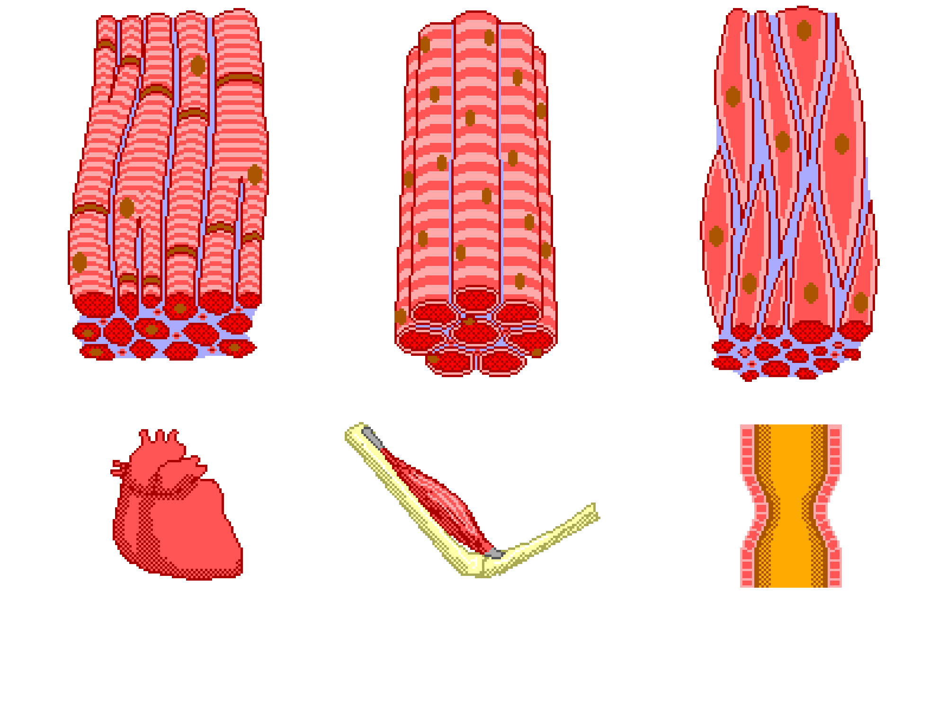
Physiologic Anatomy of Cardiac Muscle
Cardiac muscle cells are found only in the heart, are specialized to pump blood powerfully and efficiently throughout our entire lifetime.
Contractility describes the relative ability of the heart to eject a stroke volume (pump blood)
Characteristics of cardiac muscle tissue cells:
involuntary
intrinsically controlled
striated
Branched and single nucleated.
Notes:
Cardiac muscle is considered to be an involuntary tissue because it is controlled unconsciously by regions of the brain stem and hypothalamus.
It is also considered to be an intrinsic, or self-controlled, tissue because the normal cardiac rhythm is set by specialized pacemaker cardiac muscle cells in the heart itself.
The cells of cardiac muscle tissue are shorter than skeletal muscle tissue and form a network of many branches between the cells.
Intercalated disks of overlapping cell membrane form between the cardiac muscle cells to lock them together tightly and allow the quick passage of electrochemical signals between cells.
The cells do not fuse during development, leaving each cell with a single nucleus.
One commonality between skeletal and cardiac muscle is the presence of striations due to the arrangement of actin and myosin into regular myofibrils.
The presence of myofibrils and many mitochondria in cardiac muscle cells provides them with great strength and endurance to pump blood throughout an entire lifetime.

Slide 10
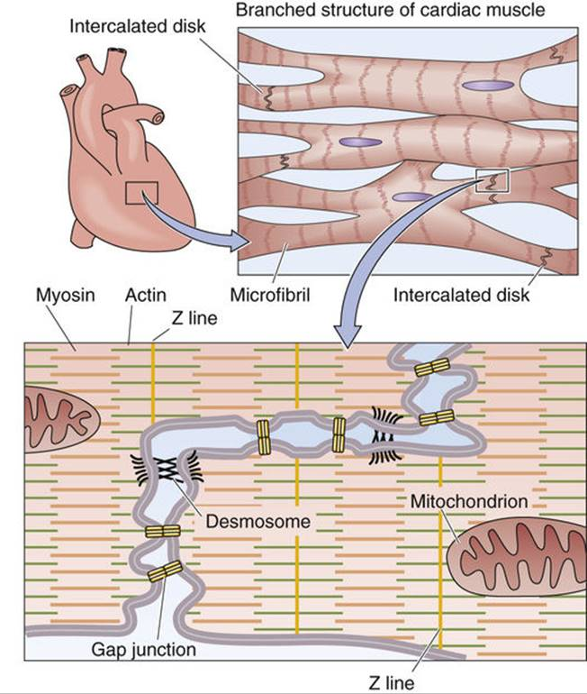
Physiologic Anatomy of Cardiac Muscle
Cardiac muscle fibers are striated
• Functional unit is called Sarcomere
• Branched and connected at intercalated discs.
• Discs contain Gap Junctions
• Nuclei are centrally located
Abundant Mitochondria
• SR is less than in skeletal muscle, but greater than in smooth muscle
• Sarcolemma: Has specialized ion channels that skeletal muscle does not – voltage-gated Ca2+ channels
• Fibers are not anchored at ends; allows for greater sarcomere shortening and lengthening
Notes:
Sarcoplasmic Reticulum:SR

Slide 11
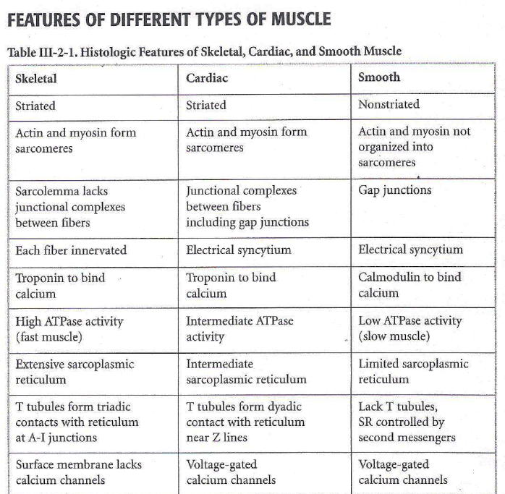

Slide 12
Cardiac Muscle as a Syncytium
Intercalated discs:
Dark areas cross cardiac muscle
Are cell membranes that separate muscle cells.
Membranes fuse and form permeable gap junctions which allow:
AP pass easily
Formation of syncytium
Within intercalated discs –two kinds of membrane junctions:
Desmosomes (anchoring)
Gap junctions
Notes:
Dark areas crossing cardiac muscle are called intercalated discs
They are cell membranes that separate cardiac muscle cells.
At intercalated disc cell membranes fuse and form permeable “communicating” junctions (gap junctions) that allow rapid diffusion of ions.
APs travel easily from one cell to the next, past the intercalated discs.
Cardiac muscle is a syncytium of many heart muscle cells interconnected, when one cell becomes excited, AP spreads to all of them throughout the latticework interconnections.

Slide 13
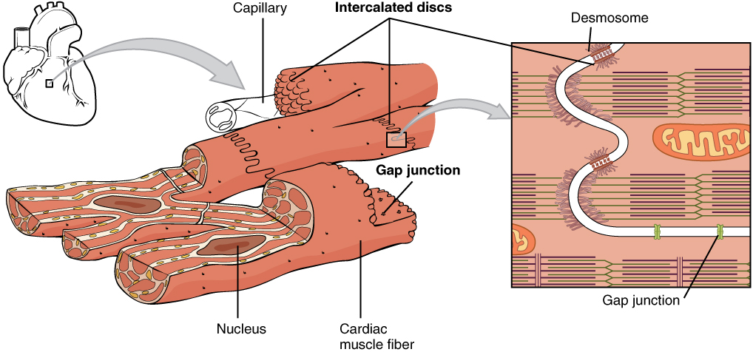
Cardiac Muscle as a Syncytium
How do gap junctions within intercalated disks aid contraction of the heart?
they allow impulses to spread from one cardiac muscle cell to another, allowing sodium, potassium, and calcium ions to flow between adjacent cells, propagating the action potential, and ensuring coordinated contractions.

Slide 14
Cardiac Muscle as a Syncytium
Heart is composed of two syncytium:
1. Atrial
2. Ventricular
Separated by fibrous tissue.
What's the importance of this separation?
Allows atria to contract ahead of ventricles
How do action potentials reach ventricles?
Action Potentials are conducted by A-V bundle.
Notes:
Heart is composed of two syncytiums:
1. Atrial
2. Ventricular
Atria are separated from ventricles by fibrous tissue surrounding heart valves.
Potentials are conducted from atrial syncytium into ventricular syncytium through a specialized conductive system called the A-V bundle.
Division of heart muscle into two syncytiums allows atria to contract ahead of ventricles (effectiveness of heart pumping).

Slide 15
Types of contraction
Isometric Contraction: generate force without changing the length of the muscle.
Isotonic Contraction: generate force by changing the length of the muscle

Slide 16
Excitation-Contraction coupling
Excitation
Increase Ca++
Contraction
Excitation of the heart is triggered by electrical impulse rather than neural transmitters.
Contraction of the heart is triggered by elevation of intracellular calcium influx.

Slide 17
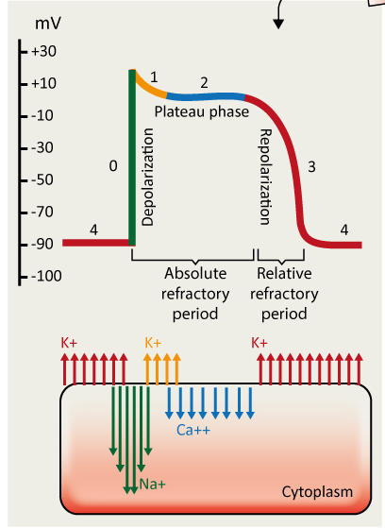
Action potential in Cardiac Muscle (ventricles)
Phase 4: Resting, K+ efflux
Phase 0: Depolarization, fast Na+(influx)
Phase 1: early repolarization, K+ efflux
Phase 2: Plateau =0.2 sec, slow Ca++ channels open causing Ca++ influx
Phase3: Repolarization: K+ efflux

Slide 18
Why is the plateau phase is critical to cardiac muscle function?
It causes ventricular contraction to last as much as 15 times as long in cardiac muscle as in skeletal muscle.
It prevents additional impulses from spreading through the heart prematurely, thereby allowing the muscle sufficient time to contract and pump blood effectively.
What causes the plateau?
Prolonged opening of the slow calcium-channels allows calcium to enter, cause plateau.
•Voltage-gated potassium channels are slower to open. This delays there return of the membrane to resting potential

Slide 19
Difference between action potential in skeletal and cardiac muscle
Skeletal muscle
Cardiac muscle
First:
AP is caused by sudden opening of large numbers of fast Na⁺channels.
Called “fast” because they remain open for only a few thousandths of a second.
First:
AP is caused by opening of 2 channels:
(1) fast Na⁺channels (same as in skeletal muscle and
(2) slow Ca⁺² channels (also called Ca⁺² -Na⁺channels or long lasting).
Notes:
Slow Ca⁺² channels differ from fast Na+ channels in that they are slower to open and remain open for several tenths of a second. (these channels maintain a prolonged depolarization ►plateau).

Slide 20
Difference between action potential in skeletal and cardiac muscle
Skeletal muscle
Cardiac muscle
Second:
At end of closure, repolarization occurs due to K+ out flux (efflux), and AP is over within a thousandth of a second.
Second:
After onset of AP, membrane permeability for K+ ↓ fivefold (does not occur in skeletal muscle).
Decreased K+ permeability ↓ out flux of K+ during plateau and prevents return of AP voltage to resting level.
When slow Ca⁺² channels close, K+ permeability ↑ rapidly returning membrane potential to resting level, ending AP.
Notes:
Second: Immediately after onset of AP, permeability of membrane for K+ ↓ fivefold (does not occur in skeletal muscle).
Decreased K+ permeability ↓ out flux of K+ during AP plateau and prevents return of AP voltage to its resting level.
When slow Ca⁺²- Na⁺channels close, permeability for K+ ↑ rapidly; Which returns the membrane potential to its resting level, ending the AP.

Slide 21
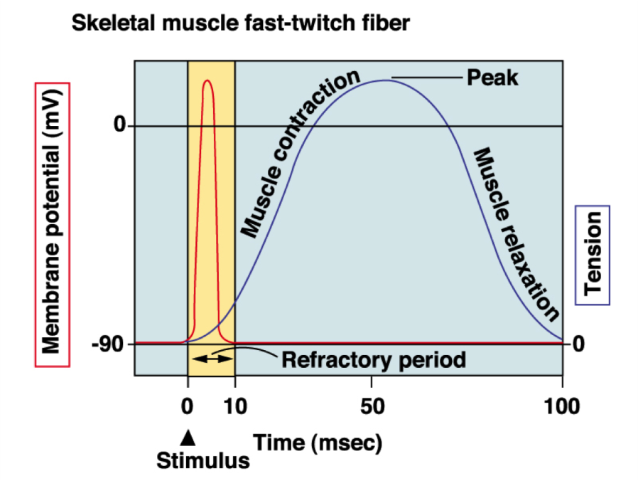
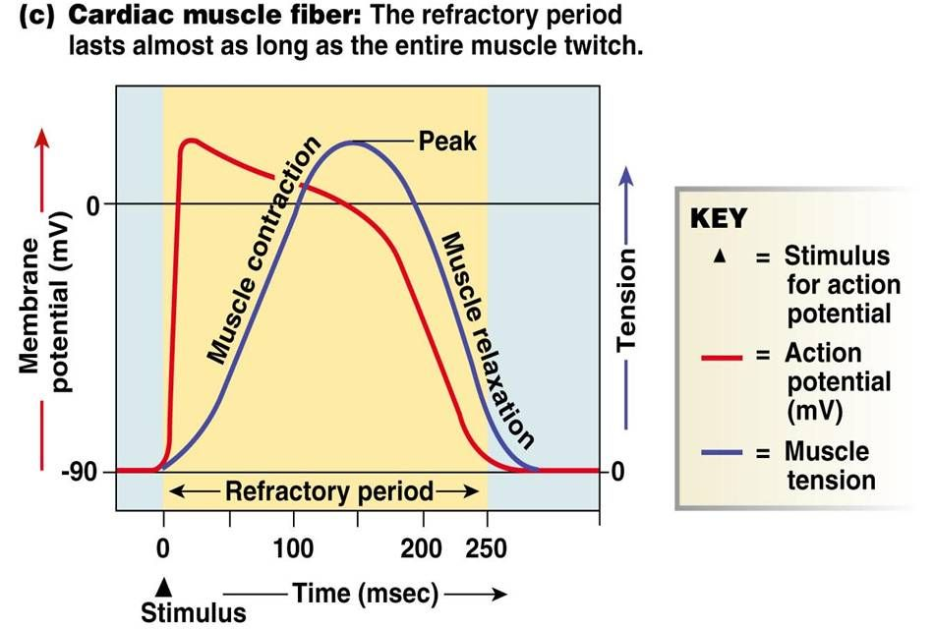
Difference between action potential of cardiac and skeletal muscle
In skeletal muscle, duration of AP is shorter than its mechanical response.
• This means that skeletal muscle can undergo tetanus via repeated stimulation
In cardiac muscle, duration of AP is same as duration of its mechanical response.
This means that cardiac muscle cannot undergo tetanus via repeated stimulation
Notes:
In cardiac muscle, the duration of action potential is same as the duration of its mechanical response. Thus the mechanical response can't be merged and therefore cardiac muscles can't be tetanized.

Slide 22
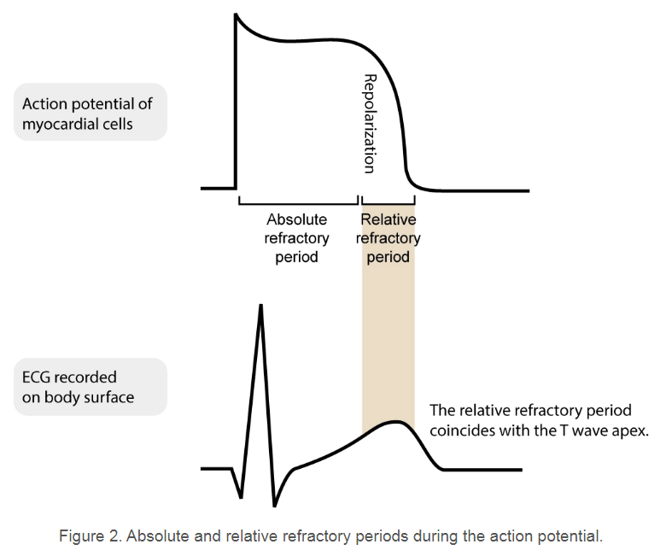
Refractory (resistant) Period of Cardiac Muscle
Absolute Refractory period (ARP) of ventricle:
0.25 -0.30 sec (signal cannot re-excite an already excited area of cardiac muscle)
Relative refractory period (RRP) of ventricle:
0.05 sec (muscle difficult to excite but can be excited by a strong signal “premature” contraction)
The ARP acts as a protective mechanism in the heart
Notes:
Refractory period (absolute) :Cardiac muscle is refractory to re-stimulation during most of the AP (additional stimulus can not trigger a new AP).
RP ventricle= 0.25-0.30 sec (duration of plateau)
RP atrial = 0.15 sec.
The ARP acts as a protective mechanism in the heart by preventing multiple, compounded action potentials from occurring. If these were to occur, the heart would be unable to adequately fill with blood and eject blood.
Many antiarrhythmic drugs alter the ARP, thereby altering cellular excitability.
Relative refractory period: muscle difficult to excite but can be excited by a strong signal “premature” contraction).
RRP ventricle= 0.05 sec, RRP atrial =0.03 sec

Slide 23
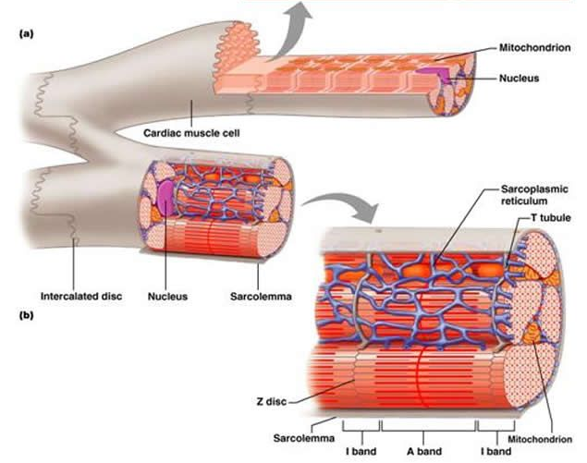
Excitation-Contraction Coupling in cardiac muscle
Cardiac muscle fibers contract via excitation-contraction coupling, using a mechanism unique to cardiac muscle called calcium -induced calcium release.
Calcium-induced calcium release involves the conduction of calcium ions into the cardiomyocyte, triggering further release of ions into the cytoplasm.
Notes:
This is the process linking electrical excitation to contraction. Calcium has an essential role in this process; a raised intracellular calcium concentration is the trigger that activates contraction.

Slide 24
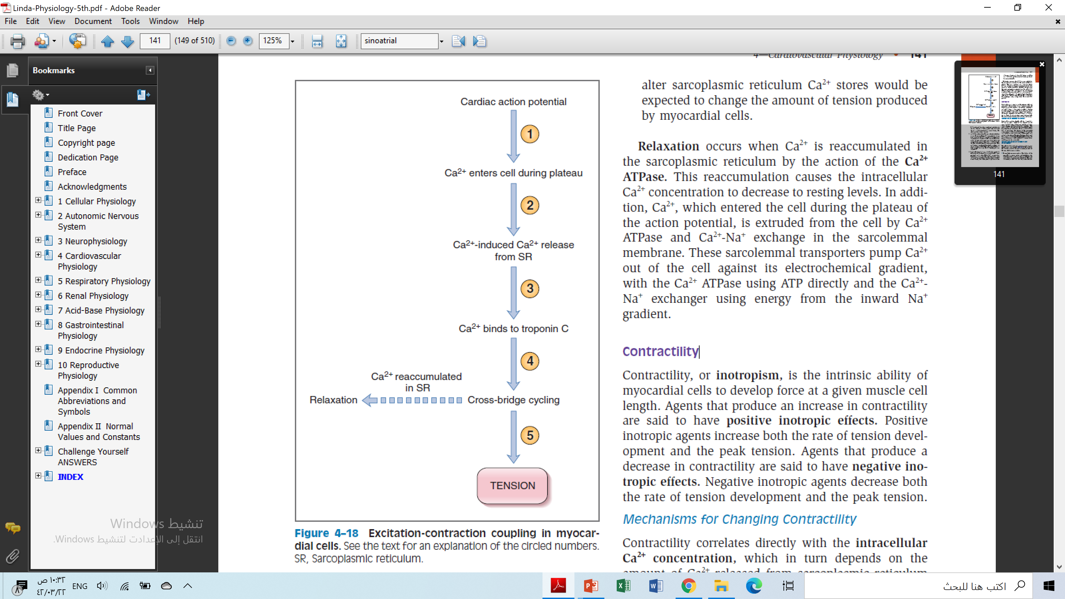
Excitation-Contraction Coupling…
AP is initiated in cell membrane, and depolarization spreads to interior of cell via T tubules.
Entry of Ca ++ triggers release of more Ca2+ from SR through ryanodine receptors.
3 and 4. Ca ++ release from the SR
Increases intracellular Ca++ which binds to troponin C, tropomyosin is moved out of the way, and interaction of actin and myosin occurs.
5. Relaxation occurs when Ca++ is re-accumulated in SR by Ca ++ ATPase (SERCA, sarco-endoplasmic reticulum calcium-ATPase).
trigger
ryanodine receptors
Ca2+ATPase
Notes:
These steps correlate with the circled numbers shown in Figure 4-18.
1. The cardiac action potential is initiated in the myocardial cell membrane, and the depolarization spreads to the interior of the cell via the T tubules.
Recall that a unique feature of the cardiac action potential is its plateau (phase 2), which results from an increase in gCa and an inward Ca2+ current in
which Ca2+ flows through L-type Ca2+ channels from extracellular fluid (ECF) to intracellular fluid (ICF).
2. Entry of Ca2+ into the myocardial cell produces an increase in intracellular Ca2+ concentration. This increase in intracellular Ca2+ concentration is not
sufficient alone to initiate contraction, but it triggers the release of more Ca2+ from stores in the sarcoplasmic reticulum through Ca2+ release channels
(ryanodine receptors). This process is called Ca2+-induced Ca2+ release, and the Ca2+ that enters during the plateau of the action potential is called the trigger Ca2+. Two factors determine how much Ca2+ is released from the sarcoplasmic reticulum in this step: the amount of Ca2+ previously stored and the size of the inward Ca2+ current during the
plateau of the action potential.
3. and 4. Ca2+ release from the sarcoplasmic reticulum causes the intracellular Ca2+ concentration to increase even further. Ca2+ now binds to troponin C, tropomyosin is moved out of the way, and the interaction of actin and myosin can occur. Actin and myosin bind, cross-bridges form and then break, the thin and thick filaments move past each other, and tension is produced. Cross-bridge cycling continues as long as intracellular Ca2+ concentration is high enough to occupy the Ca2+-binding sites on troponin C.
5. A critically important concept is that the magnitude of the tension developed by myocardial cells is proportional to the intracellular Ca2+ concentration.
Therefore, it is reasonable that hormones, neurotransmitters, and drugs that alter the inward Ca2+current during the action potential plateau or that alter sarcoplasmic reticulum Ca2+ stores would be expected to change the amount of tension produced by myocardial cells.
Relaxation occurs when Ca2+ is accumulated in the sarcoplasmic reticulum by the action of the Ca2+ATPase. This re-accumulation causes the intracellularCa2+ concentration to decrease to resting levels. In addition,Ca2+, which entered the cell during the plateau of the action potential, is extruded from the cell by Ca2+ATPase and Ca2+-Na+ exchange in the sarcolemmal
membrane. These sarcolemmal transporters pump Ca2+out of the cell against its electrochemical gradient, with the Ca2+ ATPase using ATP directly and the Ca2+-Na+ exchanger using energy from the inward Na+radient.

Slide 25
Calcium ions regulate the contraction of cardiac muscle:
Entry of extracellular calcium ions causes the release of calcium from the sarcoplasmic reticulum (calcium-induced calcium release), source of about 95% of calcium in cytosol.

Slide 26
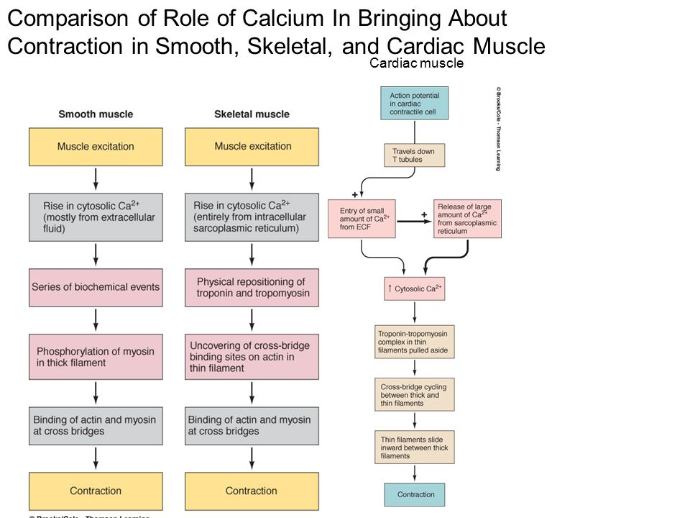

Slide 27
Excitation-Contraction Coupling…
What's the importance of Ca⁺² from T tubules?
Without Ca⁺² from T tubules, strength of cardiac muscle contraction would be reduced considerably because:
the SR is less well developed than that of skeletal muscle and does not store enough Ca⁺² to provide full contraction.
Therefore, T tubules of cardiac muscle have a diameter 5x as great as skeletal muscle tubules
Inside T tubules is a large quantity of mucopoly-saccharides that are electro-negatively charged and bind an abundant store of Ca⁺² keeping Ca⁺² available for diffusion to interior of cardiac muscle fiber when a T tubule AP appears.
Ref: Guyton and Hall

Slide 28
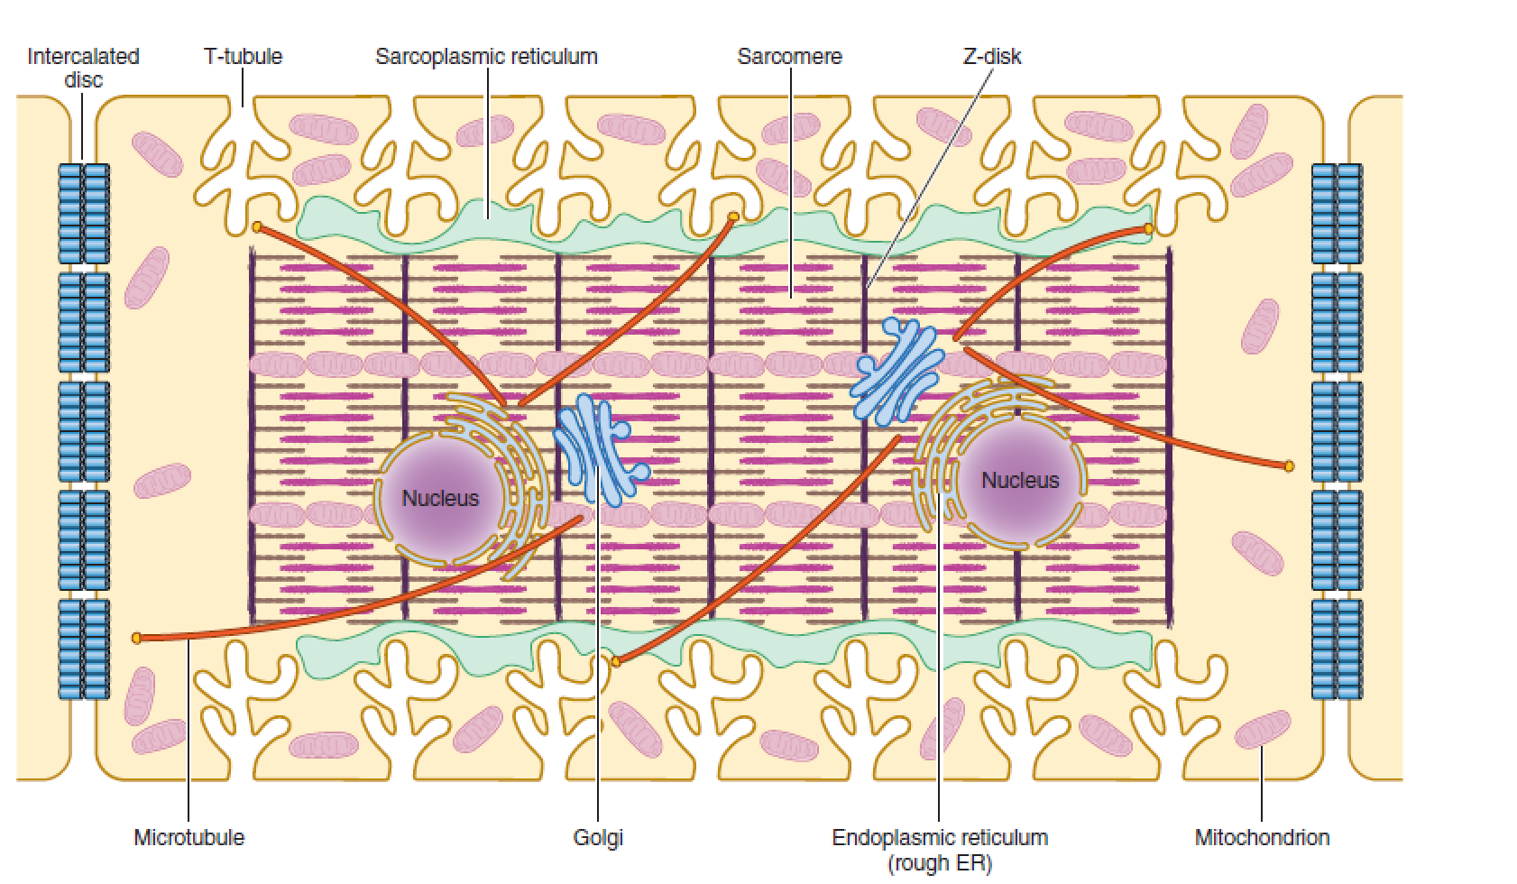
illustration of the internal structures of an adult ventricular cardiomyocyte
T-tubules, which are enriched with voltage-gated L-type calcium channels, are positioned closely near the sarcoplasmic reticulum, the primary internal calcium store.

Slide 29
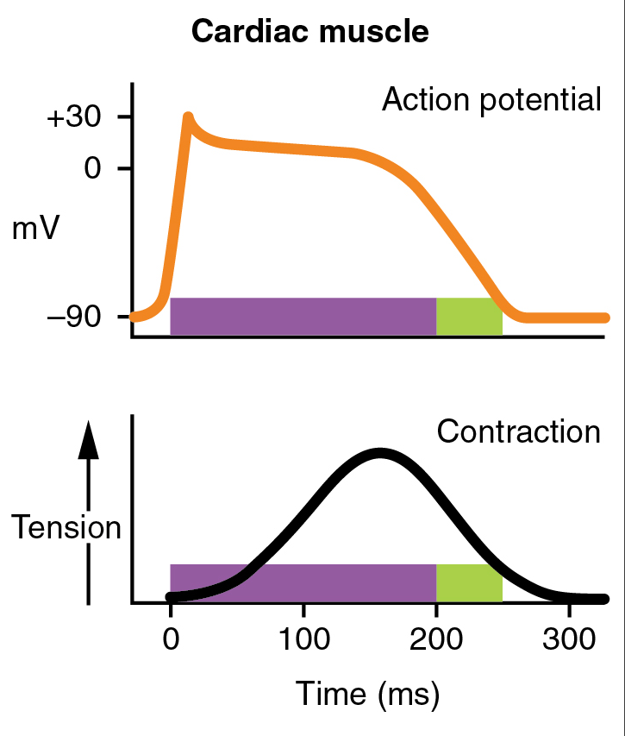
Duration of Contraction
Cardiac muscle begins to contract a few millisec after AP begins and continues to contract until a few millisec after AP ends.
The duration of contraction of cardiac muscle is mainly a function of the duration of AP (about 0.2 sec in atrial muscle and 0.3 sec in ventricular muscle).

Slide 30
Factors regulating contractility (inotropy)
Mechanisms for Changing Contractility
Contractility correlates directly with the intracellular
Ca2+ concentration
Therefore, the larger the inward
Ca2+ current and the larger the intracellular stores, the
greater the increase in intracellular Ca2+ concentration
and the greater the contractility.

Slide 31
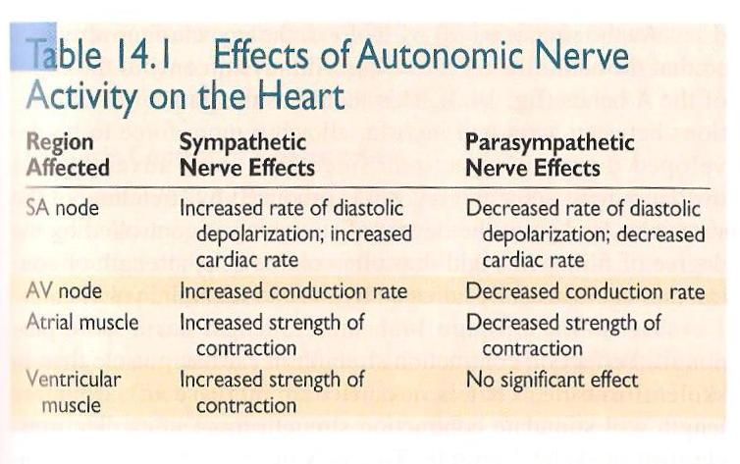
Factors regulating contractility

Slide 32
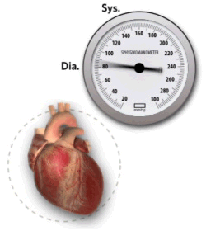
Remember this lecture each time your heart beats

Slide 33
abbreveations
AP: action potential
K+ : potasium
Na+: Sodium
RP: refractory period
SR: sarcoplasmic reticulum

