Slide 1
Cardiac electric activity
Asma Al yahya
MBBS, MSc, PhD

Slide 2
Objectives
Know The Components of The Conducting System of The Heart, The Conduction Velocities & Spread of Cardiac Impulse Through The Heart
Understand Control of Excitation and Conduction in the Heart
Identify The Action Potential of The Pace Maker and The Differences Between Pace Maker Potential & Action Potential of Myocardial Cells
Describe The Control Of Heart Rhythmicity and Impulse Conduction By The Cardiac Nerves, What is Latent and Abnormal Pacemakers

Slide 3
Abbreviations Actio potential: AP Sinoatrial : SA Atrioventricular: AV Sodium ion: Na⁺ Potassium ion: K+ Calcium ion:Ca+2 Extracellular fluid: ECF

Slide 4
Rhythmical Excitation of the Heart
The heart is endowed with a special system for:
(1) generating rhythmical electrical impulses to cause rhythmical contraction of heart muscle
(2) conducting impulses rapidly through heart.

Slide 5
Rhythmical Excitation of the Heart..
When this system functions normally:
Atria contract 1/6 of a sec ahead of ventricular contraction (allows filling of ventricles).
All portions of ventricles contract at same time (essential for effective pressure generation in the ventricular chambers)

Slide 6
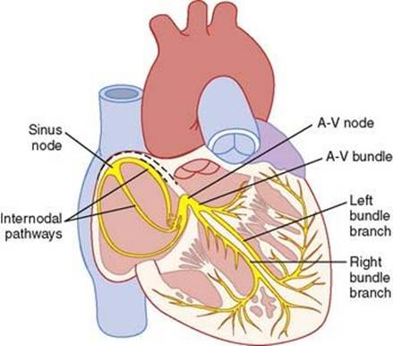
Specialized Excitatory and Conductive System of the Heart
Sinus (SA) node
Internodal pathways
A-V node
A-V bundle (Left and right)
Purkinje fibers
Notes:
Sinus (SA) node: generate rhythmical impulses
Internodal pathways: conduct impulses from sinus node to atrioventricular (A-V) node
A-V node: impulses from atria are delayed before passing into ventricles
A-V bundle: which conducts impulses from atria to ventricles
Left and right bundle
branches of Purkinje fibers: conduct cardiac impulses to all parts of ventricles.

Slide 7
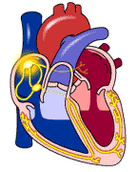
Sequence of excitation
Sinus-Atrial Node (SA node)
Atria
Atrial-ventricular Node
(AV node)
Ventricles

Slide 8
Sinus (Sinoatrial) Node
SA node is a small, flat strip of specialized cardiac muscle. Located in superior Posterolateral wall of RA
It has few contractile fibers.
Its fibers connect directly with atrial muscle.
(any AP that begins in the SA node spreads immediately into atrial muscle wall).
SA node controls heart rate i.e SA node has the fastest rate of autorhythmicity

Slide 9
Mechanism of Sinus Nodal Rhythmicity
Cardiac muscle has 3 types of membrane ion channels that play important roles in causing voltage changes of AP:
(1) fast Na⁺channels,
(2) slow Na⁺-Ca⁺ ²channels,
(3) K⁺ channels.

Slide 10
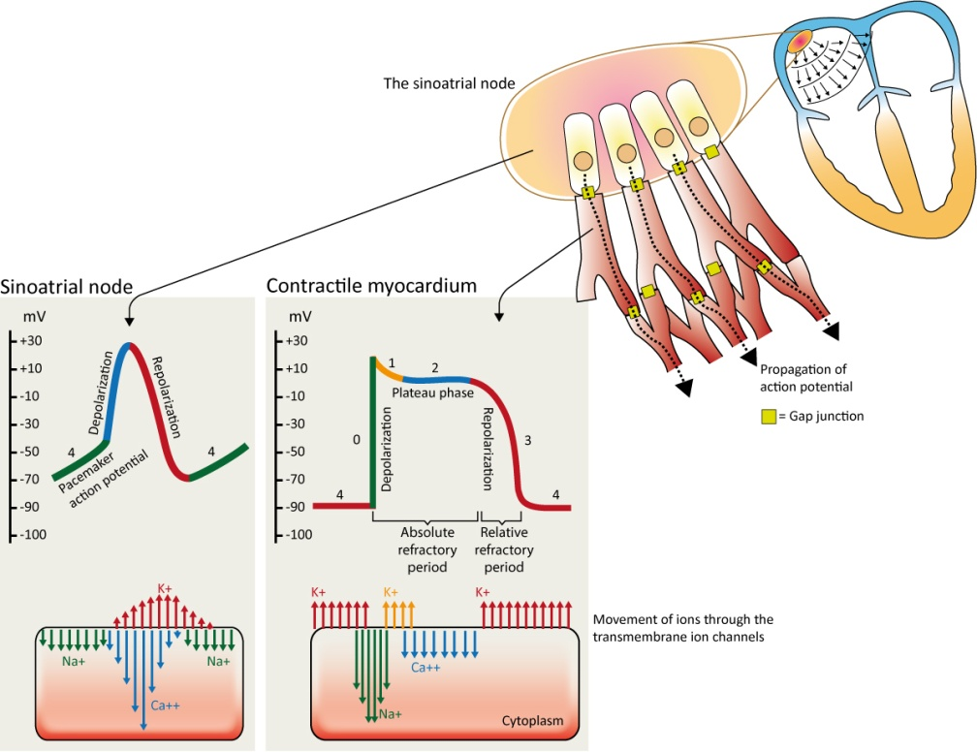
Mechanism of Sinus Nodal Rhythmicity…
Resting membrane potential of SA node has negativity of −55 to −60 mv
Why?
Because Its leaky
Notes:
Resting membrane potential of sinus nodal fiber has negativity of −55 to −60 mv, in comparison with −85 to −90 mv for ventricular muscle fiber.
cause of this lesser negativity is: cell membranes of sinus fibers are leaky to Na⁺ and Ca+2, and positive charges entering neutralize some of the intracellular negativity.

Slide 11
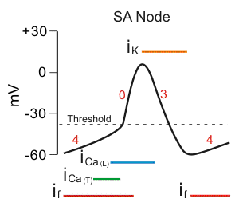
SA nodal APs are divided into 3 phases.
Phase 4: spontaneous depolarization (pacemaker potential) triggers AP at threshold between -40 and -30 mV).
Phase 0: depolarization
Phase 3: repolarization.
Once the cell is completely repolarized at about -60 mV, the cycle is spontaneously repeated.
Notes:
Phase 4 is the spontaneous depolarization (pacemaker potential) that triggers the action potential once the membrane potential reaches threshold between -40 and -30 mV).
Phase 0 is the depolarization phase of the action potential. This is followed by
phase 3 repolarization. Once the cell is completely repolarized at about -60 mV, the cycle is spontaneously repeated.

Slide 12
Mechanism of pacemaker action potential
Phase 4:
At -60 mV, Na⁺ "funny" currents enter (depolarizing) initiating Phase 4.
At -50 mV, transient or T-type Ca⁺⁺ channel opens . Ca⁺⁺ enters depolarizing cell.
At -40 mV, long-lasting, or L-type Ca⁺⁺
channels open causes more Ca⁺⁺ to enter and depolarize cell until an AP threshold is reached (between -40 and
-30 mV).
Notes:
In the SA node, three ions are particularly important in generating the pacemaker action potential.
At the end of repolarization, when the membrane potential is very negative (about -60 mV), ion channels open that conduct slow, inward (depolarizing) Na⁺ currents. These currents are called "funny" currents and abbreviated as "I_{f}". These depolarizing currents cause the membrane potential to begin to spontaneously depolarize, thereby initiating Phase 4.
As the membrane potential reaches about -50 mV, another type of channel opens. This channel is called transient or T-type Ca⁺⁺ channel. As Ca⁺⁺ enters the cell through these channels down its electrochemical gradient, the inward directed Ca⁺⁺ currents further depolarize the cell.
When the membrane depolarizes to about -40 mV, a second type of Ca⁺⁺ channel opens. These are the so-called long-lasting, or L-type Ca⁺⁺ channels. Opening of these channels causes more Ca⁺⁺ to enter the cell and to further depolarize the cell until an action potential threshold is reached (usually between -40 and -30 mV).
It should be noted that a hyperpolarized state is necessary for pacemaker channels to become activated. Without the membrane voltage becoming very negative at the end of phase 3, pacemaker channels remain inactivated, which suppresses pacemaker currents and decreases the slope of phase 4.
This is one reason why cellular hypoxia, which depolarizes the cell and alters phase 3 hyperpolarization, leads to a reduction in pacemaker rate (i.e., produces bradycardia).

Slide 13
Mechanism of pacemaker action potential
Phase 0: depolarization is caused by increased Ca⁺⁺ through the L-type Ca⁺⁺ channels that began to open toward the end of Phase 4.
Phase 3: Repolarization occurs as K⁺ channels open thereby increasing outward directed, hyperpolarizing K⁺ currents.
Notes:
Phase 0 depolarization is primarily caused by increased Ca⁺⁺ conductance (gCa⁺⁺) through the L-type Ca⁺⁺ channels that began to open toward the end of Phase 4.
Repolarization occurs (Phase 3) as K⁺ channels open (increased gK⁺) thereby increasing the outward directed, hyperpolarizing K⁺ currents. At the same time, the L-type Ca⁺⁺ channels become inactivated and close, which decreases gCa⁺⁺ and the inward depolarizing Ca⁺⁺ currents.

Slide 14
Mechanism of Sinus Nodal Rhythmicity..
Return of AP to its negative state occurs slowly, rather than the abrupt return that occurs for ventricular fiber.

Slide 16
Why does leakiness to Na⁺ and Ca+2 ions not cause the SA node fibers to remain depolarized all the time?
Answer: two events occur during the course of AP to prevent this.
Na⁺- Ca⁺² channels become inactivated (i.e., they close) within about 100 to 150 millisec after opening,
At the same time, increased numbers of K+ channels open.
K+ channels remain open with resultant excess negativity inside the fiber causing hyperpolarization
Notes:
Answer: two events occur during the course of AP to prevent this.
Na⁺- Ca⁺² channels become inactivated (i.e., they close) within about 100 to 150 millisec after opening,
At the same time, increased numbers of K+ channels open.
K+ channels remain open continuing movement of positive charges out of cell, with resultant excess negativity inside the fiber; this is called hyperpolarization.
The hyperpolarization state carries the “resting” membrane potential down to about −55 to −60 mv at the termination of the AP.

Slide 17
Why is this new state of hyperpolarization not maintained forever?
After AP is over, more K+ channels close.
Inward-leaking Na⁺ and Ca⁺² overbalances outward flux of K+,
and this causes “resting” potential to drift upward once more, reaching threshold level for discharge at a potential of about −40 mv.
Notes:
Reason is after AP is over, more and more K+ channels close.
The inward-leaking Na⁺ and Ca+2 once again overbalance outward flux of K+, and this causes “resting” potential to drift upward once more, reaching the threshold level for discharge at a potential of about −40 mv.

Slide 18
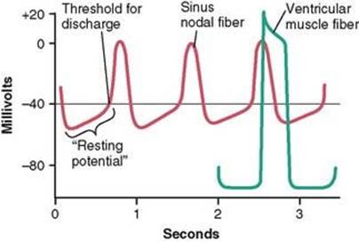
Rhythmical discharge of a sinus nodal fiber compared with that of a ventricular muscle fiber
Closing of Na⁺ -Ca+2 channels and opening of K+ channels
Entering Na⁺ and Ca+2 reduce negativity.
Resting membrane potential of SA fiber is −55 to −60 mv
K+ channels close
Resting membrane potential of ventricular muscle fiber is −85 to −90 mv
K+ channels remain open (hyperpolarization)

Slide 20
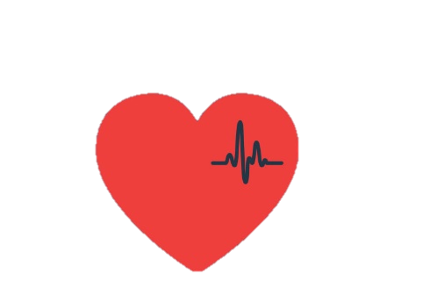
Summary SA node AP
Self-excitation to cause AP- pacemaker
Depolariza-tion
Hyperpolar-ization
drift of the “resting” potential to threshold
This process continues indefinitely throughout a person’s life.

Slide 21
Atrioventricular (AV) Node
A-V node is located in the posterior wall of the right atrium immediately behind the tricuspid valve

Slide 22
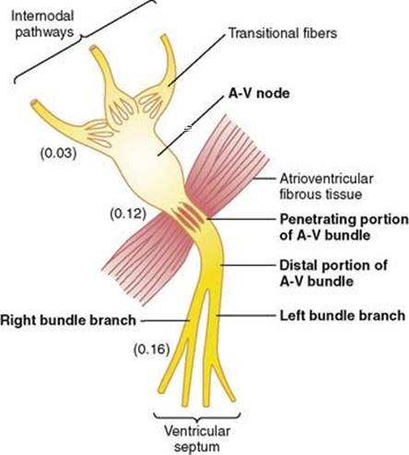
Atrioventricular Node and Delay of Impulse Conduction from the Atria to the Ventricle
1
Impulse originates in SA node
2
Reaches AV node 0.03 sec after its origin
3
Delay of 0.09 sec in A-V node
4
Enters A-V bundle, passes into ventricles.
5
Delay of 0.04 sec occurs in A-V bundle
Total delay of 0.16 sec
slow conduction in penetrating A-V bundle fibers is caused by diminished numbers of gap junctions between cells
Notes:
AV delay allows time for atria to empty their blood into ventricles before ventricular contraction begins.

Slide 23
Transmission in Ventricular Purkinje System
Purkinje fibers
very large fibers
Transmit APs at a velocity of 1.5 - 4.0 m/sec (6 times that of ventricular muscle).
Allows instant transmission of cardiac impulse throughout entire ventricular muscle.
Rapid transmission is caused by a high level of
permeability of gap junctions

Slide 24
One-Way Conduction Through A-V Bundle
Is a characteristic of the A-V bundle
Allows only forward conduction from atria to ventricles.
Atrial muscle is separated from ventricular muscle by a continuous fibrous barrier except at A-V bundle, allowing only forward conduction through the A-V bundle itself.

Slide 25
Transmission of the Cardiac Impulse in the Ventricular Muscle
Once impulse reaches ends of Purkinje fibers, it is transmitted through ventricular muscle mass by ventricular muscle fibers themselves.

Slide 26
Conduction Velocity in different cardiac tissues
Conduction Velocity (m/sec)
0.3-1 | Atria
0.01–0.05 | AV node
1–2 | Bundle of His
2-4 | Purkinje
1 m/ | Ventricle
Conduction velocity is not the same in all myocardial tissues: It is slowest in the AV node and fastest in the Purkinje fibers
Notes:
Differences in conduction velocity among the cardiac
tissues have implications for their physiologic functions.
For example, the slow conduction velocity of the
AV node ensures that the ventricles do not activate too
early (i.e., before they have time to fill with blood from
the atria). On the other hand, the rapid conduction
velocity of the Purkinje fibers ensures that the ventricles
can be activated quickly and in a smooth sequence
for efficient ejection of blood.

Slide 27
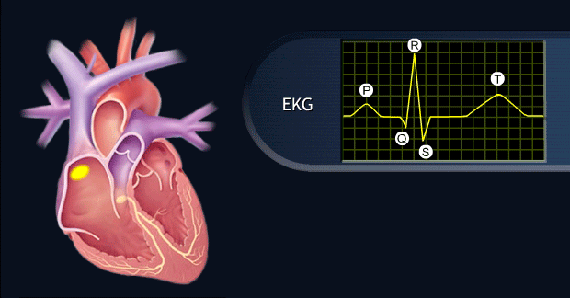
Control of Excitation and Conduction in the Heart, Sinus Node as the Pacemaker of the Heart
Why does SA node rather than A-V node or Purkinje fibers control heart’s rhythmicity?
Because its rate of rhythmical discharge is faster than any other part of heart.

Slide 28
Effect of Sympathetic Stimulation on Cardiac Rhythm and Conduction
It increases rate of sinus nodal discharge.
It increases rate of conduction, as well as the level of excitability in all portions of the heart.

Slide 29
Mechanism of the Sympathetic Effect
Stimulation of the sympathetic nerves releases the hormone norepinephrine
Norepinephrine stimulates beta-1 adrenergic receptors
increases rate of sinus nodal discharge
Increases permeability to Na⁺ and Ca+2 causing a more positive resting potential and increased excitability

Slide 30
Effect of parasympathetic Stimulation on Cardiac Rhythm and Conduction
It decreases rate of sinus nodal discharge.
It reduces rate of conduction
Strong stimulation of vagi stops rhythmical excitation by SA node or blocks transmission of cardiac impulse from atria into ventricles.

Slide 31
Mechanism of the Vagal Effects
Parasympathetic Stimulation releases acetylcholine
Acetylcholine increases permeability to K+ allowing rapid leakage of K+ out of conductive fibers.
Causes increased negativity inside fibers ( hyperpolarization) making tissue less excitable
Decreases rate of rhythm of the sinus node and A-V junctional fibers.
Notes:
Strong stimulation of vagi stops rhythmical excitation by SA node or blocks transmission of cardiac impulse from atria into ventricles.

Slide 32
Summary of Effects of Autonomic Nervous System on the Conduction velocity
Parasympathetic | Sympathetic
↓ | ↑ | Conduction velocity

Slide 33
Effect of sympathetic and parasympathetic stimulation on the SA node action potential.
Sympathetic stimulation increases
the rate of phase 4 depolarization and increases the frequency of action potentials
Parasympathetic
stimulation decreases the rate of phase 4 depolarization and hyperpolarizes

Slide 34
Latent Pacemakers
The lower you go in the heart the lower the rate
Notes:
The cells in the SA node are not the only myocardial
cells with intrinsic automaticity; other cells, called
latent pacemakers, also have the capacity for spontaneous
phase 4 depolarization. Latent pacemakers
include the cells of the AV node, bundle of His, and
Purkinje fibers. Although each of these cells has the
potential for automaticity, it normally is not expressed.
The rule is that the pacemaker with the fastest rate
of phase 4 depolarization controls the heart rate.
Normally,
the SA node has the fastest rate of phase 4
depolarization, and therefore, it sets the heart rate
(Table 4-3). Recall also that, of all myocardial cells, the
SA nodal cells have the shortest action potential duration
(i.e., the shortest refractory periods). Therefore, SA
nodal cells recover faster and are ready to fire another
action potential before the other cell types are ready.

Slide 35
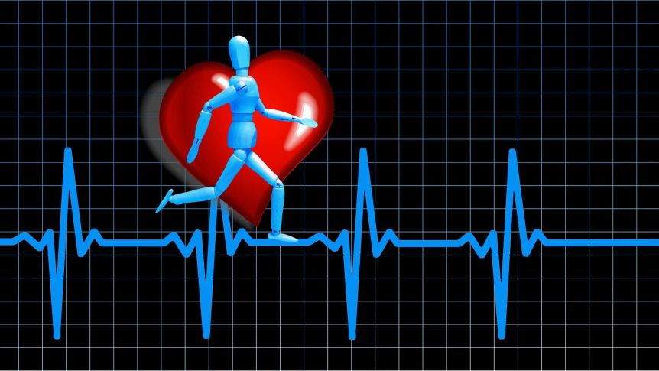
If your heart is in rhythm, so is your life

