Slide 1
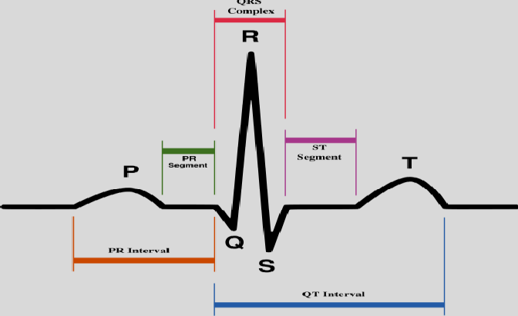
ELECTROCARDIOGRAM (ECG)
Dr Syed Shahid Habib
Professor & Consultant Clinical Neurophysiology Dept. of Physiology
College of Medicine & KKUH King Saud University

Slide 2
OBJECTIVES
Define ECG & list uses of ECG
Understand basic ECG principles
Describe ECG leads and Einthoven’s triangle
Recognize ECG waves, Intervals and, segments and their physiological correlation with significance
Determine rate and normal heart rhythm
Have some idea about ECG abnormalities in common clinical conditions

Slide 3
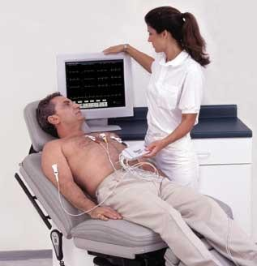
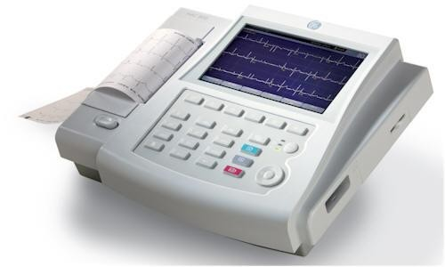
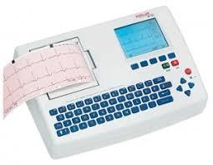
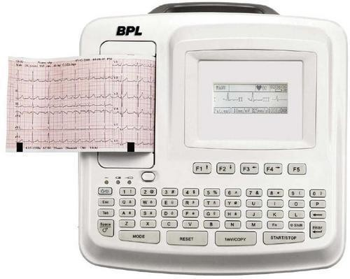
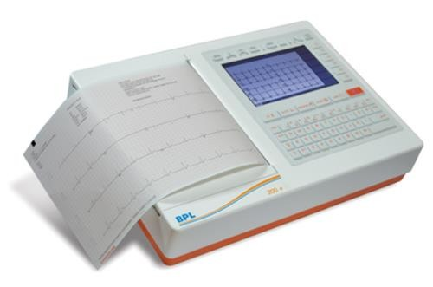
Modern ECG Machines

Slide 4
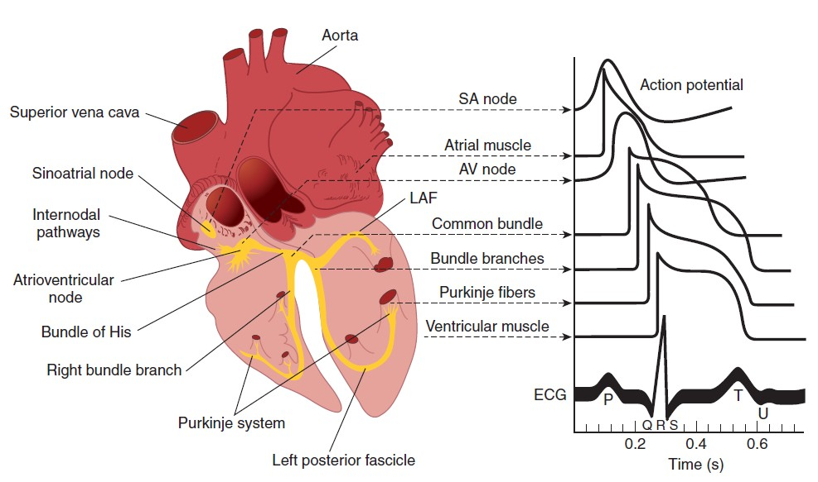
ECG is the record of the algebraic sum of electrical activity i.e. action potentials generated by the heart during cardiac cycle
The action potentials and ECG are plotted on the same time axis

Slide 5
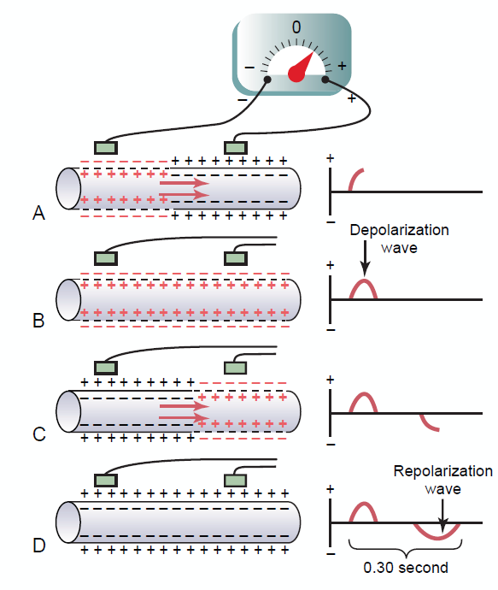
ECG PRINCIPLE
When the depolarization wave spread through heart, electrical currents pass into the surrounding tissue (body fluids are good conductors) and can be recorded from surface electrodes
Recording the depolarization wave (A and B) and the
repolarization wave (C and D) from a cardiac muscle fiber.
During depolarization, the normal negative potential inside the fiber reverses and becomes slightly positive inside and negative outside.
Notes:
In Figure 11-2A, depolarization, demonstrated by red
positive charges inside and red negative charges outside,
is traveling from left to right. The first half of the fiber has
already depolarized, while the remaining half is still polarized.
Therefore, the left electrode on the outside of the
fiber is in an area of negativity, and the right electrode is in
an area of positivity; this causes the meter to record positively.
To the right of the muscle fiber is shown a record of changes in potential between the two electrodes, as
recorded by a high-speed recording meter. Note that when
depolarization has reached the halfway mark in Figure
11-2A, the record has risen to a maximum positive value.
In Figure 11-2B, depolarization has extended over the
entire muscle fiber, and the recording to the right has
returned to the zero baseline because both electrodes are
now in areas of equal negativity. The completed wave is
a depolarization wave because it results from spread of
depolarization along the muscle fiber membrane.
Figure 11-2C shows halfway repolarization of the
same muscle fiber, with positivity returning to the outside
of the fiber. At this point, the left electrode is in an
area of positivity, and the right electrode is in an area
of negativity. This is opposite to the polarity in Figure
11-2A. Consequently, the recording, as shown to the
right, becomes negative.
In Figure 11-2D, the muscle fiber has completely repolarized,
and both electrodes are now in areas of positivity
so that no potential difference is recorded between
them. Thus, in the recording to the right, the potential
returns once more to zero. This completed negative wave
is a repolarization wave because it results from spread of
repolarization along the muscle fiber membrane.

Slide 6
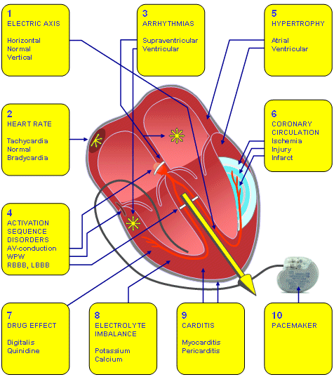
What types of information can we obtain from an ECG?
Heart rate
Heart Axis
Heart Rhythm
Myopathies
Carditis
Chamber Hypertrophy
Conduction defects
Myocardial Ischemia/MI
Electrolyte
disturbances
Drug toxicity (eg; digoxin)

Slide 7
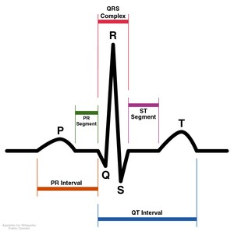
ECG Waveforms
3 waves:
P- wave
QRS complex
T- wave
3 segments:
ST segment
•TP segment
•PR segment
3 time intervals:
P-R interval
•Q-T interval
•R-R interval

Slide 8
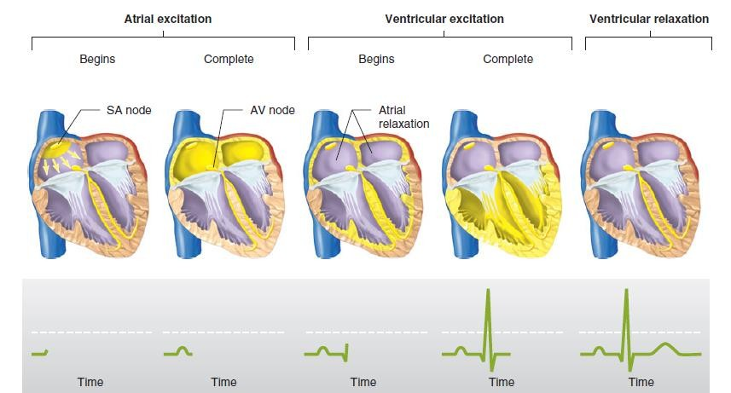
SEQUENCE OF CARDIAC EXCITATION
Anatomical position of electrical activity with Corresponding ECG waveforms

Slide 9
ECG Waveforms
P- wave
Due to atrial depolarization
P-wave is recorded before onset of atrial systole
Atrial repolarization occurs at the same time with ventricular depolarization. But, since ventricular depolarization wave is giant, it masks the atrial repolarization wave
QRS complex
T- wave
Due to ventricular depolarization
Q-wave due to depolarization of interventricular septum
R-wave due to depolarization of ventricles
S-wave due to depolarization of base of the heart
QRS complex is recorded before the onset of ventricular systole
Due to ventricular repolarization
T-wave is recorded before the onset of ventricular diastole

Slide 10
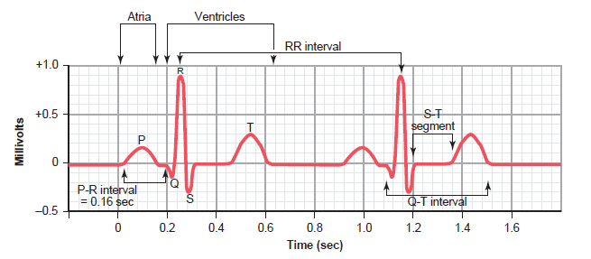

Slide 11
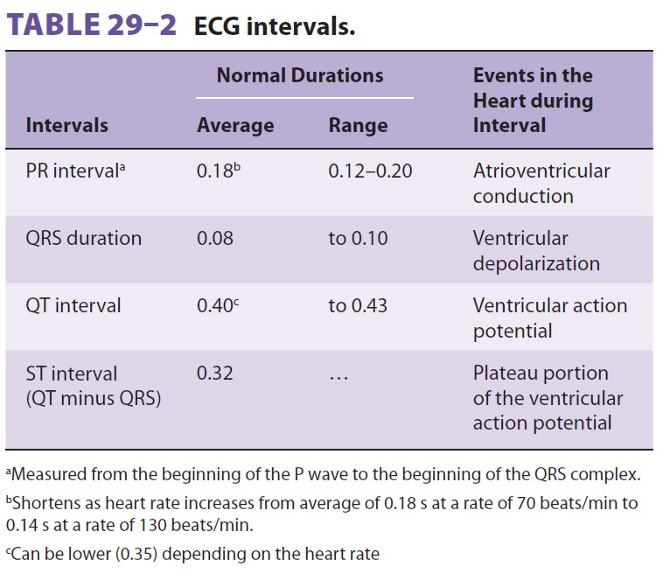

Slide 12
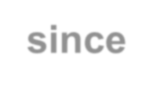
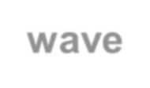
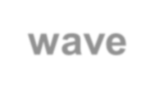
 |  | Causes of ECG Waves
ECG Wave |  |  | Cause | Represent
P- wave |  |  | Atrial depolarization | Time of electrical impulse from SA node to spread through atrial muscle. Duration = 0.08 – 0.1 sec Precedes atrial contraction by ≈ 0.01 - 0.02 sec
QRS complex |  |  | Ventricular depolarization | Measured from beginning of Q wave till end of S wave. Consists of 3 waves: Q wave: (-ve): Produced by depolarization of interventricular septum. R wave: (+ve): Produced by depolarization of ventricular wall. S wave: (-ve): Produced by depolarization of the base of the heart. Duration ≤ 0.1 sec. Precedes ventricular contraction by ≈ 0.02 sec. Occurs after P-wave by ≈ 0.12-0.2 sec = PR interval
T- wave |  |  | Ventricular repolarization | Occurs during latter part of systole, before the onset of diastole. Ventricular repolarization progresses from apex to the base of the heart. Duration = 0.27 sec.
 | Atrial repolarization occurs at the same time with ventricular depolarization. But, since ventricular depolarization wave is giant, it masks the atrial repolarization wave
12

Slide 13
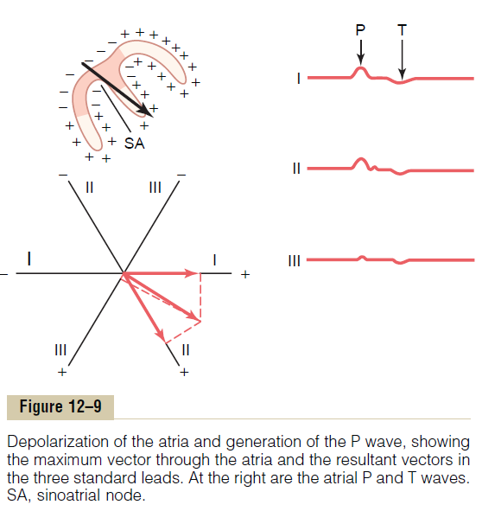
DEPOLARIZATION OF THE ATRIA—THE P WAVE
The area in the atria that also becomes repolarized first is the sinus nodal region, the area that had originally become depolarized First . Therefore, the atrial repolarization vector is backward to the vector of depolarization
In a normal ECG, the atrial T wave appears at about the same time that the QRS complex of the ventricles appears.
Therefore, it is almost always totally obscured by the large ventricular QRS complex

Slide 14
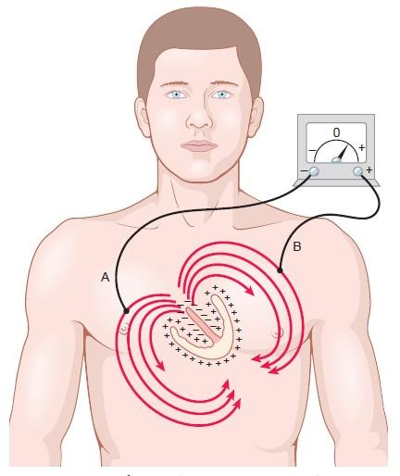
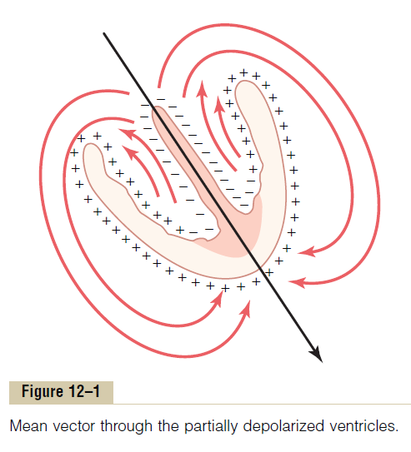
CARDIAC VECTORS
Electrical forces can be represented in the form of vectors
A vector is an arrow that points in the direction of the electrical potential generated by the current flow, with the
arrowhead in the positive direction.
The length of the arrow is proportional to the voltage of the potential.
In a normal heart, the average direction of the vector
during spread of the depolarization wave through the ventricles,
called the mean QRS vector, is about +59 degrees

Slide 15
VECTORS THAT OCCUR AT SUCCESSIVE INTERVALS DURING DEPOLARIZATION
OF THE VENTRICLES—THE QRS COMPLEX
When the cardiac impulse enters the ventricles through the atrioventricular bundle, the first part of the ventricles to become depolarized is the left endocardial surface of the septum.
It spreads through the ventricular muscle to the outside of
the heart
Q wave is caused by initial depolarization of the left side of the septum before the right side, which creates a weak vector from left to right for a fraction of a second before the usual base-to-apex vector occurs.

Slide 16
ELECTROCARDIOGRAM DURING VENT REPOLARIZATION
THE T WAVE
Because the septum and endocardial areas of the ventricular muscle depolarize first, it seems logical that these areas should repolarize first as well, but actually it is NOT so!!!!!!!!
The greatest portion of ventricular muscle mass to repolarize first is the entire outer surface of the ventricles, especially near the apex of the heart because the septum and other endocardial areas have a longer period of contraction than do most of the external surfaces of the heart so endocardial areas, conversely, normally repolarize last.
Therefore, the positive end of the overall ventricular vector during repolarization is toward the apex of the heart. As a result, the normal T wave in all three bipolar limb leads is positive, which is also the polarity of most of the normal QRS complex.

Slide 17
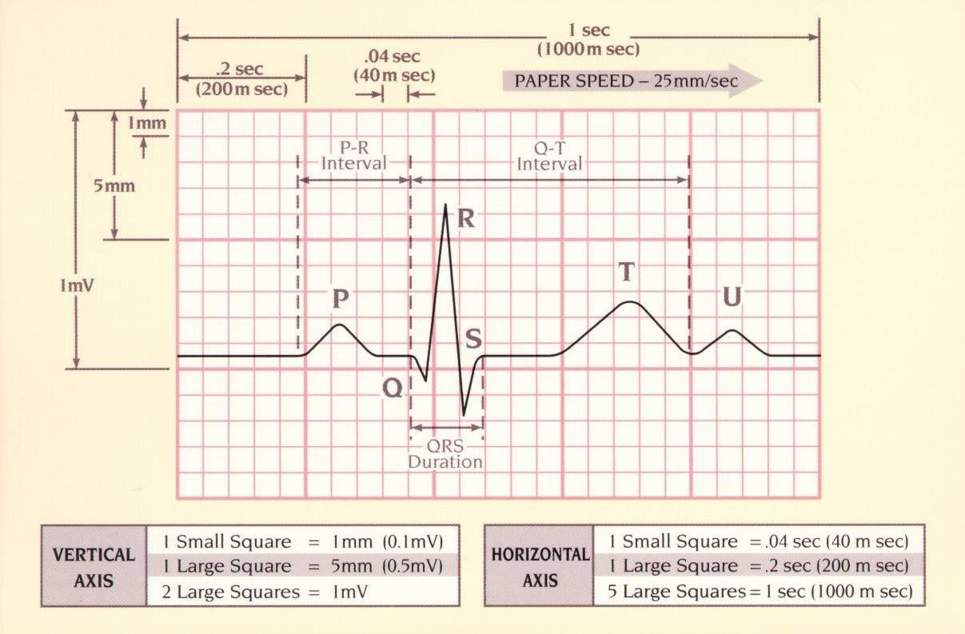
The ECG Paper

Slide 18
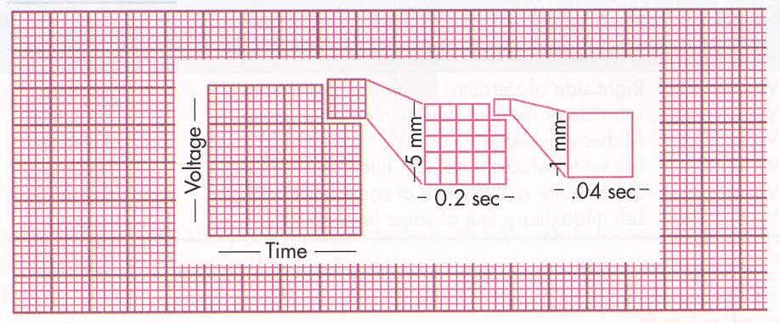
The ECG Paper

Slide 19
ECG Leads
Leads are electrodes which measure the difference in electrical potential between either:
Two exploring (Active) electrodes attached to the surface of body (bipolar leads)
One point on the body (Exploring) and a virtual reference point (Indifferent) electrode with zero electrical potential (unipolar leads)

Slide 20
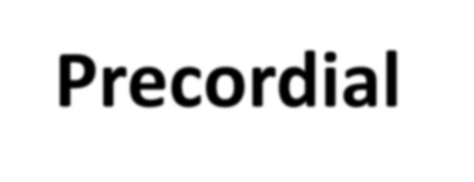
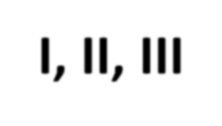
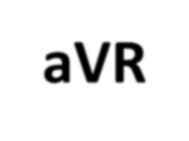
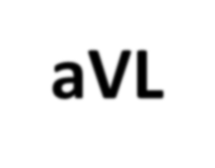
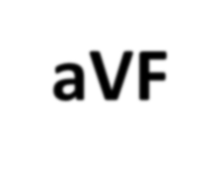
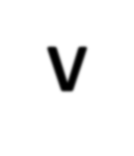
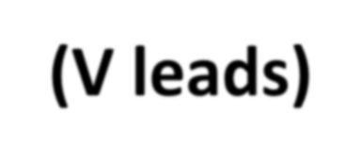
Summary of ECG Leads
 | Limb Leads | Precordial Leads
Bipolar | I, II, III (standard limb leads) | -
Unipolar (V leads) | aVR, aVL, aVF (augmented limb leads) | V₁-V₆

Slide 21
ECG Leads
The standard ECG has 12 leads
3 Standard Limb Leads (Bipolar)
3 Augmented Limb Leads (Unipolar) 6 Precordial (chest) Leads (Unipolar)
The axis of a particular lead represents the viewpoint from which it looks at the heart.

Slide 22
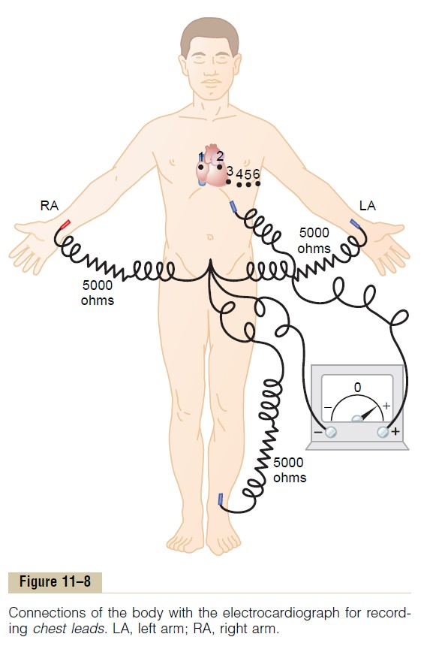
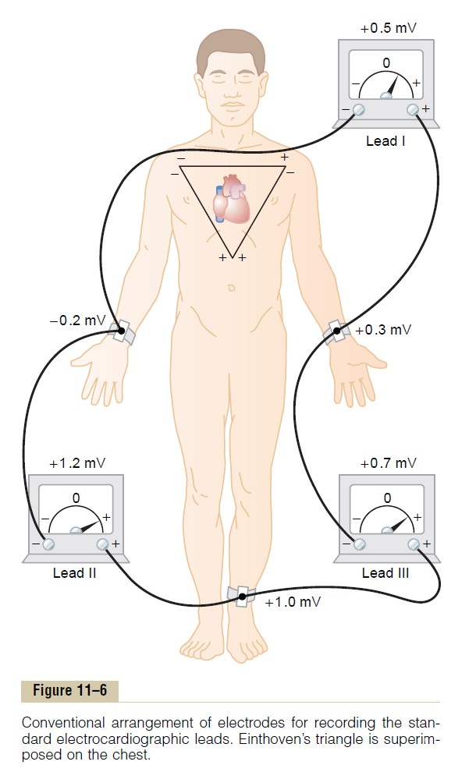

Slide 23
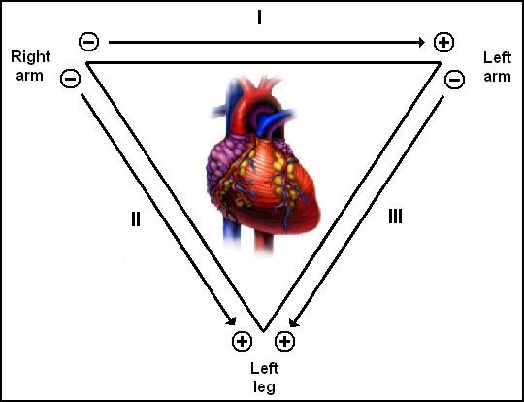
Standard Bipolar Limb Leads
Einthoven’s Law. Einthoven’s law states that if the ECGs are recorded simultaneously with the three limb leads, the sum of the potentials recorded in leads I and III will equal the potential in lead II.
Lead I + Lead III= Lead II

Slide 24
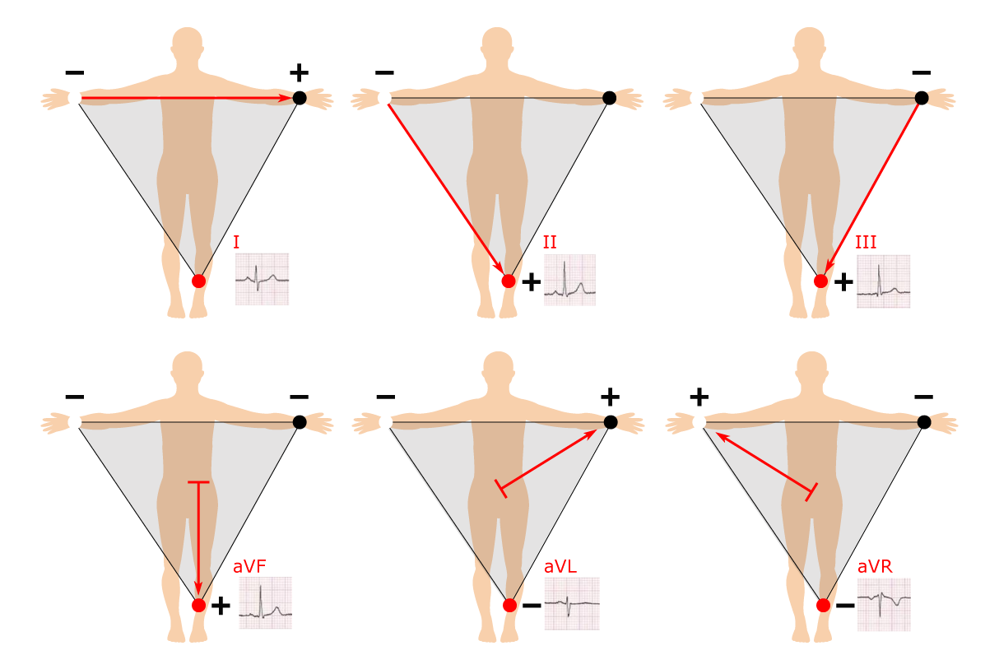

Slide 26
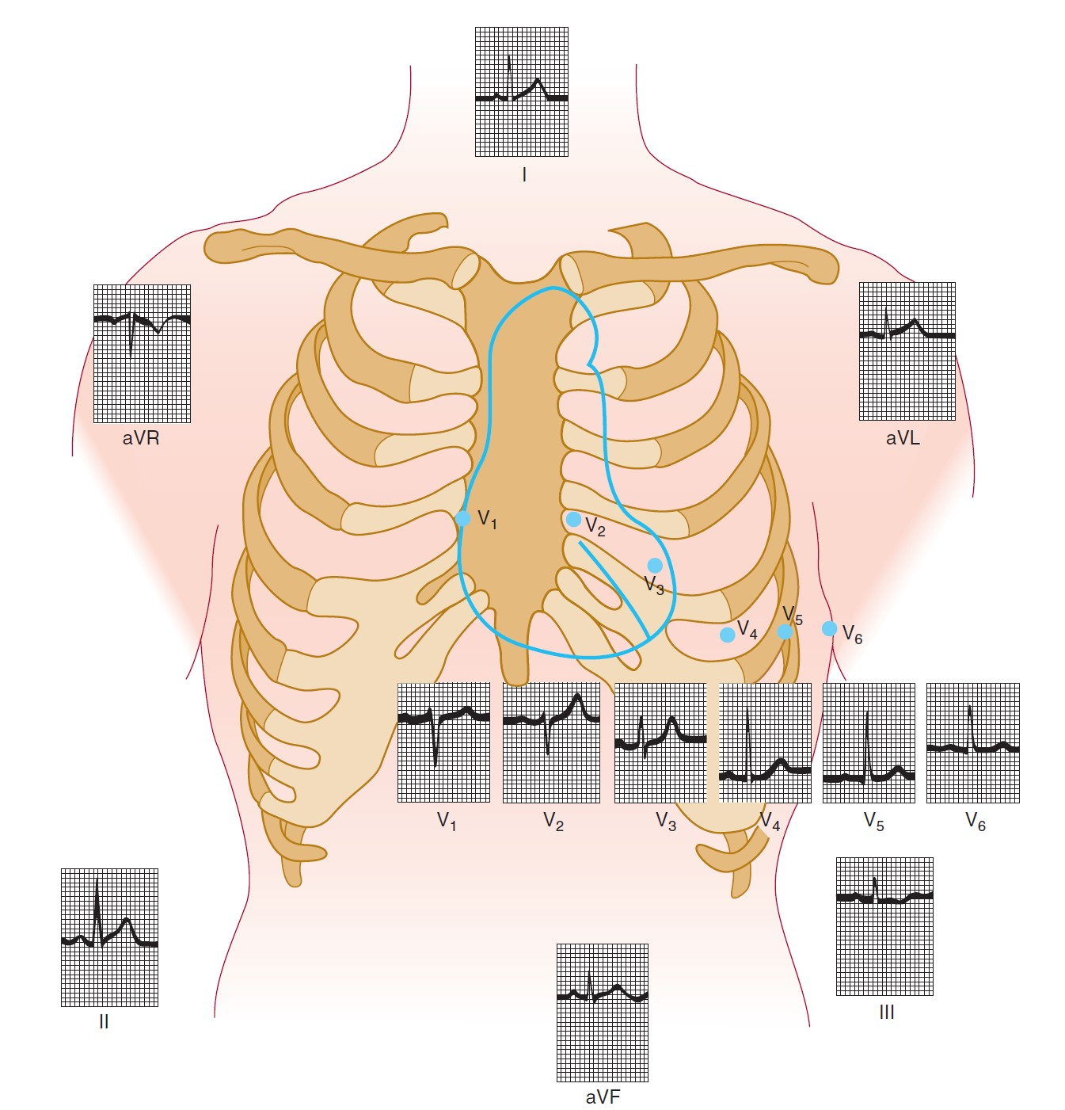

Slide 27
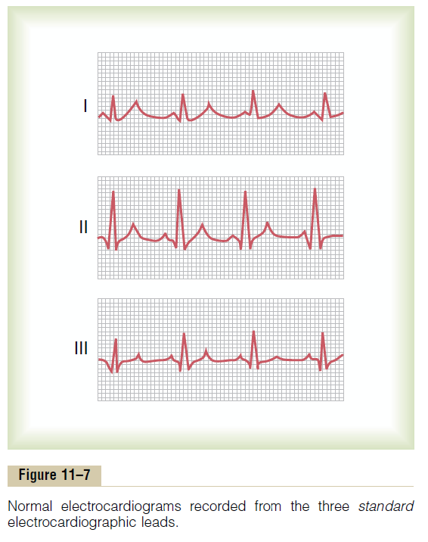

Slide 28
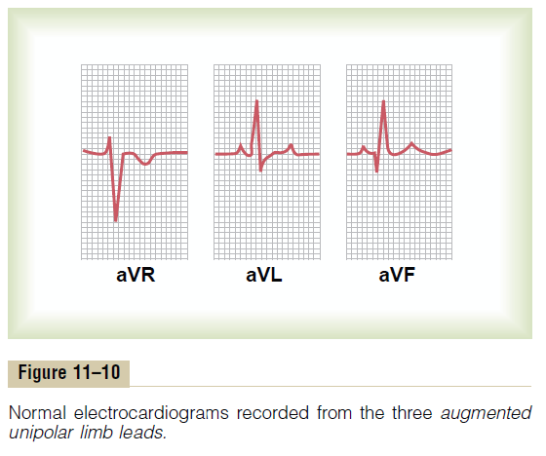

Slide 29
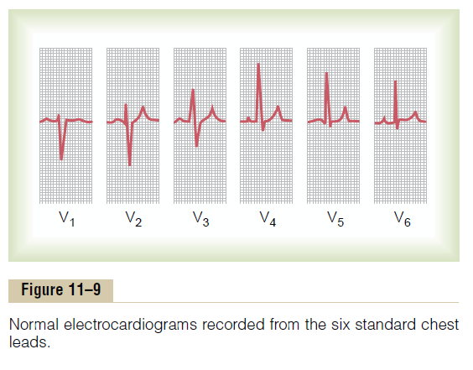

Slide 30
U-WAVE
The U wave is a wave on an electrocardiogram that is not always seen. It is typically small, and, by definition, follows the T wave. U waves are thought to represent repolarization of the papillary muscles or Purkinje fibers
Normal U waves are small, round and symmetrical and positive in lead II. It is the same direction as T wave in that lead.

Slide 31
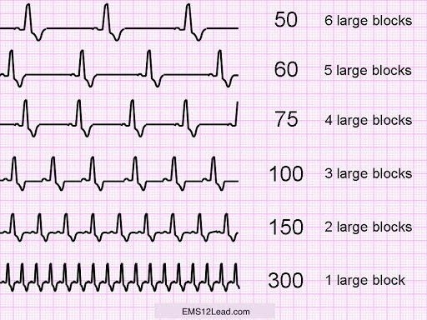
How to calculate HR from ECG
Heart Rate = 300/Large squares between R-R
OR
1500/Small squares between R-R

Slide 32
THANKS

