Slide 1
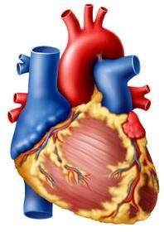
CARDIAC CYCLE
CARDIOVASCULAR SYSTEM
Dr Syed Shahid Habib
Professor & Consultant Clinical Neurophysiology Dept. of Physiology
College of Medicine & KKUH King Saud University
2/17/2021

Slide 2
OBJECTIVES
At the end of the lecture you should be able to …
Enumerate the phases of cardiac cycle
Explain the effect of heart rate on duration of systole and diastole 3.Recognize the pressure, electrical, sound and volume changes during cardiac cycle
Correlate different phases of cardiac cycle with various changes in
events.
Compare and contrast left and right ventricular pressures and volumes during the normal cardiac cycle.
Describe atrial pressure waves & their relationship to cardiac cycle 7.Describe the use of the pressure-volume loop in describing the phases of the cardiac cycle
SOURCE GUYTON 13TH ED. CHAPTER9: PAGE:113-119

Slide 3
CARDIAC CYCLE
Definition: Cardiac Cycle is the time duration comprising all the events from beginning of one heart contraction to the beginning of next heart contraction.
a
At heart rate of 75 beats per minute duration of one Cardiac cycle is 0.8 second.
What are the Events?

Slide 4
EVENTS OF CARDIAC CYCLE
Mechanical Events:
Pressure changes during cardiac cycle
Volume changes during cardiac cycle
Heart sounds Electrical Events
5. Electrocardiogram (ECG)

Slide 5
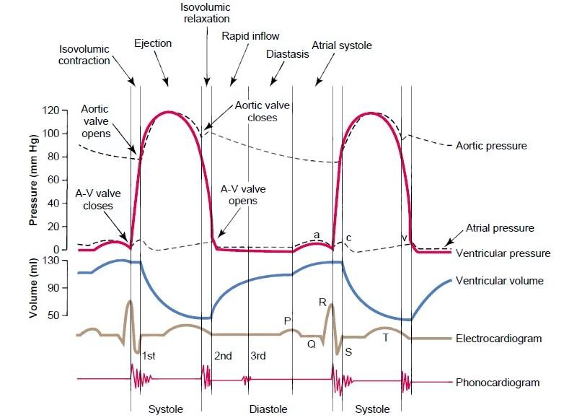
The Events of the Cardiac Cycle

Slide 6
PHASES OF CARDIAC CYCLE
Atrial Events
Atrial systole: 0.1 second
Atrial diastole : 0.7 seconds
Ventricular Events
Ventricular systole : 0.3 seconds
Ventricular diastole : 0.5 seconds
CARDIAC CYCLE
0.8 SECONDS

Slide 7
VENTRICULAR EVENTS
Ventricular systole 1.Isovolumetric contraction 2.Ejection phase
Rapid ejection
Slow ejection
Ventricular Diastole
Isovolumetric relaxation phase
Filling phase
Rapid filling
Slow filling (Continued filling)
Last rapid filling (Atrial Systole)

Slide 8
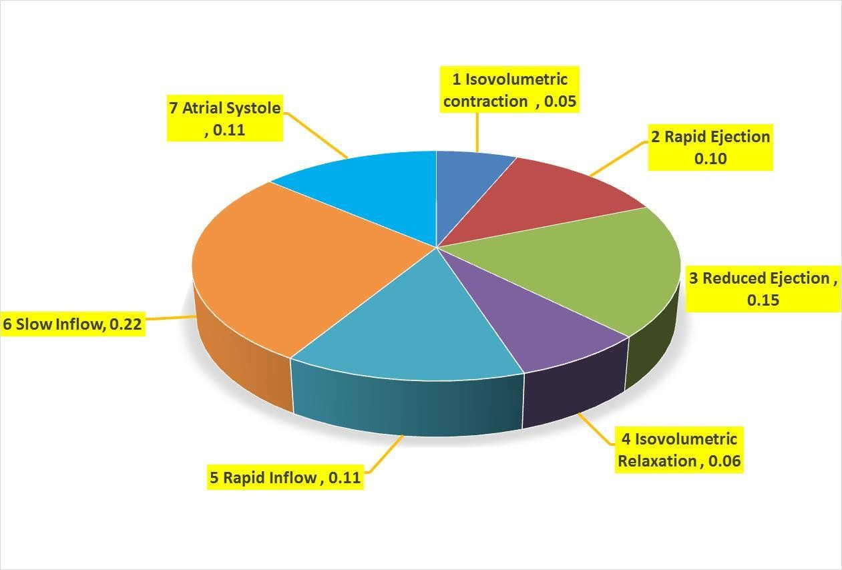
PHASES OF CARDIAC CYCLE

Slide 9
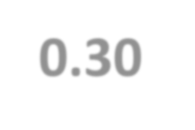
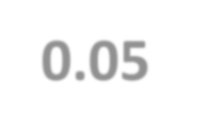
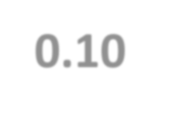
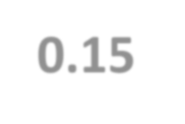
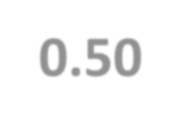
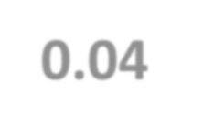
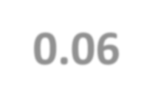
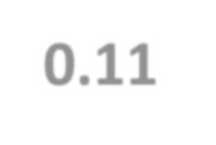
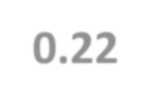
VENTRICULAR SYSTOLE 0.30 sec (Peak of R wave of QRS complex to the end of T wave)
1.ISO-VOLUMETRIC CONTRACTION |  | 0.05 sec
2.MAXIMUM EJECTION [Duration 1/3] (2/3 or 70% blood is ejected) |  | 0.10 sec
3.REDUCED EJECTION [Duration 2/3] (1/3 or 30% blood is ejected) |  | 0.15 sec
VENTRICULAR DIASTOLE 0.50 sec (End of T wave to the peak of R wave of QRS complex)
PROTODIASTOLE ??? | 0.04 sec
4.ISO-VOLUMETRIC RELAXATION | 0.06 sec
5.RAPID INFLOW/RAPID FILLING | 0.11 sec
6.SLOW INFLOW/SLOW FILLING / DIASTASIS | 0.22 sec
7.ATRIAL SYSTOLE (after P wave) | 0.11 sec
7 Phases of CARDIAC CYCLE | 0.8 Sec

Slide 10
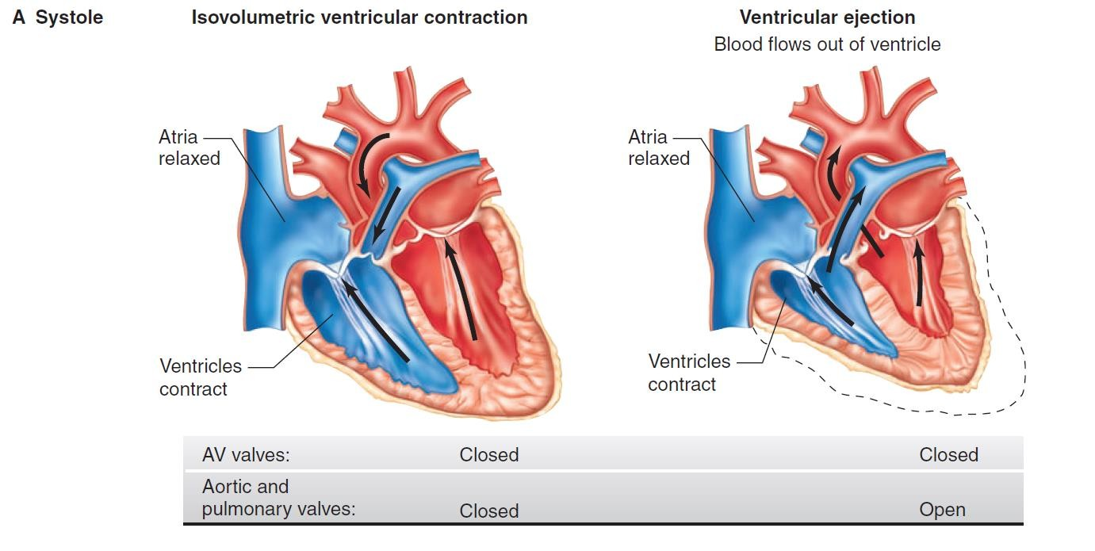

Slide 11
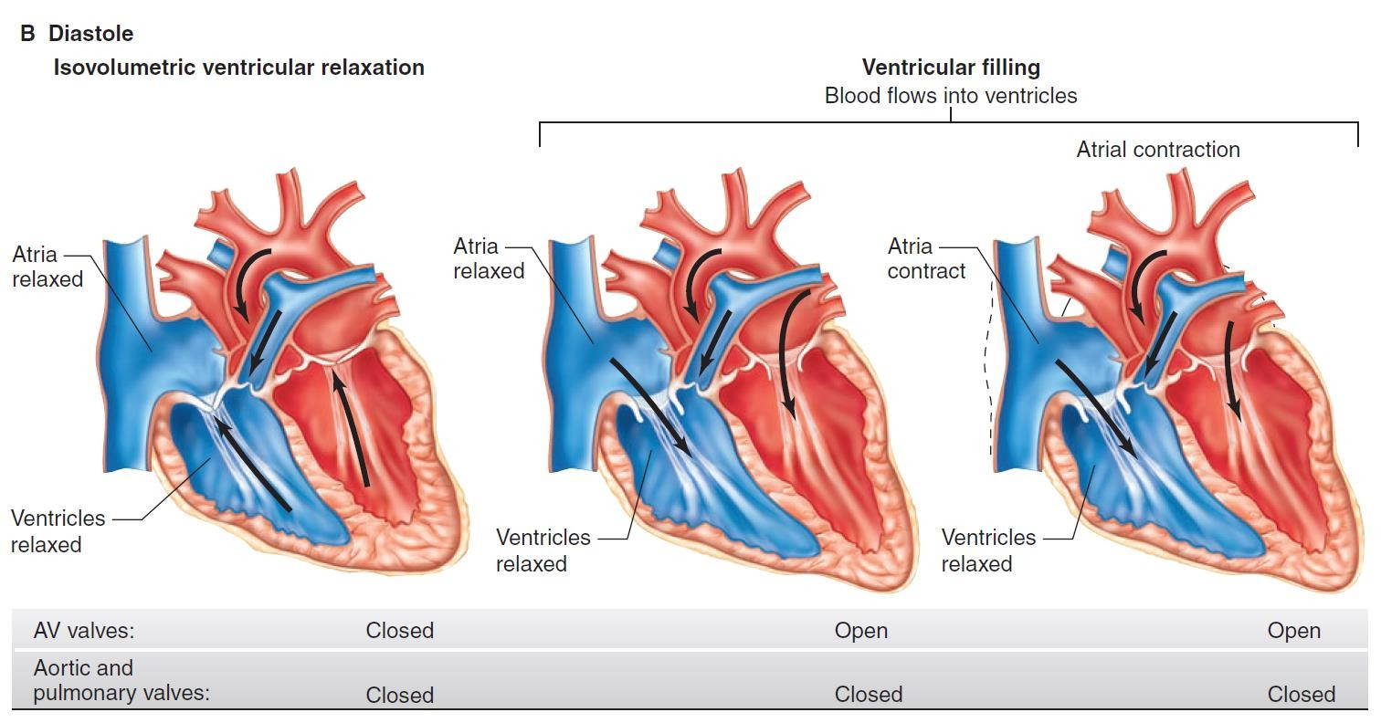

Slide 12
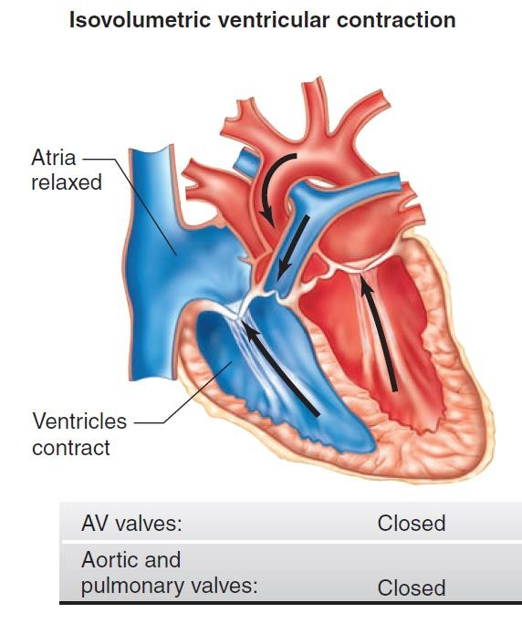
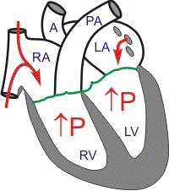
ISOVOLUMETRIC CONTRACTION
Increase in ventricular pressure > atrial pressure → AV valves close
After 0.06s, semilunar valves open
Period between AV valve closure and semilunar valve opening → heart prepares for contraction without shortening→ occurs without emptying
Tension develops without change in muscle length (Isometric/Isovolumetric)

Slide 13
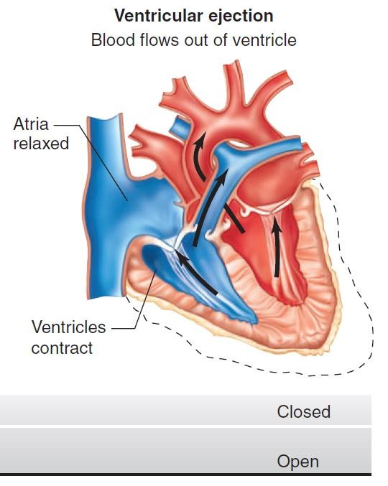
EJECTION
When LV pres > 80 mm Hg RV pres > 8 mm Hg,
The semilunar valves open.
Rapid Ejection – 70% emptying in first 1/3 duration
Slow Ejection – 30% in last 2/3 time
The pressure in the ventricle keeps decreasing until it becomes lower than that of the great vessels

Slide 14
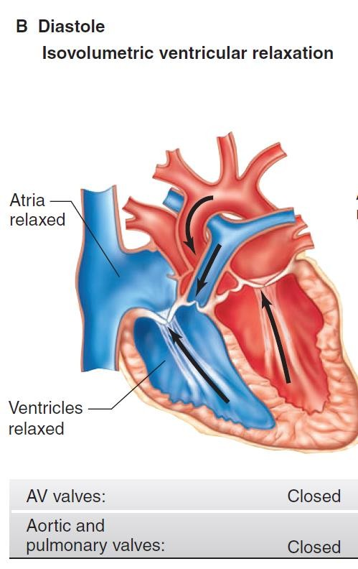
ISOVOULUMETRIC RELAXATION
When ventricle pressure < arterial
pressure→ backflow of blood → forces semilunar valves to close.
For 0.06 s, ventricle relaxes despite no change in its volume
AV and Semilunar valves are closed
Meanwhile, atria fill up and atrial
pressure gradually rises
Pressures in ventricle keep falling till it is < atrial pressure
PROTODIASTOLE???
Once the ventricular muscle is fully contracted, the already falling ventricular pressures drop more rapidly (0.04 Sec)

Slide 15
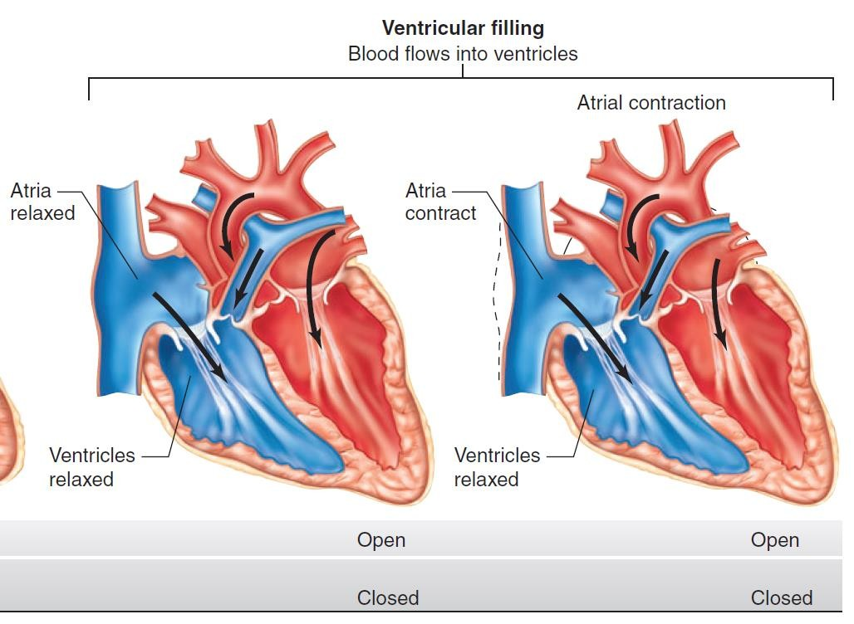
VENTRICULAR FILLING
Begins with the opening of AV valves
Rapid filling
– first 1/3 of diastole (60-70% blood flows)
Reduced filling
(Diastasis) – middle 1/3 of diastole (<5% blood flows)
Atrial contraction –
last 1/3 of diastole (25 % blood)
As the atrial pressures fall, the AV valves close and left ventricular volume is now maximum → EDV (120 ml in LV)

Slide 16
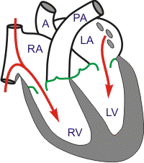
PRESSURE CHANGES IN CARDIAC CYCLE
Remember: Events are the same in the right & left sides of the heart, but with lower pressures in the right side

Slide 17
End Diastolic Volume: Volume of blood in each ventricle at the end of diastole.
It is about 110 – 130 ml.
End Systolic Volume: Volume of blood in each ventricle at the end of Systole. It is about 40 to 60 ml
Stroke Volume: It is a volume of blood pumped out by each ventricle per beat. It is about 70 ml.
Stroke volume (SV) = EDV – ESV

Slide 18
EJECTION FRACTION (EF) is the percentage of ventricular end diastolic volume (EDV) which is ejected with each stroke (60-65%).
SV or (EDV – ESV)
EF =
X 100
EDV
75
X 100 = 62.5%
120
Normal ejection fraction is about 60 – 65 %.
Ejection fraction is good index of ventricular function.

Slide 19
ATRIAL SYSTOLE
Atrial Depolarization
⬇
Atrial contraction
⬇
Atrial pressures rise
⬇
Blood flows across AV valves
ATRIA act as PRIMER PUMPS
& increase the ventricular pumping effectiveness by as much as 20-25%
Ventricular filling :
60-70% - direct flow from VR
25% - atrial contraction.

Slide 20
Heart Rate & Cardiac Cycle
Higher the rate lesser is duration of Cardiac cycle.
However, the duration of systole is much more fixed than that of diastole.
Physiologic and clinical implications of shortened diastole: The heart muscle rests during diastole. Coronary blood flows to the subendocardial portions of the left ventricle only during diastole. Furthermore, most of the ventricular filling occurs in diastole.
Up to about 180/min, filling is adequate as long as there is enough venous return, and cardiac output per minute is increased by an increase in rate. However, at very high heart rates, filling may be compromised to such a degree that cardiac output per minute falls.

Slide 21
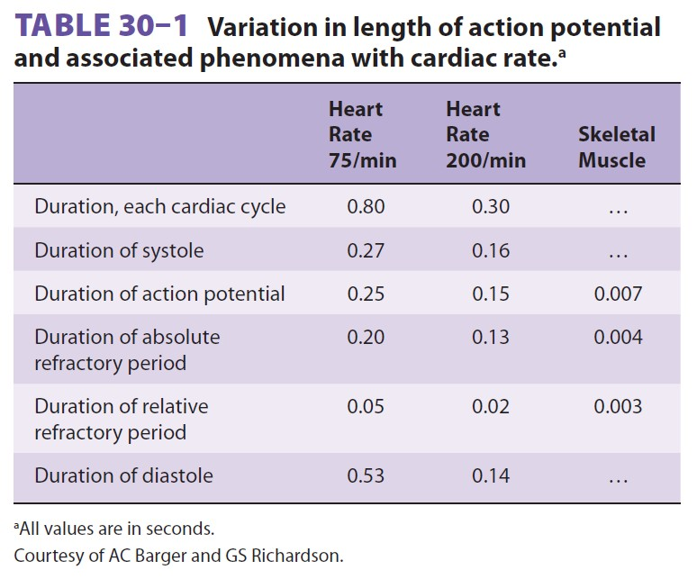

Slide 22
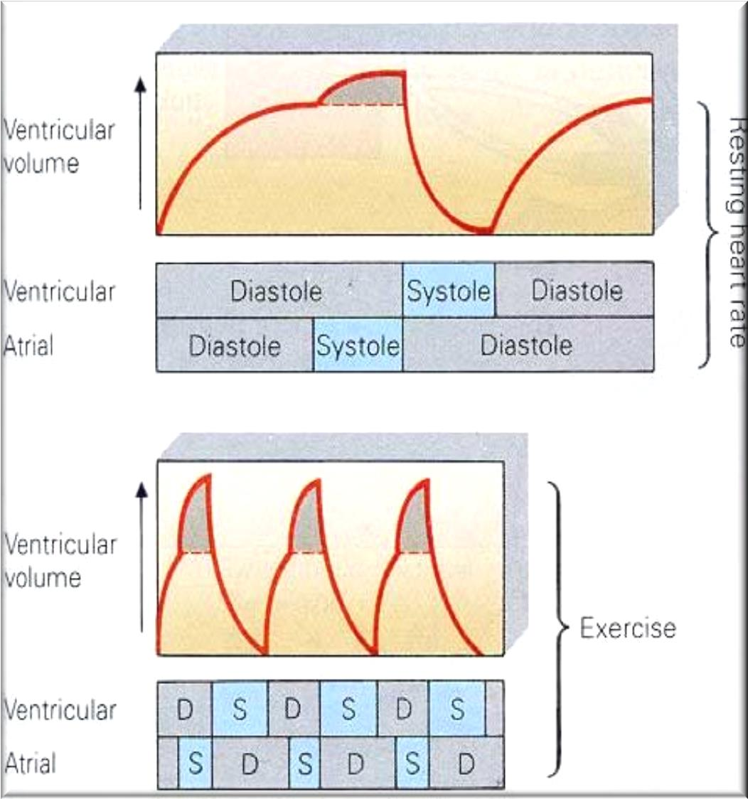
EFFECT OF ATRIAL CONTRACTION ON
VENTRICLE FILLING
At rest, atrial contraction adds little extra blood to the ventricles.
When the heart rate is high, ventricle filling time is reduced.
During exercise, atrial contraction adds a MORE amount of blood to the ventricles.

Slide 23
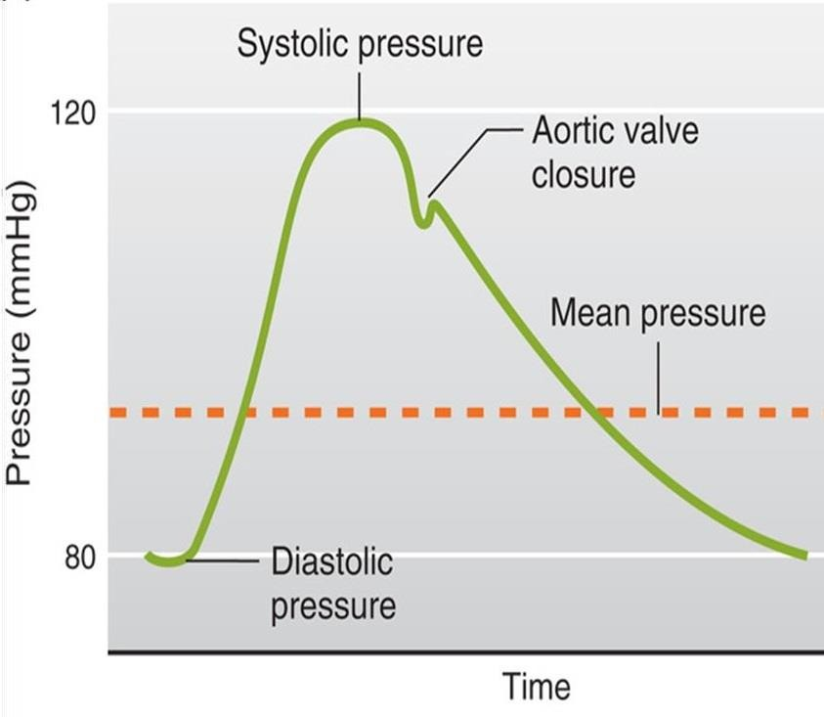
AORTIC PRESSURE CURVE
Ascending or anacrotic limb:
This coincides with the ‘rapid ejection phase’
The amount of blood enters aorta > leaves
Aortic pressure ↑ up to 120 mmHg
Descending or catacrotic limb: (Has 4 stages)
Pulmonary artery pressure changes are similar to the aortic pressure changes [Magnitude 3-4 times Less]. Normal pulmonary artery pressure during the cardiac cycle ≈ 25-30/4- 12 mmHg

Slide 24
Descending / Catacrotic limb - 4 STAGES
↓ Aortic pressure:
This coincides with the ‘reduced ejection phase’
The amount of blood enters aorta
< leaves
Dicrotic notch (incisura):
Due to closure of aortic valve
There is sudden drop in aortic pressure
This notch is seen in the aortic pressure curve at end of ventricular systole
Dicrotic wave:
Due to elastic recoil of the aorta
Slight ↑ in aortic pressure
Slow ↓ in aortic pressure: up to 80 mmHg Due to continued flow of
blood from aorta → systemic
circulation

Slide 25
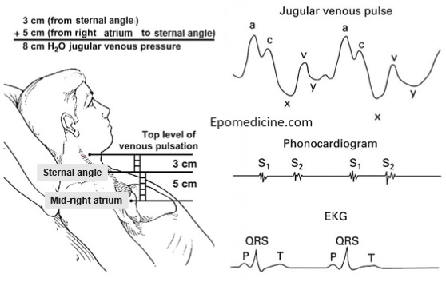
Atrial pressure changes during the cardiac cycle THE JUGULAR VENOUS PULSE (JVP)

Slide 26
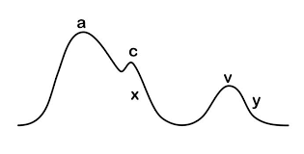
Atrial pressure waves
‘a’ wave: Atrial systole:
↑ atrial pressure during atrial contraction
‘c’ wave: Ventricular systole
+ve as a result of bulging of AV valve into the atria during ‘isovolumetric contraction phase’
-ve as a result of pulling of the atrial muscle & AV cusps down during ‘rapid ejection phase’, resulting in ↓ atrial pressure

Slide 27
Atrial pressure waves
‘v’ wave: Atrial diastole
+ve: atrial pressure ↑ gradually due to continuous VR
-ve as a result of ↓ atrial
pressure during ‘rapid filling phase’
‘x’ descent:
Downward displacement of AV valves during ‘reduced ejection phase’
‘y’ descent:
↓ atrial pressure during ‘reduced filling phase’

Slide 28
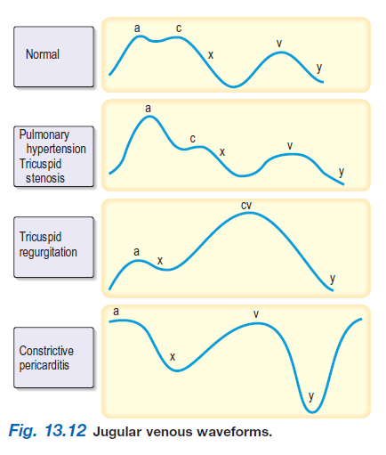

Slide 29
ABNORMALITIES OF “a” WAVE
Elevated a wave
Tricuspid stenosis
Decreased ventricular compliance (ventricular failure,
pulmonic valve stenosis, or pulmonary hypertension)
Cannon a wave
Atrial-ventricular asynchrony (atria contract against a closed tricuspid valve)
complete heart block, following premature ventricular contraction, during ventricular tachycardia, with ventricular pacemaker
Absent a wave
Atrial fibrillation or atrial standstill Atrial flutter

Slide 30
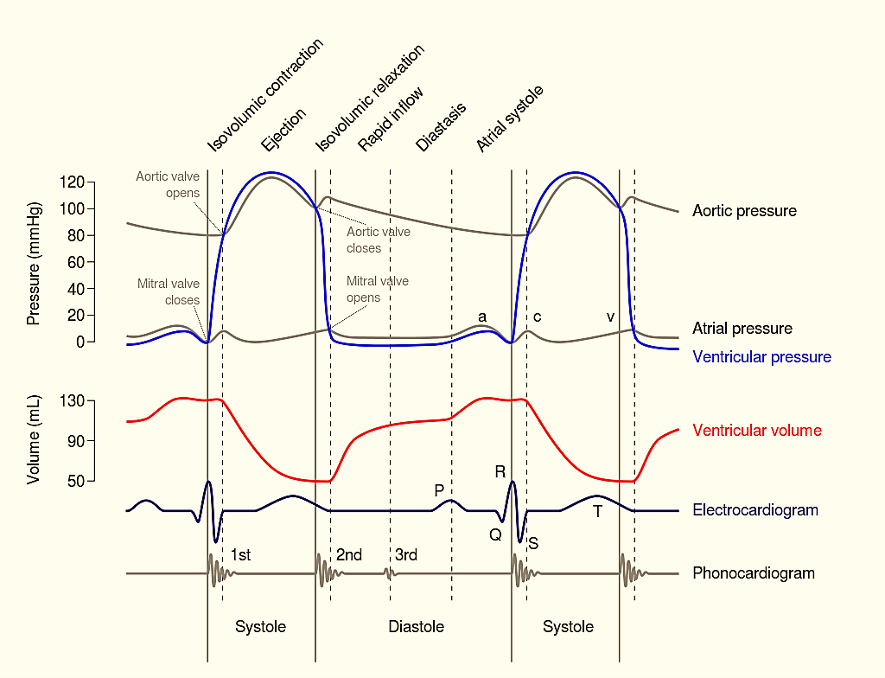
CORRELATING EVENTS TOGETHER
₄TH
26

Slide 31
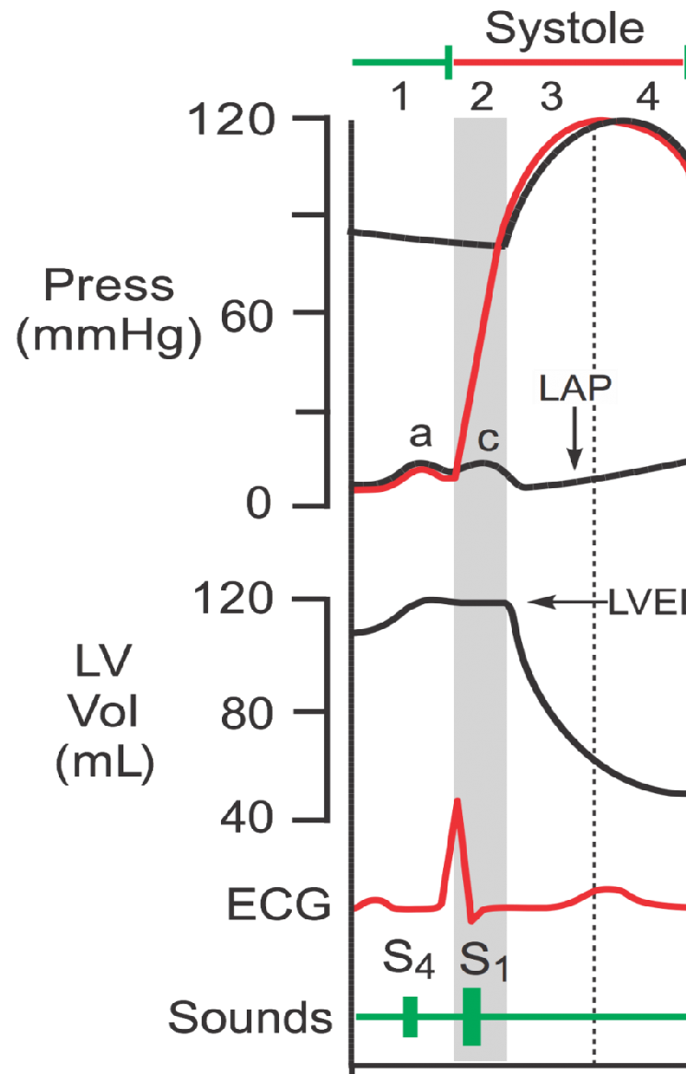
Phase of atrial contraction at end of diastole (JVP – ‘a’ wave ) [ ≈ 0.11 sec]
Preceded by atrial depolarization ( P wave).
Valves: A-V valves open (semilunar valves closed). blood goes from atria to ventricles.
Ventricular volume: up to 130 ml (EDV) .
Ventricular pressure: First slightly ↑ due
to entry of blood from atria. Then ↓ due to dilatation of ventricles. In both cases, it is less than atrial P.
Atrial pressure: First ↑ due to systole of atria. Then ↓ due to blood passage into ventricles.
4th (S4) Heart sound heard (Vibration of the vent wall during atrial contraction).
ATRIAL SYSTOLE: 1
R
P
T

Slide 32
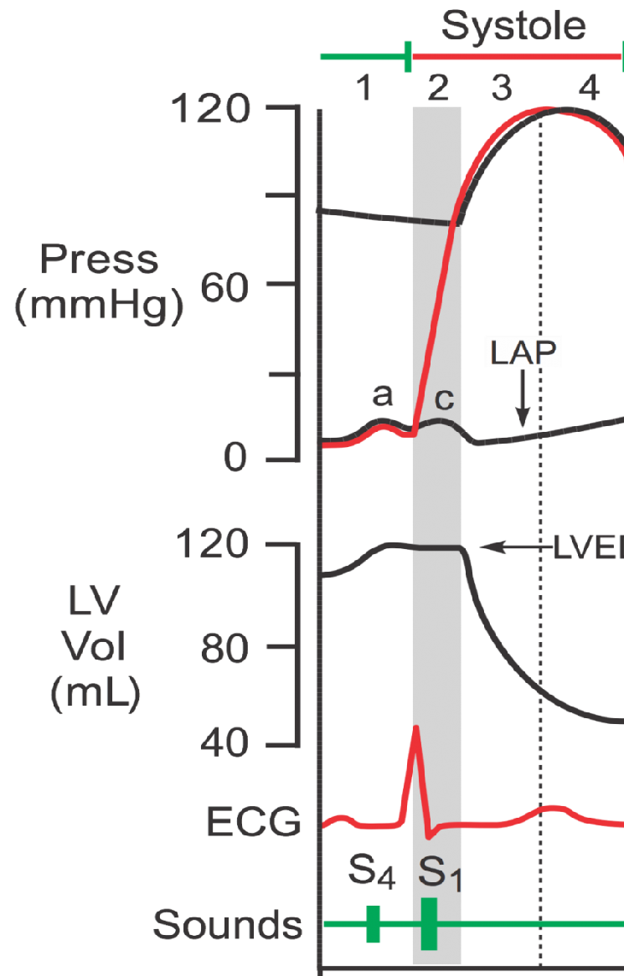
ISOVOLUMETRIC CONTRACTION: 2
Start of ventricular systole [≈ 0.04 sec]
Starts with closure of A-V valves.
Heart Sounds: S₁
Semilunar valves: Still closed
Ventricle contracts with no changes in
volume ( isometrically, no shortening)
ECG: End of QRS complex
Volume in ventricle: EDV (120 ml)
Ventricular pressure: ↑ suddenly
Aortic valve opens at the end of this
phase, when LV exceeds 80mmHg.
Atrial pressure: ↑ due to doming of cusps
of closed A-V valves into atria.
JVP – ‘c’ wave → due to the bulging of the
Tricuspid valve into RA
R
P
T

Slide 33
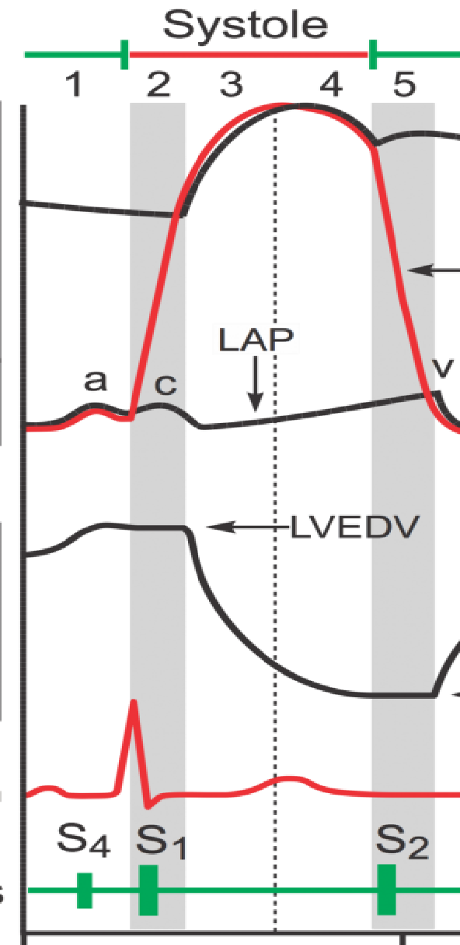
EJECTION 3 Rapid, 4 Slow
The ventricles contract isotonically (with shortening) ejecting 75% of stroke volume.
Duration: ≈ 0.10 sec.
Semilunar valves open at beginning of this
phase when LV pressure exceeds 80 mmHg.
AV valves: Still closed.
Ventricular pressure: 
Ventricular volume: 
Atrial pressure: First  because when ventricles contract, they pull fibrous AV ring with AV valves downward
Heart sounds: none
Aortic pressure: 
ECG – T wave
Heart sounds – none
R
P
T

Slide 34
EJECTION 3 Rapid, 4 Slow
The ventricles contract with lesser force and less blood is ejected (end of systole).
Almost 25% of Stroke Volume is ejected.
Duration: ≈ 0.15 sec.
AV valves: Still closed.
Semilunar valves: Still opened.
Atrial pressure: Still  gradually due to venous return.
Ventricular volume: Continue to .
Ventricular pressure: 
Heart sounds: none
Aortic pressure:  Even at the end of systole pressure in the aorta is maintained at 80-90 mm Hg (Why?)
ECG: T wave
Heart sounds: none
R
P
T

Slide 35
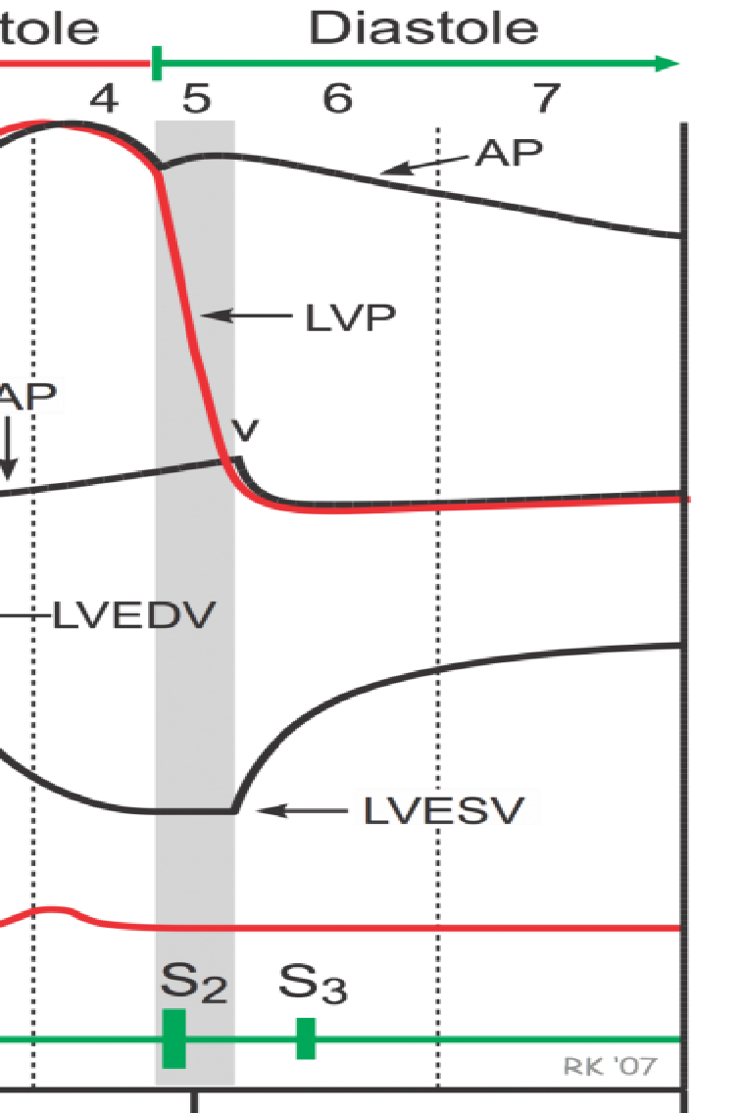
ISOVOLUMETRIC RELAXATION: 5
The ventricles relax at the start of diastole.
It lasts for ≈ 0.06 sec.
Ventricular volume: is constant at the ESV (60 ml).
Semilunar valves: close at the beginning of the phase (Result in S2).
A-V valves: Still closed.
Ventricular pressure:  rapidly,
Atrial pressure: Still  gradually due to accumulation of venous blood. (JVP: ‘v’ wave)
ECG: End of T wave
Aortic pressure curve: INCISURA - backflow of blood coming across a closed aortic valve
T

Slide 36
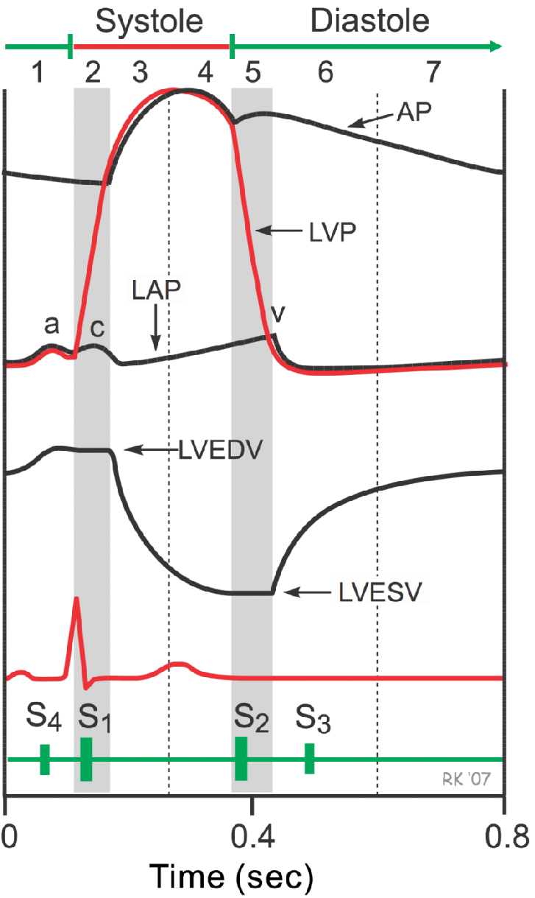
VENTRICULAR FILLING
Rapid filing 6: Reduced filling 7: Atrial contraction 1
About 60-70% of blood passes passively to the ventricles [≈ 0.11 sec].
Heart sound: [S3] due to rush of blood into ventricles and vibration in ventricular wall.
Semilunar valves: Still closed.
Atrial pressure: First sudden ↓ due to rush of blood from atria to ventricles. Then gradually  due to entry of venous blood.
Ventricular volume:  because it is being filled with blood.
Ventricular pressure: Slightly  but < atrial pressure
R
P
T

Slide 37
VENTRICULAR FILLING
Rapid filing 6: Reduced filling 7: Atrial contraction 1
Remaining atrial blood flows slowly into ventricles by pressure gradient <5%. [≈ 0.22 sec]
A-V valves: still open.
Semilunar valves: Still closed.
Atrial pressure: Still ↑
Ventricular volume: Still ↑
Ventricular pressure: Slightly ↑ gradually
R
P
T
➢JVP – ‘y’ descent in first 2/3 & ‘a’ wave in last 1/3
➢ECG – P wave before atrial systole

Slide 38
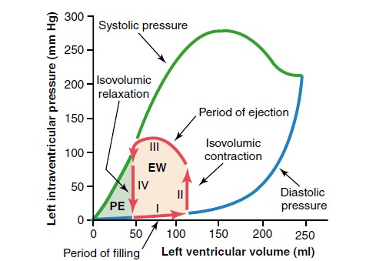
“Volume-Pressure Diagram” During the Cardiac Cycle; Cardiac Work Output.

Slide 39
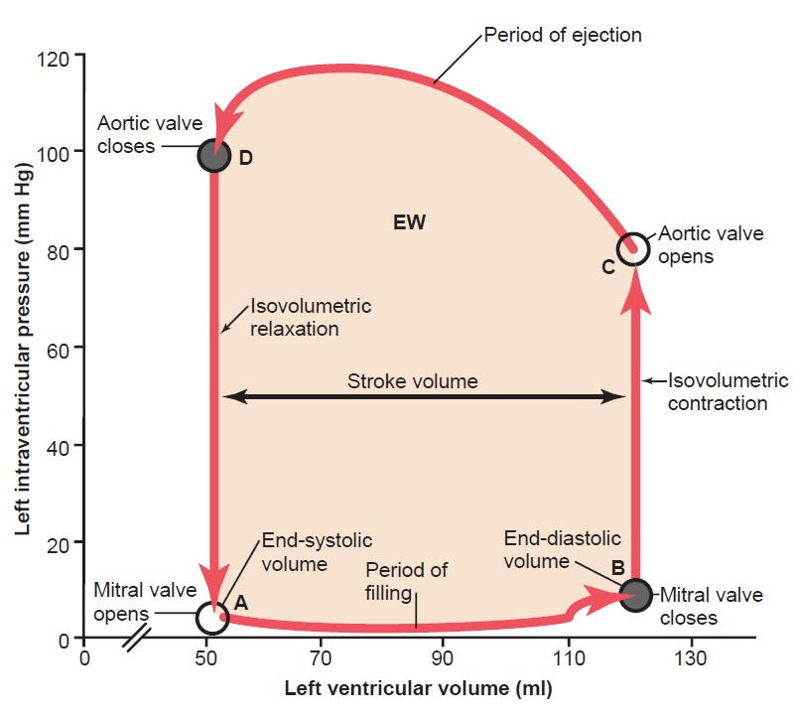
VENTRICULAR PRESSURE - VOLUME LOOP
Plots LV pressure
against LV volume through one complete cardiac cycle
→ Late Diastole
(Filling phase)

Slide 40
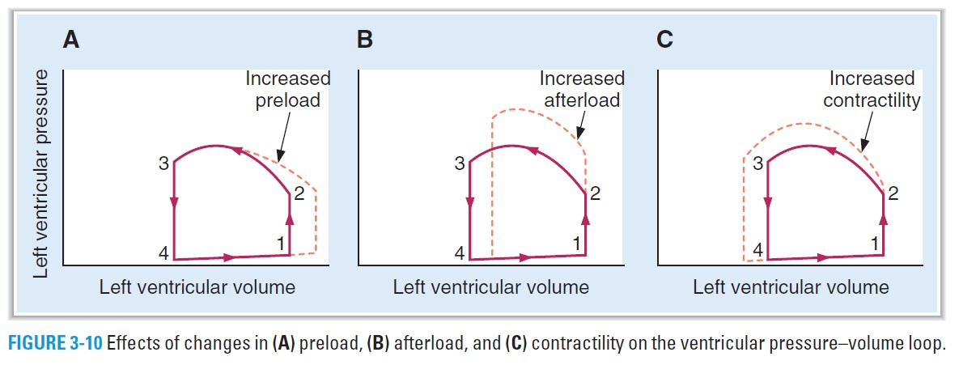
A. Increased preload: ↑ venous return → increase in SV based on the Frank–Starling relationship….reflected in increased width of the PV loop.
B. Increased afterload: due to an increase in aortic pressure →
decrease in stroke volume….is reflected in decreased width of the PV loop.
C. Increased contractility: → increased width & height of the PV loop.

Slide 41
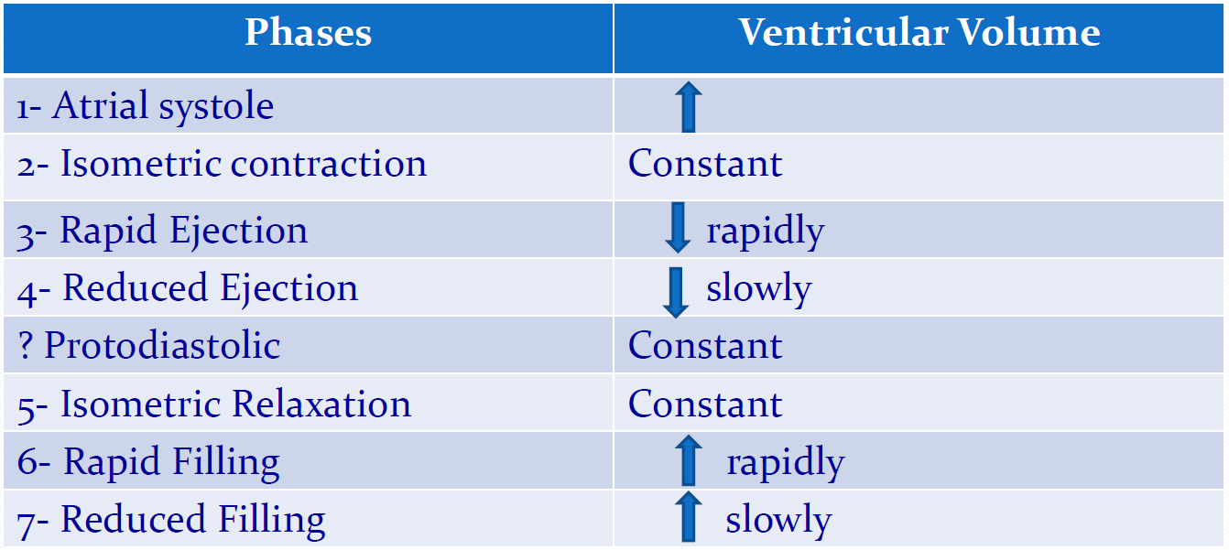
VENTRICULAR VOLUME CHANGES

Slide 42
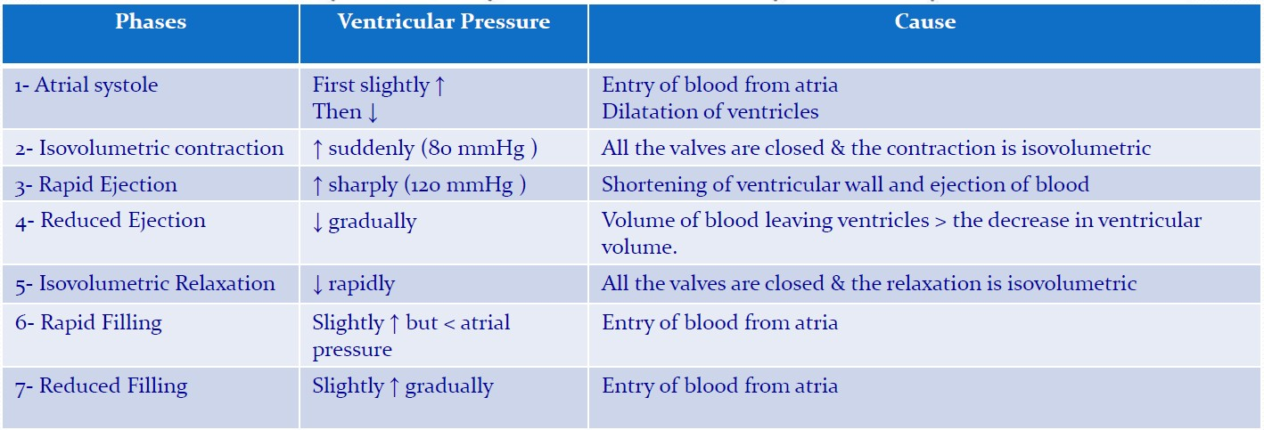
VENTRICULAR PRESSURE CHANGES

Slide 43
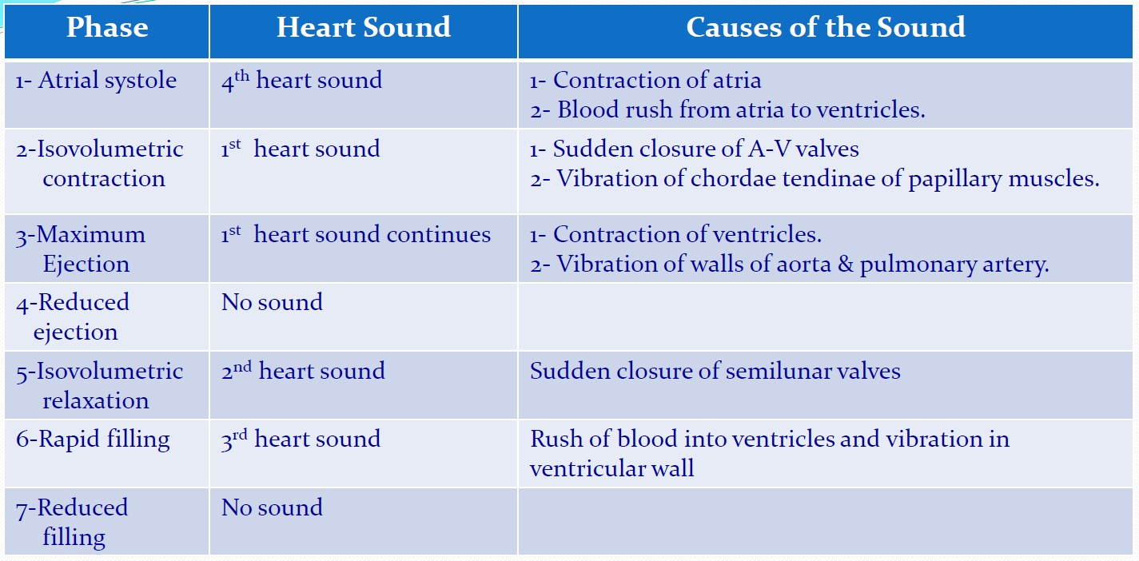
HEART SOUNDS & CARDIAC CYCLE

Slide 44
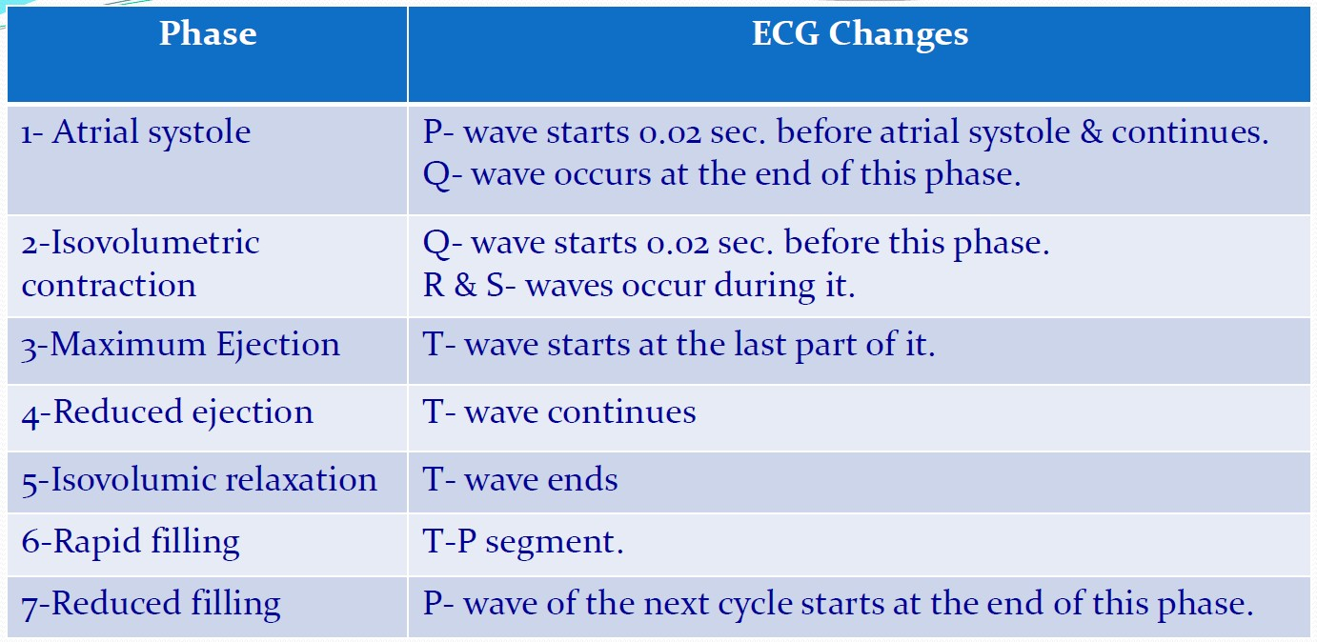
ECG CHANGES IN CARDIAC CYCLE

Slide 45
Good luck

