Slide 1
Cystitis Renal Block
Dr. Khalifa Binkhamis & PROF.HANAN HABIB
Department of Pathology, Microbiology Unit
2021

Slide 2
Objectives
1-Define the term cystitis and recall who commonly gets cystitis.
2- Describe the pathogenesis and risk factors of cystitis.
3- List the most common causative organisms of cystitis
4- Recall the different types of cystitis ( infectious and non-infectious).
5- Describe the clinical presentation of cystitis
6- Describe the laboratory diagnosis of cystitis
7- Recall the antimicrobial agents suitable for the treatment and prevention of cystitis.

Slide 3
Introduction
Urinary Tract infection (UTI) divided into upper and lower urinary tract infections
Patient presents with urinary symptoms and significant bacteriuria= 10⁵ bacteria/ml
Asymptomatic bacteriuria when the patient presents with significant bacteria in urine but without symptoms

Slide 4
Prevalence of Bacteriuria in different age groups

Slide 5
Classification
Lower UTIs
Cystitis (infection of the bladder; superficial mucosal infections)
Urethritis (sexually transmitted pathogens)
- urethritis in men & women
Prostatitis and Epididymitis
Upper UTIs Acute pyelonephritis
Chronic pyelonephritis
Uncomplicated UTI (empirical therapy is possible)
Complicated UTI (nosocomial UTI, relapses, structural or functional abnormalities )

Slide 6
Pathogenesis of cystitis
Due to frequent irritation of the mucosal surfaces of the urethra and the bladder.
Infection results when bacteria ascends to the urinary bladder . These bacteria are residents or transient members of the perineal flora, and are derived from the large intestine flora.
Toxins produced by uropathogens.
Conditions that create access to bladder are:
- Sexual intercourse due to short urethral distance.
- Catheterization of the urinary bladder , instrumentation

Slide 7
Pathogenesis of cystitis
Haematogenous through blood stream from other sites of infection (less common).

Slide 8
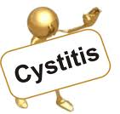
Cystitis
In women : cystitis is common due to a number of reasons:
- Short urethra
- Pregnancy
- Decreased estrogen production during menopause.
In men: mainly due to persistent bacterial infection of the prostate.

Slide 9
Cystitis
In both sexes: common risk factors are :
- Presence of bladder stone
- Urethral stricture
- Catheterization of the urinary tract
- Instrumentation
- Diabetes mellitus
- Obstruction
- Structural abnormalities
Uncomplicated UTI usually occurs in non pregnant, young sexually active females without structural or neurological abnormalities

Slide 10
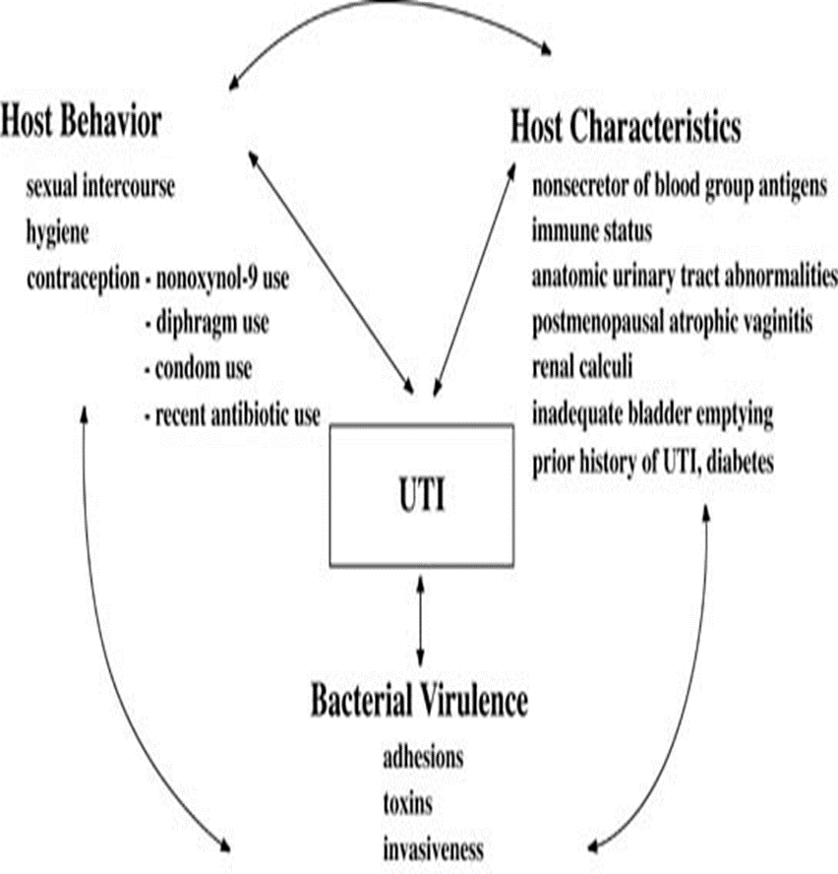
Pathogenesis

Slide 11
Etiologic agents
E.coli is the most common (90%) cause of cystitis. Other Enterobacteriaceae include (Klebsiella pneumoniae, Proteus spp.) Other gram negative rods eg. P.aeroginosa.
Gram positive bacteria: Enterococcus faecalis, group B Streptococcus and Staphylococcus saprophyticus {honeymoon cystitis}.
Candida species
Venereal diseases (gonorrhea, Chlamydia) may present with cystitis.
Schistosoma haematobium in endemic areas.

Slide 12
Pathogens involved
Uncomplicated UTI
E. coli 64%
Enterobacteriaceae 16%
Enterococcus spp 20%
Pseudomonas spp <1%
S. aureus <1%
Special cases
S. epidermidis
S. saprophyticus
Yeasts (catheter related)
Viruses (Adenovirus, Varicella)
Chlamydia trachomatis
Complicated UTI
E. coli
Enterobacteriaceae
Pseudomonas spp
Acinetobacter spp
judge, often multi-resistant strains)
(% is not possible to

Slide 13
Clinical presentation
Symptoms usually of acute onset.
Dysuria (painful urination)
Frequency (frequent voiding)
Urgency (an imperative call for toilet)
Hematuria (blood in urine) in 50% of cases.
Usually no fever.

Slide 14
Vaginitis (5%) Candida spp.
T. vaginalis
Cystitis (80%)
E. coli,
S. saprophyticus
Proteus spp.
Klebsiella spp.
Urethritis (10-15%)
C. trachomatis,
N. gonorrhoeae
H. simplex
Other bacteria?
Dysuria and frequency
Non-infectious (<1%)
Hypoestrogenism
Functional obstruction
Mechanical obstruction
Chemicals

Slide 15
How to differentiate between cystitis and urethritis ?
Cystitis is of more acute onset
More sever symptoms
Pain, tenderness on the supra-pubic area.
Presence of bacteria in urine (bacteriuria)
Urine cloudy, malodorous and may be bloody

Slide 16
Differential diagnosis (types of cystitis)
Non-infectious cystitis such as:
Traumatic cystitis in women
Interstitial cystitis ( unknown cause, may be due to autoimmune attack of the bladder)
Eosinophilic cystitis
Hemorrahagic cystitis due to radiotherapy or chemotherapy.

Slide 17
Laboratory diagnosis of cystitis
Specimen collection:
Most important is clean catch urine [Midstream urine (MSU)] to bypass contamination by preneal flora and must be before starting antibiotic.
Supra-pubic aspiration or catheterization may be used in children.
Catheter urine should not be used for diagnosis of UTI.

Slide 18
2- Microscopic examination:
About 90% of patients have > 10 WBCs /cu.mm
Gram stain of uncentrifuged sample can be done.
One organism per oil-immersion field is indicative of infection.
Blood cells, parasites or crystals can be seen

Slide 19
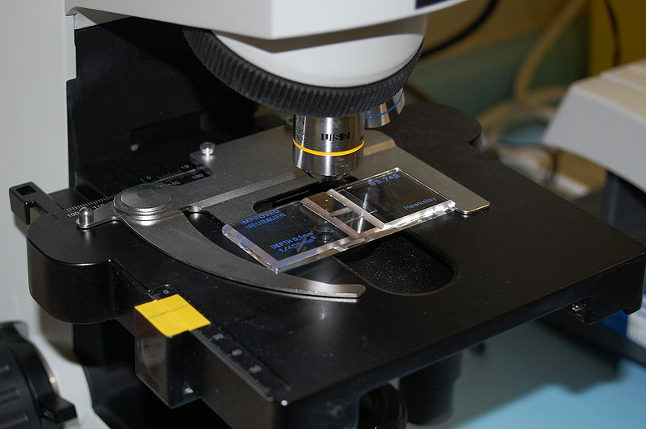
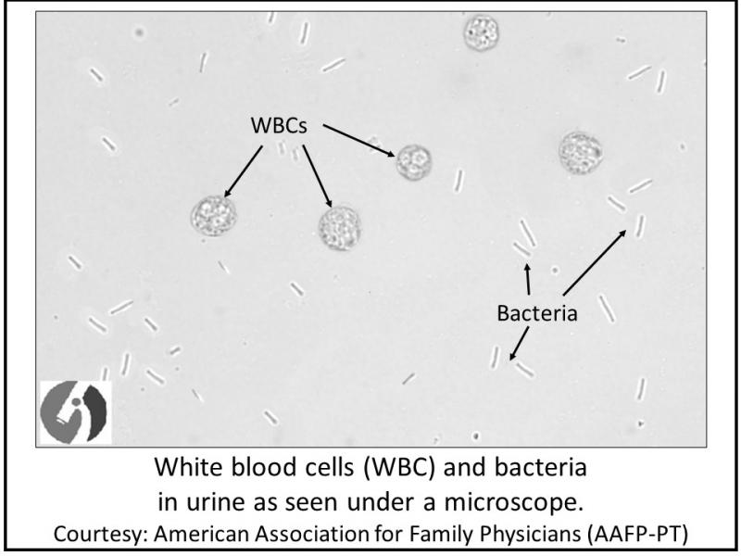

Slide 20
3- Chemical screening tests:
Urine dip stick –rapid, detects nitrites released by bacterial metabolism and leukocyte esterase from inflammatory cells. Not specific.
4- Urine culture: important to identify bacterial cause and antimicrobial sensitivity .
Quantitative culture typical of UTI ( >100,000 cfu/ml) Lower count (<100,000 or less eg. 1000 cfu/ml ) is indicative of cystitis if the patient is symptomatic.

Slide 21
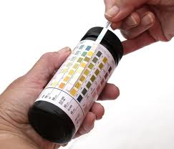
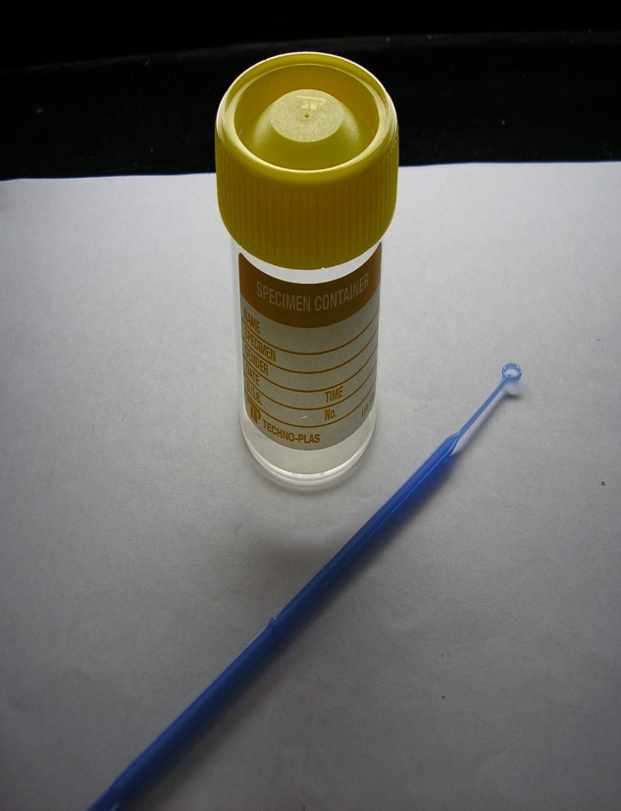
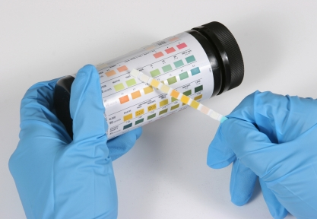
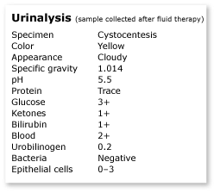
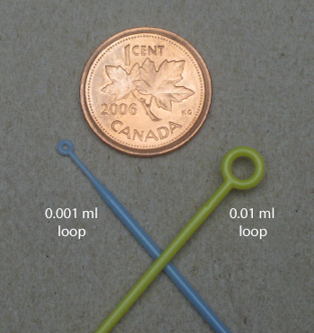

Slide 22
Quantitative urine culture
Using 0.001/ml loop
1 colony = 1000 CFU/ml
100 colonies = 100,000 CFU/ml

Slide 23
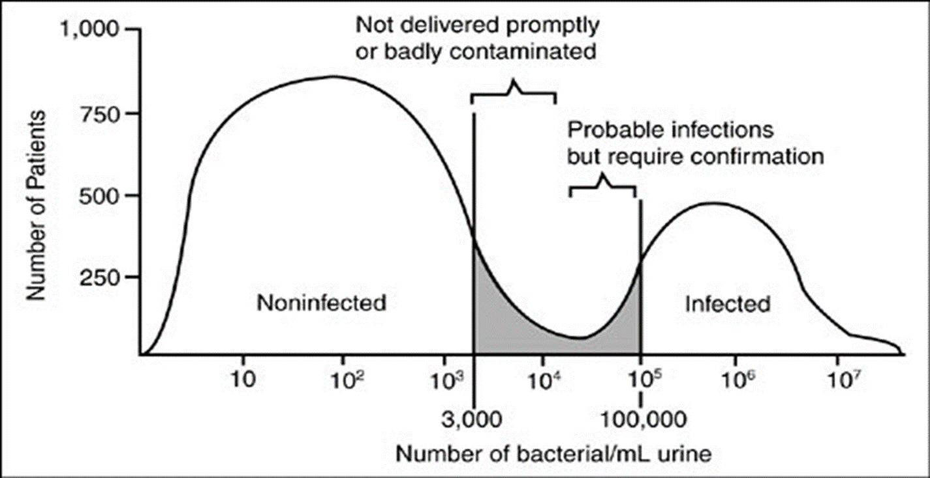

Slide 24
Recurrent cystitis
Three or more episodes of cystitis /year
Requires further investigations such as Intra-Venous Urogram (IVU) or Ultrasound to detect obstruction or congenital deformity.
Cystoscopy required in some cases.

Slide 25
Treatment of cystitis
Empiric treatment commonly used depending on the knowledge of common organism and sensitivity pattern.
Treatment best guided by susceptibility pattern of the causative bacteria.
Common agents: Ampicillin or Amoxacillin, Amoxacillin-Clavulanic acid , Cephradine, Ciprofloxacin, Norfloxacin, Gentamicin or TRM-SMX.

Slide 26
Treatment of cystitis
Duration of treatment: three days for uncomplicated cystitis
10-14 days for complicated and recurrent cystitis.
Prophylaxis required for recurrent cases by Nitrofurantoin or TRM-SMX.
Prevention : drinking plenty of water and prophylactic antibiotic.

Slide 27
Reference
Ryan, Kenneth J. Sherris Medical Microbiology. Latest edition. McGraw –Hill Education

Slide 28
Tutor contact
hahabib@ksu.edu.sa

