Slide 1
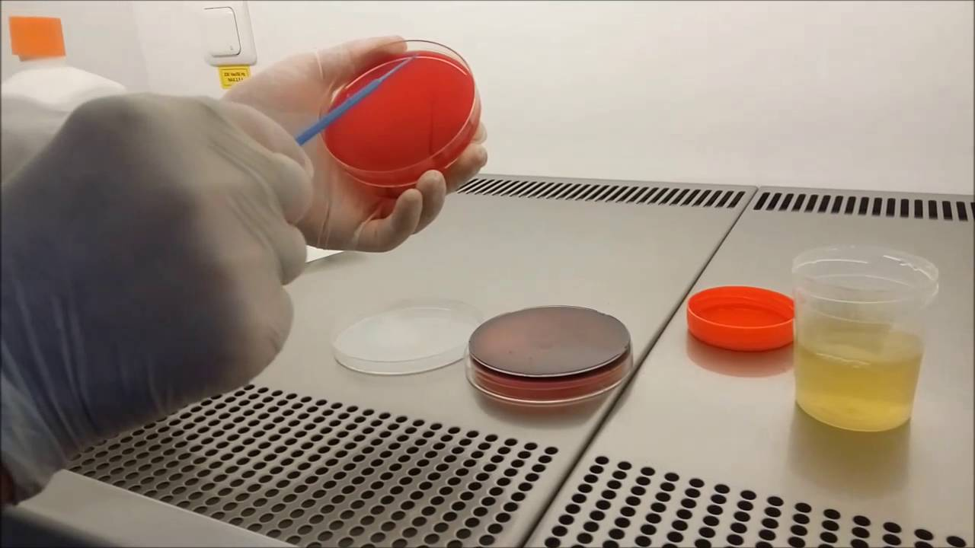
URINARY TRACT INFECTION
Microbiology Practical Class
Renal System Block
First Year
Dr. Fawzia Al-Otaibi

Slide 2
Objectives
It is expected that by the end of this practical class, students should be able to:
Know the important steps in specimen collection and transport to the lab.
How to process urine Specimens in the lab.
Urine microbiological and biochemical analysis.
Organisms culture and identification.
Antibiotic susceptibility testing.
Results interoperation.
Know the clinically important etiological Organisms associated with UTI, their identification and susceptibility testing.

Slide 3
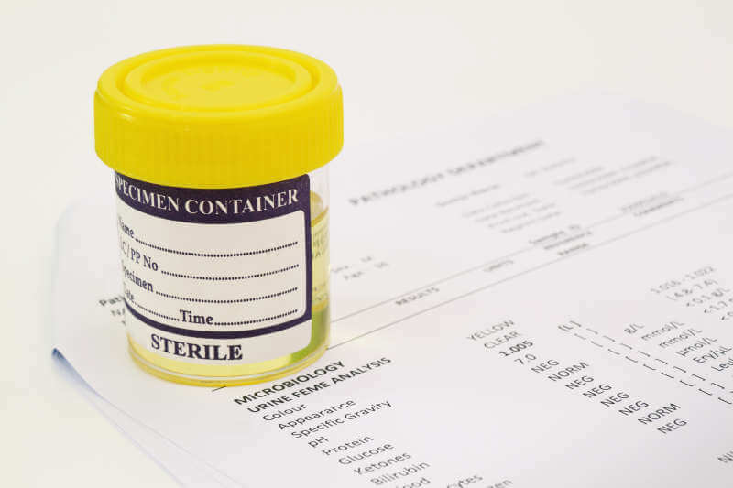
SPECIMEN COLLECTION

Slide 4
TYPE OF SPECIMENS
Midstream urine (MSU)
Adhesive bag
Suprapubic Aspiration
Catheter sample

Slide 5
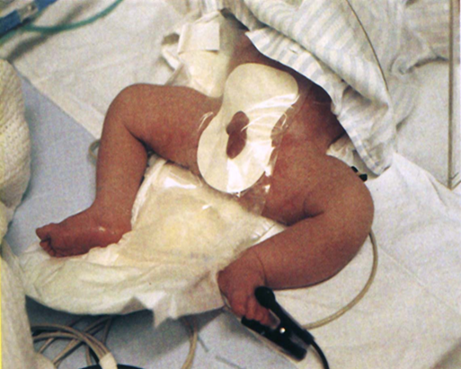
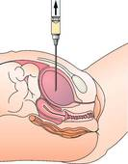
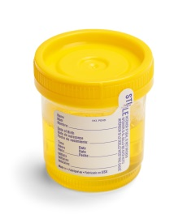
TYPE OF SPECIMENS
Suprapubic Aspiration | Adhesive bag | Midstream Urine (MSU)
The urinary catheter Urine specimens for laboratory investigations can be collected from catheterized patients as shown (left). The second port is for putting fluids into the bladder (right). Urine from the drainage bag should not be tested because it may have been standing for several hours. | Catheter sample

Slide 6
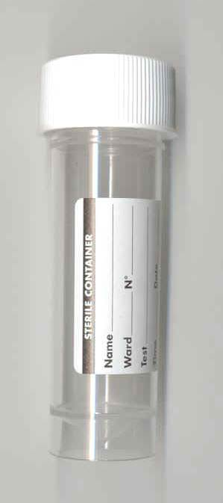
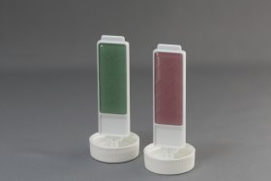
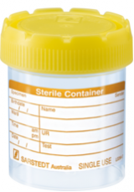
Sterile Urine Container
Dip slides
One side is CLED media, the other can be MacConkey (MAC) agar or blood agar.

Slide 7
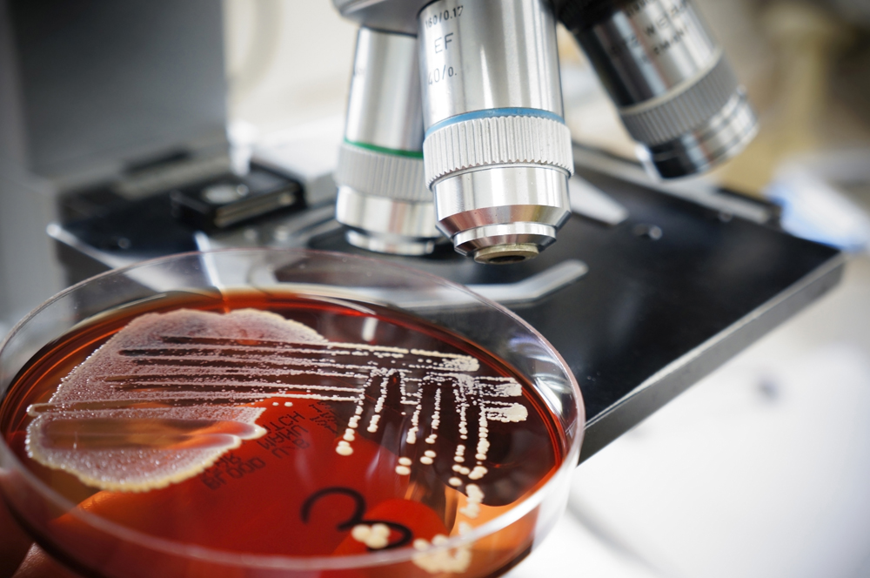
SPECIMEN PROCESSING

Slide 8
Specimen processing:
Urine analysis
Microbiological
Biochemical
Culture and identification
Antimicrobial Susceptibility testing
Results interpretation

Slide 9
Urine Analysis
Biochemical
Microbiological
Macroscopic
Microscopic

Slide 10
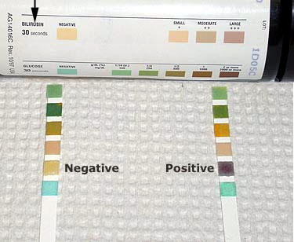
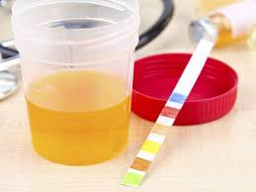
Biochemical Urine
Examination (Dip stick)
leukocyte esterase
Nitrate test
PH
Glucose
Bilirubin

Slide 11
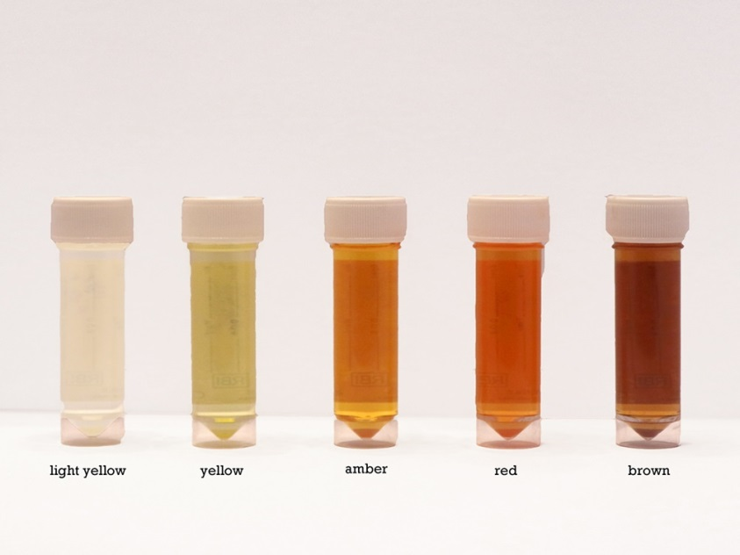
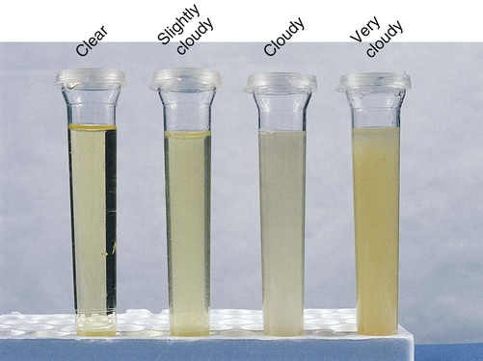
Microbiological Urine Examination
Macroscopic:
Color
Odor
Turbidity

Slide 12
Microbiological Urine Examination
Microscopic:
cell-counting (WBC, RBC)
Parasite (Ovum, Trichomonas, yeast)
Casts

Slide 13
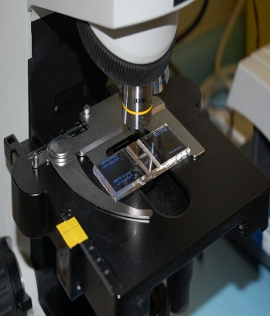
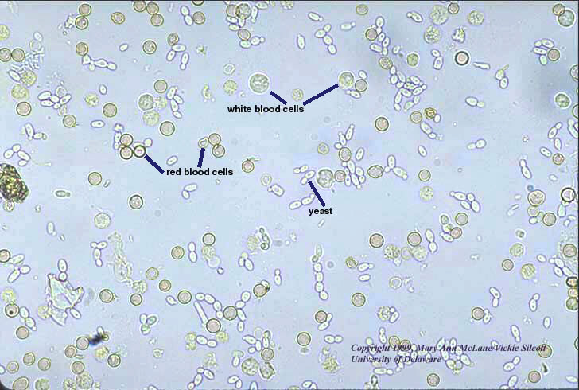
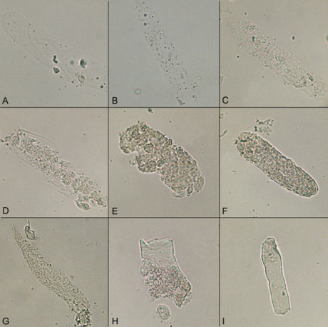
Microscopic Urine
Examination (WET MOUNT)
cell-counting (WBC, RBC)
Parasite | Casts

Slide 14
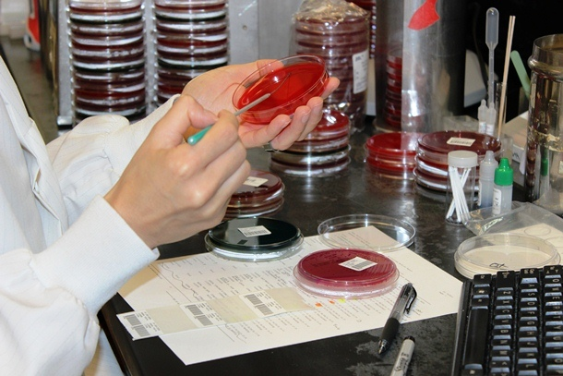
Culture and Identification

Slide 15
Culture and Identification
Culture media
Urine inoculation and reading of culture
Identification of cultured organisms

Slide 16
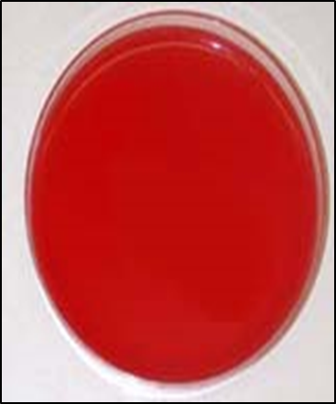
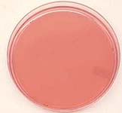
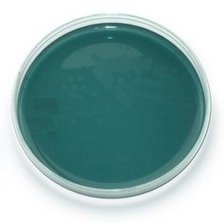
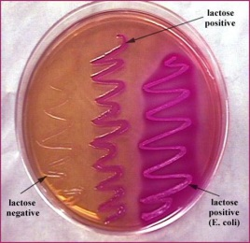
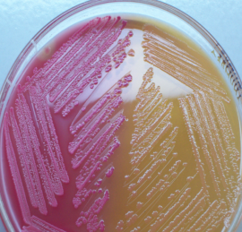
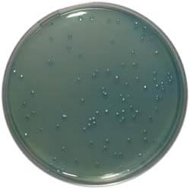
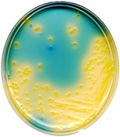
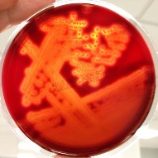
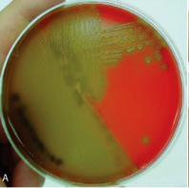
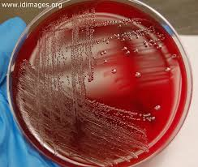
Culture Media Routinely Used for Urine Culture
CLED Agar | MacConkey Agar | Blood Agar
Selective culture medium, for detection and isolation of E. coli and coliform bacteria in urine. | Differential culture medium, showing both lactose and non-lactose fermenting colonies. LFC = Pink NLFC = Colorless or appear same as the medium. | Enriched culture medium, for culturing fastidious organism and observed the hemolytic reaction(Beta,Alpha,Gama).

Slide 17
Urine Inoculation
Quantitative (Colony counts)
a urine sample is streaked on surface of Blood Agar plate and CLED agar / Mc Conkey agar with a special loop calibrated to deliver a known volume.
+ 1
+ 2
+ 3
+ 4
Over night incubation
Isolation of colonies,
Biochemical tests,
Drug susceptibility test,
Over night incubation
RESULT

Slide 18
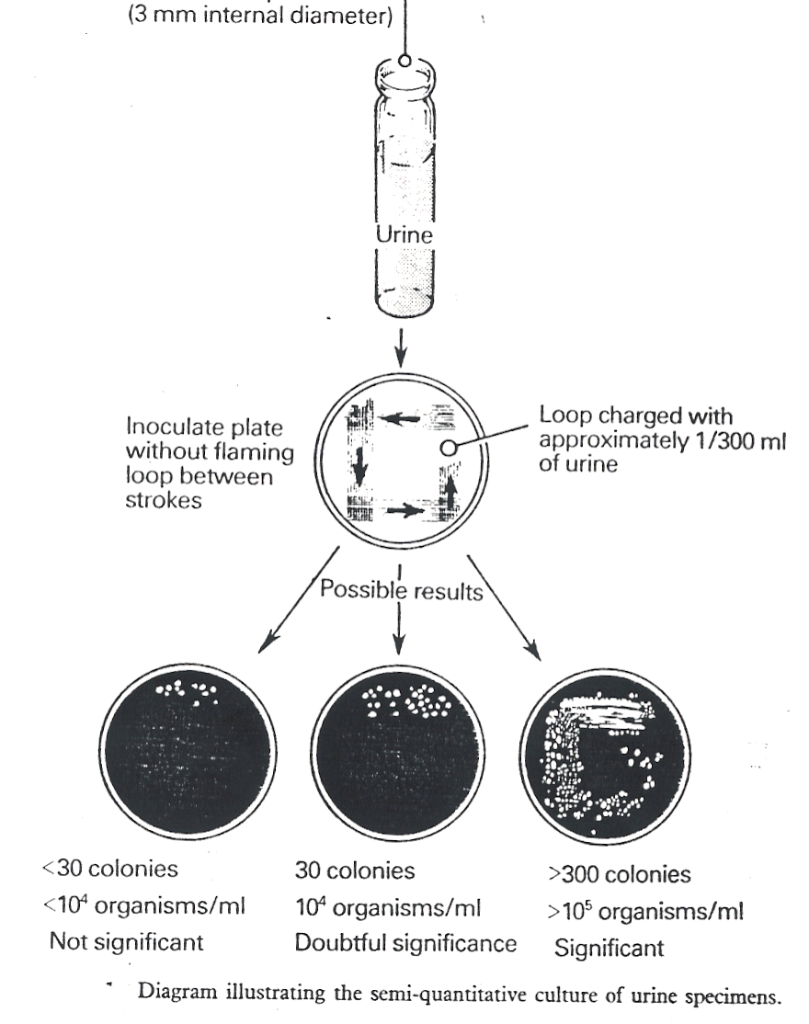
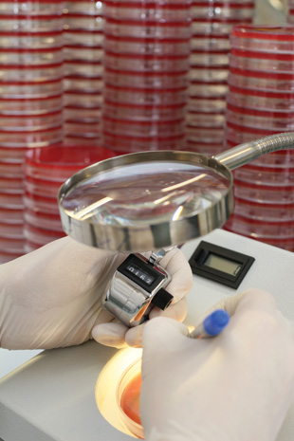
Smi-Qantitative Culture of Urine Sample

Slide 19
Identification of cultured organisms
Biochemical tests.
Type of hemolysis
Serological tests

Slide 20
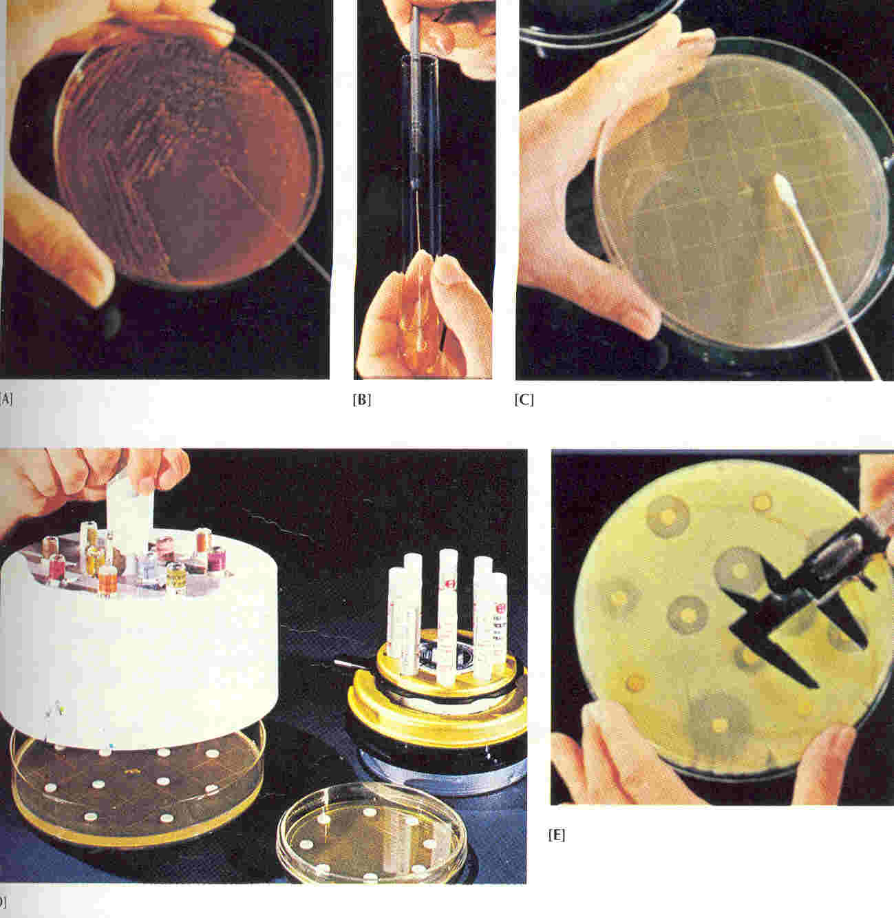
Antimicrobial Susceptibility Testing AST

Slide 21
Methods of AST
Disk diffusion test
E test

Slide 22
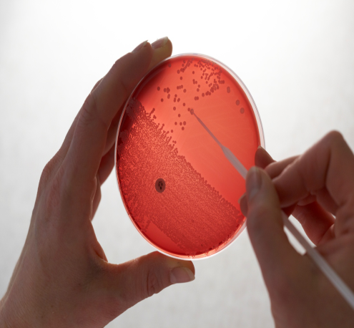
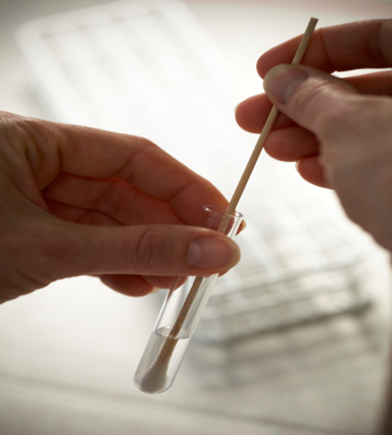
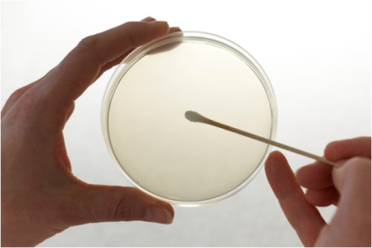
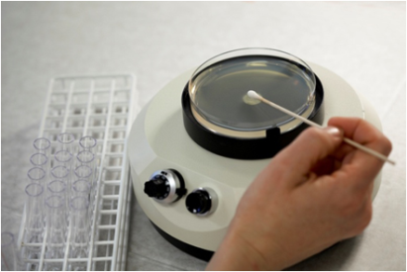
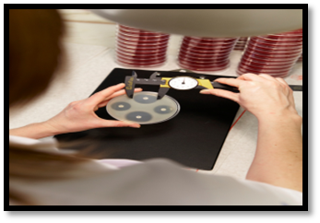
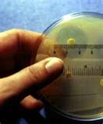
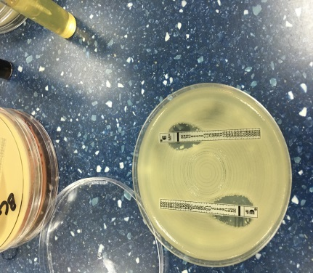
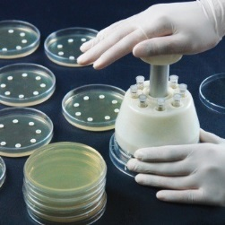
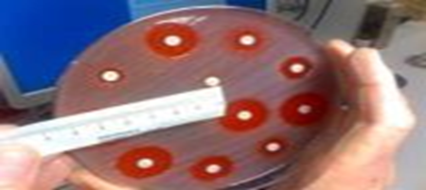
The Antibiotic Sensitivity Testing Method
Select well-isolated colonies | Inoculum suspension | Spread the inoculum
Apply antibiotics disks | Read the result

Slide 23
Disk Diffusion Method

Slide 24
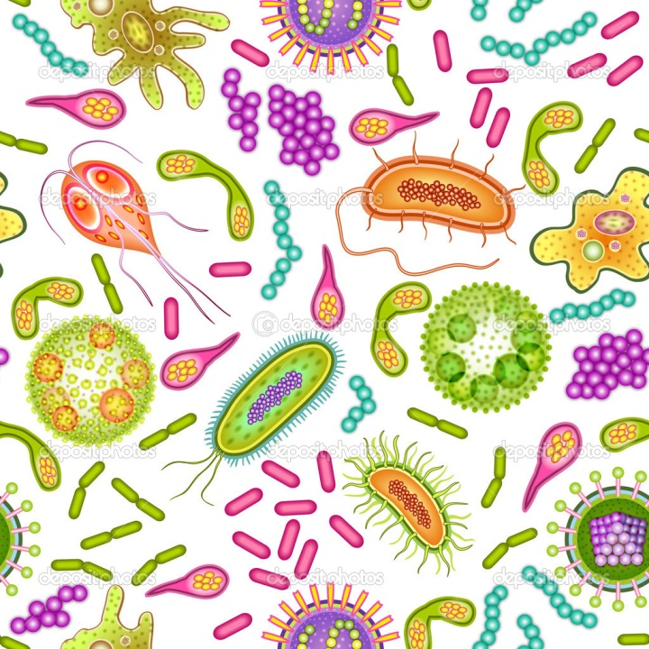
ETIOLOGICAL MICROORGANISMS OF CLINICALLY IMPORTANT PATHOGENS CAUSING UTI

Slide 25
Etiological Agents of UTI
Bacterial
Fungal
Parasites

Slide 26
BACTERIA CAUSING UTI
Gram- negative bacilli
Enterobacteriace
Non-Enterobacteriace
Gram-positive cocci
Staphylococci
Coagulase-positive (Staph. aureus)
Coagulase negative (Staph. saprophyticus)
Coagulase negative (Staph. epidermidis)
Streptococcus (group B)
Enterococci

Slide 27
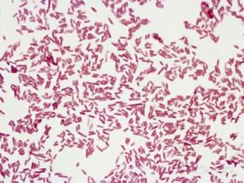
Gram Negative Bacilli
Enterobacteriacae
Non-Enterobacteriacae

Slide 28
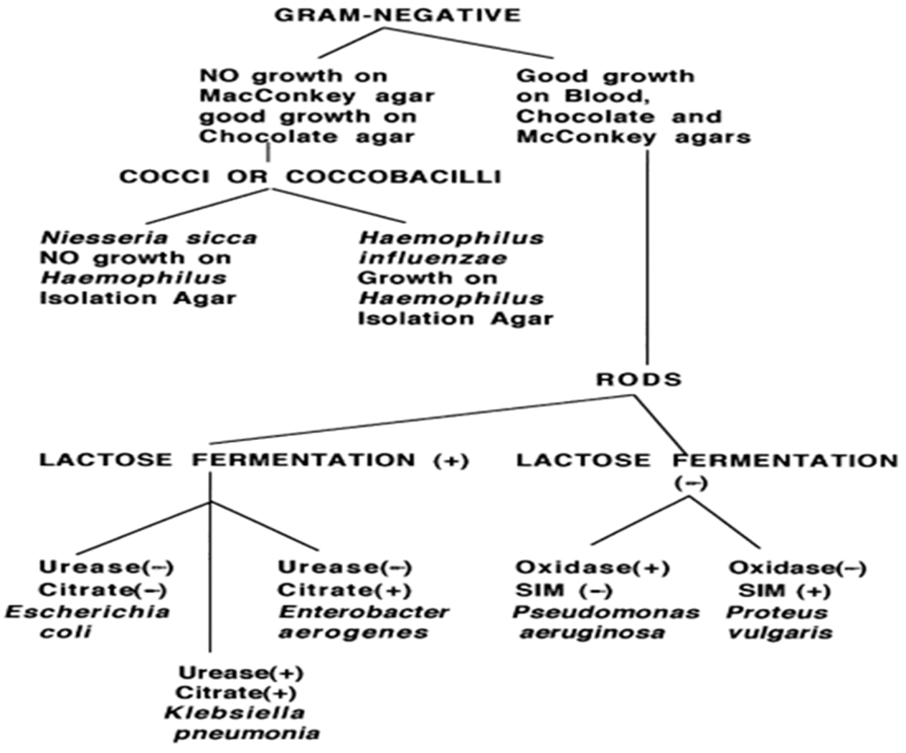

Slide 29
Enterobacteriacae
Escherichia coli
Klebseilla
Proteus
Other Enterobacteriaceae
(Enterobacter,Citrobacter….)
Pseudomonas aeruginosa

Slide 30
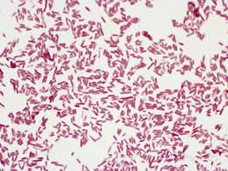
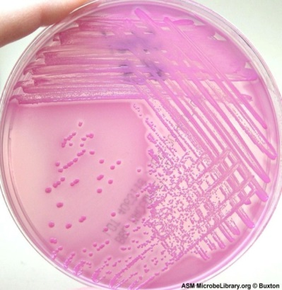
E. coli
Microscopic appearance Gram negative bacilli |  |  | Morphology
 |  |  | Culture
APE 20 E test |  |  | Identification
MacConkey agar showing growth of Lactose fermenter
Pink colonies
LFC
CLED agar showing growth of Lactose fermenter
yellow colonies
LFC
Indole Reactions Test:
Positive

Slide 31
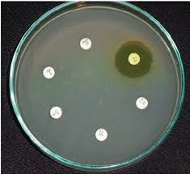
E. coli
Antibiotic Susceptibility Test

Slide 32
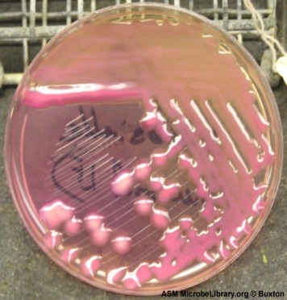
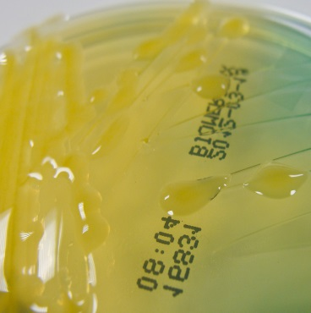
Klebseilla spp
Microscopic appearance Gram negative bacilli |  |  | Morphology
 |  |  | Culture
APE 20 E test |  |  | Identification
MacConkey agar showing growth of Lactose Fermenter
Mucoid Pink colonies
LFC
CLED agar showing growth of Lactose fermenter
Mucoid yellow colonies
LFC
Indole Reactions Test:
Negative

Slide 33
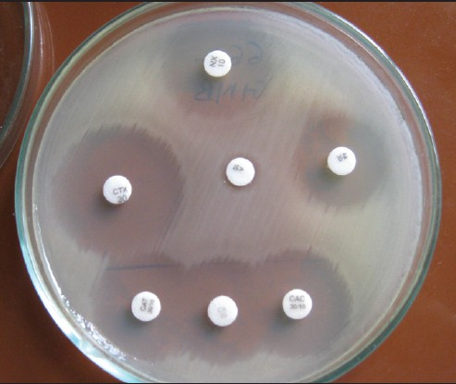
Klebseilla spp
Antibiotic Susceptibility Test

Slide 34
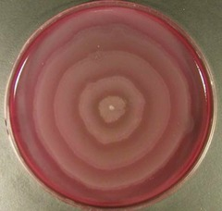
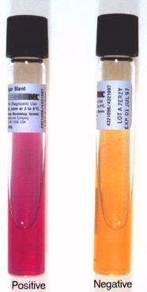
Proteus spp
Microscopic appearance Gram negative bacilli |  |  | Morphology
 |  |  | Culture
APE 20 E test |  |  | Identification
Blood culture plate showing swarm of
Proteus
CLED [(Cystine-Lactose-Electrolyte-Deficient) - Inhibits The Proteus Swarming
Proteus is Urease positive
Urease splits urea into ammonia; and alkalinizes the urine with production of crystals

Slide 35
Proteus spp
Antibiotic Susceptibility Test

Slide 36
Pseudomonas spp
Microscopic appearance Gram negative bacilli |  |  | Morphology
 |  |  | Culture
APE 20 E test |  | Oxidase positive test | Identification
MacConkey agar showing growth of Non-Lactose Fermenter
Mucoid Pink colonies
NLFC
Nutrient Agar showing growth of Pseudomonas
pigmentation

Slide 37
Pseudomonas spp
Antibiotic Susceptibility Test

Slide 38
Gram Positive Cocci
Staphylococci
Coagulase-positive (Staph. aureus)
Coagulase negative (Staph. saprophyticus)
Coagulase negative (Staph. epidermidis)
Streptococcus (group B)
Enterococci

Slide 39
Staph. aureus
Microscopic appearance: Gram positive cocci in clusters |  | Morphology
 |  | Culture
Catalase 2H2O2 O2 + 2H2O Catalase test = Positive Streptococci vs. Staphylococci | Coagulase test = Positive | Identification
Blood culture plate showing growth of golden yellow colonies
+
_

Slide 40
Staph. aureus
Antibiotic Susceptibility Test

Slide 41
Staph. saprophyticus
Microscopic appearance: Gram positive cocci in clusters |  |  | Morphology
 |  |  | Culture
Novobiocin Test Resistant | Catalase 2H2O2 O2 + 2H2O Catalase test = Positive Streptococci vs. Staphylococci | Coagulase test = Negative | Identification
Blood culture plate showing growth of white colonies
+
_
R S

Slide 42
Staph. saprophyticus
Antibiotic Susceptibility Test

Slide 43
Staph. epidermidis
Microscopic appearance: Gram positive cocci in clusters |  |  | Morphology
 |  |  | Culture
Staph.epidermidis vs. Staph. saprophyticus Novobiocin test Sensitive | Catalase 2H2O2 O2+2H2O Catalase test = Positive Streptococci vs. Staphylococci | Coagulase test Negative | Identification
Blood culture plate showing growth of white colonies
+
_
R S

Slide 44
Staph. epidermidis
Antibiotic Susceptibility Test

Slide 45
Strept. agalactiae (group B)
Microscopic appearance: Gram positive cocci in chains |  |  | Morphology
 |  |  | Culture
Streptics Mix bacterial colony with various group-specific antisera on a slide | Catalase 2H2O2 O2 + 2H2O Catalase test = Negative Streptococci vs. Staphylococci | CAMP test Positive | Identification
Blood culture plate showing growth of Beta-haemolitic colonies

Slide 46
Strept. agalactiae (group B)
Antibiotic Susceptibility Test

Slide 47
Enterococci
Microscopic appearance: Gram positive cocci in chains |  | Morphology
 |  | Culture
Catalase 2H2O2 O2 + 2H2O Catalase test = Negative Streptococci vs. Staphylococci | Both Group D streptococci and enterococci produce a positive (left) bile Esculin hydrolysis test. | Identification
Blood culture plate showing growth of Beta-haemolitic colonies
+ -
+ -

Slide 48
Enterococci
Antibiotic Susceptibility Test

Slide 49
Enterococci
Microscopic appearance: Gram positive cocci in chains |  | Morphology
 |  | Culture
Catalase 2H2O2 O2 + 2H2O Catalase test = Negative Streptococci vs. Staphylococci | Both Group D streptococci and enterococci produce a positive (left) bile Esculin hydrolysis test. | Identification
Blood culture plate showing growth of Beta-haemolitic colonies
+ -
+ -

Slide 50
FUNGI CAUSING UTI
Candida albicans

Slide 51
Candida albicans
Microscopic appearance: Gram positive cocci in chains |  | Morphology
 |  | Culture
Germ tube test Psitive | Chlamydospore test Positive | Identification
Candida albicans
on blood agar
Candida albicans on (SDA)
Sabouraud's Dextrose Media

Slide 52
PARASITES CAUSING UTI
Schistosoma haematobium

Slide 53
Schistosoma haematobium
(urine; eggs 115-170 x 45-65 micrometers) (primates)

Slide 54
GRAM NEGATIVE | GRAM POSITIVE
Escherichia coli | Enterococcus
Klebsiella | Staphylococcus saprophyticus
Proteus | Streptococcus agalactiae (group B)
Other Enterobacteriaceae (Enterobacter,Citrobacter….) | Staphylococcus aureus¹ (Associated with staphylococcemia
Pseudomonas aeruginosa
Other organisms ;
Candida albicans
Schistosoma haematobium
Tricomonas vaginalis

