Slide 1
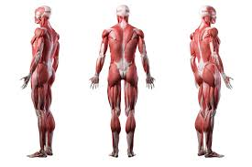
SKELETAL MUSCLES
Dr. SAMEERAH SHAHEEN
Assistant Professor
MBBS, Msc, PhD
sshahee@ksu.edu.sa
31 August 2021

Slide 2
OBJECTIVES
At the end of the lecture, students should be able to:
Describe the main criteria of skeletal muscles.
Describe the attachments of skeletal muscles.
Describe the different directions of skeletal muscle fibers.
Describe the mode of action of skeletal muscles.
Describe briefly the naming of skeletal muscles.
Describe briefly the nerve supply of skeletal muscles.

Slide 3
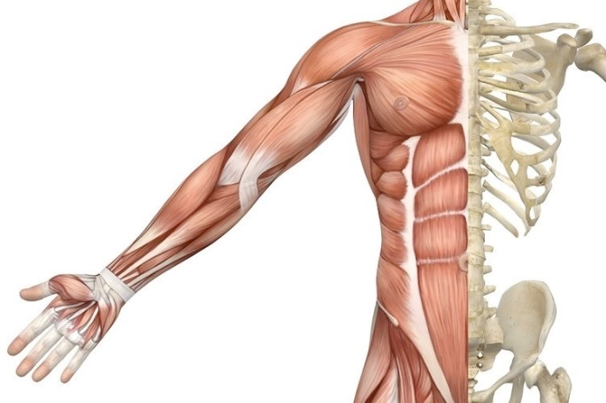
INTRODUCTION
Musculoskeletal is a general term which is defined as relating to muscles and bones of the skeleton.
▪ The musculoskeletal system comprises bones, joints, cartilage, bursae, tendons, muscles and ligaments.
▪ It is the system that moves the body and maintains its form.
▪ Study of this system consists of osteology (the study of bones),
arthrology (the study of joints), and myology (the study of muscles).
▪ The musculoskeletal system does not work in isolation.
▪ It is closely linked with many other systems in the body, including
the nervous system, genitourinary system, circulatory system,
immune system, respiratory system, digestive system and
endocrine system.

Slide 4
Classification of muscles
Muscles are classified on the base of their:
Location
Action
Microscopic structure

Slide 5
BASED ON LOCATIONS
Skeletal
Cardiac
Visceral
ATTACHED TO BONES &
PRODUCE MOVEMENT
WALLS OF THE HEART
WALLS OF VISCERAL ORGANS

Slide 6
BASED ON ACTIONS
Voluntary: muscle
Subject to conscious control: e.g., Muscles attached to skeleton
Involuntary: muscles
Not under conscious control: e.g., muscles of the heart & other organs

Slide 7
BASED ON MICROSCOPIC STRUCTURES
Striated:
The muscle fibers show transverse striations e.g., skeletal & cardiac muscles
Non striated (smooth):
No striations e.g., visceral muscles

Slide 8
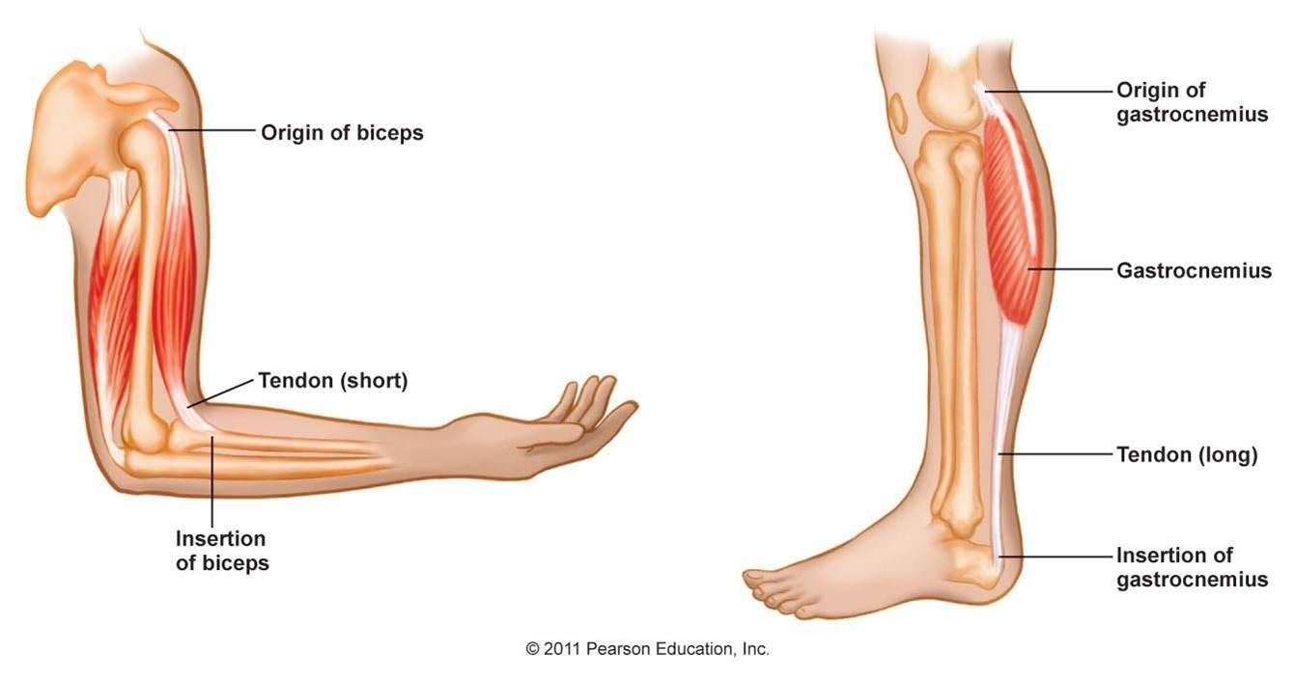
SKELETAL MUSCLES
MAIN CRITERIA
▪ Striated. ▪ Attached to skeleton. ▪ Produce movement of skeleton.
▪ Voluntary. ▪ Supplied by Somatic Nerves.

Slide 9
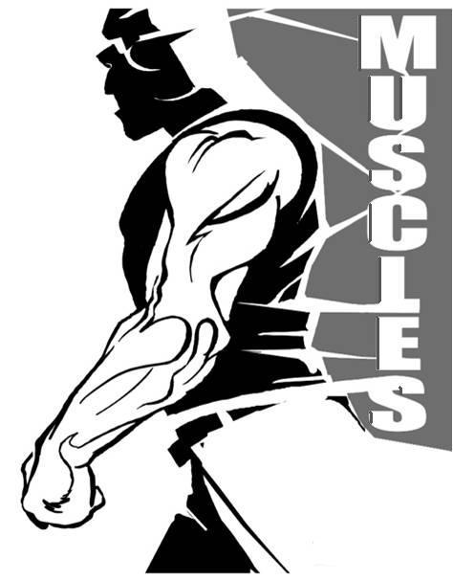
SKELETAL MUSCLES
FUNCTIONS
Movement of body
Maintain posture
Generate heat
Stabilize joints

Slide 10
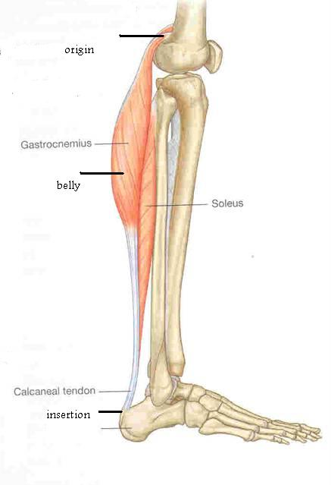
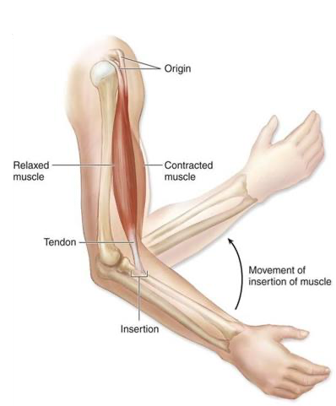
ATTACHMENTS
The skeletal muscles are attached to bones at not less than two points:
Origin
Attached to less mobile or
immovable bone
Least movable
Mostly fleshy
Proximal end
Insertion
Attached to the movable bones
Most movable
Mostly fibrous
Distal end
At insertion, the muscles are attached by means of strong cord- like tendons or by sheet-like aponeurosis.
When the muscle contracts, the insertion moves toward the origin.

Slide 11
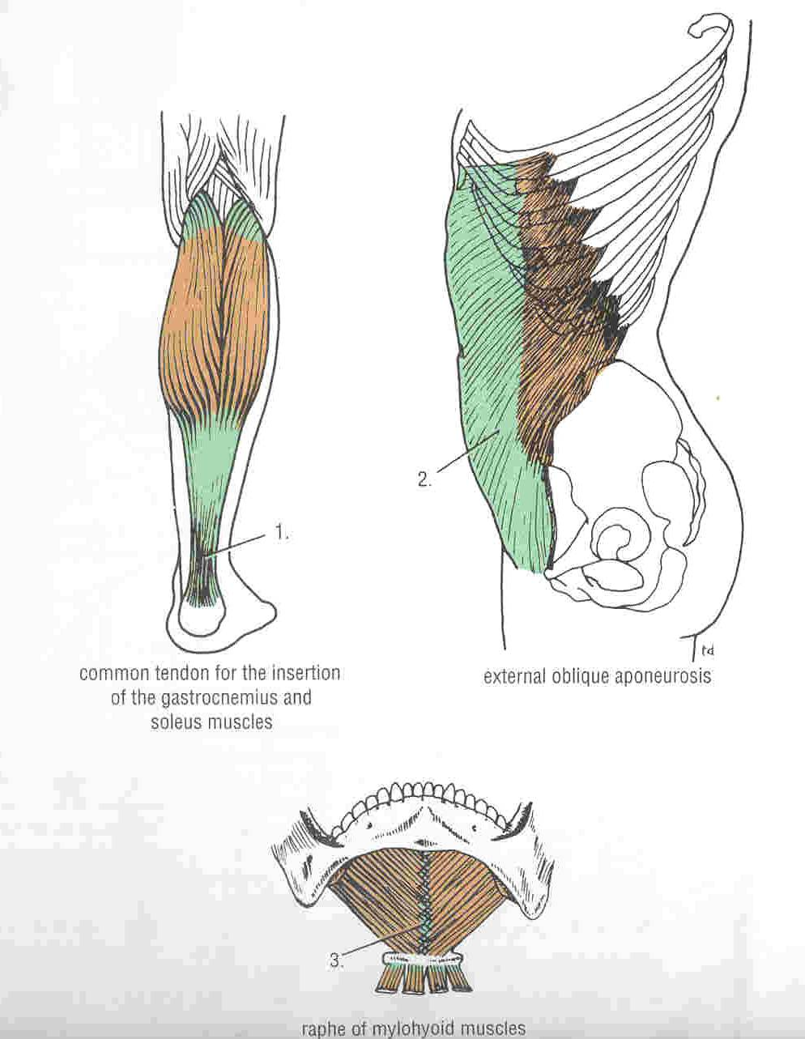
TYPES OF ATTACHMENTS
Muscles are attached to bones, cartilage or ligaments by:
(1) Tendons :
A tough cord of fibrous connective tissue that usually connects muscle to bone and is capable of withstanding tension.
(2) Aponeurosis :
A thin broad and strong sheet of fibrous tissue.
(3) Raphe :
An interdigitation of the tendinous ends of the flat muscles.
• Example: mylohyoid raphe

Slide 12
DIRECTIONS OF MUSCLES
The range of motion and the power of a muscle depends on the arrangement of its fascicles.
The fiber arrangement can be:
Fusiform Spindle-shaped (round, thick belly, & tapered ends).
Circular
Surround a body opening or orifice, constricting it when contracted.
Convergent

Slide 13
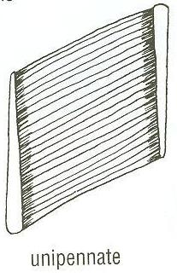
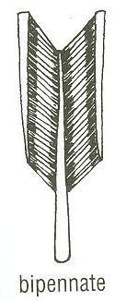
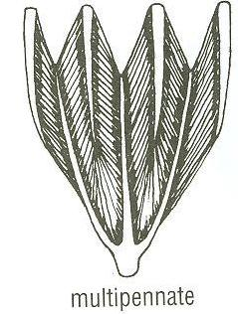
DIRECTIONS OF MUSCLES
Parallel
More range of movement, less powerful.
Pennate
More powerful, less range of movement.
Unipennate
Bipennate
multipennate
The long parallel arrangement give more range of motion but is not usually very powerful.
parallel
The pennate muscles shorten very little but are very powerful.

Slide 14
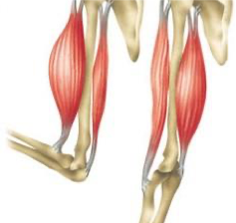
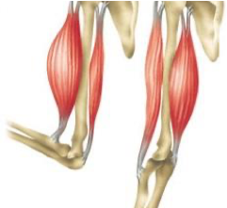
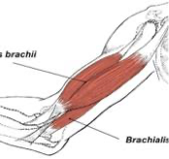
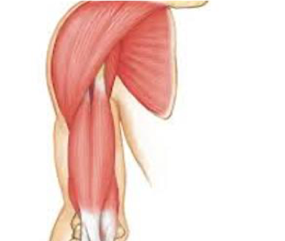
MODE OF ACTIONS
PRIME MOVER
Prime Mover (Agonist) -It is the chief muscle responsible for a particular movement.
Antagonist -It opposes the action of the prime mover.
-Before contraction of prime mover, antagonist must be relaxed.
Synergist -Muscles that assist the prime mover in a particular movement.
Fixator
-Its contraction does not produce movement by itself, but it stabilizes the origin of the prime mover so that it can act efficiently.
ANTAGONIST
SYNERGIST
FIXATOR

Slide 15
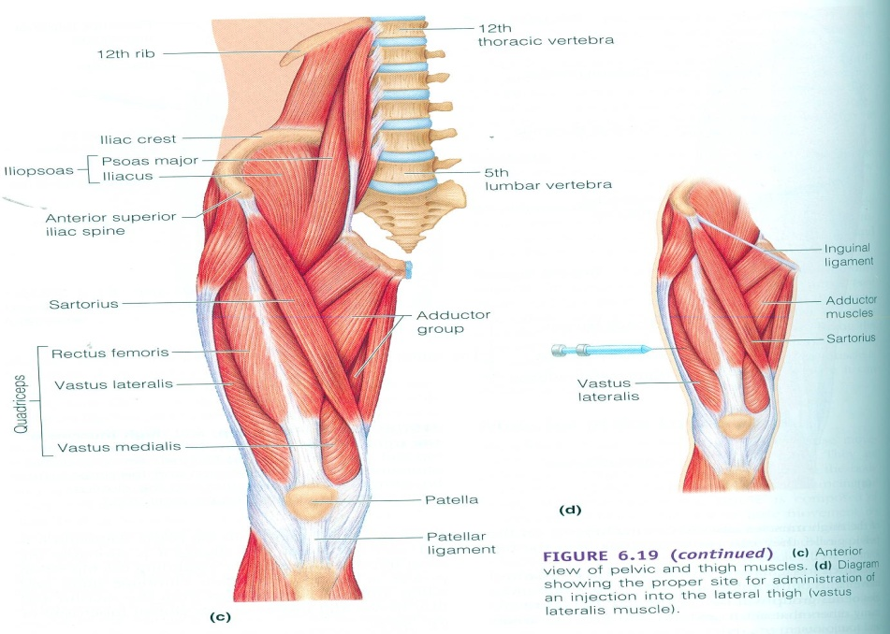
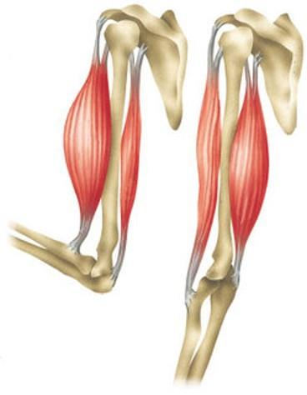
PRIME MOVER (AGONIST)
It is the chief muscle responsible for a particular movement.
Example:
o Quadriceps Femoris is the prime mover for extension of the knee joint.
Biceps Brachii is the prime mover for flexion of the elbow joint and forearm.

Slide 16
ANTAGONIST
It opposes the action of the prime mover.
Before contraction of prime mover, antagonist must be relaxed.
Example:
- Triceps Brachii is the antagonist for prime mover for flexion of the elbow joint and forearm.
- Biceps Femoris (Flexor of knee). - It opposes the action of quadriceps when the knee joint is extended.

Slide 17
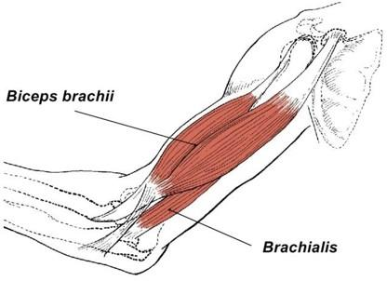
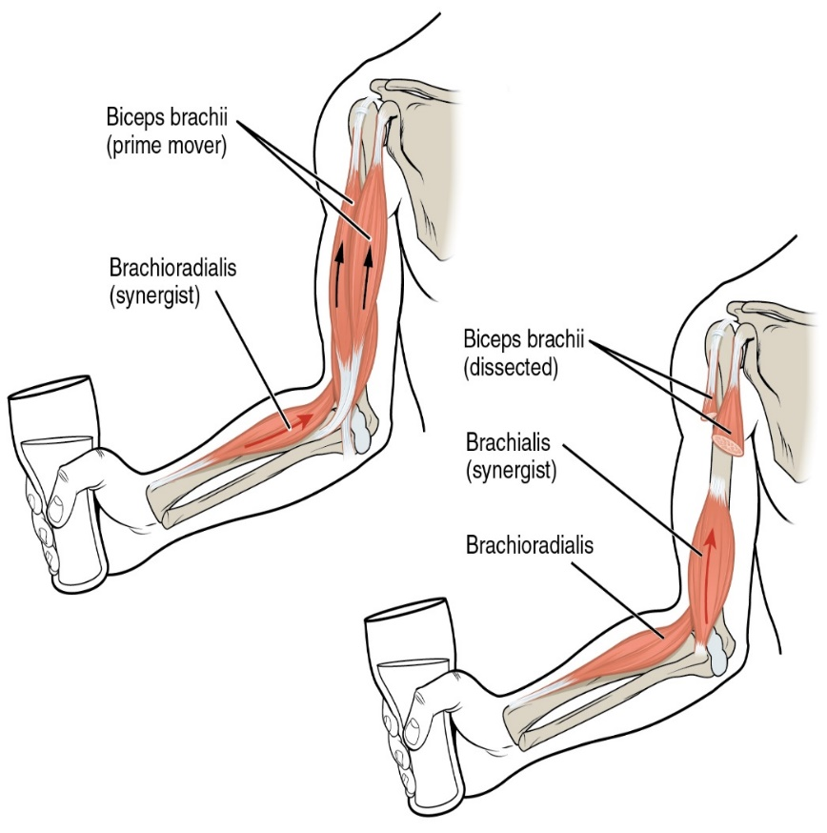
SYNERGIST
Prevents unwanted movement in an intermediate joint crossed by the Prime Mover.
Helps prime movers by adding a little extra force to the same movement OR By reducing undesirable or unnecessary movement.
Synergists are sometimes called neutralizers because they help cancel out, or neutralize, extra motion from the agonists to make sure that the force generated works within the desired plane of motion.
▪ Example: Biceps and Bracioradialis:
The biceps is the prime mover in the elbow joint.
Bracioradialis acts as a synergistic muscle to stabilize the joint thus aiding in the motion.
o Flexors and Extensors of wrist joint: they contract to fix wrist joint in order that flexors and extensors of fingers work efficiently.
Brachialis muscle for Biceps prime mover muscle.

Slide 18
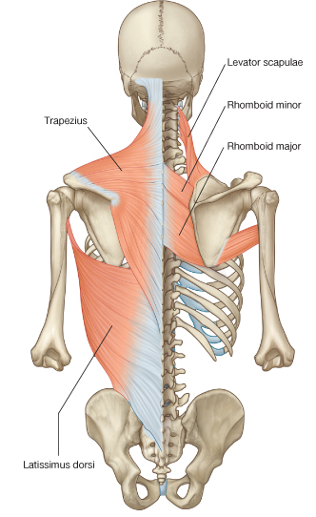
FIXATOR
Its contraction does not produce movement by itself but it stabilizes the origin of the prime mover so that it can act efficiently.
Example:
o Deltoid muscle for Biceps prime mover muscle.
o Muscles attaching the shoulder girdle to the trunk contract to fix shoulder girdle, allowing deltoid muscle (taking origin from shoulder girdle) to move shoulder joint (humerus).

Slide 19
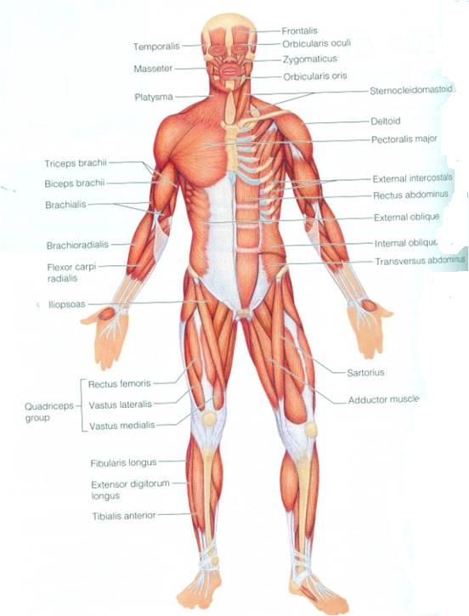
NAMING OF MUSCLES
Size
o Major or Maximus (large)
Minor or minimus (small).
Latissimus (broad).
Longus (long).
Brevis (short).
Position
o Pectoralis (pectoral region)
Depth
o Superficialis (superficial)
Profundus (deep).
Externus (external).

Slide 20
NAMING OF MUSCLES
Shape
o Deltoid (triangular)
Teres (rounded)
Rectus (straight).
Number of Heads
o Biceps (2 heads)
o Triceps (3 heads)
Quadriceps (4 heads).
Attachments
o Coracobrachialis from coracoid process to arm
Action
o Flexor digitorum: flexion of digits

Slide 21
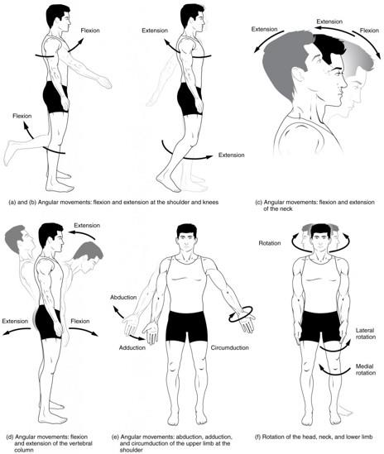
TYPES OF BODY MOVEMENTS
Flexion
o Movement that brings the two bones closer to each other (decreases the angle of joint).
Extension
o Movement that increases the angle, or the distance between the two bones.
Adduction
o Movement of the limb toward the midline of the body.
Abduction
o Movement of the limb away from the midline of the body.
Rotation
o Movement of a bone around a vertical axis.
Circumduction
o Combination of all the above movements.

Slide 22
MUSCLE EXERCISE
The amount of work done by a muscle is reflected in changes in the muscle itself.
Muscle inactivity leads to muscle weakness and wasting.
Regular exercise increases muscle size, strength and endurance.

Slide 23
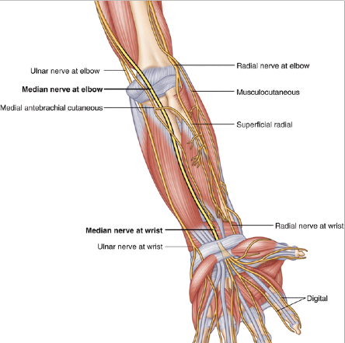
MUSCLES INNERVATION
The somatic nervous system (is the part of the peripheral nervous system) associated with skeletal muscle voluntary control of body movements.
The nerves supplying the skeletal muscles are Mixed.
60% are Motor 40% are Sensory
It contains some Autonomic fibers
o Sympathetic
The nerve enters the muscle at about
the middle point of its deep surface.

Slide 24
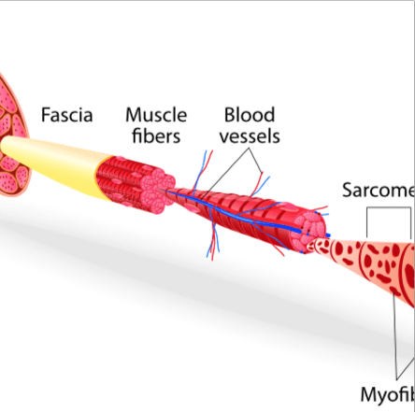
BLOOD SUPPLY
During extreme physical exertion, more than 80% of cardiac output can be directed to contracting muscles.
The vascular inflow to skeletal muscles is provided by primary arteries, which represent the last branches of the arterial supply that arise before entry into the tissue.
The primary arteries are appropriately distributed along the long axis of the muscle and give rise to feed arteries that course toward the epimysium of the muscle at right or oblique angles to the primary arteries.

Slide 25
CLINICAL ANATOMY

Slide 29
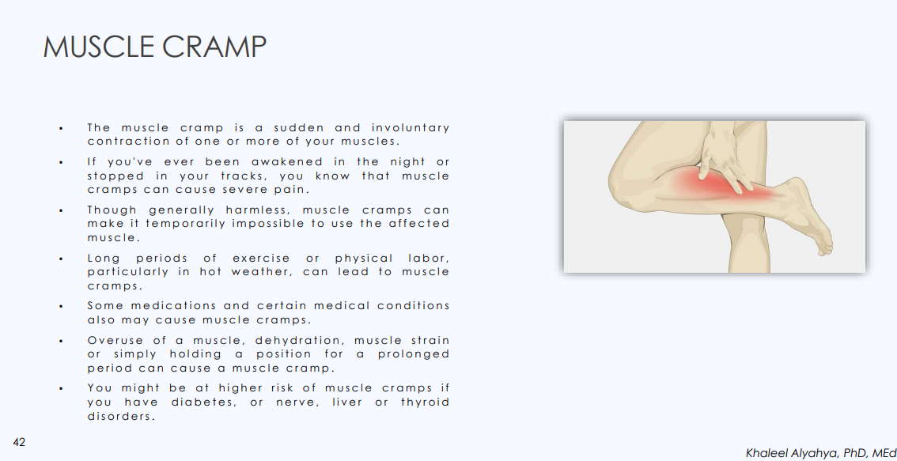

Slide 30
SUMMARY
Skeletal muscles are striated, voluntary muscles attached to & move the skeleton.
They have 2 attachments: origin & insertion.
Their fibers may be parallel or oblique (pennate) to the line of pull.
According to mode of action, they are classified as: prime mover, antagonist, synergist or fixator.
They may be named according to: size, shape, number of heads, position, attachments, depth or action.
They are supplied by a mixed somatic nerve.

Slide 31
THANK YOU

