Slide 1
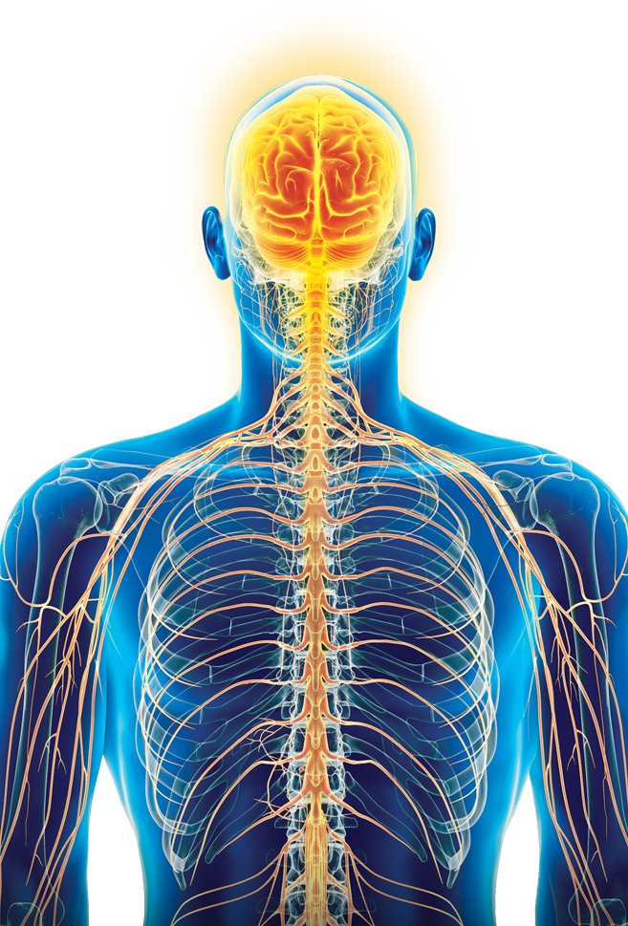
Autonomic Nervous System
Department of Anatomy
Dr. SAMEERAH SHAHEEN
Assistant Professor
MBBS, Msc, PhD
sshahee@ksu.edu.sa
05 September 2021

Slide 2
OBJECTIVES
At the end of the lecture, students should be able to:
Define the autonomic nervous system.
Describe the structure of autonomic nervous system
Trace the pre-ganglionic & postganglionic neurons in both sympathetic & parasympathetic nervous system.
Enumerate in brief the main effects of sympathetic & parasympathetic system

Slide 3
Autonomic Nervous System
Concerned with the innervation and control of involuntary structures: visceral organs, smooth & cardiac muscles and glands.
Along with the endocrine system, its primary function is homeostasis of the internal environment.
Located both in the central and peripheral nervous systems.
Regulated (controlled) by hypothalamus.

Slide 4
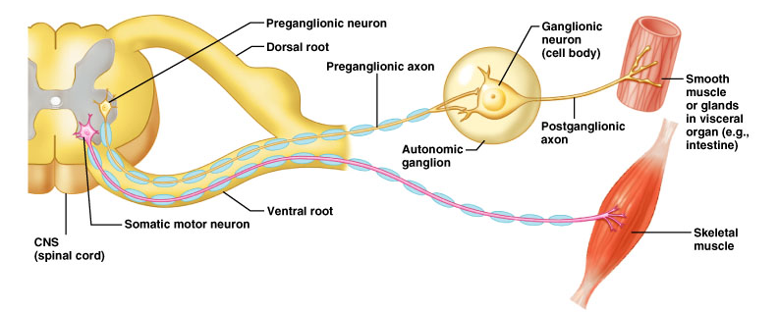
Autonomic Nervous System
Unlike the somatic nervous system, the efferent pathway of the autonomic nervous system is made up of two neurons called as preganglionic and postganglionic neurons.
The cell bodies of the preganglionic neurons are present in the brain and spinal cord. Their axons synapse with the postganglionic neurons whose cell bodies are present in the autonomic ganglia.

Slide 5
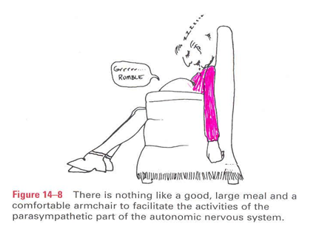
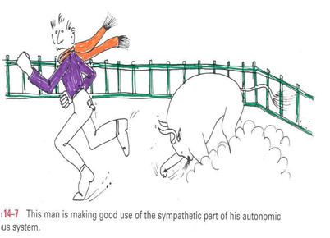
Autonomic Nervous System
Sympathetic
Parasympathetic
“fight, flight, or fright”
Activated during exercise, excitement, and emergencies.
“rest and digest”
Concerned with conserving energy.
Both divisions operate in conjunction with one another (have antagonistic control over the viscera) to maintain a stable internal environment
Notes:
Based on the anatomical, physiological and pharmacological characteristics, the autonomic nervous system is divided into:
Sympathetic: Activated during exercise, excitement, and emergencies. “fight, flight, or fright”
Parasympathetic: Concerned with conserving energy. “rest and digest”

Slide 6
Parasympathetic
Sympathetic
Preganglionic neuron
Short
Long
Preganglionic fiber
Ganglion
Postganglionic neuron
Long
Short
Postganglionic fiber
Target organ
Target organ

Slide 8
Sympathetic Division
Preganglionic neurons:
located in the lateral gray horn of T₁-L₂ segments of spinal cord
(Thoracolumbar outflow)

Slide 9
Sympathetic Division

Slide 10
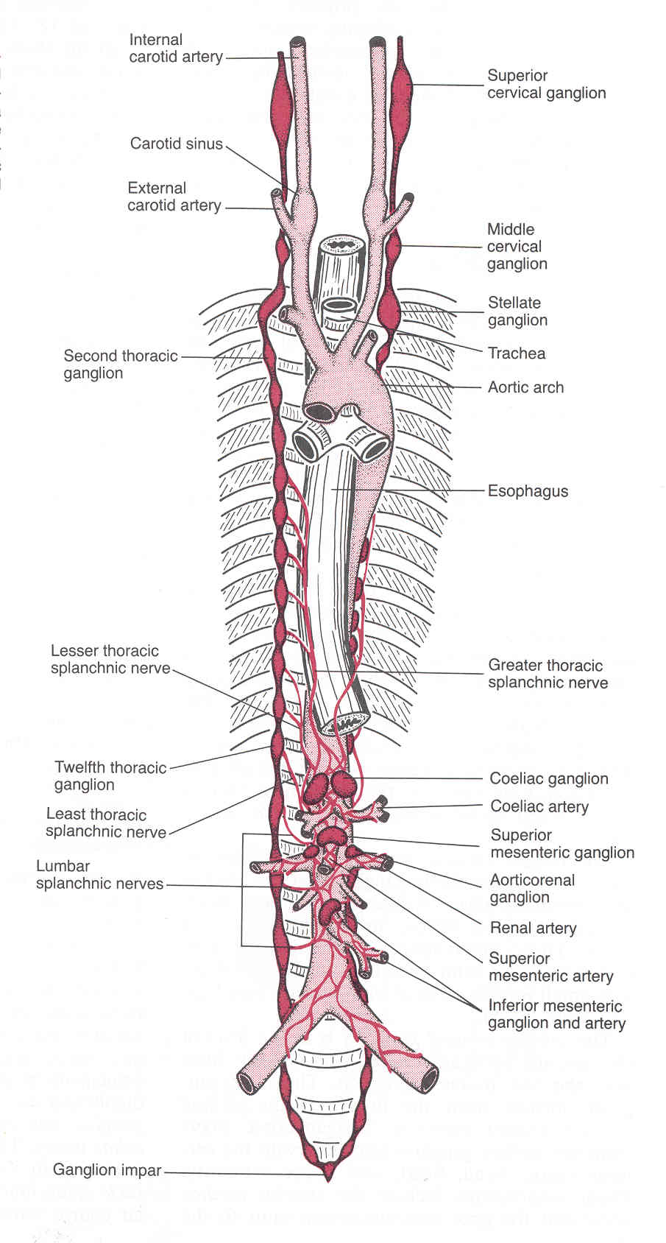
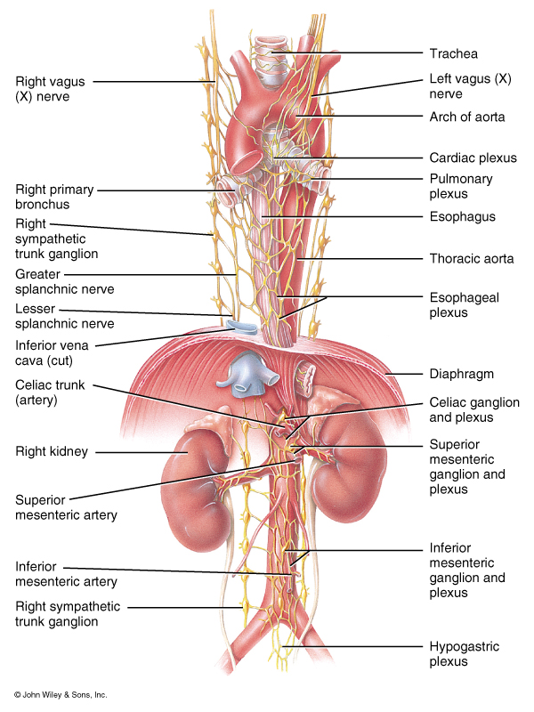
Sympathetic Ganglia
Located nearer the central nervous system as:
Prevertebral: celiac & mesenteric
Paravertebral forming sympathetic chain

Slide 11
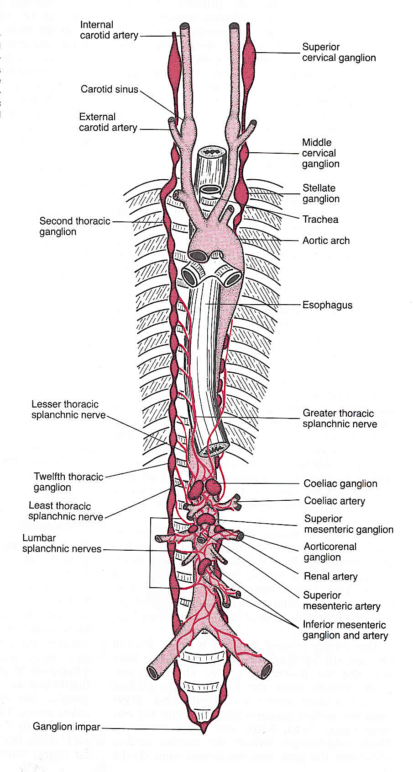
Paravertebral Ganglia
They are interconnected to form
2 sympathetic chains,
one on each side of vertebral column.
Number of ganglia:
Three in cervical part of chain
Eleven to twelve in thoracic part
Four in lumbar & sacral parts each.
The chains end into a common ‘ganglion impar’ in front of coccyx

Slide 12
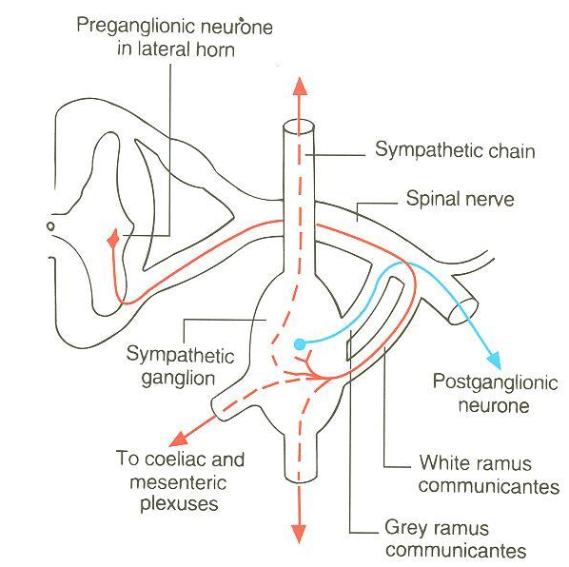
Preganglionic fibers
Run in the ventral roots of the spinal nerve.
Travel through the spinal nerve, and then join the sympathetic chain via the white rami communicans (WRC).

Slide 13
Preganglionic fibers
Within the sympathetic chain, these fibers may:
Ascend, descend or remain at the same level to synapse with neurons (postganglionic) of paravertebral ganglia located in sympathetic chain.
Leave the sympathetic chain (without synapse) to reach coeliac & mesenteric ganglia (around branches of abdominal aorta) to synapse with their neurons (postganglionic).

Slide 14
Postganglionic fibers
From the sympathetic chain ganglia enter again into the spinal nerve through grey rami communicants (GRC) to supply structures in head & thorax + blood vessels & sweat glands.
From the cells of coeliac & mesenteric ganglia supply abdominal & pelvic viscera.

Slide 15
Sympathetic Nervous system Anatomy

Slide 16
Parasympathetic Division
Preganglionic neurons
Located in:
Nuclei of the 3rd, 7th, 9th & 10th cranial nerves, in the brain stem (Cranial outflow)
&
The lateral gray horn of S₂-S₄ segments of spinal cord (Sacral outflow)

Slide 17
Parasympathetic Division
Preganglionic fibers from cranial outflow are carried by 3rd, 7th, 9th & 10th cranial nerves and terminate in ciliary, pterygopalatine, submandibular, otic & peripheral ganglia.
Postganglionic fibers innervate organs of the head, neck, thorax, and abdomen.

Slide 18
Parasympathetic Division
Preganglionic fibers from sacral outflow are carried by pelvic splanchnic nerves to peripheral ganglia in pelvis where they synapse.
Postganglionic fibers innervate organs of the pelvis and lower abdomen.

Slide 21
Thank You
We Must accept finite disappoinment
but
never lose infinite hope

