Slide 1
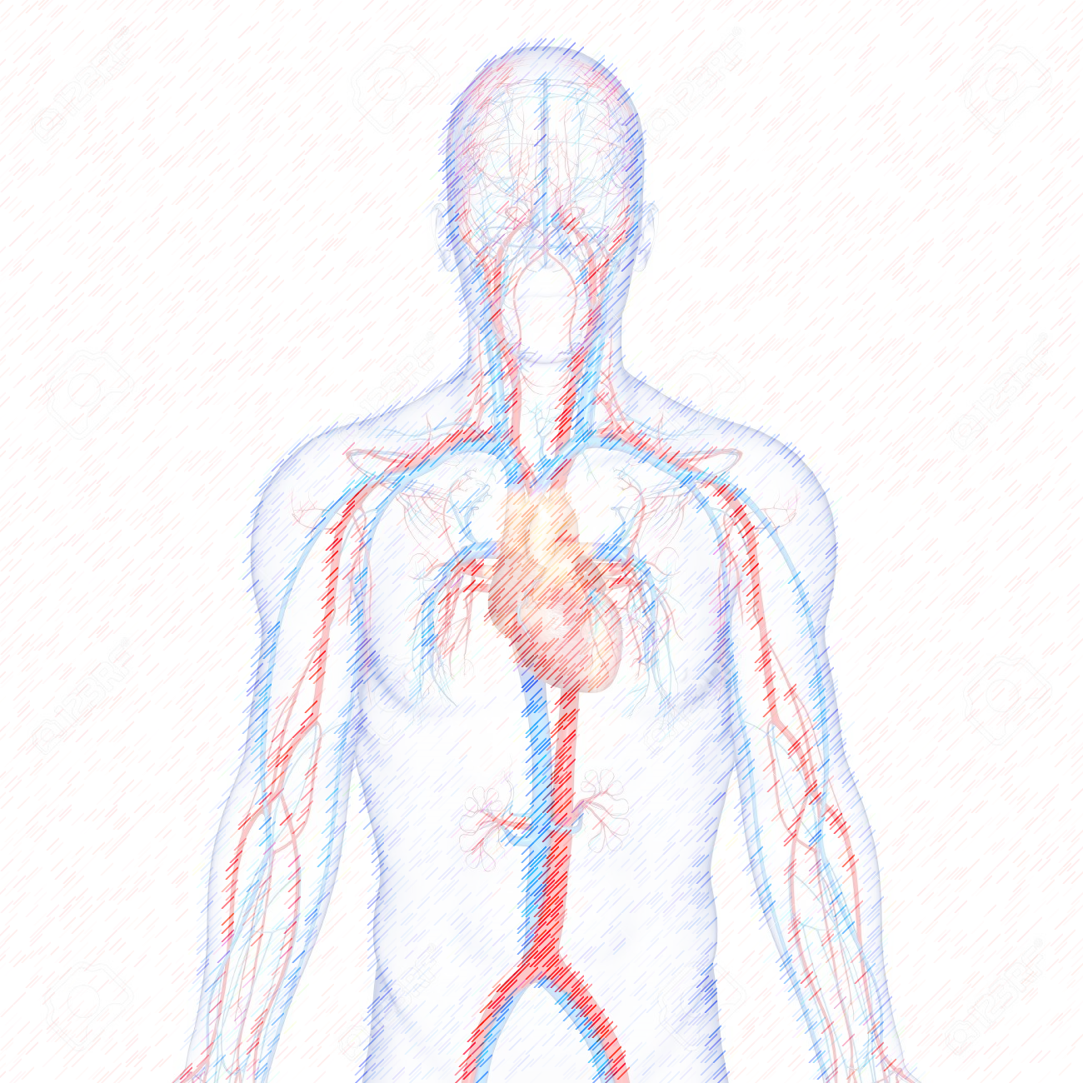
Introduction of Cardiovascular System

Slide 2
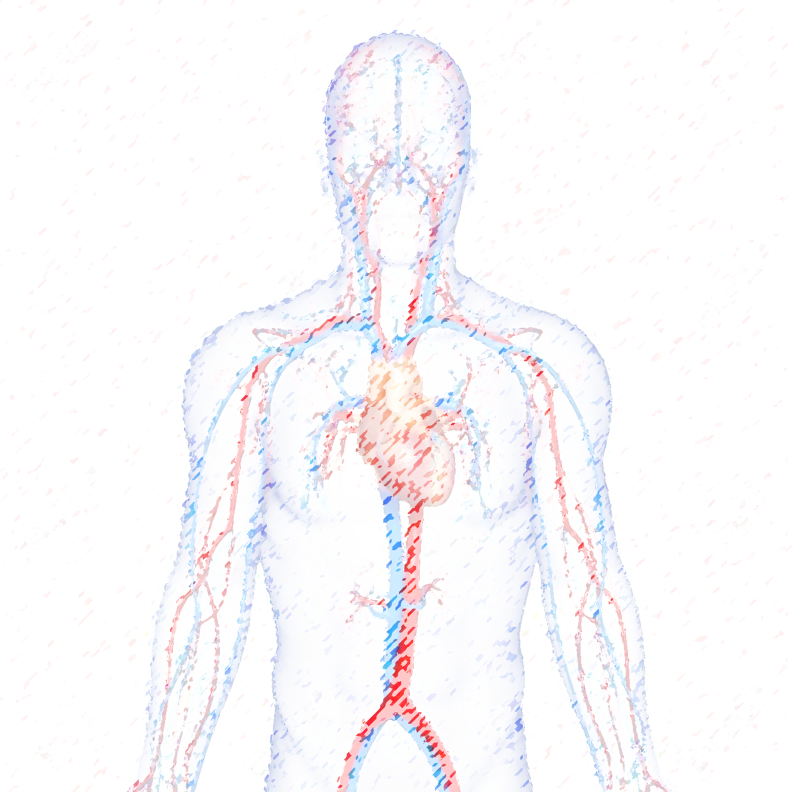
Objectives
Cardiovascular System
Foundation Block
By the end of this session, student should be able to:
Identify the components of the cardiovascular system.
Describe the Heart as regards (position, chambers and valves).
Describe the Blood vessels (Arteries, Veins and Capillaries).
Describe the Portal System.
Describe the Sinusoids.
Describe the Functional and Anatomical end arteries.
Describe the Arteriovenous Anastomosis.

Slide 3
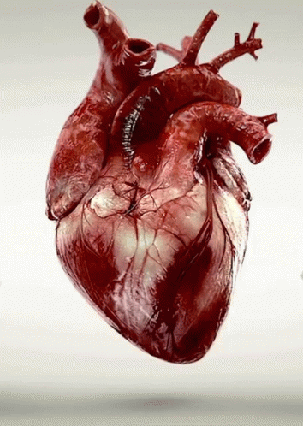
Functions
Cardiovascular System
Foundation Block
It is a transportation system which uses the blood as the transport vehicle.
Transports - water, oxygen, nutrients and hormones to cells.
Transports - wastes, including carbon dioxide, away from the cells.
(vital for body homeostasis)
Helps - maintain correct body temperature.
The force to move the blood around the body is provided by the beating Heart.

Slide 4
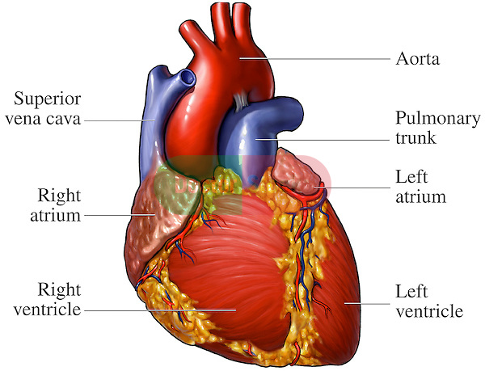
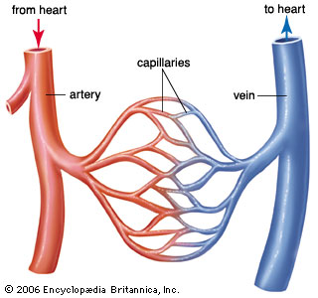
What is the cardiovascular system comprised of?
Cardiovascular System
Foundation Block
The parts of the cardiovascular system include:
The heart, which is the organ that pumps the blood,
& a network of blood vessels:
Arteries: The blood vessels that take blood away from the heart.
Veins: Blood vessels that return blood to the heart.
Capillaries: Very small vessels that lie between the arteries and veins.

Slide 5
Cardiovascular System
Foundation Block
THE HEART

Slide 6
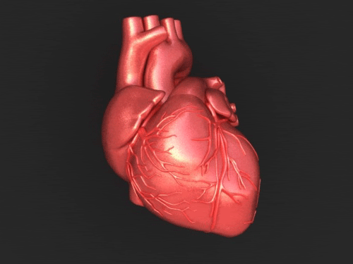
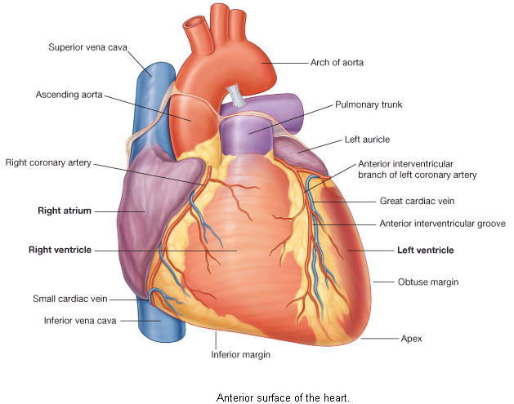
THE HEART
Cardiovascular System
Foundation Block
.Is a muscular pump responsible for circulation .
. Is a hollow, cone shaped muscular pump that keeps circulation going on.
Is usually the size of fist of the same person
Has:
Apex & Base.
Two Surfaces: Diaphragmatic & Sternocostal.
Three borders: Right, Left, Inferior.

Slide 7
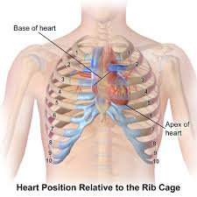
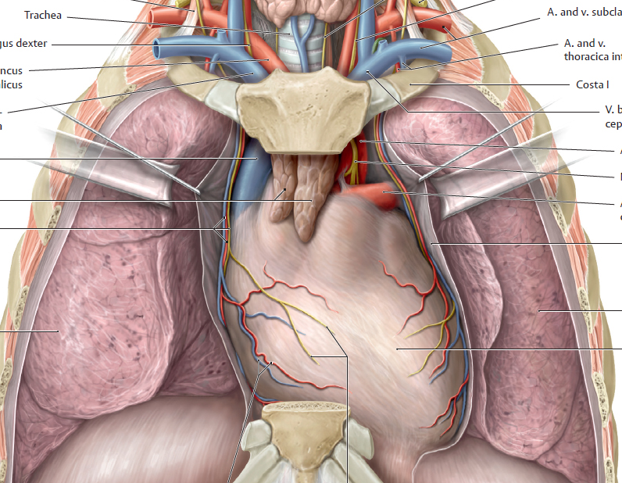
THE HEART POSITION/LOCATION
Cardiovascular System
Foundation Block
Lies obliquely in the thorax between the two pleural sacs.
“More specifically within a centrally located
partition Known as the Middle Mediastinum”
2/3 of the heart lies to the left of median plane.
Enclosed by a double sac of serous membrane (Pericardium).

Slide 8
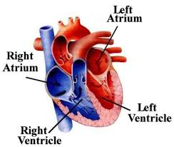
Cardiovascular System
Foundation Block
4 CHAMBERS , Two Atria (Right & Left)
and
Two Ventricles (Right & Left)
ATRIA:
Are Superior in position.
Are the receiving chambers.
have thin walls.
The upper part of each atrium is the Auricle.
Left Atrium receives arterial blood coming from the lungs.
The Right Atrium is the first chamber that receives the venous blood entering to the heart.

Slide 9
THE HEART- CHAMBERS
Cardiovascular System
Foundation Block
VENTRICLES:
Are inferior chambers.
have thick walls.
Are discharging chambers (Actual Pump).
Their contraction propels blood out of the heart into the circulation.
The left ventricle forms the APEX of the heart.

Slide 10
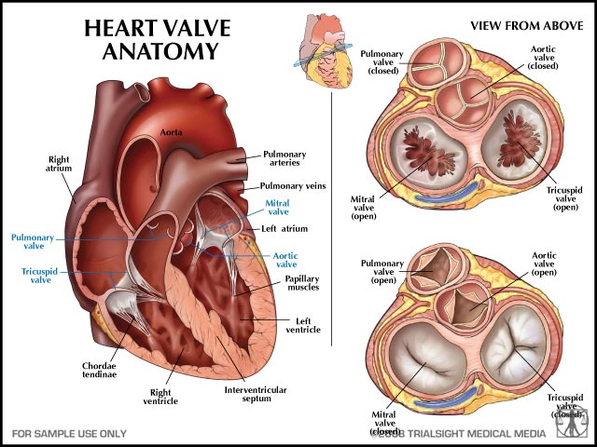
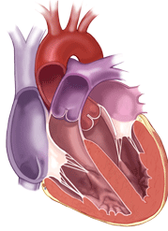
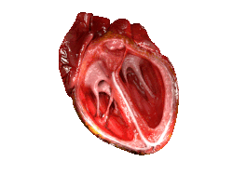
THE HEART- VALVES
Cardiovascular System
Foundation Block
4 VALVES
Two Atrioventricular (between Atria & Ventricles)
Right AVV : Tricuspid
Left AVV : Bicuspid (Mitral)
Allow the blood to flow in one direction i.e. from the atria to the ventricles.
Two Semilunar (aortic & Pulmonary)
Found between the right and left ventricles and the great arteries leaving the heart (Aorta & Pulmonary trunk respectively).
They allow the flow of blood from the ventricles to these arteries.

Slide 11
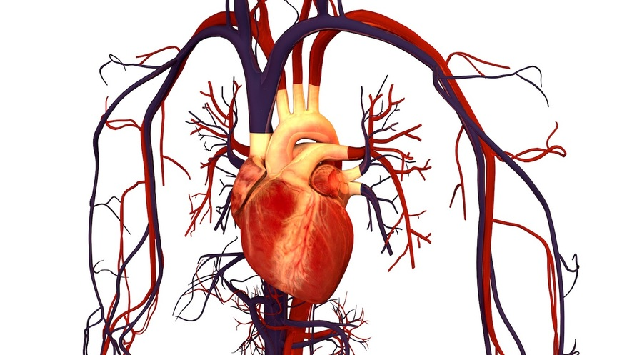
THE BLOOD VESSELS
Cardiovascular System
Foundation Block

Slide 12
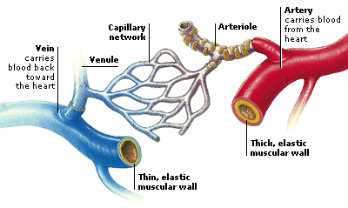
BLOOD VESSELS
Cardiovascular System
Foundation Block
ARTERIES
Thick walled, DO NOT have valves.
The smallest arteries are arterioles.
VEINS
Thin walled.
Many of them possess valves.
The smallest veins are venules
The smallest blood vessels (microscopic).
Form a network between the arterioles and venules.
Site of exchange between tissue and blood
Wall only consist of endothelium
e.g. Tissue with no capillaries; Cornea of eye and Hyaline cartilage
CAPILLARIES

Slide 13
Cardiovascular System
Foundation Block
Sinusoids
Wide capillaries with discontinuous endothelium
Numerous in LIVER, SPLEEN& BONE MARROW, PITUITARY GLAND

Slide 14
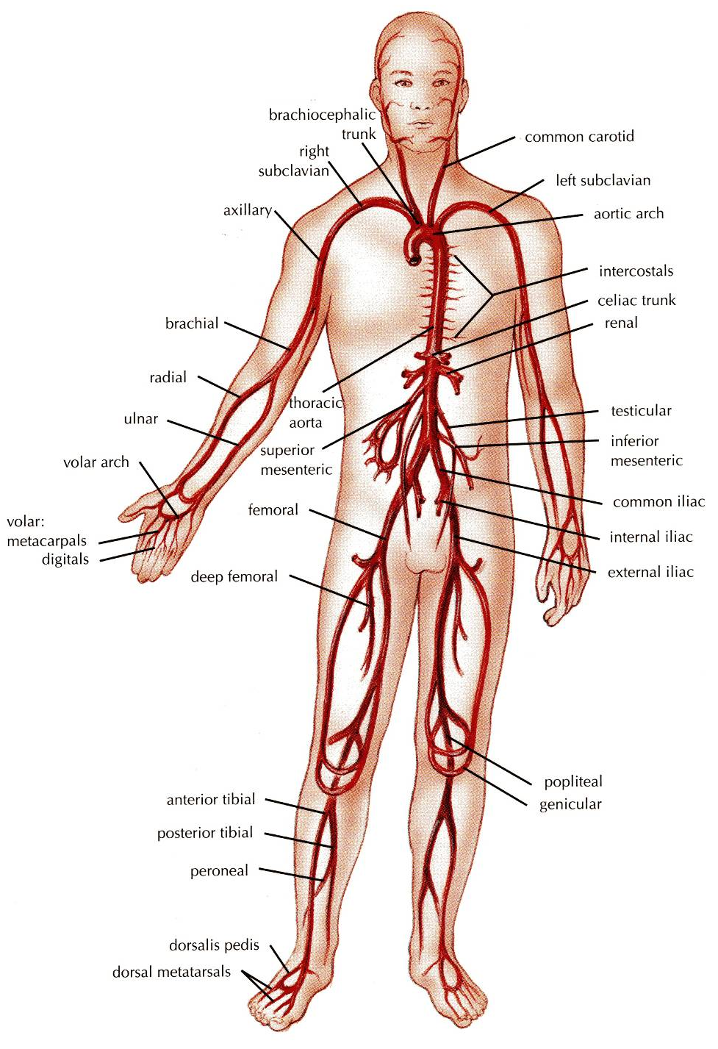
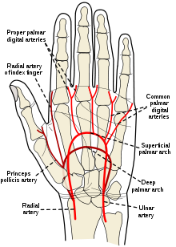
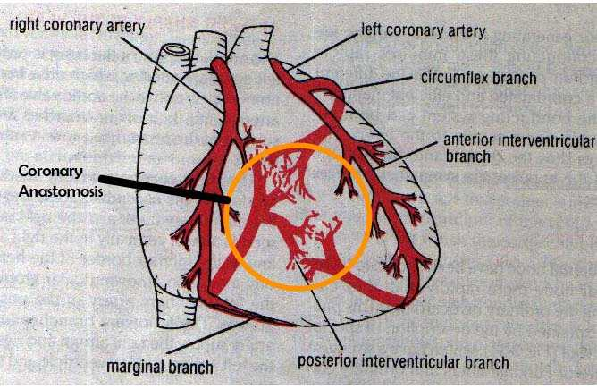
Cardiovascular System
Foundation Block
Arterial Anastomoses
ARTERIES
is a connection between two arteries, i.e. arteries meet END to END
(arterio-arterial anastomosis)
Actual
Potential
transport blood from the heart and distribute it to the various tissues of the body through their branches
Actual
Potential

Slide 15
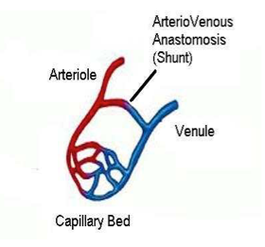
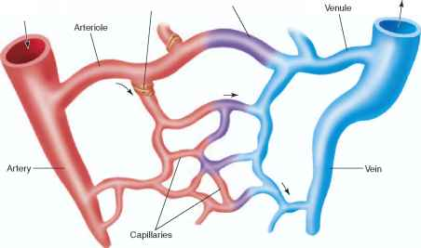
Cardiovascular System
Foundation Block
ARTERIOVENOS ANASTOMOSIS
Direct connections between the arteries and veins without the intervention of capillaries.
EXAMPLE: Tips of the Fingers and Toes.
May have a role in temperature regulation
A circulatory anastomosis is a connection between two blood vessels.
Arterio-arterial anastomosis
Veno-venous anastomosis
Arterio-venous anastomosis.

Slide 16
Cardiovascular System
Foundation Block
END ARTERIES
No precapillary anastomosis between adjacent arteries, interruption of arterial blood flow- INFARCTION / GANGREEN
e.g. Liver, spleen, kidney, retina
Anatomic End arteries:
Vessels whose terminal branches do not anastomose with branches of arteries supplying adjacent areas (Central artery of Retina).
Functional End arteries:
The terminal branches do anastomose with those of adjacent arteries but the anastomosis is insufficient to keep the tissue alive if one of the arteries is occluded.
Functional End arteries

Slide 17
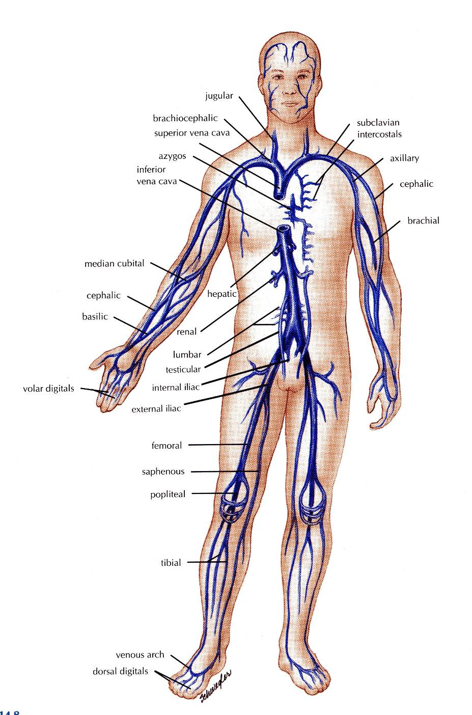
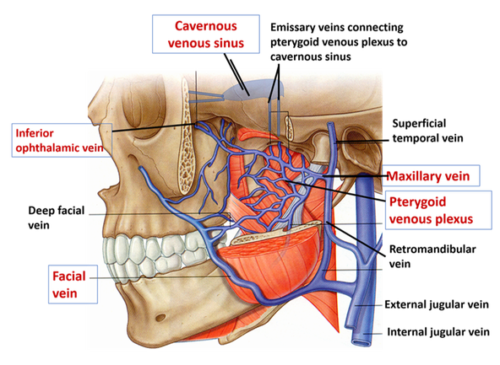
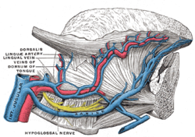
Cardiovascular System
Foundation Block
VENAE COMITANTES
Deep veins accompying the arteries, usually two.
VEINS
They transport blood back to the heart.
The smaller venules (Tributaries) unite to form larger veins which commonly join with one another to form Venous Plexuses.

Slide 18
Cardiovascular System
Foundation Block
BLOOD CIRCULATION
Cardiopulmonary Circulation
Systemic Circulation
CARDIOPULMONARY:
Takes place between the heart and lungs.
The Right side of the heart (Right atrium & ventricle) receive oxygen poor blood
This blood is pumped from the heart through the Pulmonary Trunk to the lungs.
Gas exchange takes place in the lungs.
It returned to the left side of the heart (left atrium & ventricle) through 4 Pulmonary Veins
SYSTEMIC:
Takes place between the heart and each cell of the body.
Blood is pumped from the left ventricle to all body tissues through the AORTA AND ITS SYSTEMIC ARTERIES which ultimately terminates in capillaries.
Oxygen poor blood circulates from the tissues to the capillaries, venules & veins back to the right atrium through the Systemic Veins.

Slide 19
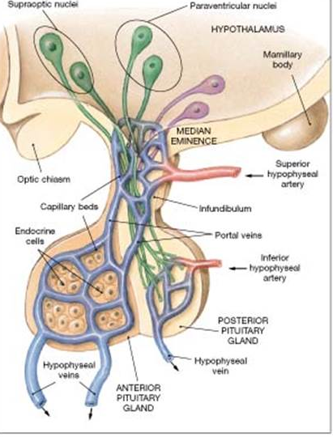
Cardiovascular System
Foundation Block
PORTAL CIRCULATION
It is a system of vessels interposed between Two Capillary Beds.
It takes place in the liver and some endocrine glands (Pituitary gland).
Veins leaving the gastrointestinal tract do not go direct to the heart.
They pass to the Portal Vein.
This vein enters the liver and breaks up into veins of diminishing size which ultimately join capillary like vessels (Sinusoids); first capillary bed.
Venous blood enter 2nd capillary bed then to smaller veins that leave the liver through hepatic veins.

Slide 20
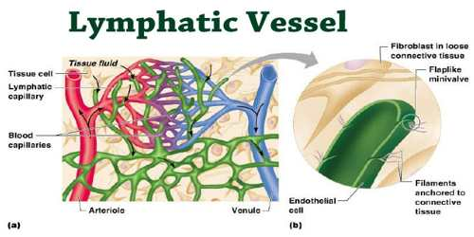
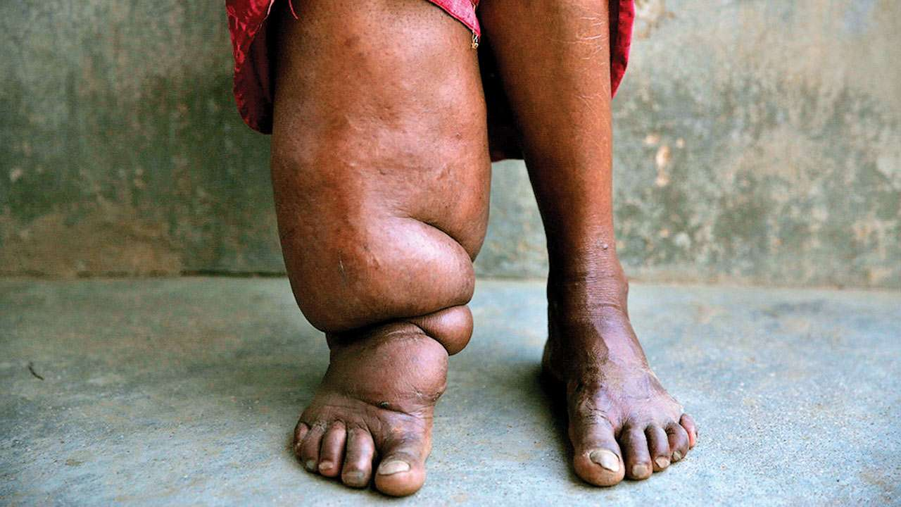
Cardiovascular System
Foundation Block
Not all the blood entering a part returns by the way of veins.
Much of it becomes TISSUE FLUID (LYMPH) returns by the way of vessels called LYMPHATIC VESSELS
Lymph is a clear-to-white fluid made of: White blood cells, especially lymphocytes
The lymphatic system is unique, in that it is a ONE-WAY system that returns lymph fluid via vessels to the cardiovascular system.
Lymph vessel have more valves than veins.
In general superficial lymphatics follow veins, while deep lymphatics follow arteries
LYMPHATICS
Elephantiasis

Slide 21
Cardiovascular System
Foundation Block
The cardiovascular system is a transporting system.
It is composed of the heart and blood vessels.
The heart is cone shaped, covered by pericardium and composed of four chambers.
The blood vessels include the arteries, veins and capillaries.
Arteries transport the blood from the heart.
The terminal branches of the arteries can anastomose with each other freely or be anatomic or functional end arteries.
Veins transport blood back to the heart.
Capillaries are smallest vessels; connecting the arteries to the veins.
Sinusoids are special type of capillaries.
The portal system is composed of two sets of capillaries and found in the liver & pituitary gland
SUMMARY

Slide 22
Cardiovascular System
Foundation Block
Self Assessment
Can you name an tissue or organ?
with NO capillaries.
Having portal system.
Functional end arteries.
Anatomical end arteries.
Contain sinusoids
Elephantiasis results from interruption of __________system.
Arteriovenous anastomoses is found in__________________.
Apex of the heart is formed by________________________.
The smallest arteries are called_______________________.

