Slide 1
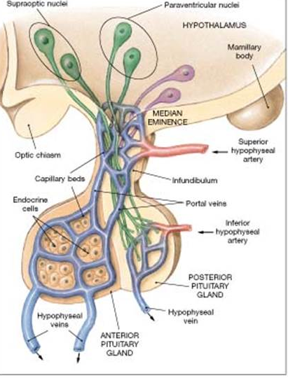
Cardiovascular System
Foundation Block
PORTAL CIRCULATION
It is a system of vessels interposed between Two Capillary Beds.
It takes place in the liver and some endocrine glands (Pituitary gland).
Veins leaving the gastrointestinal tract first capillary bed do not go direct to the heart.
They pass to the Portal Vein.
This vein enters the liver and breaks up into veins of diminishing size which ultimately join capillary like vessels (Sinusoids); second capillary bed.
Venous blood from 2nd capillary bed then to smaller veins that leave the liver through hepatic veins.

