Slide 1
Glucose Metabolism (Glycolysis)

Slide 2
Objectives
By the end of this lecture, students are expected to:
Recognize glycolysis as the major oxidative pathway of glucose
List the main reactions of glycolytic pathway
Discuss the rate-limiting enzymes/Regulation
Assess the ATP production (aerobic/anaerobic)
Define pyruvate kinase deficiency hemolytic anemia
Discuss the unique nature of glycolysis in RBCs.

Slide 3
Glycolysis: An Overview
Glycolysis, the major pathway for glucose oxidation, occurs in the cytosol of all cells.
It is unique, in that it can function either aerobically or anaerobically, depending on the availability of oxygen and intact mitochondria.
It allows tissues to survive in presence or absence of oxygen, e.g., skeletal muscle.
RBCs, which lack mitochondria, are completely reliant on glucose as their metabolic fuel, and metabolizes it by anaerobic glycolysis.

Slide 4
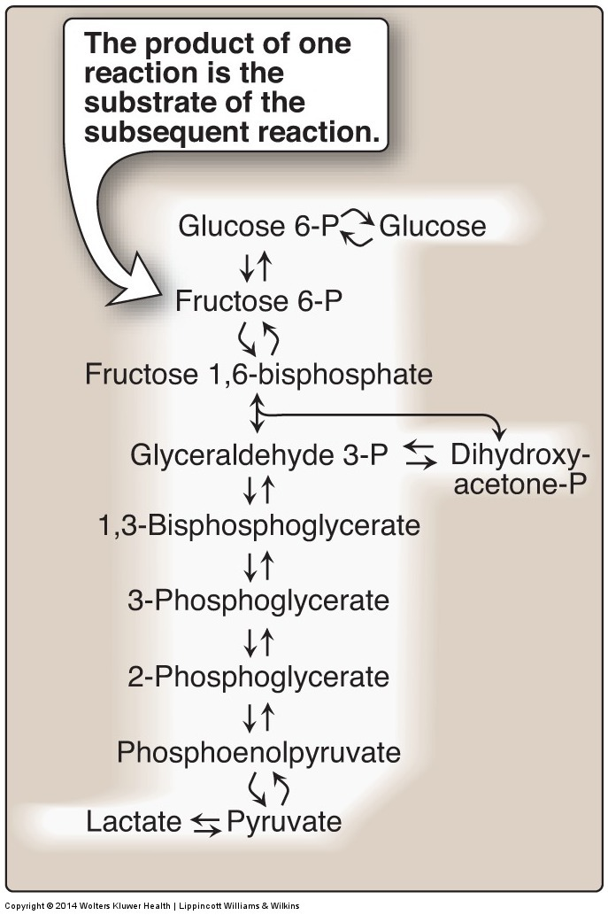
Glycolysis

Slide 5
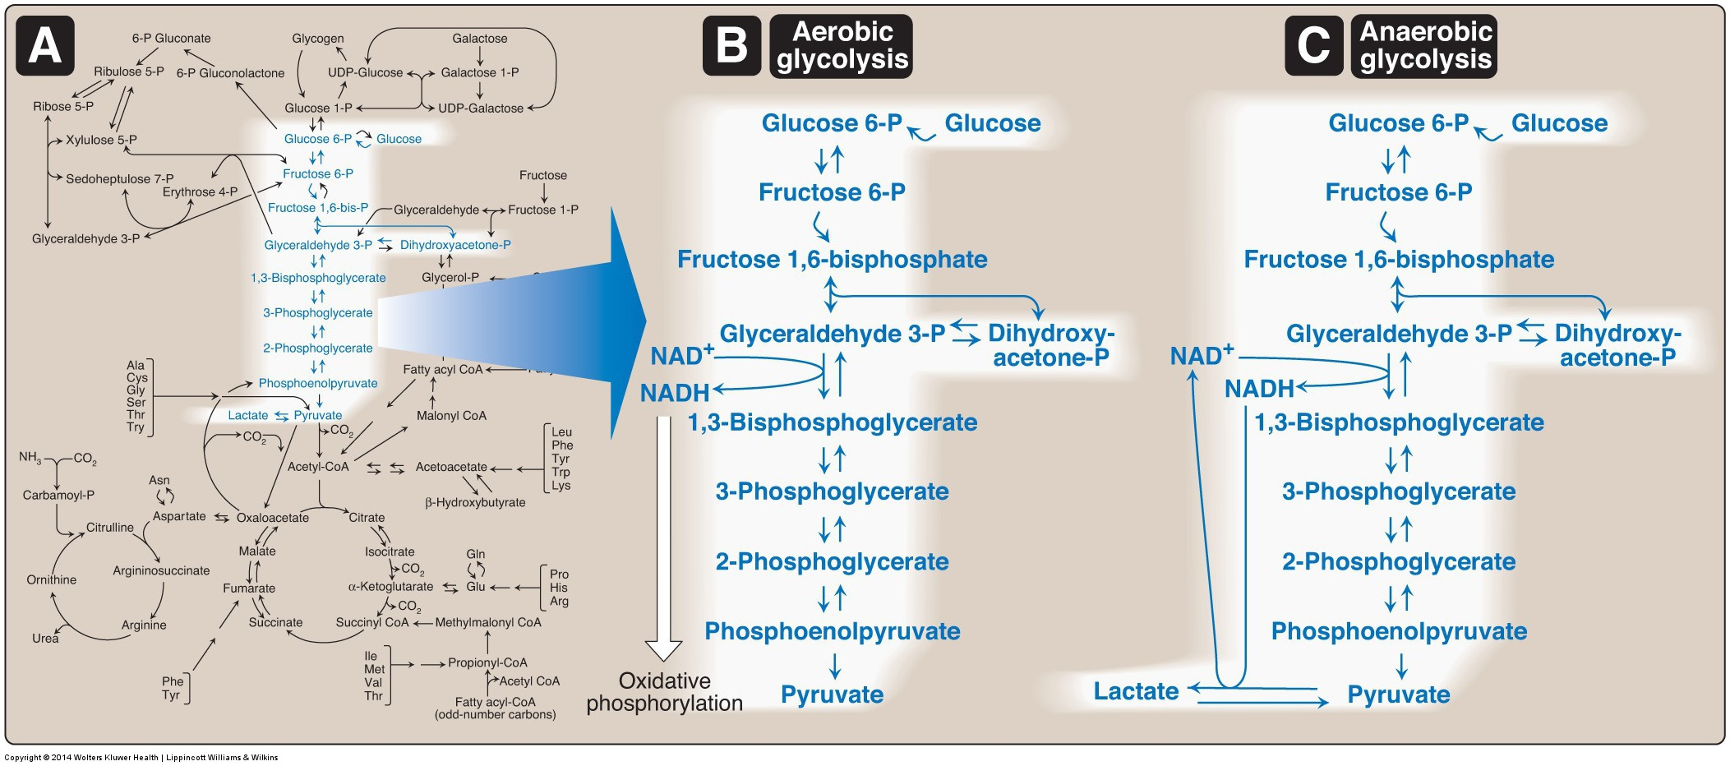
Aerobic Vs Anaerobic Glycolysis

Slide 6
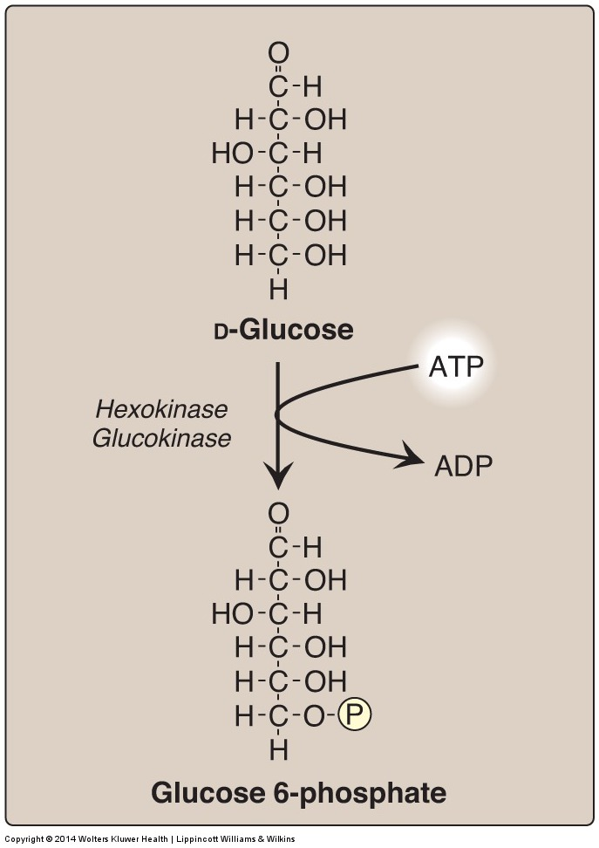
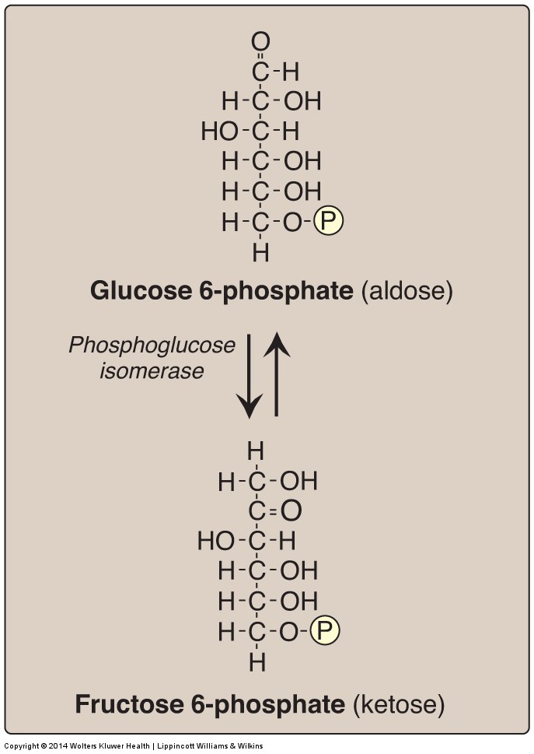
Aerobic Glycolysis (1st and 2nd reactions)
Most tissues
Hepatocytes

Slide 7
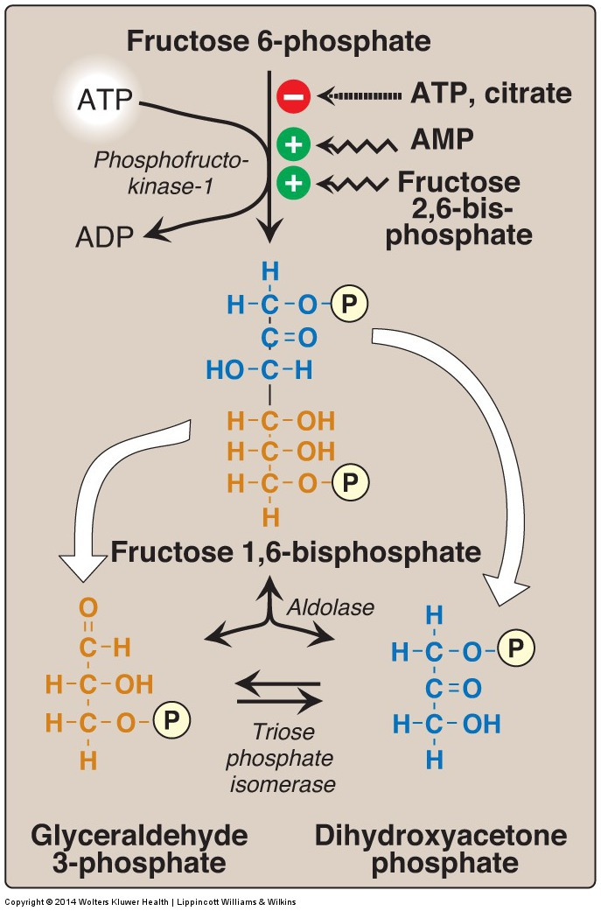
Aerobic Glycolysis (Reactions: 3rd – 5th)

Slide 8
Aerobic Glycolysis
(Reactions: 6th – 10th)
2
2
2
2
2
2
Notes:
Rate-limiting reaction is the slowest reaction in a series of reactions. It is used to calculate the rate law of the overall reaction. Recall from thermochemistry that slow reactions tend to have higher activation energy (energy “hill’). Slower reactions have to climb a higher energy hill to produce transition states and, subsequently, products; therefore, rate-limiting reaction will have the highest activation energy of all reactions in the series. Enthalpy (exothermic or endothermic) does not determine the speed of a reaction; therefore, a rate-limiting reaction could be exothermic or endothermic.

Slide 9
Regulation: Glucokinase/Hexokinase
Hexokinase – it is inhibited by the reaction product, glucose-6-P which accumulates when further metabolism of this hexose is reduced
Glucokinase – It is inhibited indirectly by Fructose-6-P and is indirectly stimulated by glucose

Slide 10
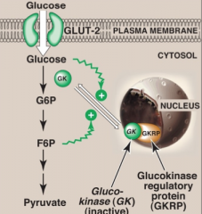
Glucokinase (GK) Regulation
In the presence of high fructose-6-phosphate, GK translocates and binds tightly to GKRP (glucokinase regulatory protein) in the nucleus, making it inactive
When glucose levels are high in blood and hepatocytes (GLUT-2), GK is released from GKRP and enters the cytosol

Slide 11
Regulation: PFK-1

Slide 12
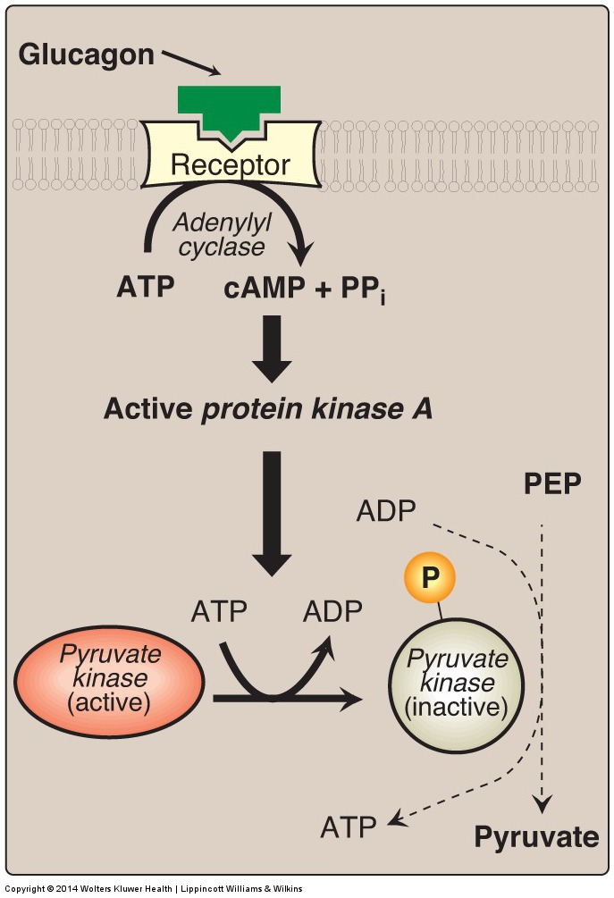
Pyruvate Kinase Covalent Modification

Slide 13
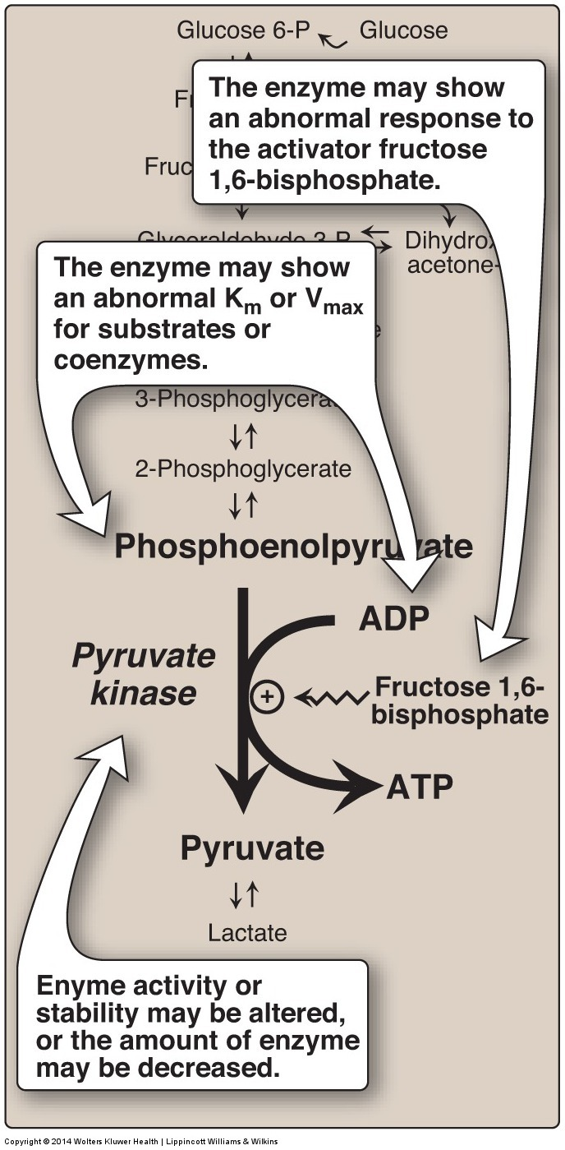
Pyruvate Kinase Deficiency Hemolytic Anemia
PK Mutation may lead to:
Altered Enz. Kinetics.
Altered response to activator.
Decreased the amount of the Enz. or its stability

Slide 14
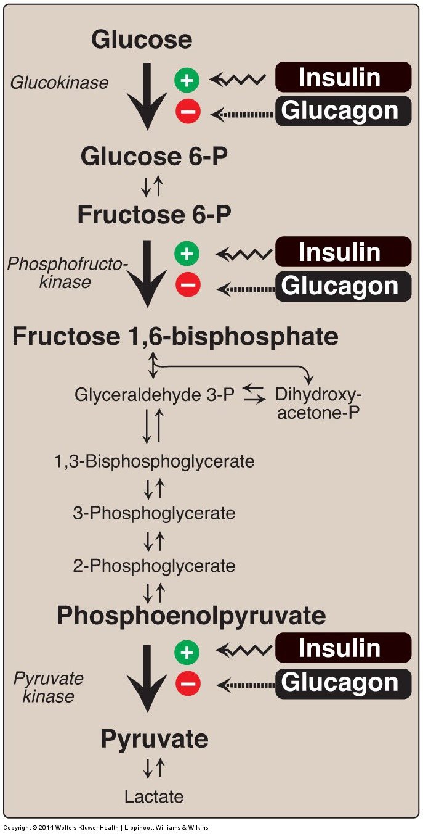
Long-Term Regulation of Glycolysis
Insulin: Induction
Glucagon: Repression

Slide 15
Summary (Regulation of Glycolysis)
Regulatory Enzymes (Irreversible reactions):
Glucokinase/hexokinase
PFK-1
Pyruvate kinase
Regulatory Mechanisms:
Rapid, short-term: Allosteric, Covalent modifications
Slow, long-term: Induction/repression
Apply the above mechanisms for each enzyme where applicable

Slide 16
Glycolysis
For each NADH, 3 ATP will be produced by ETC in the mitochondria

Slide 17
Substrate-level phosphorylation vs. Oxidative phosphorylation
Phosphorylation is the metabolic reaction of introducing a phosphate group into an organic molecule.
Oxidative phosphorylation: The formation of high-energy phosphate bonds by phosphorylation of ADP to ATP coupled to the transfer of electrons from reduced coenzymes to molecular oxygen via the electron transport chain (ETC); it occurs in the mitochondria.
Substrate-level phosphorylation: The formation of high-energy phosphate bonds by phosphorylation of ADP to ATP (or GDP to GTP) coupled to cleavage of a high-energy metabolic intermediate (substrate). It may occur in cytosol or mitochondria

Slide 18
Aerobic Glycolysis (Net ATP produced)
ATP Consumed:
2 ATP
ATP Produced:
Substrate-level 2 X 2 = 4 ATP
Oxidative-level 2 X 3 = 6 ATP
Total 10 ATP
Net: 10 – 2 = 8 ATP

Slide 19
Anaerobic Glycolysis
NADH produced cannot be used by ETC for ATP production.
(No O₂ and/or No mitochondria)
Less ATP production, as compared to aerobic glycolysis.
Lactate is an obligatory end product, Why?
Because if not formed, All cellular NAD⁺ will be converted to NADH, with no means to replenish the cellular NAD → Glycolysis stops→ death of the cell

Slide 20
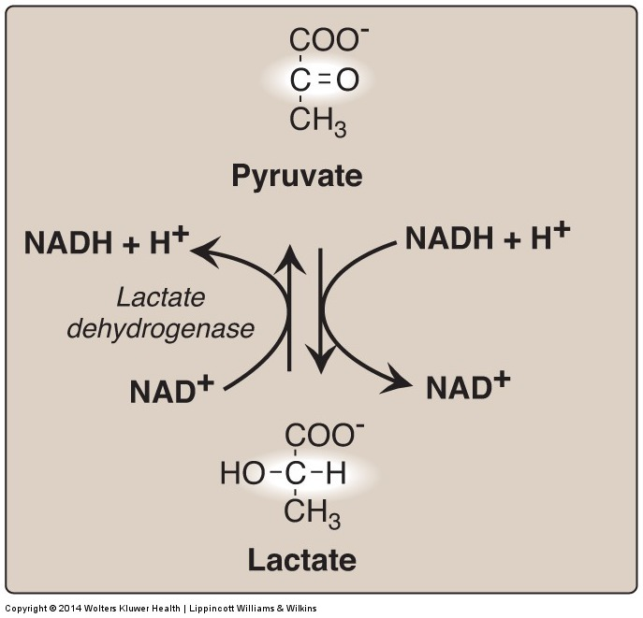
Lactate Dehydrogenase

Slide 21
Anaerobic Glycolysis (Net ATP produced)
ATP Consumed:
2 ATP
ATP Produced:
Substrate-level 2 X 2 = 4 ATP
Oxidative-level 2 X 3 = 6 ATP
Total 4 ATP
Net: 4 – 2 = 2 ATP

Slide 22
2
Anaerobic Glycolysis in RBCs
(2,3-BPG Shunt)
2
2
2
2
2

Slide 23
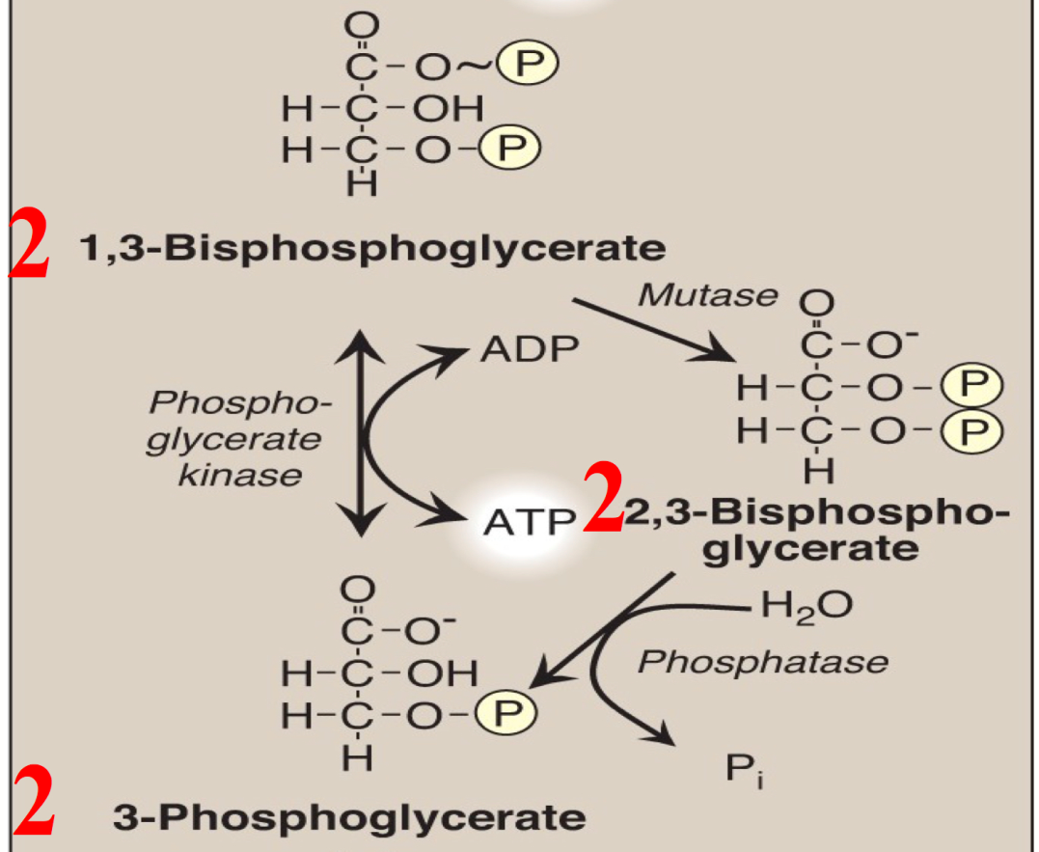
Anaerobic Glycolysis in RBCs (2,3-BPG Shunt)

Slide 24
Glycolysis in RBCs (Net ATP produced)
ATP Consumed:
2 ATP
ATP Produced:
Substrate-level 2 X 2 = 4 ATP
1 X 2 = 2
Oxidative-level 2 X 3 = 6 ATP
Total 4 or 2 ATP
Net: 4 – 2 = 2 ATP
2 – 2 = 0 ATP
or

Slide 25
Glycolysis in RBCs (Summary)
End product:
Lactate
No net production or consumption of NADH
Energy yield:
If no 2,3-BPG is formed: 2 ATP
If 2,3-BPG shunt occurs: 0 ATP
PK Deficiency hemolytic anemia depends on:
Degree of PK Deficiency
Compensation by 2,3-BPG

Slide 26
Take Home Messages
Glycolysis is the major oxidative pathway for glucose
Glycolysis is employed by all tissues
Glycolysis is a tightly-regulated pathway
PFK-1 is the rate-limiting regulatory enzyme
Glycolysis is mainly a catabolic pathway for ATP production, But it has some anabolic features (amphibolic)
Pyruvate kinase deficiency in RBCs results in hemolytic anemia

Slide 27
Take Home Messages
Net energy produced in:
Aerobic glycolysis: 8 ATP
Anaerobic glycolysis: 2 ATP
Net energy produced in glycolysis in RBCs:
Without 2,3 BPG synthesis: 2 ATP
With 2,3 BPG synthesis: 0 ATP

Slide 28
Reference
Lippincott Illustrated Review of Biochemistry, 6th edition, 2014, Unit 2, Chapter 8, Pages 91-108.

