Slide 1
Glucose Metabolism (Gluconeogenesis)

Slide 2
Objectives
The importance of gluconeogenesis as an important pathway for glucose production
The main reactions of gluconeogenesis
The rate-limiting enzymes of gluconeogenesis
Gluconeogensis is an energy-consuming, anabolic pathway

Slide 3
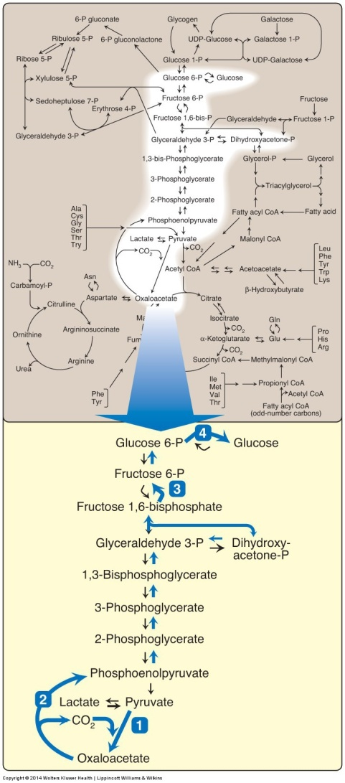
Gluconeogenesis in general metabolism
The gluconeogenesis pathway shown as one of the essential pathways of energy metabolism.

Slide 4
Gluconeogenesis: An Overview
Site: Liver (mainly) and Kidneys
Both mitochondria and Cytosol are involved
Exception: if the substrate is Glycerol: only cytosol
Gluconeogenic substrates:
Glycerol
Lactate and Pyruvate
Glucogenic amino acids

Slide 5
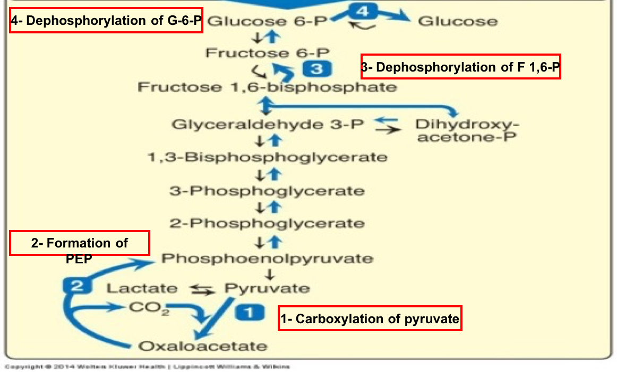
Gluconeogenesis Pathway

Slide 6
Gluconeogenic Substrates: Glycerol
*GK
Glycerol 3-phosphate
Glycerol
ATP
ADP
NAD+
Glycerol 3-phosphate
dehydrogenase
NADH
Glucose
Dihydroxyacetone phosphate
*GK: Glycerol kinase (present only in liver & kidneys)

Slide 7
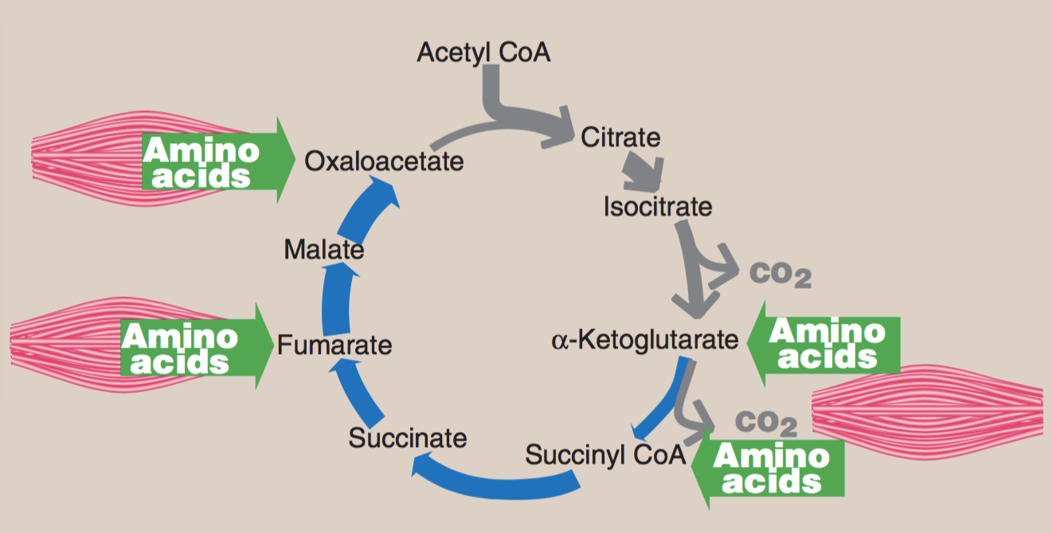
Glucogenic Amino Acids
Aspartate (Asp)
Asparagine (Asn)
Glutamate (Glu)
Glutamine (Gln)
Phenylalanine (Phe)
Tyrosine (Tyr)
Methionine (Met)
Valine (Val)

Slide 8
Gluconeogenic Substrates
Alanine (Ala)
Glycine (Gly)

Slide 9
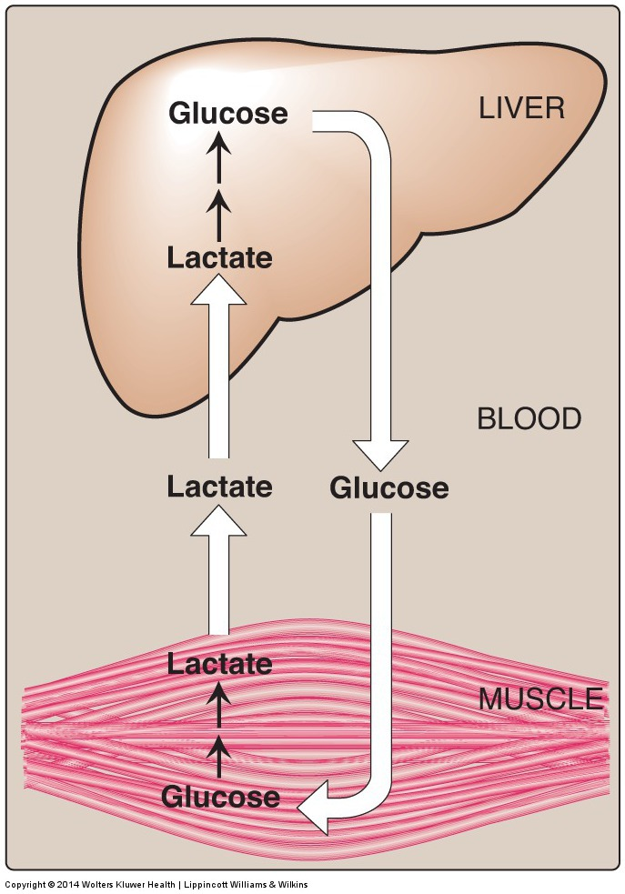
Gluconeogenic Substrates: Lactate (Cori Cycle)

Slide 10
Pyruvate Carboxylation
Pyruvate Carboxylase
Biotin
Pyruvate
Oxaloacetate
CO₂
ATP
ADP + P_{i}

Slide 11
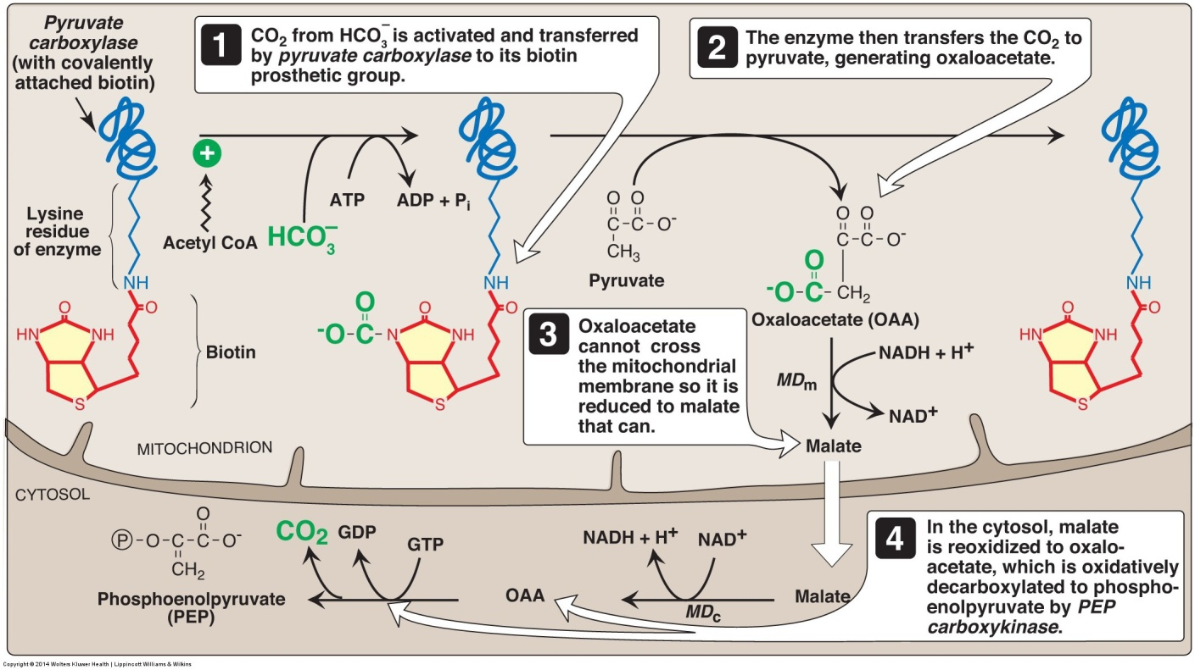
Pruvate Carboxylase and PEP-CK
Fasting:
Acetyl CoA
(From FAO)*
*Fatty
Acid
Oxidation
Pyruvate carboxylase + PEP-CK = Pyruvate kinase

Slide 12
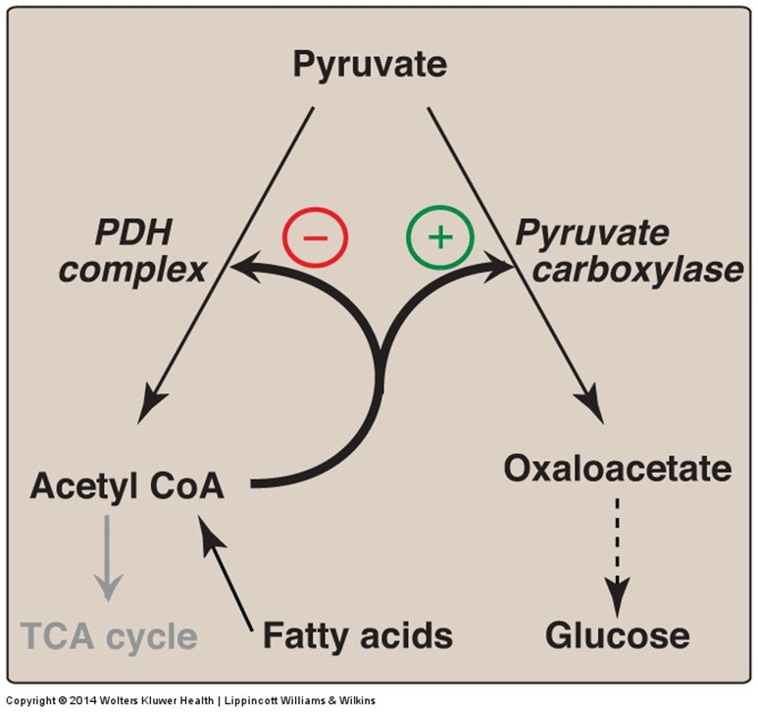
Regulation of Pyruvate Carboxylase reaction
Acetyl CoA diverts pyruvate away from oxidation and toward gluconeogenesis

Slide 13
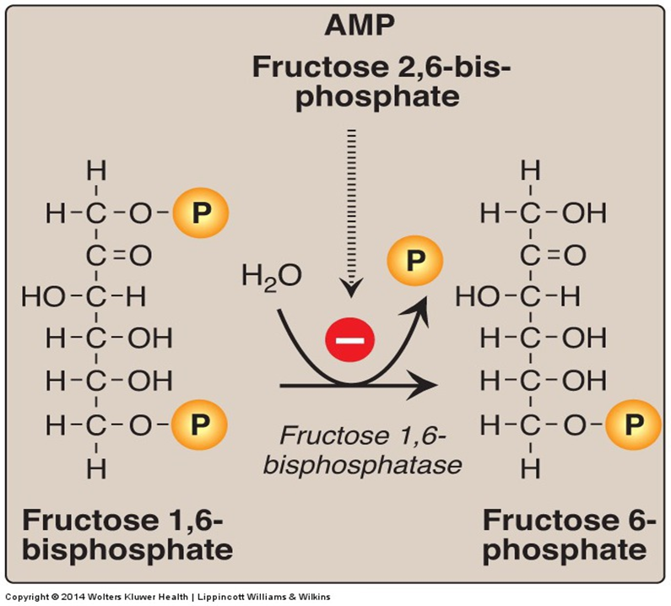
Fructose 1,6-Bisphosphatase
Dephosphorylation of fructose 1,6-bisphosphate
Fructose 1,6-bisphosphatase = PFK-1

Slide 14
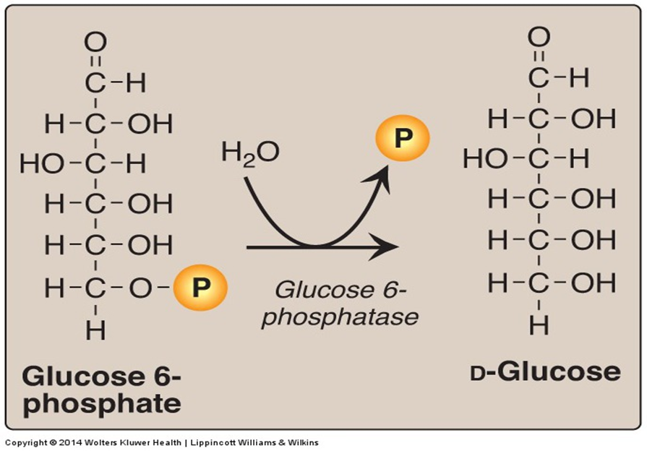
Glucose 6-Phosphatase
Dephosphorylation of glucose 6-phosphate allows release of free glucose from the liver and kidney into blood
Glucose 6-phosphatase = Glucokinase

Slide 15
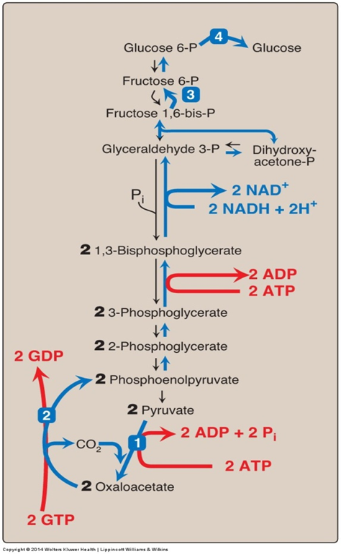
Gluconeogensis: Energy- Consumed
Six High-Energy Phosphate Bonds From Pyruvate to Glucose

Slide 16
Gluconeogenesis: Regulation
Reciprocal control
Gluconeogenesis & Glycolysis
Allosteric:
Acetyl CoA (Pyruvate carboxylase)
AMP or ATP
F 2,6-Bisphosphate
Glucagon ( I/G ratio) stimulates gluconeogenesis
- Allosteric ( F 2,6-Bisphosphate)
- Induction (PEP-CK)
+
-
+
F 1,6-bisphosphatase
-

Slide 17
Take Home Messages
Gluconeogenesis is an important pathway for glucose production from non-carbohydrate sources during prolonged fasting.
Lactate, glycerol and glucogenic amino acids are the major gluconeogenic substrates.
Gluconeogenesis is not a simple reversal of glycolysis. In fact, gluconeogenesis requires 4 unique reactions to circumvent the 3 irreversible reactions of glycolysis.
Gluconeogenesis and glycolysis are reciprocally controlled, allowing efficient glucose metabolism.
It is mainly anabolic pathway that consumes ATP for the synthesis of glucose.

Slide 18
Reference
Lippincott Illustrated Review of Biochemistry, 6th edition, 2014, Unit 2, Chapter 10, Pages 117-124.

