Slide 1
Molecular biology (2)
(Foundation Block)

Slide 2
Objectives
By the end of this lecture, the students should be able to:
To understand DNA replication
To know the transcription of genetic material into messenger RNA
To get an idea about the translation of mRNA into a functional protein.

Slide 3
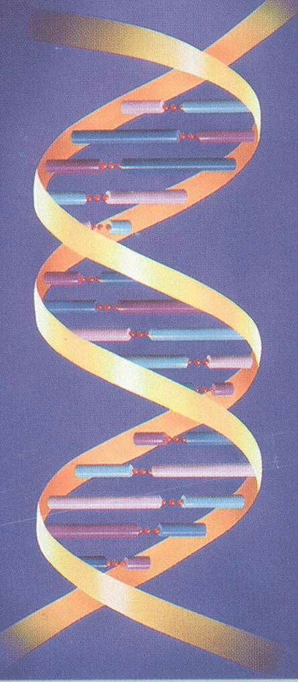
DNA is the genetic material
Therefore it must:
Replicate faithfully.
Have the coding ability to produce proteins for all cellular functions.

Slide 4
Features of Eukaryotic DNA Replication
Semiconservative with respect to parental strand:
Daughter DNA molecules contain one parental
strand and one newly-replicated strand.
Bidirectional with multiple origins of replication.
Origin
5’
3’
3’
5’

Slide 5
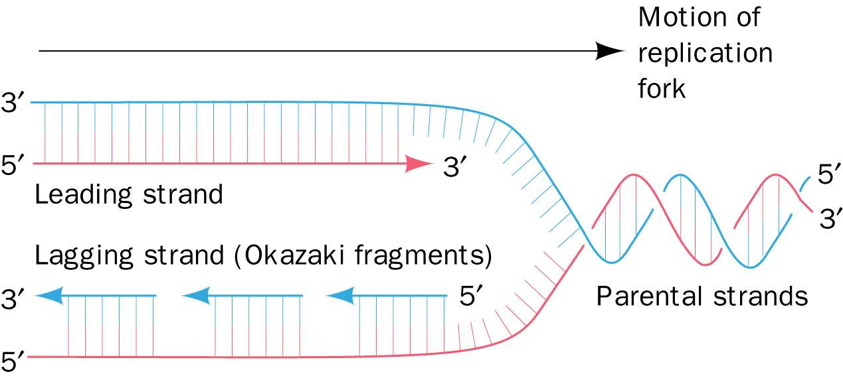
Primed by short stretches of RNA.
Semi-discontinous
Semidiscontinuous DNA replication. In DNA replication, both daughter strands (leading strand red, lagging strand blue) are synthesized in their 5’ → 3’ directions

Slide 6
Proteins involved in DNA Replication
DNA Helicase.
Single-stranded DNA binding proteins.
DNA Primase.
DNA polymerases (5 types: α; β; γ; δ; ε).
DNA ligase.
Topoisomerases:
Topoisomerase I.
Topoisomerase II.
Telomerases

Slide 7
Steps in DNA Replication
3’
3’
5’
5’
3’
5’
3’
5’
Helicase protein binds to DNA sequences called origins and unwinds DNA strands.
Single-Stranded binding proteins prevent single strands from rewinding.
Primase protein makes a short segment of RNA primer complementary to the DNA.

Slide 8
Overall direction
of replication
DNA polymerase:
Adds DNA nucleotides to the RNA primer.
Proofreads bases added and replaces incorrect nucleotides
3’
3’
5’
5’
3’
5’
3’
5’

Slide 9
Leading strand synthesis continues in a 5’ to 3’ direction.
Discontinuous synthesis produces 5’ to 3’ DNA segments (Okazaki fragments).
Overall direction
of replication
3’
3’
5’
5’
3’
Okazaki fragment
5’
3’
5’
3’
5’

Slide 10
3’
3’
5’
3’
5’
3’
5’
3’
5’
5’
Exonuclease activity of DNA polymerase removes RNA primers

Slide 11
DNA polymerase fills the gaps.
Ligase forms bonds between sugar-phosphate backbone
3’
3’
5’
3’
5’
3’
3’
5’
5’

Slide 12
The central dogma of Molecular Biology
A portion of DNA, called a gene, is transcribed into RNA.
RNA is translated into proteins.

Slide 13
Transcription (mRNA synthesis)
A portion of DNA (a gene) is transcribed into messenger RNA (mRNA).
Only one of the DNA strands is transcribed (antisense strand).
The RNA polymerase II is responsible for this process.
The direction of transcription is 5’ → 3’.

Slide 14
Steps of mRNA synthesis
Chain initiation:
RNA polymerase II binds to promoter region of DNA to start transcription.

Slide 15
Steps of mRNA synthesis
Chain elongation:
A portion of DNA template unwinds (opens) at the point of RNA synthesis.
This forms a short length of RNA-DNA hybrid.
Chain termination:
DNA contains specific sites which stop transcription (at a sequence of 4-10 AT base pairs).

Slide 16
Post-transcriptional modification
Capping: Addition of a methylated guanine nucleotide at
5’ end of mRNA
Function:
To prevent mRNA degradation by exonucleases.
It helps the transcript bind to the ribosome during protein synthesis.
Polyadenylation: Addition of a poly(A) tail (a highly conserved
AAUAA sequence) at 3’ end of mRNA.
Functions:
To protect the mRNA from degradation
For ribosomal RNA recognition
Intron removal for releasing mature mRNA from nucleus.

Slide 17
The central dogma of Molecular Biology
A portion of DNA, called a gene, is transcribed into RNA.
RNA is translated into proteins.

Slide 18
Translation (Protein synthesis)
A process of protein synthesis from mRNA
mRNA has genetic codes for amino acids present in proteins.
The genetic code is a dictionary that identifies the correspondence between a sequence of nucleotide bases and a sequence of amino acids.
Each individual word in the code is composed of three nucleotide bases (codons).

Slide 19
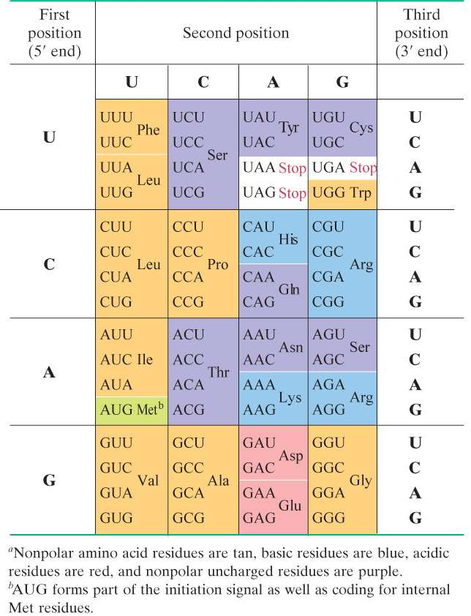
64 possible codons:
61 codons specify 20 amino acids
One start codon (AUG)
3 stop codons
UAA, UAG and UGA

Slide 20
Components required for Translation
Amino acids.
Transfer RNA (tRNA).
Aminoacyl-tRNA synthetases.
mRNA.
Functionally competent ribosomes.
Protein factors.
ATP and GTP.

Slide 21
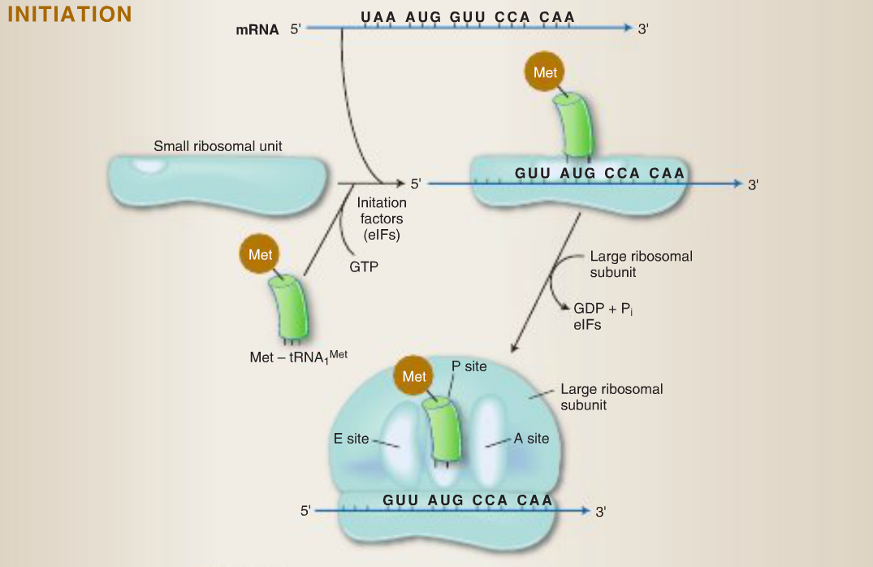
Steps in Protein Translation

Slide 22
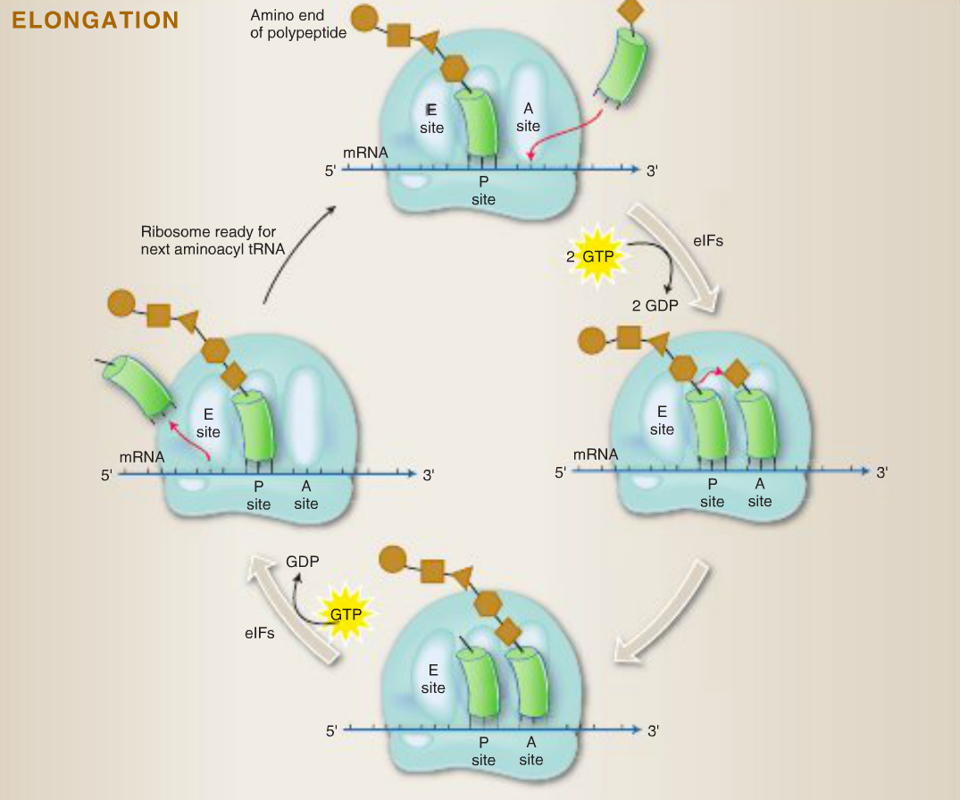
Peptidyltransferase

Slide 24
Take home messages
DNA is the genetic material, so it must replicate faithfully and have the coding ability to produce proteins for all cellular functions.
Only one strand of DNA (antisense strand) is transcribed into mRNA.
The synthesized mRNA is protected from the destruction and prepared for translation through post-transcriptional modification.
mRNA transcription and protein synthesis processes are the same in both prokaryotic eukaryotic cells with some differences.

Slide 25
References
Lippincott’s Illustrated reviews: Biochemistry 6th edition, Unit 6, chapters 29, 30 and 31, Pages 395-448.
Lippincott’s Illustrated reviews: Cell and Molecular Biology, Unit 2, Chapters 7, 8 and 9, Pages 69-106.

