Slide 1
Enzymes and Coenzymes I
Dr. Sumbul Fatma
Clinical Chemistry Unit
Department of Pathology

Slide 2
What are Enzymes?
Enzymes are biological catalysts that speed up the rate of a reaction without being changed in the reaction
All enzymes are protein in nature
But all proteins are not enzymes
Substance upon which the enzymes act are called substrates
Enzyme converts substrates into product(s)

Slide 4
Properties of Enzymes
Active site-
The region of enzyme that binds with the substrate and where catalysis occurs
All enzymes have one or more active sites
Specificity-
Enzymes bind to their specific substrates in the active site to convert them to product(s)
Regulation-
Enzymes can be activated or inhibited so that the rate of product formation responds to the need of the cell

Slide 5
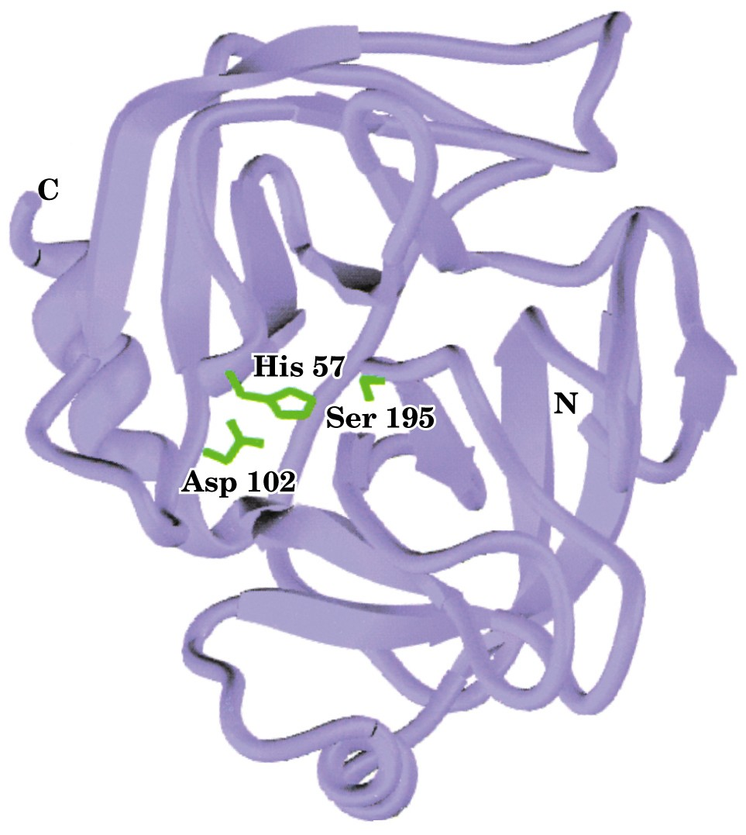
Structure of trypsin enzyme
Page 519

Slide 6
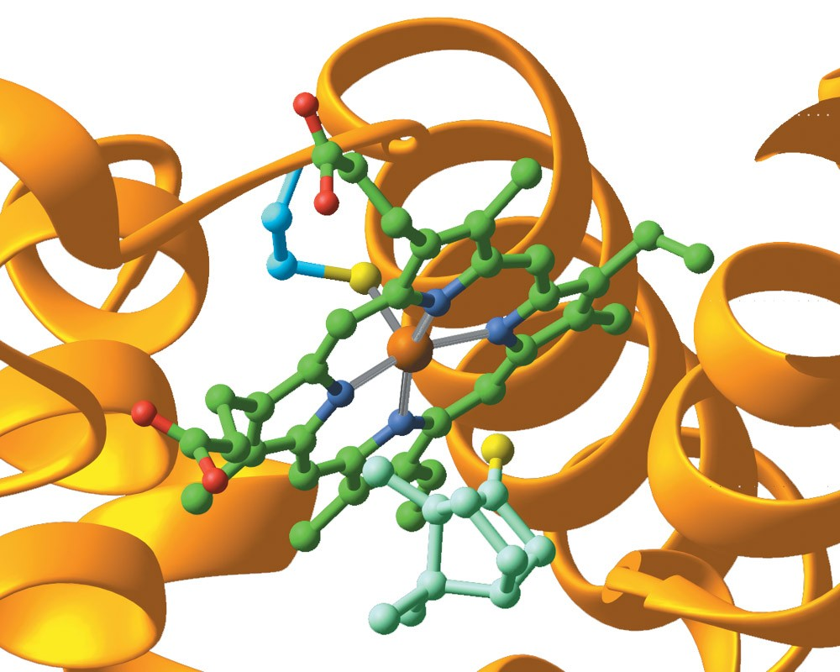
An enzyme with its active site
Page 533

Slide 7
Enzyme specificity
Enzymes are highly specific
Interact with only one or a few of the substrates
Catalyze only one type of reaction

Slide 8
Enzyme-substrate binding
Two models have been proposed
Lock and key binding
Induced fit binding

Slide 9
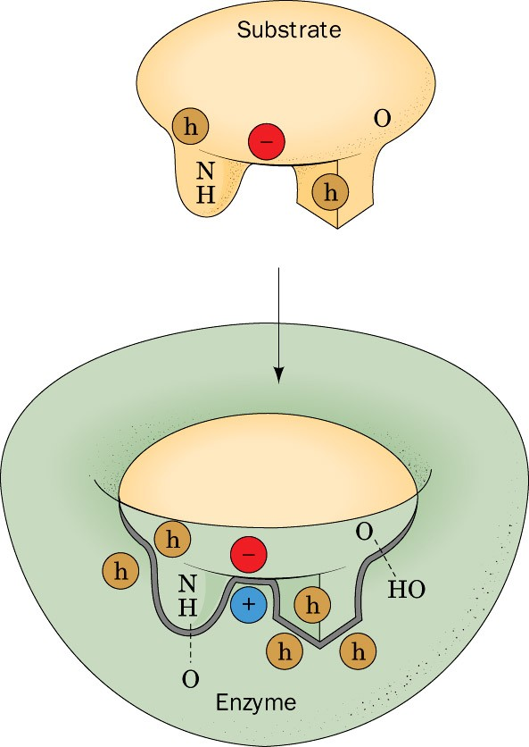
Lock and key binding
The enzyme has an active site that fits the exact dimensions of the substrate
Page 460

Slide 10
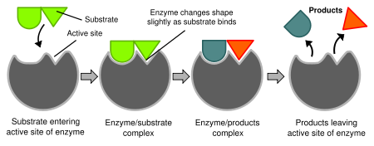
Induced fit binding
After the binding of substrate, the enzyme changes its shape to fit more perfectly with substrate

Slide 11
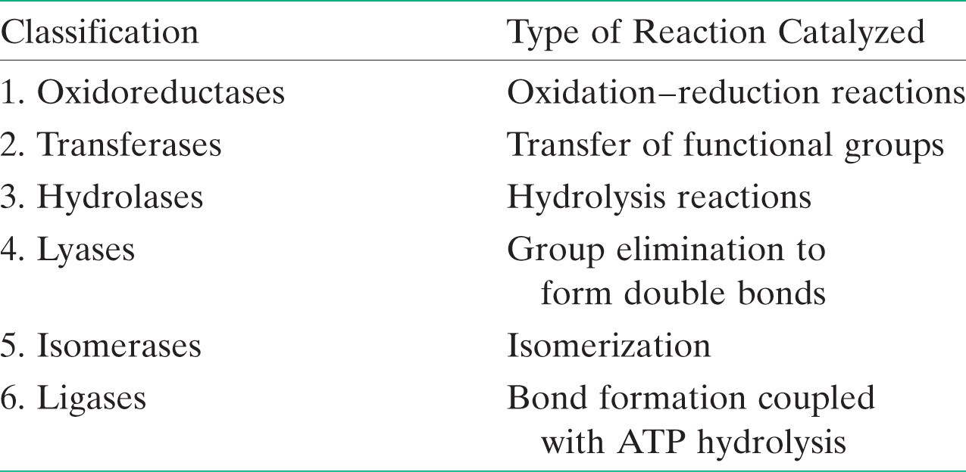
Classification of Enzymes
Classified into six types according to the reaction catalyzed
Page 470

Slide 12
Enzyme nomenclature (Naming)
Enzyme nomenclature is based on the rules given by IUBMB (International Union of Biochemistry and Molecular Biology)
EC 3.4.17.1 (carboxypeptidase A)
EC = Enzyme Commission
Class.Subclass.Subsubclass.Enzyme number

Slide 13
Holoenzymes
Some enzymes require non-protein groups to become active
The inactive form of enzyme without its non-protein part is called an apoenzyme
Apoenzyme (inactive) + nonprotein part =
Holoenzyme (active)

Slide 14
Cofactors and Coenzymes
If the non-protein part is a metal ion such as Cu²⁺, Fe³⁺, Zn²⁺, etc., it is called cofactor
If small organic molecules, known as coenzymes such as NAD⁺
Prosthetic groups
Cosubstrates

Slide 15
Coenzymes
Coenzymes that are permanently associated with an enzyme known as prosthetic groups e.g. FAD
Coenzymes that only temporarily associate with an enzyme known as cosubstrates e.g. NAD
Apoenzyme (inactive) + Cofactor/coenzyme =
Holoenzyme (active)

Slide 16
Ribozymes, Isoenzymes and zymogens
Ribozymes are RNAs with enzyme activity
Isoenzymes are enzymes that catalyze the same chemical reaction but they have slightly different structures
Zymogens are inactive enzyme precursors that require a biochemical change to become active e.g. cleavage of a peptide blocking the active site

Slide 17
Enzymes decrease activation energy of a reaction
In every chemical reaction, the reactants pass through a transition state that has greater energy than that of the reactants or products alone
The difference in energy between the reactants and the transition state is called the activation energy
If the activation energy is available then the reaction can proceed forming products

Slide 18
An enzyme reduces the activation energy required for a reaction
It provides an alternative transition state of lower energy called the enzyme-substrate complex and thus speeds up the reaction
Enzymes decrease the activation energy but they do not alter the change in the free energy (∆G)

Slide 19
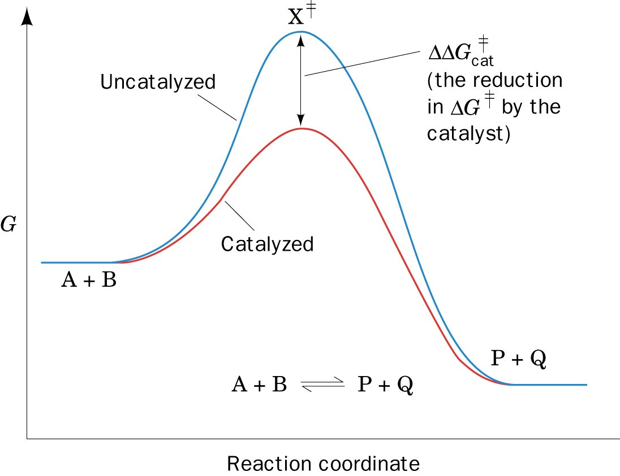
The effect of a catalyst on the transition state diagram of a reaction
Page 477

Slide 20
Enzyme Activity or Velocity
Velocity is the rate of a reaction catalyzed by an enzyme
Enzyme activity is expressed as:
mmoles of product formed/min/mg enzyme

Slide 21
Factors that affect enzyme activity
Effect of temperature
Every enzyme has an optimal temp. for catalyzing a reaction
The rate of an enzyme reaction initially increases with rise in temperature
At high temp. enzymes are denatured and become inactive
In humans most enzyme have an optimal temp. of 37ºC

Slide 22
Factors that affect enzyme activity
Effect of pH
Effect of pH on the ionizable groups in the active site of enzyme or in the substrate affect catalysis
Every enzyme has an optimal pH for catalyzing a reaction
Most enzymes have highest activity between pH 6 and pH 8
Pepsin has highest activity at pH 2

Slide 23
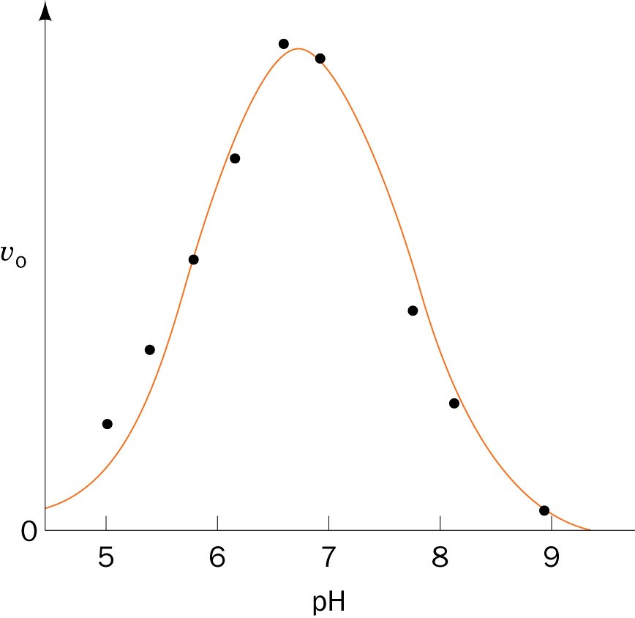
Effect of pH on the initial rate of the reaction catalyzed by most enzymes (the bell-shaped curve)
Page 487

Slide 24
Factors that affect enzyme activity
Effect of [E] and [S]
The reaction velocity increases initially with increasing [S]
At low [S], the reaction rate is proportional to [S]
Further addition of substrate has no effect on enzyme velocity (v)
The rate of an enzyme reaction is directly proportional to the conc. of enzyme if the substrate concentration [S] is higher than enzyme

Slide 25
Enzyme kinetics
The model of enzyme kinetics was first proposed by Michaelis and Menten in 1913 and later modified by Briggs and Haldane
The Michaelis Menten equation describes the relationship of initial rate of an enzyme reaction to the [S]

Slide 26
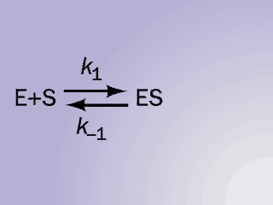

Slide 27
Initial rate of enzyme reaction
Pre-steady state kinetics
When an enzyme is mixed with high concentration of substrate, there is an initial short period of time (a few hundred microseconds) during which intermediates leading to the formation of product gradually build up

Slide 28
Steady state kinetics
After initial state, the reaction rate and the concentration of intermediates change slowly with time called steady state reaction
An intermediate is said to be steady state when its rate of synthesis is equal to its rate of degradation

Slide 29
Michaelis Menten Equation
It measures the initial velocity (v_{o}) of an enzyme reaction
V_{max} [S]
v_{o} = ------------
K_{m} + [S]
[S] = substrate concentration
V_{max} = maximum velocity
K_{m} = Michaelis constant

Slide 30
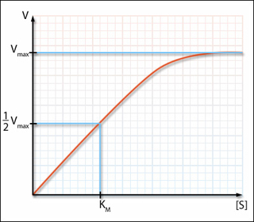
Initial velocity v_{o} of a simple Michaelis–Menten reaction versus the substrate concentration[S]

Slide 31
K_{m} (Michaelis Constant)
K_{m} is the substrate concentration at which the initial rate is one-half of the maximum rate (½ V_{max})
It is the [S] required to saturate half of all of the active sites of an enzyme

Slide 32
The K_{m} value of a substrate depends on its affinity with the enzyme
High K_{m} means low affinity with enzyme (more substrate needed to saturate the enzyme)
Low K_{m} means high affinity with enzyme (less substrate needed to saturate the enzyme)

Slide 33
Lineweaver-Burk plot
Also called the double-reciprocal plot, obtained by taking reciprocals of the Michaelis Menten equation
It is plotted to calculate the Km and Vmax values and to determine the mechanism of action of enzyme inhibitors

Slide 34
Initial velocity v_{o} of a simple Michaelis–Menten reaction versus the substrate concentration[S]

Slide 35
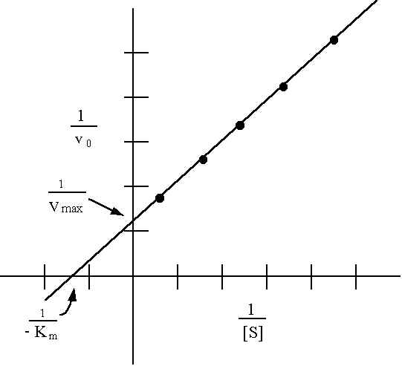
Lineweaver-Burk plot

Slide 36
References
Illustrated Reviews in Biochemistry by Lippincott

