Slide 1
Metabolism: Anabolism and Catabolism
By
Dr. Sumbul Fatma

Slide 2
Objectives
Understand the concept of metabolic pathway
Identify types & characters of metabolic pathways- anabolic and catabolic
Identify ATP as the energy currency of cells

Slide 3
Metabolism
All the chemical reactions taking place inside a cell are collectively known as METABOLISM
Metabolism consists of:
energy consuming (anabolic) pathways
energy producing (catabolic) pathways

Slide 4
Pathway Vs Chemical Reaction
Metabolic Pathway:
A multi-step sequence of chemical reactions
A product of first reaction becomes a substrate for second reaction
Integrated pathways: Metabolism

Slide 5
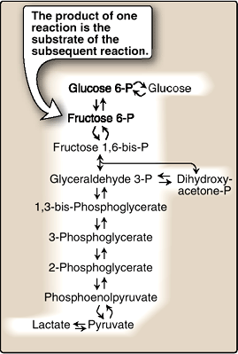
Glycolysis, an example of a metabolic pathway

Slide 6
Metabolic Map
Different pathways can intersect, forming an integrated and purposeful network of chemical reactions “The Metabolic Map”

Slide 7
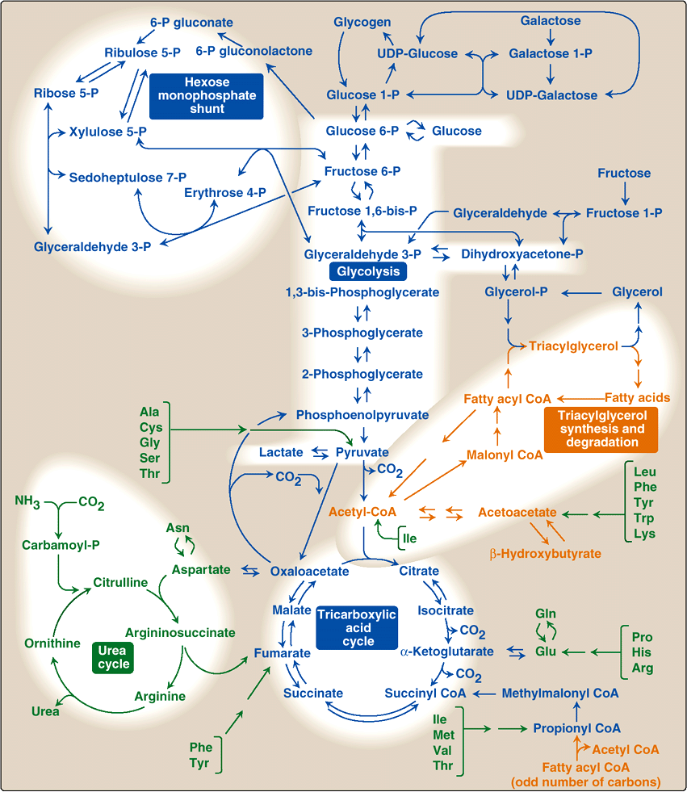

Slide 8
Classification
Most pathways can be classified
catabolic
anabolic
Note: Pathways that regenerate a component are called cycles

Slide 9
Catabolic Pathways

Slide 10
Anabolic Pathways
Precursor molecules into complex molecules
Endergonic reactions require ATP
Divergent process

Slide 11
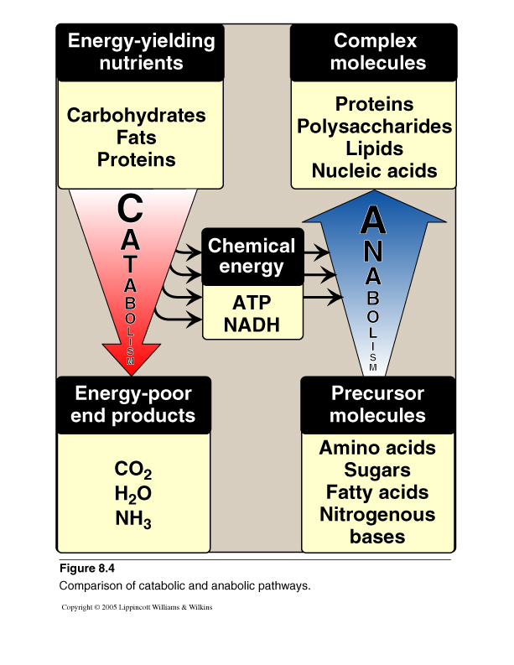
Catabolism Vs Anabolism

Slide 12
Comparison of catabolic and anabolic pathways
Anabolic
Catabolic
Simple to complex molecules
Endergonic
Involves reductions
Requires NADPH
Divergent process
Complex to simple molecules
Exergonic
Involves oxidations
Requires NAD⁺
Convergent process
Notes:
Eplain what

Slide 13
Amphibolic Pathways
Amphi = Dual, amphibolic: dual pathway
For example,
Krebs cycle is mainly a catabolic cycle, but with some anabolic features,
e.g., part of Krebs cycle is used for the synthesis of glucose from amino acids
Therefore, Krebs cycle is amphibolic

Slide 14
Energy Currency: ATP
ATP + H₂O ADP +P_{i}
The free energy liberated in the hydrolysis of ATP is used to drive the endergonic reactions
ATP is formed from ADP and P_{i} when fuel molecules are oxidized
This ATP-ADP cycle is the fundamental mode of energy exchange in biological systems

Slide 15
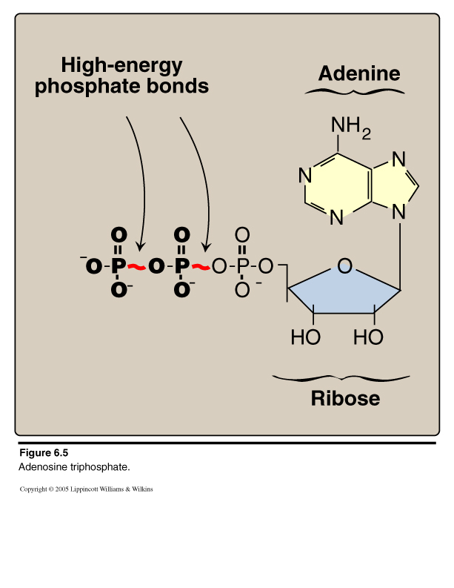
Adenosine Triphosphate (ATP)
Δ Gº -7.3 kcal/mol/bond

Slide 16
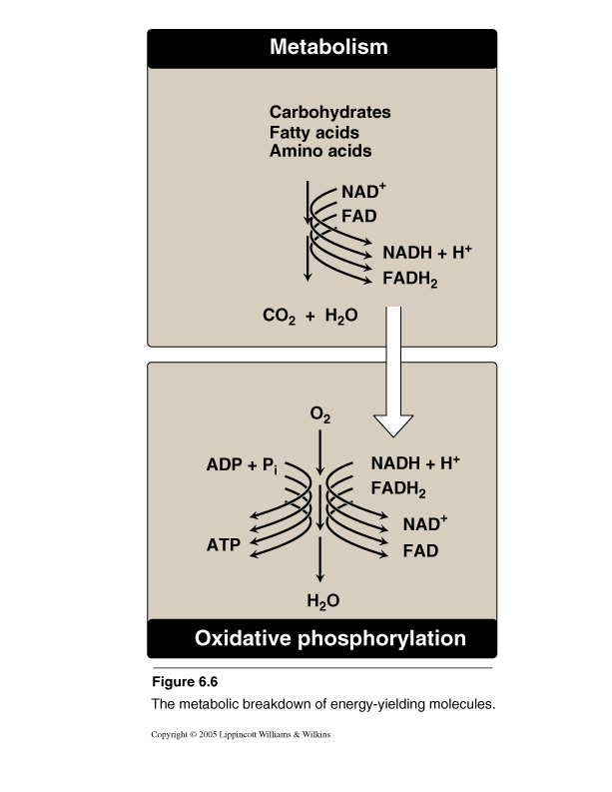
Oxidation-Reduction in Metabolism
E-rich compounds e.g.,
E-rich
reduced coenzymes
Oxidation
ETC

Slide 17
Oxidation/Reduction
Oxidation:
Loss of hydrogen
Loss of electrons
Reduction:
Gain of hydrogen
Gain of electrons

Slide 18
NAD⁺/ NADH

Slide 19
Regulation of Metabolism
Intracellular signals:
Substrate availability
Product inhibition
Allosteric activators
Intercellular communications:
Chemical signaling (hormones):
Second messenger
cAMP, cGMP
Ca/phosphatidylinositol

Slide 20
Metabolic Fuel
Carbohydrates & lipids (mainly) and proteins (little extent) are used for energy production
These are- glucose, fatty acids and amino acids
Glucose is the major metabolic fuel of most tissues

Slide 21
Take Home Message-1
Metabolism is the sum of all biochemical pathways that occur inside the cells.
A metabolic pathway is a multistep sequences of enzyme-catalyzed reactions.

Slide 22
Take Home Message-2
Catabolism is a convergent process that provides energy to cells in the form of ATP.
Anabolism is a divergent process that consumes energy for the synthesis of complex molecules.
Metabolic pathways are tightly regulated and highly integrated.

Slide 23
Take Home Message-3
ATP is the energy currency of the cells

Slide 24
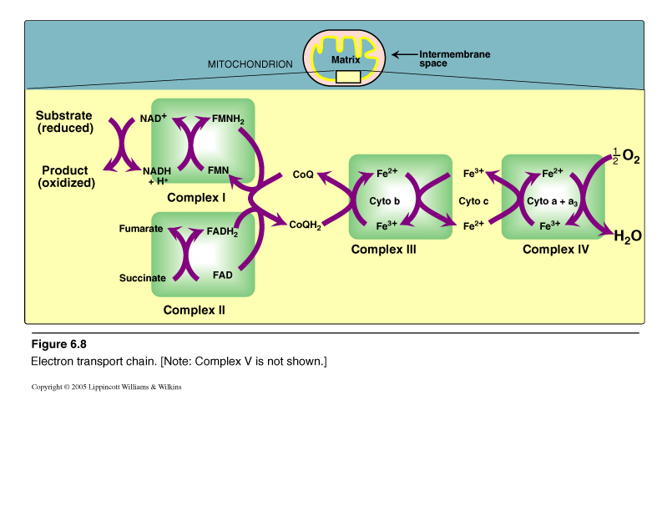
Electron Transport Chain (ETC)
Figure For Illustration only
Non-protein mobile carrier
Sites for ATP Synthesis
Electron transport and ATP synthesis are tightly coupled processes

