Slide 1
Introduction to embryology
Dr. Sanaa Al Sharawi, Dr.Essam Salama

Slide 2
Objectives
After this lecture you should be able to :
Define Embryology.
Define the developmental periods.
Define the significance of embryology.
Knew the different embryological terminology.
Define the nomenclature used to describe body parts, positions, and relationships.
Describe in brief the important events in embryology.

Slide 3
Definition of Embryology
This term generally referes to prenatal development of embryos and fetuses.
“Human embryology’’ is the science concerned with the origin and development of a human being starting from a zygote to the birth of an infant.
Development does not stop at birth. Important changes, in addition to growth occur after birth (postnatal changes) e.g.,development of teeth and female breasts.

Slide 4
SIGNIFICANCE OF EMBRYOLOGY
Importance of Embryology :
The study of prenatal stages of development, especially those occurring during the embryonic period is to understand the normal body structure and the causes of any congenital anomalies happen.
So,It is concerned with various genetic and /or environmental factors that disturb the normal development producing birth defects.

Slide 5
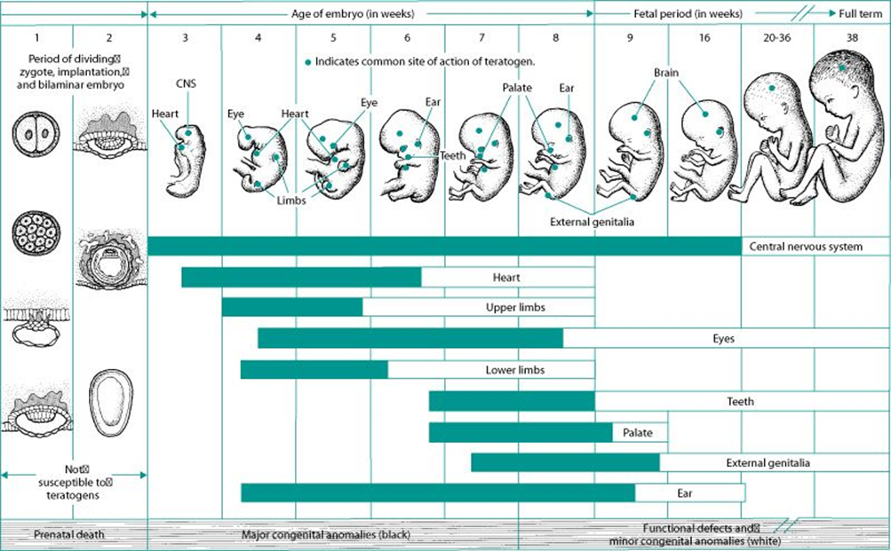
Developmental periods :
Developmental periods are divided into :
1- Prenatal development :
It is the main developmental changes occurring before birth, including :
The embryonic period : starts from the fertilization to the end of 8th week.
The fetal period : begins from the 9th week untill birth.
2- postnatal development :
The changes occurring after birth, like teeth and breast.
Prenatal development is more rapid than postnatal development and results in more striking changes.

Slide 6
Critical Periods of Human Development
This is the stage of development of an embryo that is susceptible to an agent, such as a drug or virus, which can lead to congenital abnormalities.
Embryological Development is most easily disrupted when the tissues and organs are forming during the embryonic period.

Slide 7
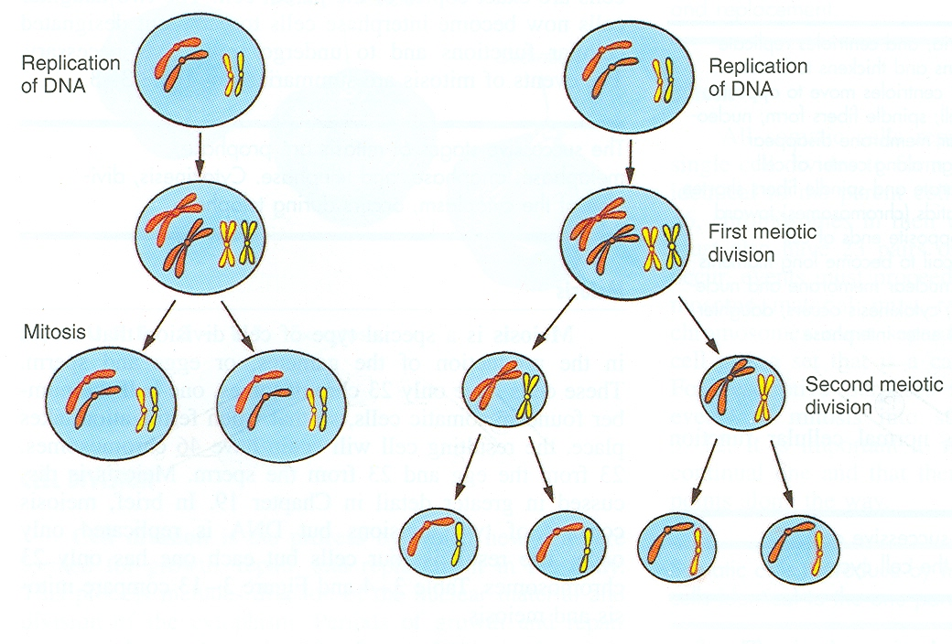
Common terminology :
Oocyte; the immature ovum or female germ cell.
Ovum; the mature female germ cell.
Sperm; the mature male germ cell.
Zygote; the fertilized ovum.
Cell division : there are two types of cell division:
A- Mitotic : It occurs in the somatic cell, it produces 2 cells each contains 44 autosomes and 2 sex chromosomes (Diploid number of chromosomes).
B- Meiotic (reduction) : It occurs in the primitive germ cells in the testes or the ovaries, it includes 2 stages 1st & 2nd meiotic divisions, it produces 2 cells then 4 cells ; each contains 22 autosomes and one sex chromosomes (Haploid number of chromosomes).

Slide 8
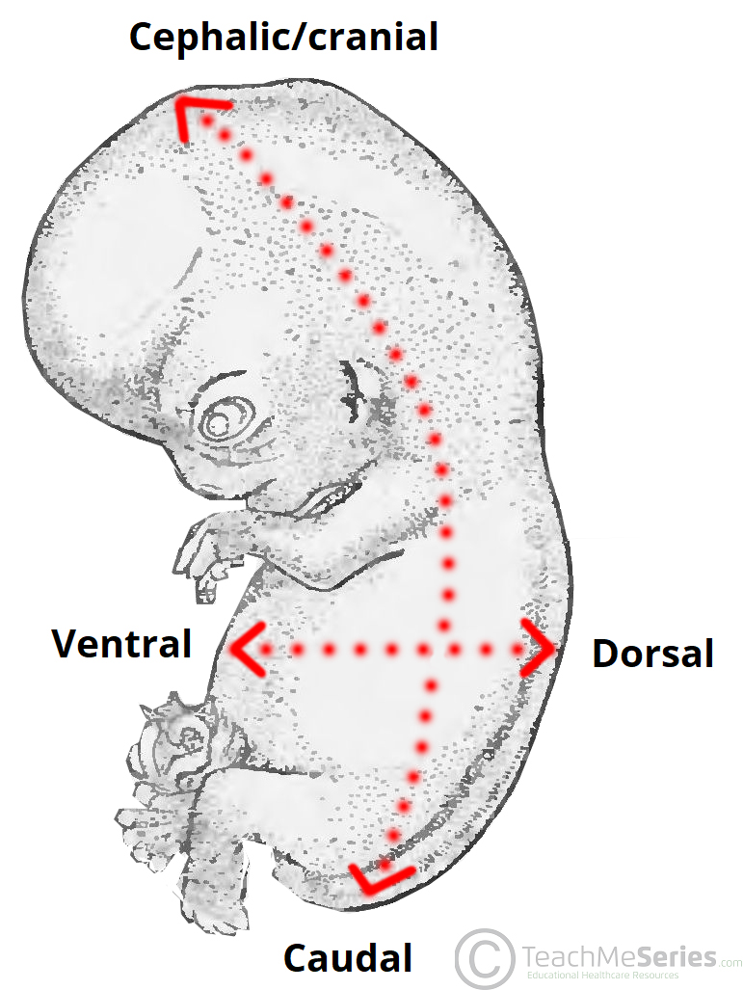
Descriptive Terms of the embryo :
Related to the Directions:
Cranial; the top of the embryo or the head.
Cephalic; superior or the head.
Caudal; inferior or the tail end.
Dorsal; back of the embryo.
Ventral; anterior or the belly side.
Medial; near to the midline.
Lateral; flank side.

Slide 9
Descriptive Terms:
Related to the Plans or sections:
Longitudinal; median or sagittal.
Coronal; frontal.
Transverse; horizontal

Slide 10
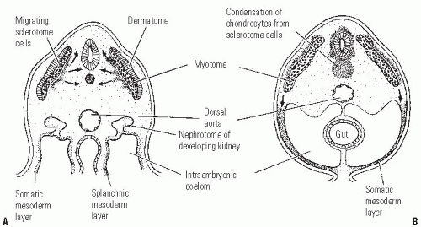
Plans or sections:
Transverse; horizontal
Longitudinal Section
Coronal Section

Slide 11
Major events during embryonic period
Gametogenesis.
Fertilization.
Implantation.
Development of the Central Nervous System : begins at 3rd week.
Development of Heart : begins at 3rd week.
Embryonic Folding : 4th week

Slide 12
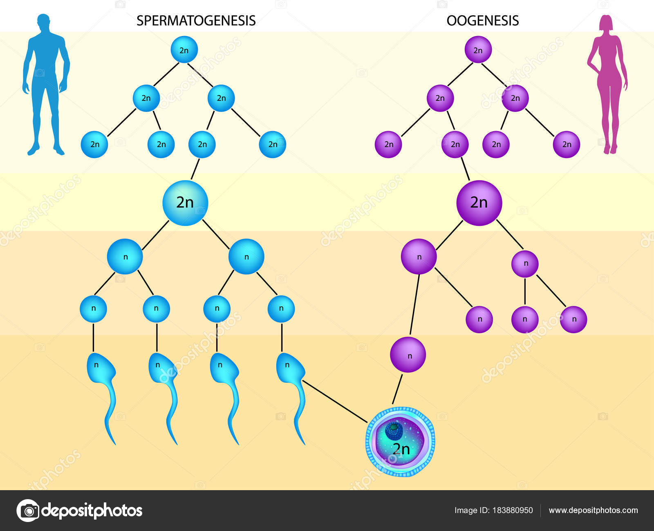
GAMETOGENESIS
It is the production of mature gametes (sperm and ova) in the gonads (testes in males and ovaries in females).
It is divided into:
1- Spermatogenesis.
2- Oogenesis.

Slide 13
SPERMATOGENESIS
It is the process of formation of mature sperms.
Occurs in the semenifrous tubules of testis.
Starts from puberty till old ages.
It ends by formation of mature sperms with haploid number of chromosomes.

Slide 14
Results of spermatogenesis;
1- Reduction of chromosomal number from the diploid to the haploid number.
2- Change the primitive germ cell (spermatogonia) to the motile sperm.
3- Increase the number of the sperms.

Slide 15
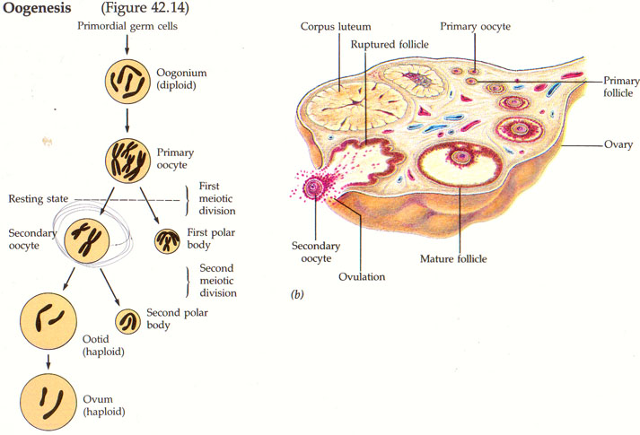
OOGENESIS
It is the process of formation of mature ovum,
It occurs in the cortex of the ovary,
starts; during fetal life, completed after puberty, and fertilization and continues till menopause.
It ends by formation of mature ovum with haploid number of chromosomes.

Slide 16
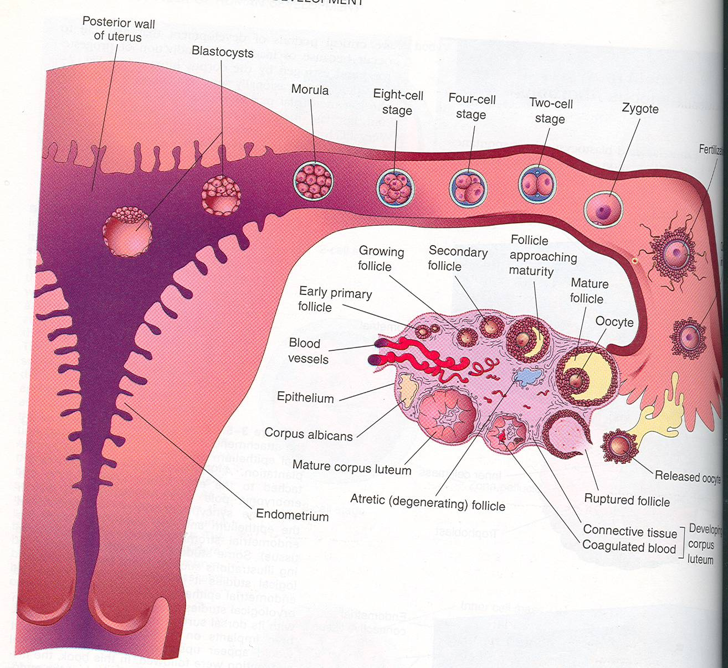
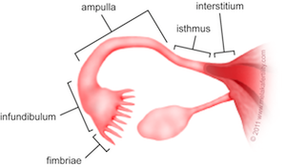
FERTILIZATION
Definition:
It is the process during which a mature male gamete (sperm) unites with a mature female gamete (oocyte) to form a single cell (ZYGOTE).
Site : It occurs in the uterine tube.
Results of fertilization:
The diploid number of chromosomes is restored.
The sex of the embryo is determined.
Initiates cleavage (cell division) of the zygote.

Slide 17
IMPLANTATION
It is the process of embedding of the blastocyct in the endometrium of the uterus,
It begins: one week after fertilization.
It is completed : by the 12th day after fertilization.
Normal site of implantation :
In the upper part of the posterior surface of the body of uterus near the fundus.
Abnormal site of implantation (ectopic pregnancy) :
Most common type of ectopic pregnancies occurs in the uterine tube.

Slide 18
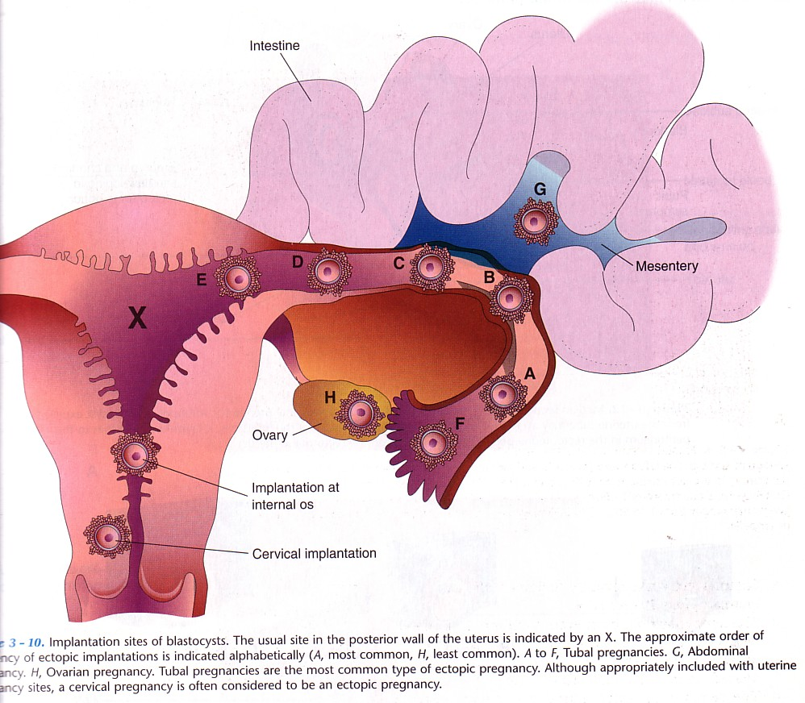
Ectopic Implantation (Pregnancy)
The usual site of implantation is the posterior wall of the body of uterus (X).
Tubal pregnancy is the most common type of ectopic pregnancy (A).
Ovarian pregnancy is the least common type of ectopic pregnancy (H).

Slide 19
BILAMINAR DISC
It is The differentiation of the cells into Two layers :
(A) Epiblast
High columnar cells adjacent to the amniotic cavity.
(B) Hypoblast
Small cuboidal cells adjacent to
Yolk sac.

Slide 20
TRILAMINAR DISC
Now the embryonic disc is formed of 3 layers :
Embryonic Ectoderm
Intraembryonic Mesoderm.
Embryonic Endoderm.
Cells in these layers will give rise to all tissues and organs of the embryo.

Slide 21
Reference :
MOORE PERSAUD “ THE DEVELOPING HUMAN” Clinically Oriented Embryology. 7th edition

Slide 22
Thank you

