Slide 1
CONNECTIVE TISSUE (C.T.)
Objectives:
By the end of this lecture, the student should be able to:
Enumerate the general characteristics of C.T.
Classify C.T. into C.T. proper (C.T.P.) and special types of C.T.
Describe components of C.T.P.
Classify C.T.P.
Describe the structure, distribution, and function of different types of C.T.P.
Enumerate the functions of C.T.
Understand the following clinical applications:
Edema.
Tumors of adipose tissue.

Slide 2
DEFINITION OF C.T.
It is one of the 4 basic tissues.
It is mesodermal in origin.
It supports, binds, and connects other tissues and organs providing structural and metabolic support for them.
General Characteristics of C.T.
C.T. is formed of widely separated, few cells with abundant extracellular matrix.
Most C.T. are vascular.

Slide 3
COMPONENTS & TYPES OF CONNECTIVE TISSUE
Components of C.T.
Cells: different types.
Fibers: collagenous, elastic & reticular.
Matrix: the intercellular substance, in which cells and fibers are embedded.
Soft
Rigid (firm, rubbery)
Hard (solid)
Fluid (liquid)
Types of C.T.
C.T. Proper
Cartilage
Bone
Blood

Slide 4
Components of Connective Tissue Proper
Components of C.T. Proper:
Cells.
Fibers.
Matrix.

Slide 5
(A) Cells
1- Fibroblasts.
2- Macrophages.
3- Mast cells.
4- Plasma cells.
5- Adipose cells (Adipocytes, Fat cells).
6- Leucocytes.

Slide 6
1- Fibroblasts
L/M:
Most common cell; found nearly in all types of C.T. proper.
Flat branched cells (spindle-shaped) with basophilic cytoplasm.
They can divide.
Old fibroblasts are called fibrocytes.
Function:
Formation of proteins of C.T. fibers.
Formation of C.T. matrix.
Healing of wounds.

Slide 7
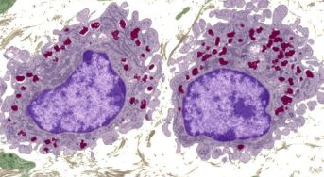
2- Macrophages
L/M:
Basophilic cytoplasm, rich in lysosomes.
Irregular outlines.
They can divide.
They originate from blood monocytes.
Function:
Phagocytosis.

Slide 8
3- Mast Cells
L/M:
Cytoplasm contains numerous basophilic cytoplasmic granules.
Function:
Secrete heparin (anticoagulant).
Secrete histamine (allergic reactions).

Slide 9
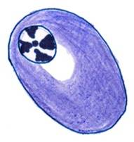
4- Plasma Cells
L/M:
Basophilic cytoplasm with a negative Golgi image.
Nucleus: spherical, eccentric with a clock-face appearance of chromatin.
Derived from B-lymphocytes.
Function:
Secretion of antibodies (immunoglobulins).

Slide 10
5- Adipose Cells (Adipocytes, Fat Cells)
Two types: unilocular and multilocular.
L/M of Unilocular Adipose Cells:
Large, spherical, with a single large fat droplet.
Thin rim of cytoplasm at the periphery.
Nucleus: flattened, peripheral.
Function: Synthesis, storage and release of fat.
L/M of Multilocular Adipose Cells:
Small cells with multiple, small lipid droplets.
Nucleus: spherical, not flattened.
Function: production of body heat because of their large number of mitochondria.

Slide 11
6- Leucocytes (White Blood Cells)
Appear normally in C.T. proper.
Neutrophils increase in acute inflammation.
Lymphocytes and monocytes increase in chronic inflammation.
Eosinophils and basophils increase in allergic inflammation.

Slide 12
(B) Fibers
1- Collagen Fibers (made of collagen type I):
Non-branched fibers, arranged in bundles.
Acidophilic.
2- Reticular Fibers (made of collagen type III):
Branch and form a network.
Stained black with silver.
N.B. Other important types of collagen include: type II (in cartilage). type IV (in basement membranes)
3- Elastic Fibers (made of elastin):
Branched.
Stained brown with orcein.

Slide 13
Types of Connective Tissue Proper
Types of C.T. Proper:
Loose (Areolar) C.T.
Dense Collagenous C.T.
Elastic C.T.
Reticular C.T.
Adipose Tissue.

Slide 14
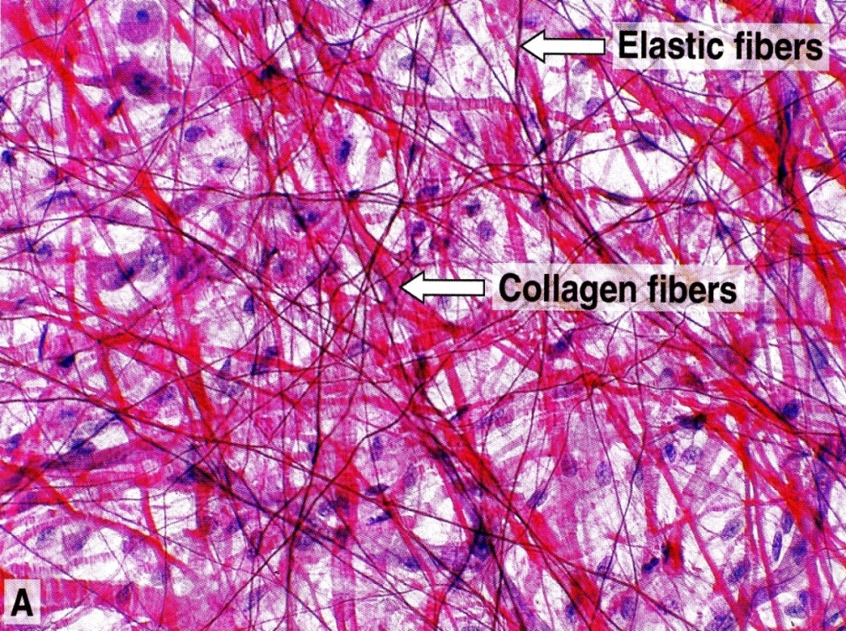
I- LOOSE (AREOLAR) C.T.
The most common type of C.T. proper.
L/M:
Contains all the main components of C.T.P.: all types of C.T. cells & fibers + abundant matrix.
No predominant element in loose C.T.
Sites:
e.g. Subcutaneous tissue.

Slide 15
II- DENSE COLLAGENOUS C.T.
L/M:
Predominance of collagen fibers + fibroblasts.
Sites:
1- Dense regular: e.g. tendons, ligaments.
2- Dense irregular: e.g. dermis of the skin, capsules.
Function: tough tissue; resistant to stretch.
1
2

Slide 16
III- ELASTIC TISSUE
L/M:
Predominance of elastic fibers (sheets or membranes) + fibroblasts.
Sites:
Large arteries, e.g. Aorta
Function: elastic tissue; stretchable.

Slide 17
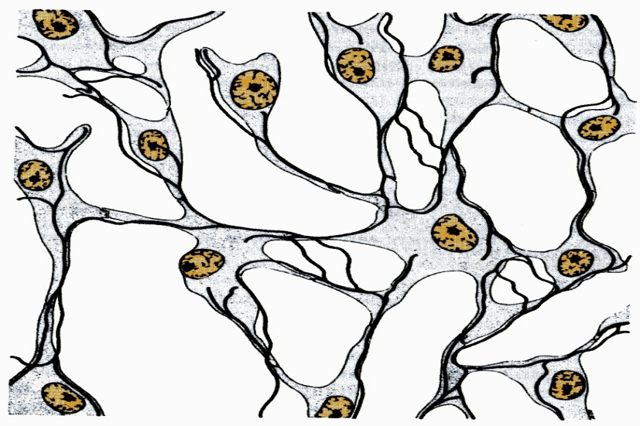
IV- RETICULAR TISSUE
L/M:
Predominance of reticular fibers + reticular cells (specialized fibroblasts).
Sites:
Stroma of organs: e.g. liver, lymph node, spleen.
Function: structural support.

Slide 18
V- UNILOCULAR ADIPOSE TISSUE (WHITE ADIPOSE TISSUE)
L/M:
Predominance of unilocular fat cells.
Sites:
Subcutaneous tissue, especially in:
Buttocks.
Abdominal wall.
Female breast.
Around the kidney.
Function:
Synthesis, storage, & release of fat.
Supports organs, e.g. kidney.
Heat insulation.

Slide 19
Functions of Connective Tissue Proper
Supports, binds, and Connects other tissues and organs.
Nourishes the surrounding structures, through its blood vessels.
Its Cells provide healing of injured tissues, produce heparin, histamine & antibodies, store fat & preserve body temperature and protect against microorganisms.
Its Fibers provide rigidity or elasticity.

Slide 20
Clinical Applications
Edema:
Under normal circumstances, extracellular fluid returns to the blood capillaries or enters lymph vessels to be returned to the blood.
Inflammation causes accumulation of excess tissue fluid within loose connective tissue beyond what can be returned via the capillaries and lymph vessels. This results in gross swelling, or edema, in the affected area.
Edema can also result from obstruction of venous or lymphatic vessels.

Slide 21
Clinical Applications
Tumors of adipose tissue:
Tumors of adipose tissue may be benign or malignant. They may form anywhere in the body.
Lipomas are common benign tumors of adipocytes.
Liposarcomas are malignant tumors of adipocytes.
The tumor cells may resemble either unilocular adipocytes or multilocular adipocytes.

Slide 22
References & Resources
For Theoretical:
Textbook of Histology, Leslie P. Gartner. 4th Edition.
For Practical:
Di Fiore’s Atlas of Histology, Victor P. Eroschenko. 12th Edition.

Slide 23
Thank you

