Slide 1
PATHOLOGY Chapter: CELL INJURY [Topics in 3 lectures: cell injury, free radical injury, necrosis and apoptosis, cellular accumulations, pathological calcification, adaptation to cell injuries] (lecture 1)
Notes:
‹#›

Slide 2
Objectives for Cell Injury Chapter (in 3 lectures)
The students should:
Understand the concept of cells and tissue adaptation to environmental stress including the meaning of hypertrophy, hyperplasia, aplasia, atrophy, hypoplasia and metaplasia with their clinical manifestations.
Is aware of the concept of hypoxic cell injury and its major causes.
Understand the definitions and mechanisms of free radical injury.
Knows the definition of apoptosis, tissue necrosis and its various types with clinical examples.
Able to differentiate between necrosis and apoptosis.
Understand the causes of and pathologic changes occurring in fatty change (steatosis), accumulations of exogenous and endogenous pigments (carbon, silica, iron, melanin, bilirubin and lipofuscin).
Understand the causes of and differences between dystrophic and metastatic calcifications.

Slide 3
Lecture 1 outline
Adaptation to environmental stress/cell injury: hypertrophy, hyperplasia, atrophy, squamous metaplasia, osseous metaplasia and myeloid metaplasia.
Cell injury
Hypoxic cell injury and its causes (ischaemia, anaemia, carbon monoxide poisoning, decreased perfusion of tissues by oxygen, carrying blood and poor oxygenation of blood).
Free radical injury: definition of free radicals, mechanisms that generate free radicals, mechanisms that degrade free radicals.
Reversible and irreversible cell injury

Slide 4
CELLULAR ADAPTATION
Adaptations are reversible changea in response to changes in the cells environment.
Physiologic adaptations: usually represent responses of cells to normal stimulation by hormones or endogenous chemical mediators the hormone-induced enlargement of the breast during pregnancy or to the demands of mechanical stress (in the case of muscles).
Pathologic adaptations are responses to stress that allow cells to modulate their structure and function and thus escape injury, but at the expense of normal function, such as squamous metaplasia of bronchial epithelium in smokers.

Slide 5
The intracellular milieu of cells is normally tightly regulated such that it remains fairly constant, a state referred to as homeostasis. As cells encounter physiologic stresses (such as increased workload in the heart) , they can undergo adaptation, achieving a new steady state and preserving viability and function.
If the adaptive capability of the cell is exhausted or if the external stress is too harmful, cell injury develops.
Within certain limits injury is reversible and cells return to normal.
But, in severe or persistent stress the injury becomes irreversible and leads to cell death.

Slide 6
CELLULAR ADAPTATIONS TO STRESS
Cells are constantly adjusting/adapting their structure and function to accommodate changing demands.
When cells face physiologic or pathologic stress/stimuli, they undergo adaptation.
The principal adaptive responses are
hypertrophy,
hyperplasia,
atrophy,
metaplasia.

Slide 7
Hypertrophy
Hypertrophy is an increase in the size of cells resulting in an increase in the size of the organ
Stated another way, in pure hypertrophy there are no new cells, just bigger cells containing increased amounts of structural proteins and organelles.
hypertrophy occurs when cells have a limited capacity to divid.
Hypertrophy can be physiologic or pathologic and is caused either by increased functional demand or by growth factor or hormonal stimulation:
Physiological:
the skeletal muscles undergo only hypertrophy in response to increased demand by exercise. (weightlifter.)
The massive enlargement of the uterus during pregnancy occurs as a consequence of estrogen stimulated smooth muscle hypertrophy
Pathologic:
Cardiomyocytes are cells of the heart (myocardium), they undergo hypertrophy in hypertension or aortic valve disease).

Slide 8
Hypertrophy
Hypertrophy of skeletal muscle fibers. Taken at the same magnification (a) shows transverse section of skeletal muscle fibers with no hypertrophy and (b) shows skeletal muscle fibers with hypertrophy (notice the increase in size of the fibers).

Slide 9
Hyperplasia
Is an increase in the number of cells
It may lead to an increase in the size of an organ/ tissue.
Hyperplasia takes place if the tissue contains cell populations capable
of replication; it may occur concurrently with hypertrophy and often in
response to the same stimulus
Hyperplasia can be physiologic or pathologic.
A) Physiologic hyperplasia are of two types
Hormonal hyperplasia e.g. the proliferation of the glands of the female breast at puberty and during pregnancy
Compensatory hyperplasia e.g. when a portion of liver is partially resected, the remaining cells multiply and restore the liver to its normal size
B) Pathologic hyperplasia is caused by abnormal excessive stimulation of cells by hormones or growth factors e.g. excess estrogen hormone leads to endometrial hyperplasia in the uterus which causes abnormal menstrual bleeding.

Slide 10
Hyperplasia
An important point is that in all of these situations, the hyperplastic process remains controlled; if the signals that initiate it abate, the hyperplasia disappears.
It is this responsiveness to normal regulatory control mechanisms that distinguishes pathologic hyperplasia from cancer, in which the growth control mechanisms become permanently dysregulated or ineffective .
Nevertheless, in many cases, pathologic hyperplasia constitutes a fertile soil in which cancers may eventually arise. For example, patients with hyperplasia of the endometrium are at increased risk of developing endometrial cancer.

Slide 11
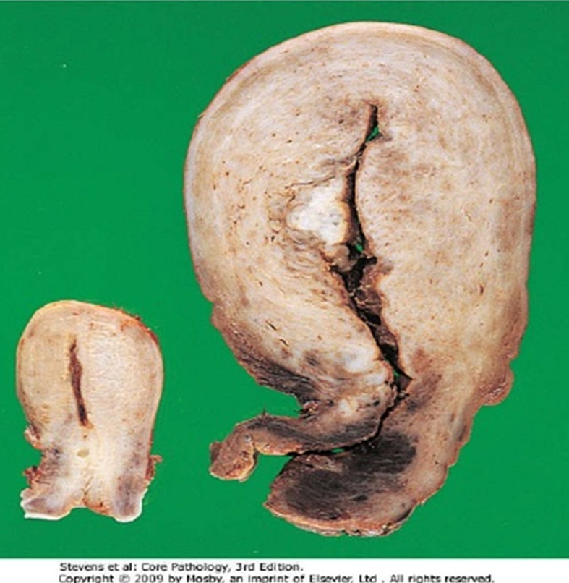
Hypertrophy and hyperplasia of uterus during pregnancy
Hypertrophy and hyperplasia of uterine smooth muscle layer (myometrium) during pregnancy.
On the left: is a normal uterus normal myometrium thickness.
On the right: is the uterus of a recently pregnant woman in which there is marked increase in the myometrial thickness. This is due to the hypertrophy and hyperplasia of uterine myometrium.

Slide 12
Atrophy
Atrophy is shrinkage in the size of cells.
A reduced demand on cells can lead to atrophy.
When a sufficient number of cells are involved, the entire organ decreases in size, becoming atrophic.
Atrophic cells are not dead but have diminished function. In atrophic cells there is decreased protein synthesis and increased protein degradation.
Causes of atrophy include
decreased workload or disuse (e.g. immobilization of a limb in fracture),
loss of innervation (lack of neural stimulation to the peripheral muscles caused by injury to the supplying nerve causes atrophy of that muscle)
diminished blood supply,
inadequate nutrition
loss of endocrine stimulation (e.g. the loss of hormone stimulation in menopause)
aging: senile atrophy of brain can lead to dementia.
Some of these stimuli are physiologic (the loss of hormone stimulation in menopause) and others pathologic (denervation)

Slide 13
Metaplasia
Certain types of cells are extra sensitive to a particular toxic agent or environment. When they get exposed to that agent or environment they get replaced by another type of cell which is better able to tolerate that toxic agent or environment. This is known as metaplasia.
In metaplasia the cells adapt by changing (or differentiating) from one type of cell into another type of cell. Metaplasia is usually a reversible provided the causative toxic agent is removed.
Examples include:
Squamous metaplasia
Columnar cell metaplasia
Osseous metaplasia
Myeloid metaplasia

Slide 14
Metaplasia 1) Squamous metaplasia
In squamous metaplasia, the columnar cells are replaced by squamous cells. Examples of squamous metaplasia are seen in:
the respiratory tract: the columnar cells lining the bronchus are replaced by squamous cells following chronic injury in smokers. The squamous epithelium is able to survive the toxicity of tobacco better than the columnar epithelium. Although the metaplastic squamous epithelium will survive better, the important protective functions of columnar epithelium are lost, such as mucus secretion and ciliary action.
the cervix at the squamocolumnar junction: columnar cells are replaced by squamous cells following chronic irritation and inflammation.
If the causative agent persists, it may predispose to or provide a platform for cancer to develop. In fact, it is thought that cigarette smoking initially causes squamous metaplasia and later squamous cell cancer arise from it.
Similarly squamous cell carcinoma of cervix may arise from the squamous metaplasia of cervix.

Slide 15
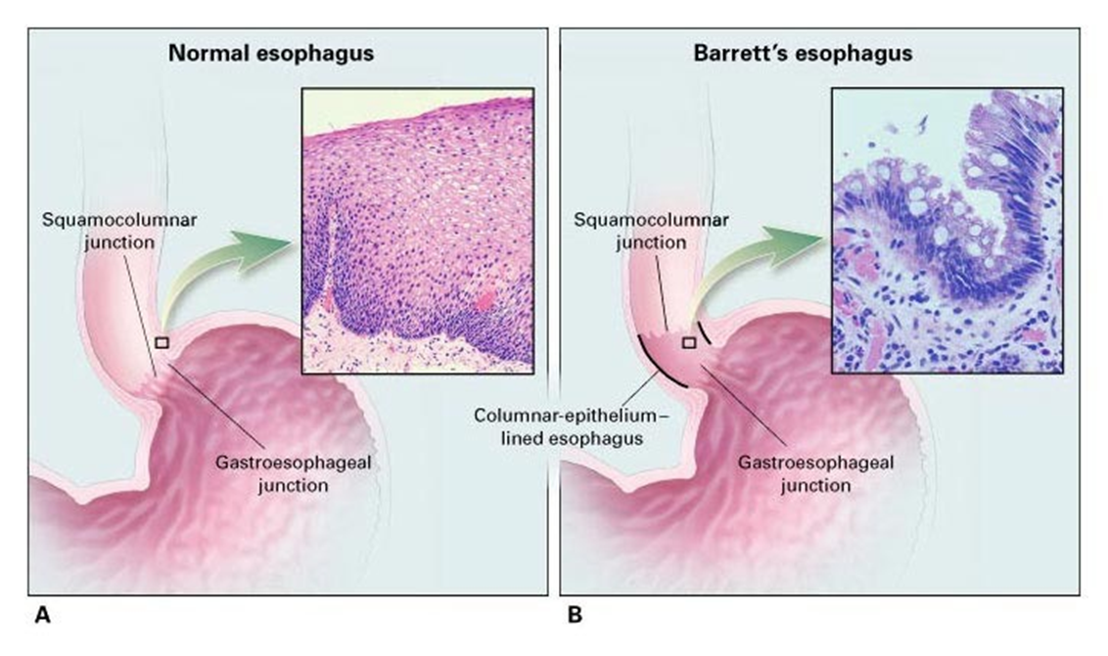
Metaplasia
2) Columnar cell metaplasia: it is the replacement of squamous cells by columnar cells. It is seen in the esophagus in chronic gastro-esophageal acid reflux disease. The normal stratified squamous epithelium of the lower esophagus cannot handle the acidity of reflux disease and undergoes metaplastic transformation to columnar epithelium. This change is called as Barrett’s oesophagus and it can be precancerous and lead to development of adenocarcinoma of esophagus.
N Engl J Med 2002; 346:836-842 DOI: 10.1056/NEJMcp012118

Slide 16
Metaplasia
3) Osseous metaplasia: it is the formation of new bone at sites of tissue injury. Cartilagenous metaplasia may also occur.
4) Myeloid metaplasia (extramedullary hematopoiesis): is the proliferation of hematopoietic tissue in sites other then the bone marrow such as liver or spleen.

Slide 17
SUMMARY

Slide 18
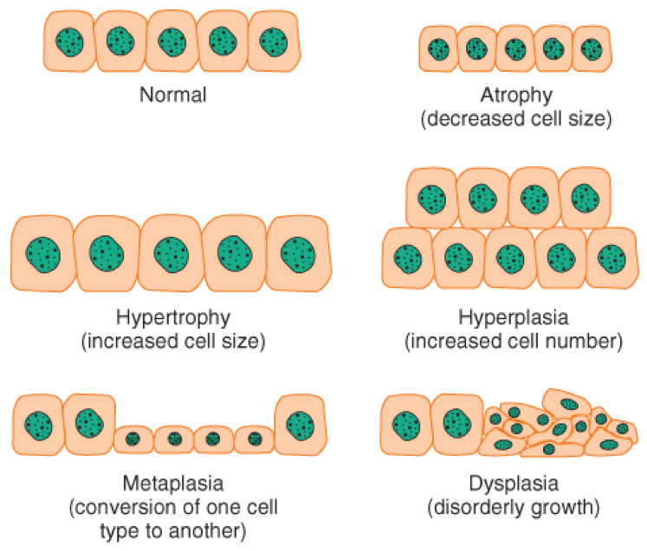
https://o.quizlet.com/nlCsBzEqK1bNJCyLHl12QA_b.png

Slide 19
NOTE: the term “hypoplasia” and “aplasia” are not adaptations
Hypoplasia refers to an organ that does not reach its full size. It is a developmental disorders and not an adaptive response.
Aplasia is the failure of cell production and it is also a developmental disorders e.g. during fetal growth aplasia can lead to agenesis of organs.

Slide 20
CELL INJURY

Slide 21
Normal cell
Stress/increased
demand
Adaptation e.g. hypertrophy
Injurious stimuli
e.g. hypoxia
Unable to adapt
Cell injury
No more injurious stimuli
Persistent or
strong injurious stimuli
injury is reversible
2 possibilities
tissue repair but with diminished capacity 🡪 impaired cell function
injury becomes irreversible 🡪cell death (necrosis or apoptosis)
complete repair
Cells/ tissue back to normal
Restoration of normal organ function.

Slide 22
CELL INJURY
When the cell is exposed to an injurious agent/stress/stimulus, and it leads to injury of the cell, it is termed cell injury.
Cell injury is reversible up to a certain point, but if the stimulus persists or is severe from the start, the cell reaches a point of no return and suffers irreversible cell injury and ultimately cell death.
Cell death is death of a cell as a result of cell injury.
There are two principal patterns of cell death, necrosis and apoptosis.
CELL DEATH
Necrosis is the type of cell death that occurs due to disease, injury, or failure of the blood supply (ischemia) and it is always pathologic.
Apoptosis occurs when a cell dies through activation of an internally controlled suicide program.
Notes:
‹#›

Slide 23
Causes of Cell Injury
Causes of injury (are the same for both reversible and irreversible ):
1) Oxygen Deprivation (hypoxic cell injury). It is a common cause of cell injury and cell death. Hypoxia can be due to:
Ischemia (obstruction of arterial blood flow), E.g. in myocardial infarction and atherosclerosis.
Inadequate oxygenation of the blood e.g. lung disease and carbon monoxide poisoning
Decreased oxygen-carrying capacity of the blood e.g. anemia
Inadequate tissue perfusion due to cardiorespiratory failure, hypotension, shock etc
Also some cell types are more vulnerable to hypoxic injury then others e.g. neurons are most susceptible followed by cardiac muscle, hepatocytes and then skeletal muscles.
Notes:
‹#›

Slide 24
Causes of Cell Injury cont.
2)Physical Agents e.g. mechanical trauma, burns and deep cold, sudden changes in atmospheric pressure, radiation, and electric shock
3) Toxins. Potentially toxic agents are encountered daily
in the environment; these include air pollutants, insecti cides, CO, asbestos, cigarette smoke, ethanol, and drugs
4)Infectious Agents
5) Immunologic agents e.g. thyroid damage caused by autoantibodies.
6) Genetic Derangements eg sickle cell anemia.
7) Nutritional Imbalances
8) Aging
Notes:
‹#›

Slide 25
MECHANISM OF CELL INJURY
Depletion of ATP
Cell membrane damage/defects in membrane permeability:
Mitochondrial damage:
It is seen specially in hypoxic injury and cyanide poisoning.
Ribosomal damage:
It is seen in alcohol damage of liver cells and with antibiotic use.
Nuclear and DNA damage:
Influx of intracellular calcium leading to loss of normal calcium balance: ischemia causes an increase in intracellular calcium concentration. Increased Ca2+ in turn activates a number of enzymes which cause damage.
Free radical injury: see details in the next 2 slides
Notes:
‹#›

Slide 26
Free radical injury
Free radical injury (oxidative stress): is due to excess accumulation of oxygen-derived free radicals Free radicals: are highly reactive and harmful atoms that have a single unpaired electron in the outer orbit. These atoms are called reactive oxygen species/free radicals. The free radicals are produced in our cells by various mechanisms (called free radical generating systems). They are produced by:
Normal metabolism/ respiration: produce free radicals as a bi-product of mitochondrial respiration during normal respiration (reduction-oxidation reactions that occur in normal metabolism).
Ionizing radiation injury e.g. UV light, x-rays result in production of free radicals.
Chemical toxicity: enzymatic metabolism of exogenous chemicals or drugs produce free radicals.
Oxygen therapy and reperfusion injury produce free radicals.
Immune response or inflammation (neutrophilic oxidative burst)
Transition metals such as iron and copper can trigger production of free radicals.
The names of the common free radicals are:
superoxide anion radical (O2-),
hydrogen peroxide (H2O2),
and hydroxyl ions (OH).
Nitric oxide (NO) is an important chemical mediator generated by various cells and it can also act as a free radical.
Notes:
‹#›

Slide 27
Free radical injury contd.
Free radicals cause damage to lipids, proteins, and nucleic acids:
Lipids: lipid peroxidation of membranes 🡪 damage of cell membranes & organelles etc.
Proteins: oxidative modification of proteins🡪 protein fragmentation.
Nucleic acid: DNA damage🡪 cell aging & malignant transformation of cells.
How does our body fight the free radicals? Certain substances in the cells remove or inactivate the free radicals in order to minimize injury caused by them. They are called “free radical scavenging system”. These substances are:
Antioxidants: e.g. vitamins E, A and C (ascorbic acid).
Enzymes: which break down hydrogen peroxide and superoxide anion e.g. Catalase, Superoxide dismutases, Glutathione peroxidase and mannitol.
NOTE: Any imbalance between free radical-generating and radical-scavenging systems results in oxidative stress causing cell injury.
Notes:
‹#›

Slide 28
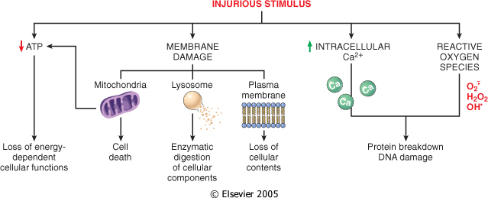
Cellular and biochemical sites of damage in cell injury.
Downloaded from: Robbins & Cotran Pathologic Basis of Disease (on 4 September 2005 02:13 PM)
© 2005 Elsevier
Notes:
‹#›

Slide 29
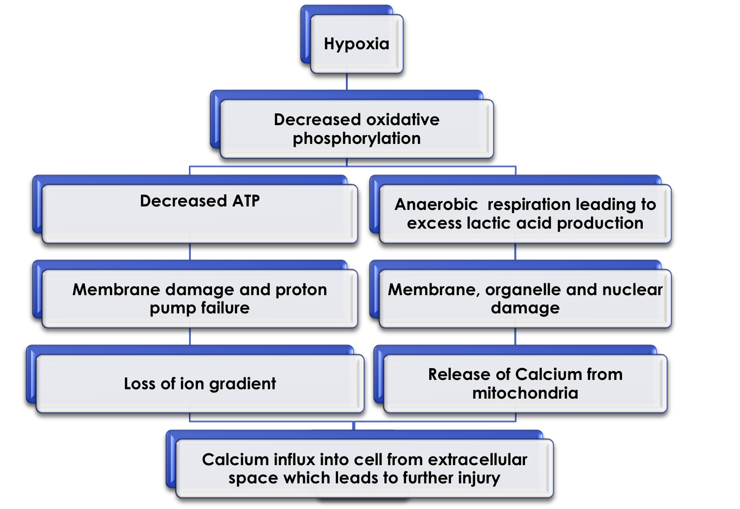
Mechanism in hypoxic cell injury

Slide 30
Reversible Cell Injury:
Cell injury can be reversible or irreversible.
The type of injury, the time duration of injury and the severity of injury will determine the extent of cell damage i.e. whether the injury is reversible or irreversible.
Reversible Cell Injury: initially cell injury is reversible. If the injurious stimulus is
removed the damage can be reversed.
The two main morphologic correlates of reversible cell injury are cellular swelling and fatty change.
• Cellular swelling is commonly seen in cell injury associated with increased permeability of the plasma membrane.
Microscopic examination may show small, clear vacuoles within the cytoplasm; these represent
distended and pinched-off segments of the endoplasmic reticulum (ER).This pattern of nonlethal injury is sometimes called
hydropic change or vacuolar degeneration.
• Fatty change is manifested by the appearance of triglyceride
containing lipid vacuoles in the cytoplasm. It is principally
encountered in organs that are involved in lipid metabolism,
such as the liver.
The cytoplasm of injured cells also may become redder
(eosinophilic
Notes:
‹#›

Slide 31
Other intracellular changes associated with cell injury include
1-plasma membrane alterations
2- mitochondrial changes such as swelling
3- dilation of the ER with detachment of ribosomes and dissociation of polysomes;
4- nuclear alterations, such as clumping of chromatin.
The cytoplasm may contain so-called “myelin figures,” which are collections of phospholipids resembling myelin sheaths that are derived from damaged cellular membranes.

Slide 32
Irreversible Cell Injury
Persistent or excessive injury causes cells to pass into irreversible injury. Irreversible injury is marked by
severe mitochondrial damage with the appearance large, amorphous densities in mitochondria.
Severe plasma/cell membrane damage
Increased eosinophilia
Numerous myelin figures
Rupture of lysosomes leakage and enzymatic digestion of cellular contents
Nuclear damage:
pyknosis (shrinkage),
karyolysis (dissolution)
karyorrhexis (break down or fragmentation)

Slide 34
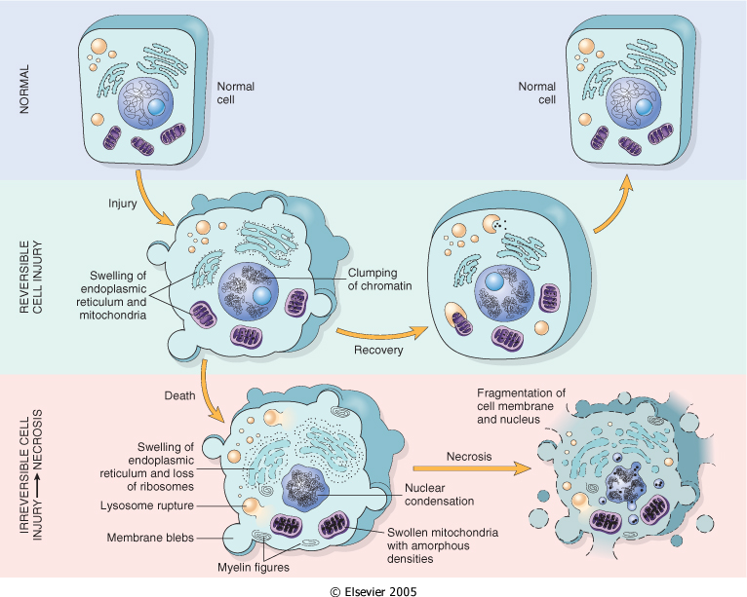
n
Downloaded from: Robbins & Cotran Pathologic Basis of Disease (on 4 September 2005 10:51 AM)
© 2005 Elsevier
Notes:
‹#›

