Slide 1





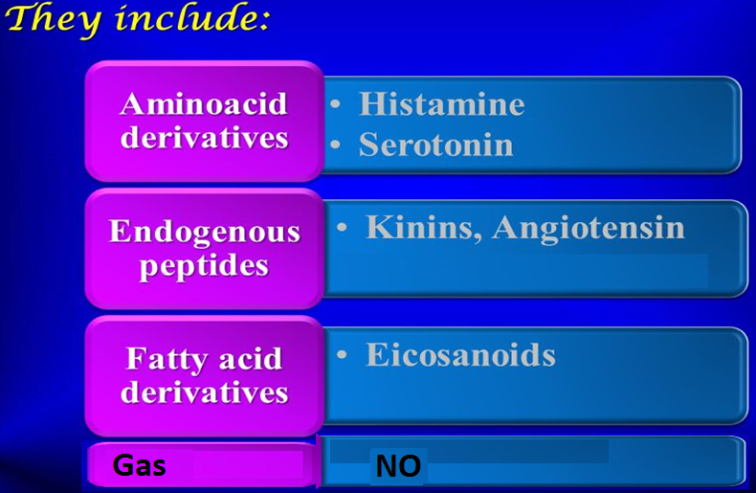
Autacoids
WINTER
Self remedy
They have autocrine or paracrine effects
Template
Produced locally, act locally & metabolized locally
Paracrine
Have different biological actions including modulation of the activity of smooth muscles, glands, nerves, platelets & other tissues.
Autocrine
Notes:
Are endogenous chemical signals exerts multiple physiological effects either locally or within a the specified organ or paracrine factors. An autacoid (molecule secreted locally to increase or decrease the activity of nearby cells)
When these autacoids released by various stimuli they can produce physiological or pathological effects in various parts of the body.
Their function as neurotransmitter & neuromodulator, & immunomodulators

Slide 2
Autacoids
WINTER
ILOS
Template
To describe the synthesis, receptors & functions of histamine, 5-HT, eicosanoids, nitric oxide, angiotensin, & kinins
To study the agents which enhance or block their effects.
Notes:
Intended Learning Outcomes

Slide 3
1- Histamine

Slide 4
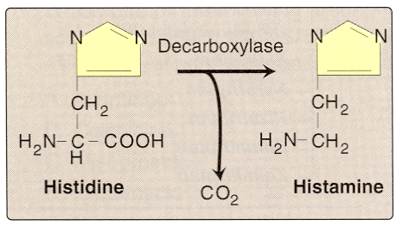
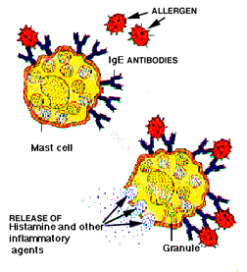
Histamine
Synthesis:- from L- histidine
Stored in mast cells, basophils, lung, intestinal mucosa
Release:- during allergic reaction, inflammatory reaction
Notes:
Hist is synthesized from the aa L histidine
Hist is an important mediator of immediate allergy like urticaria n inflammatory rx
Most tissue histamine is sequestered & bound in granules (vesicles) in mast cells or basophils

Slide 5
Histamine receptors
Receptor Type | Major Tissue Locations | Major Biologic Effects
H₁ | Smooth muscle, Endothelial cells, Brain | Acute allergic responses
H₂ | Gastric parietal cells, Cardiac muscle, Mast cells, Brain | Secretion of gastric acid & increase in *COP
H₃ | Central nervous system | Neurotransmission
H₄ | Mast cells, Eosinophils, T-cells | Regulating immune responses
* COP: cardiac output
Notes:
Strong evidence implicates endogenous NT histamine in many brain functions such as neuroendocrine control, cardiovascular regulation,
thermal & body weight regulation, sleep & arousal.
Nervous system—Histamine is a powerful stimulant of sensory nerve endings, especially those mediating pain and itching.
This H1-mediated effect is an important component of the urticarial response & reactions to insect & nettle stings.
Cardiovascular system—In humans, injection or infusion of histamine causes a decrease in systolic & diastolic BP & an increase in HR.
The BP changes are caused by the direct vasodilator action of histamine on arterioles & precapillary sphincters; the increase in heart rate involves both stimulatory actions of histamine on the heart & a reflex tachycardia.
Flushing, a sense of warmth, & headache may also occur during histamine administration, consistent with the vasodilation. The decrease in BP is usually accompanied by a reflex tachycardia.

Slide 6
Actions
Histamine stimulates gastric acid secretion, through H2- receptors
Stimulation of H1-receptors contract smooth muscles, bronchioles, uterus
Increases bowel peristalsis
Notes:
involuntary movements of the longitudinal & circular muscles, primarily in the digestive tract.

Slide 7
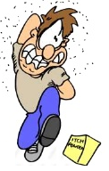
Actions of histamine
Slow IV or SC injection causes flushing of skin, raise temperature, edema, increase blood flow to the periphery, increase heart rate & COP (through increasing Ca²⁺ influx)
Rapid IV bolus injection induces a fall in blood pressure, headache, due to dilation of blood vessels
Intradermal injection causes itching.
Notes:
Histamine is a natural VD
Histamine is a component of some venoms & stinging secretions.

Slide 8
Histamine receptor blockers
WINTER
Physiological antagonist: epinephrine
Template
Histamine h1 receptor antagonists :
First generation
Diphenhydramine, Promethazine
Second generation
Cetirizine, Fexofenadine.
Notes:
Injection of epinephrine can be lifesaving in systemic anaphylaxis & in other conditions in w massive release of hist occurs
These drugs competitively block & bind to histamine H1 R

Slide 9

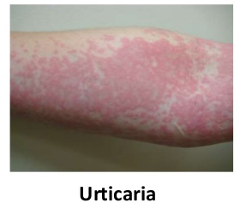
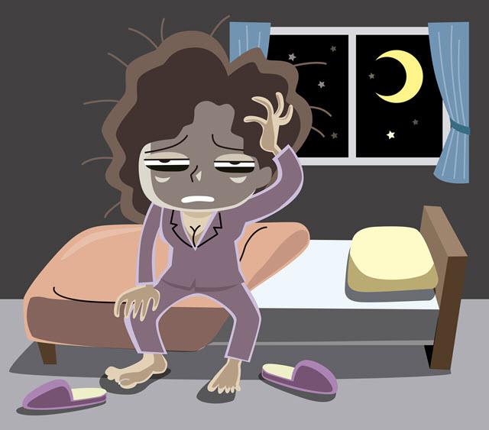

Histamine H1 receptor blockers
First generation
Has a sedating effect
Clinical uses:
Allergic rhinitis
Urticaria
Insomnia
Motion sickness
Notes:
The first-generation H1-receptor antagonists have many actions in addition to blockade of the actions of histamine. The large number of these actions probably results from the similarity of the general structure to the structure of drugs that have effects at muscarinic cholinoceptor, a adrenoceptor, serotonin, & local anesthetic receptor sites. Some of these actions are of therapeutic value & some are undesirable.
On vasculature: 1- Antihist block histamine vasoD, capillary permeability & edema
2- Antialllergic: they relieve urticarial itching, angioedema
3- The effect is sufficiently prominent with some agents to make them useful as “sleep aids” & unsuitable for daytime use.
Urticaria: hives, skin rash
4- Antinausea, & antiemetic actions—Several first-generation H1 antagonists have significant activity in preventing motion sickness. They are less effective against an episode of motion sickness already present.
Motion sickness: The antihistaminic drugs with the greatest effectiveness in this application are diphenhydramine & promethazine.

Slide 10
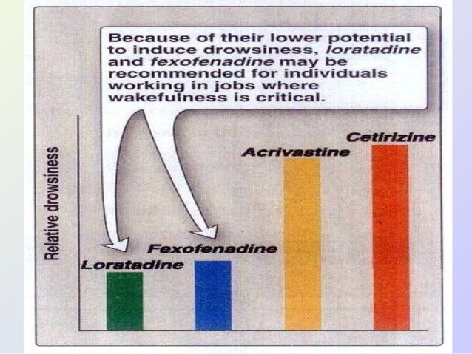
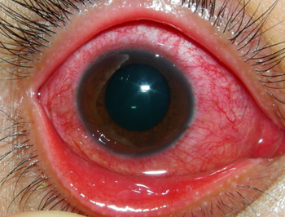
Histamine H1 receptor blockers
Second generation
Non-sedating effect
Clinical uses
Allergic conditions such as:-
Allergic rhinitis
Conjunctivitis
Urticaria.
Notes:
Second-generation H1 blockers are less sedating, owing in part to reduced distribution into the CNS
Loratadine :2nd generation
Conjunctivitis: pinkeye. The conjunctiva is the thin clear tissue that lies over the white part of the eye & lines the inside of the eyelid. Due to irritation, allergy, bacteria or virus infections

Slide 11
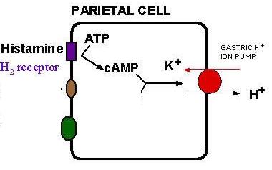
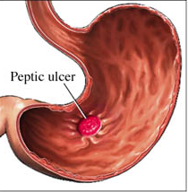
H2- receptor blockers
Histamine plays an important role in the formation & secretion of HCl by the activity of H2 receptors
Blockers of H2 receptors inhibit gastric acid secretion
e.g. Cimetidine & Ranitidine
Used for treatment of:
Gastritis
Peptic ulcers
Notes:
Improved receptor selectivity has stronger therapeutic activity
Drugs that blocked acid secretion & had no H1 agonist or antagonist effects.
Through activation of H2 receptors, histamine potentiates gastrin-induced acid secretion. H2 receptor activation enhances the production of second messenger adenosine monophosphate (cAMP) by adenyl cyclase. As you can see in the figure, the other molecules involved in gastric hydrochloric acid secretion are gastrin & Ach. H2 blockers, such as ranitidine, are drugs commonly used in the treatment of ulcers and heartburn.
Histamine Rs are G protein-coupled receptors. increase adenylyl cyclase activity, cAMP concentration, & intracellular Ca2+ concentration histamine is mediated by activation of adenylate cyclase & generation of cAMP. Which activates H+ K+ ATPase to pump H that form HCL.

Slide 12

H3- receptor blockers
e.g. Betahistine
It produces dilatation of blood vessels in inner ear
Used in treatment of :
Vertigo of Ménière’s disease & other balance disturbances of vestibular origin
Side effects:
May produce headache & insomnia.
Notes:
Betahistine has a very strong affinity as an antagonist for histamine H₃ receptors (presynaptic) & a weak affinity as an agonist for histamine H₁ receptors.
Betahistine has 2 mechanisms of action. Primarily, it a full agonist on the H₁ receptors located on blood vessels in the inner ear. This gives rise to local vasodilation & increased permeability, which helps to reverse the underlying problem of endolymphatic hydrops.
More importantly, betahistine has a powerful antagonistic effects at H₃ receptors, thereby increasing the levels of neurotransmitters histamine, acetylcholine, norepinephrine, serotonin, & GABA released from the nerve endings. The increased amounts of histamine released from histaminergic nerve endings can stimulate receptors. This stimulation explains the potent vasodilatory effects of betahistine in the inner ear, that are well documented.
Betahistine seems to dilate the blood vessels within the inner ear which can relieve pressure from excess fluid & act on the smooth muscle.
It is postulated that betahistine's increase in the level of serotonin in the brainstem inhibits the activity of vestibular nuclei.
Ménière's disease (MD) is a disorder of the inner ear that is characterized by episodes of feeling like the world is spinning (vertigo), ringing in the ears (tinnitus), hearing loss, & a fullness in the ear.
Insomnia : lack of sleep.

Slide 13
2- Eicosanoids

Slide 14
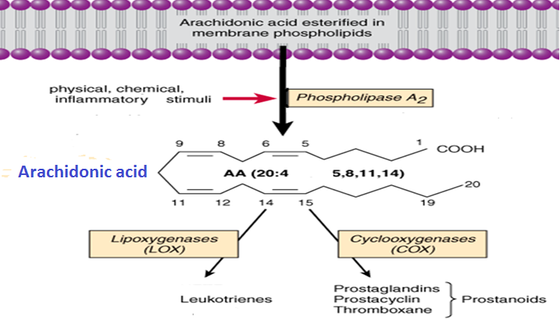
eicosanoids
WINTER
NSAIDS
synthesis
Glucocorticoids
Zileuton
Template
Notes:
AA is a poly unsaturated fatty acid, contains 20 C atoms & 4 double bonds
Then AA is oxygenated by LOX or COX
Eicosanoids are local hormones act in an autocrine or paracrine on cells close to their site of production. (not circulating hormones)
These Eicosanodes that is derived from AA play a role in inflammation, fever promotion, BP regulation & blood clotting & they also influence the immune response, respiratory & reproductive processes.
TXA2 is a potent VC.

Slide 15
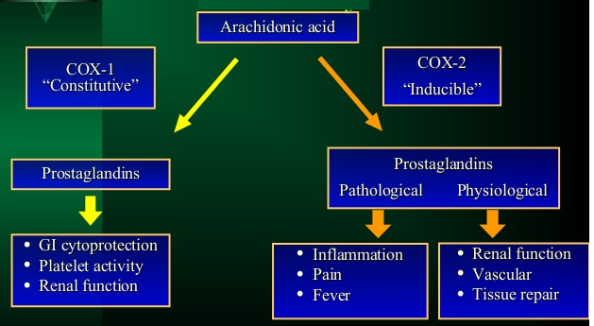
Cox Isozymes
Notes:
There are 2 forms of COX activity: COX1 is expressed constitutively in most cells: gastric mucosa, kidney, platelets, & vascular endothelial cells.
The PGs & TXAs have major effects on smooth muscle in the vasculature, airways, & GI & reproductive tracts. Contraction of smooth muscle is mediated by the release of Ca2+, while relaxing effects are mediated by the generation of cAMP. Many of the eicosanoids’ contractile effects on smooth muscle can be inhibited by lowering extracellular Ca or by using Ca channel-blocking drugs.
COX-2 (PGS-2) is inducible (its expression varies depending on the stimulus) & is expressed in macrophages & monocytes in response to inflammation.
Because of their biologic activity, the eicosanoids, their specific receptor antagonists & enzyme inhibitors, have great therapeutic potential.
Plt: PGE2 affect platelet aggregation (low conc of PGE2 activate & high inhibit) plt aggregation.
Renal: Both the medulla & the cortex of the kidney synthesize prostaglandins. Renal cortical COX-2-derived PGE2 & PGI2 maintain renal blood flow & glomerular filtration rate through their local vasodilating effects. These prostaglandins also modulate systemic BP through regulation of water & Na+ excretion.
Vascular: TXA2 is a potent VC. Vasodilator prostaglandins, especially PGI 2 and PGE2, promote vasodilation by increasing cAMP and decreasing smooth muscle intracellular Ca.

Slide 16
Actions of prostaglandins
They are pro-inflammatory
Cause vasodilatation of vascular smooth muscle
High conc PG inhibits platelets aggregation Low conc PG increases platelet aggregation
Sensitize neurons to cause pain
Induce labor / abortion.

Slide 17
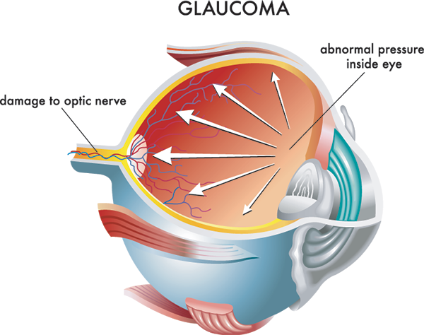
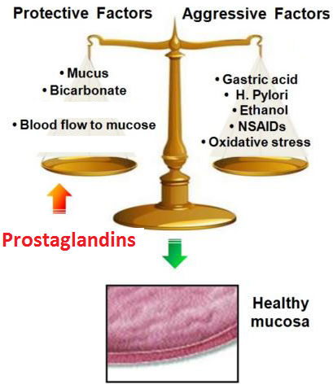
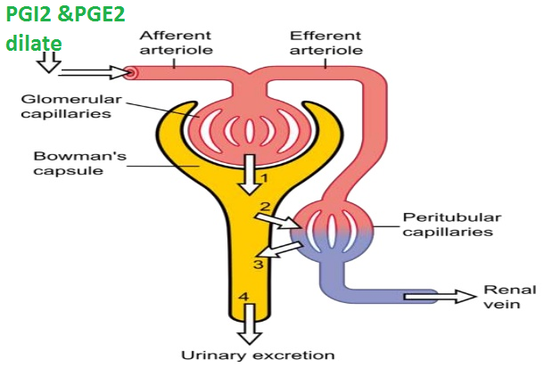
Actions of prostaglandins
Decrease intraocular pressure
Acts on thermoregulatory center of
hypothalamus to ↑ body temperature
Acts on kidney to increase glomerular filtration
Acts on parietal cells of stomach to protect gastric mucosa.
Notes:
On the eye: involves increased outflow of aqueous humor from the anterior chamber

Slide 18
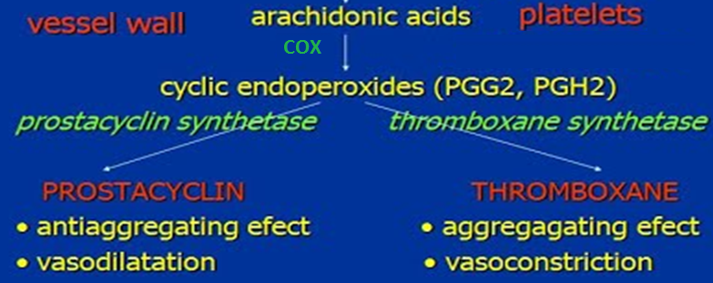
Prostacyclin versus thromboxane

Slide 19
Clinical uses of PGs analogs
WINTER
Carboprost (PGF): Induce abortion in first trimester
Template
Latanoprost (PGF): Glaucoma
Misoprostol (PGE1): Peptic ulcer
Alprostadil (PGE1): Erectile dysfunction
Zileuton (lipoxygenase inhibitor): Asthma
Zafirlukast (leukotriene receptor blocker): Bronchial asthma.
Notes:
Misoprostol, a PGE1 derivative, is a cytoprotective prostaglandin used in preventing peptic ulcer
Latanoprost & several similar compounds are topically active PGF2α derivatives used in ophthalmology to reduce intraocular pressure in open-angle glaucoma or ocular HTN. The mechanism of this action is unclear but probably involves increased outflow of aqueous humor from the anterior chamber via the uveoscleral pathway.
leukotrienes (inflammatory mediators) also promote eosinophil adherence, degranulation, cytokine or chemokine release, & oxygen radical formation.

Slide 20
3- Nitric oxide

Slide 21
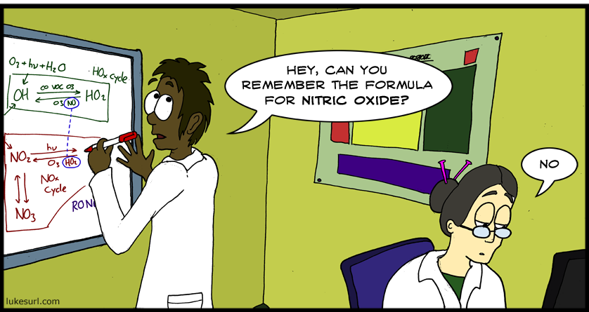
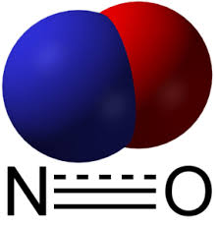
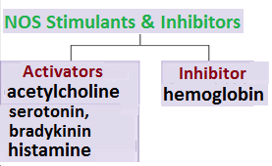
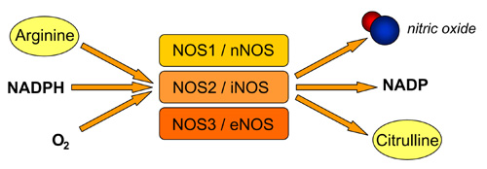
Nitric oxide
Biosynthesis
Synthesized from L- arganine by nitric oxide synthase (NOS)
NO release is stimulated by:
acetylcholine, 5-HT bradykinin & histamine
There are 3 isoforms of the enzyme NOS.
Notes:
Is a gaseous signaling molecule
α-nicotinamide adenine dinucleotide phosphate (NADPH).

Slide 22
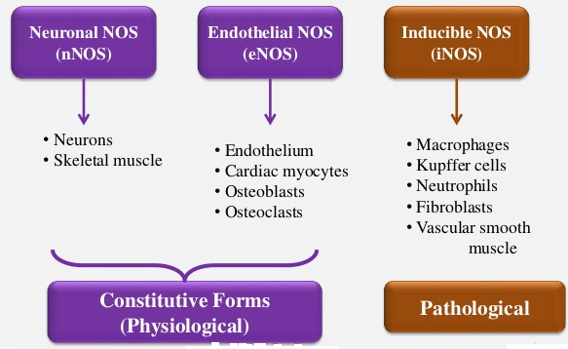
Isoforms of nos
Notes:
NO, is a highly reactive signaling molecule that is made by any of three closely related NO synthase
This mediator is very important in the CNS, NT function depends on NO release
Is synthesised on demand, NO is synthesized on demand & is neither stored in synaptic vesicles nor released by exocytosis, but simply diffuses from nerve terminals.
Kupffer cells: specialized macrophages located in the liver, Kupffer cells (KC) constitute 80-90% of the tissue macrophages present in the body. They reside within the lumen of the liver sinusoids, & are therefore constantly exposed to gut-derived bacteria, microbial debris & bacterial endotoxins, known to activate macrophages.
treatment with inflammatory mediators, such as bacterial endotoxin, resulted in the production of nitrate and nitrite, molecules that are byproducts of NO breakdown.

Slide 23
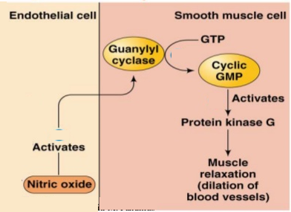
NO Mechanism of Action
Combining with haem in guanylate cyclase, activating the enzyme, increasing cGMP & thereby lowering [Ca²⁺]_{i}
Ca²⁺
Notes:
The major target of NO is soluble guanylyl cyclase (sGC), a heme-containing enzyme that generates cyclic guanosine monophosphate (cGMP) from guanosine triphosphate (GTP).
NO binds to the heme in sGC, resulting in enzyme activation & elevation in intracellular cGMP levels. cGMP activates protein kinase G (PKG), which phosphorylates specific proteins. In blood vessels, NO-dependent elevations in cGMP & PKG activity result in the phosphorylation of proteins that lead to dephosphorylation of myosin light chains & relaxation, reduced cytosolic calcium levels & subsequently reduced contraction of vascular sm m.

Slide 24
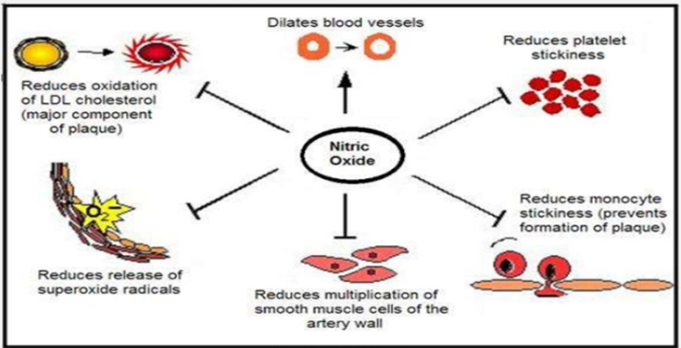
Actions of NO
Inhibition of platelet & monocyte adhesion & aggregation
Inhibition of smooth muscle proliferation
Protection against atherogenesis
Synaptic effects in the peripheral & CNS
Host defense & cytotoxic effects on pathogens
Cytoprotection
Notes:
NO functions as a signalling molecule in the nervous system
NO diffuses from nerve terminals, as well as acting as a neurotransmitter, NO has a neuromodulatory role
Apart from being a vasodilator and regulating blood pressure, NO also has antithrombotic effects.
NO is not stored (so not like glutamate & dopmine), but rather is synthesized on demand & immediately diffuses to neighboring cells.
NO is Similar to PGI2 reduce vascular tone & pulmonary vascular tone
NO also protects against atherogenesis. A major antiatherogenic mechanism of NO involves the inhibition of proliferation & migration of vascular sm m cells
NO reduces endothelial adhesion of monocytes and leukocytes, which are early steps in the development of atheromatous plaques. This effect is due to the inhibitory effect of NO on the expression of adhesion molecules on the endothelial surface.
In addition, NO may act as an antioxidant, blocking the oxidation of LDL & thus preventing or reducing the formation of foam cells in the vascular wall. Plaque formation is also affected by NO-dependent reduction in endothelial cell permeability to lipoproteins.
Sepsis is a systemic inflammatory response caused by infection. Endotoxin components from the bacterial wall along with endogenously generated TNF-α & other cytokines induce synthesis of iNOS in macrophages, neutrophils, & T cells, as well as hepatocytes, sm m cells, ECs, & fibroblasts. This widespread generation of NO results in exaggerated hypotension, shock, & in some cases, death. This hypotension is reduced or reversed by NOS inhibitors in humans as well as in animal models.
The generation of NO has both beneficial & detrimental roles in the host immune response & in inflammation. The host response to infection or injury involves the recruitment of leukocytes & the release of inflammatory mediators, such as tumor necrosis factor & interleukin-1. This leads to induction of iNOS in leukocytes, fibroblasts, & other cell types. The NO that is produced, along with peroxynitrite that forms from its interaction with superoxide, is an important microbicide. NO also appears to play an important protective role in the body via immune cell function. When challenged with foreign antigens, Th1 cells respond by synthesizing NO, which has roles in Th1 cells. The importance of NO in Th1 cell function is demonstrated by the impaired protective response to injected parasites in animal models after inhibition of iNOS. NO also stimulates the synthesis of inflammatory PGs by activating cyclooxygenase isoenzyme 2 (COX-2). Through its effects on COX-2, its direct vasodilatory effects, & other mechanisms, NO generated during inflammation contributes to the erythema, vascular permeability, & subsequent edema associated with acute inflammation.

Slide 25
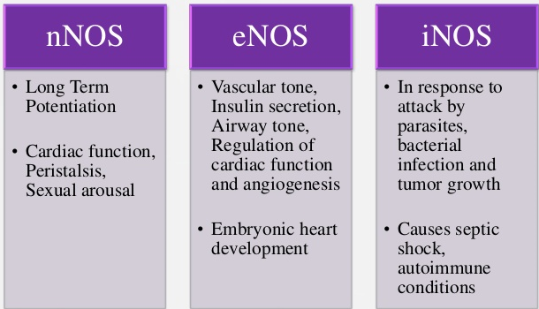
Actions of nos
WINTER
Template
Notes:
nNOS in nerve terminals, in neurons of most organs
NO is considered as a co-transmitter mediator especially for the para-sympathetic postganglionic neurons. Muscarinic agonist release NO from the EC
NO itself can be used therapeutically. Inhalation of NO results in reduced pulmonary artery pressure & improved perfusion of ventilated areas of the lung. Inhaled NO is used for pulmonary hypertension, acute hypoxemia, & CPR, & there is evidence of short-term improvements in pulmonary function. Inhaled NO is stored as a compressed gas mixture with nitrogen, which does not readily react with NO, & further diluted to the desired concentration upon administration. NO can react with O2 to form nitrogen dioxide, a pulmonary irritant that can cause deterioration of lung function.

Slide 26
No in therapeutics
Endothelial NO production is reduced in patients with diabetes, hypertension & atherosclerosis
Overproduction of NO occurs in neurodegenerative diseases (e.g. Parkinsonism) & in septic shock
NO donors have well established therapeutic uses e.g. in hypertension & angina pectoris
NO is used in critical care to treat pulmonary hypertension in neonates
NO is used in patients with right ventricular failure secondary to pulmonary embolism
Sildenafil potentiates the action of NO on corpora cavernosa smooth muscle.
It is used to treat erectile dysfunction.
Notes:
Sildenafil acts to increase cGMP by inhibiting its breakdown by phosphodiesterase isoform 5 (PDE-5).

Slide 27
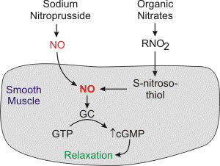
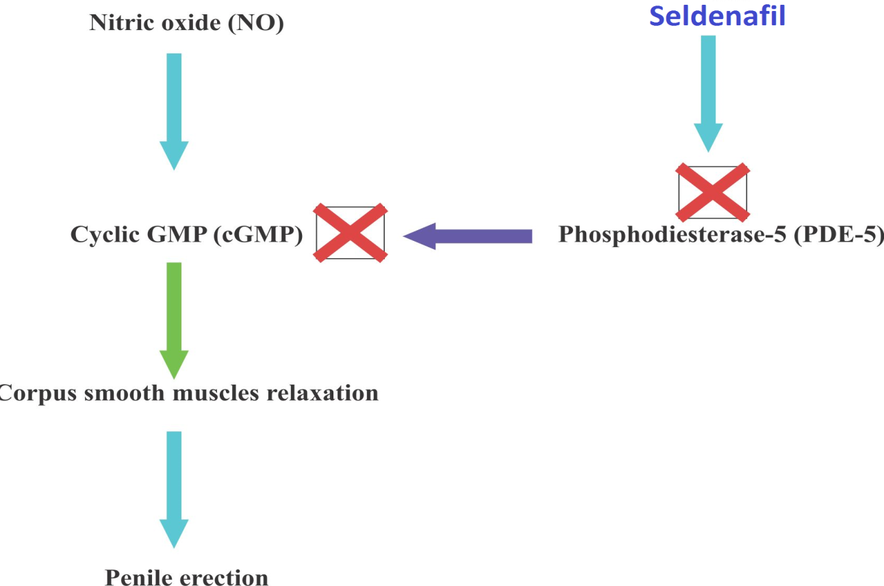

Slide 28
4- Angiotensin
Notes:
Part II

Slide 29
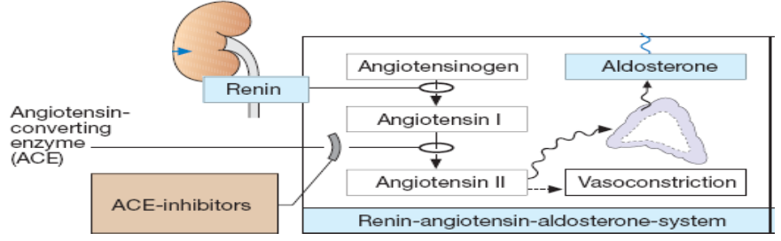
angiotensin
Biosynthesis
Renin released from the kidney converts angiotensinogen to Ag I
ACE converts Ag I to Ag II
Notes:
Angiotensinogen is the circulating protein substrate from which renin cleaves ANG I. It is synthesized in the liver.
Angiotensin II acts directly on the zona glomerulosa of the adrenal cortex to stimulate aldosterone synthesis & release. At higher concentrations, ANG II also stimulates glucocorticoid synthesis. Angiotensin II acts on the kidney to cause renal vasoconstriction, increase proximal tubular Na reabsorption, & inhibit the release of renin.

Slide 30
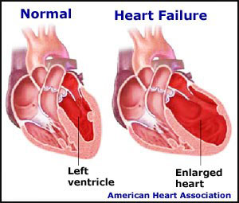
Actions of angiotensin II
Promotes vasoconstriction directly or indirectly by releasing NA & AD
Increases force of contraction of the heart by promoting Ca²⁺ influx
Increases aldosterone release → sodium & water retention
Causes hypertrophy of vascular & cardiac cells & increases synthesis & deposition of collagen by cardiac fibroblasts (remodeling).
Notes:
Angiotensin II is mitogenic (triggering mitosis) for vascular & cardiac muscle cells & may contribute to the development of cardiovascular hypertrophy.
It also exerts a variety of important effects on the vascular endothelium. Indeed, overactivity of the renin-angiotensin system has been implicated as one of the most significant factors in the development of hypertensive vascular disease. Considerable evidence now indicates that ACE inhibitors & ANG II receptor antagonists slow or prevent morphologic changes (remodeling) following myocardial infarction that would otherwise lead to heart failure.
Collagen forms a scaffold to provide strength & structure. Collagen occurs throughout the body, but especially in the skin, bones, & connective tissues.
Collagen is a hard, insoluble, & fibrous protein that makes up one-third of the protein in the human body. In most collagens, the molecules are packed together to form long, thin fibrils.
Pressure overload with coronary arterial HTN causes myocardial hypertrophy & coronary vascular changes such as medial hypertrophy with an increase in collagen deposition in the interstitial, coronary vascular, & perivascular tissue.
Increased collagen deposition is highly linked to myocardium stiffness.

Slide 31
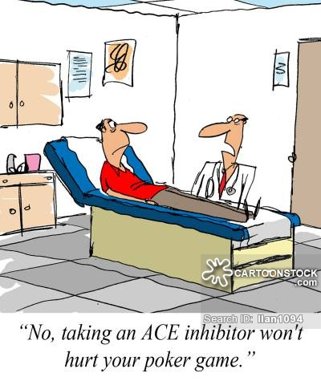
Angiotensin inhibitors
ACE inhibitors: e.g. Captopril
Angiotensin receptor blockers (ARBs): e.g. Losartan.

Slide 32
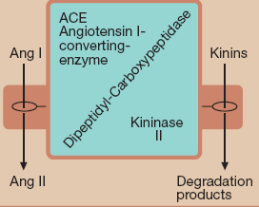
ACE inhibitors
WINTER
Cause a fall in blood pressure in hypertensive patients especially those with high rennin levels
Template
Clinical uses:
Hypertension
Cardiac failure
Following myocardial infarction.
Notes:
ACEIs 1- Reduce peripheral resistance & thereby reduce afterload; 2- Reduce salt & water retention (by reducing aldosterone secretion) & in that way reduce preload. 3- The reduction in tissue angiotensin levels also reduces sympathetic activity through diminution of angiotensin’s presynaptic effects on NE release. 4- Finally, these drugs reduce the long-term remodeling of the heart & vessels, an effect that may be responsible for the observed reduction in mortality & morbidity.
Converting enzyme is a dipeptidyl carboxypeptidase with two active sites that catalyzes the cleavage of dipeptides from the carboxyl terminal of certain peptides. Its most important substrates are ANG I, which it converts to ANG II, & bradykinin (Vasodilator), which it inactivates. So the hypotensive activity of captopril results both from an inhibitory action on the renin-angiotensin system & a stimulating action on the kallikrein-kinin system.

Slide 33
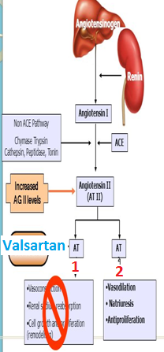
Angiotensin receptor blockers
Angiotensin receptors AT₁ & AT₂
AT₁ receptors predominate in vascular smooth muscle, mediate most of the known actions of Ang, coupled to G proteins & DAG
Similar uses to ACEI
Notes:
AT Rs are widely distributed in the body.
Ang 2 bind equally to AT1 & 2
AT 1 receptors predominate in vascular smooth muscle.
AT1:
VC
Renal Na reabsorption
Cell growth & proliferation (remodeling).
Stimulation of AT2 receptors causes VD that may serve to counteract the VC resulting from AT 1 receptor stimulation.
AT2 receptor-mediated VD appears to be nitric oxide-dependent & may involve the bradykinin B2 receptor-nitric oxide-cGMP pathway.
In biochemical signaling, DAG functions as a second messenger signaling lipid, & is a product of the hydrolysis of the phospholipid phosphatidylinositol 4,5-bisphosphate (PIP2) by the enzyme phospholipase C (PLC) (a membrane-bound enzyme) that, through the same reaction, produces inositol trisphosphate (IP₃). Although inositol trisphosphate diffuses into the cytosol, DAG remains within the plasma membrane, due to its hydrophobic properties. IP₃ stimulates the release of calcium ions from the smooth endoplasmic reticulum, whereas DAG is a physiological activator of protein kinase C (PKC).

Slide 34
5- Kinins

Slide 35
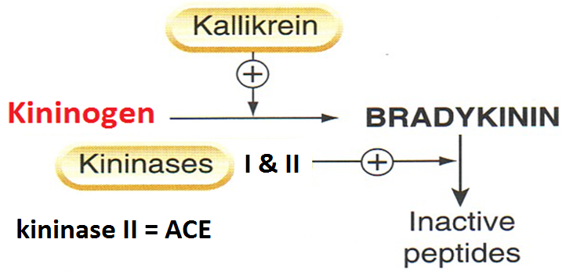
kinins
Are Bradykinin & kallidin
Bradykinin is formed by proteolytic cleavage of circulating proteins (kininogens)
Notes:
Kallikreins are serine proteases present in plasma (plasma kallikrein) & in several organs (tissue kallikrein), including the kidneys, pancreas, intestine, sweat glands, and salivary glands. The two groups are secreted as zymogens and are activated by proteolytic cleavage.
Kininogens—the substrates for kallikreins & precursors of kinins—are present in plasma, lymph, & interstitial fluid.
Kallidin can be converted to bradykinin by an arginine aminopeptidase. The two kinins are present in plasma & urine. Bradykinin is the predominant kinin in plasma.
Kinins are metabolized rapidly (half-life < 15 seconds) by nonspecific exopeptidases or endopeptidases, commonly referred to as kininases.

Slide 36
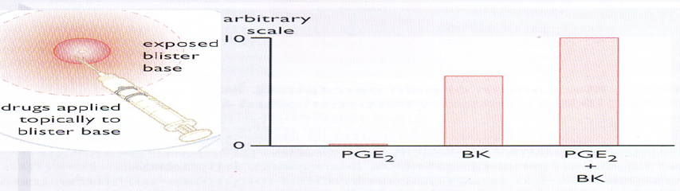
Actions of bradykinin
Causes pain, this effect is potentiated by PG. Has a role in inflammation
  Potent vasodilator, reduces blood pressure
If injected locally it dilates arterioles [→generation of PGI, release of NO] & increases permeability of post capillary venules
Constricts most smooth muscles, intestine, uterus bronchiole, contraction is slow & last long
Stimulation of epithelial ion transport & fluid secretion in airways & GIT.
Notes:
Kinins produce marked arteriolar dilation in several vascular beds, including the heart, skeletal muscle, kidney, liver, & intestine. In this respect, kinins are approximately 10 times more potent on a molar basis than histamine. The vasodilation may result from 1- a direct inhibitory effect of kinins on arteriolar smooth muscle 2- or may be mediated by the release of NO or 3- vasodilator PGs such as PGE2 & PGI2.
When injected intravenously, kinins produce a rapid but brief fall in blood pressure that is due to their arteriolar vasodilator action. IV infusions of the peptide fail to produce a sustained decrease in BP; prolonged hypotension can only be produced by progressively increasing the rate of infusion. The rapid reversibility of the hypotensive response to kinins is due primarily to reflex increases in HR, myocardial contractility, & COP.
The arteriolar dilation produced by kinins causes an increase in pressure and flow in the capillary bed, thus favoring efflux of fluid from blood to tissues. This effect may be facilitated by increased capillary permeability resulting from contraction of ECs & widening of intercellular junctions, & by increased venous pressure secondary to constriction of veins. As a result of these changes, water & solutes pass from the blood to the extracellular fluid, lymph flow increases, & edema may result.
Bradykinin has long been known to produce the 4 classic symptoms of inflammation—redness, local heat, swelling, & pain. Kinins are rapidly generated after tissue injury & play a pivotal role in the development & maintenance of these inflammatory processes. Kinins are potent pain-producing substances when applied to a blister base or injected intradermally. They elicit pain by stimulating nociceptive afferents in the skin and viscera.

Slide 37
Receptors & clinical uses
  Receptors B1 & B2 (both are G protein-coupled receptors)
  B1 inducible under condition of inflammation
  B1 receptor has low affinity to bradykinin
  plays a significant role in inflammation & hyperalgesia
  B2 constitutive
  High affinity to bradykinin & mediates the majority of its effects.
Notes:
B1 receptors appear to have a very limited distribution in mammalian tissues & have few known functional roles. Studies with knockout mice that lack functional B1 receptors suggest that these receptors participate in the inflammatory response & may also be important in long-lasting kinin effects such as collagen synthesis & cell multiplication.
By contrast, B2 receptors have a widespread distribution that is consistent with the multitude of biologic effects that are mediated by this receptor type. Agonist binding to B2 receptors sets in motion multiple signal transduction events, including Ca²⁺ mobilization, chloride transport, formation of nitric oxide, & activation of phospholipase C, phospholipase A2, & adenylyl cyclase. Bradykinin displays the highest affinity in most B2 receptor systems.
Hyperalgesia increased sensitivity to pain or painful stimuli.

Slide 38
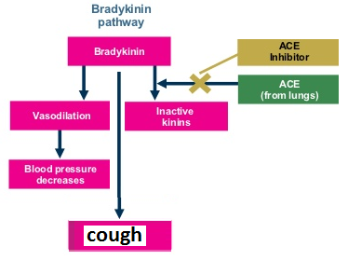
Therapeutic uses
WINTER
Template
  No current therapeutic use of bradykinin
  Increased bradykinin is implicated in the therapeutic efficacy & cough produced by ACEIs.

Slide 39
6- Serotonin

Slide 40
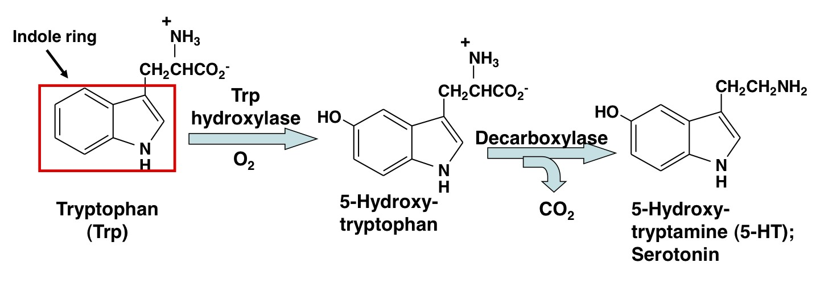
Serotonin [5ht]
Serotonin is synthesized from the amino acid L-tryptophan
Notes:
Like histamine, serotonin is widely distributed in nature, being found in plant and animal tissues, venoms, and stings.
It is synthesized in biologic systems from the amino acid L-tryptophan by hydroxylation of the indole ring followed by decarboxylation of the amino acid

Slide 41
Serotonin [5-ht]
distribution
1] Intestinal wall: in chromaffin cells, in neuronal cells in the myenteric plexus
2] Blood, in platelets, released when aggregated, in sites of tissue damage
3] CNS: a neurotransmitter, in midbrain
Notes:
over 90% of the serotonin in the body is found in enterochromaffin cells in the GIT. These cells synthesize serotonin, store the amine in a complex with adenosine triphosphate (ATP) and other substances in granules, and release serotonin in response to mechanical & neuronal stimuli. This serotonin interacts in a paracrine fashion with several different 5-HT receptors in the gut. Some of the released serotonin diffuses into blood vessels & is taken up & stored in platelets.
In the blood, serotonin is found in platelets, which are able to concentrate the amine by means of an active serotonin transporter mechanism (SERT) similar to that in the membrane of serotonergic nerve endings. Once transported into the platelet or nerve ending, 5-HT is concentrated in vesicles by a vesicle-associated transporter (VAT) that is blocked by reserpine.
Serotonin is also found in the raphe nuclei of the brainstem, which contain cell bodies of serotonergic neurons that synthesize, store, and release serotonin as a
transmitter. Stored serotonin can be depleted by reserpine in much the same manner as this drug depletes catecholamines from vesicles in adrenergic nerves and the adrenal medulla.

Slide 42
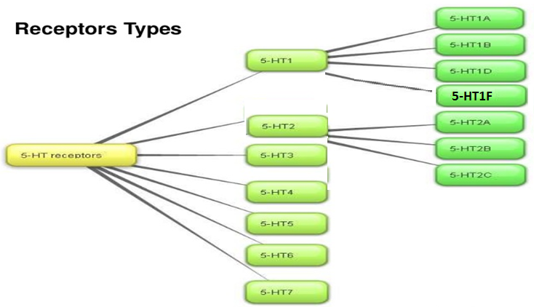
5-ht
receptors

Slide 43
Actions of 5-ht
GIT: 5-HT increases motility
Contracts uterus, bronchiole, other smooth muscles
Blood vessels:-
Contracts large vessels by a direct action & relaxes other vessels by releasing NO
Increases capillary pressure & permeability.
Notes:
Brain serotonergic neurons are involved in numerous diffuse functions such as mood, sleep, appetite, & temperature regulation, as well as the perception of pain, the regulation of blood pressure, and vomiting. Serotonin is clearly involved in psychiatric depression & also appears to be involved in conditions such as anxiety and migraine. Serotonergic neurons are found in the enteric nervous system of the gastrointestinal tract & around blood vessels.

Slide 44
5-ht actions
WINTER
Platelets:- causes aggregation, aggregated platelets release 5-HT
Template
Neuronal terminals: 5-HT stimulates nociceptive neuron endings → pain
CNS;-stimulates some neurons & inhibits others, inhibits release of other neurotransmitters.

Slide 45

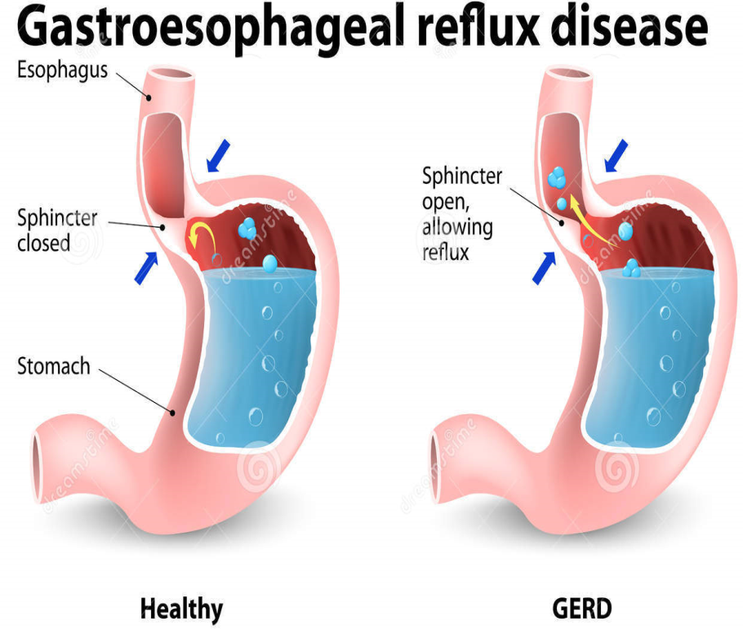
5-ht receptor agonists
Buspirone:- 5-HT1A agonist, effective anxiolytic
Cisapride:-
5-HT4 -receptor agonist, used in gastroesophageal reflux & motility disorders.

Slide 46
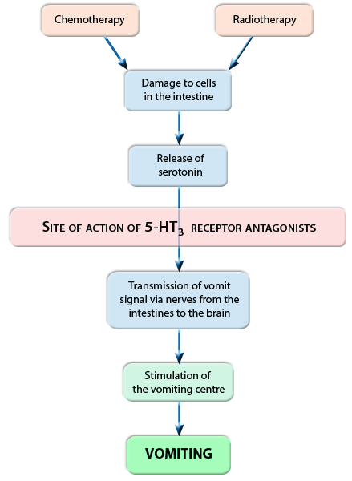

5-ht receptor antagonists
Selective 5-HT3 antagonist, Ondansetron, antiemetic action, for cancer chemotherapy

Slide 47
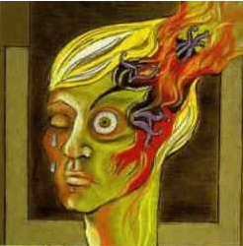
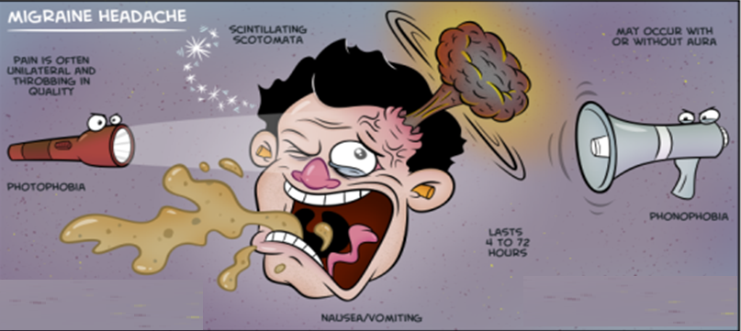
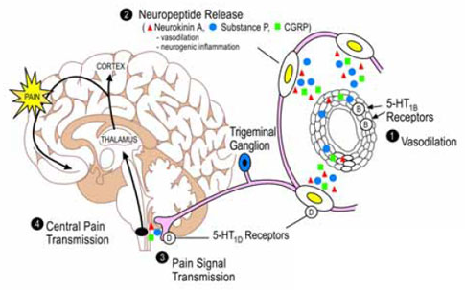
Clinical conditions in which 5-ht is implicated
1-migraine
Activation of trigeminal system leads to vasodilator peptides release promoting an inflammatory reaction
This increases flow of sensory traffic through the brain stem, the thalamus & the cortex.

Slide 48
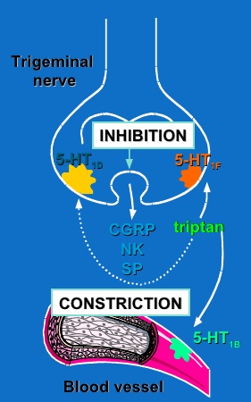
sumatriptan
5-HT 1B, 1D & 1F-receptor agonists, effective in acute migraine attack
It binds to 5HT1B, in cranial blood vessels causing vasoconstriction & 1D & 1F in presynaptic trigeminal nerve causing inhibition of pro- inflammatory neuropeptide release.

Slide 49
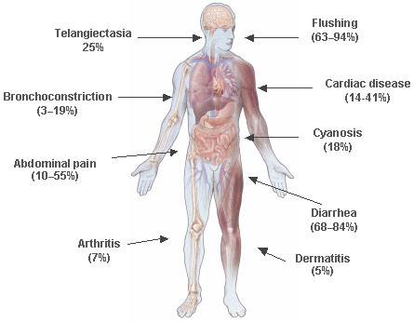
2- Carcinoid syndrome
A malignant tumor of intestinal chromaffin cells
The tumor releases 5-HT, SP, PGs, kinins & histamine causing flushing, diarrhea, bronchoconstriction & hypotension
Serotonin antagonists (cyproheptadine, 5HT2 antagonist) could be administered to control diarrhea, flushing & malabsorption.

