Slide 1
BLOOD PHYSIOLOGY
White Blood Cells
(WBC)
Dr. Nervana Mostafa

Slide 2
Lecture content
Formation of WBC.
Types of WBC.
Sites of formation and life span of WBC.
Maturation & function
Phagocytosis

Slide 3
Objectives
At the end of this lecture student
should be able to:
Describe different Types of WBC
Recognize the general functions of
WBC
Describe genesis and site of formation of WBC.
3

Slide 4
Objectives
At the end of this lecture student should be
able to:
Describe stages of neutrophil formation
Describe the role of neutrophils in defending
the body against infection
Describe the process of phagocytosis.
4

Slide 5
Red blood cells (5-6 million/ml)
White blood cells
(5000/ml)
3

Slide 6
White Blood Cells
- Leucocytes are formed in bone marrow & lymph tissue
- Function: Protection against infection by:
*Phagocytosis
*Secretion of antibodies
- WBC = 4000—11000/ml

Slide 7
Types of WBC
Granular (polymorphnuclear PMN):
Neutrophil 62%.
–
lobulated nucleus 2-5, purple
cytoplasmic granules.
Eosinophil 2-3%.
– 2 lobe nucleus, coarse red granules.
Basophil 0-1%.
•
–
rarely segmented nucleus, nucleus hidden by large round bluish granules

Slide 8
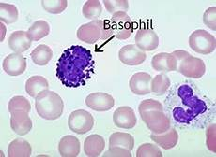

Slide 9
Types of WBC
15-20um, kidney shape nucleus.
Lymphocyte 30%
round nucleus
small (5-8um)
large (9-15um)
2. A granular
– Monocytes
5.3%

Slide 11
Genesis of WBC
Two major lineage of WBC are
formed:
Myelocytic: granular, monocytes.
Lymphocytic: lymphocytes.

Slide 12
Genesis of WBC

Slide 13
Sites of WBC Formation
Sites of WBC formation
Granulocytes (neutrophil, basophil, eosinophil) in bone marrow.
Monocytes- bone marrow.
lymphocytes- bone marrow,
thymus, lymphoid tissues.
•
•

Slide 14
Life span of WBCs
Granulocytes= 4-5 days in tissues.
During infection life span only few hours because they die after ingesting bacteria.
Monocytes = 10-20hours then they leave blood to tissues transform into macrophage, its life span goes up to months.
Lymphocytes = weeks to months
according to its type.

Slide 15
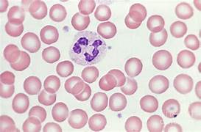
White Blood Cells
NEUTROPHILLS

Slide 16
Formation & Maturation of Neutrohils
Formed in Bone Marrow
Stem cells →
Myeloblast →
Promyelocytes →
Neutrophil myelocytes →
Young neutrophil metamyelocytes →
Band neutrophil →
Polymorphnuclear neutrophil –PMNL
(Mature Neutrphils) released into the blood.

Slide 18
Neutrophil Function
Defense against infection: Neutrophil has the ability of engulfing bacteria or organism by a process of phyagocytosis.
Steps of Phygocytosis
Chemotaxis
Margination
Diapedesis
Ameoboid movement
Engulfing and killing of a microbe

Slide 19
Chemotaxis, margination & diapedesis
Dr Sitelbanat 2011

Slide 20
Chemotaxis
The attraction of neutrophils to inflamed area following chemotactic substances released from the infected site.
* Chemotactic substances:
Bacterial toxin
Degenerative products of inflamed tissue
Complement system
Reaction product of plasma clotting

Slide 21
Margination & Diapedesis
WBC marginate along the wall of blood capillaries.
WBC squeezes itself through endothelial holes leaving blood capillaries (diapedesis).
WBC move by amoeboid motion towards inflammation area following chemotactic substance released from site of infection.
Upon reaching the site of infection neutrophils start to engulf infecting organism.

Slide 23
Phagocytosis
*Selective process: foreign substance recognize
by:
Rough surface.
No protective protein coat, which prevents phagocytosis.
Marked by certain substance e.g Complement 3 or antibodies making them ready for killing a process known as Opsonization.
3.
Neutrophils encircle the bacteria with pseudopodia and engulf it inside into a vacuole (phagosome), takes 3-20 bacteria.

Slide 24
Dr Sitelbanat 2011

Slide 25
Microbial killing
* Digestion of organism inside the phagosome;
•Fusion of intracellular lysosomes with phagosome vacuole.
•Lysosomes discharge its proteolytic enzymes such as myeloperoxidase, catalase into the vacuole, killing and digesting the engulfed bacteria.
And/OR
•Release of bactericidal such as superoxide, hydrogen peroxide to kill the bacteria.

Slide 26
Microbial killing
Dr Sitelbanat 2011

Slide 27
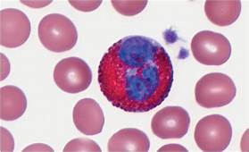
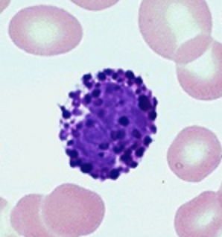
White Blood Cells - Granulocytes
EOSINOPHILLS &
BASOPHILS

Slide 28
Formation & Maturation of Eosinophils
Formed in Bone Marrow:
Stem cells → Myeloblast→ Promyelocytes →
Eosinophil myelocytes →
Eosinophil metamyelocytes →
polymorphnuclear eosinophil (Mature Eosinophil) released into blood.

Slide 29
Eosinophil Function
•
•
Phagocytosis.
High eosinophil count:
Parasitic (hook worm, ascaris, bilharzia) Allergic (asthma, rhinitis, drug reaction)
–
–
* Eosinophil attach themselves to parasites and
releases substances (hydrolytic enzymes, superoxide) to kill it.

Slide 30
Formation & Maturation of Basophils
1- Formed in Bone Marrow.
2- Stem cells → Myeloblast→ Promyelocytes →
Basophil myelocytes →
3- Polymorphnuclear Basophil (Mature Basophils) released into blood.

Slide 31
Basophils
Secrets:
Heparin to prevent clotting.
Histamine, bradykinin & serotinin to contribute to inflammation response.
The release of these substances cause local and vascular reactions characteristic of allergic manifestation.

Slide 32
White Blood Cells
MONOCYTES & MACROPHAGES

Slide 33
Monocytes & Macrophages
Formed in Bone Marrow
.1
Stem cell → monoblast → promonocyte → mature monocytes released into blood.
Stay for 10-20 hours in circulation.
Then leave blood to tissues transforming into larger cells macrophage.
.4 Macrophage life span is longer upto few months.
.2
.3

Slide 34
Function of Monocytes & Macrophages
Macrophages are a powerful phagocytic cells, first line of defense
– Ingest up to 100 bacteria.
–
–
Ingest larger particles as old RBC.
Get rid of waste and survive (tissue scavengers).
Functions as anti-inflammatory cells,
Directly: phygocytosis of bacteria, dead cells.
Indirectly: cooperating with lymphocytes by recognizing foreign body (take in foreign body process it and present it to lymphocytes).

Slide 35
Direct anti-Inflammatory

Slide 36
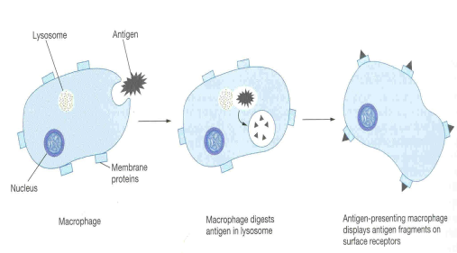
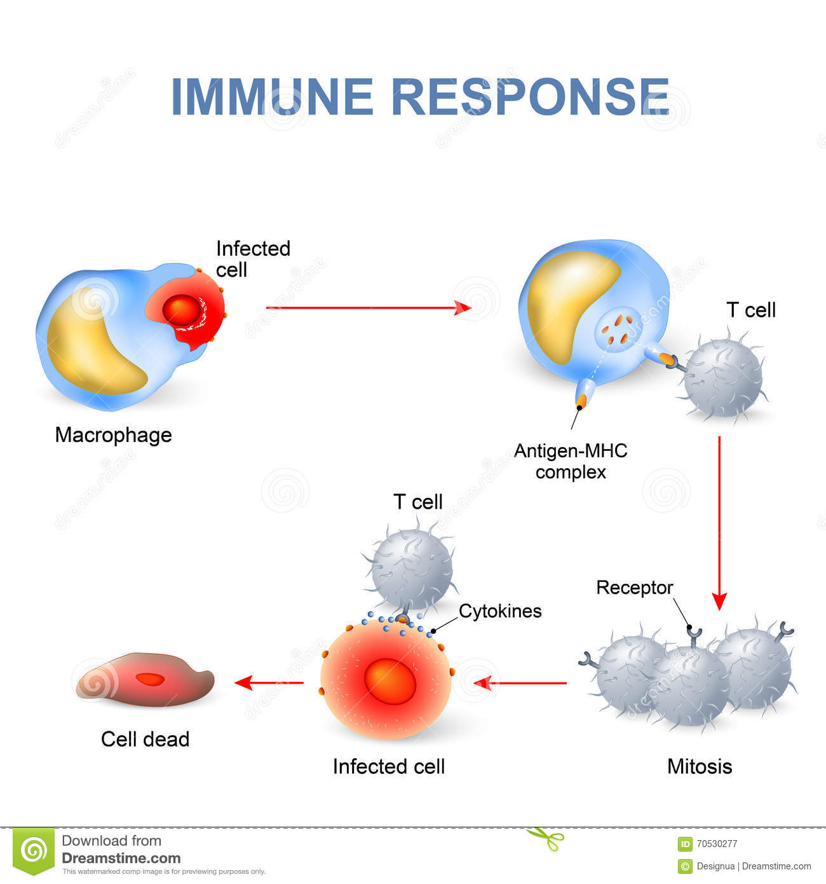
Indirect anti-inflammatory

Slide 37
Reticuloendothelial ^{system (RES)}
Consist of:
Monocytes.
Macrophage.
Endothelial cells (bone marrow,
spleen, lymph node)
•
Located in all tissues especially: skin
(histocytes), liver (kupffer), spleen, bone
marrow, lymph nodes, lung.

Slide 38
Functions of Reticuloendothelial system
Phagocytosis: Bacterial, dead cells,
foreign particles.
Breakdown of Hb.
Immune function: processing antigen & antibodies production (indirect).
Storage of iron.

Slide 39
White Blood Cells
LYMPHOCYTES

Slide 40
Lymphocytes Formation & Maturation
.1 Formed in bone marrow, thymus, lymphoid tissues.
Stem cell (thymus, lymphoid tissue & bone marrow) → lymphoblast → intermediate pyronophilic blast cell → lymphocytes.
.3 Life Span Of Lymphocytes range from weeks
to months according to its type.
.2

Slide 41
LYMPHOCYTES Function and types
Function:
Types:
.1 Thymus dependent (T-lymphocytes).
.2 Thymus-independent (B-lymphocytes).
independent

Slide 42
T-Lymphocytes (Thymus dependent)
•
Formed in bone marrow or lymphoid tissue migrate to thymus for maturation.
Life spans 100-130 days.
Circulate between blood, tissues, lymph.
Types of T-lymphocytes:
•
•
•
–
–
–
T-helper
T-cytotoxic Natural killer
Functions
1- Cellular immunity (e.g. graft rejection - delayed hypersensitivity).
2- Role in antibody secretion.

Slide 43
B-Lymphocytes (thymus-independent)
•
•
First discovered in Bird Bursa. Formed in: Bone marrow, germinal
layer of lymph node, red pulp of spleen.
Life span 2-7 days.
•
It transforms into large plasma cell that produces antibodies.
Function: Humoral immunity.
•
Stimulated by antigen transforming

Slide 44
Leucopenia
Low WBC count
Causes;
2- typhoid fever.
4- B12 & folic acid↓
1- malnutrition.
3- drugs.
5- radiation

Slide 45
Leucocytosis
Increased WBC
Physiological
Diurnal ↓ morning ↑ evening.
After physical exercise.
Stress or Adrenaline injection.
Pathological
Bacterial infection (tonsilitis, Appendicitis, wound infection).
Parasitic infections infection.
Allergic conditions.

Slide 46
Leukaemia
- Cancer of WBC due to chromosomal abnormality caused by chemicals, radiation, and viruses.
- WBC more than 50x10^{3.}
- Types of leukaemia:
1- Myeloblast leukaemia → myeloid cells.
2- Lymphoblast leukaemia → lymphocytic cells (Acute or chronic onset).
Mostly, accompanied with anaemia, bleeding and infections.

Slide 47
Objectives
At the end of this lecture student
should be able to:
Describe Esinophils formation and functions
Describe Basophils formation and
functions
Describe Monocytes and macrophage formation and functions.
Describe Reticuloendothelial componants
and functions
.3
.4
47

Slide 48
Objectives
At the end of this lecture student should be
able to:
Describe lymphocytes formation and
maturation.
Describe the functions of the different
types of lymphocytes.
Recognise leucocytosis and leucopenia.
Recognize type of leukaemia
48

Slide 49
Lecture content
.1 Eosinophils and Basophilophils formation,
maturation and function
Monocytes and macrophage formation, maturation and function Reticuloendothelial system component and function
Lymphocytes formation, maturation and
function
Leucocytosis, leucopenia and leukemia
.2
.3
.4
.5

