Slide 1
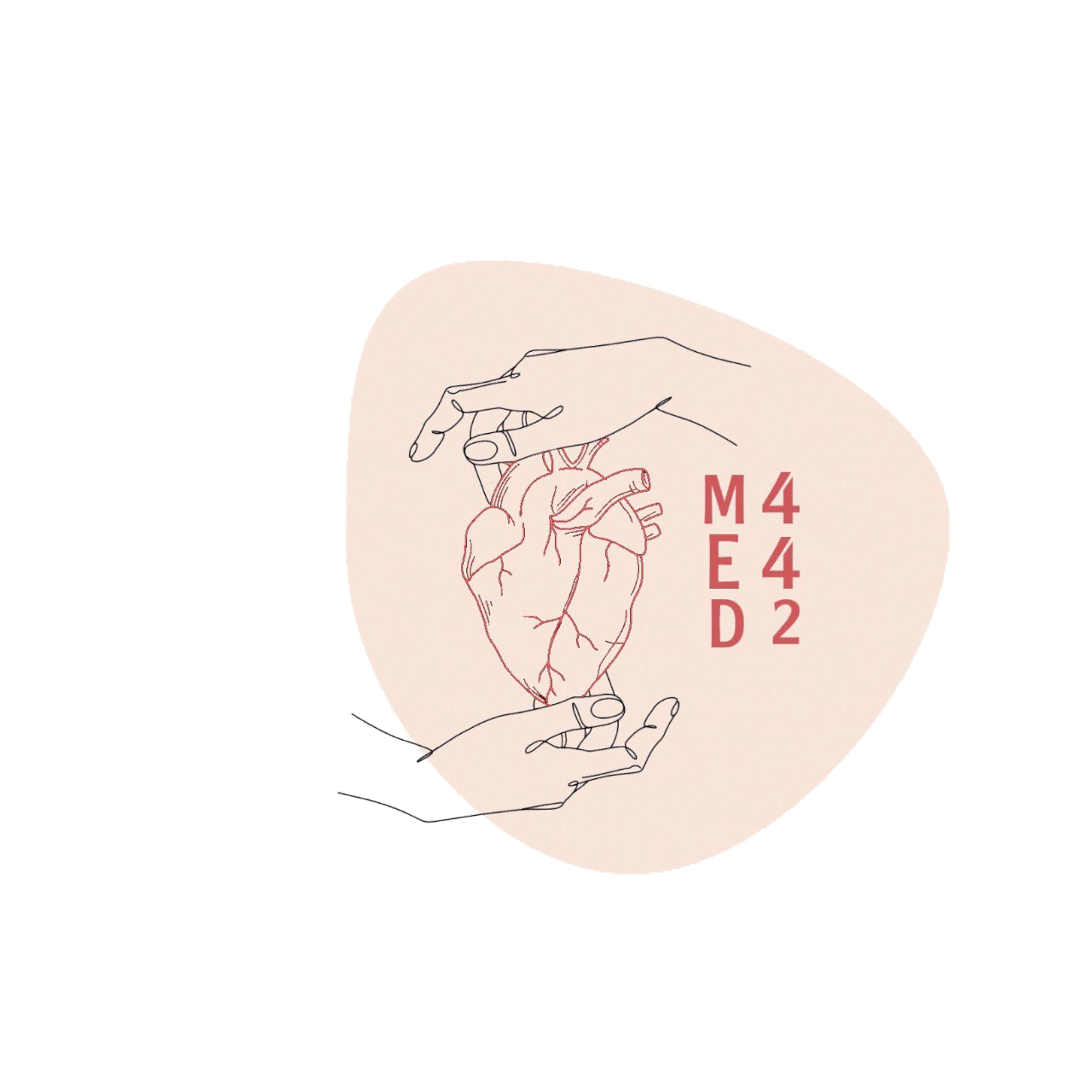
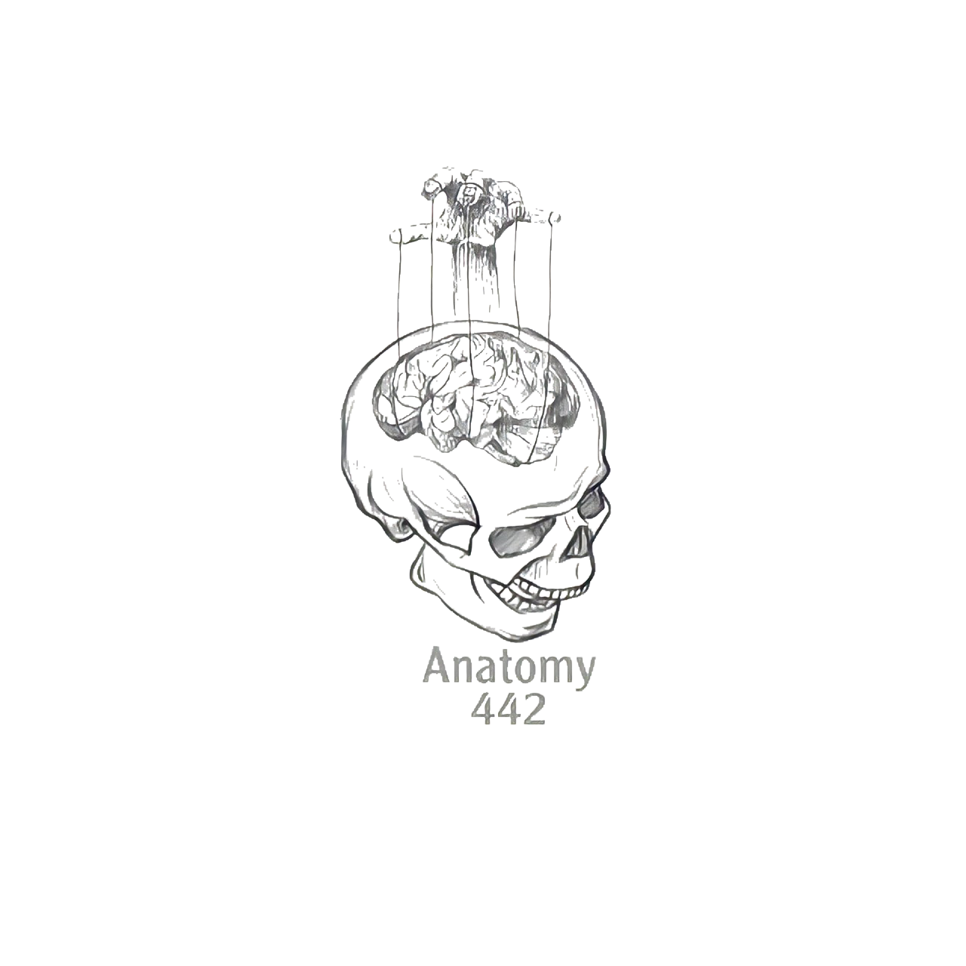
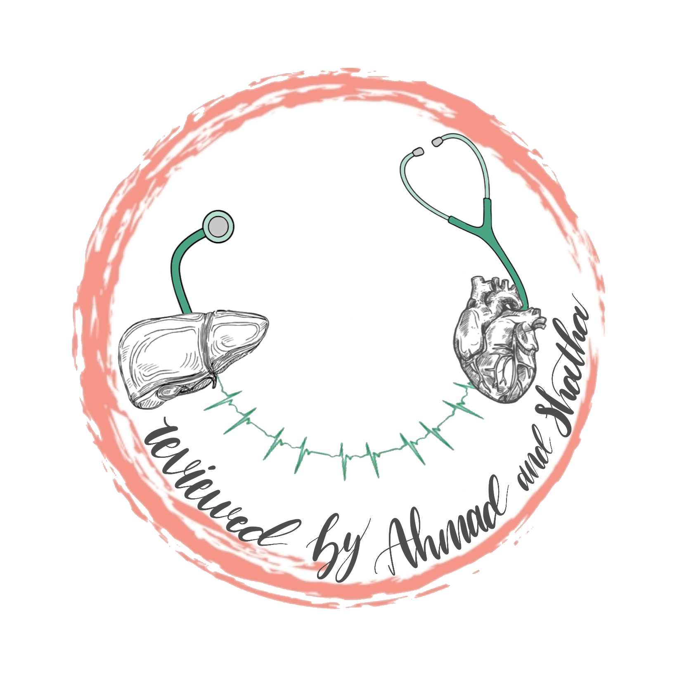
Introduction to Anatomy and Skeletal System
Click logo for editing file
Color index:
Main text
Red: important
Pink: in girls slides only
Blue: in boys slides only
Green: Doctors notes
Grey: Extra info
Lecture 1

Slide 2
Objectives
At the end of the lecture , students should be able to:
● Define the word “Anatomy”.
● Enumerate the different anatomical fields.
● Describe the anatomical position.
● Describe different anatomical terms of position & movements as well different
anatomical planes.
● Classify bones according to shape, structure & development.
● Enumerate different bones of both axial & appendicular skeleton.

Slide 3
WHAT IS ANATOMY?
The word Anatome is of Greek origin meaning cutting up (ana= up; tome= cutting). Anatomy can be defined as the study of the shape & structure of the body parts.
Subdivisions of anatomical science:
Gross (macroscopic) anatomy: Study of human body with naked eye .
Microscopic anatomy; (Histology): Study of fine structure (cells & tissues) of the human body with the help of microscope.
Developmental anatomy; ( Embryology).
Radiological anatomy:The study of the body and its organs and tissues using x-ray imaging.
Applied anatomy: application of anatomical knowledge,, in the diagnosis and treatment of disease.
Surface anatomy: superficial anatomy, without dissection.
Surgical anatomy: study of the structure and morphological characteristics of the tissues and organs of the body as they relate to surgery.

Slide 4
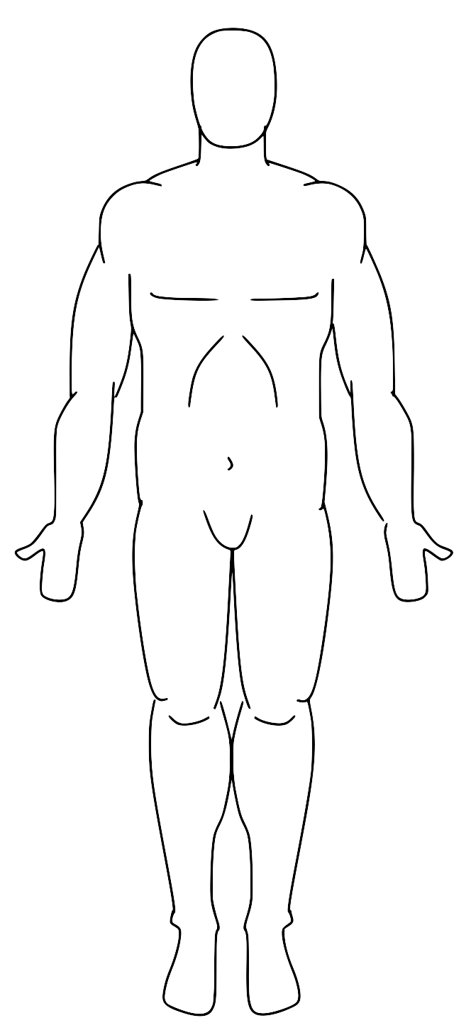
ANATOMICAL POSITION
It is the standard position in which the body assume to describe its parts.
1-Body is erect
2-Arms hanging by the side
3-Palms facing forward
4-Feet are parallel

Slide 5
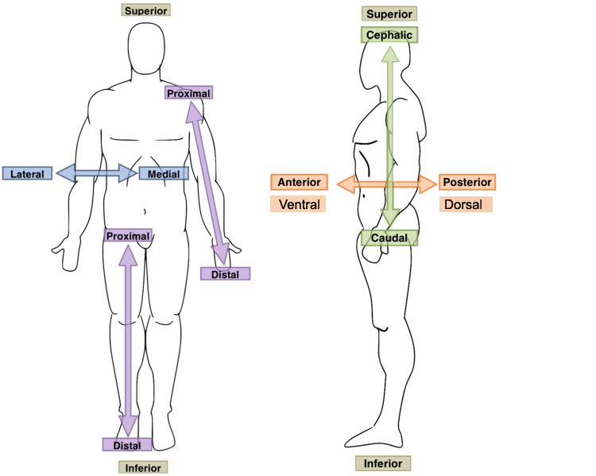
ANATOMICAL TERMINOLOGY
TERMS OF POSITION:
● Superior/cephalic (cranial): near to head.
● Inferior (caudal): away from head.
● Anterior (ventral): near to front.
● Posterior (dorsal): near to back.
● Medial: near to median plane.
● Lateral: away from median plane
● Proximal: near to trunk.
● Distal: away from trunk.
● Superficial: near to skin (surface).
● Deep: away from skin.

Slide 6
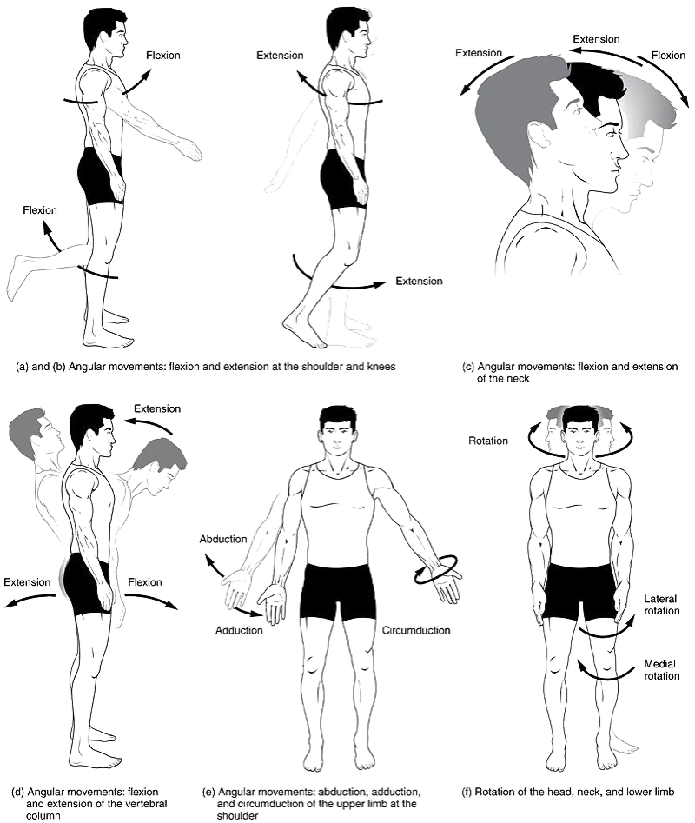
ANATOMICAL TERMINOLOGY
TERMS OF GENERAL MOVEMENT:
Flexion: approximation of 2 parts (decreasing the angle between 2 parts).
Extension: straightening (increasing the angle between 2 parts).
Abduction: away from median plane.
Adduction: toward median plane.
Lateral rotation: rotation away from median plane.
Medial rotation: rotation toward median plane.
Circumduction: combined movements of flexion,
extension, abduction & adduction.

Slide 7
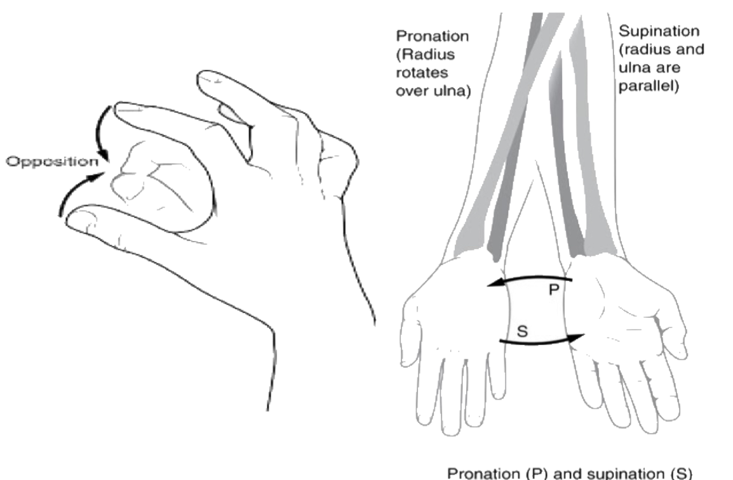
In Girls slides only
SPECIAL MOVEMENT OF UPPER LIMB
Opposition:
Bringing tips of fingers and thumb together
as in picking something up
Supination:
Lateral rotation of the forearm.
The palm faces Anteriorly.
The radius and ulna are Parallel.
Joint Movement
Pronation:
Medial rotation of the forearm.
The palm faces Posteriorly.
The radius crosses the ulna and the two
bones form an X.

Slide 8
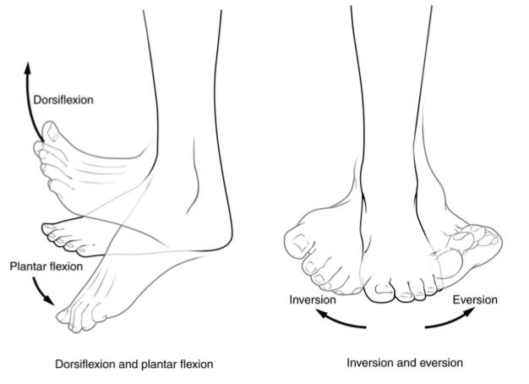
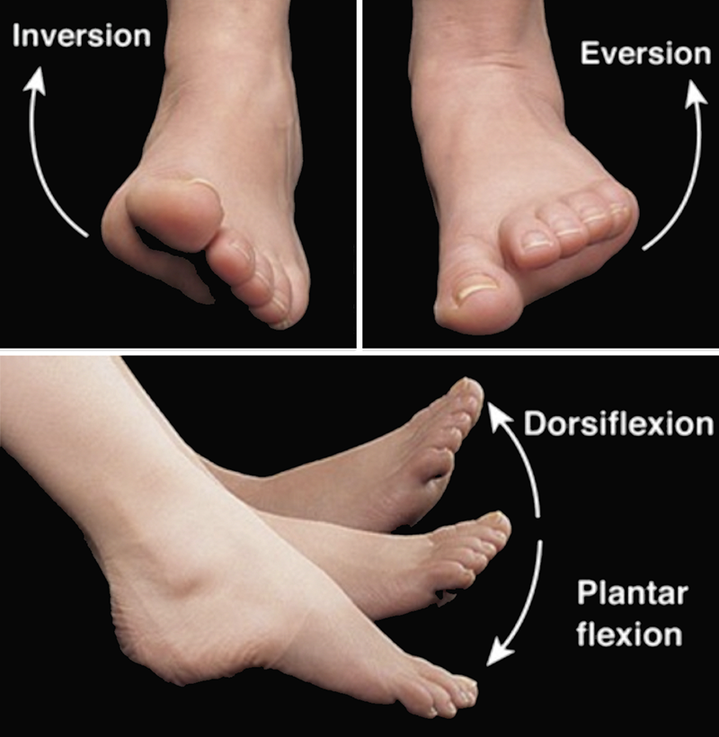
In Girls slides only
SPECIAL MOVEMENT OF LOWER LIMB
Dorsiflexion:
Flexing the foot up.
(Standing on the heels).
Plantar flexion:
Flexing the foot down.
Movement with pointing the toes.
Inversion:
The sole faces in a medial direction.
Eversion:
The sole faces in a lateral direction.

Slide 9
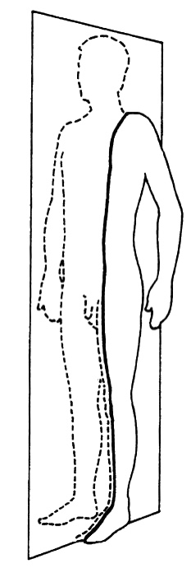
ANATOMICAL PLANES & SECTIONS
1-Sagittal / Longitudinal (median):
divides the body
into 2 equal halves (right & left).
Frontal (coronal):
divides the body into anterior & posterior parts.
2-Parasagittal (paramedian):
divides the body
into 2 unequal parts (right & left).
Transverse / Horizontal (cross):
divides the body
into superior & inferior parts.

Slide 10
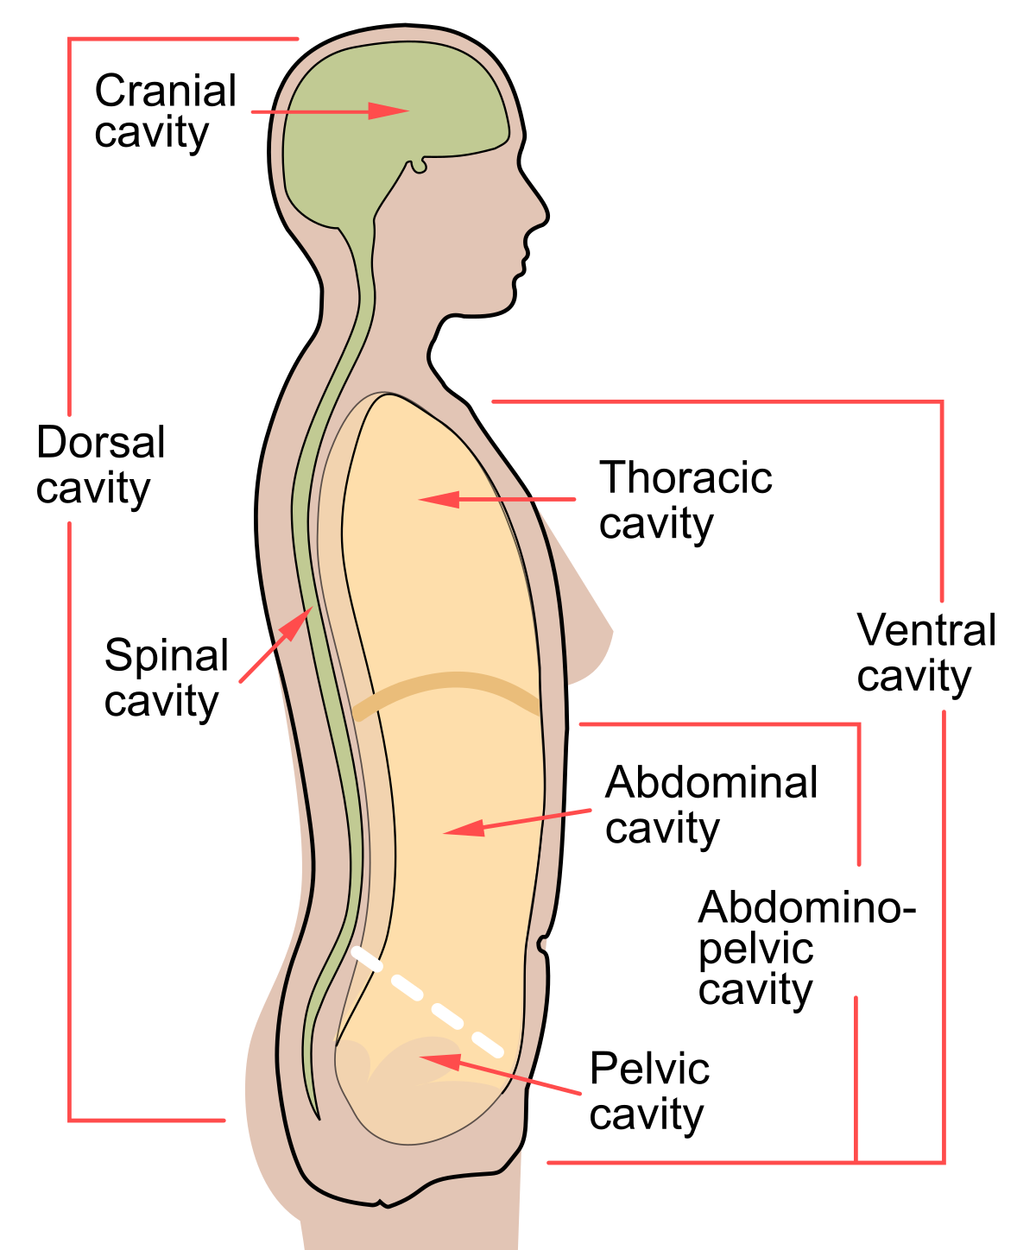
BODY CAVITIES
1- Ventral body cavity: divided by diaphragm into:
-Thoracic cavity: superior to diaphragm, contains
heart & lungs.
-Abdominal cavity: inferior to diaphragm, contains
stomach, intestine, liver, urinary bladder, etc…
(abdominal cavity is also called abdominopelvic cavity)
2- Dorsal body cavity:divided into 2 parts continuous with each other:
-Cranial cavity: space inside skull, contains brain
-Spinal cavity: space inside vertebral column, contains spinal cord

Slide 11
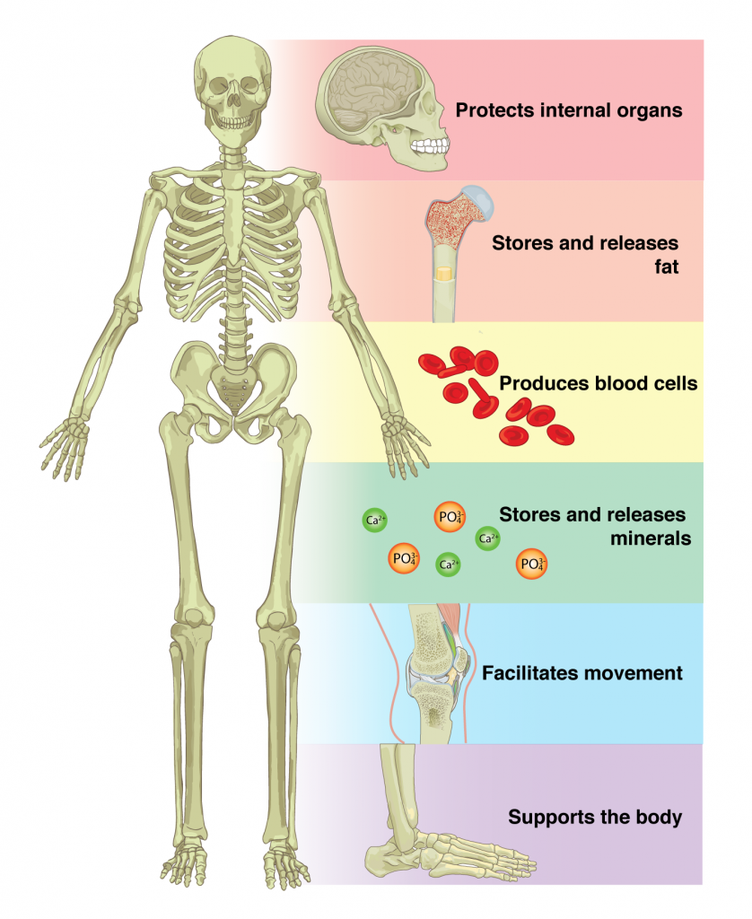
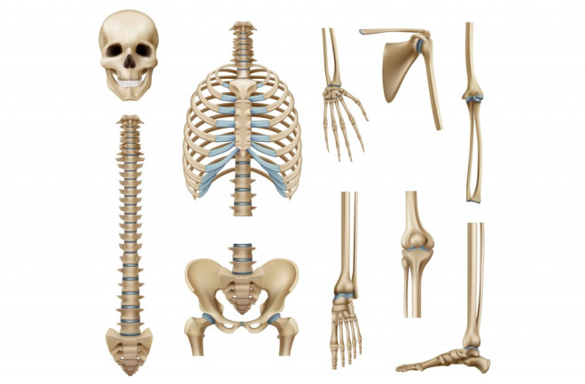
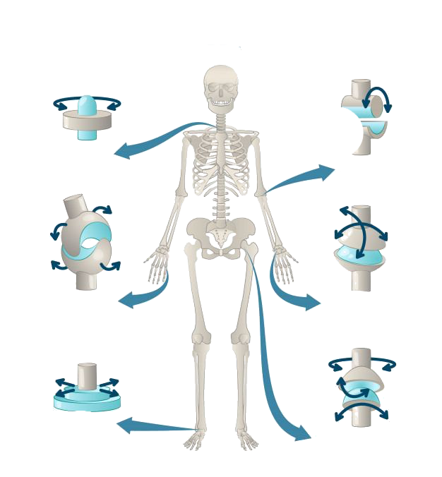
SKELETAL SYSTEM
Function of bones:
Skeletal system is composed of:
1-Bones
2-Joints (Articulations between bones)
in the bone marrow.
e.g. calcium and phosphorus.
Attachment:
of muscles.

Slide 12
CLASSIFICATION OF BONE
Short bone: carpal and tarsal bones.
Development
Shape
Structure
Membranous
Long bone: Femur, humerus, tibia, ﬁbula, clavicle, metatarsals, and metacarpals.
Spongy
Cartilaginous
Irregular bone: vertebrae, sacrum.
Compact
Flat bone: sternum, skull, and scapula.

Slide 13
THE SKELETON
The skeleton is formed of 206 bones The skeleton is divided into:
Axial skeleton
Appendicular skeleton
Bones of the trunk 80 bones.
Bones of the girdles. and limbs 126 bones.

Slide 14
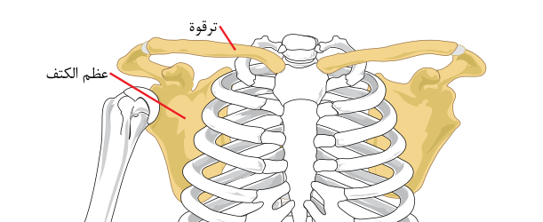
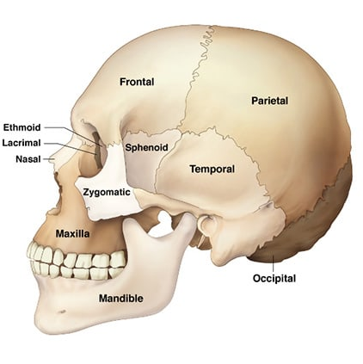
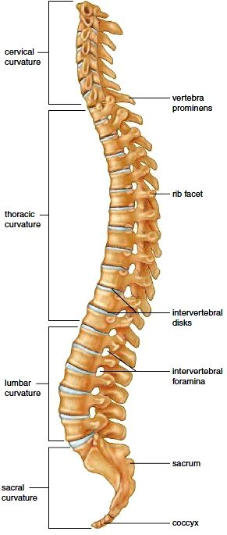
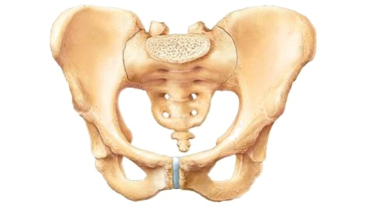
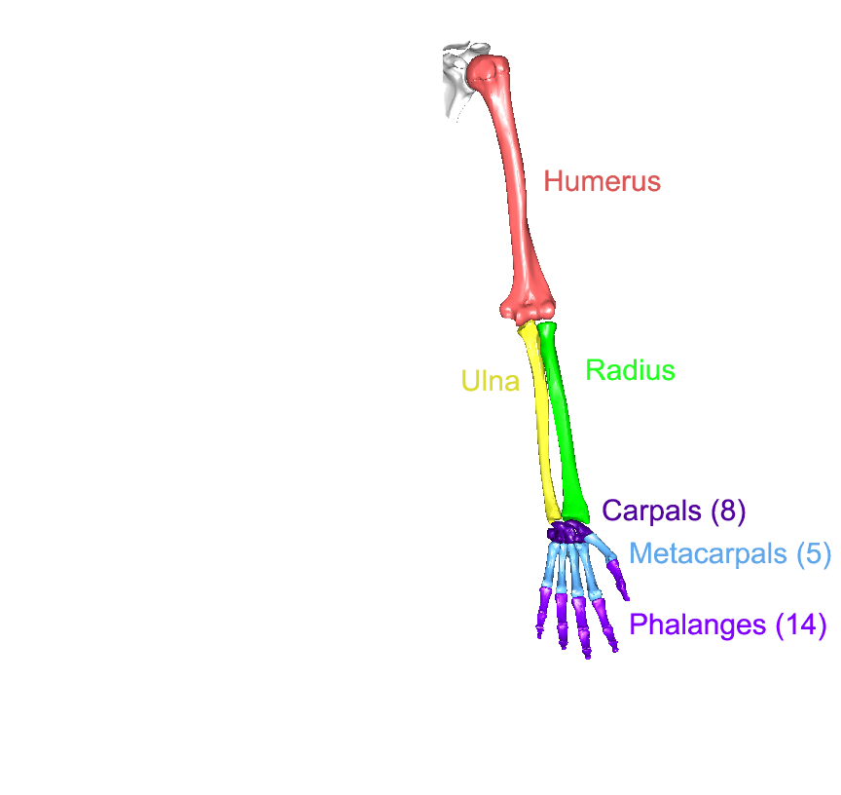
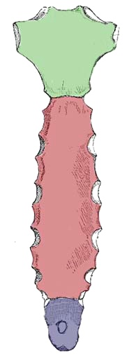
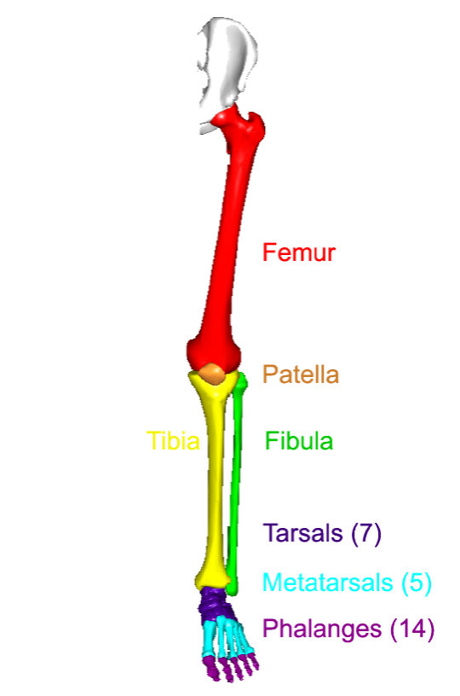
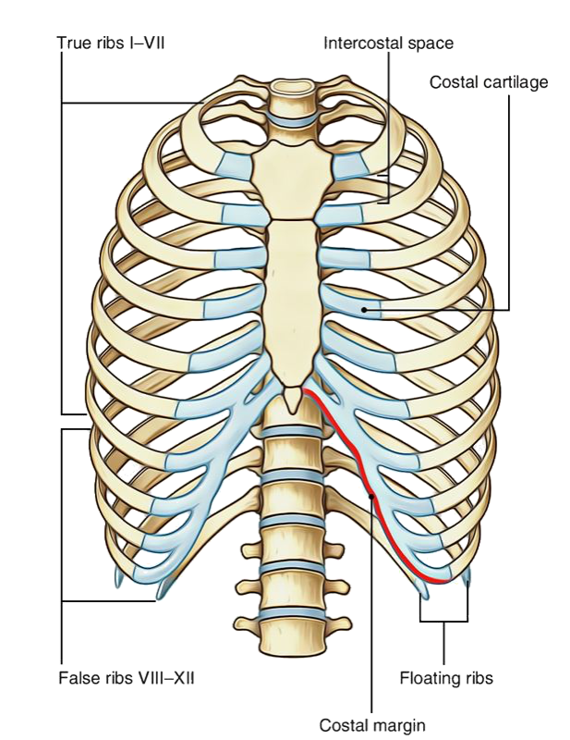
THE SKELETON cont...
AXIAL | APPENDICULAR
Skull | Pectoral girdle
Vertebral Column | Pelvic girdle
Sternum | Lower limb
Ribs | Upper limb

Slide 15
THE SKULL
The skull is divided into:
● Cranium bones:
(Bones enclosing brain)
○ Frontal
○ Occipital
○ Parietal (pair)
○ Temporal (pair)
● Facial bones:
(Bones of the face)
○ Maxilla (pair)
○ Nasal (pair)
○ Zygomatic (pair)
○ Mandible (The only movable
bone in the skull)

Slide 16
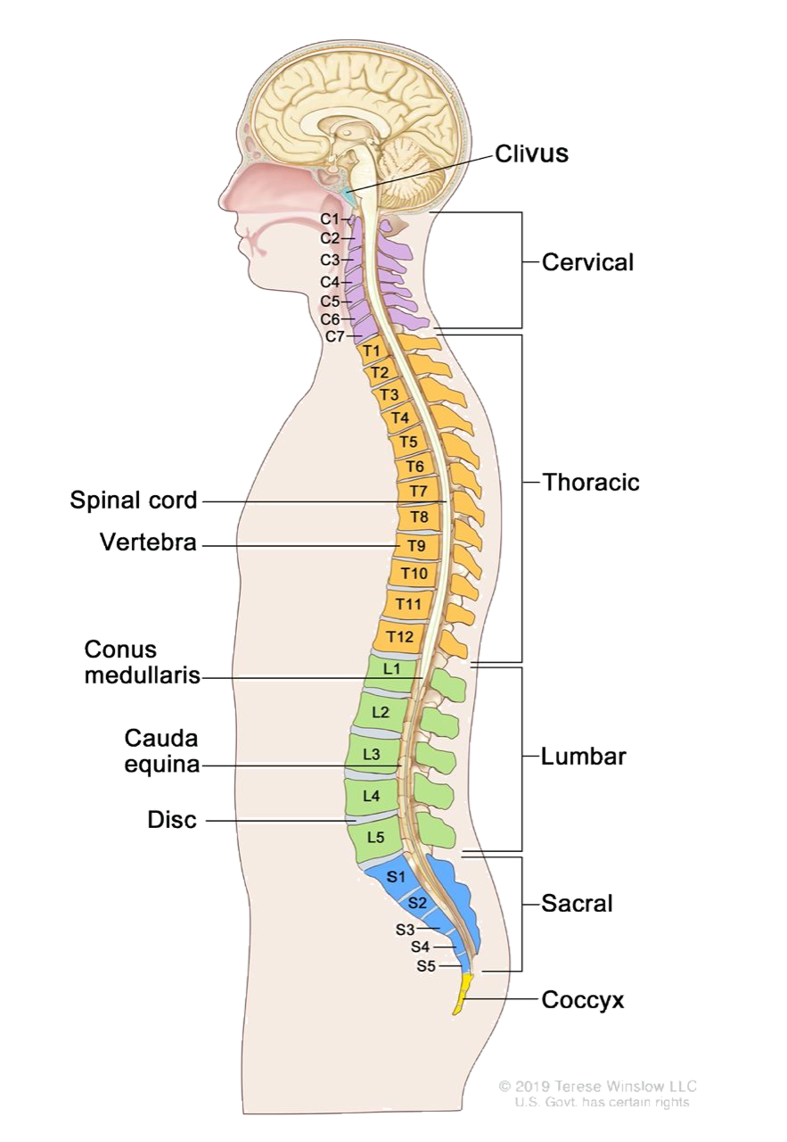
THE VERTEBRAL COLUMN
● Number: 33 vertebrae
● Function:
- protects the spinal cord and
- supports the body
● Formed of:
○ 7 cervical
○ 12 thoracic
○ 5 lumbar
○ 5 sacral, fused to form sacrum
○ 4 coccygeal, fused to form coccyx
Can’t Talk Like Salman’s Cousin
Cristiano To Lukaku Shoot Corner

Slide 17
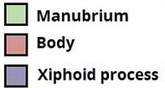
THE STERNUM & RIBS
● Ribs made of 12 pairs:
-Upper 7 pairs are true ribs
because they articulate with the Sternum directly.
- 8, 9, 10 pairs are false ribs
Do not articulate with the ribs and sternum directly, but are connected by to the 7th rib by cartilage.
- 11, 12 pairs are floating ribs
Only connected by the vertebrae.
● All ribs articulate with vertebrae posteriorly.
● Sternum made of 3 parts:
○ Manubrium
○ Body
○ Xiphoid process
(Note:The false ribs include the floating ribs)

Slide 18
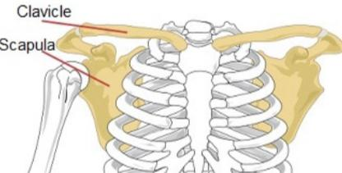
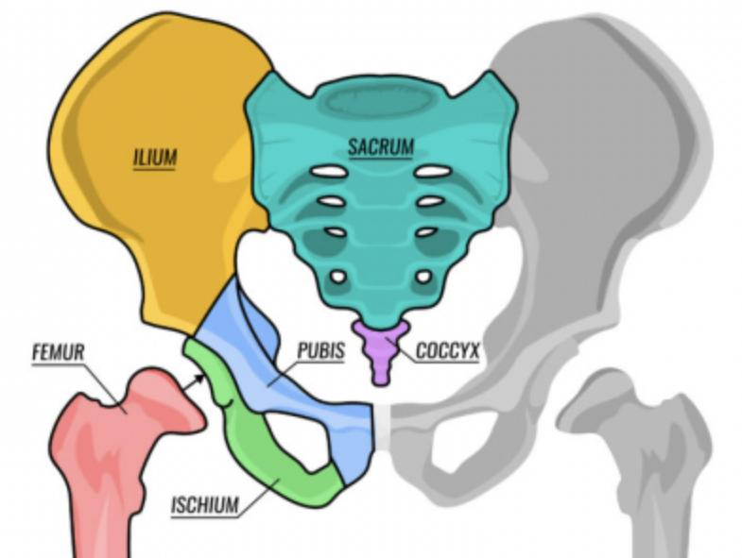
THE GIRDLES
1. Pectoral girdle formed of:
○ Clavicle
○ Scapula
(Two bones on each side)
Connects upper limb with axial
skeleton
2. Pelvic girdle formed of:
○ Hip bone
(one only on each side)
Connects lower limb with axial
skeleton

Slide 19
THE UPPER LIMBS
Upper limb
Bones of the arm
Bones of the forearm
Bones of the hand
Humerus
Radius (lateral)
Ulna (medial)
8 Carpals (in two rows)
5 Metacarpals
14 Phalanges
● 2 for thumb
● 3 for each of medial 4 fingers

Slide 20
THE UPPER LIMBS
Lower limb
Bone of thigh
Bones of the leg
Bones of the foot
Femur
Fibula (lateral)
Tibia (medial)
Patella (in front of the knee)
7 Tarsals
(in two rows)
5 Metatarsals
14 Phalanges
- 2 for big toe
- 3 for each of lateral 4 toes
Dr note: Tibia is thicker than Fibula

Slide 21
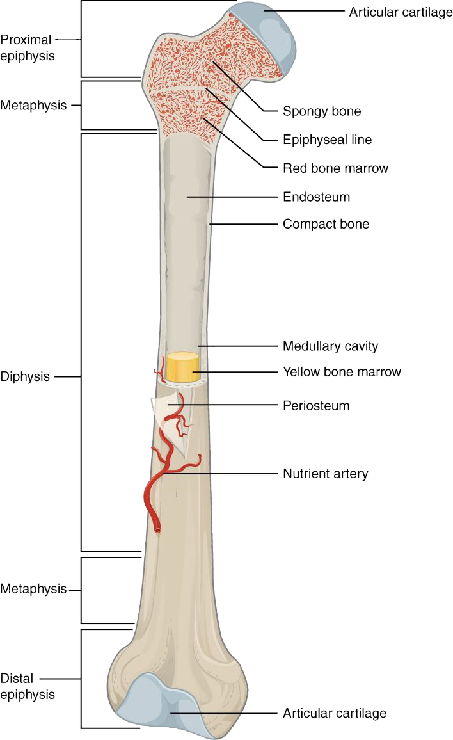
LONG BONES
Contains the epiphyseal plate
of cartilage
that is responsible
for linear bone growth
Long bones are formed of:
1-Metaphysis: Region of contact between epiphysis & diaphysis
2-Ends/epiphysis:
Spongy bone(cancellous)
3-Shaft/diaphysis: Compact bone

Slide 22
MCQs :
1-One of the following is an irregular bone:
A-Scapula
B-Skull
C-Sacrum
D-Sternum
2-Name the lateral bone of the leg:
A-Patella
B-Tibia
C-Radius
D-Fibula
3-In Eversion the sole faces in a …. direction
A-Medial
B-Lateral
C-Anterior
D-Posterior
4-Region of contact between epiphysis & diaphysis:
A- Metaphysis
B- Deltaphysis
C-Bone marrow
D-Spongy bone
5-combined movements of flexion extension abduction & adduction
A-Flexion
B-Medial Rotation
C-Circumduction
D- Eversion
6-All ribs articulate with vertebrae:
1-C
2-D
3-B
4-A
5-C
6-B
A-Anteriorly
B-Posteriorly
C-Superficially
D-Dorsally

Slide 23
Team Leaders
Mishal Alsuwayegh
Arwa Alghamdi
Anatomyteam442@gmail.com
Team Members
By : Faisal Alomar
Faisal Alomar | Mohammed Aldawsari
Mohammad Alrashed | Waleed AlRashoud
Salman Albadr | Fares Alotaibi
Omar Alkadhi | Mohammed Alamri
Abdulaziz AlShalhoub | Saleh Aldeligan
Lina Almohsen | Maha Alkoryshy
Hissah Alshiqari | Rahaf Almotairi
Maha Alzahrani | Jana Alhazmi
Sarah Albenmousa | Lina Alyahya
Alhnouf Alyami | Shaden Albassam

