Slide 1
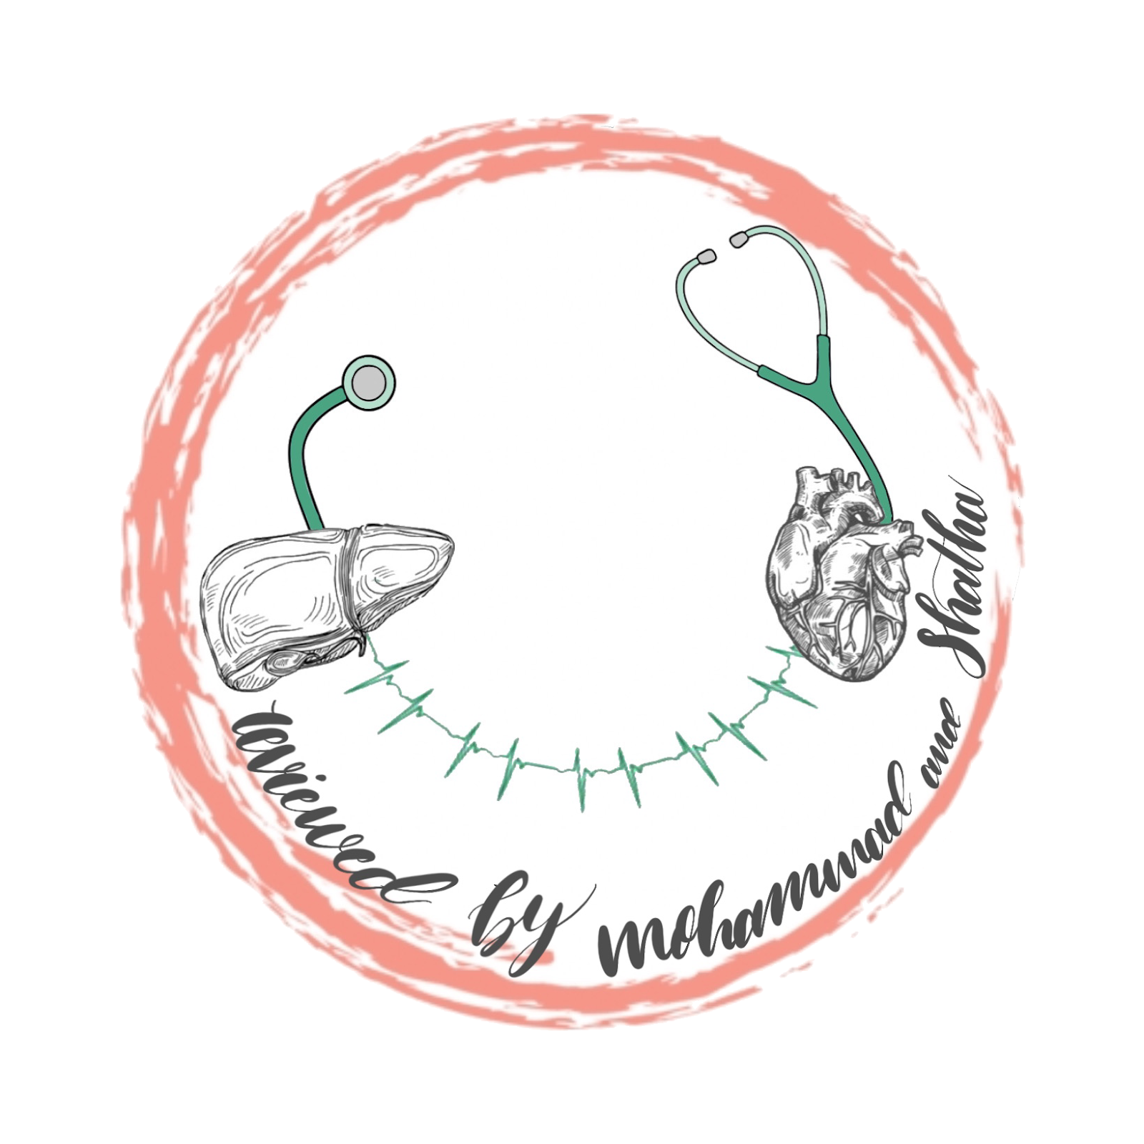
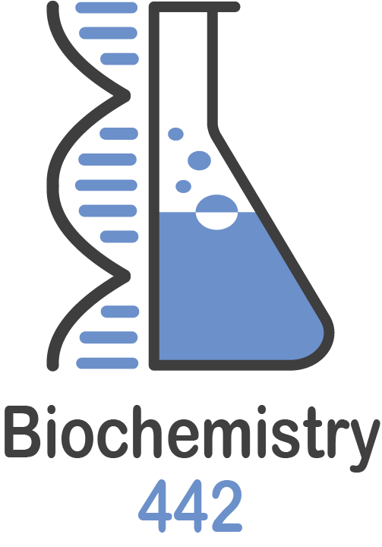
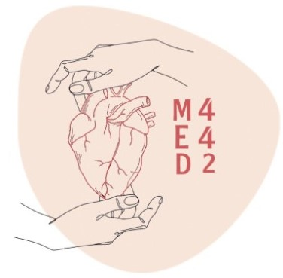
Lecture 10
Color Index
Girls’ slides
Boys’ slides
Doctors’ notes
Important
Extra info
Major metabolic pathways of glucose and glucose transport
Editing File

Slide 2
Objectives
Define a metabolic pathway
Describe the general metabolic pathways for glucose
( production and utilization )
Briefly describe the HMP
Recognize the mechanisms of glucose transport
By the end of the lecture, students are expected to:

Slide 3
Metabolic pathway of glucose (catabolic & anabolic)
Definition:
[441] : Sequence of reactions, which are put together so that the product of any reaction becomes a substrate of the next reaction. Giving you at the end of the reaction a final product, called the final end product of the pathway.
Site:
1- Cellular ( tissue )
2- Subcellular
Rate-limiting enzymes
(441): Determine the
rate of that particular reaction
(fast or slow).
There is two types of reactions in metabolic pathways
Regulatory mechanism(s)
1- rapid, short-term (mostly - covalent modification - allosteric 2- Slow, long-term - induction - repression
Catabolic Reaction
Where breakdown happens
Anabolic Reaction
Where building happens

Slide 4
Metabolic pathways of glucose
There is two paths for glucose:
production for glucose
utilization of glucose
Four ways to break down glucose
Anabolic
There is two ways to do it
Catabolic
Anabolic
Glycolysis
Glycogenesis
Synthesis of glycogen
HMP / PPP
HMP: Hexose Monophosphate Pathway
PPP: Pentose Phosphate Pathway
HMP/PPP all the same
Hexose interconversion
Glycogenolysis
it happens at breakage of glycogen
Gluconeogenesis
production of glucose from non-carbohydrate molecules
Hexose interconversion
converting other hexoses into glucose. e.g., fructose to glucose
Glycolysis (Main)
gluconeogenesis
Krebs (Main)
glycogenesis
glycogenolysis
HMP

Slide 5
Metabolic pathways of glucose
Glycolysis:
Oxidation of glucose to provide energy ( the main pathway of glucose metabolism )
With oxygen
The cells with mitochondria and an adequate supply of oxygen produce Pyruvate
Without oxygen
The cells that lack of mitochondria and absence of oxygen the product will be Lactate

Slide 6
Metabolic pathways of glucose
Glycogenesis:
Synthesis of glycogen from glucose mainly in liver, muscle and cytosol
Glycogenolysis:
Degradation of glycogen into glucose mainly liver, muscle and cytosol
gluconeogenesis:
Synthesis of glucose from non-carbohydrate precursors
The precursors could be lactate, pyruvate, glycerol And alpha-keto acids
It requires both mitochondria and cytosolic enzyme
Occurs in liver and kidney
Hexose Monophosphate pathway(HMP):
HMP shunt is an alternative pathway for glucose oxidation
It isn’t involved in the generation of energy
Around 10% of glucose is entered in this pathway
In liver & kidney, this percentage is up to 30%

Slide 7
HMP biomedical importance
What is cytochrome p450 ?
the cytochrome P450 (CYP) enzymes are membrane-bound hemoproteins that play a pivotal role in the detoxification of xenobiotics, cellular metabolism and homeostasis
There is two main functions :
1
Provides NADPH
Which is required for :
Synthesis of fatty acids, steroid and some amino acids.
Detoxification of drugs by (cytochrome p450)
In scavenging ( removing ) the free radicals
2
Provides pentose
The pentose and its derivatives are useful in the synthesis of :
1- Nucleic acids ( DNA & RNA )
2- Nucleotides ( ATP, NAD, FAD and CoA )

Slide 8
Tissue distribution
in the cytosol of :
Liver
30%
Adrenal cortex
30%
Lactating mammary gland
10%
Gonads
10%
Adipose
Tissue
10%
Lens
&
Cornea
10%
Erythrocytes
to reduce
Glutathione
10%

Slide 9
HMP SHUNT
Note: the important points that you need to know are on the picture of the shunt.
Helpful Video :)
It means (Another pathway)
PHASES
MAIN-OUTCOME
ENZYMES
-Oxidative (irreversible): from Glucose 6-phophate till Ribulose 5-phosphate (end product)
-Non-Oxidative (reversible): from Ribulose 5-phosphate till the end of pathway
NADPH
. synthesis of fatty acids, steroid, amino acid
Ribose
synthesis of
DNA, RNA, ATP, FAD, NAD
DHD Eitt .
wanna know how?
Dehydrogenase - Hydrolase – Dehydrogenase
(oxidative phase)
Epimerase - isomerase - transketolase – transaldolase
(non-oxidative phase)
Text

Slide 10
HMP SHUNT
GLUCOSE 6-PHOSPHATE
6-PHOSPHO-GLUCONOLACTONE
6 PHOSPHO-GLUCONATE
RIBULOSE 5 PHOSPHATE
By?
Glucose 6-phosphate Dehydrogenade (G6PD)
NADPH , H+
NADP+ ,H20
REMEMBER
DHD Eitt
6-phospho-gluconolactone Hydrolase (Lactonase)
NADPH , H+
NADP+ ,H20
6-phospho-gluconate Dehydrogenase (6PGD)
Ribose 5-phosphate isomerase
Phospho-pentose Epimerase
قلنا في محاضرة الإنزيمات ان الآيزو ما يغير شيء الا ترتيب المركبات.
عشان كذا الإسم تشوفه متشابه مره مع المركب الأساسي
RIBOSE 5-PHOSPHATE
XYLULOSE 5-PHOSPHATE
Transketolase
And coenzyme called: thiamine pyrophosphate (TPP) (vitamin B1)
SEDOHEPTULOSE 7-PHOSPHATE
GLYCERALDEHYDE 3-PHOSOHATE
Transaldolase
Transketolase + TPP
ERYTHROSE 4-PHOSPHATE
FRUCTOSE 6-PHOSPHATE
XYLULOSE 5-PHOSPHATE
GLYCERALDEHYDE 3-PHOSPHATE
Glycolytic pathway
Enzymes:blue
Product:dark purple,two dark yellow
Irreversible”oxidative”:
Reversible”non-oxidative”
The stranger reaction: dark yellow
Precursor product for non-ox.: purple
FRUCTOSE 6-PHOSPHATE
Read me
Glycolytic pathway
Glycolytic pathway

Slide 11
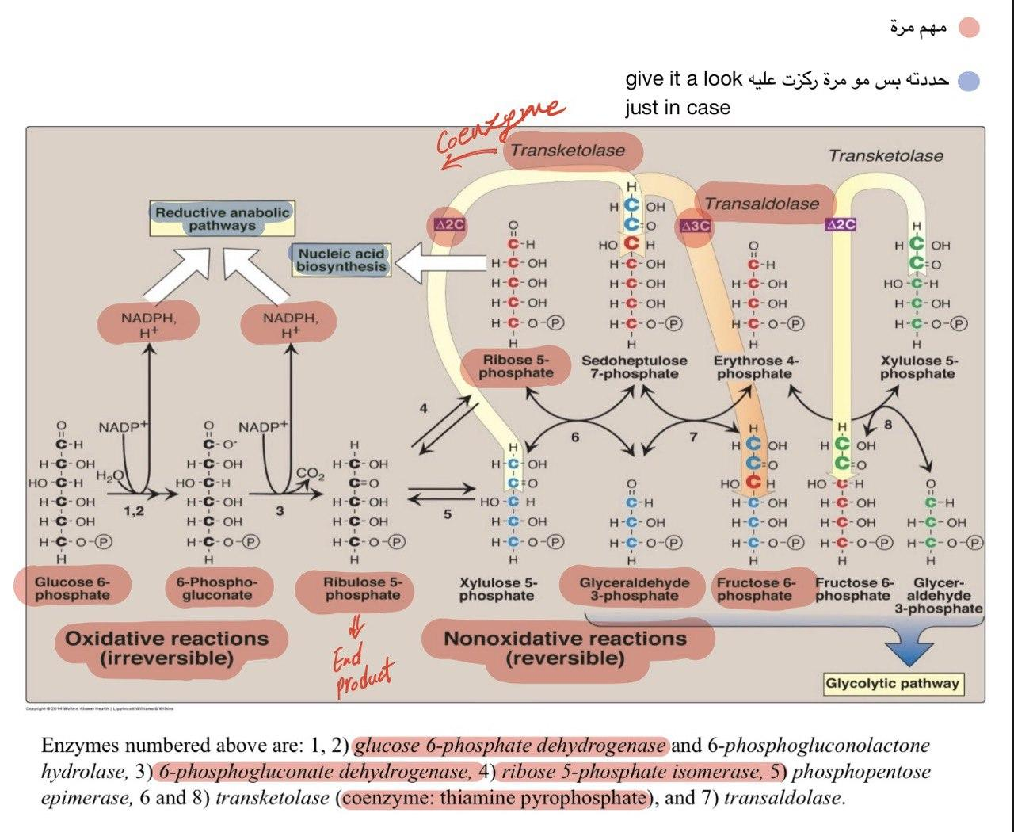
NOTES
Note: you must know the highlighted points, they’re all u need to know
Points you need to know:
Oxidative reactions: everything except the structure
Nonoxidative reactions: 3 points
1-Glycolysis metabolites
. glyceraldehyde 3-phosphate
. Fructose 6-phosphate
2-transketolase transfer 2C and needs coenzyme thiamine pyrophosphate(TPP)
3-transaldolase transfer 3C
Text

Slide 12
Notes special thanks to 441
Oxidative | Non-Oxidative
​● RATE LIMIT ENZYME FOR ALL THIS PATHWAY IS Glucose 6-phosphate dehydrogenase (G6PD) . how? because without this enzyme, all the pathway won’t occur, this enzyme has The ability to switch on/off the pathway “extremely important” ● From oxidative phase we will get TWO NADPH . one from reaction 1, another from reaction 3 ● All oxidative reactions are irreversible | ​● The precursor for this phase is Ribulose 5-phosphate ● From non-oxidative phase we will get a Ribose 5-phosphate “pentose sugar” ● All non-oxidative reactions are reversible ● Products with the dark yellow color, are catalyzed by Transketolase to form another new reaction with new products, it is a specific reaction in this phase as you see because none of those compounds are doing like them ● Transketolase requires an important co-factor which is thiamine pyrophosphate (TPP) to be activated “extremely important”

Slide 13
Clinical Correlation
Deficiency in Glucose 6-phosphate dehydrogenase (G-6-PD) result in:
● the only way the body get NADPH is from HMP shunt, so if there is deficiency in the rate-limit enzyme which is G-6-PD, NADPH won’t
formed, and this lead to stop affect the things that required NADPH “in slide 9”
while the pentoses, body can get them from other resource, so there is no much effect
Hemolytic anemia
destruction of red blood cells
Neonatal jaundice
(effects the liver)
neonatal: relating to
newborn children
Kidney failure

Slide 14
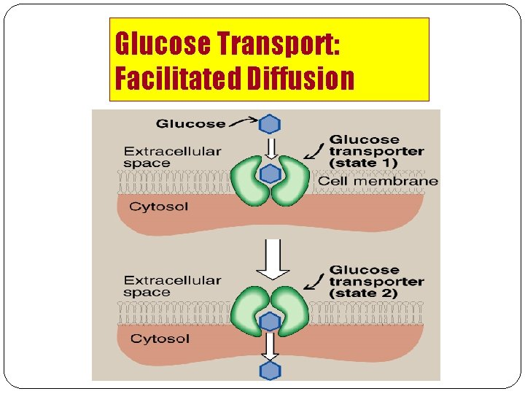
Glucose Transport
Glucose is hydrophobic molecule that’s why it cannot pass easily inside the cell so it needs another way to go inside the cell either by
Co-transporter which will take Na+ and glucose together to go inside the cell or by Facilitated diffusion which mean it has a specific carrier
to it. (thanks to 439 team)
Na+-Monosaccharide Cotransporter “dependent”
Na+-Independent Facilitated Diffusion
- Against concentration gradient
low conc. to high conc.
- Energy dependent why? because it’s against conc.
- Carrier-mediated
- Coupled to Na+ transport
- Small intestine, renal tubules & choroid plexus
- Down the concentration gradient
- Energy Independent (Passive transport)
- Glucose Transporters (GLUT 1-14)

Slide 15
Glucose Transporter Tissue-specific expression pattern:
transporter | Location | function
GLUT-1 | RBCs and brain | Glucose uptake from blood
GLUT-2 | Liver, kidney & pancreas | Blood & cells (either direction)
GLUT-3 | Neurons | Glucose uptake from blood
GLUT-4 | Adipose tissue & skeletal muscle | Glucose uptake from blood Involved in diabetes
GLUT-5 | Small intestine & testes | Fructose transport
GLUT-7 | Liver (ER-membrane) | -

Slide 16
Take Home Messages
● There are multiple pathways for glucose that can be grouped in to catabolic (utilizing glucose) or
anabolic (producing glucose).
● Glycolysis is the major metabolic pathway of glucose breakdown to provide energy.
● Alternative pathway for glucose oxidation but not meant for producing energy.
● Has two phases- oxidative and non-oxidative.
● During oxidative phase, glucose-6-P is oxidized with generation of 2 moles of NADPH, and one mole
of pentose phosphate, with liberation of CO2.
● During non-oxidative phase, pentose phosphate is converted to intermediates of glycolysis.

Slide 17
Quiz
1- Which of the following is produces glucose ?
A) Hexose interconversion | B) Glycolysis | C) Glycogenesis | D) Krebs
2- Which coenzyme dose transketolase needs to transfer 2C ?
A) thiamine pyrophosphate (TPP) | B) isomerase | C) hydrolase | D) 6PG-dehydrogenase
3- which enzyme is used with glucose 6-phosphate and is a rate limiting enzyme ?
A) 6 phospho gluconate dehydrogenase | B) thiamine pyrophosphate | C) Glucose6- dehydrogenase | D) Transketolase
4- Detoxification of drugs is provided by
A) Pentose sugar | B) NAD+ | C) Nucleic acids | D) NADPH
5- Deficiency in Glucose 6- phosphate dehydrogenase causes all the below EXCEPT ?
A) Aplastic anemia | B) Kidney failure | C) Hemolytic anemia | D) Neonatal jaundice
1. A
2. A
3. C
4. D
5. A

Slide 18
SAQs
How many NADPH will you get from the oxidative phase and is the reactions reversible or irreversible?
3 characteristics of Na+ monosaccharide cotransporter ?
The metabolic pathway that results in the generation of glucose from certain
non-carbohydrate carbon substrates?
SAQs Answer key:
1) 2 NADPH and the reactions are irreversible
2)slide 14
3)Gluconeogenesis

Slide 19
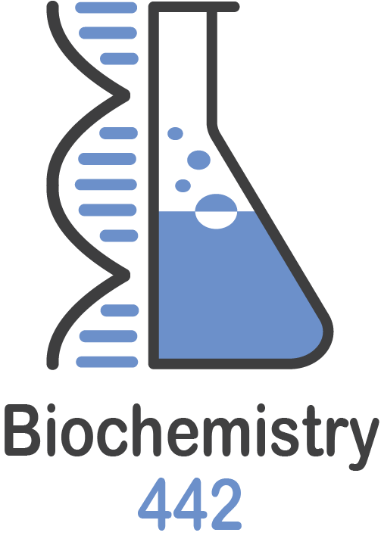
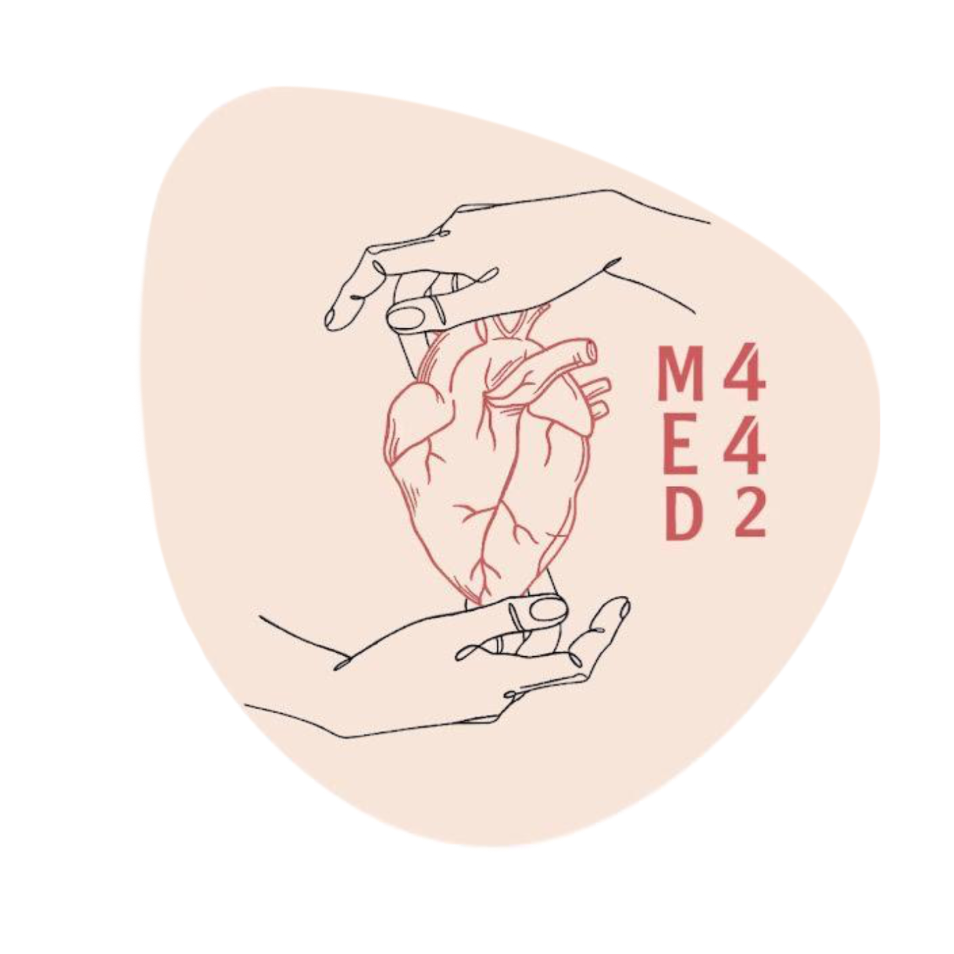
Our Team
Meshari Alshathri
Talal Alharbi
Azzam Alotaibi
Basel Al-Zahrani
Saleh Aldeligan
Mohammed AlGhamdi
Abdulaziz Lafy
Rayan Alahmari
Mohammed Alrobeia
Abdullah Alqarni
Osama alzahrini
Saif Alotaibi
Othman Abdullah
Hazem Almalki
Abdullah alshahri
Mohammed Alshehri
Raneem Alwatban
Mayssam Aljaloud
Rahaf Almotairi
Najla aldhbiban
Nouf Alsaigh
Raseel Alwehibi
Mashael Alasmri
Razan Almanjomi
Razan Almohanna
Mashael Alsuliman
Reema Alhussien
Moudi Alsubaie
Renad Alayidh
Sara Alzahrani
Leaders
Arwa Alghamdi, Ajwan Aljohani & Mohammed Al-zeer

