Slide 1
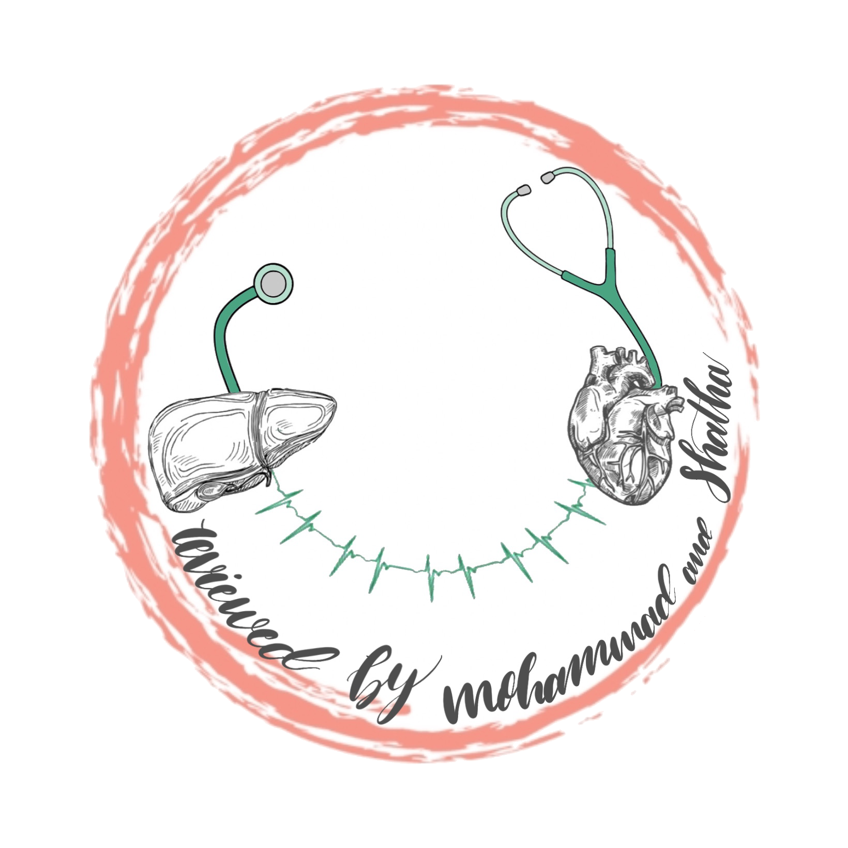
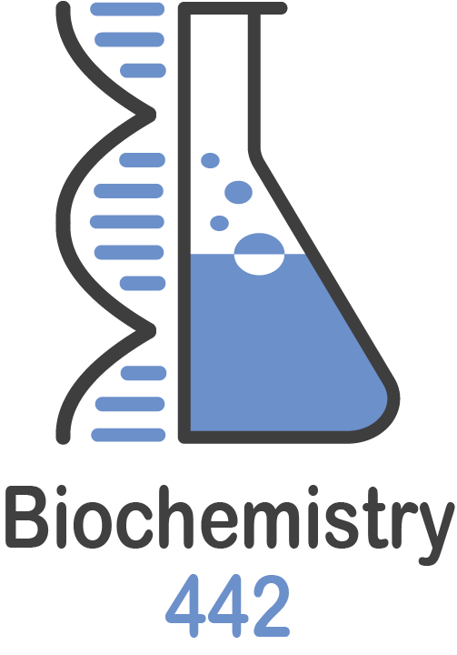
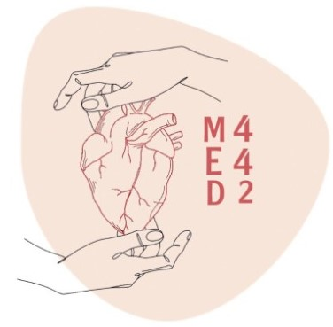
Lecture 15
Color Index
Girls’ slides
Boys’ slides
Doctors’ notes
Important
Extra info
BIOCHEMICAL MARKERS FOR DIAGNOSIS AND FOLLOW UP OF DISEASES
Editing File

Slide 2
Objectives
Upon completion of this lecture, the students should be able to:
Define biomarkers and its criteria
Recognize different types of biochemical markers
Demonstrate the clinical applications of biomarkers in diagnosis of various diseases

Slide 3
What is a biomarker?
A biological molecule found in blood, other body fluids, or tissues that indicates a normal or abnormal process such as a disease or a condition.
Most common body fluids for the measurement of biomarkers are:
1. Serum 2. Blood (Plasma) 3. Urine
E.g.: glucose is biomarker for diabetes.
Biomarkers
Plasma-specific
Tissue-specific
-Normally present in plasma.
-Perform their functions in blood.
-High level of activity in plasma than in tissue cells.
-Examples: blood clotting enzymes (thrombin), cholinesterase, etc.
-Present inside the cell.
-A low concentration can be detected in plasma due to cellular turnover.
-Released into the body fluids in high
conc. due to: cell damage, and defective cell membrane.

Slide 4
Cell Damage
Diagnosis and Prognosis
Cell damage can be due to:
1- Tissue inflammation, example:
ALT* in liver disease (e.g. acute hepatitis) ALT*: alanine aminotransferase.
Amylase in acute pancreatitis.
2- Ischemia → hypoxia → infarction →↑ plasma [Troponin] in myocardial infarction.
Diagnosis: Identification of a disease from its signs and symptoms.
Prognosis: The future outcome of a disease.

Slide 5
Criteria of a good biomarker assay:
A good biomarker assay should be:
Able to accurately diagnose a disease
Able to accurately predict prognosis of a disease.
Compliant with treatment follow up
Easily obtainable from blood, urine, etc.
Sensitive: Sensitivity is the ability of an assay to detect small quantities of a marker.
Even if biomarker low or in early stage, it will detect.
Specific: Specificity is the ability of an assay to detect only the marker of interest.
One biomarker → one disease
Robust to produce fast results
Able to be rapid+robust to deliver results faster. team441
Assay is an analytical
test by which we can
measure biochemical
markers in the lab.

Slide 6
Enzymes as biomarkers:
Enzymes
Hormones
Proteins
Amylase
Anti-Mullerian hormone (AMH)
a-Fetoprotein
Lipase
Prostate Specific Antigen (PSA)
Alanine aminotransferase (ALT)
Cystatin C
Aspartate aminotransferase (AST)
B-type Natriuretic Peptide (BNP)

Slide 7
Amylase
Enzymes
Enzymes are clinically used for the diagnosis and prognosis of various diseases.
Elevated serum amylase is a diagnostic indicator of acute pancreatitis.
Amylase level greater than 10 times the upper limit indicate acute pancreatitis.
Test has low specificity because elevated serum amylase is also present in other diseases
Amylase appear in serum within 2-12 hours after abdominal pain and returns to normal within 3-5 days .
Lipase
Serum Lipase has higher specificity than serum Amylase (elevated only in acute pancreatitis)
It appears in plasma with 4-8 hours (faster) and remains for 8-14 days (longer)

Slide 8
Case
A GP was called to see 21-year-old female student who had been complaining a flu-like illness for two days, with symptoms of fever, vomiting and abdominal tenderness in the right upper quadrant. On examination, she was jaundiced, moreover; the liver was enlarged and tender. A blood sample was taken for liver function tests which showed elevated ALT (Alanine aminotransferase) and AST (Aspartate aminotransferase)
What is the most likely diagnosis?
Acute Hepatitis

Slide 9
Enzymes
Aspartate Aminotransferase (AST) and Alanine Aminotransferase (ALT)
Produced by
Elevated in
AST
Heart, liver, skeletal muscles, kidney, erythrocytes
Liver disease, heart disease, skeletal muscle disease, hemolysis
AALT
Liver
Liver disease
ALT is more specific than AST because it only elevates in liver diseases

Slide 10
Summary for enzyme biomarkers:
Acute Pancreatitis Biomarkers
1-Lipase More specificity / within 4-8 hrs up to 8-14 days
2-Amylase Low specificity (present in other diseases) / within 2-12 hrs up to 3-5 days/ x10 the upper limit
Acute hepatitis Biomarkers
1- ALT More specific to Liver diseases
2- AST Low specificity (elevated in other diseases)

Slide 11
Proteins as Biomarkers
Tumor
markers
1- a-Fetoprotein
2- Prostate specific Antigen (PSA)
3-Cystatin C
4- B-type natriuretic peptide
Tumor marker: A molecule secreted by a tumor that is measure for diagnosis and management of a tumor.

Slide 12
Proteins as Biomarkers
1- a-Fetoprotein: (Nonspecific tumor marker)
It’s produced by the fetal liver and falls until term→ In newborn babies a-fetoprotein levels are very low.
It remains low under normal conditions.
High conc. are observed in:
Hepatocellular carcinomas (hepatoma)
Testicular carcinomas
GI tract carcinomas
High serum levels are also found in benign (non-cancerous) conditions. Eg: Hepatitis.
High conc. not always suggestive of a tumor.
It is a nonspecific marker
2- Prostate Specific Antigen (PSA):
Produced by prostate gland.
PSA level is used as a tumor marker to aid and monitoring in patients with prostatic cancer.
Less specific in diagnosis.
High serum levels are also observed in:
Benign prostatic hyperplasia (BPH)
Prostatic inflammation/infection

Slide 13
Proteins as Biomarkers
3- Cystatin C
A cysteine protease inhibitor mainly produced by all nucleated cells of the body.
Useful biomarker for measuring glomerular filtration rate (GFR) in assessing kidney function and failure.
Unlike Creatinine, its serum conc. is independent of gender, age, or muscle mass.
Abnormally high serum levels of Cystatin C indicate early renal disease (kidney failure).
Clinically useful marker for detecting:
Early kidney disease.
Monitoring kidney transplantation.
4-B type natriuretic peptide (BNP)
A peptide secreted mainly in the cardiac ventricles in response to cardiac expansion and pressure overload
High serum levels are observed in congestive heart failure.
It can be used to differentiate patients whose symptoms are due to heart failure from those whose symptoms are due to other causes such as pulmonary disease.

Slide 14
Hormones as biomarkers:
Anti-Mullerian Hormone (AMH)
In females it is produced by ovaries.
Appears to be best marker for estimating egg cell reserve in the ovaries (ovarian reserve testing)
Only growing follicles produce AMH.
Plasma AMH levels strongly correlate with number of growing follicles
Anti-Mullerian Hormone (AMH)
It tells you about the fertility status of a woman.
High levels in women with Polycystic Ovarian Syndrome PCOS
Low levels in women with ovarian dysfunction

Slide 15
Take Home Messages
Biochemical markers are essential for accurate and non-invasive laboratory tools offering the treating physician fast means for better management.
They could be proteins, enzymes, or hormones.
Biomarkers are used for diagnosis, prognosis and follow up of diseases.
A biomarker exhibit good diagnostic and prognostic values.
Examples of biomarkers used in different diseases will help understand their qualities and limitations.
Recent development in medicine provides new biomarkers.

Slide 16
Quiz
1- A biological molecule that can be measured to follow up a disease or a treatment.
a) Biomarker | b) Diagnosis | c) Prognosis | d) Serum
2- A biomarker that is released in myocardial infarction:
a) PSA | b) AMH | c) a-fetoprotein | d) Troponins
3- Which of these biomarkers can be considered as tumor markers?
a) a-fetoprotein | b) PSA | c) Amylase | d) A and B
4- Which of these Biomarkers elevate only in acute pancreatitis?
a) Amylase | b) Lipase | c) ALT | d) AST
5- Which biomarker can be used to differentiate between heart failure and pulmonary diseases?
a) PSA | b) AMH | c) BNP | d) Cystatin C
1- A
2- D
3- D
4- B
5- C

Slide 17
SAQ
Enumerate the qualities of a good biomarker:
Side 5
List 3 cases where High concentration of A-fetoprotein is observed:
Slide 12

Slide 18
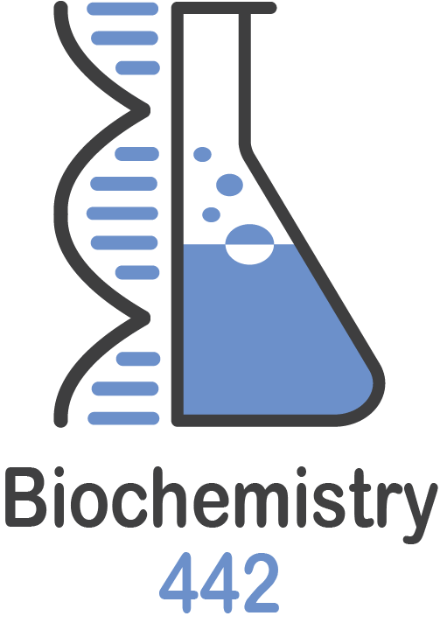
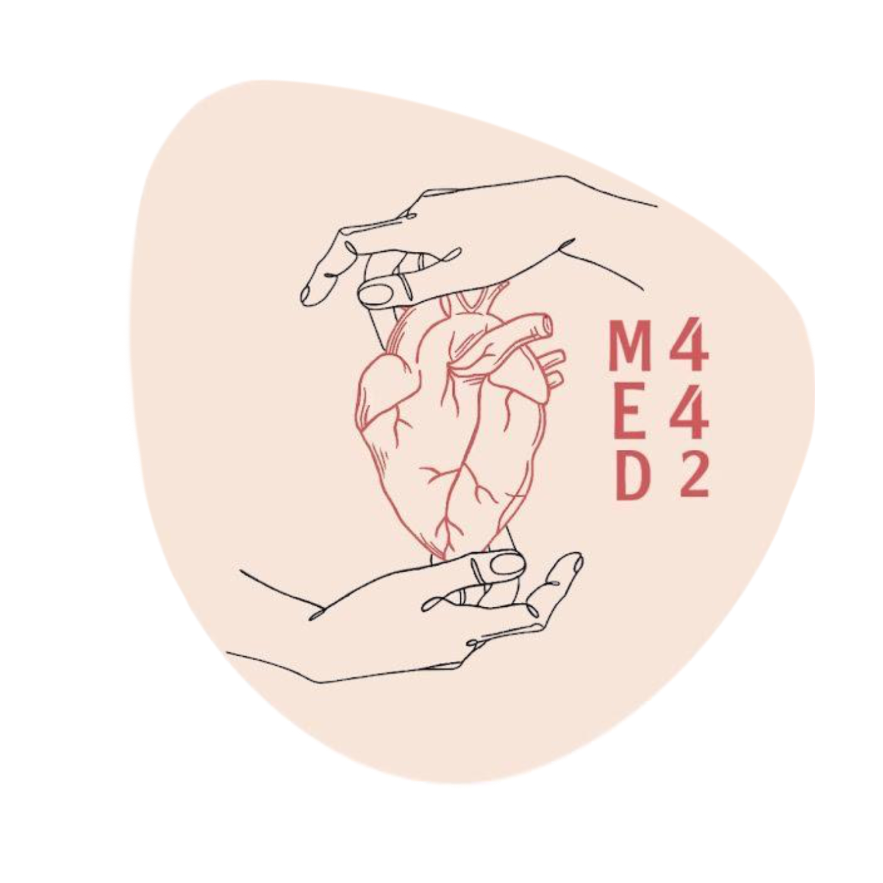
Our Team
Meshari Alshathri
Talal Alharbi
Azzam Alotaibi
Basel Al-Zahrani
Saleh Aldeligan
Mohammed AlGhamdi
Abdulaziz Lafy
Rayan Alahmari
Mohammed Alrobeia
Abdullah Alqarni
Osama alzahrini
Saif Alotaibi
Othman Abdullah
Hazem Almalki
Abdullah alshahri
Mohammed Alshehri
Raneem Alwatban
Mayssam Aljaloud
Rahaf Almotairi
Najla aldhbiban
Nouf Alsaigh
Raseel Alwehibi
Mashael Alasmri
Razan Almanjomi
Razan Almohanna
Mashael Alsuliman
Reema Alhussien
Moudi Alsubaie
Renad Alayidh
Sara Alzahrani
Leaders
Arwa Alghamdi, Ajwan Aljohani & Mohammed Al-zeer

