Slide 1
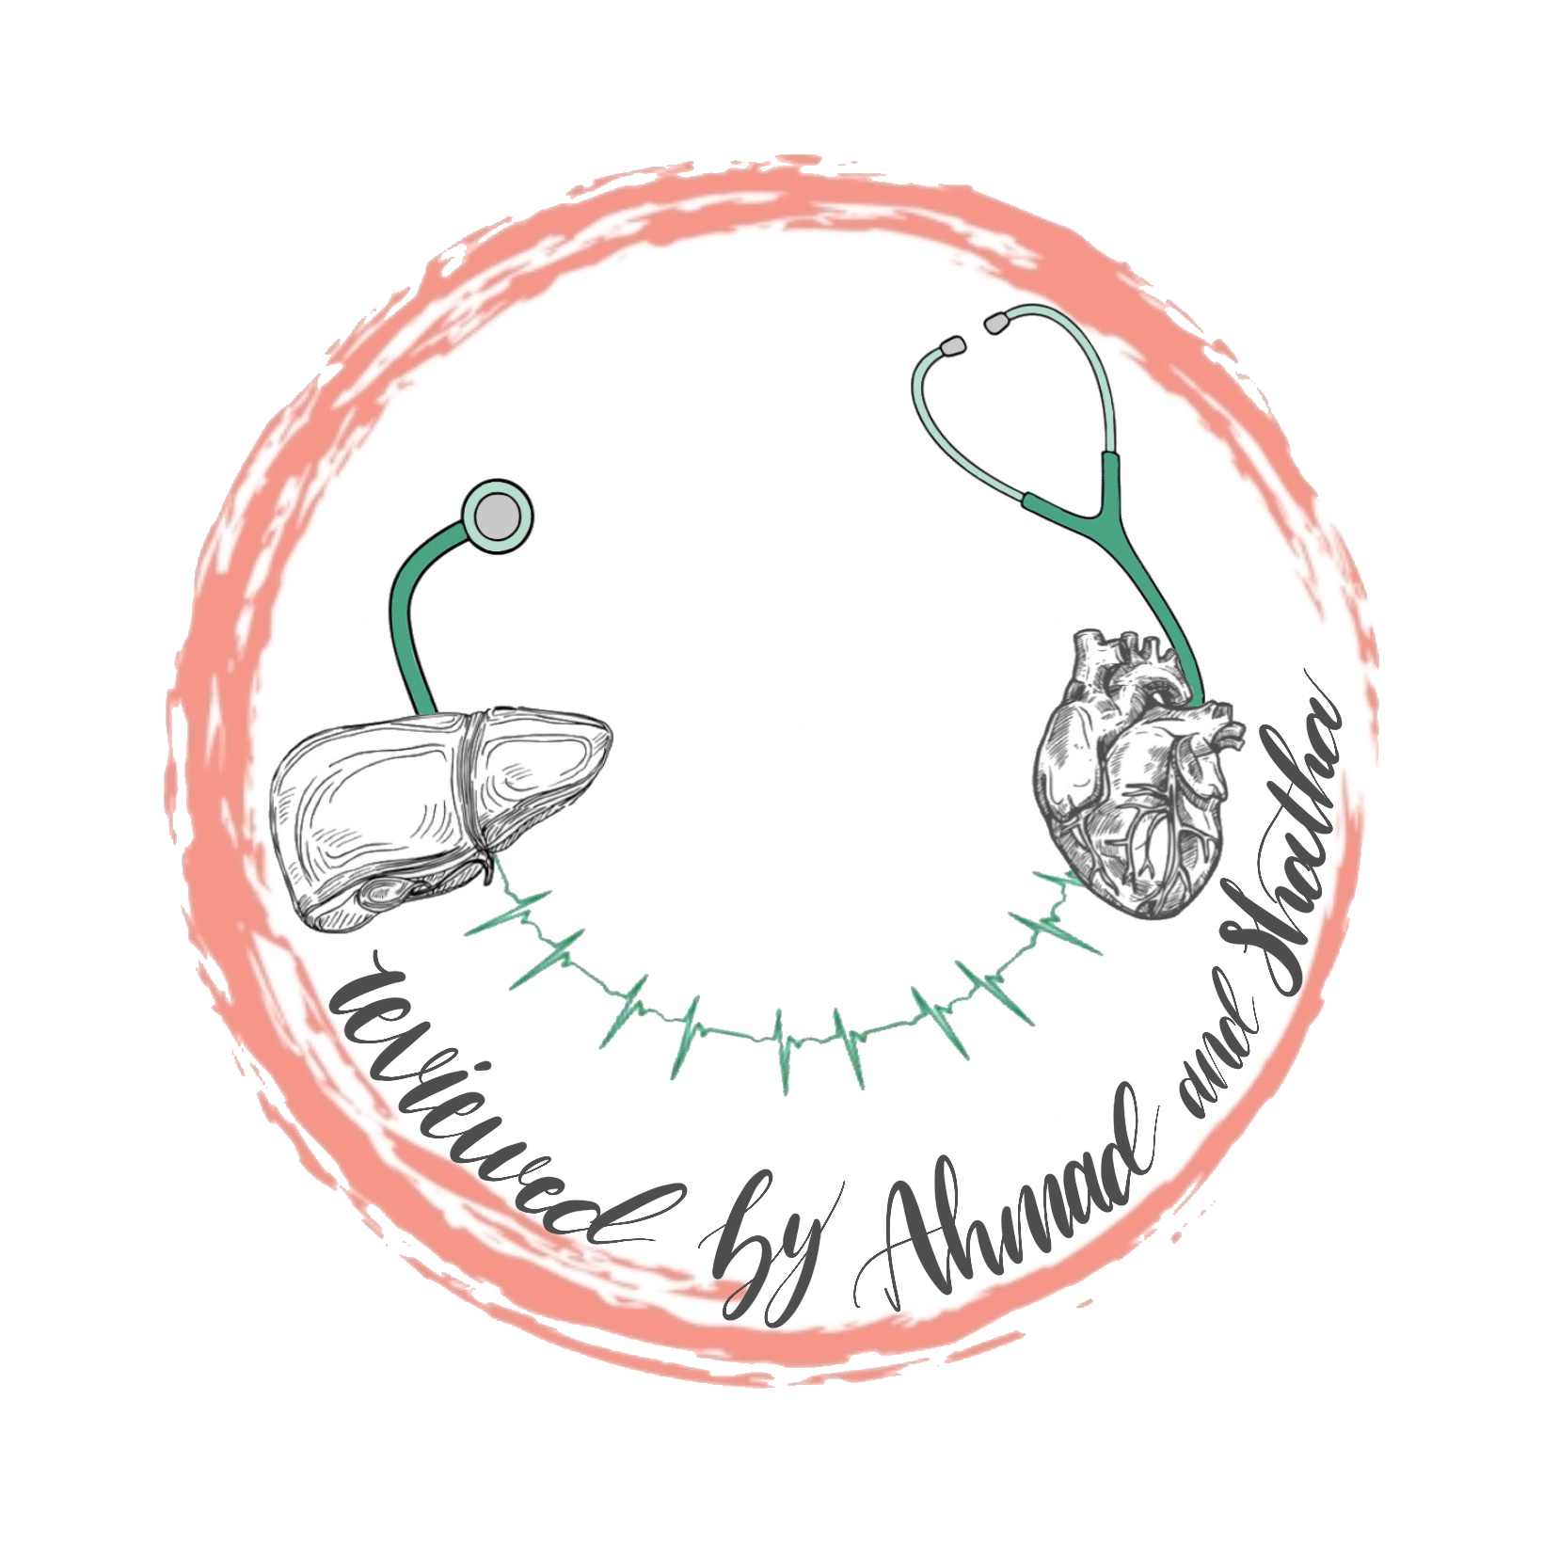
HUMAN CHROMOSOMES
1
Foundation block
Human genetics 442
RED : Important
PINK : F. slides
BLUE : M. slides
GREEN : Doctors notes
GRAY : Extra
Editing file

Slide 2
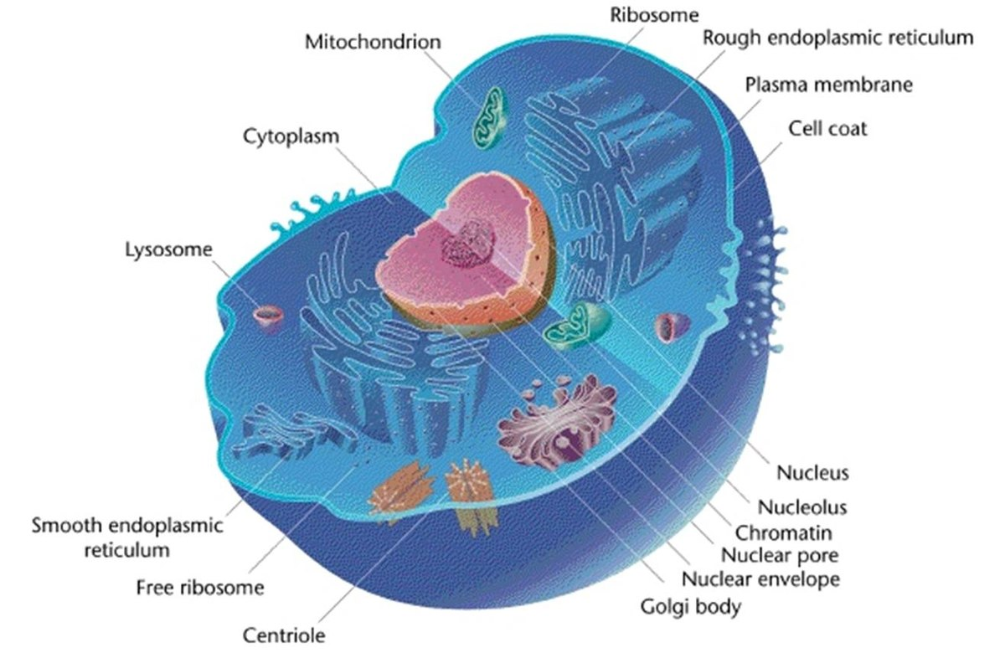
Eukaryotic cell
Not important

Slide 3
GENETICS:
Cytogenetics
1
The study of the structure and function of chromosomes and chromosome behaviour during somatic and germline division.
Non-Banded Karyotype
Banded karyotype
High resolution karyotype
Molecular genetics
2
The study of the structure and function of genes at a molecular level and how the genes are transferred from generation to generation.
Fluorescent in situ hybridization (FISH)
Extra note: most of cancers are genetic mutations and most of the treatments are biological

Slide 4
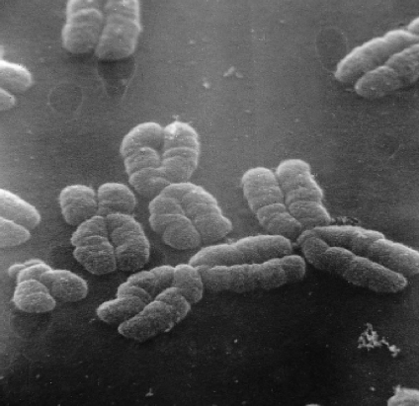
Human Cytogenetics
CHROMOSOMES
Definition : the study of human chromosomes in health and disease.
Chromosome studies are an important laboratory diagnostic procedure in :
prenatal diagnosis e.g. diagnosing Trisomy
certain patients with mental retardation and multiple birth defect
patients with abnormal sexual development
some cases of infertility or multiple miscarriages
in the study and treatment of patients with malignancies & hematologic disorders
carry genetic material
heredity: each pair of homologues consists of one paternal and one maternal chromosome, Crossing over occurs in meiosis I (prophase I).
The intact set is passed to each daughter cell at every mitosis.
1-
2-
3-
EM of human chromosomes

Slide 5
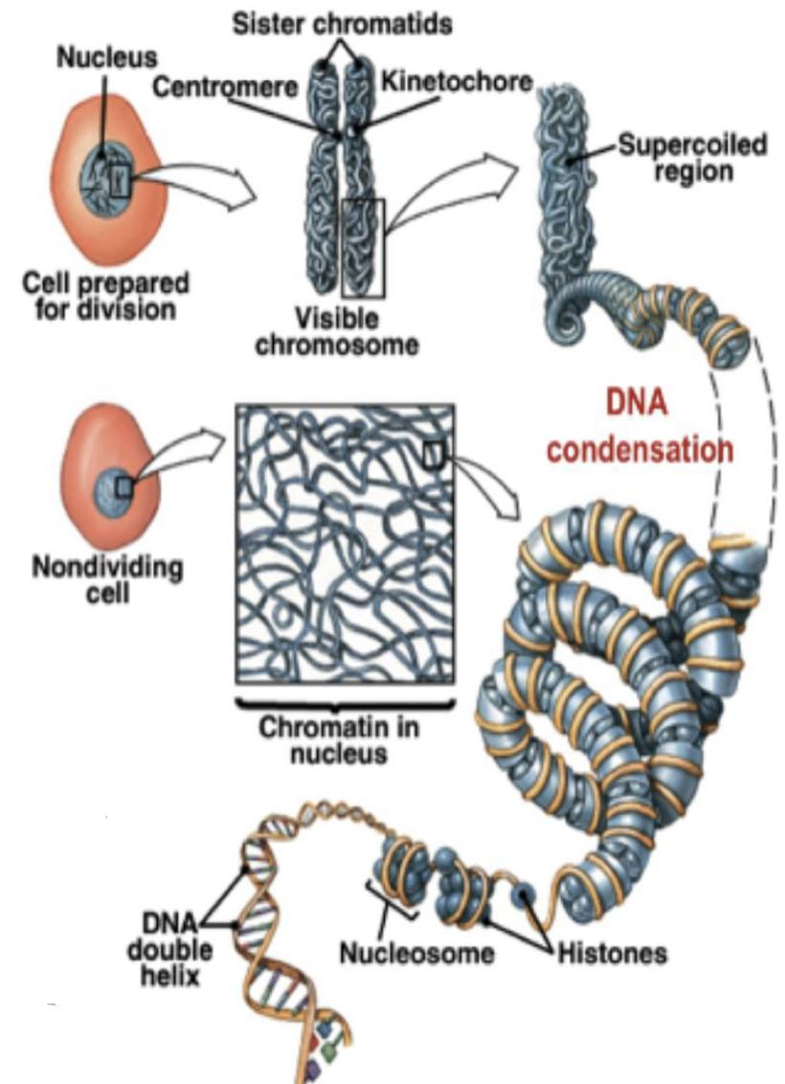
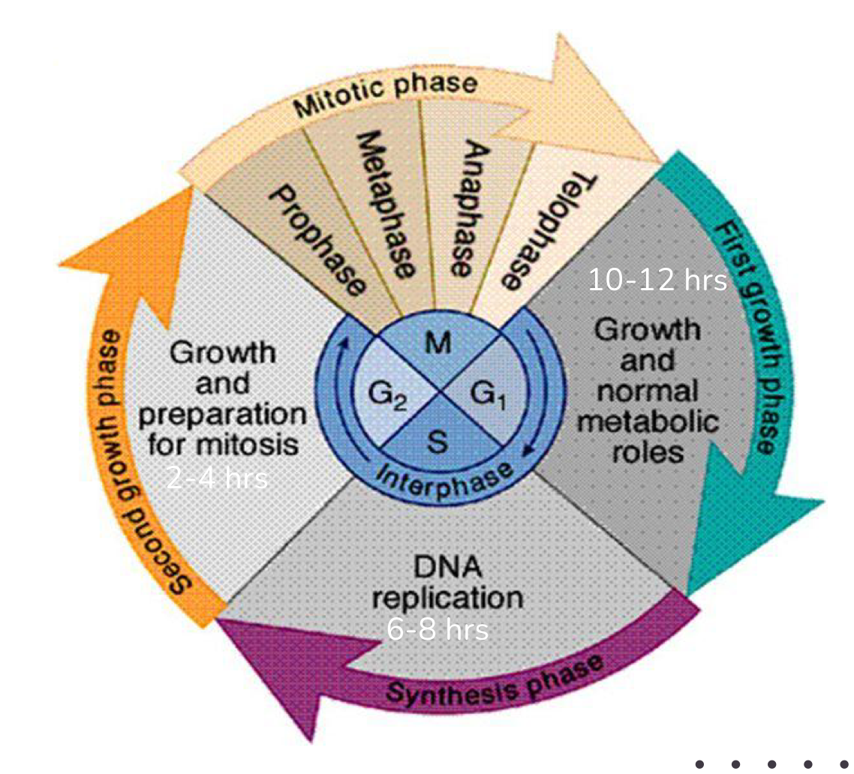
Structure of Chromosomes
Orders of DNA coiling and folding:
Primary coiling: DNA double helix
Secondary coiling: around histones (basic proteins) → nucleosomes, Histones are positively charged proteins. Remember: Nucleosomes consist of the histone octamer. (Biochemistry first lecture)
Tertiary coiling chromatin fiber
Chromatin fibers form long loops on non-histone proteins →tighter coils →chromosome
Mitotic cell cycle
Mitotic cell cycle can be divided into two major phases:
Interphase
G1 (cell growth)
S (DNA synthesis)
G2 (cell growth)
Mitotic phase
Prophase
Metaphase أفضل مرحلة لعمل الكاريوتايبينق
Anaphase
Telophase
Extra Note :
Chromosome develop in mitotic phase (prophase)

Slide 6
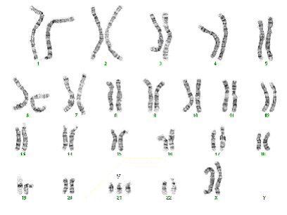
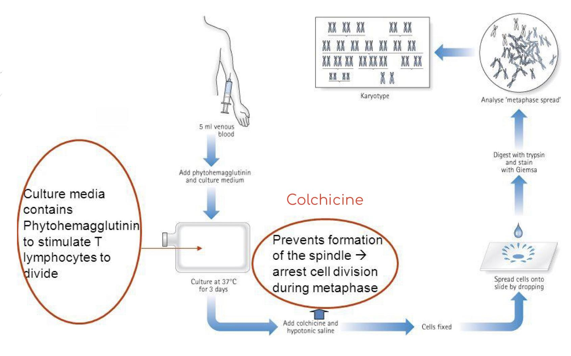
Karyotype
Chromosome Preparation from Peripheral Blood
Steps involved:
CULTURING
HARVESTING
Slide-Making
Banding
Staining
Karyotyping
Chromosome Analysis
Important points
Phytohemagglutinin: stimulate T lymphatocytes to divide
Colchicine and hypotonic saline: arrest cell division during metaphase
Giemsa: stain

Slide 7
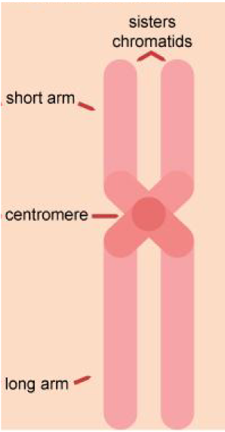
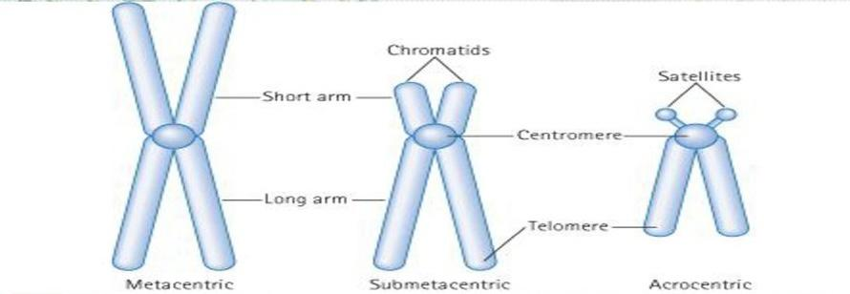
Metaphase chromosomes
Centromeric position arm length
Don’t forget single complete set of chromosomes. (N=23 for humans)
1
The 2 sister-chromatids are principally held together at the centromeric region.
2
Each chromosome has a centromere (CEN) region contains the kinetochore.
CEN divides the chromosome into two arms:
● short arm (P arm)
● long arm (Q arm)
3
4
Each arm terminates in a telomere.
1
The ratio of the lengths of the two arms is constant for each chromosome.
This ratio is an important parameter for chromosome identification and allows classification of chromosomes into several basic morphological types:
i-metacentric ii-sub-metacentric iii-acrocentric
2
3
In the human karyotype chromosome pairs 13, 14, 15, 21, 22, Y chromosome are acrocentric.
Chromosome pairs 1,3,16,19 are metacentric.
Rest chromosome pairs are sub-metacentric, including X chromosome.

Slide 8
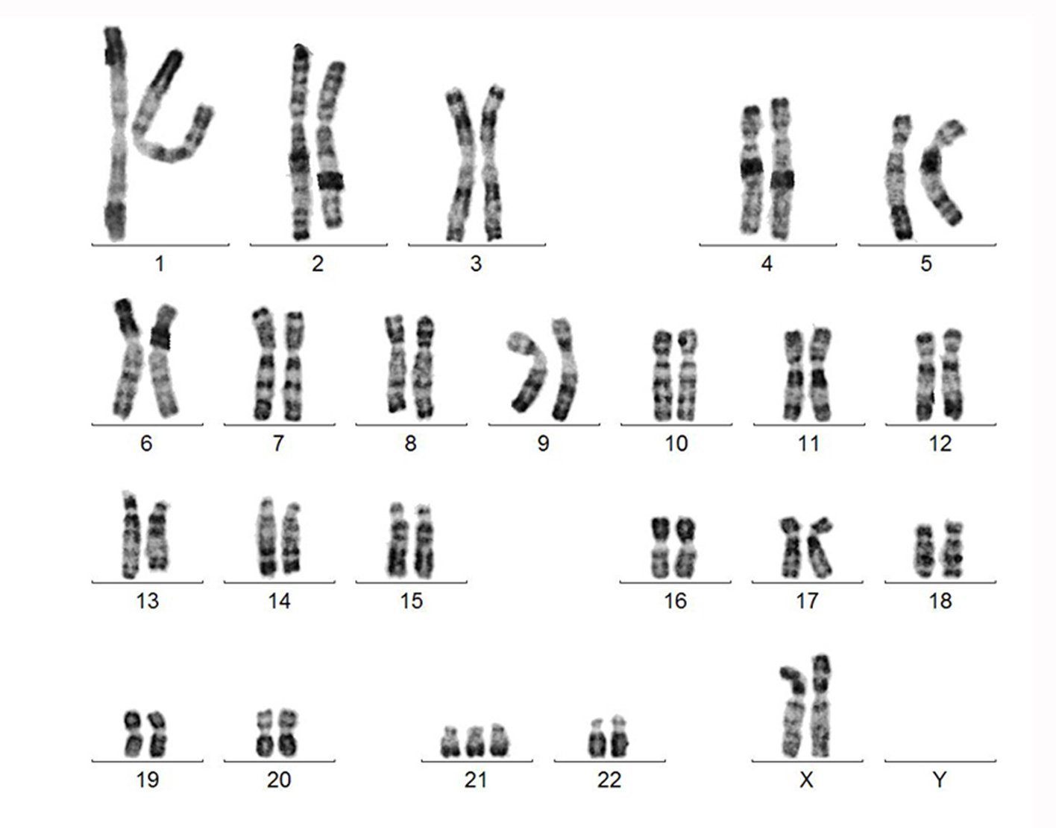
Chromosomal classification
Karyotyping
22 pairs of autosomes, numbered from 1 to 22 by order of decreasing length
1 pair of sex chromosomes:
XX in the female
XY in the male.
Based on:
1-the length. (Each chromosome is unique in length)
2-the position of the centromere.
3-the presence or absence of satellites.
Chromosomal satellite is the term given to that part of the end of a chromosome that is separated from the rest of the chromosome by a secondary constriction.

Slide 9
Banding
Items in the Description Of Karyotype
Normal Karyotypes
Abnormal Karyotypes
46, XY (male)
46, XX (female)
Down Syndrome (47,XY,+ 21)
Turner Syndrome (45,X)
1
Certain staining techniques cause the chromosomes to take on a banded appearance,
2
Each arm presenting a sequence of dark and light bands
Patterns are specific and repeatable for each chromosome
3
4
Allowing accurate identification and longitudinal mapping for locating gene positions and characterising structural changes.
Patterns, and the nomenclature for defining positional mapping have been standardised
5

Slide 10
Chromosome Banding
Band resolution = estimate of number of light + dark bands per haploid set of chromosomes 400 -850+
G Banding:Treat with trypsin and then with Geimsa Stain. Most common in karyotyping.
Adenine&Thymine will appear as dark regions(stained), while Cytosine&Guanine will appear as light regions(not stained).
R Banding:Heat and then treat with Geimsa Stain.
Unlike G Banding, Adenine&Thymine will apear as light regions(not stained), while Cytosine&Guanine will appear as dark regions(stained).
Q Banding:Treat with Quinicrine dye giving rise to fluorescent bands. It requires an ultraviolet fluorescent microscope.
C Banding:Staining of the Centromere. Treat with acid followed by alkali prior to G banding
The difference is in the stain and how to create it depending on what you are looking for

Slide 11
Banded Karyotype: Normal Banded Karyotypes
Fluorescence In-Situ Hybridization (FISH)
A normal G-banded male Karyotype
A normal R-banded male Karyotype
FISH of interphase nuclei with a chromosome 21 centromeric probe showing 3 signals consistent with trisomy 21
FISH of metaphase with a probe for telomere showing signals at the end of each chromatid
AT-rich regions stain darker than GC-rich regions
GC-rich regions stain darker than AT-rich regions

Slide 12
Take Home Messages
The packaging of DNA into chromosomes involves several orders of DNA coiling and folding
The normal human karyotype is made up of 46 chromosomes consisting of 22 pairs of autosomes and a pair of sex chromosomes, XX in the female, and XY in the male.
Each chromosome consists of a short (p) and a long (q) arm joined at the centromere.
Chromosomes are analyzed using cultured cells and specific banding patterns can be identified using special staining techniques.
FISH is based on the ability of a single-stranded DNA probe to anneal to its complementary target sequence. It can be used to identify and study genes on chromosomes in metaphase or interphase.

Slide 13
MCQs:
1 .A Molecular cytogenetic technique based on the ability of a single stranded DNA probe to anneal with its complementary target sequence:
(FISH) | B) G. Binding | C) Quinidine | D) Karyotype
2. Which one of the following chemicals is used to arrest cell division during metaphase for karyotyping?
Cell culture media | B) Colchicine | C) Phytohemagglutinin | D) Trypsin
Answer key: 1-A. 2-B. 3-A. 4-D. 5-D
3. In … we treat it with trypsin and then with Geimsa stain.
G Banding | B) R Banding | C) C Banding | D) Q Banding
4. The study of human chromosome in health and disease:
Biochemistry | B) Cytogenetics | C) Molecular genetics | D) Human cytogenetics
5. Cytogenetics:
Non-banded karyotype | B) Banded karyotype | C) High resolution karyotype | D) All of them

Slide 14
MCQs:
6. Treat with heat and then Geimsa stain:
G Banding | B) R Banding | C) Q Banding | D) C Banding
7. The study of the structure and function of chromosomes and chromosome behavior during somatic and germline division:
Biochemistry | B) Cytogenetics | C) Molecular genetics | D) Histology
8. The genotype of Turner’s syndrome is …
Answer key: 6-B. 7-B. 8-B. 9-C. 10-B
47,XY,+21 | B) 45,X | C) 47,XXY | D) 46,XX
9. CEN divides the chromosome into two arms: the short arm (p arm) and the long arm (q arm), each arm terminates in a…
Colchicine | B) Trypsin | C) Telomere | D) Centromere
10. Culture media contains Phytohemagglutinin to stimulate…to divide.
B lymphocyte | B) T lymphocyte | C) Trypsin | D) Colchicine

Slide 15
Team members
M - team
F - team
Ali Jabaan
Mohammed Alzeer
Khaled Arbeed
Abdulaziz Alnasser
Muhannad Almuadi
Saleh Alkholaifi
Malik Halees
Abdullah Awartani
Walaa Almutawa
Shahad Almarshad
Razan Alsulami
Atheer Alahmari
Reema Aljubreen
Mayssam Aljaloud
Jana Alhazmi
Layan Alburikan
Team leaders
Nawaf Alrefaei “leader”
Ibrahim Alhezam “sub-leader”
Razan Almohanna “leader”
Maram Beyari “sub-leader”
&
humangenetics442@gmail.com

