Slide 1
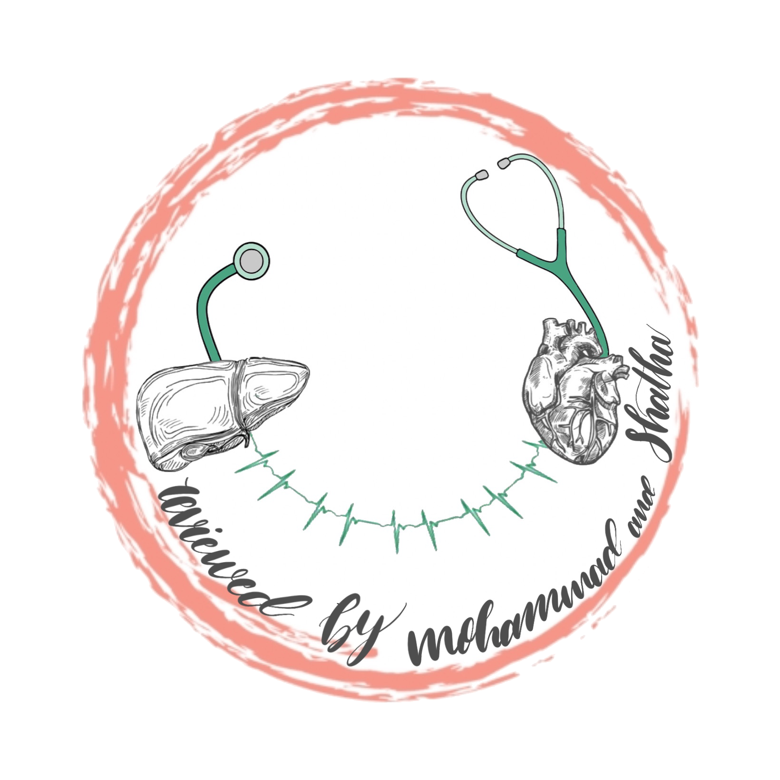
CHROMOSOMAL ANOMALIES
2
Foundation block
Human genetics 442
RED : Important
PINK : F. slides
BLUE : M. slides
GREEN : Doctors notes
GRAY : Extra
Editing file

Slide 2
Objectives
01
Describe and explain the events in mitosis & meiosis.
02
Deﬁne non-disjunction and describe its consequences on meiosis.
03
Classify chromosomal abnormalities: Numerical & structural
04
Understand the common numerical autosomal disorders: trisomies 21, 13, 18.
05
Understand the common numerical sex chromosome disorders: Turner`s. Klinefelter`s syndromes
06
Recognize the main structural anomalies in chromosomes.

Slide 3
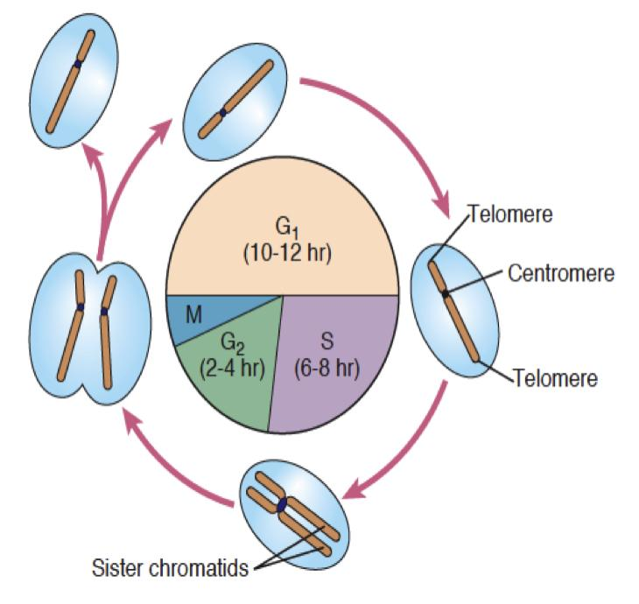
Cell cycle
1.Interphase
Interphase: is the portion of the cell cycle that is not accompanied by gross changes under the microscope, and includes the G1, S and G2 phases. During interphase :
the cell grows (G1)
replicates its DNA (S)
and prepares for mitosis (G2)
G1
S phase
G2
Ready for mitosis
One diploid
Lasts only 10-12 hours.
Duplications of each chromosome’s DNA Result: 2 sister
chromatids.
Lasts 6-8 hours
Chromosome begins to condense and become visible.
Lasts 2-4 hours
Interphase prepared 2 daughter cells = 2 equal genetic information, the cell now starts dividing by mitosis.
Lasts less than 6 hours if not identical,it causes disorders
cell is carrying out its everyday activities

Slide 4
Cell cycle
2. Events of mitosis
t stands for somatic cells
1.Prophase:
formation of mitotic Spindle & pair of centrosomes.
2.Prometaphase:
-Nuclear membrane dissolves.
- Chromosomes to disperse & attach by kinetochores to mitotic spindle microtubules.
3.Metaphase: Chromosomes condensed & line up at the equatorial plane.
4.Anaphase:
-Chromosomes separate at centromere.
- Sister chromatids of each chromosome become independent daughter chromosomes.
5.Telophase:
-Chromosomes decondense from their highly
contacted state.
-Nuclear membranes reform around each of the 2 daughter nuclei. -resume their interphase

Slide 5
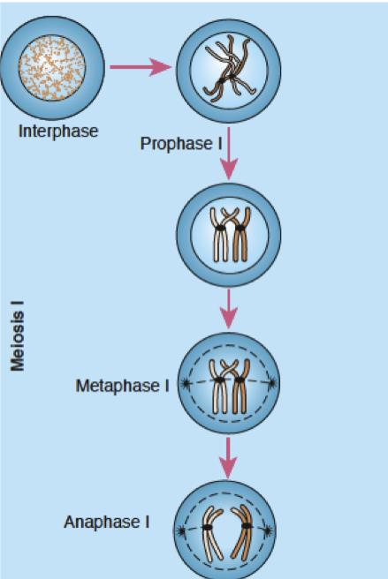
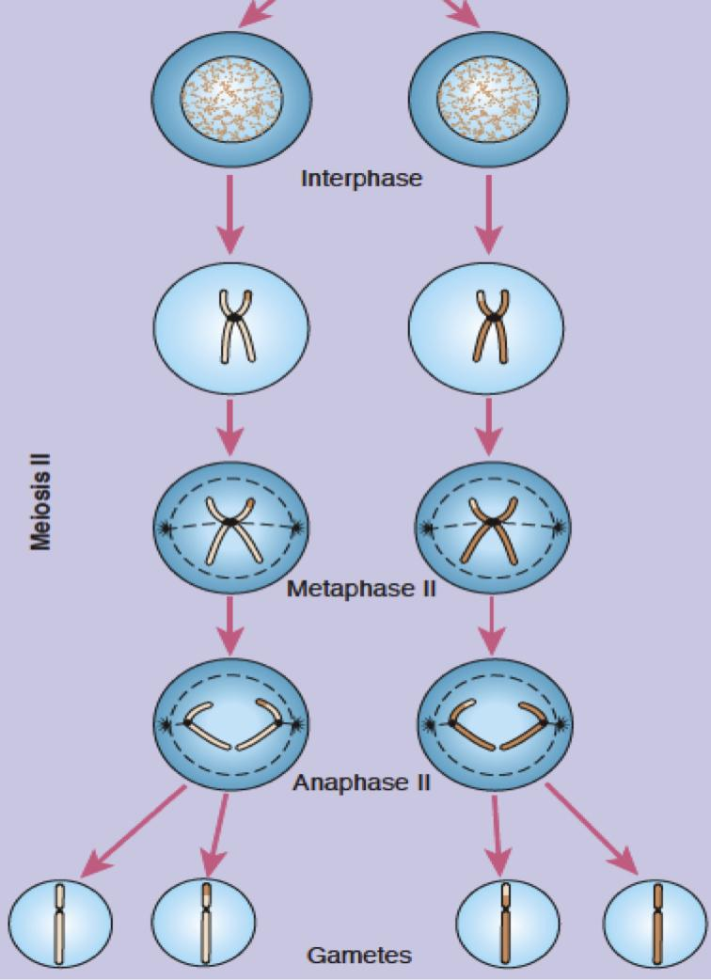
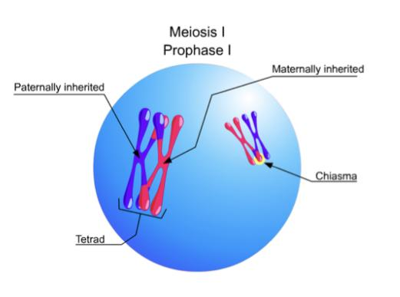
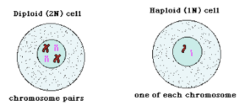
Events of Meiosis I & II
Starts as 1 diploid cell, ends as 2 haploid cells.
Starts as 2 haploid cells, ends as 4 haploid cells.
Separation of sister chromatids
Separation of homologous chromosomes

Slide 6
Non-disjunction in meiosis
The failure of chromosomes to disjoin normally during meiosis phase 1 or phase 2 (Do not separate)
Two chromosome homologs migrate to the same daughter cell instead of disjoining normally and migrating to different daughter cells
The result of this error is a cell with an imbalance of chromosomes (Aneuploidy)
Can affect each pair of chromosomes.
Is not a rare event

Slide 7
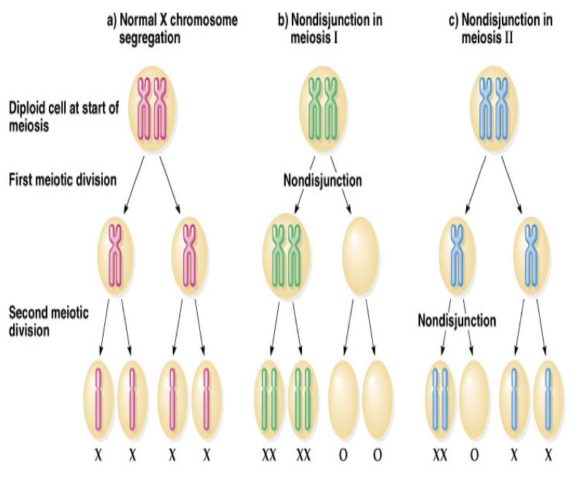
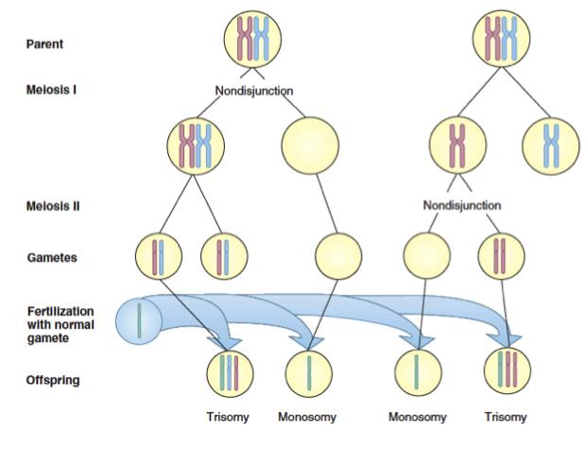
Non disjunction in first meiotic division produces 4 unbalanced gametes.
Non disjunction in second division produces 2 normal gametes & 2 unbalanced gametes: -Gamete with an extra autosome -Nullosomic gamete (missing one
In meiotic nondisjunction:
This product of fertilization with normal gamete would be monosomic and trisomic offspring (Aneuploidy)

Slide 8
Types of Chromosomal Anomalies
Numerical
Structural
Affect the number of complete haploid set (n) of chromosomes.
Most cases when fertilization happens at old maternal age
Affect the structure and organization of genomic content of the chromosome
In sex chromosomes
In autosomes
1.Reciprocal translocation 2.Robertsonian
translocation
3.Interstitial deletion
4.Inversion
5.Isochromosome
6.Ring formation
a- turner's syndrome (Monosomy 45,XO)
b- Klinefelter syndrome
(47,XXY) males
a- Down syndrome trisomy 21 (47,XY+21)
b- Edward”s syndrome trisomy 18 (47,XY,+18)
c- Patau syndrome trisomy 13 (47,XY,+13)

Slide 9
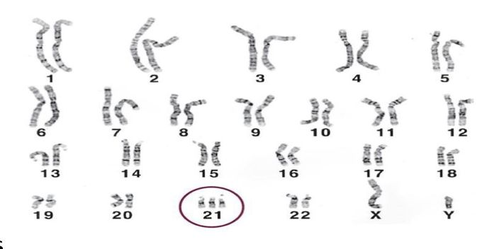
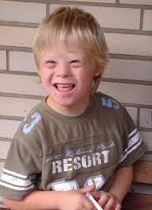
Down syndrome, trisomy 21 (in autosomes)
Karyotype: 47, XY, +21
Most cases arise from non disjunction in the first meiotic division
The incidence of trisomy 21 rises sharply with increasing maternal age
The father contributing the extra chromosome in 15% of cases
the symptoms include :
characteristic facial, dysmorphologies, an IQ of less than 50
“The name of each syndrome, classification &
its karyotype” are the most important to know

Slide 10
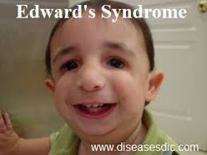
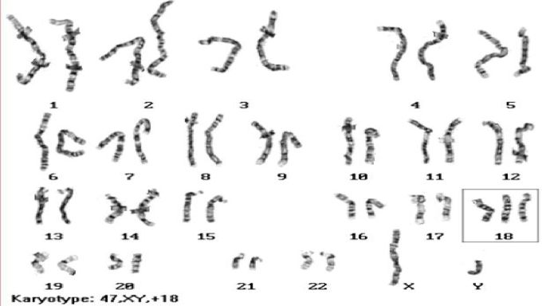
Edward's syndrome, Trisomy 18 (in autosomes)
Karyotype: 47, XY, +18
The second most common autosomal trisomy, after Down syndrome
It occurs in around one in 6,000 live births
Most babies die in the first year and many within the first month & has a very low rate of survival
Common anomalies are:
heart abnormalities, kidney malformations, and other Internal organ disorders
“The name of each syndrome, classification &
its karyotype” are the most important to know

Slide 11
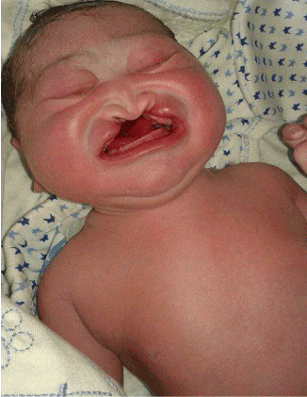
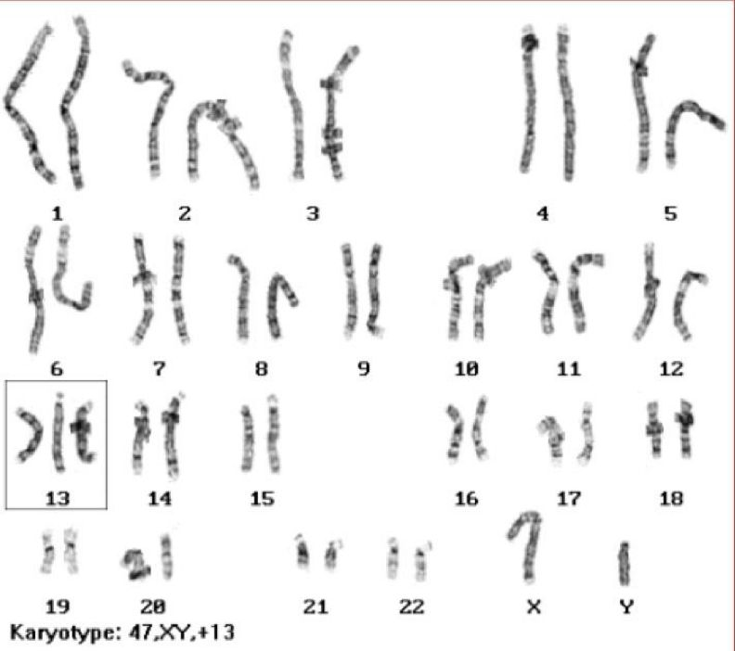
Patau Syndrome, Trisomy 13 (in autosomes)
Karyotype: 47, XY, +13
50 % of these babies die within the first month and very few survive beyond the first year
Most cases, as in Patau syndrome, involve maternal ( mother) non-disjunction
the symptoms include :
multiple dysmorphic features
“The name of each syndrome, classification &
its karyotype” are the most important to know

Slide 12
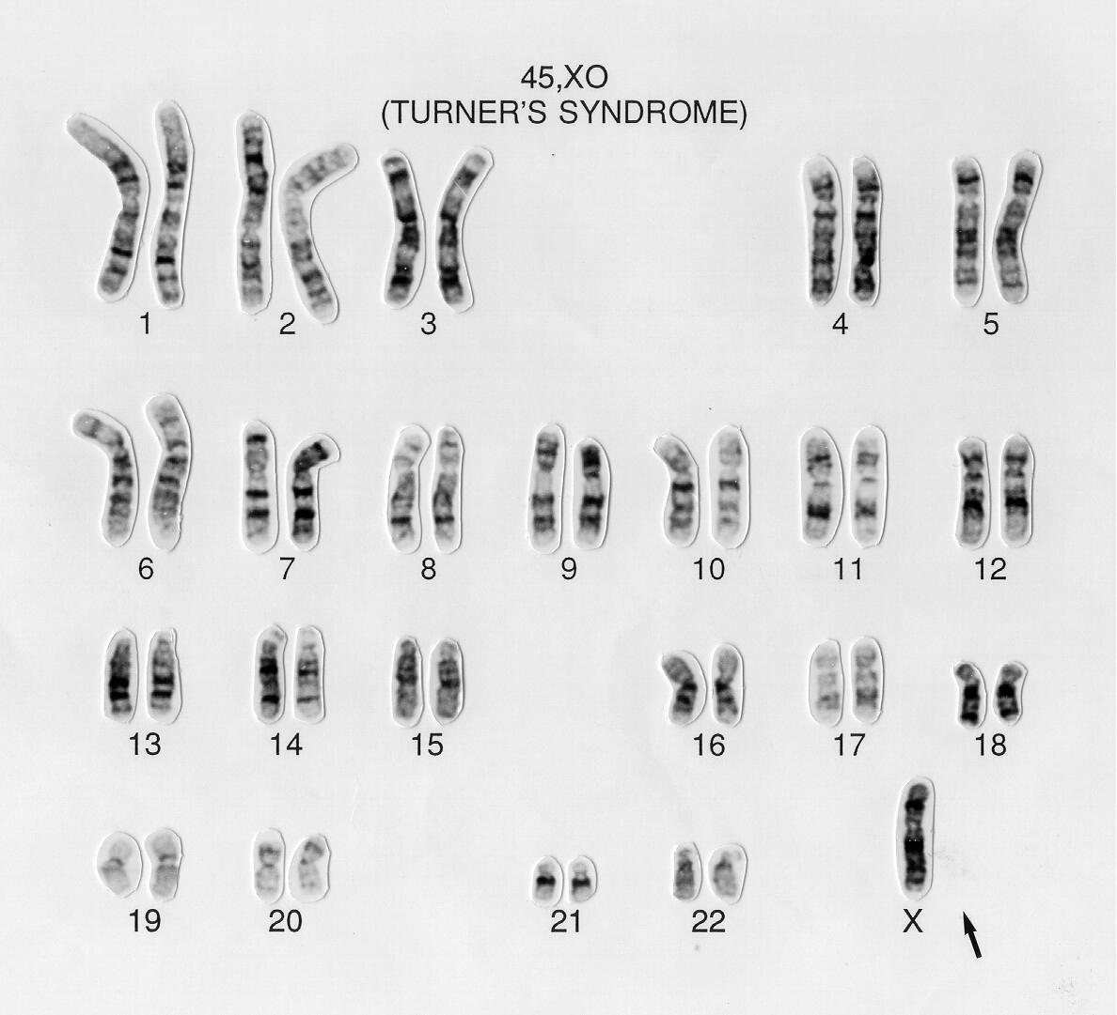
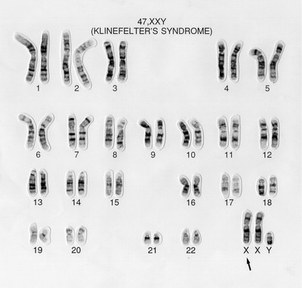
Numerical Anomalies in Sex chromosomes
Turner’s Syndrome(females) also called “Monosomy X”
Karyotype 45, XO
Occurring in 1 in 4000 phenotypic females.
As a result of paternal meiotic non-disjunction.
The only viable monosomy in humans.
Characteristics: Webbed neck, Individuals are genetically female, not mature sexually, Sterile, Short stature, Broad chest, Low hairline, Streak ovaries, Normal intelligence, Normal life span
Klinefelter Syndrome (males)
Karyotype 47,XXY
1/600 males, due to non-disjunction of X chromosomes during meiosis I in females.
Characteristics:
Male sex organs : unusually small testes which fail to produce normal levels of testosterone -> breast enlargement (gynaecomastia) and other feminine body characteristics.
Patients are taller and thinner than average and may have a slight reduction in IQ but generally they have normal intelligence
No spermatogenesis = sterile

Slide 13
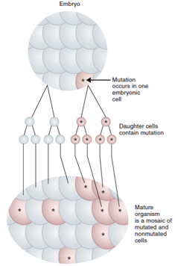
Mosaicism
It is the presence of more than one genetically distinct cell line in the body. (may be inactive)
● A mosaic individual is made of 2 (or more) cell populations, coming from only 1 zygote.
● It is denoted by a slash between the various clones observed E.g. 46, XY/ 47, XY, +21.
● Numerical mosaic anomaly is usually due to a mitotic non-disjunction.
● A mosaic must not be confused with a chimeras.
Chimerism is the presence in an individual of two or more genetically distinct cell lines derived from more than one zygote. E.g. 2 sperms fertilize 2 ova then the 2 zygotes fuse to form 1 embryo.
Females Dr note : this is very important
Females Dr note : this is very important

Slide 14
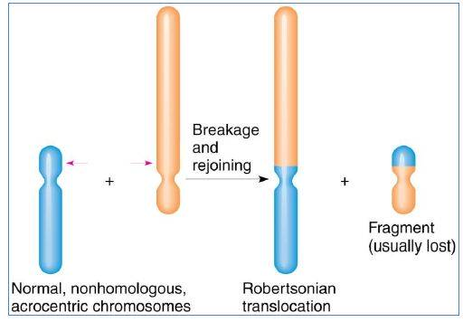
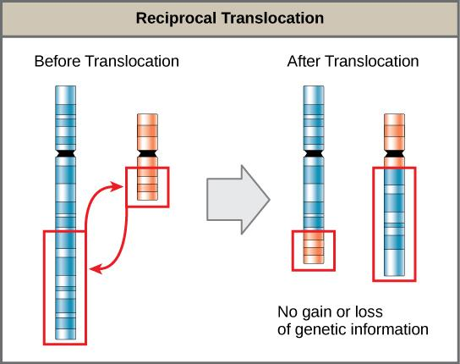
Reciprocal translocation
Robertsonian translocation
Structural anomalies
Females dr, notes: this is not important
Is a form of gene rearrangement where portions of two chromosomes ( Different chromosome) are simply exchanged with no net loss of genetic information.
E.g. Philadelphia chromosome (Reciprocal translocation between chromosome 22 and the long arm of chromosome 9).
The occurrence of the Philadelphia chromosome in hematopoietic cells can produce chronic myelogenous leukemia (CML).
Short arms of two non homologous chromosomes are lost and the long arms fuse at the centromere to form a single chromosome.
Confined to the acrocentric Chromosomes (no p arm) (13, 14, 15, 21, 22, and Y chromosome).
Carriers have only 45 chromosomes in each cell, But they are phenotypically unaffected.

Slide 15
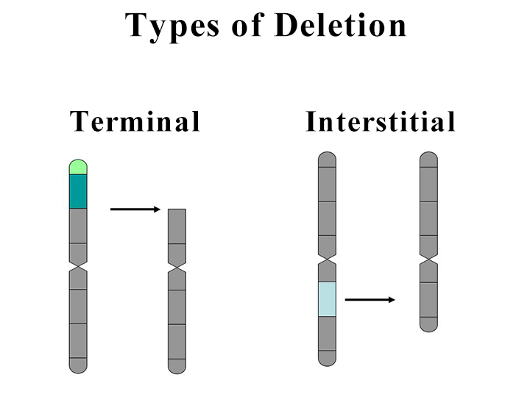
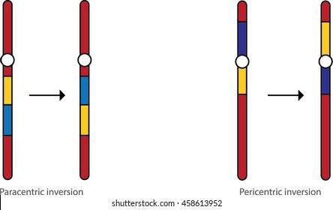
Inversion
Deletion
Females dr. note: this is not important
Loss of a segment from a chromosome, either terminal or interstitial.
Invariably, but not always, results in the loss of important genetic material.
Deletion is therefore an unbalanced Rearrangement. (common in cancer)
Indicated in nomenclature del.
Occurs when a segment of chromosome breaks, and rejoining (بطريقة خاطئة) within (same chromosome) the chromosome effectively.
Written in nomenclature as inv.
Only large inversions are normally detected.
They are balanced rearrangements that rarely cause problems in carriers. (but it is also seen in cancer)
karyotype description is as follows:
46: the total number of chromosomes.
XY: the sex chromosomes (male).
del(7): deletion in chromosome 7.
(q11.23q21.2): breakpoints of the deleted segment.

Slide 16
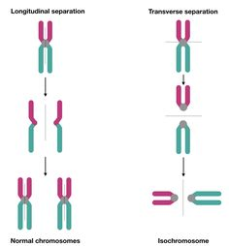
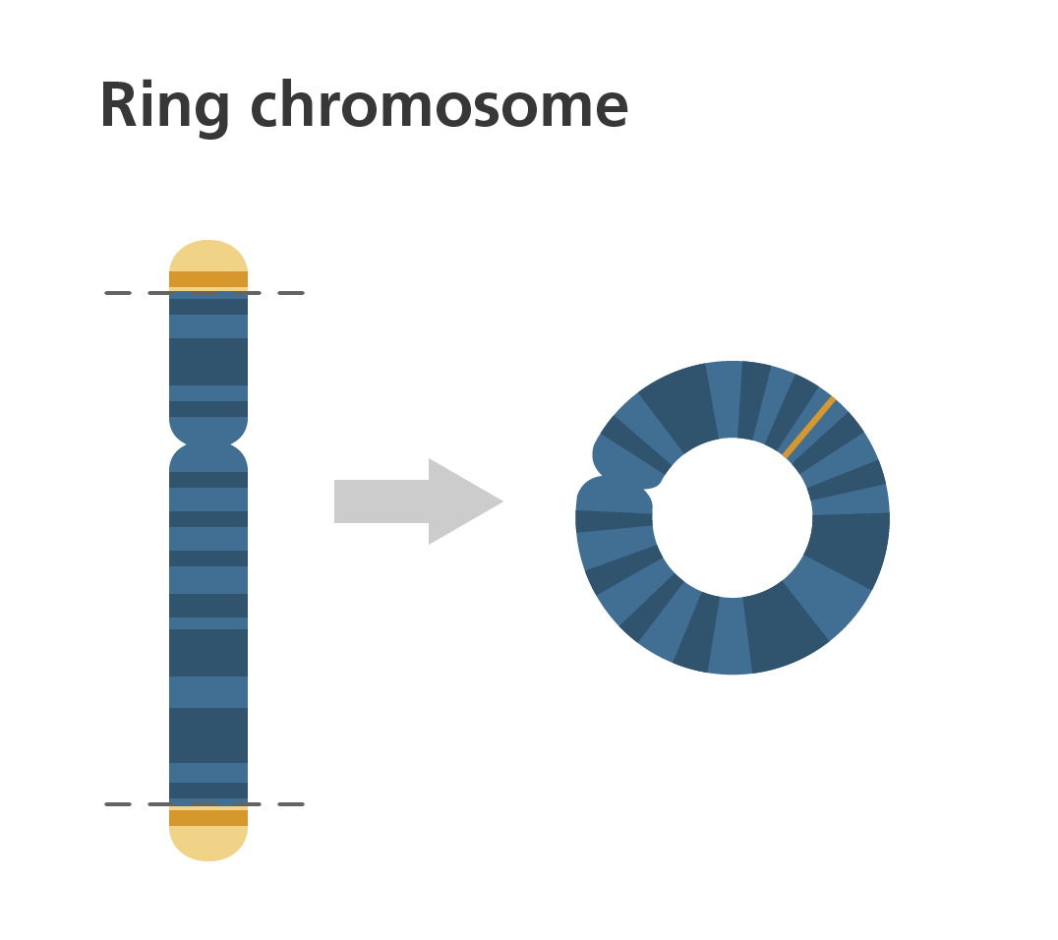
Isochromosome
Ring formation (Ring chromosome)
Longitudinal separation
Transverse separation
A break on each arm of a chromosome.
Two sticky ends.
Reunion of the ends as a ring loss of the 2 distal chromosomal fragments.
Ring chromosomes are often unstable in mitosis.
The most probable explanation for isochromosome is that the centromere has divided transversely rather than longitudinally.
Normal chromosome
Isochromosome

Slide 17
MCQS:
What is the genotype of Klinefelter syndrome?
45,XO | B) 47,XY,+18 | C) 47,XXY | D) 47,XY,+21
2. Individual made of 2 cell populations coming from 1 zygote is known as:
Chimerism | B) Mosaicism | C) Down syndrome | D) Deletion
3. Loss of a segment from the chromosome is known as:
Deletion | B) translocation | C) inversion | D) isochromosome
Answer key: 1C - 2B - 3A - 4B - 5D
4. The nuclear membrane reforms in mitosis during:
Anaphase | B) Telophase | C) Metaphase | D) Prophase
5. Non-disjunction in first meiotic division produces:
2 normal gametes | B) 4 normal gametes | C) 2 unbalanced gametes | D) 4 unbalanced gametes

Slide 18
Team members
M - team
F - team
Ali Jabaan
Mohammed Alzeer
Khaled Arbeed
Abdulaziz Alnasser
Muhannad Almuadi
Saleh Alkholaifi
Malik Halees
Abdullah Awartani
Walaa Almutawa
Shahad Almarshad
Razan Alsulami
Atheer Alahmari
Reema Aljubreen
Mayssam Aljaloud
Jana Alhazmi
Layan Alburikan
Team leaders
Nawaf Alrefaei “leader”
Ibrahim Alhezam “sub-leader”
Razan Almohanna “leader”
Maram Beyari “sub-leader”
&
humangenetics442@gmail.com

