Slide 1
MODE OF INHERITANCE
3
Foundation block
Human genetics 442
RED : Important
PINK : F. slides
BLUE : M. slides
GREEN : Doctors notes
GRAY : Extra
Editing file

Slide 2
Objectives
01
Assess Mendel’s laws of inheritance.
02
Understand the bases of Mendelian inheritance.
03
Deﬁne various patterns of single gene inheritance using family pedigree and Punnett square.

Slide 3
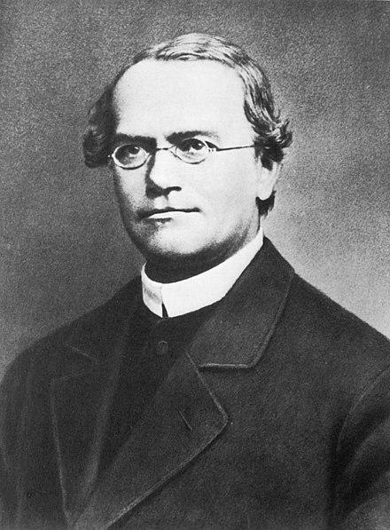
Father of Genetics
Discovered some of basic laws of heredity
His published his work entitled Experiments on Plant Hybrids in 1866 However, largely ignored
He died in 1884 with his work still unnoticed
Gregor Mendel
Born 1822
Monk and teacher
His work rediscovered in 1900

Slide 4
Interpreting the outcomes of Mendel’s breeding experiments
Team 434:
An individual inherits 2 alleles for each gene (character), one from each parent. If the 2 alleles are the same, the individual is homozygous for that gene. If the alleles are different, the individual is heterozygous.
The plant characteristics being studied were each controlled by a pair of factors, one of which was inherited from each parent. Factors nowadays are known as “Genes”.
The pure-bred plants, with two identical genes, used in initial cross would now be referred to a homozygous.
Homozygous = two identical alleles.
The hybrid F1 plants, each of which has one gene for tallness and one for shortness, would be referred to as heterozygous.
Heterozygous = two different alleles.
The genes responsible for these contrasting characteristics are referred to as allelomorphs, or alleles for short.

Slide 5
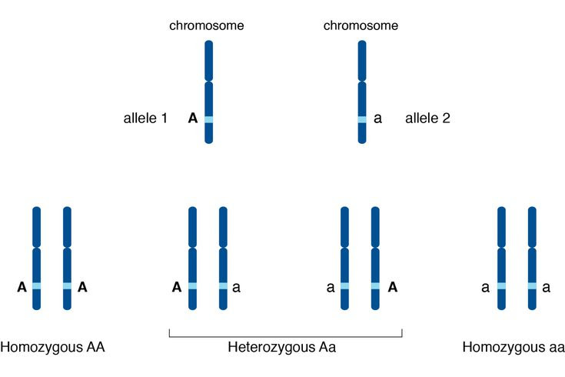
Genotype
Homozygous (same alleles)
Heterozygous (differ alleles)
for dominant alleles e.g. AA.
It’s a combination of recessive and dominant alleles e.g. Aa.
for recessive alleles e.g. aa.

Slide 6
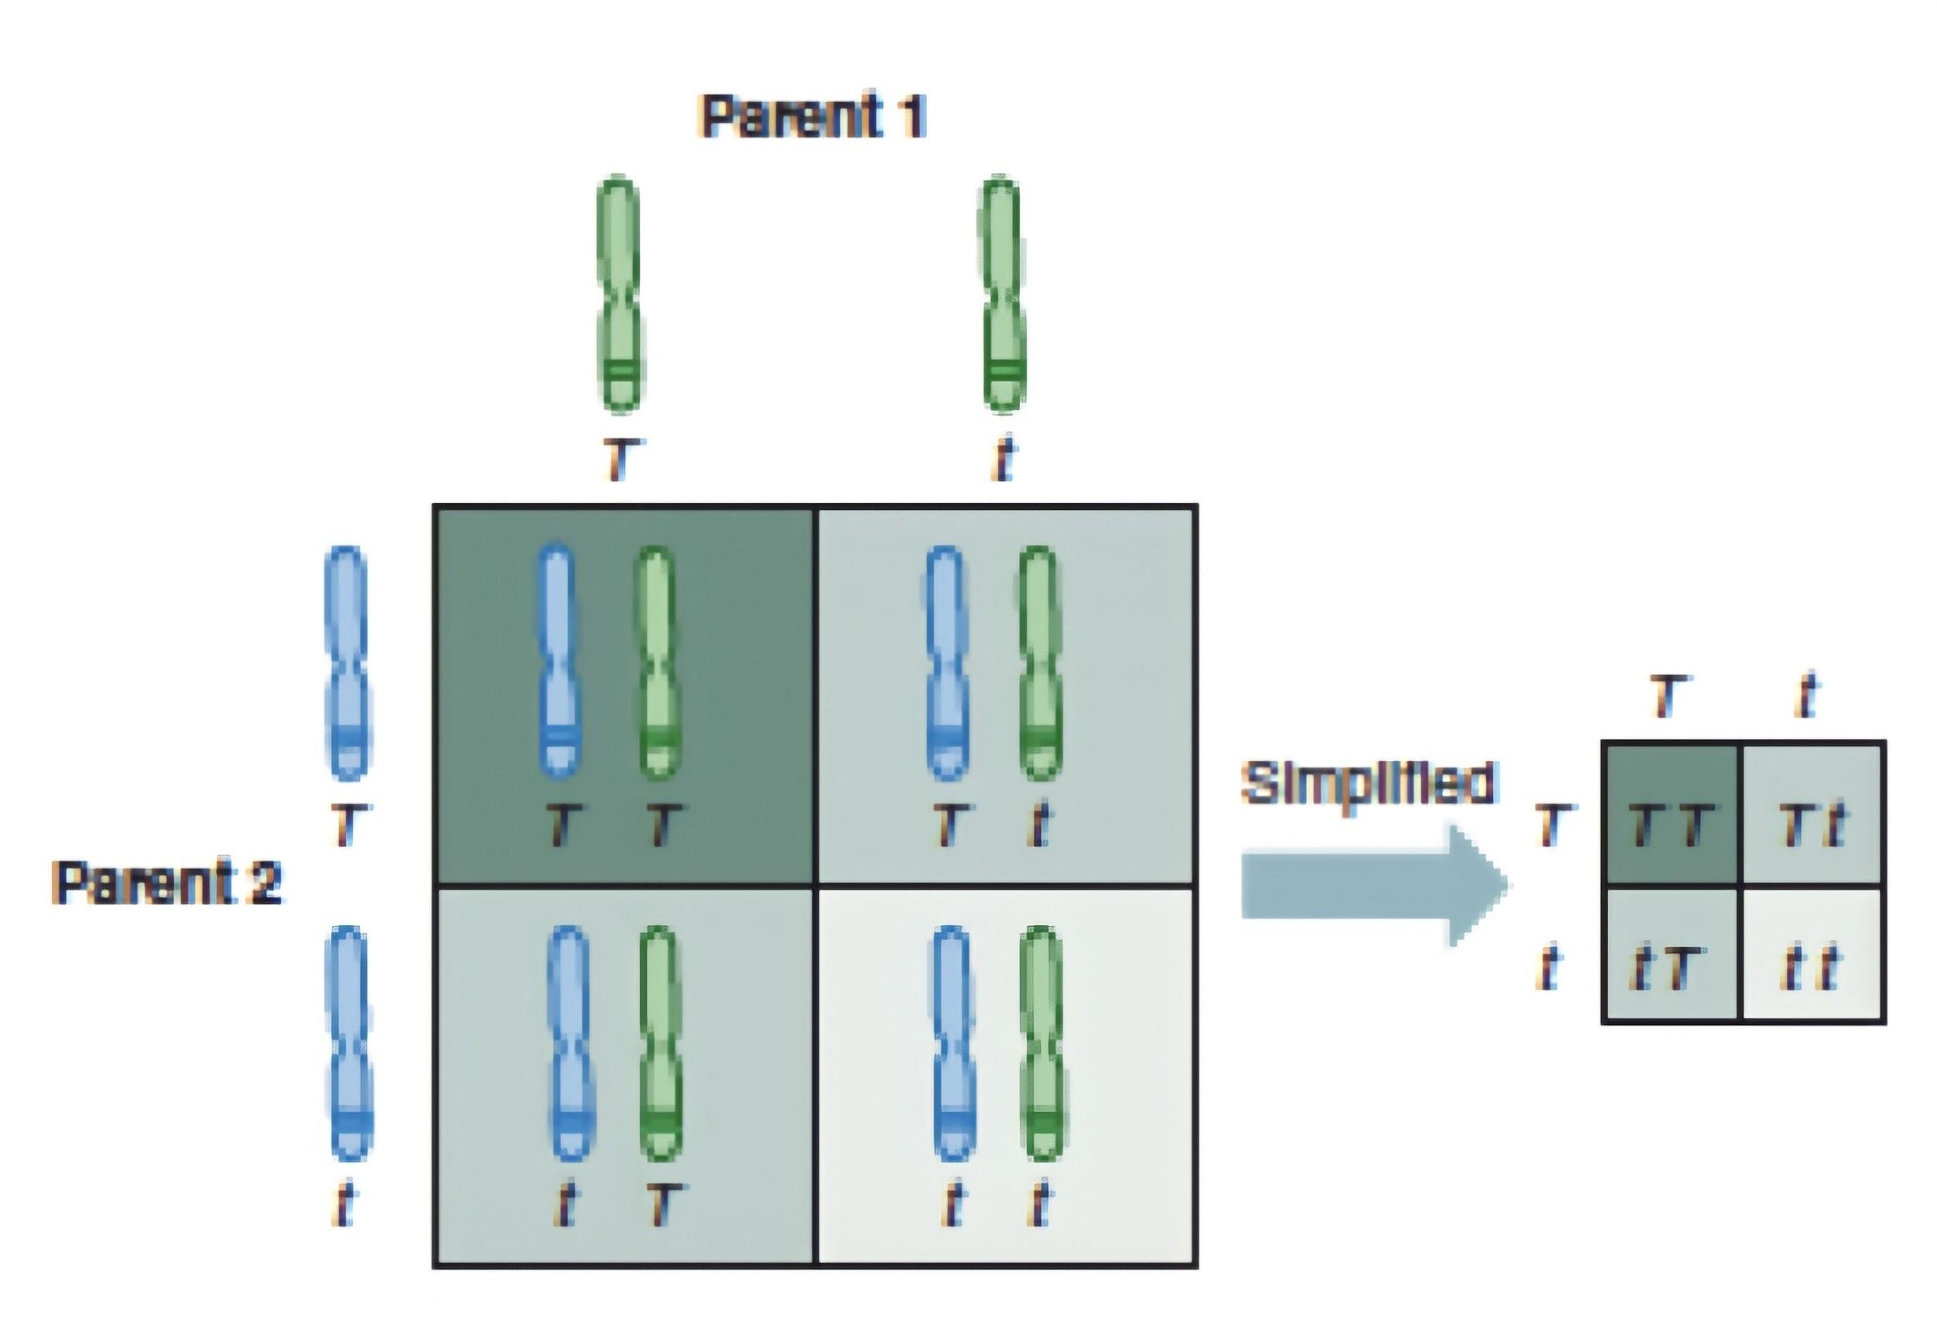
Punnet Square
(It’s named after Reginald C. Punnett, who devised approach)
1
Each parent can only
contribute one allele per gene.
2
These genes are found on
the chromosomes of
gametes of parents.
3
Offspring (ذرية ) will inherit
2 alleles to express that gene.

Slide 7
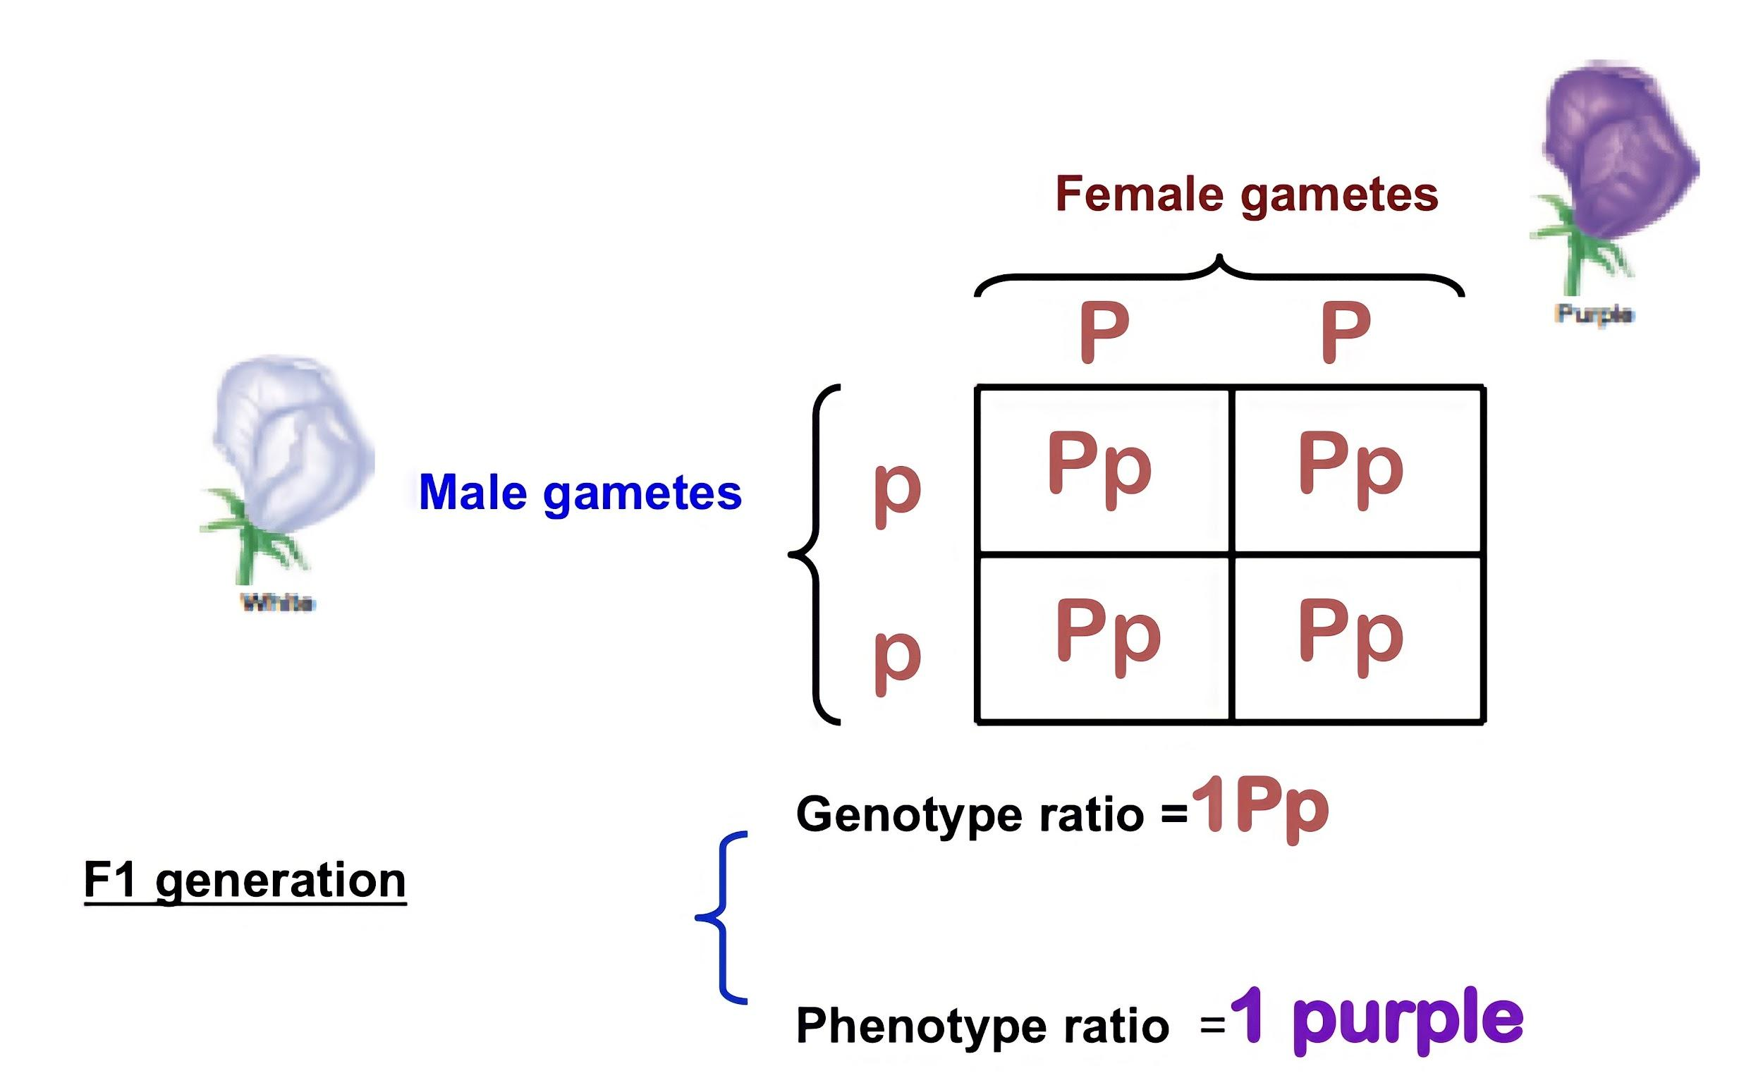
Law of Dominance or Uniformity
COMPLETE DOMINANCE: one allele is dominant to another allele.
Team 437:
In a cross of parents that are pure for contrasting traits, only one form of the trait will appear in the next generation All offspring will be heterozygous and express only the dominant trait.
Recall Mendel’s 1st experiment.
CROSS: Pure bred purple female x White male.
P1 generation =PP x pp .

Slide 8
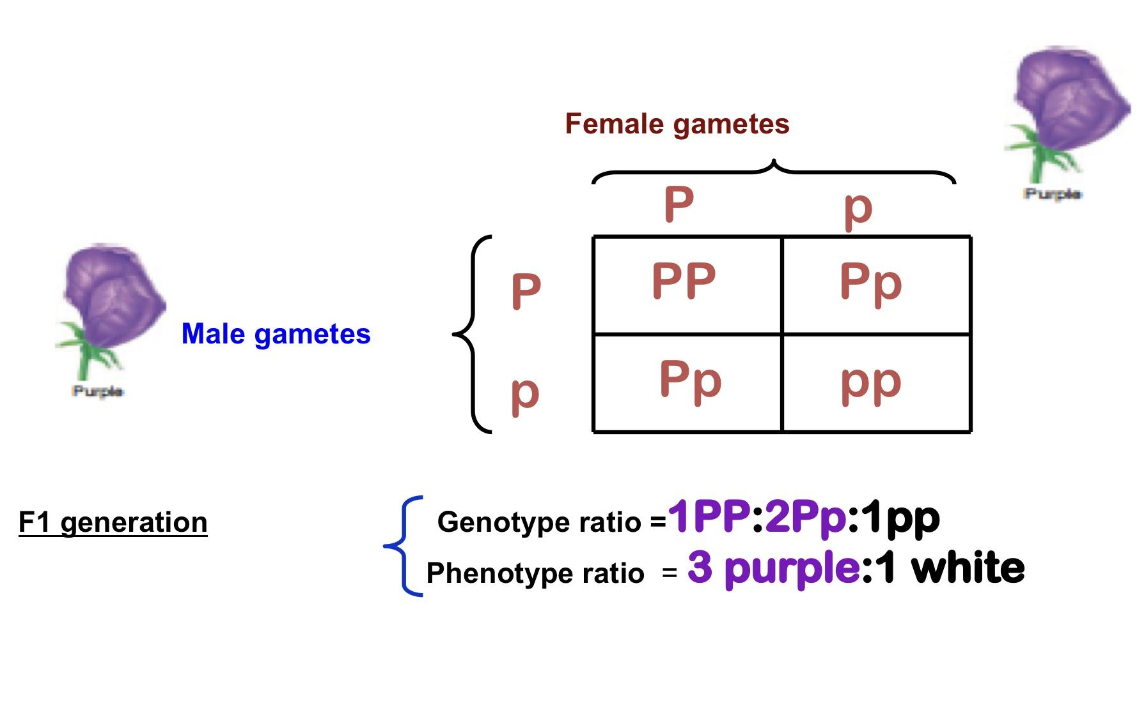
Law of Segregation
Definition:
Recall
Cross
P1 generation
the alleles of a given locus segregate into separate gametes. ( Team 439 )
Mendel’s 2nd experiment.
Two F1 generation offspring with each other.
=Pp x Pp
Team 437:
The two copies of a gene segregate (or separate) from each other during transmission from parent to offspring. Therefore, only one copy of each gene is found in a gamete. At fertilization, two gametes combine randomly, potentially producing different allelic combinations

Slide 9
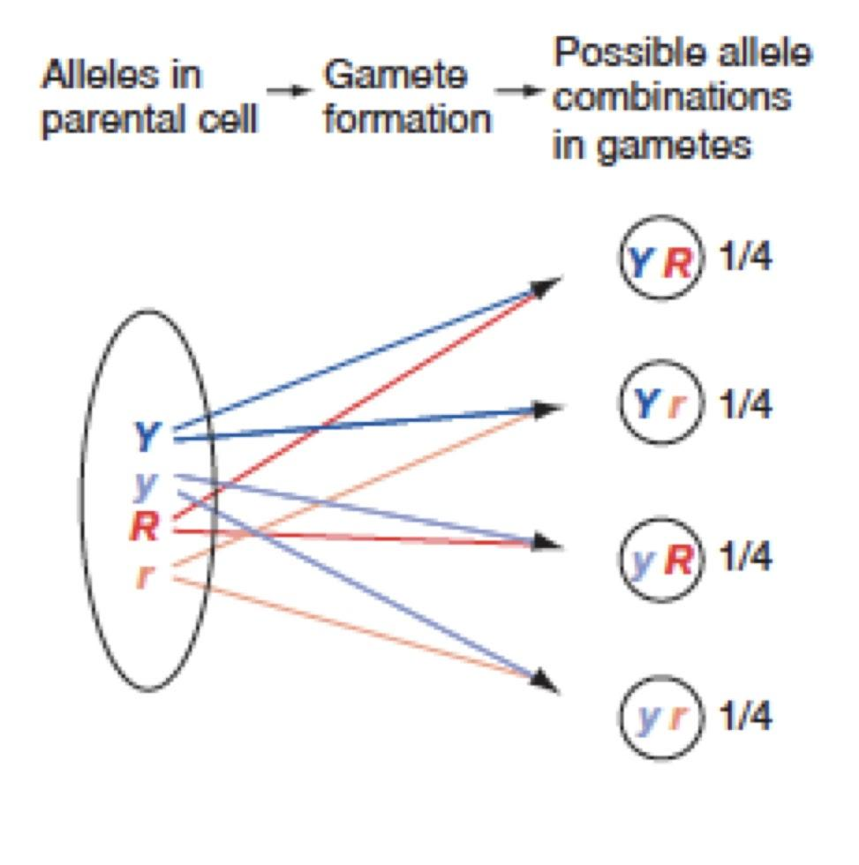
Law of independent assortment
Definition
During gamete formation, different pairs of alleles segregate independently of each other.
Interpretation
- In a dihybrid cross, each pair of alleles assorts independently during gamete formation.In the gametes, Y is equally likely to be found with R or r (that is, Y R = Y r ); the same is true for y (that is, y R = y r).
- As a result, all four possible types of gametes ( Y R, Y r ,y R, and y r ) are produced in equal frequency among a large population.
Team 436:
- The alleles for different genes usually separate and inherited independently of one another. - So, in dihybrid crosses you will see more combinations of the two genes.

Slide 10
THE CHROMOSOME THEORY OF INHERITANCE AND SEX CHROMOSOMES
How chromosomal transmission is related to the patterns of inheritance observed by Mendel?

Slide 11
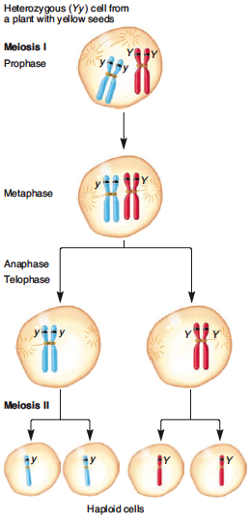
Mendel’s law of segregation can be explained by the segregation of homologs during meiosis
1
The two copies of a gene are contained on homologous chromosomes.
2
In this example using pea seed color, the two alleles are Y (yellow) and y (green).
3
During meiosis, the homologous chromosomes
segregate from each other.
4
leading to segregation of the two alleles into separate gametes.

Slide 12
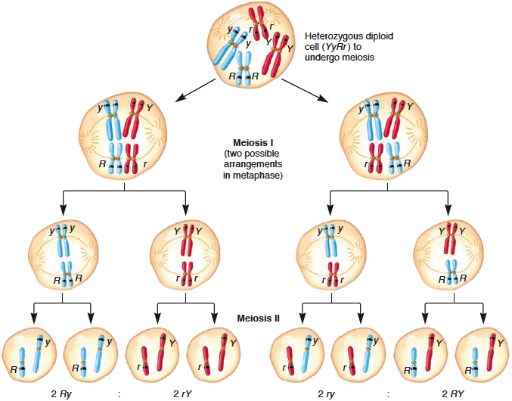
Mendel’s law of independent assortment can be explained by the random alignment of bivalents during metaphase of meiosis I
Dr’s note :
Bivalents mean pair of chromosomes.
01
This figure shows the assortment of two genes located on two different chromosomes, using pea seed color and shape as an example (YyRr).
02
During metaphase of meiosis I, different possible arrangements of the homologs within bivalents
03
can lead to different combinations of the alleles in the resulting gametes.
04
On the left, the dominant R allele has sorted with the recessive y allele
05
On the right, the dominant R allele has sorted with the dominant Y allele.

Slide 13
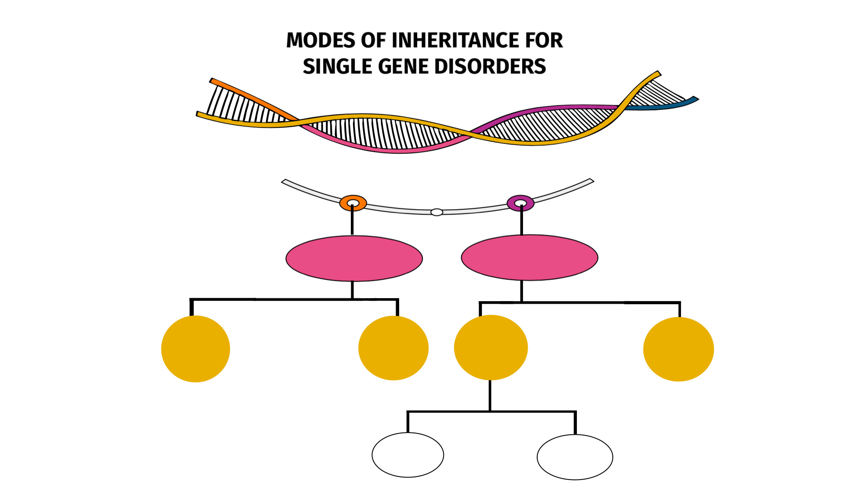
Important slide
Autosomal
Sex Linked
Sex linked
Recessive
Dominant
X Linked
Y Linked
Recessive
Dominant

Slide 14
Autosomal Dominant
Autosomal Recessive
Mostly related to Endogamy “زواج الأقارب”
The trait (character, disease)
appears in every generation.
1
The trait (character, disease) is recessive
1
2
The trait expresses itself only in
homozygous state
2
Unaffected persons do not
transmit the trait to their children.
3
Unaffected persons (heterozygotes)
may have affected children
(if the other parent is heterozygote)
Examples:
1- Huntington disease
2- Myotonic dystrophy
3- Neurofibromatosis type 1
4- Marfan syndrome … etc.
3
4
The parents of the affected child
maybe related (consanguineous)
In autosomal recessive
Dr’s note :
Which case that the trait will appear in every generation? Autosomal Dominant.
Dr’ s note:
A person needs 2 copies of the gene to be affected (aa).
Males and female are equally affected.
Examples:
Cystic fibrosis, Phenyketonuria, Sickle cell
anaemia, Thalassaemia etc.
5
While in Autosomal dominant, the genotype of affected person will be either (AA) or (Aa).

Slide 15
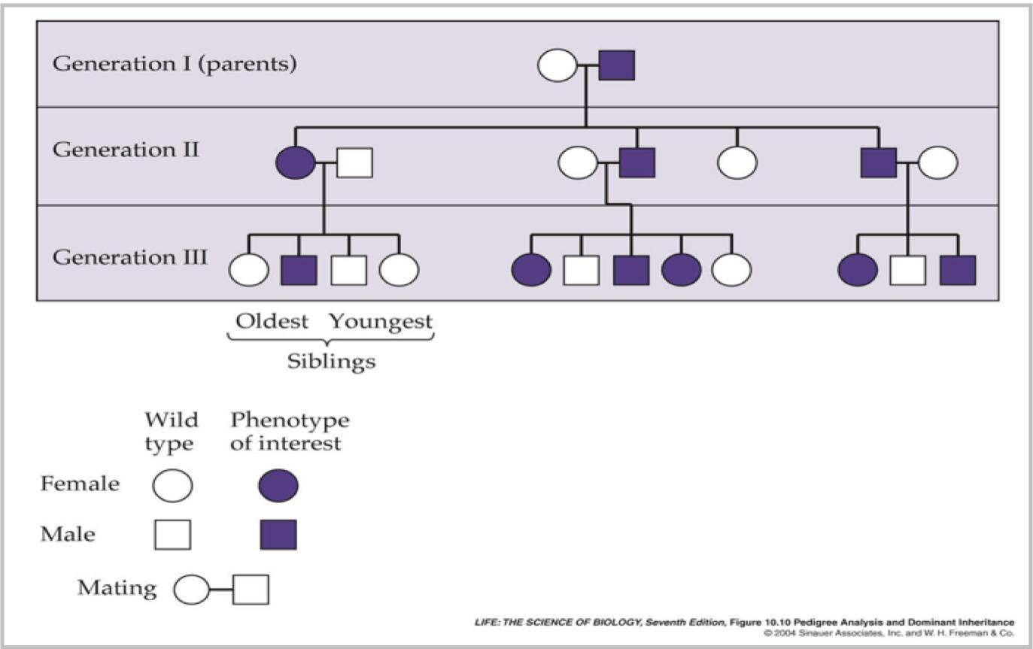
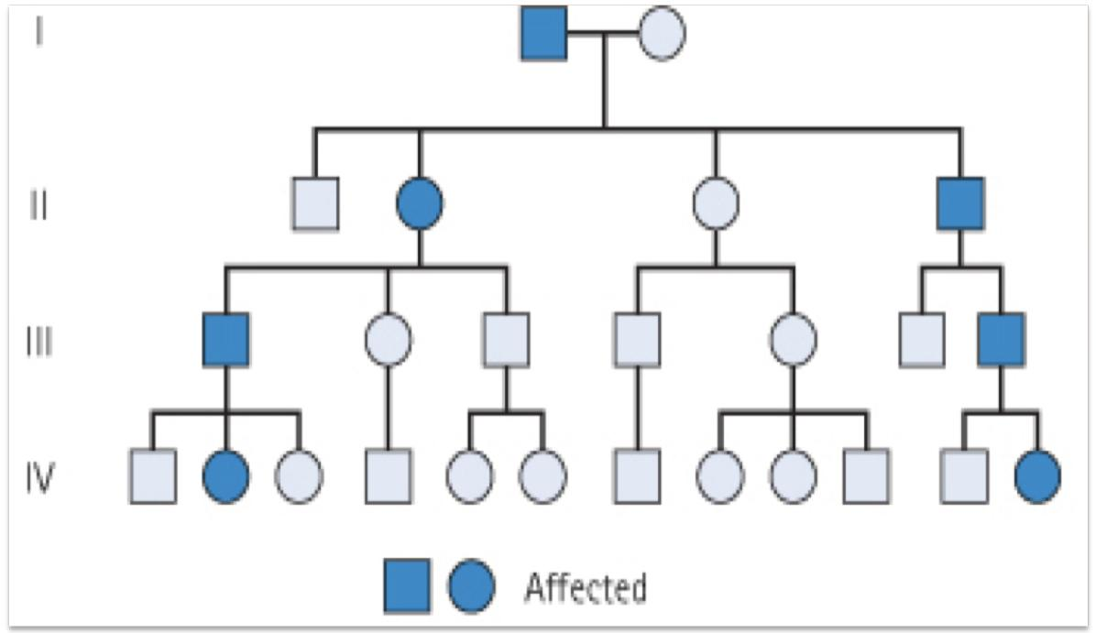
A Pedigree Analysis
Family Tree of an Autosomal Dominant Mode of Inheritance
Note the presence of male-to-male (i.e. father to son) transmission.
Dr’s note:
●The pedigree is essential part
of history taking in genetics.
● The probability of each child being affected is 25% , but not for all children,25%.
The Dr’s note:
A person only needs 1
copy of the gene to be affected (AA,Aa).

Slide 16
Punnett square showing autosomal recessive inheritance
2- One Parent Heterozygous
3- One Parent Homozygous
1- Both Parents Heterozygous
Mother
Mother
100% offspring carriers
Mother
25% Normal
50% Normal
A
a
A
a
A
A
A
AA
Aa
A
AA
Aa
a
Aa
Aa
Father
Father
Father
a
Aa
aa
A
AA
Aa
a
Aa
Aa
50% Trait “Heterozygous normal but carrier”
25% offspring “affected Homozygous
50% normal but carrier “Heterozygous”
Unaffected persons (heterozygotes) may have affected children (if the other parent is heterozygote)

Slide 17
Family tree of an Autosomal recessive disorder Sickle cell disease (SS)
Team 439 :
Skip one generation
A family with sickle cell disease -Phenotype
Hb Electrophoresis
AA AS SS

Slide 18
Sex – Linked Inheritance
Definition: The inheritance of a gene present on the sex chromosomes.
The Inheritance Pattern is different from the autosomal inheritance.
Inheritance differs in males from females.
X-Linked
Two types
Y-Linked

Slide 19
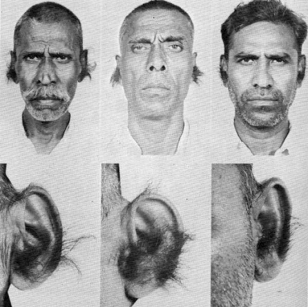
X-Linked inheritance
Y-Linked inheritance
● The gene is present on the X chromosome.
● The inheritance follows specific pattern.
● Males have one X chromosome, and are hemizygous .
● Females have 2 X chromosomes, they may be homozygous or heterozygous.
● These disorders may be :
recessive or dominant.
● The gene is present on the Y chromosomes.
● The gene is passed from fathers to sons only.
● Daughters are not affected.
● Hairy ears in India.
● Male are Hemizygous, the condition exhibits itself whether dominant or recessive.
Hemizygous:describes an individual who has only one member of a chromosome pair or chromosome segment rather than the usual two.
Hairy ears in India.
100% of males are affected.
Father
X
Y*
X
XX
XY*
Mother
X
XX
XY*

Slide 20
X – Linked Recessive Inheritance
The incidence (الإصابة) of the X-linked disease is higher in male than in female
The trait is passed from an affected man through all his daughters to half their sons
The trait is never transmitted directly from father to sons.
An affected women has affected sons and carrier daughters.
X Linked Recessive Disorders:
Albinism, Fragile X syndrome, Hemophilia, Muscular dystrophy.

Slide 21
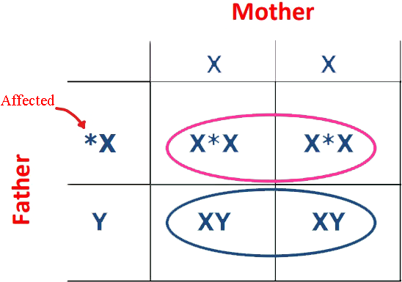
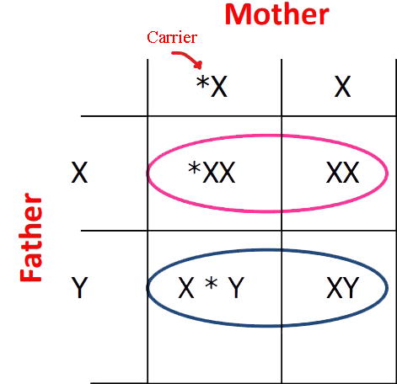
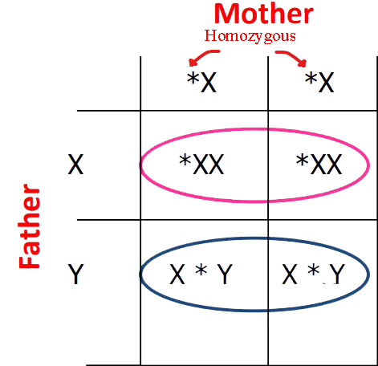
Punnett square showing X-linked Recessive type of Inheritance
Normal female, affected male
1
1. All sons are normal
2. All daughters carriers “not affected”
Carrier female, normal male
2
1. 50% sons affected
2. 50% daughters carriers
Homozygous female, normal male
3
1. All daughters carriers.
2. All sons affected.

Slide 22
X – Linked Dominant Disorders
The gene is on X Chromosome and is dominant
The trait occurs at the same frequency in both
males and females
Hemizygous male and heterozygous females
express the disease.

Slide 23
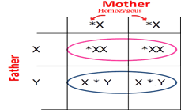
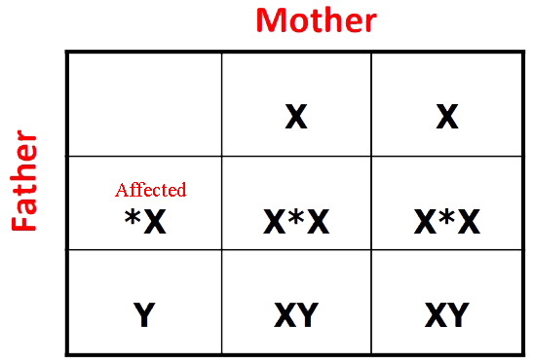
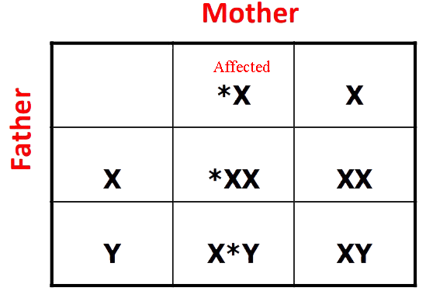
Punnett square showing X-linked Dominant type of Inheritance
Dr note in case of Affected female (homozygous) and normal male
All sons and daughters are affected
Affected female (heterozygous) and
normal male
Affected male and normal female
50% sons & 50% daughters are affected
All daughters affected
All sons normal

Slide 24
TAKE HOME MESSAGE:
An accurate determination of the family pedigree is an important part of the work up of every patient
These patterns depend on location of the gene locus on the chromosomal, which may be autosomal or sex chromosome-linked, and whether the phenotype is dominant or recessive
Pedigrees for single-gene disorders may demonstrate a straightforward, typical mendelian inheritance pattern

Slide 25
MCQ’s
A trait or disorder determined by a gene on one of the sex chromosomes is said to be:
Autosomal inheritance | B) Sex-linked inheritance | C) Recessive inheritance | D) Dominant inheritance
2. The person with the alleles (AA) is known to be :
Homozygous | B) Heterozygous | C) Hemizygous | D) None of them
3. One of the following is an example of Y-Linked inheritance disease :
Answer keys : 1-B , 2-A , 3-A , 4-C , 5-A
A)Hairy ears in India. | B) Huntington disease | C) Thalassaemia | D) Sickle cell anaemia
4. The physical expression of a character is called :
Morphology | B) Genotype | C) Phenotype | D) dominant
5. Affected male with X-linked Dominant disease and normal female, their sons will be :
100 % normal | B) 50 % normal , 50 % affected | C) 50 % normal , 50 % affected | D) 100 % affected

Slide 26
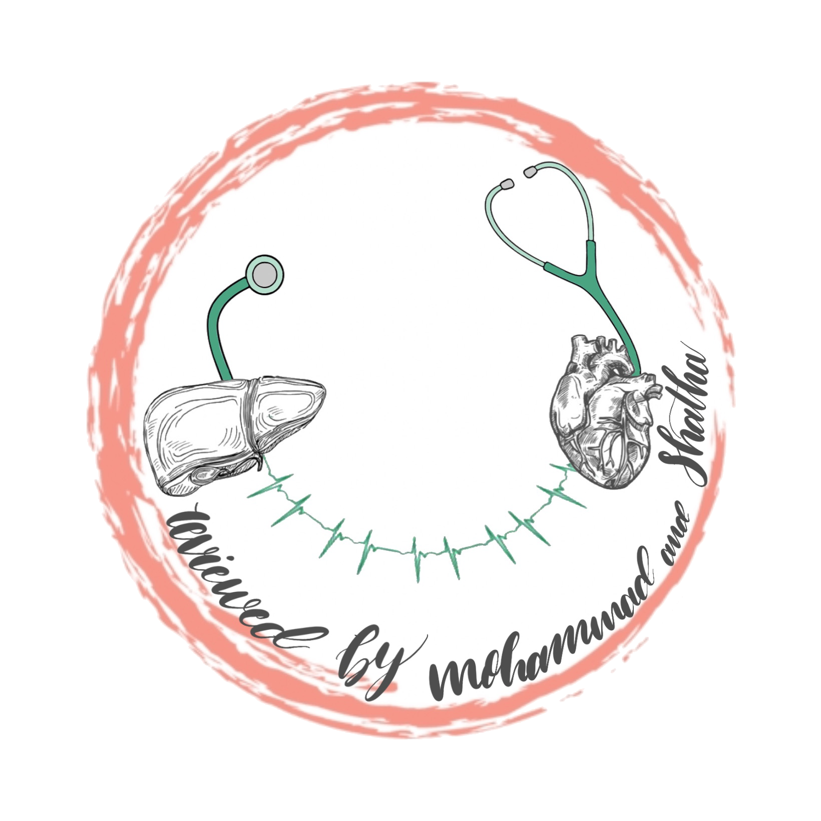
Team members
M - team
F - team
Ali Jabaan
Mohammed Alzeer
Khaled Arbeed
Abdulaziz Alnasser
Muhannad Almuadi
Saleh Alkholaifi
Malik Halees
Abdullah Awartani
Walaa Almutawa
Shahad Almarshad
Razan Alsulami
Atheer Alahmari
Reema Aljubreen
Mayssam Aljaloud
Jana Alhazmi
Layan Alburikan
Team leaders
Nawaf Alrefaei “leader”
Ibrahim Alhezam “sub-leader”
Razan Almohanna “leader”
Maram Beyari “sub-leader”
&
humangenetics442@gmail.com

