Slide 1
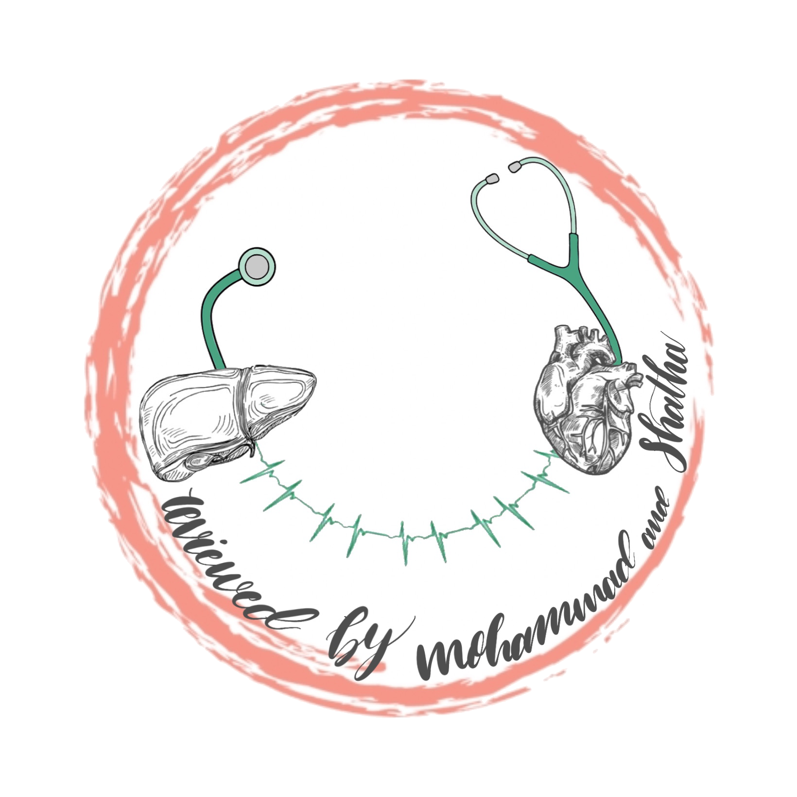
ATYPICAL MODE OF INHERITANCE
4
Foundation block
Human genetics 442
RED : Important
PINK : F. slides
BLUE : M. slides
GREEN : Doctors notes
GRAY : Extra
Editing file

Slide 2
OBJECTIVES
01
Codominant traits & Pseudodominant inheritance.
02
Heterogeneity & Mitochondrial inheritance.
03
Anticipation & Pleiotropy.
04
New mutation & Variable expressivity.
05
Complex trait: Multifactorial/Polygenic.

Slide 3
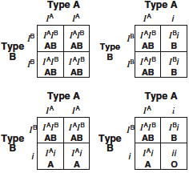
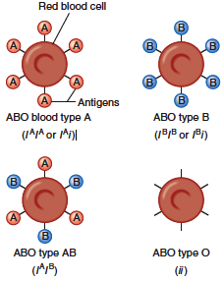
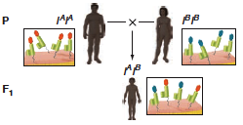
CODOMINANT TRAITS
This pattern occurs when the heterozygote expresses both alleles simultaneously without forming an intermediate phenotype.
For example:
In blood typing, an individual carrying the A and B alleles has an AB blood type.
-Most genes exist in multiple alleles
Dr’s note:
The only thing that you have to know from this slide is the definition of Codominant trait and its example.

Slide 4
PSEUDODOMINANT INHERITANCE
is the situation in which the inheritance of a recessive trait mimics a dominant pattern.
Description of the pedigree:
1- The husband is a heterozygous for
an autosomal recessive.
2- The wife is a homozygous for
an autosomal recessive.
3- Their children have a 1 in 2 (50%) chance of being affected homozygous i.e.pseudodominant.

Slide 5
ATYPICAL INHERITANCE OF SINGLE - GENE DISORDERS
What are the situations in which the inheritance of single-gene disorders diverges from typical mendelian patterns?
Maternal mitochondrial mutations inheritance.
Anticipation.
Atypical autosomal dominant defects:
- Pleiotropy
- Variable expressivity
- Reduced penetrance
- New mutation
Unusual inheritance patterns due to genomic imprinting.
Mosaicism:
- Somatic mosaicism
- Germline mosaicism

Slide 6
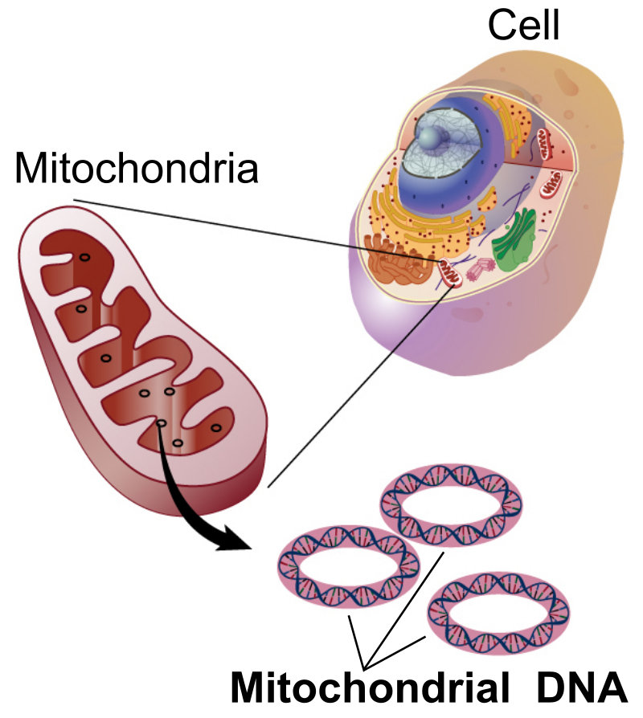
MITOCHONDRIAL INHERITANCE
Each cell contains many copies of mitochondrial DNA with more being found in high energy demanding cells (e.g brain & muscle).
Mitochondria & its DNA are inherited from the mother (through ova).
mtDNA : small circular double-stranded molecule containing 37 Genes (coding for rRNA, tRNA, and some of the proteins of the mitochondrial electron transport chain).

Slide 7
Homoplasmy vs Heteroplasmy
Heteroplasmy
is when multiple mtDNAs are different thus having two populations of mtDNA; normal mtDNA & mutant mtDNA.
Homoplasmy
is when multiple mtDNAs are almost identical.
The proportion of mutant mtDNA varies between cells & tissues.
Thus, a range of phenotypic severity in mitochondrial inheritance.
The more mutant the more severity.

Slide 8
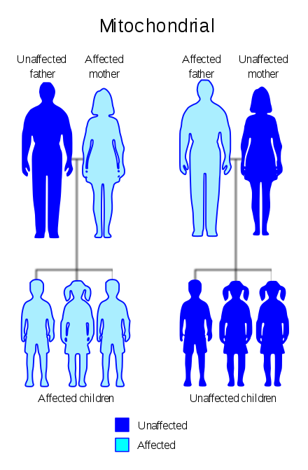
MITOCHONDRIAL INHERITANCE
Mitochondria & their genes are passed from the mother.
Cells have many mitochondria. If an oocyte is heteroplasmic, differing numbers of copies of mitochondrial mutations may be transmitted.
The phenotype reflects the proportion of mitochondria bearing the mutation.
Typical example of an mitochondrial disorder:
Cytoplasm is inherited from the mother only
(the mitochondria are present in the cytoplasm)
Leber Hereditary Optic Neuropathy (LHON)
Rapid optic nerve death blindness in young adult life
males don’t transmit the disease

Slide 9
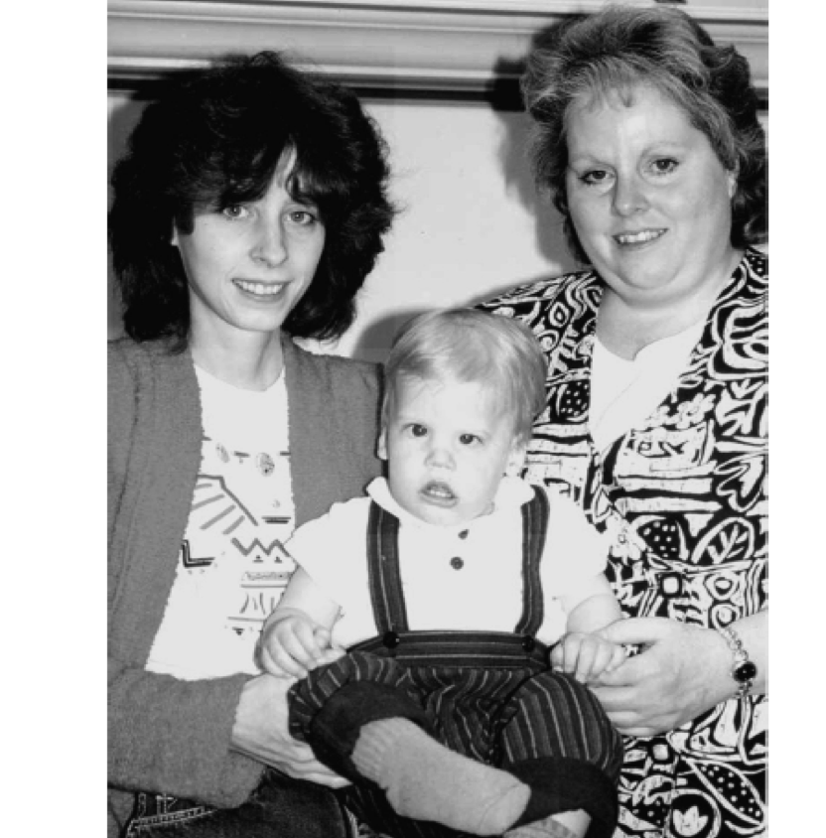
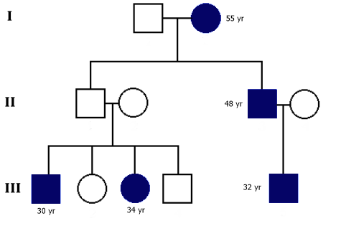
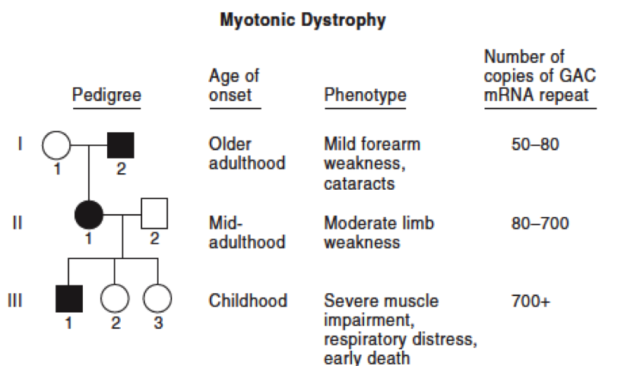
Anticipation
The severity of the disease is increases from one generation to another
A pattern of inheritance in which individuals in the most recent generations of a pedigree develop a disease at an earlier age or with greater severity than do those in earlier generation.
The reason might be the gradual expansion of trinucleotide repeat polymorphisms within or near a coding gene.
Huntington disease
Myotonic dystrophy
Examples of anticipation diseases:
Myotonic dystrophy pedigree showing ANTICIPATION
Normal number of copies of GAC is <37

Slide 10
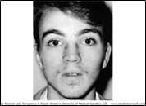
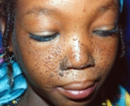
Pleiotropy
Pleiotropic : is a single-gene disorder with many symptoms, or a gene that controls several functions or has more than one effect.
One gene causes multiple symptoms, mutations and disorders
causes autosomal dominant disorders
For example:
tuberous sclerosis
affected individuals can present with either learning difficulties, Epilepsy, facial rashes , or all features

Slide 11
Variable expressivity
The clinical features in autosomal dominant disorders can show striking variation from person to person, even in the same family
For example:
In Autosomal dominant polycystic kidney disease:
Different responses
some
develop renal failure in early adulthood.
have just a few renal cysts that do not significantly affect renal function.
others

Slide 12
Reduced Penetrance
In some individuals heterozygous for gene mutations giving rise to certain autosomal dominant disorders there may be no abnormal clinical features, representing so called: reduced penetrance or “skipping a generation”
Someone is carrying the gene but looks healthy
Example: Down syndrome I can be carrying the gene but I don’t show any clinical features
Reduced penetrance might be due to:
modifying effects of other genes
interaction of the gene with environmental factors

Slide 13
New mutation
أول شخص يبدأ يظهر عنده الجين
● In autosomal dominant disorders an affected person will usually have an affected parent.
● This is not always the case and it is not unusual for a trait to appear in an individual when there is no family history of the disorder.
● The sudden unexpected appearance of a condition arising as a result of a mistake occurring in the transmission of a gene is called a new mutation.

Slide 14
Achondroplasia
A form of short-limbed dwarfism, in which the parents usually have normal stature
Diagnosis/testing:
Characteristic clinical and radiographic finding
Molecular genetic tests: mutation in the FGFR3 gene on chromosome 4p16.3 (coding for fibroblast growth factor receptor 3)
“The offspring of persons with achondroplasia had a 50% chance of having achondroplasia”
What other possible explanations for the 'sudden' appearance of this disorder?
Variable expressivity
non-penetrance: One of the parents might be heterozygous for the mutant allele but so mildly affected that it has not previously been detected
the family relationships not being as stated, e.g. non-paternity

Slide 15
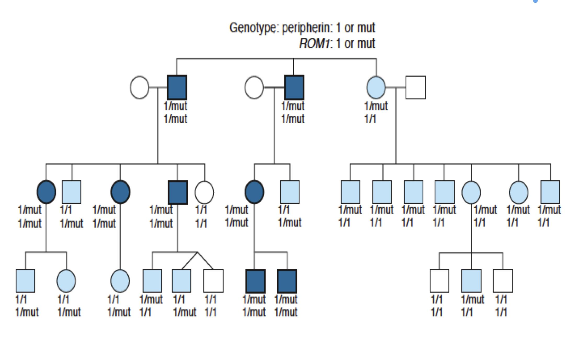
COMPLEX TRAITS
PEDIGREE OF A FAMILY WITH RETINITIS PIGMENTOSA DUE TO DIGENIC INHERITANCE
Complex traits are conditions which are likely to be due to the interaction of more than one gene.
Multiple genes cause multiple disorders
The effects may be additive, one may be rate-limiting over the action of another, or one may enhance or multiply the effect of another.
e.g. Digenic inheritance: where a disorder has been shown to be due to the additive effects of heterozygous mutations at two different gene loci
In man one form of retinitis pigmentosa, a disorder of progressive visual impairment, is caused by double heterozygosity for mutations in two unlinked genes, which both encode proteins present in photoreceptors. Individuals with only one of these mutations are not affected.

Slide 16
MULTIFACTORIAL/POLYGENIC DISORDERS
Human characteristics such as height, skin color and intelligence could be determined by the interaction of many genes, each exerting a small additive effect.
This model of quantitative inheritance can explain the pattern of inheritance for many relatively common conditions including:
– congenital malformations such as cleft lip and palate
– late-onset conditions such as:
• Hypertension
• Diabetes mellitus Type II to be specific.
• Alzheimer disease
The prevailing view is that genes at several loci interact to generate a susceptibility to the effects of adverse environmental trigger factors.

Slide 17
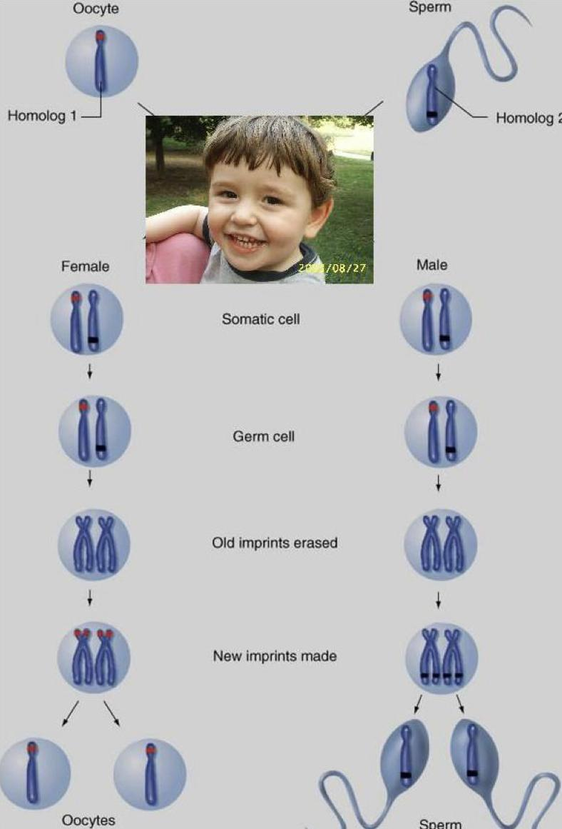
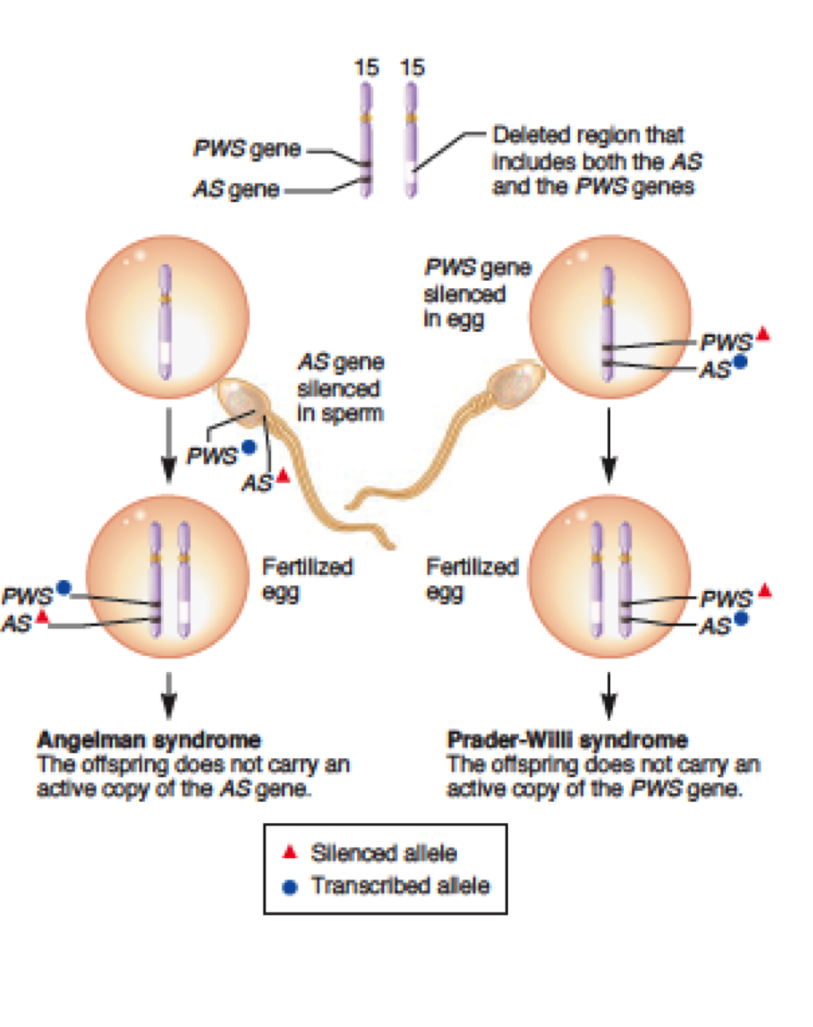
GENOMIC IMPRINTING
An example of Non-Mendelian Inheritance
The role of imprinting in the development of Angelman and Prader-Willi syndromes
It affects so many generations
Certain chromosomes retain a memory or “imprint” of parental origin that influences whether genes are expressed or not during gametogenesis
A small region on chromosome 15 contains two different genes designated the AS gene and PWS gene in this figure.
If a chromosome 15 deletion is inherited from the mother, Angelman syndrome occurs because the offspring does not inherit an active copy of the AS gene (left).
Alternatively, the chromosome 15 deletion may be inherited from the father, leading to Prader-Willi syndrome.
The phenotype of this syndrome occurs because the offspring does not inherit an active copy of the PWS gene (right).

Slide 18
TAKE HOME MESSAGE:
An accurate determination of the family pedigree is an important part of the workup of every patient.
Exceptions to Mendelian inheritance do occur in single-gene disorders.
The inheritance pattern of an individual pedigree may be obscured by a number of other factors that may make the mode of inheritance difficult to interpret.
Some characteristics and many common familial disorders, do not usually follow a simple pattern of Mendelian inheritance.

Slide 19
MCQ’s
The majority of genes exist in:
Single allele | B) Multiple alleles | C) Without any allele | D) None
2. The type of inheritance where the inheritance of a recessive trait mimics a dominant pattern is:
Codominant inheritance | B) Recessive inheritance | C) Dominant inheritance | D) Pseudodominant inheritance
3. The following pedigree shows:
Answer keys: 1B , 2D , 3C , 4C , 5B
Codominant trait | B) New mutations | C) Anticipation | D) Pleiotropy
4. Mitochondria (& their DNA) are inherited from:
Both parents | B) The father | C) The mother | D) None of them
5. the presence of two populations of mtDNA in a cell; the normal mtDNA & the mutant mtDNA :
Homoplasmy | B) Heteroplasmy | C) Homozygous | D) Heterozygous

Slide 20
Team members
M - team
F - team
Ali Jabaan
Mohammed Alzeer
Khalid Arbeed
Abdulaziz Alnasser
Muhannad Almuadi
Saleh Alkholaifi
Malik Halees
Abdullah Awartani
Walaa Almutawa
Shahad Almarshad
Razan Alsulami
Atheer Alahmari
Reema Aljubreen
Mayssam Aljaloud
Jana Alhazmi
Layan Alburikan
Team leaders
Nawaf Alrefaei “leader”
Ibrahim Alhezam “sub-leader”
Razan Almohanna “leader”
Maram Beyari “sub-leader”
&
humangenetics442@gmail.com

