Slide 1

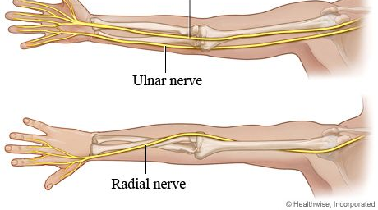


Radial & Ulnar Nerves

Slide 2
Objectives
By the end of this session the students should be able to:
Describe the anatomy of the radial and ulnar nerve regarding to origin, course, and distribution.
List the branches of the nerves.
Describe the causes and manifestations of nerve injury.

Slide 3
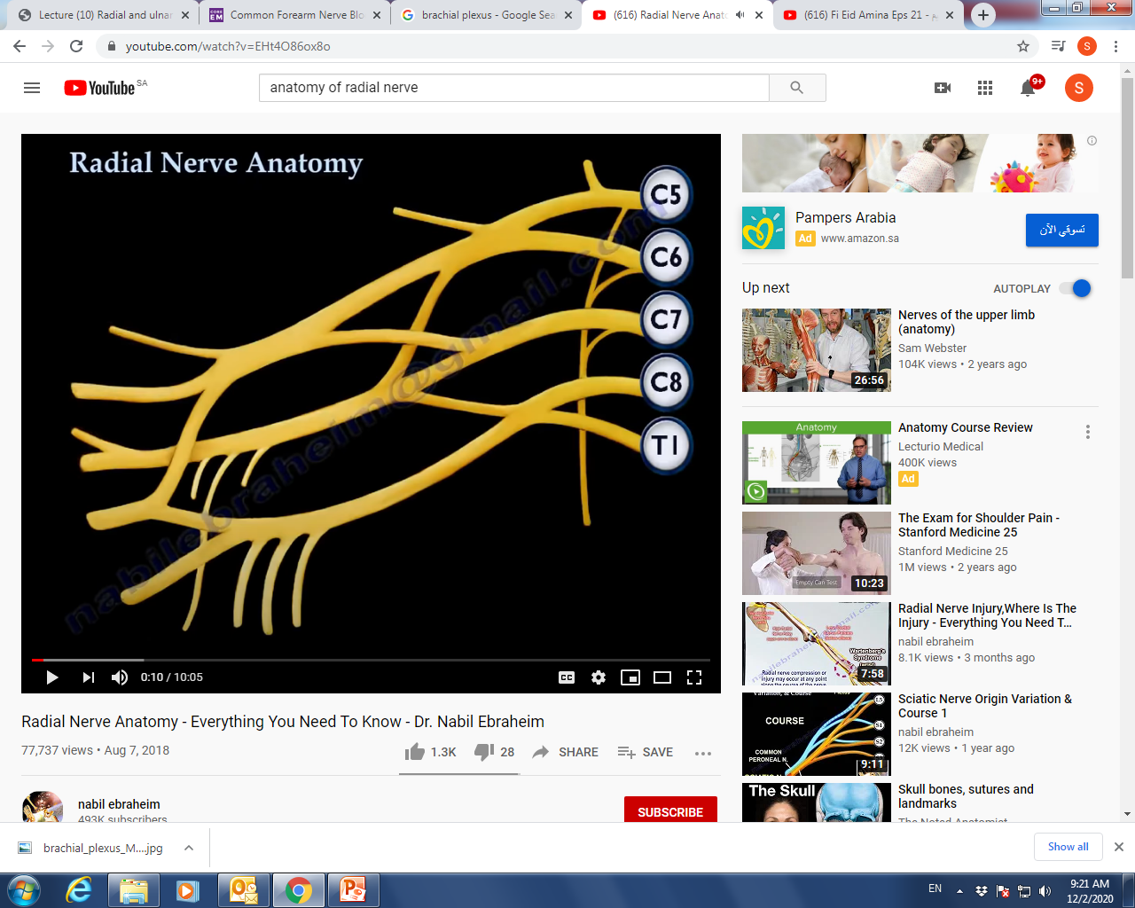
Radial Nerve Anatomy
The radial nerve arises from the posterior cord of the brachial plexus.
The radial nerve receives branches from each nerve root from C5-T1.
Posterior Cord
Radial Nerve
One of the five branches of the posterior cord of the brachial plexus.
The largest branch.
Begins in the axilla.

Slide 4
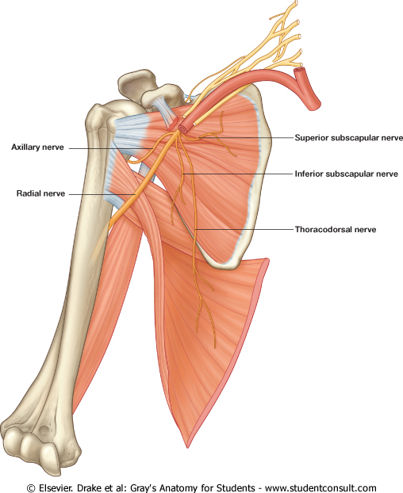
Radial Nerve Anatomy
The radial nerve courses on the posterior wall of the axilla and lies posterior to the axillary artery and on top of the subscapularis, the teres major, and the lattissmus dorsi muscles.
The radial nerve continuous into the posterior compartment of the arm.
Then gives three branches in the axilla:
Muscular Branch to Long head of Triceps.
Muscular Branch to medial
head of triceps.
3. Posterior Cutaneous nerve of the arm.

Slide 5
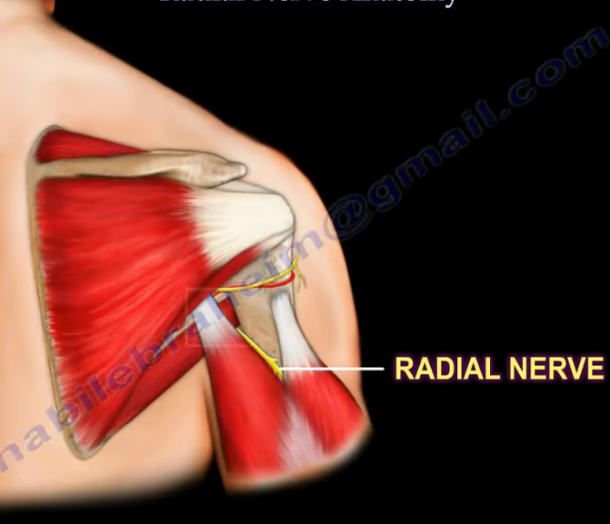
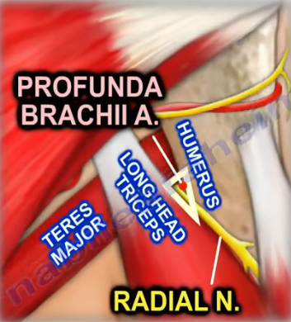
Radial Nerve Anatomy
The radial nerve next travels through
the triangular interval with the
profunda brachi artery posteriorly.
The triangle intervals boundaries:
Teres major (proximal)
Long head triceps (medial)
Humeral shaft (lateral)
Contains: the profunda brachii
artery and the radial nerve.
The radial nerve enters the upper arm between the long head and the medial head of triceps and then it runs towards the spiral groove of the humerus.

Slide 6
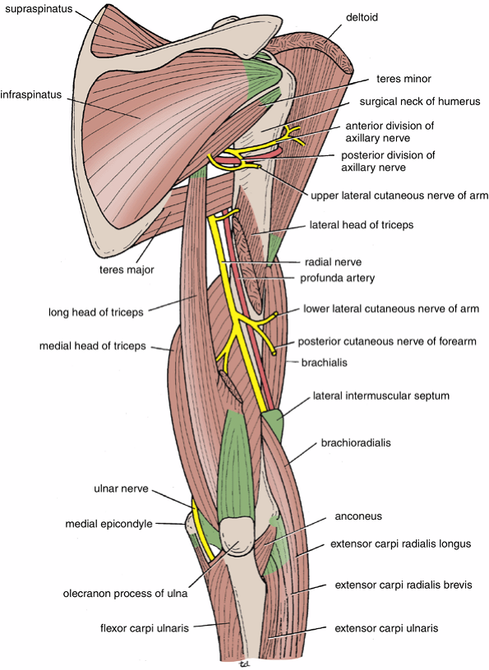
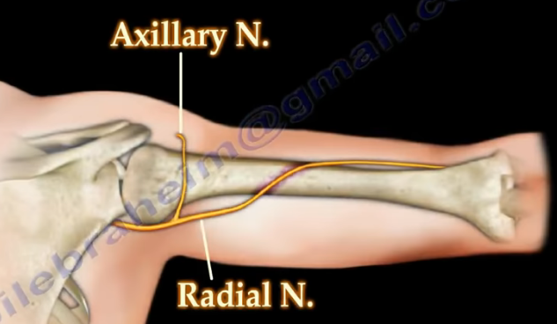
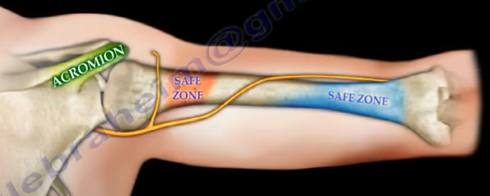
Radial Nerve Anatomy
The spiral groove is a thin, bare area of bone
that lies in the upper 2/3 of the back of
the humerus between the lateral and
medial heads of triceps.
In the spiral groove, the nerve is
accompanied by the Profunda Vessels,
and it lies directly in contact with the
shaft of the humerus
(a Dangerous Position).
Spiral Groove
Notes:
Four branches arise from the radial nerve within the spiral groove:

Slide 7
Radial Nerve Anatomy
Four branches arise from the radial nerve within the spiral groove:
Cutaneous:
Lower lateral cutaneous nerve of arm.
Posterior cutaneous nerve of forearm.
Muscular:
3. Lateral & Medial heads of triceps.
4. Anconeus.
Dr. Sameerah

Slide 8
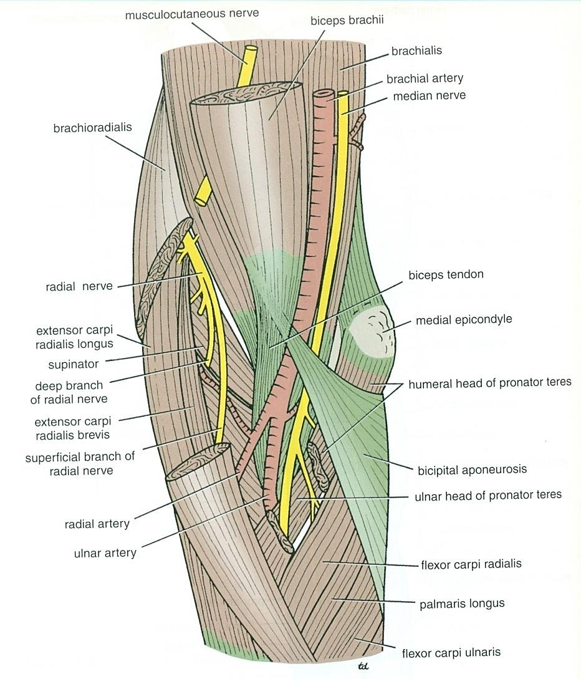
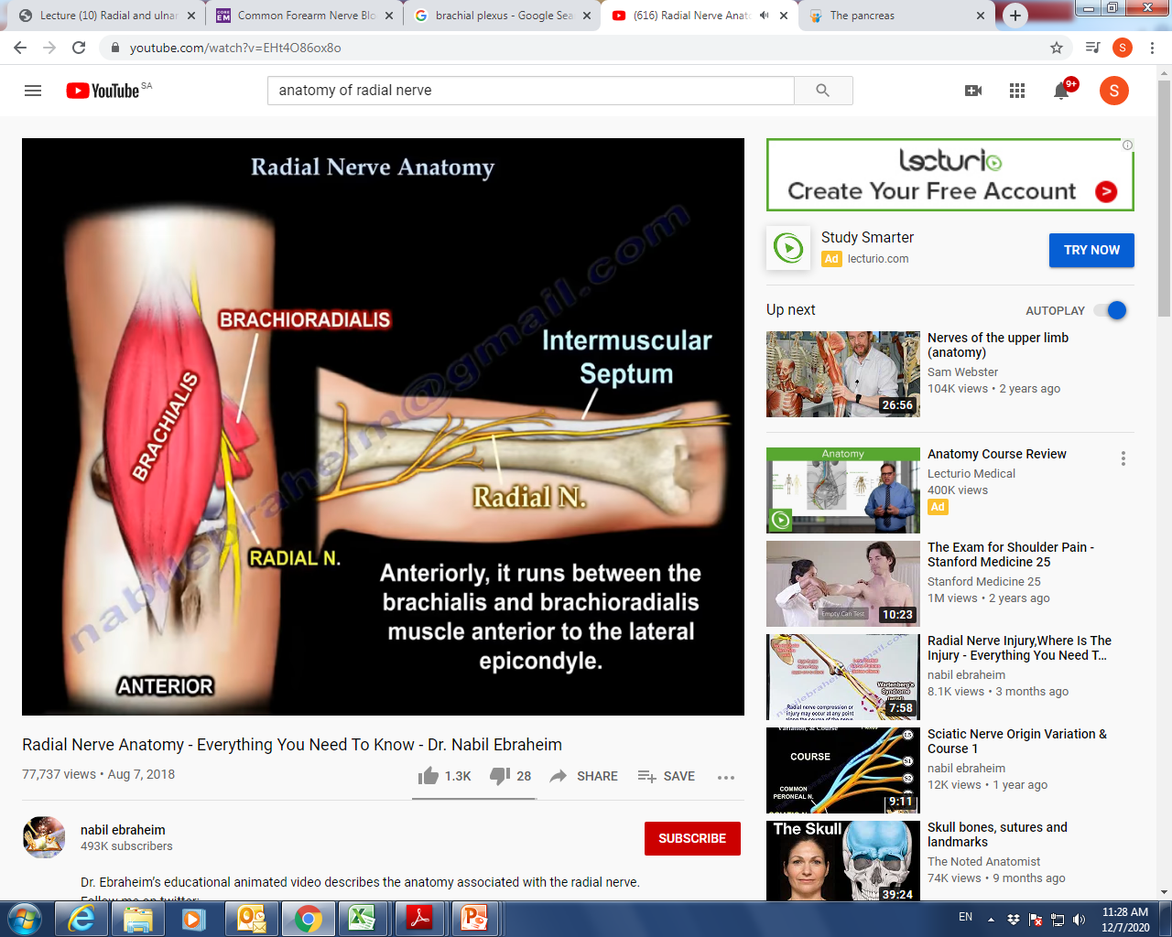
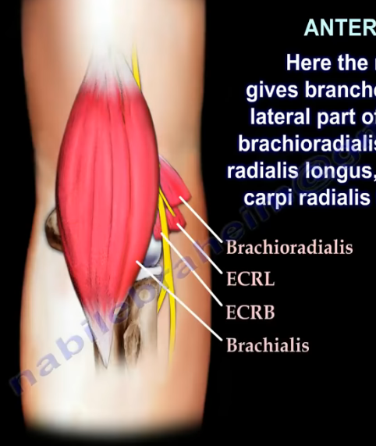
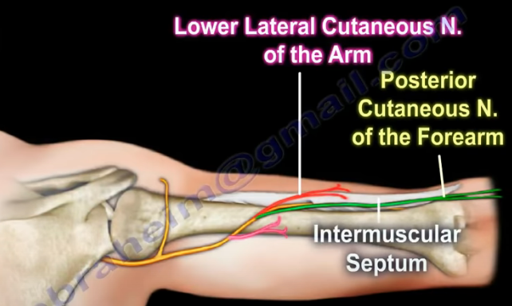
Radial Nerve Anatomy
It pierces the Lateral Intermuscular septum & enters the ant. compartment of the arm (7.5 cm) above elbow joint.
Anteriorly, it runs between the brachialis and brachioradialis muscles anterior to the Lateral Epicondyle.
Here it gives muscular branches to:
Lateral part of the brachialis,
Brachioradialis,
ECRL,
adialis
nerve
Passes forward into the Cubital Fossa

Slide 9
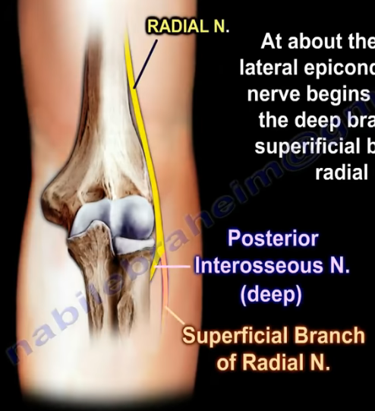
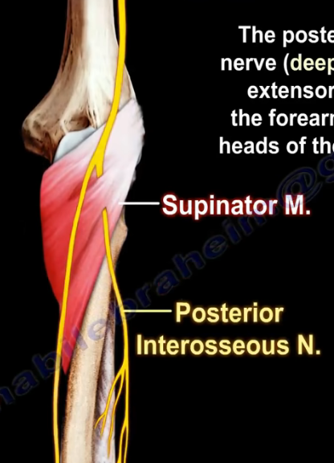
Radial Nerve Anatomy
At about the level of the lateral
epicondyle, the radial nerve begins to
divide into:
superficial branch and deep branch.
1.Superficial branch
  Continuation of the radial nerve.
  Purely cutaneous.
2. Deep branch (Post.interosseous):
Winds around the neck of the radius, and enters the extensor compartment of the forearm between the two heads of the supinator muscle.
Purely Motor nerve.

Slide 10
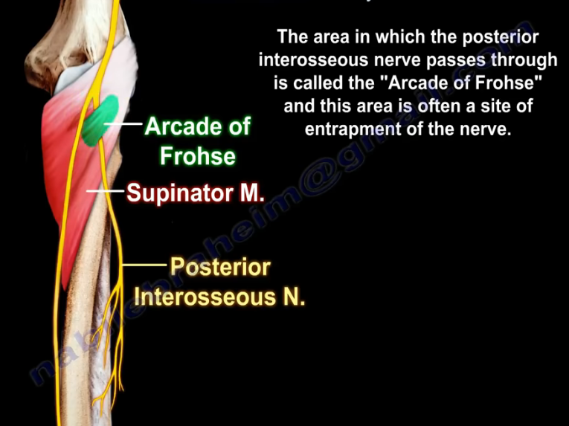
Radial Nerve Anatomy

Slide 11
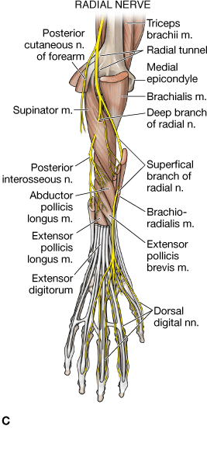
Radial Nerve Anatomy
Deep Branch (Post. interosseous):
Supplies these muscles on the radial side and dorsal surface of the forearm:
Muscular:
  Extensor carpi radialis brevis.
  Supinator.
  Extensor carpi ulnaris.
  Extensor digitorium
  Extensor digiti mini
  Abductor pollicis longus.
  Extensor pollicis brevis.
  Extensor pollicis longus.
  Extensor indicis.
2.
6.
8.
7.
4.
Dr. Sameerah

Slide 12
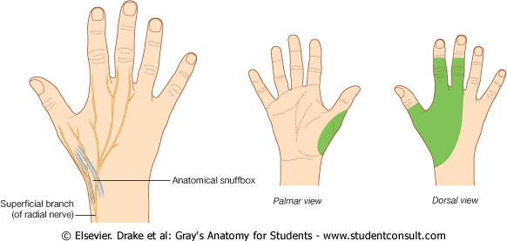
Radial Nerve Anatomy
The Superficial branch of radial nerve: runs down the flexor comp. of the forearm and winds around the lower end of the radius deep to brachiradialis. Then crosses the pollicis muscles to reach the back of the hand towards the anatomical snuff box.
The Superficial branch is a terminal division of the radial nerve & a sensory nerve supplying the majority of the dorsum of the hand:
    Lateral two-thirds of dorsum of hand.
    Lateral three and half fingers.
Dr. Sameerah

Slide 13
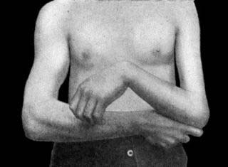
Radial Nerve Anatomy
Applied Anatomy:
Radial nerve compression or injury may occur at any point along
the course of the nerve.
Very high radial nerve palsy (in the axilla):
A dislocation at the shoulder joint, or a fracture of the proximal
humerus and rarely excessive nerve compression at the axilla.
All motor and sensory function below the axilla will be affected.
Motor functions:
  Loss of function of triceps and loss of elbow extension.
  The patient is unable to extend at the forearm, wrist and
  fingers.
  Patient will experience wrist drop due to loss of function of
  forearm extensors.
Dr. Sameerah
Notes:
(branch to long & medial heads of triceps)
the triceps brachii and muscles in posterior compartment are affected.
The patient is unable to extend at the forearm, wrist and fingers. Unopposed flexion of wrist occurs, known as wrist-drop.

Slide 14
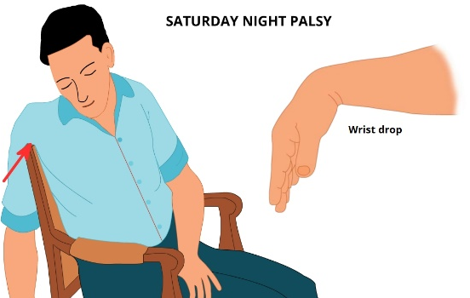
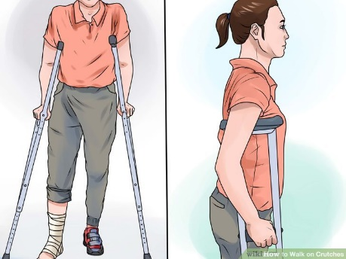
Radial Nerve Anatomy
Applied Anatomy:
Sensory functions:
Loss of sensation over the lateral and posterior arm,
Posterior forearm,
Dorsal surface of the lateral three and a half digits.
Causes of compression or injury to the radial nerve at axilla:
Saturday night palsy:
The person draping the arm
over the chair in a state
of diminished consciousness.
Crutch Palsy:
Compression on the nerve from
walking with crutches.
Dr. Sameerah
Notes:
Sensory functions – all four cutaneous branches of the radial nerve are affected.

Slide 15
Radial Nerve Anatomy
B. High radial nerve palsy (In the Radial Groove) :
The radial nerve is tightly bound within the spiral groove of the humerus. Thus, it is most susceptible to damage with a fracture of the humeral shaft.
Motor functions:
The triceps brachii may be weakened, but is not paralysed. ?
Muscles of the posterior forearm are affected. The patient is unable to extend at the wrist and fingers. Patient will experience wrist drop due to loss of function of forearm extensors.
Sensory functions:
The superficial branch of the radial nerve will be damaged,
resulting in sensory loss to the dorsal surface of the lateral
three and half digits.
Dr. Sameerah
Notes:
Compression or fracture causing Injury to the radial nerve
within spiral groove: Most common fracture of the shaft of the
humerus
The triceps brachii may be weakened, but is not paralysed (branches to the long and lateral heads of the triceps arise proximal to the radial groove).
Sensory functions – the cutaneous branches to the arm and forearm have already arisen. The superficial branch of the radial nerve will be damaged, resulting in sensory loss to the dorsal surface of the lateral three and half digits and the associated area on the dorsum of the hand.

Slide 16
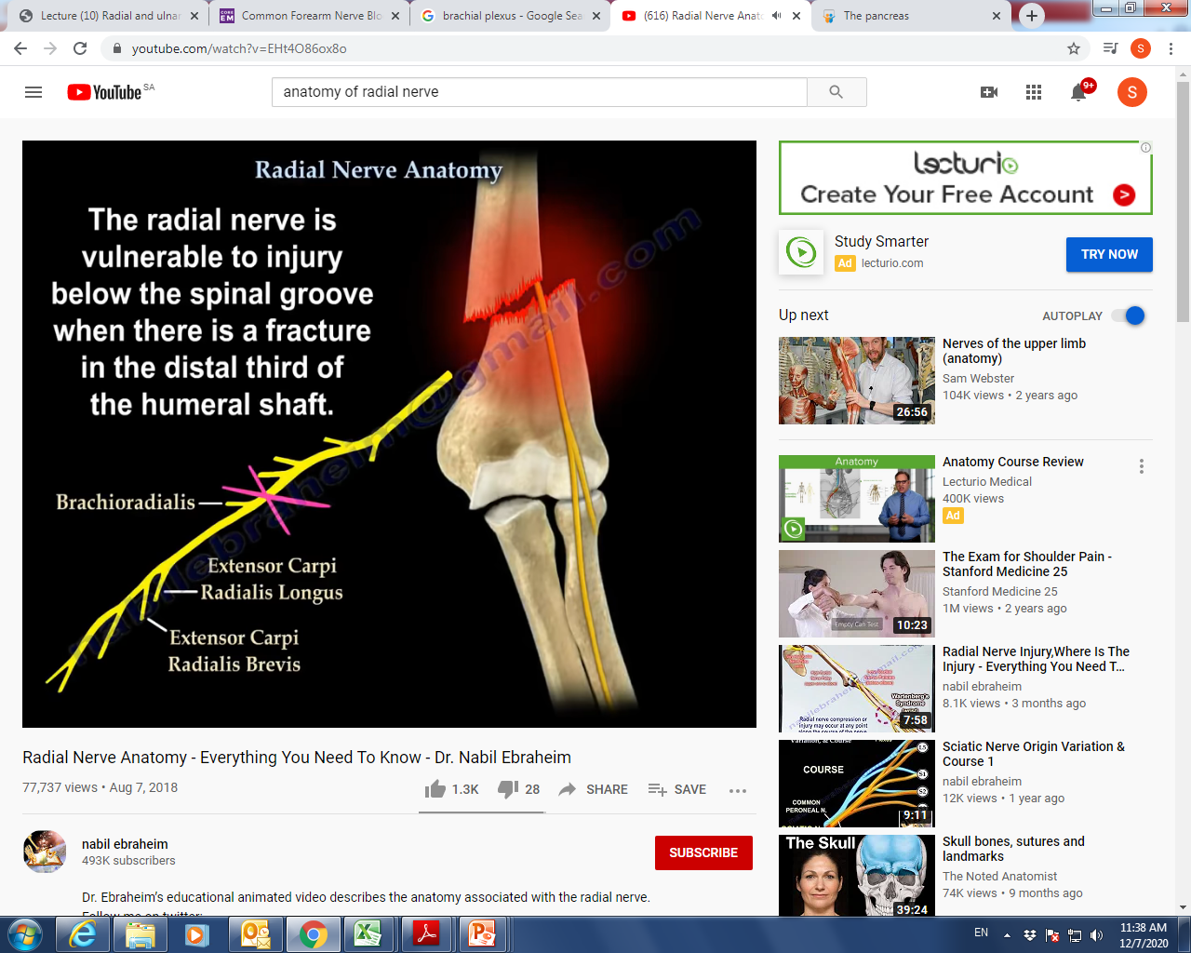
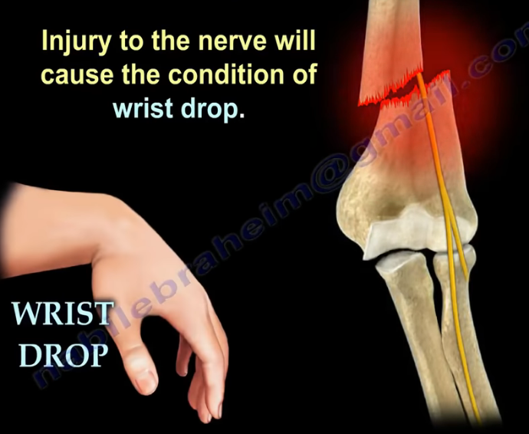
Radial Nerve Anatomy

Slide 17
Applied Anatomy:
C. Injury of the Deep Branch (Post. interosseous) In the Forearm:
Causes:
  Fractures of the proximal end of the radius (radial head).
  Posterior dislocation of the radius.
  Majority of the muscles in posterior forearm are affected & the patient will experience weakness of finger extension.
  “Wrist Drop does not occur”
  Why?
  The nerve supply to the extensor carpi radialis longus, so it is unaffected, therefore it will keep the wrist joint extended.
  No wrist Drop
  Sensory loss – None
  Overlapping by the median and ulnar nerves
Dr. Sameerah
Notes:
“No wrist Drop” {Ref. snell p-539}

Slide 18
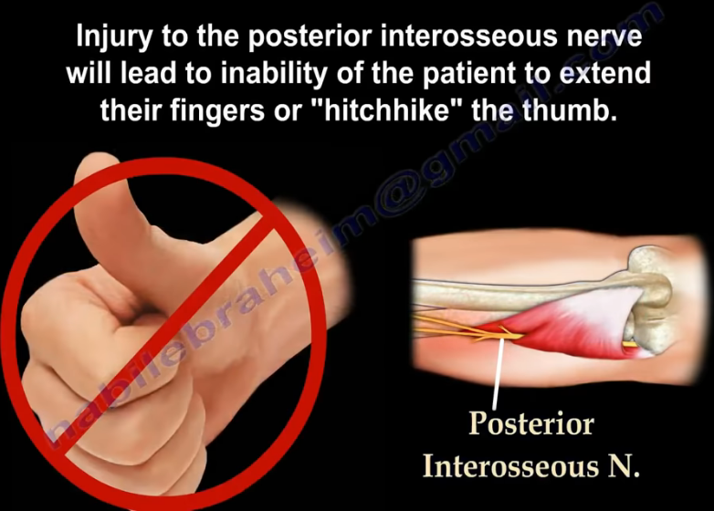
Radial Nerve Anatomy
Dr. Sameerah

Slide 19
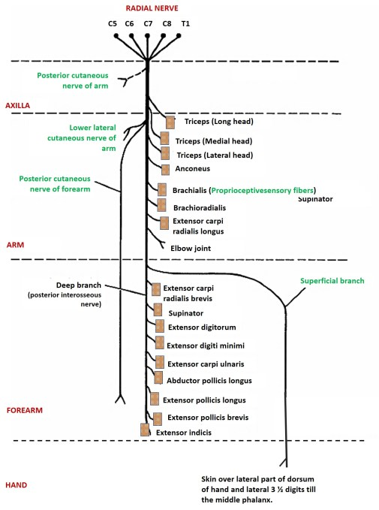
Radial Nerve
Summary of
main branches
Dr. Sameerah

Slide 20
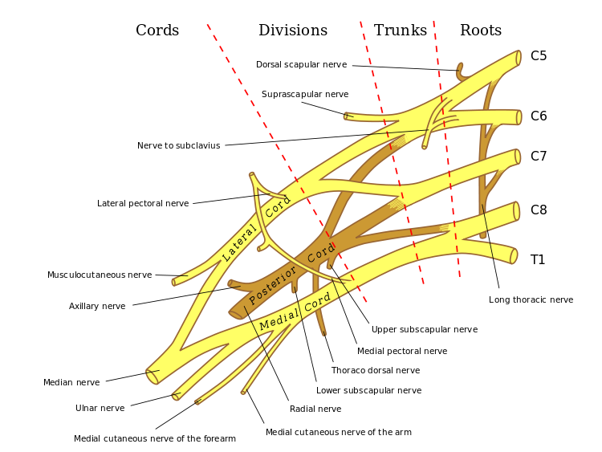
Ulnar Nerve Anatomy
The ulnar nerve originates from the C8-T1 nerve roots which form the medial cord of the brachial plexus.
Dr. Sameerah

Slide 21
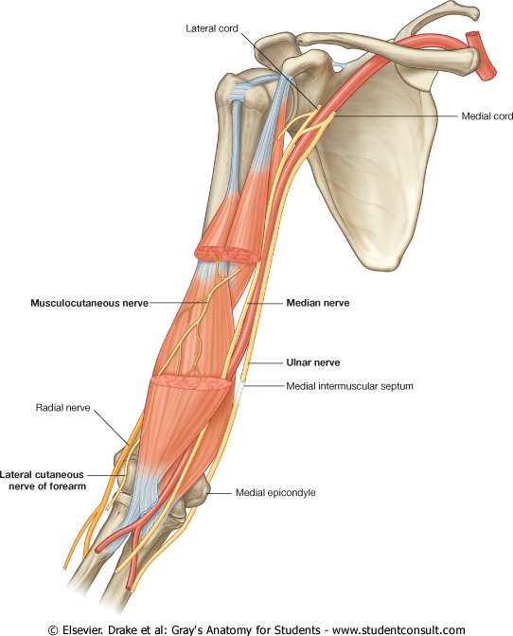
Ulnar Nerve Anatomy
Origin:
Begins in the axilla
Continuation of the medial cord
Course: In Arm
Descends along the medial side of the following arteries:
  Axillary artery.
  Brachial artery.
Pierces the medial Intermuscular Septum to reach the post. Comp.
Passes behind the medial epicondyle of the humerus at the elbow.

Slide 22
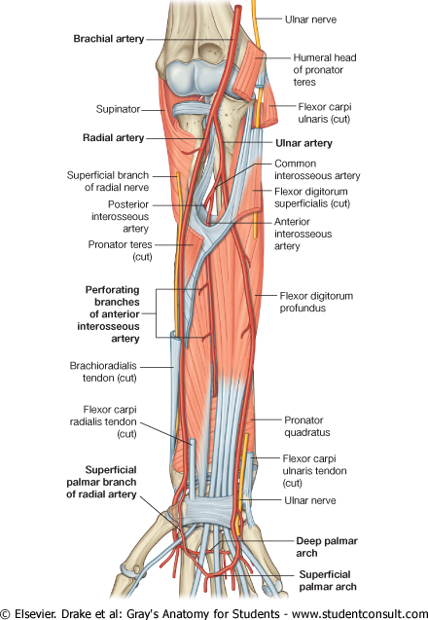
Ulnar Nerve Anatomy
Course: In Forearm
Enters between the two heads of the Flexor Carpi Ulnaris muscle.
Lies deep to the Flexor Carpi Ulnaris.
It is medial to Ulnar Artery.

Slide 23
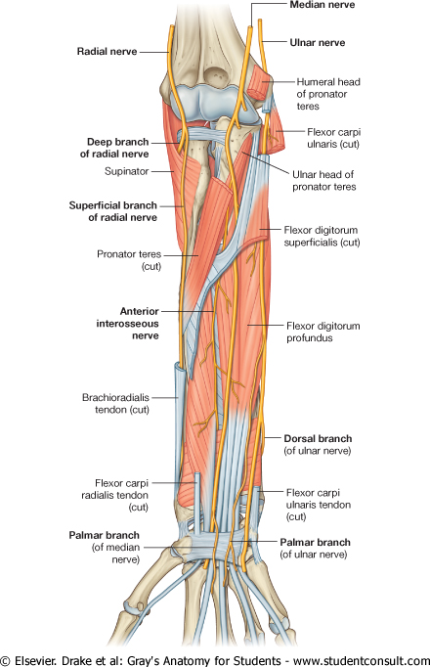
Ulnar Nerve Anatomy
Supplies: Some flexors muscles on ulnar side of the forearm.
Branches: in the Forearm
Muscular to (1 & 1/2 muscles)
1. Flexor Carpi Ulnaris.
2. Medial 1/2 of Flexor Digitorum Profundus.
Articular to Elbow joint
The ulnar nerve then travels alongside the ulna bone of the forearm into the wrist.
In the lower part of the forearm the ulnar nerve lies lateral to the FCU & medial to ulnar artery.

Slide 24
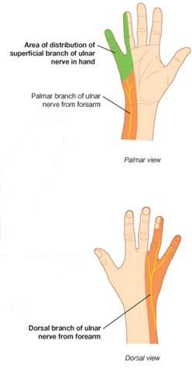
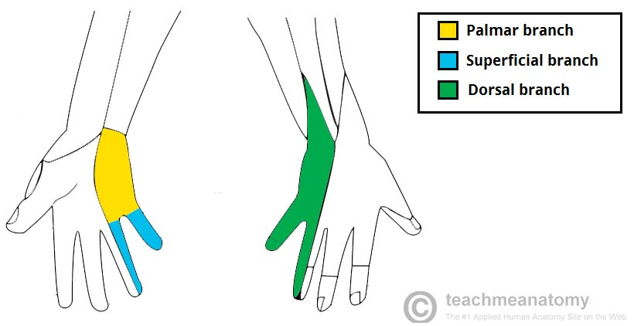
Ulnar Nerve Anatomy
Branches: in the Forearm
Cutaneous:
  Dorsal (posterior) cutaneous:
  Supplies the skin of Medial third of dorsum of the hand & dorsum of Medial 1+1/2 fingers.
  Palmar cutaneous:
  Supplies the skin over the medial third of the palm.
Dr. Sameerah

Slide 25
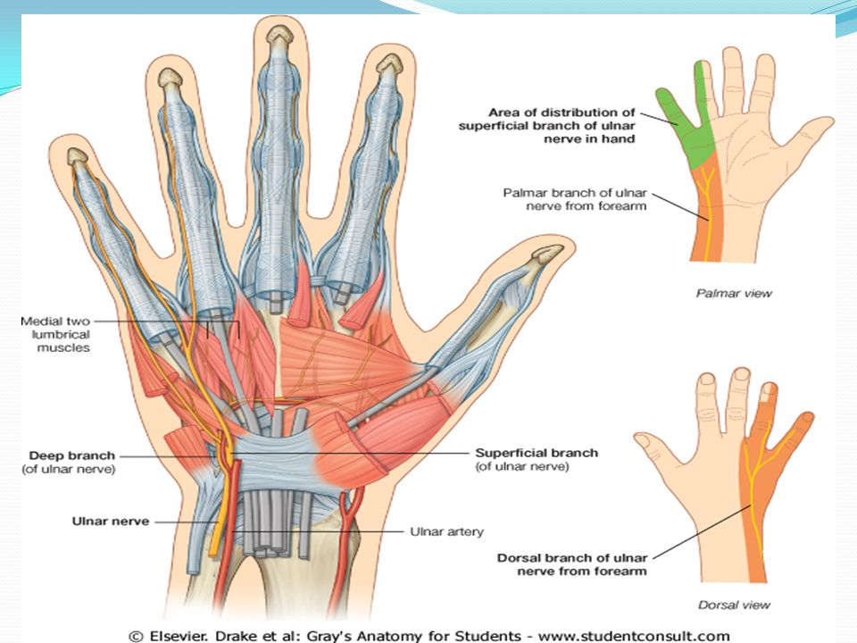
Ulnar Nerve Anatomy
Course: At wrist
The ulnar nerve enters
the palm of the hand .
Passes:
  Anterior to Flexor Retinaculum.
  Lateral to Pisiform bone &
  Hook of hamate.
  Medial to Ulnar artery.
Ends by dividing into :
Superficial & Deep branches

Slide 26

Ulnar Nerve Anatomy
Terminal Branches:
A. Superficial branch
Muscular to Palmaris Brevis.
Cutaneous:
  Supplies the skin over the Palmar aspect of the medial 1+ ½ fingers (including nail beds).

Slide 27
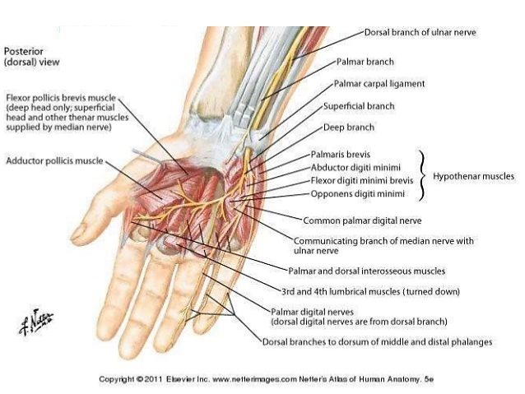
Ulnar Nerve Anatomy
Terminal Branches:
Supplies most of the
intrinsic muscles of the hand.
B. Deep Branch
Muscular to:
Hypothenar Eminence.
All Interossei (Palmar & Dorsal).
Medial two (3rd & 4th) Lumbricals.
Adductor pollicis
4.
1
2
3
Articular to Carpal joints

Slide 28
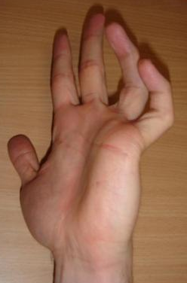
Ulnar Nerve Anatomy
Applied Anatomy
Most commonly injured
  Behind the elbow
  At wrist
  The classical sign of a low lesion “CLAW HAND”
    Hyperextension of the MCP joints of ring and little fingers
    Flexion of the IP joints
  WHY?
  Paralysis of interossei & lumbricals
  Unopposed actions of extensors & FDP

Slide 29
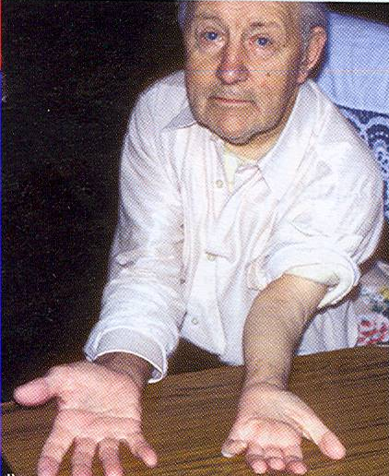
Ulnar Nerve Anatomy
Applied Anatomy
Behind the elbow
Atrophy of Ulnar side of forearm.
Flexion of the wrist with Abduction.
Wasting of Hypothenar Eminence
Claw hand.
At the elbow
Claw Hand.
Wasting of Hypothenar Eminence.

Slide 30
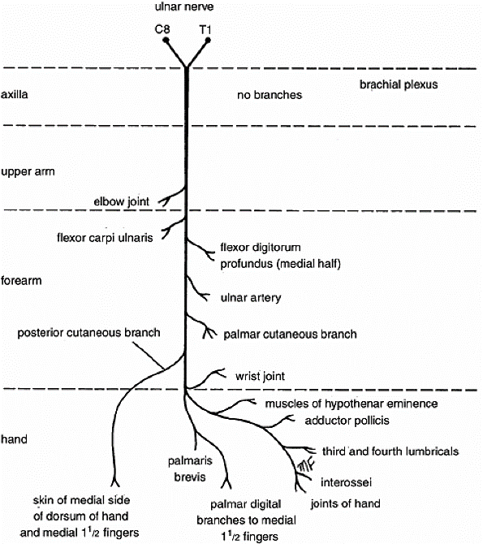
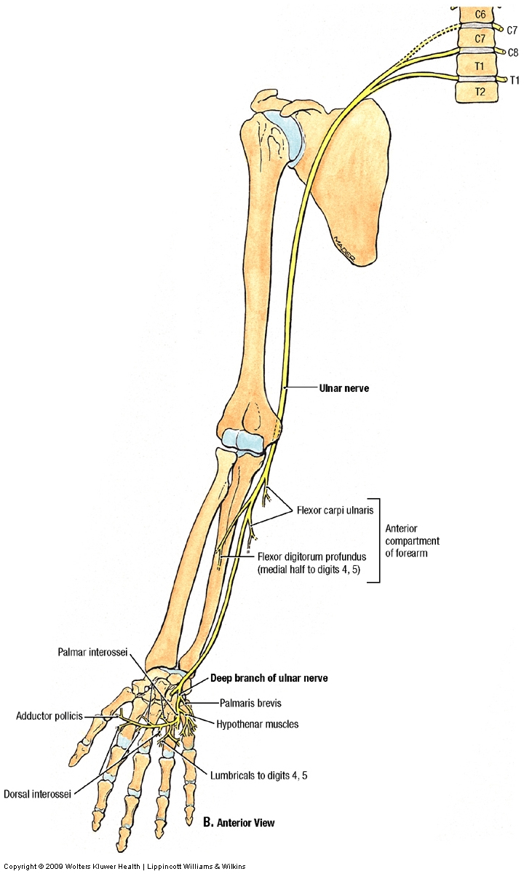
Ulnar Nerve Anatomy
Summary of main branches

Slide 31

Thanks for Listening

