Slide 1
* HIP JOINT KNEE JOINT * ANKLE JOINT
BY DR.SANAA ALSHAARAWY

Slide 2
HIP JOINT

Slide 3
OBJECTIVES
At the end of the lecture, students should be able to:
List the type & articular surfaces of hip joint.
Describe the ligaments of hip joints (extra- & intra-capsular ligaments).
Describe movements of hip joint.

Slide 4
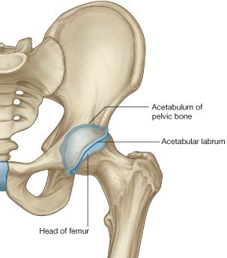
TYPES & ARTICULAR SURFACES
TYPE:
It is a synovial, ball & socket joint.
ARTICULAR SURFACES:
Acetabulum of hip (pelvic) bone
Head of femur.

Slide 5
LIGAMENTS (3 Extracapsular)
Intertrochanteric line
Iliofemoral ligament: Y-shaped strong ligament, anterior to joint, limits extension
Pubofemoral ligament: antero-inferior to joint, limits abduction & lateral rotation
Ischiofemoral ligament: posterior to joint, limits medial rotation

Slide 6
LIGAMENTS (3 Intracapsular)
Acetabular labrum: fibro-cartilaginous collar attached to margins of acetabulum
to increase its depth for better retaining of head of femur (it is completed inferiorly by transverse ligament).
Transverse acetabular ligament: converts acetabular notch into foramen (acetabular foramen) through which pass acetabular vessels.
Ligament of femoral head: carries vessels to head of femur (artery of ligament of femoral head ; branch of obturator artery).

Slide 7
MOVEMENTS
FLEXION: Iliopsoas (mainly), sartorius, pectineus, rectus femoris.
EXTENSION: Hamstrings (mainly), gluteus maximus (powerful extensor).
ABDUCTION: Gluteus medius & minimus, sartorius.
ADDUCTION: Adductors, gracilis.
MEDIAL ROTATION: Gluteus medius & minimus.
LATERAL ROTATION: Gluteus maximus, quadratus femoris, piriformis, obturator externus & internus.

Slide 8
KNEE JOINT

Slide 9
OBJECTIVES
At the end of the lecture, students should be able to:
List the type & articular surfaces of knee joint.
Describe the capsule of knee joint, its extra- & intra-capsular ligaments.
List important bursae in relation to knee joint.
Describe movements of knee joint.

Slide 10
TYPES & ARTICULAR SURFACES
Knee joint is formed of:
Three bones.
Three articulations.
Femoro-tibial articulations: between the 2 femoral condyles & upper surfaces of the 2 tibial condyles (Type: synovial, modified hinge).
Femoro-patellar articulations: between posterior surface of patella & patellar surface of femur (Type: synovial, plane).

Slide 11
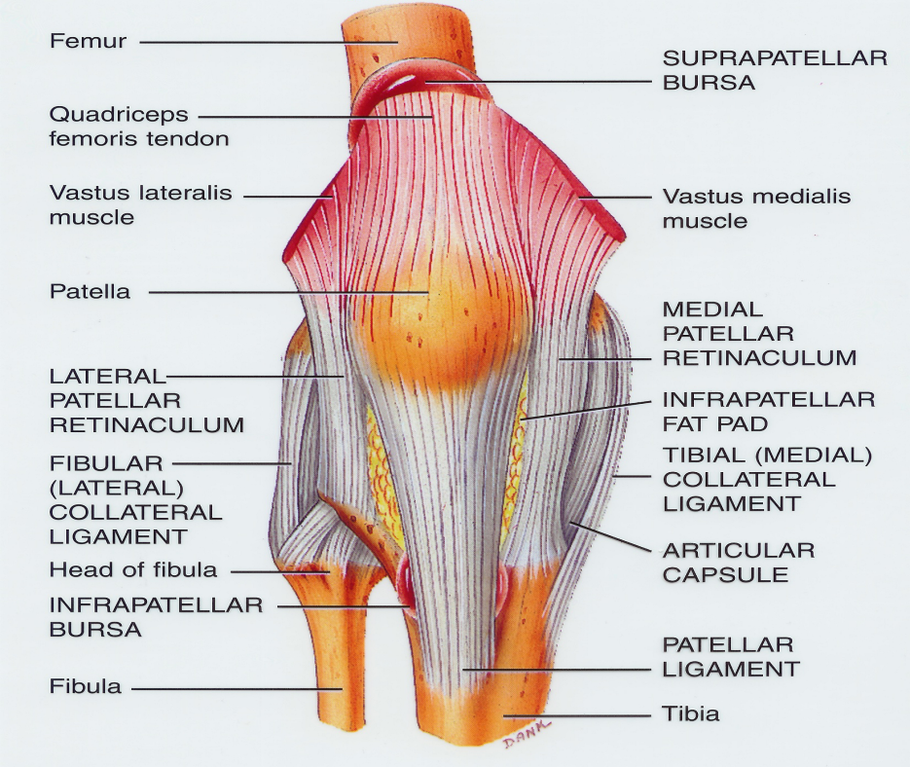
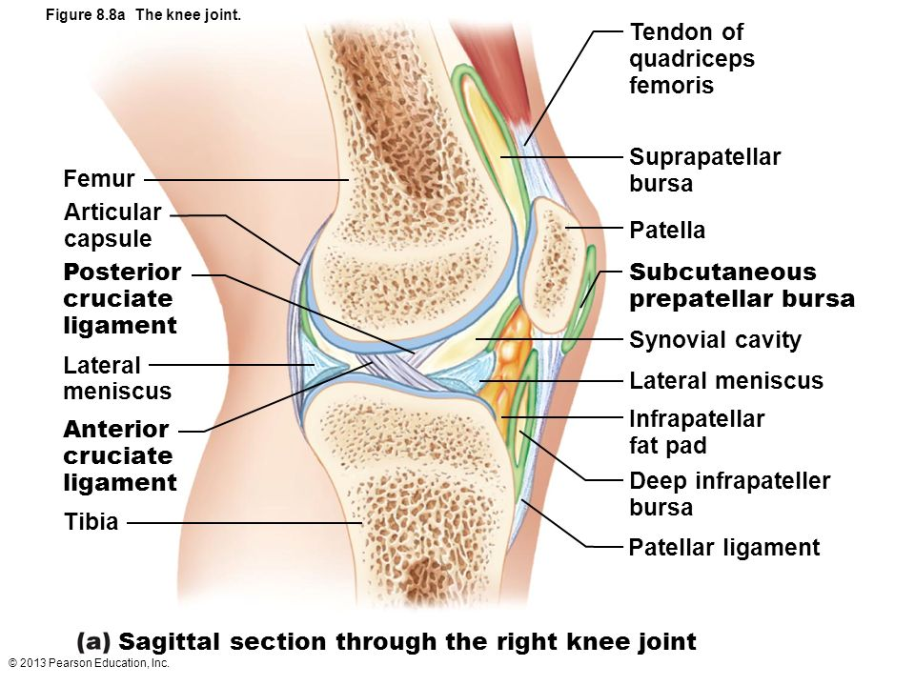
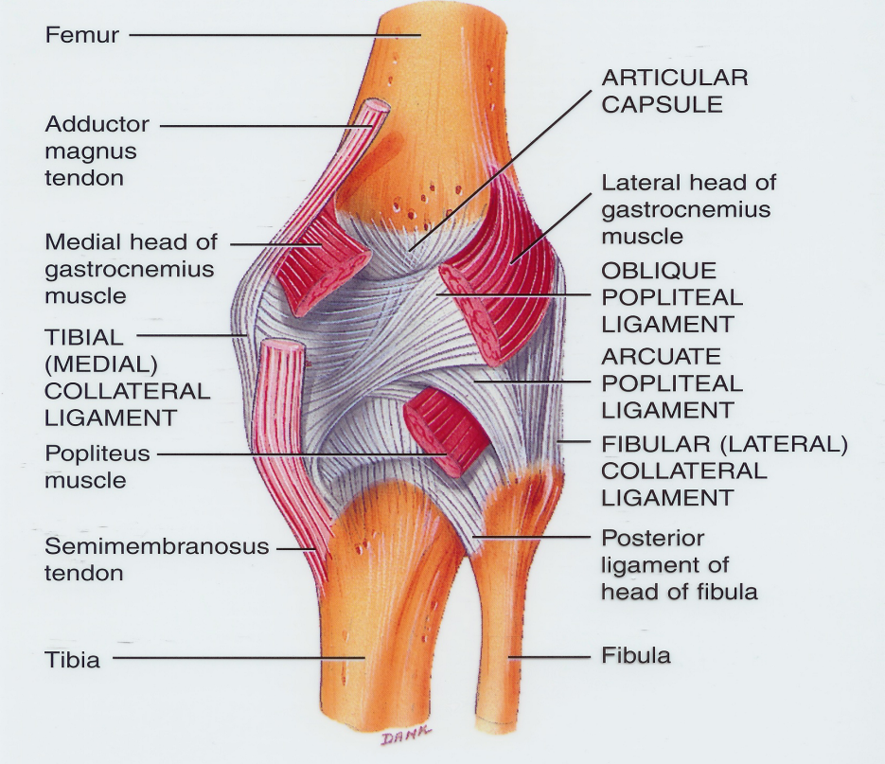
CAPSULE
Is deficient anteriorly & is replaced by: quadriceps femoris tendon, patella & ligamentum patellae.
Possesses 2 openings: one for popliteus tendon & one for communication with suprapatellar bursa.

Slide 12
EXTRA-CAPSULAR LIGAMENTS
Ligamentum patellae (patellar ligament): from patella to tibial tuberosity.
Medial (tibial) collateral ligament: from medial epicondyle of femur to upper part of medial surface of tibia (firmly attached to medial meniscus).
Lateral (fibular) collateral ligament: from lateral epicondyle of femur to head of fibula (separated from lateral meniscus by popliteus tendon).
Oblique popliteal ligament: extension of semimembranosus tendon.

Slide 13
INTRA-CAPSULAR STRUCTURES
ATTACHMENTS:
Each meniscus is attached by anterior & posterior horns into upper surface of tibia.
The outer surface of medial meniscus is also attached to capsule & medial collateral ligament: so; medial meniscus is less mobile & more liable to be injured.
FUNCTIONS:
They deepen articular surfaces of tibial condyles.
They serve as cushions between tibia & femur.
MENISCI
They are 2 C-shaped plates of fibro-cartilage.
The medial meniscus is large & oval.
The lateral meniscus is small & circular.

Slide 14
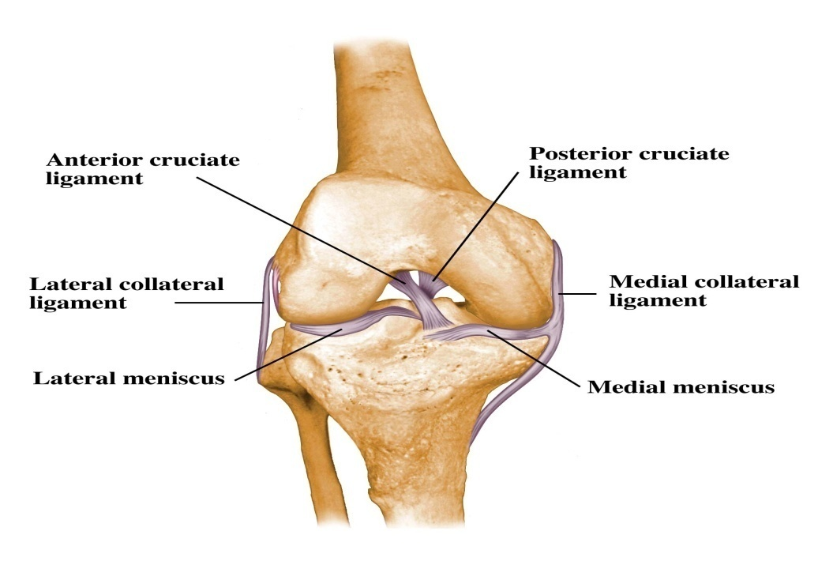
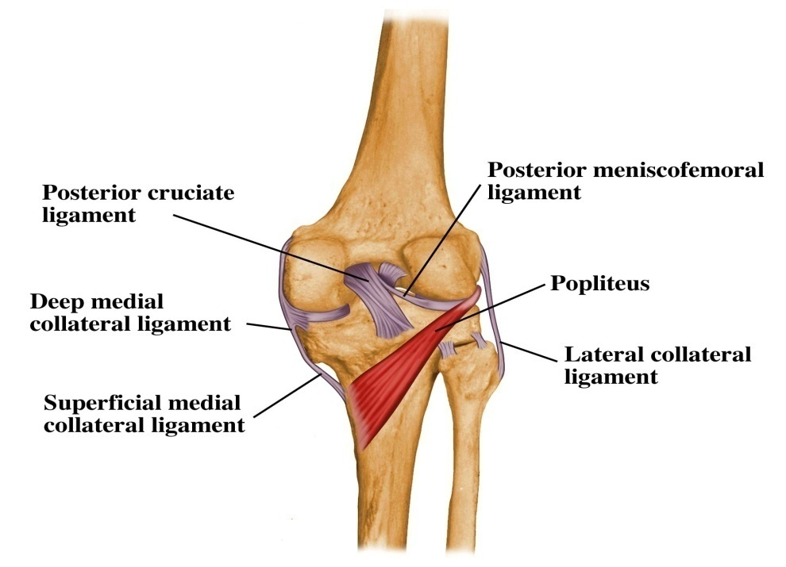
INTRA-CAPSULAR LIGAMENTS
ANTERIOR & POSTERIOR CRUCIATE LIGAMENTS
ATTACHMENTS:
Anterior cruciate: from anterior part of intercondylar area of tibia to posterior part of lateral condyle of femur.
Posterior cruciate: from posterior part of intercondylar area of tibia to anterior part of medial condyle of femur.
FUNCTIONS:
Anterior cruciate: prevents posterior displacement of femur on tibia.
Posterior cruciate: prevents anterior displacement of femur on tibia.

Slide 15
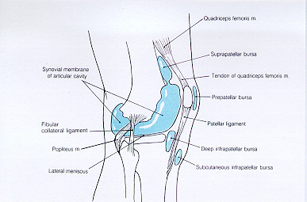
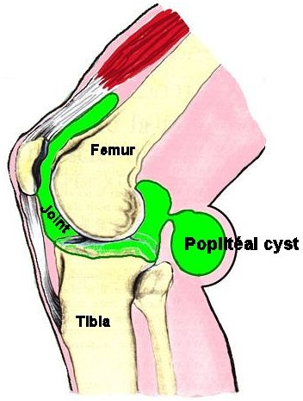
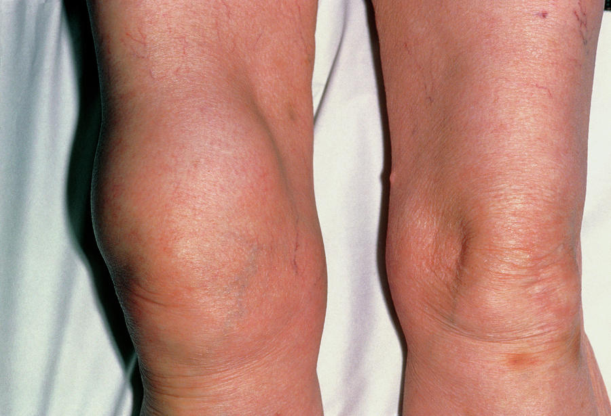
IMPORTANT BURSAE RELATED TO KNEE
Suprapatellar Bursitis
Suprapatellar bursa: between femur & quadriceps tendon, communicates with
synovial membrane of knee joint (Clinical importance?)---It is commonly inflamed bursa leads to bursitis.
Prepatellar bursa: between patella & skin.
Deep infrapatellar bursa: between tibia & ligamentum patella.
Subcutaneous infrapatellar bursa: between tibial tuberosity & skin.
Popliteal bursa (not shown): between popliteus tendon & capsule, communicates with synovial membrane of knee joint.

Slide 16
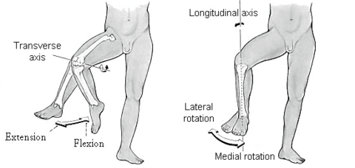
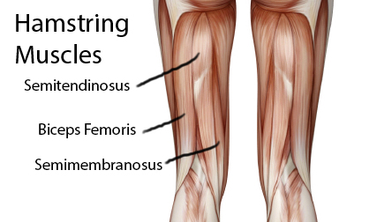
MOVEMENTS
FLEXION:
Mainly by : hamstring muscles : biceps femoris , semitendinosus & semimembranosus.
Assisted by : sartorius , gracilis & popliteus.
EXTENSION:
Quadriceps femoris.
ACTIVE ROTATION (PERFORMED WHEN KNEE IS FLEXED) :
A) MEDIAL ROTATION:
Mainly by : semitendinosus & semimembranosus.
Assisted by : sartorius & gracilis.
B) LATERAL ROTATION:
Biceps femoris.

Slide 17
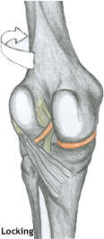
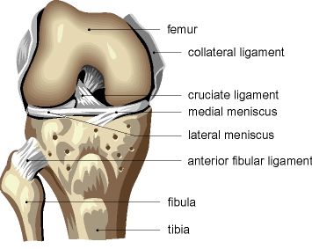
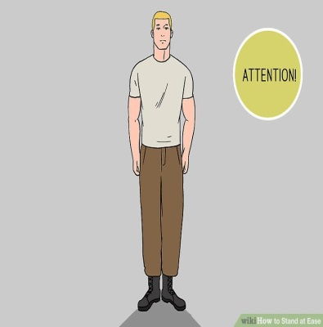
MOVEMENTS (cont’d)
INACTIVE (DEPENDANT) ROTATION :
A) LOCKING OF KNEE:
Slight Lateral rotation of tibia (or medial rotation of femur due to the shape of condyles), at the end of extension
Results mainly by tension of anterior cruciate ligament.
In locked knee, all ligaments become tight.
B) UNLOCKING OF KNEE:
Medial rotation of tibia (lateral rotation of femur), at the beginning of flexion.
Performed by Popliteus to relax ligaments & allow easy flexion.
Locking of knee
Stand at ease
Unlocking of knee

Slide 18
ANKLE JOINT

Slide 19
OBJECTIVES
At the end of the lecture, students should be able to:
List the type & articular surfaces of ankle joint.
Describe the ligaments of ankle joints.
Describe movements of ankle joint.
Apply Hilton’s law about nerve supply of joints.

Slide 20
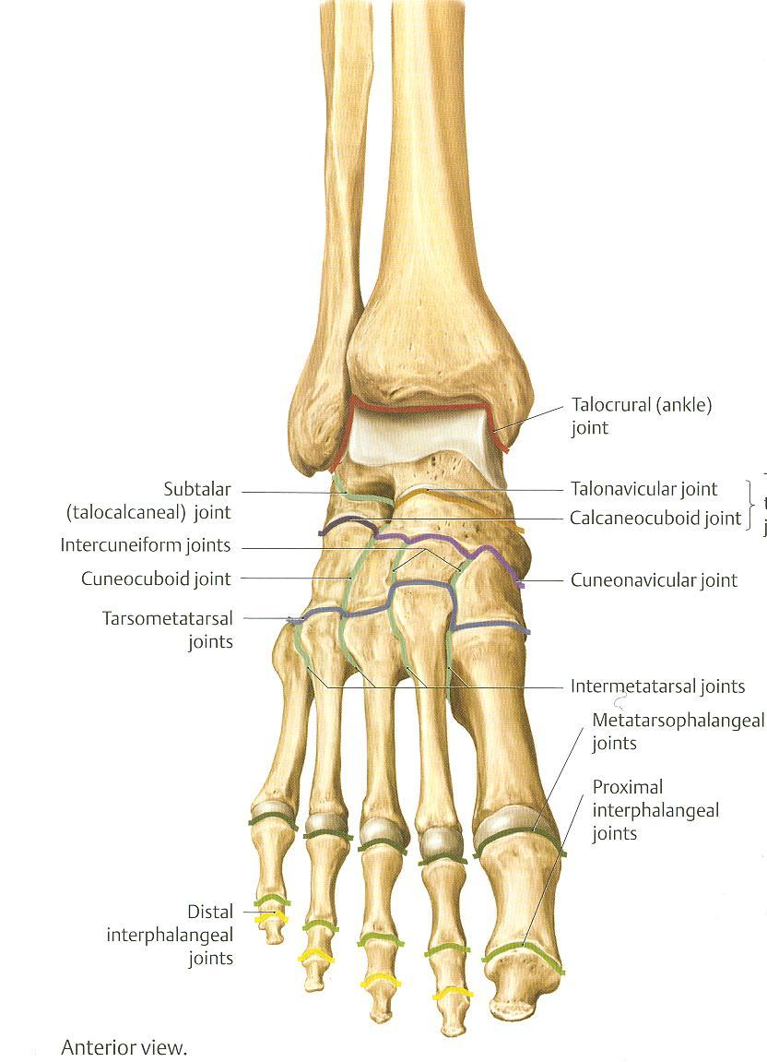
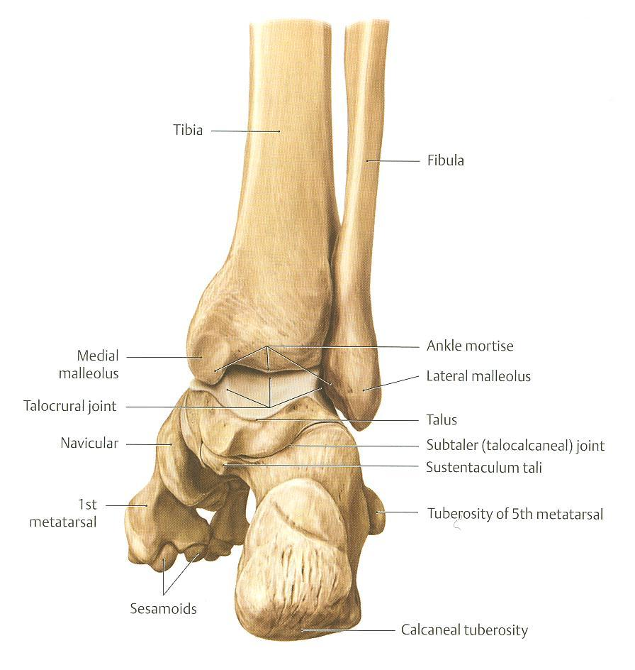
TYPES & ARTICULAR SURFACES
TYPE:
It is a synovial, hinge joint.
ARTICULAR SURFACES:
UPPER:
A socket formed by: the lower end of tibia, medial malleolus & lateral malleolus.
LOWER:
Body of talus.

Slide 21
LIGAMENTS
LATERAL LIGAMENT:
Composed of 3 separate ligaments.
Anterior talofibular ligament.
Calcaneofibular ligament.
Posterior talofibular ligament.
MEDIAL (DELTOID) LIGAMENT:
A strong triangular ligament.
Apex: attached to medial malleolus.
Base: subdivided into 4 parts:
Anterior tibiotalar part.
Tibionavicular part.
Tibiocalcaneal part.
Posterior tibiotalar part.
1
3
4
3
1
2
2

Slide 22
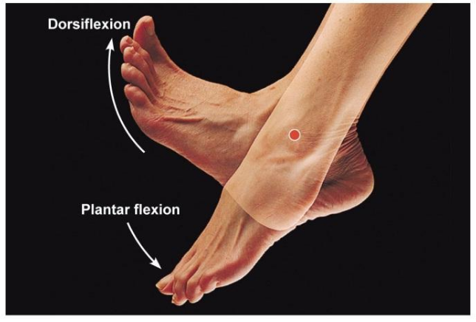
MOVEMENTS
DORSIFLEXION:
Performed by muscles of anterior compartment of leg (tibialis anterior, extensor hallucis longus, extensor digitorum longus & peroneus tertius).
PLANTERFLEXION:
Initiated by soleus.
Maintained by gastrocnemius.
Assisted by other muscles in posterior compartment of leg (tibialis posterior, flexor digitorum longus & flexor hallucis longus) + muscles of lateral compartment of leg (peroneus longus & peroneus brevis).

Slide 23
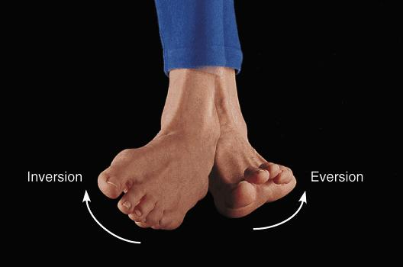
N.B.
INVERSION & EVERSION MOVEMENTS occur at the talo-calcaneo-navicular joint.
MUSCLES PERFORM INVERSION :
MUSCLES PERFORM EVERSION :
Tibialis anterior.
Tibialis posterior.
Peroneus longus.
Peroneus brevis.
Peroneus tertius.

Slide 24
NERVE SUPPLY
REMEMBER HILTON’S LAW:
“The joint is supplied by branches from nerves supplying muscles acting on it”.

Slide 25
THANK YOU

Slide 26
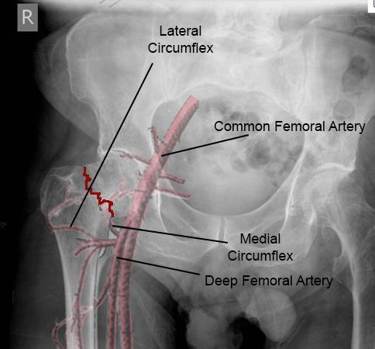
Fracture neck of the femur
It is common after age of (60) years especially in women because of Osteoporosis.
It results in a vascular necrosis of the head of femur.
Blood supply to femoral head; Mainly is medial femoral circumflex.
Displacement of femoral neck fracture will disrupt the blood supply and cause an intracapsular hematoma

Slide 27
DISLOCATION OF HIP JOINT
CONGENITAL
More common in girls and associated with inability to adduct the thigh.
The upper lip of the acetabulum fails to develop adequately.
The head of the femur rides up out of the acetabulum onto the gluteal surface of the ileum.

Slide 28
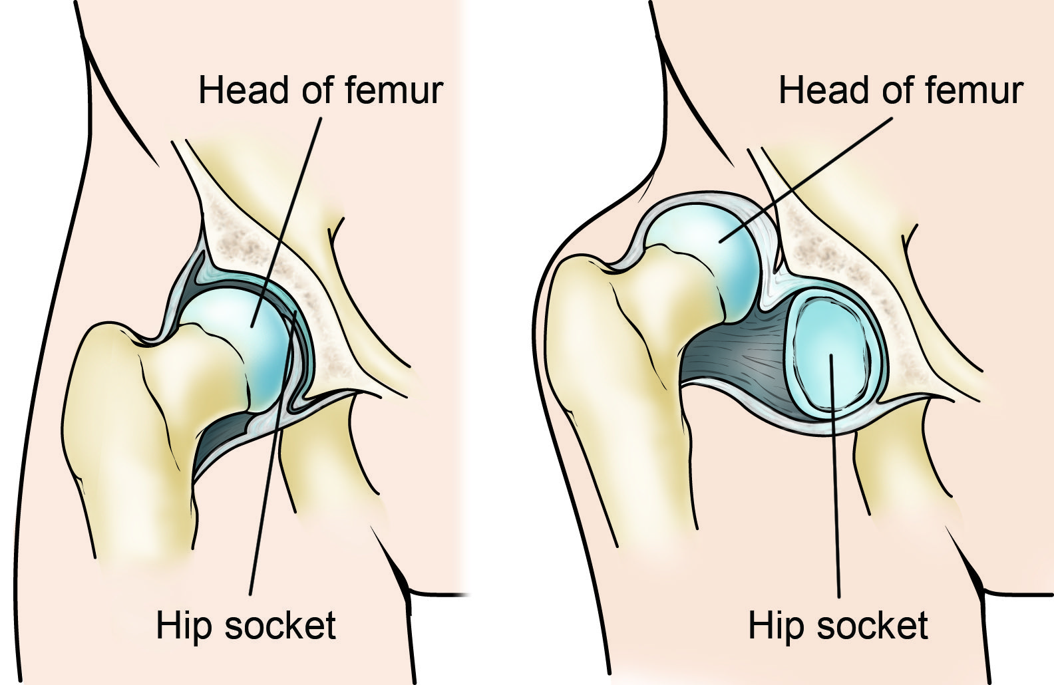
TRAUMATIC Hip Dislocation:
It is common in motor vehicle accidents when the thigh is flexed and adducted.
The dislocated head is displaced posteriorly to lie on the posterior surface of the ileum.
In posterior dislocation the sciatic nerve is liable to be injured.

Slide 29
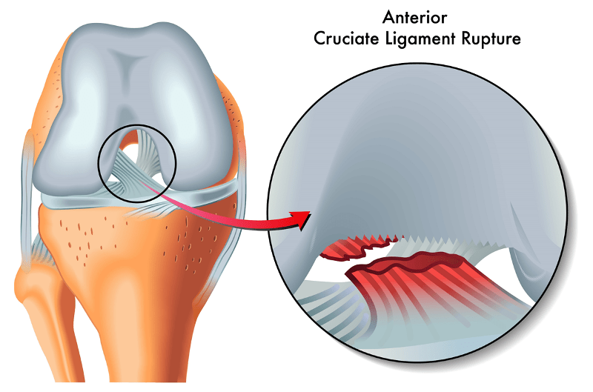
Knee joint injury
1. Meniscal tears :
These pieces of cartilage can tear suddenly during sporting activities; With a sudden meniscus tear, a pop may be heard or felt in the knee. They may also tear slowly due to aging (degenerative meniscus tear).
2. Anterior cruciate ligament injuries :
Injuries to the ACL can be serious and require surgery.
A grade 1 sprain is a mild injury to the ACL, while a grade 3 refers to a complete tear.
Causes : sports as in Football; Improperly landing from a jump or quickly changing the direction.
3. Posterior cruciate ligament injuries :
An injury to the posterior cruciate requires powerful force while the knee is in a bent position.
This happens when someone falls hard onto a bent knee or is in an accident.

Slide 30
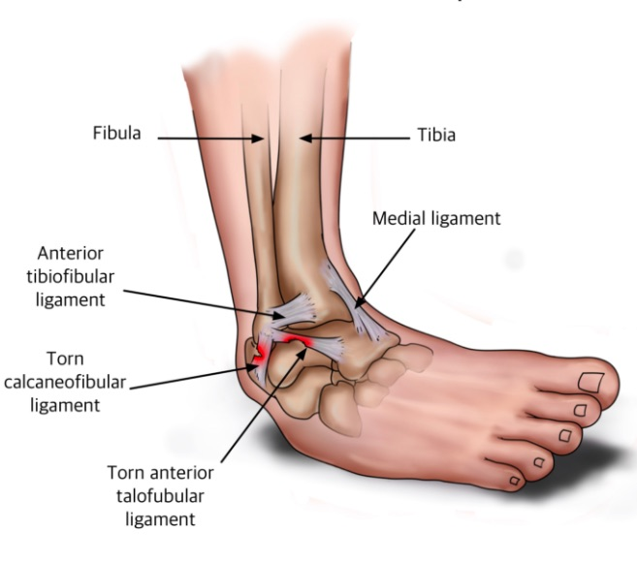
What are Kinds of Ankle Injuries?
Ankle injuries are Sprains, Strains, and Fracture; That affect bone, ligament, or tendon.
A sprain is a common sports injury, but can also happen any time a sudden twist displaces the ankle joint.
A sprain is the term that describes damage to ligaments when they are stretched beyond their normal range of motion. It ranged from mild to a complete tear or rupture.
A strain refers to damage to muscles and tendons as a result of being pulled or stretched too far.
A fracture describes a break in one or more of the bones in the ankle joint.

