Slide 1
SHOULDER REGION
Dr. Tahani AL-Matrafi

Slide 2
OBJECTIVES
At the end of the lecture, students should:
List the name of muscles of the shoulder region.
Describe the anatomy of muscles of shoulder region regarding: attachments of each of them to scapula & humerus, nerve supply and actions on shoulder joint
List the muscles forming the rotator cuff and describe the relation of each of them to the shoulder joint.
Describe the anatomy of shoulder joint regarding: type, articular surfaces, stability, relations & movements.

Slide 3
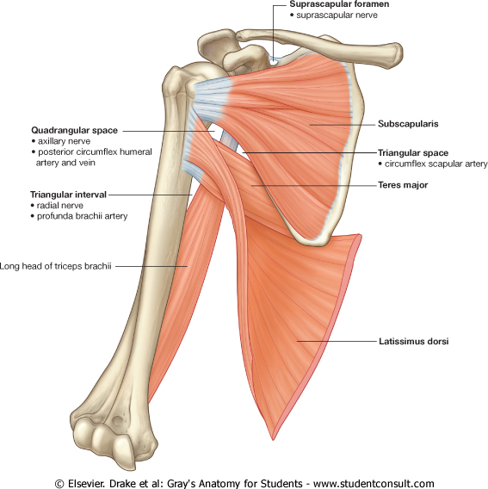
MUSCLES OF SHOULDER REGION
These are muscles connecting scapula to humerus (move humerus through shoulder joint):
Deltoid.
Supraspinatus.
Infraspinatus.
Teres minor.
Teres major.
Subscapularis.
2
1
4
3
5
6

Slide 4
DELTOID
A triangular muscle that forms the rounded contour of the shoulder.
Origin: lateral 1/3 of clavicle ,acromion and spine of scapula
(= insertion of trapezius).
Insertion: deltoid tuberosity of humerus.
Nerve supply: axillary nerve.
Actions:
Anterior fibers: flexion & medial rotation of humerus (arm, shoulder joint).
Middle fibers: abduction of humerus from 15° - 90 °.
Posterior fibers: extension & lateral rotation of humerus.

Slide 5
SUPRASPINATUS & INFRASPINATUS
Origin:
Supraspinatus: supraspinous fossa.
Infraspinatus: infraspinaous fossa.
Insertion: greater tuberosity of humerus.
Nerve supply: Suprascapular nerve.
Action:
Supraspinatus: abduction of humerus from 0° - 15°.
Infraspinatus: lateral rotation of humerus.
S
I

Slide 6
TERES MINOR
Origin: lateral (Axillary) border of Scapula.
Insertion: greater tuberosity of humerus.
Nerve supply: axillary nerve.
Action: lateral rotation of humerus.

Slide 7
TERES MAJOR
Origin: lateral border ofscapula.
Insertion: medial lip of bicipital groove of humerus (with latissimus dorsi & pectoralis major).
Nerve supply: lower subscapular nerve.
Actions: extension, adduction & medial rotation of humerus (as action of latissimus dorsi).

Slide 8
SUBSCAPULARIS
Origin: subscapular fossa.
Insertion: lesser tuberosity of humerus.
Nerve supply: upper & lower subscapular nerves.
Action: medial rotation of humerus.

Slide 9
SHOULDER JOINT
STABILITY: (NOT STABLE) ?
Head of humerus is 3 times larger than glenoid cavity
Capsule is redundant.
Few ligamentous support: glenoid labrum, coracohumeral
Main Support: muscles around the joint (ROTATOR CUFF)
Wide range of movement
TYPE:
Synovial, multiaxial (ball & socket)
ARTICULAR SURFACES:
Head of humerus
Glenoid cavity of scapula

Slide 10
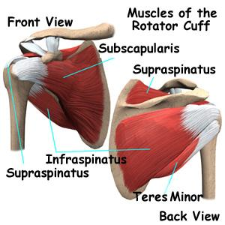
ROTATOR CUFF
S
A tendinous cuff around the shoulder joint covering its Anterior, Posterior and Superior aspects.
The cuff is deficient Inferiorly and this is the site of potential weakness.
It is formed of 4 muscles: Supraspinatus, Infraspinatus, Teres minor & Subscapularis (SITS).
The tone of these muscles help in stabilizing the shoulder joint.
I
S
T

Slide 11
Rotator cuff can be damaged due to trauma (during playing baseball) or disease (in older individuals).
Trauma can tear or rupture one or more tendon (s) forming the cuff. Patients with rotator injury will present with pain, shoulder instability, and limited range of motion.
Supraspinatus tendon is the most common site of rotator cuff injury.

Slide 12
BURSAE IN RELATION TO SHOULDER JOINT
They reduce friction between tendons, joint capsule & bone.
They are liable to be inflammed following injury of rotator cuff muscles.
Subscapularis bursa: between subscapularis tendon & capsule.
Infraspinatus bursa: between infraspinatus tendon & capsule.
Subacromial bursa: between deltoid, supraspinatus and capsule.
3
2
1

Slide 13
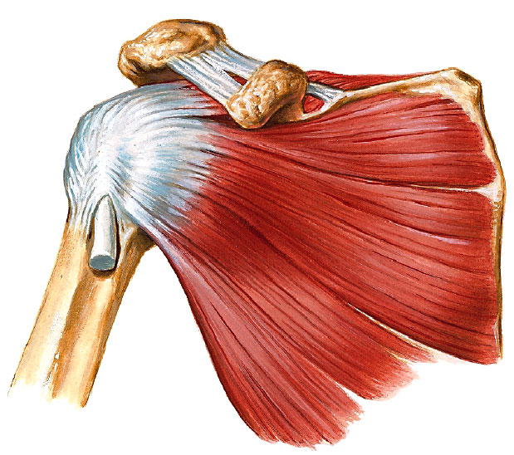
RELATIONS OF SHOULDER JOINT
Supraspinatus
Subscapularis
Infraspinatus
Teres minor
Axillary nerve
ANTERIOR: subscapularis
POSTERIOR: infraspinatus, teres minor
SUPERIOR: supraspinatus
INFERIOR: axillary nerve

Slide 14
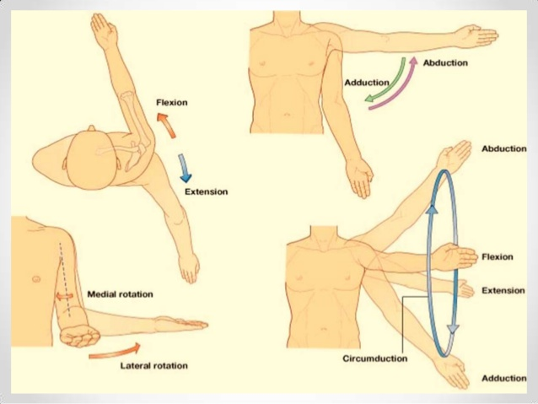
MOVEMENTS OF SHOULDER JOINT

Slide 15
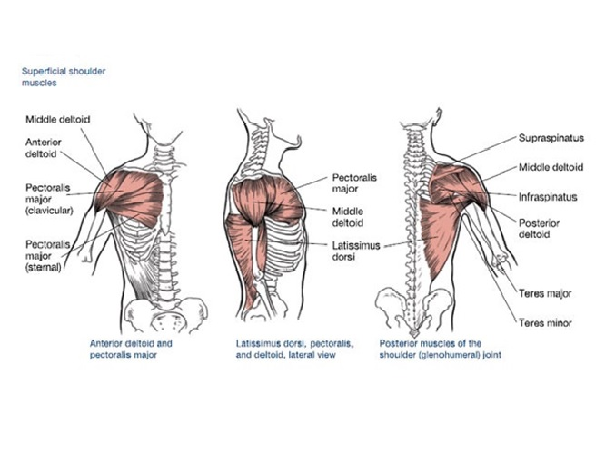
MOVEMENTS OF SHOULDER JOINT
FLEXION:
Anterior fibers of deltoid
Pectoralis major
Coracobrachialis
(muscle of arm)
Short head of biceps brachii
(muscle of arm)
EXTENSION:
Posterior fibers of deltoid
Latissimus dorsi
Teres major

Slide 16
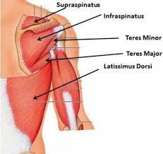
MOVEMENTS OF SHOULDER JOINT
ABDUCTION:
From 0° - 15°: Supraspinatus
From 15° - 90 °: Middle
fibers of deltoid
ADDUCTION:
Pectoralis major
Latissimus dorsi Inserted in bicipital groove
Teres major

Slide 17
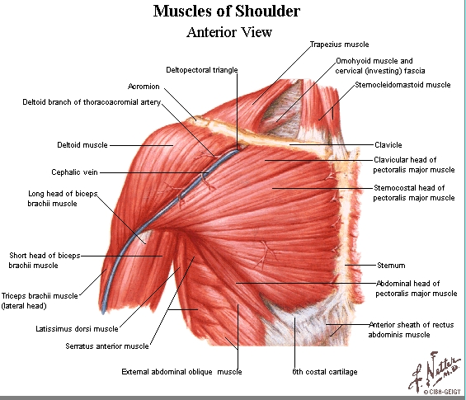
MOVEMENTS OF SHOULDER JOINT
MEDIAL ROTATION:
Pectoralis major
Latissimus dorsi Inserted in bicipital groove
Teres major
Anterior fibers of deltoid
Subscapularis
LATERAL ROTATION:
Posterior fibers of deltoid
Infraspinatus
Teres minor

Slide 18
SUMMARY
MUSCLES OF SHOULDER REGION:
Origin: scapula.
Insertion: humerus.
Action: move humerus (SHOULDER JOINT)
Nerve supply: anterior rami of spinal nerves through brachial plexus.
ROTATOR CUFF: 4 muscles in scapular region surround and help in stabilization of shoulder joint (supraspinatus, infraspinatus, teres minor, subscapularis).

Slide 19
SUMMARY
Shoulder joint:
Type: synovial, ball & socket
Articular surfaces: head of humerus & glenoid cavity of scapula
Stability: depends on rotator cuff
Relations: rotator cuff and axillary nerve
Movements: flexion, extension, abduction, adduction, medial & lateral rotation

Slide 20
QUESTIONS
Which one of the following muscles is inserted into the lesser tuberosity of the humerus?
Subscapularis
Deltoid
Teres major
Infraspinatus
Which one of the following muscles is part of the rotator cuff?
Subscapularis.
Deltoid.
Teres major.
Rhomboid minor.
Regarding the shoulder joint, which one of the following statements is correct?
It is a stable joint.
It is a synovial joint of hinge variety.
Latissimus dorsi muscle adducts shoulder joint.
Downward dislocation of shoulder joint may cause injury to the radial nerve.

