Slide 1
VASCULATURE OF THE UPPER LIMB
Dr. Essam Salama Dr. Amal Alrabia

Slide 2
Objectives
At the end of the lecture, the students should be able to :
Identify the origin of the vascular supply for the upper limb.
Describe the main arteries and their branches of the arm, forearm & hand.
Describe the vascular arches for the hand.
Describe the superficial and deep veins of the upper limb

Slide 3
Arteries Of The Upper Limb
Right subclavian
artery
Left subclavian
artery
Axillary artery
Brachial artery
Radial
artery
Ulnar artery
Palmar arches

Slide 4
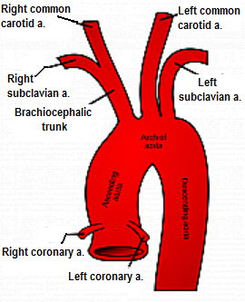
The Subclavian Artery
The right artery originates from the brachiocephalic artery.
The left artery originates from the arch of the aorta
Cotinues as Axillary artery at the lateral border of the 1st rib

Slide 5
The Axillary Artery
Begins at the lateral border of the 1st rib as continuation of the subclavian artery.
Continues as brachial artery at lower border of teres major muscle.
Is closely related to the cords of brachial plexus and their branches
Is enclosed within the axillary sheath.
Is crossed anteriorly by the pectoralis minor muscle, and is divided into three parts; 1st, 2nd & 3rd.
Subclavian artery
Brachial artery
Axillary artery

Slide 6
The 1st part of the axillary artery
Extends from the lateral border of 1st rib to upper border of the pectoralis minor muscle.
Related:
Anterioly: the pectoralis major muscle, skin, and crossed by the cephalic vein
Posteriorly:the long thoracic nerve.
Laterally: the three cords of the brachial plexus.
Medially: the axillary vein
ONE branch: Highest thoracic artery
1st rib
1st part
2nd part
Highest thoracic artery a.
3rd part
Pectoralis minor
Teres major

Slide 7
The 2nd part of the axillary artery
Lies behind the pectoralis minor muscle.
Related:
Anterioly: the pectoralis minor, the pectoralis major muscle, and, skin.
Posteriorly: the posterior cord of the brachial plexus, the subscapular muscles and, shoulder joint.
Laterally: the lateral cord of the brachial plexus, Medially: the medial cord of the brachial plexus, and the axillary vein
TWO branches:
Thoracoacromial .
Lateral thoracic.
1st rib
1st part
2nd part
3rd part
Thoraco-acromial a.
Pec. minor
Lateral Thoracic a.
Teres major

Slide 8
The 3rd part of the axillary artery
Extends from the lower border of pectoralis minor muscle to the lower border teres major muscle.
Related:
Anteriorly: the pectoralis major muscle, lower down crossed by medial root of the median nerve
Posteriorly: the subscapular, latissimus dorsi, and the teres major muscles and, the axillary and radial nerves.
Laterally: the coracobrachialis, biceps, and humerus, lateral root of the median nerve and musculocutaneous nerves
Medially: the ulnar nerve, the axillary vein, and, the medial cutaneous nerve of the arm.
Gives THREE Branches:
Subscabular,
Anterior circumflex humeral
Posterior circumflex humeral.
1st rib
1st part
2nd part
3rd part
Pec. minor
Teres major
Subscapular a.
Anterior & posterior circumflex humeral aa.

Slide 9
Arterial anastomosis around the shoulder joint
The wide range of movement of the shoulder may be accompany with kinking of the axillary artery and a temporary occlusion of its lumen
To compensate for this arterial anastomosis is carried about by;
Branches from the subclavian artery:
The suprascapular artery
The superficial cervical artery
Branches from the axillary artery:
The subscapular artery
The anterior circumflex humeral artery
The posterior circumflex humeral artery

Slide 10
The Brachial Artery
Axillary artery
Is a continuation of the axillary artery at the lower border of teres major muscle.
Provides main arterial supply for the arm.
Terminates opposite neck of radius by dividing into radial & ulnar arteries.
Brachial artery
radial artery
ulnar artery

Slide 11
Brachial Artery: Relations
Anteriorly: it is superficial and overlapped from the lateral side by coracobrachialis and biceps, crossed from above downward by medial cutanous nerve of the forearm, median nerve, and bicipital aponeurosis.
Posterioly: triceps, coraco-brachialis and brachialis.
Medially: in the upper part of the arm; basilic vein, and ulnar nerve, in the lower part of the arm; median nerves.
Laterally: above; the median nerve, coracobrachialis and biceps muscles, the biceps tendon, in the lower part
coracobrachialis
biceps
brachialis
Ulnar n.
Median n.

Slide 12
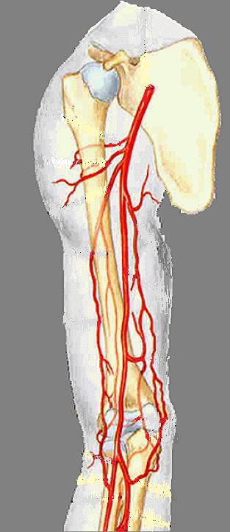
Brachial Artery: Branches
Muscular.
Nutrient to humerus.
Profunda brachii
Superior ulnar collateral.
Inferior ulnar collateral.

Slide 13
Profunda brachii
It arises from the brachial artery near its origin.
It accompanies the radial nerve through the spiral groove, suppling the triceps muscle and sends anastomosis around the elbow joint

Slide 14
The Ulnar Artery
The larger of the two terminal branches of the brachial artery.
Begins in the cubital fossa at the level of neck of radius.
Descends through the anterior compartment of the forearm.
Enters the palm, in front of the flexor retinaculum, with the ulnar nerve.
Ends by forming the superficial palmer arch, by anastomosing with superficial palmer branch of radial artery.
Ulnar artery
Superficial palmar arch

Slide 15
Ulnar Artery: Branches
Muscular .
Recurrent branch for anastomosis around the elbow joint.
Common interosseous artery, which gives anterior and posterior interosseous arteries.
Branch to anastomoses around the wrist joint.

Slide 16
The Radial Artery
The smaller of the two terminal branches of the brachial artery.
Begins in the cubital fossa at the level of neck of radius.
Descends downward and laterally.
Leaves the forearm by winding around the lateral aspect of the wrist to reach the dorsum of the hand.
Radial artery

Slide 17
Radial Artery: Branches
Muscular
Recurrent branch for anastomosis around the elbow joint.
Superficial palmar branch , joins the ulnar artery to form the superficial palmar arch.

Slide 18
Arterial anastomosis around the elbow joint
Brachial artery
Superior ulnar collateral.
Inferior ulnar collateral.
Profunda brachii
a middle and a radial collateral artery.
Ulnar Artery
Anterior and posterior ulnar Recurrent.
Posterior interosseous
interosseous recurrent
Radial Artery
Radial Recurrent

Slide 19
Arteries of the Palm
Ulnar artery:
Enters the hand, anterior to the flexor retinaculum, on the lateral side of the ulnar nerve and pisiform bone.
It gives a deep branch, and continues as the superficial palmar arch.
Ulnar artery
FR
Superficial palmar arch

Slide 20
Arteries of the Palm
Radial artery;
Leaves dorsum of the hand by turning forward between the proximal ends of the 1st and 2nd metacarpal bones and two heads of the 1st dorsal inerossous muscle.
On entering the palm it continues as deep palmar arch.
It gives; arteria radialis indecis and arteria princeps policis.
Radial artery
1st dorsal interosseous muscle

Slide 21
The Superficial Palmar Arch
Radialis indices a.
Is the direct continuation of the ulnar artery, as it curves laterally behind the palmar aponeurosis, infront of the long flexor tendons
It is completed on the lateral side by a branch from the radial artery.
It lies approximately at the level of the distal border of the extended thumb.
It gives; four digital arteries from its convexity to supply the fingers.
Princeps pollicis a.
Digital arteries
Ulnar a.
Radial a.

Slide 22
Is a continuation of the radial artery as it curves medially beneath long flexor tendons, in front of the metacarpal bones and interosseous muscles.
It is completed on the medial side by the deep branch of ulnar artery.
It lies at a level of the proximal border of extended thumb.
It sends branches;
superiorly to share in anastomosis around the wrist joint &
inferiorly to join the digital branches of the superficial palmar arch.
The Deep Palmar Arch
Ulnar a.
Radial a.

Slide 23
The superficial palmar arch is more distal than the deep palmar arch.

Slide 24
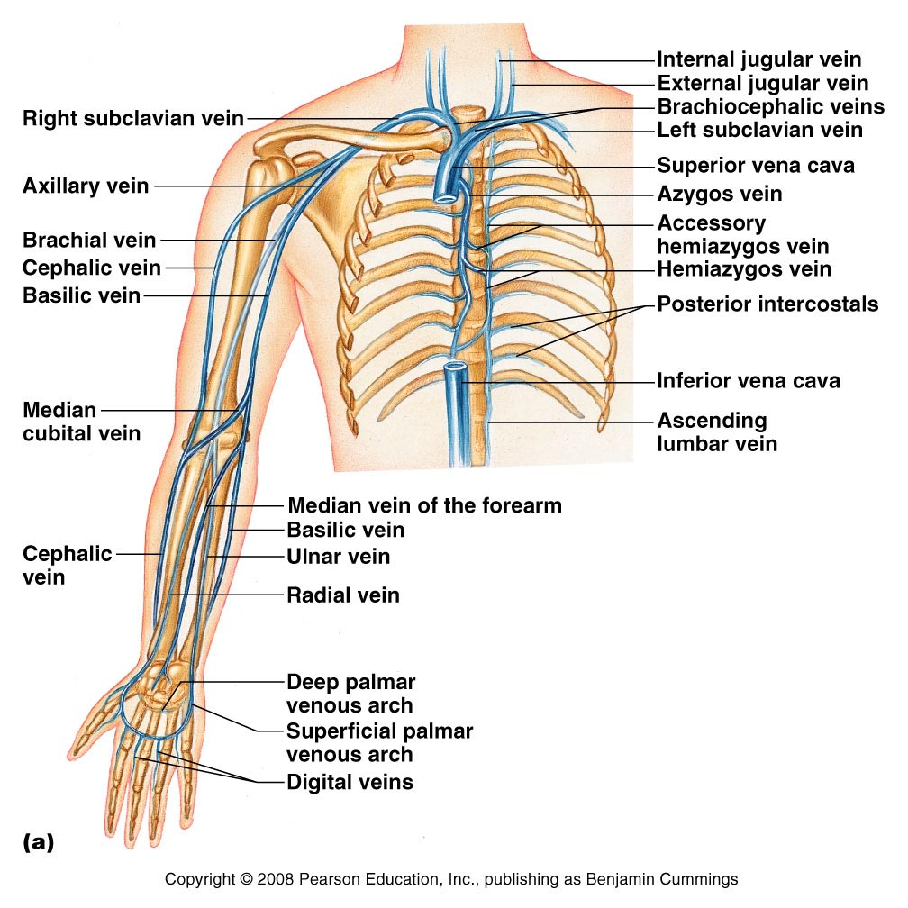
Veins of the Upper Limb
The veins of the upper limb are divided into two sets: Superficial and Deep
The two sets anastomose frequently with each other.
The superficial veins are placed immediately beneath the skin, in the superficial fascia.
The deep veins accompany the arteries, and constitute the venæ comitantes of those vessels

Slide 25
Superficial Veins of the Upper Limb
Dorsal Venous Arch (network)
The dorsal digital veins drain into dorsal metacarpal veins, which unite to form a dorsal venous arch or network.
Dorsal venous network lies on the dorsum of the hand, in the subcutanous tissue, proximal to the metacarpophalangeal joints
Drains into the cephalic vein laterally, and basilic vein medially

Slide 26
Cephalic Vein
Basilic Vein
Arises from the lateral end of the dorsal venous arch of hand.
Ascends on radial side of the forearm to the elbow and continues up the arm in the deltopectoral groove.
Pierces clavipectoral fascia to drain into the axillary vein.
Arises from the medial side of the dorsal venous arch of hand.
Ascends on the ulnar side of forearm to the elbow , in the middle of the arm, it pierces the deep fascia and joins the brachial vein or axillary vein.
Median Cubital Vein
Links cephalic vein and basilic vein in the cubital fossa.
Is a frequent site for venipuncture.

Slide 27
Deep Veins of the Upper Limb
Accompany the arteries of the same region and bear similar names.
Venae commitantes: They are generally arranged in pairs, and are situated one on either side of the corresponding artery, and connected at intervals by short transverse branches.
The superficial and deep palmar arterial arches are each accompanied by a pair of venæ comitantes which constitute the superficial and deep palmar venous arches, and receive the veins corresponding to the branches of the arterial arches.
The deep veins of the forearm are the venæ comitantes of the radial and ulnar veins.
The brachial veins are placed one on either side of the brachial artery.

Slide 28
The axillary vein:
Begins at the lower border of the Teres major, as the continuation of the basilic vein.
Ends at the outer border of the first rib as the subclavian vein.
Receives the brachial veins and, close to its termination, the cephalic vein.
The subclavian vein:
Is the continuation of the axillary vein.
Extends from the outer border of the first rib to the sternal end of the clavicle, where it unites with the internal jugular to form the brachiocephalic (innominate) vein.

Slide 29
Thank you

