Slide 1
Purine Degradation & Gout
(Musculoskeletal Block)

Slide 2
Objectives
By the end of this lecture, students should be familiar with:
Purine degradation, uric acid formation and its association with gout.
Fate of uric acid in humans.
Recognize the importance of uric acid in the pathogenesis of gout.
Overview of Gout classification and treatment.

Slide 3
Purine degradation pathway
The major source of dietary nucleic acids (purines and pyrimidines) is meat
Purine and pyrimidine bases are absorbed by the intestine
The ingested bases are mostly degraded into different products by degradation pathways
These products are then excreted by the body

Slide 4
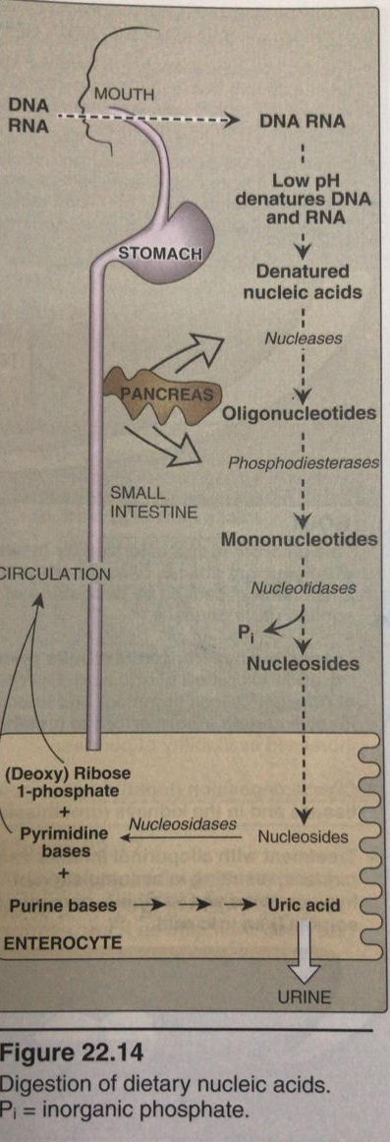

Slide 5
Dietary
DNA / RNA
Nucleotides
Pancreatic
nucleases
Nucleotidases
Nucleosidases
Free purine
bases + Ribose
Nucleosides
Purine
Degradation
pathway
Free pyrimidine
bases + Ribose
Pyrimidine
Degradation
pathway
Uric acid
Malonyl CoA

Slide 6
Purine degradation pathway
Adenosine and guanosine (purines) are finally degraded to uric acid by:
Purine degradation pathway

Slide 7
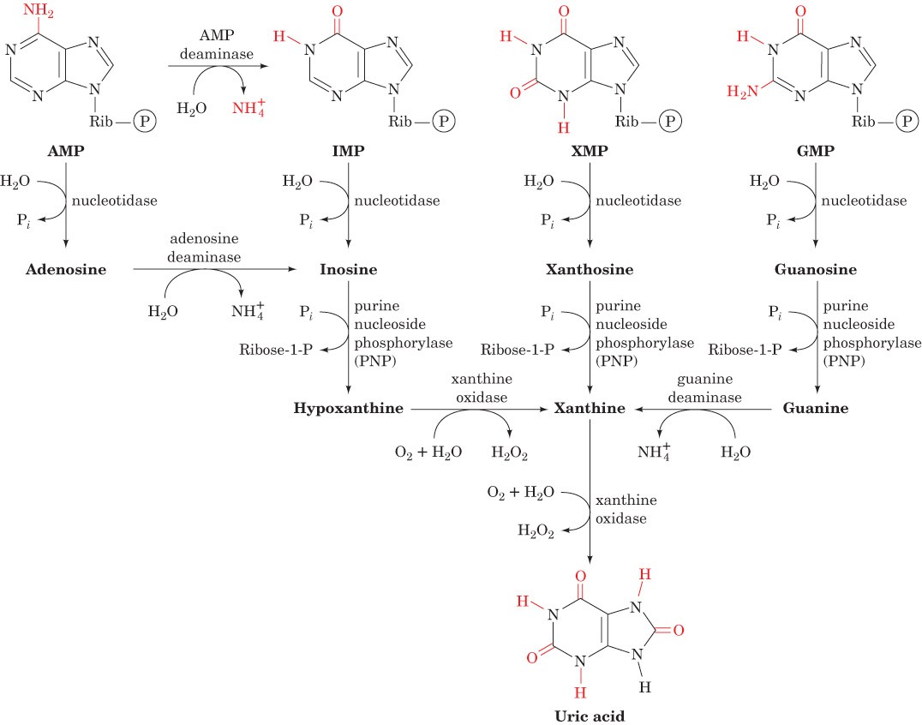
Major pathways of purine catabolism in animals
Page 1093
Voet Biochemistry 3e
© 2004 John Wiley & Sons, Inc.
Xanthine Oxidase- Rate limiting enzyme of purine degradation

Slide 8
AMP
AMP
deaminase
IMP
XMP
GMP
H₂O
H₂O
H₂O
H₂O
Nucleotidase
Nucleotidase
Nucleotidase
Nucleotidase
Pi
Pi
Pi
Pi
Adenosine
Adenosine
deaminase
Inosine
Xanthosine
Guanosine
Pi
Pi
Pi
PNP
PNP
PNP
Ribose 1-P
Ribose 1-P
Ribose 1-P
Hypoxanthine
Xanthine
oxidase
Xanthine
deaminase
Guanine
Guanine
Xanthine
oxidase
URIC ACID

Slide 9
Fate of uric acid in humans
In humans, primates, birds and reptiles the final product of purine degradation is uric acid
Uric acid is excreted in the urine
Some animals convert uric acid to other products:
Allantoin
Allantoic acid
Urea
Ammonia

Slide 10
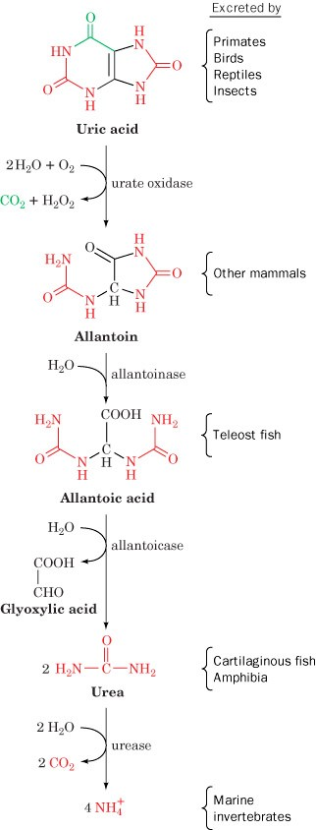
Degradation of uric acid to ammonia in some animals
Page 1097
Voet Biochemistry 3e
© 2004 John Wiley & Sons, Inc.

Slide 11
Fate of uric acid in humans
Uric acid is less soluble in water
Reptiles, insects and birds excrete uric acid as a paste of crystals
To save water
Humans excrete uric acid in urine

Slide 12
Fate of uric acid in humans
Humans do not have enzymes to further degrade uric acid
Excessive production of uric acid causes deposition of uric acid crystals in the joints leading to:
Gout
Hyperuricemia

Slide 13
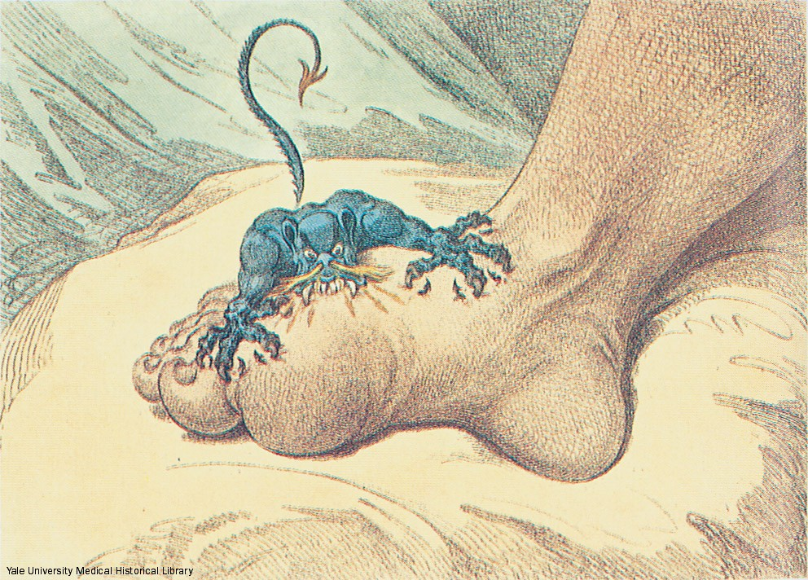
The Gout, a cartoon by James Gilroy (1799)
Page 1097
Voet Biochemistry 3e
© 2004 John Wiley & Sons, Inc.

Slide 14
Gout
Gout is a disease due to high levels of uric acid in body fluids
7.0 mg/dL and above
Uric acid accumulates because of:
Overproduction or
Underexcretion

Slide 15
Gout
Painful arthritic joint inflammation due to deposits of insoluble sodium urate crystals (especially big toe)
Affects 3 per 1000 persons
Sodium urate crystals accumulate in kidneys, ureter, joints leading to chronic gouty arthritis

Slide 16
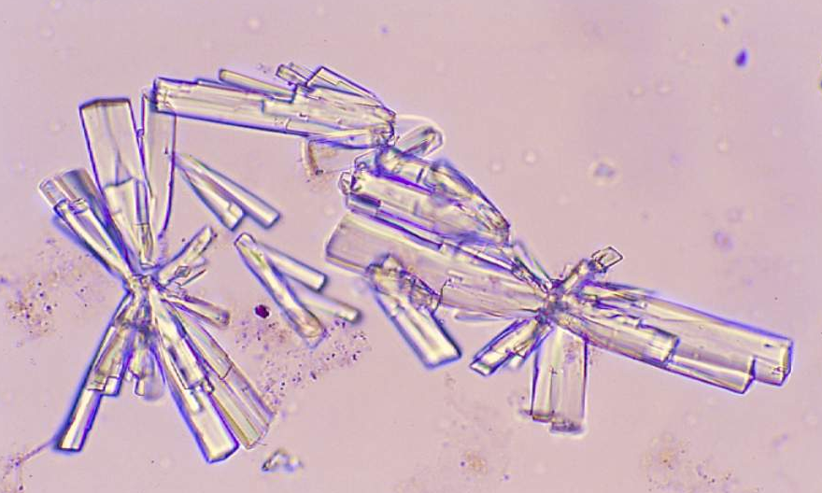
Sodium urate crystals in urine
Voet Biochemistry 3e
© 2004 John Wiley & Sons, Inc.

Slide 17
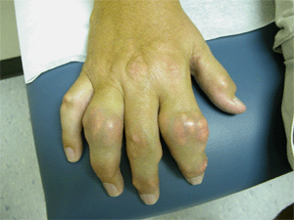
Voet Biochemistry 3e
© 2004 John Wiley & Sons, Inc.

Slide 18
Gout
Inaccurately associated with overeating and drinking
Alcohol used to be contaminated with lead during manufacture and storage
Lead decreases excretion of uric acid from kidneys causing hyperuricemia and gout
Excessive meat comsumption increases uric acid production in some individuals

Slide 19
Gout
Two main causes
Overproduction of uric acid
Underexcretion of uric acid

Slide 20
Classification of Gout
Clinical Category | Metabolic defect
Primary Gout (90% of cases)
Enzyme defects-Unknown (85% to 90% of cases ) | Overproduction of uric acid -Normal excretion (Majority) -Increased excretion (Minority ) Underexcretion of uric acid with normal production
Known enzyme defects – e.g., Partial HGPRT deficiency (rare) | Overproduction of uric acid
Secondary Gout (10% of cases )
Associated with increase nucleic acid turnover – e,g. Leukaemia | Overproduction of uric acid with increase urinary excretion
Chronic renal disease | Reduced excretion of uric acid with normal production
Inborn errors of metabolism – e.g complete HGPRT deficiency (Lesch-nyhan syndrome) | Overproduction of uric acid with increased urinary excretion
Hypoxanthine-guanine phosphoribosyltransferase (HGPRT)

Slide 21
Biochemical Diagnosis
Joint fluid test
The definitive diagnosis of gout requires aspiration and examination of synovial fluid from an affected joint (or material from a tophus) using polarized light microscopy to confirm the presence of needle-shaped monosodium urate crystals.
Blood test
It uses to measure the levels of uric acid

Slide 22
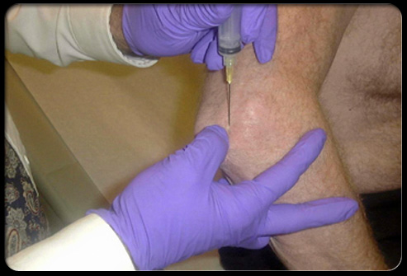
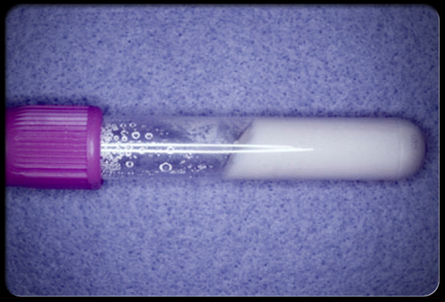

Slide 23
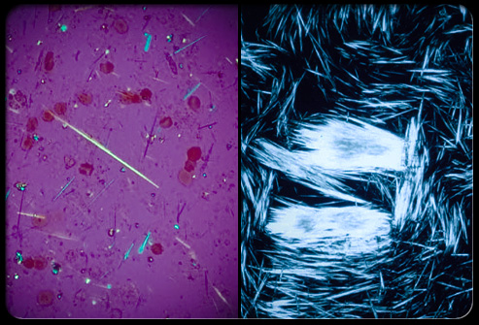
Monosodium urate crystals

Slide 24
Treatment
To reduce pain and inflammation (analgesics, anti-inflammatory drugs)
To increase uric acid excretion (uricosuric agents)
To reduce uric acid production
Allopurinol (xanthine oxidase inhibitor)

Slide 25
Major pathways of purine catabolism in animals
Page 1093
Voet Biochemistry 3e
© 2004 John Wiley & Sons, Inc.

Slide 26
Take home message
The biochemical causes that contribute to the development of gout and hyperuricemia are defects in purine degradation pathway and impaired excretion of uric acid.
Hyperuricemia does not always cause gout.

Slide 27
