Slide 1
NSAIDs Epidemiology
NSAIDs account for 3.8% of all prescriptions
A significant quantity is sold over the counter (OTC)
Use increases with age
90% of all NSAIDs prescriptions are issued to patients at ages over 65 years
NSAIDs is the most prominent risk for gastric ulceration, hemorrhage & perforation
The prevalence of NSAID-induced ulcers is 10% to 30% .
Notes:
& bec of the inappropriate NSAIDs therapy is a common cause of actual & potential adverse effects, such as bleeding & GI ulceration, w exacerbates the patient's medical condition & might even be life threatening.

Slide 2
ILos
To focus on the general mechanism of action of NSAIDs
To classify NSAIDs on basis of their specificity to COX isoenzymes
To outline the common pharmacodynamic effects & ADRs of NSAIDs
To detail on the pharmacokinetic properties & pharmacodynamic effects of selected NSAIDs.

Slide 3
MECHANISM OF ACTION OF NSAIDs
NSAIDs inhibit cyclo oxygenase enzyme
Notes:
Pharmacodynamics
NSAID anti-inflammatory activity is mediated chiefly through inhibition of PG biosynthesis
A stimulus causes disturbance in cell membranes, this will activate the phospholipids to release AA. The cell damage associated with inflammation acts on cell membranes to release leukocyte lysosomal enzymes; AA is then liberated from precursor compounds, & various eicosanoids are synthesized. The lipoxygenase pathway of arachidonate metabolism yields leukotrienes, which have a powerful chemotactic effect on eosinophils, neutrophils, & macrophages & promote bronchoconstriction & alterations in vascular permeability. During inflammation, stimulation of the neutrophil membranes produces oxygen-derived free radicals & other reactive molecules such as hydrogen peroxide & hydroxyl radicals. The interaction of these substances with AA results in the generation of chemotactic substances, thus perpetuating the inflammatory process. Chronic inflammation involves the release of multiple cytokines & chemokines plus a very complex interplay of immunoactive cells.
Leukotriens & PGs >>> Alteration of vascular permeability, bronchial constriction, increased secretion

Slide 4
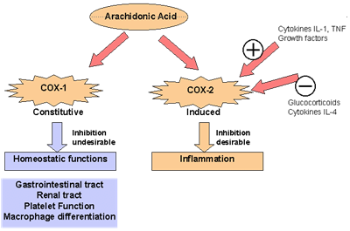
COX isoforms
COX3 is found in the brain
Notes:
Selectivity for COX-1 versus COX-2 is variable & incomplete for the older NSAIDs, but selective COX-2 inhibitors have been synthesized. The selective COX-2 inhibitors do not affect platelet function at their usual doses. The efficacy of COX-2-selective drugs equals that of the older NSAIDs, while GI safety may be improved.
On the other hand, selective COX-2 inhibitors increase the incidence of edema, hypertension, & possibly, myocardial infarction.
The NSAIDs decrease the sensitivity of vessels to bradykinin & histamine, affect lymphokine production from T lymphocytes, & reverse the vasodilation of inflammation. To varying degrees, all newer NSAIDs are analgesic, anti-inflammatory, & antipyretic, & all (except the COX-2-selective agents & the nonacetylated salicylates) inhibit platelet aggregation. NSAIDs are all gastric irritants & can be associated with GI ulcers and bleeds as well, although as a group the newer agents tend to cause less GI irritation than aspirin.

Slide 5
Classification of NSAIDs
Aspirin, Diclofenac, piroxicam,
Ibuprofen, naproxen
Nonselective COX-1/COX-2
Inhibitors
Selective COX-2
Inhibitors
Coxibs
Preferential COX-2 inhibitors
Meloxicam
COX-3 inhibitors
Paracetamol

Slide 6
Inflammatory factors
PGS
-
NSAIDs
+
Bradykinin
Histamine
Nociceptors at nerve endings
Pharmacodynamic effects
PAIN
1-analgesic
Notes:
Non opioid analgesics

Slide 7
2-Antipyretic
Pyrogens
PGs
NSAIDs
Thermoregulatory centre
-
Set point↑
Heat production↑
Heat dissipation↓
Fever

Slide 8
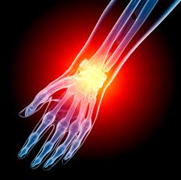
3-Anti-inflammatory
-
NSAIDs
PGs
Inflammatory factors
+
Symptoms of inflammation
Bradykinin
Histamine
Serotonin
Red , Heat , Swelling, Pain
Notes:
have anti-inflammatory effects, so they are appropriate for the treatment of both acute & chronic inflammatory conditions.
Salicylates & other similar agents used to treat rheumatic disease share the capacity to suppress the signs & symptoms of inflammation including pain. These drugs also exert antipyretic effects.

Slide 9
Clinical uses
Fever
Headache, Migraine,
Dental pain, Dysmenorrhea
Common cold
Rheumatoid arthritis / myositis

Slide 10
adrs
GIT upsets (nausea, vomiting)
GIT bleeding & ulceration
Hypersensitivity reaction
Inhibition of uterine contraction
Salt & water retention
Notes:
Cardiovascular: Fluid retention, hypertension, edema, & rarely, myocardial infarction & congestive heart failure.

Slide 11
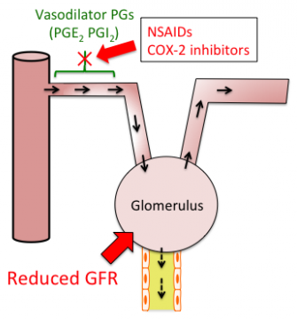
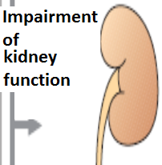
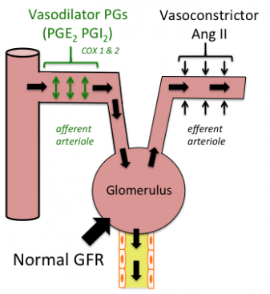
adrs
NSAIDs cause hemodynamically- mediated acute renal failure
Notes:
Nephrotoxicity, reported for all NSAIDs, is due, in part, to interference with the autoregulation of renal blood flow, w is modulated by PGs (E2 & I2).

Slide 12
Non selective cox inhibitors
Aspirin
Diclofenac
Ibuprofen
Ketoprofen
Naproxen
Piroxicam
Indomethacin

Slide 13
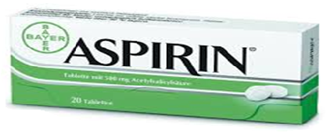
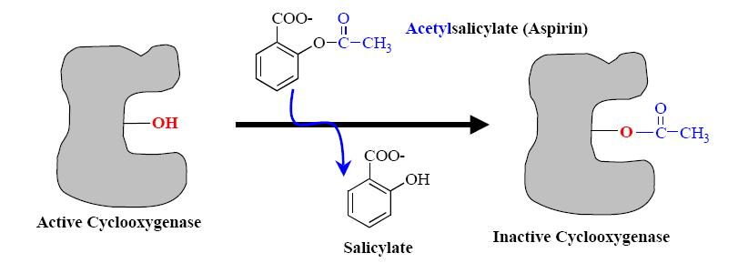
Non selective cox inhibitors
Mechanism of action
Aspirin inhibits COX irreversibly
Notes:
Aspirin irreversibly acetylates & blocks platelet COX, while the non-COX-selective NSAIDs are reversible inhibitors. Thus prevent the binding of AA

Slide 14
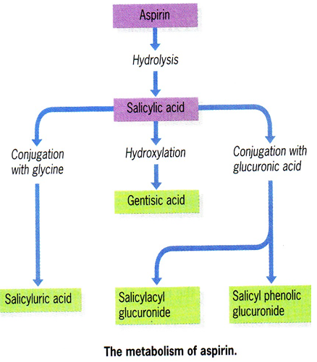
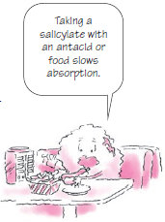
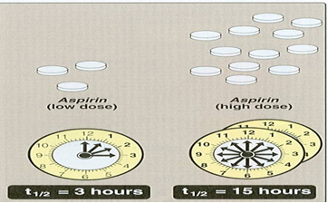
Pharmacokinetics
Metabolized by hydrolysis & then conjugation
Why a high dose has a long plasma half- life?
Notes:
NSAID metabolism proceeds, in large part, by way of the CYP3A or CYP2C families of P450 enzymes in the liver
While renal excretion is the most important route for final elimination

Slide 15
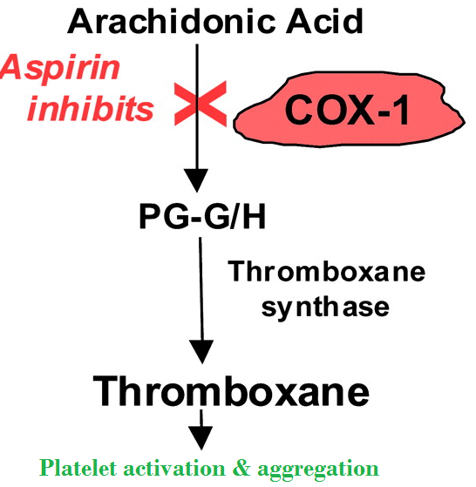
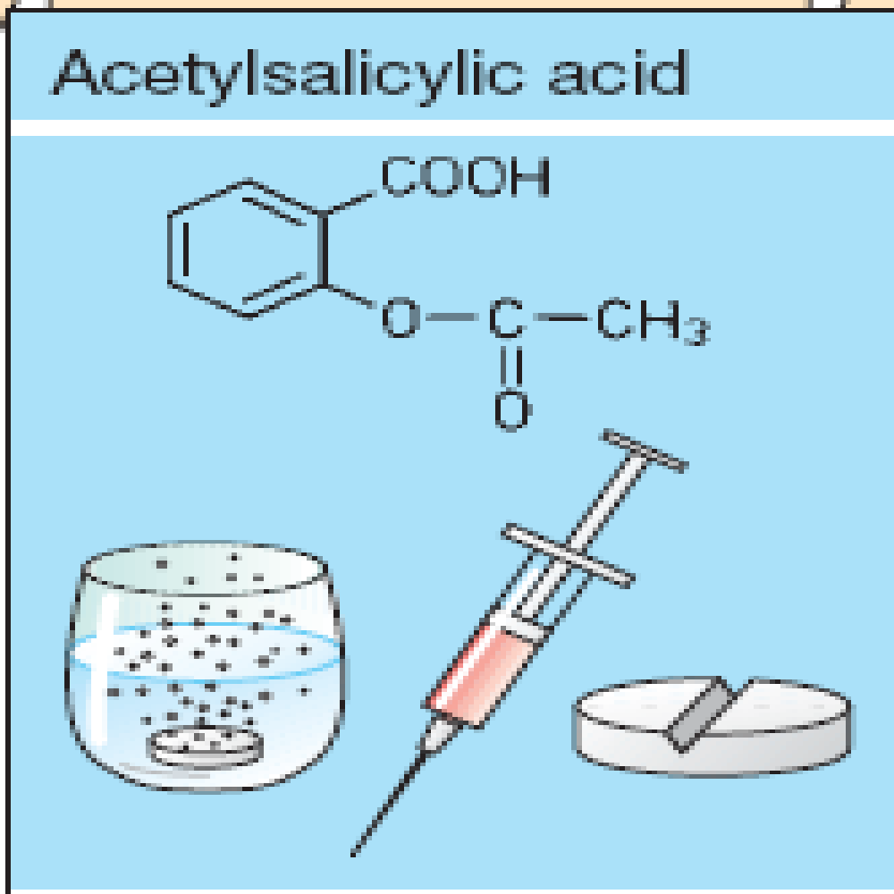
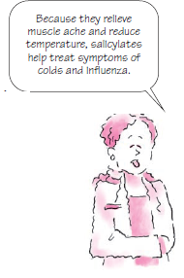
Clinical uses
Acute rheumatic fever
Reducing the risk of myocardial infarction (cardioprotective)
Prevention of pre-eclampsia
Chronic use of small doses ,
reduce the incidence of
colon cancer
Notes:
Aspirin is currently the most widely prescribed treatment in the prevention of cardiovascular complications. Aspirin decreases the incidence of transient ischemic attacks, unstable angina, coronary artery thrombosis with myocardial infarction, & thrombosis after CABG
Prevention of pre-eclampsia ??
Preeclampsia is a multisystem disorder of pregnancy that is usually defined as HTN & proteinuria diagnosed after 20 weeks of gestation.
This endothelial dysfunction involves increased peroxidation of endothelial lipids associated with a decrease in antioxidant protection. The peroxidation of lipids activates COX & inhibits prostacyclin synthase, thus inducing rapid imbalance in the TXA2/prostacyclin (PGI2) ratio in favor of TXA2. TXA2 favors systemic vasoconstriction, w is little compensated in this context by the vasodilator effect of prostacyclins, levels of w drop sharply. In preeclampsia, platelet TXA2 increases significantly, whereas prostacyclin drops sharply. TXA2/PGI2 imbalance can be reversed by 2 weeks of TR with low-dose aspirin, w inhibits TXA2 secretion, & thus platelet aggregation, without altering secretion of endothelial prostacyclin (PGI2), thereby favoring systemic VD.
Several large epidemiologic studies have shown a 50% reduction in relative risk for this neoplasm when the drugs are taken for 5 years or longer. The mechanism for this
protective effect is unclear but possibly related to its COX-inhibiting effects.

Slide 16
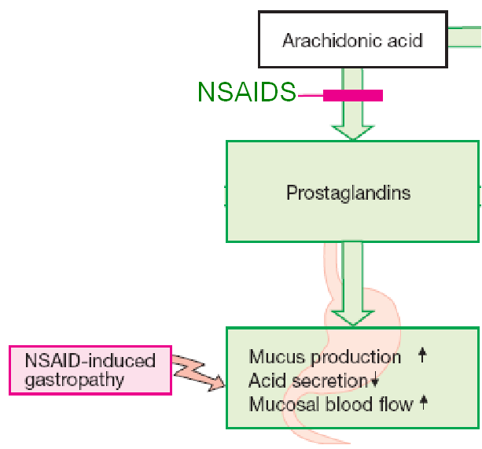
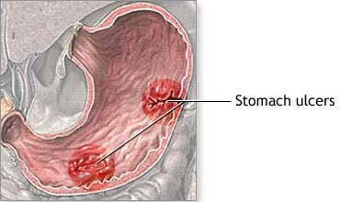
Adrs at clinical doses
Hypersensitivity
Acute Gouty arthritis
Reye's syndrome
Impaired haemostasis
GIT side effects, dyspepsia, nausea, vomiting
Mucosal damage→ hemorrhage
Notes:
Reye's syndrome is a rare disorder that causes brain & liver damage (swelling). Although it can happen at any age, it is most often seen in children.
Reye’s syndrome usually occurs in children who have had a recent viral infection, such as chickenpox or the flu. Taking aspirin to treat such an infection greatly increases the risk of Reye’s.
The first symptom of Reye’s is usually vomiting. This is followed by irritability or aggressiveness. After that, children may become confused & lethargic. They may have seizures or fall into a coma. There is no cure for Reye’s syndrome. HE, symptoms can sometimes be managed. For ex, steroids help reduce swelling in the brain.
Impaired hemostasis: impaired platelets aggregation

Slide 17
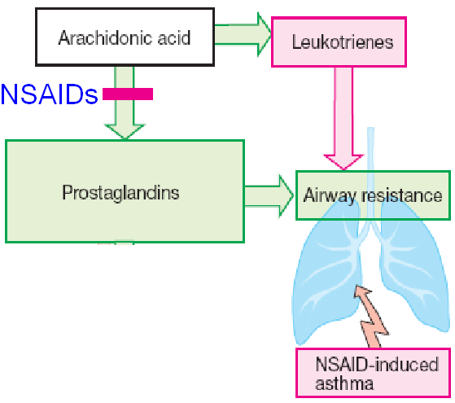
Adrs at clinical doses
Bronchospasm in aspirin- sensitive asthmatics

Slide 18
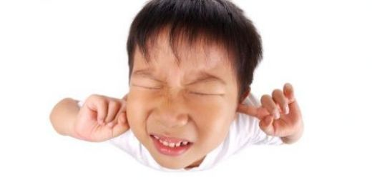
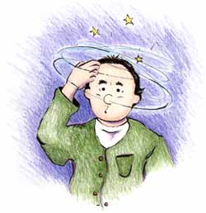
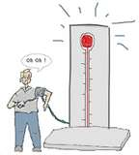
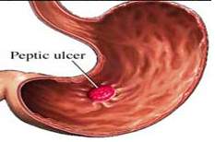
ADRS at overdose
Salicylism (ringing of ear , vertigo)
Hyperthermia
Gastric ulceration & bleeding
Notes:
Hyperthermia ?

Slide 19
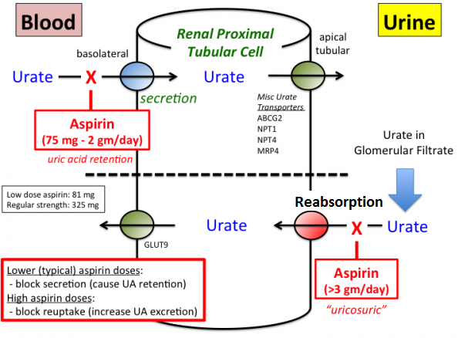
contraindications
Peptic ulcer
Pregnancy
Hemophilic patients
Patients taking
anticoagulants
Children with
viral infections
Gout (small doses)
Notes:
Why in pregnancy ?
The antiplatelet action of aspirin contraindicates its use by patients with hemophilia. Hemophilia is defect in clotting mechanism >> bleeding

Slide 20
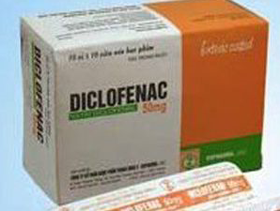
Non selective cox inhibitors
Clinical uses
Analgesic
Antipyretic
Anti-inflammatory
Acute gouty arthritis
Locally to prevent post- operative ophthalmic inflammation (solution)

Slide 21
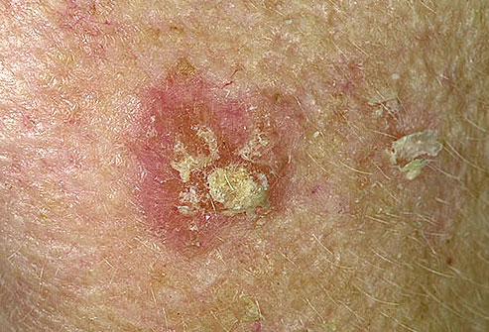
preparations
Diclofenac with misoprostol decreases upper gastrointestinal ulceration, but result in diarrhea
Diclofenac with omeprazole to prevent recurrent bleeding
0.1% ophthalmic preparation for postoperative ophthalmic inflammation
A topical gel 3% for solar keratoses
Rectal suppository as analgesic
Oral mouth wash
IM preparations for pain & fever.
Notes:
GI ulceration may occur less frequently than with some other NSAIDs.
A preparation combining diclofenac & misoprostol
Misoprostol helps to decrease your risk of serious ulcer complications such as bleeding. This medication protects your stomach lining by lowering the amount of acid that comes in contact with it.
It is a PG analogue — specifically, a synthetic prostaglandin E₁ so it is CI in pregnancy & used to induce abortion.
Misoprostol is used for the prevention of NSAID-induced gastric ulcers. It acts upon gastric parietal cells, inhibiting the secretion of gastric acid by G-protein coupled R-mediated inhibition of adenylate cyclase, w leads to decreased intracellular cyclic AMP levels & decreased proton pump activity at the apical surface of the parietal cell. Bec other classes of drugs, especially H2-R antagonists & proton pump inhibitors, are more effective for the TR of acute peptic ulcers, misoprostol is only indicated for use by people who are both taking NSAIDs & are at high risk for NSAID-induced ulcers, including the elderly & people with ulcer complications. Misoprostol is sometimes co-prescribed with NSAIDs to prevent their common adverse effect of gastric ulceration (e.g. with diclofenac in Arthrotec).
Another combination of diclofenac & omeprazole was also effective with respect to the prevention of recurrent bleeding, but renal adverse effects were common in high-risk patients.
A 0.1% ophthalmic preparation is promoted for prevention of postoperative ophthalmic inflammation & can be used after intraocular lens implantation & strabismus surgery. A topical gel containing 3% diclofenac is effective for solar keratoses.
Solar keratosis /actinic keratosis (also commonly known as sunspots) are rough, red, scaly, / crusty spots on the skin that are caused by excessive exposure to Ultraviolet Radiation from the sun. They are more common on sun-exposed areas, such as the face, nose, ears, chest, forearms, & back of the hands.
IM for pain & fever.

Slide 22
Selective COX-2 inhibitors:
coxibs
Celecoxib
Etoricoxib
Paracoxib
Lumiracoxib
Notes:
Since aspirin, the original NSAID, has a number of adverse effects, many other NSAIDs have been developed in attempts to improve upon aspirin’s efficacy & decrease its toxicity.
COX-2 selective inhibitors, /coxibs, were developed in an attempt to inhibit PG synthesis by the COX-2 isozyme induced at sites of inflammation without affecting the action of the constitutively active “housekeeping” COX-1 isozyme found in the GI tract, kidneys, & platelets.
COX-2 inhibitors at usual doses have no impact on platelet aggregation, w is mediated by thromboxane produced by the COX-1 isozyme. As a result, COX-2 inhibitors do not offer the cardioprotective effects of traditional nonselective NSAIDs.
Clinical data suggested a higher incidence of cardiovascular thrombotic events associated with COX-2 inhibitors such as rofecoxib & valdecoxib, resulting in their withdrawal from the market.

Slide 23
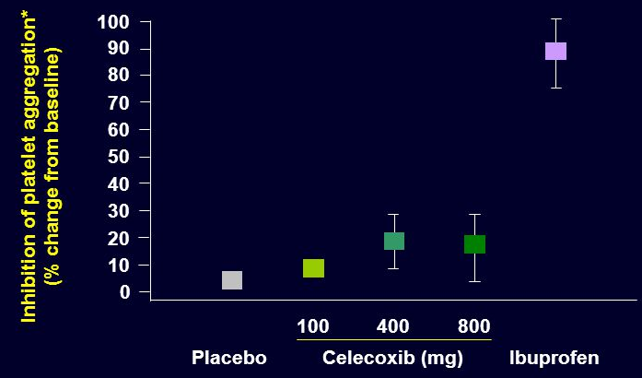
Selective COX-2 inhibitors
Potent anti-inflammatory
Antipyretic & analgesic
Lower incidence of gastric upset
No effect on platelet aggregation (COX-1)

Slide 24
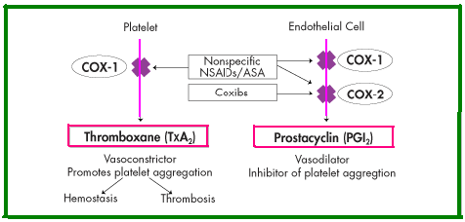
General ADRs
Renal toxicity
Dyspepsia & heartburn
Allergy
Cardiovascular (do not offer the cardioprotective effects of non-selective group)
Should not be given to a patient with CV disease
Notes:
Recommended doses of COX-2 inhibitors cause renal toxicities similar to those associated with traditional NSAIDs.

Slide 25
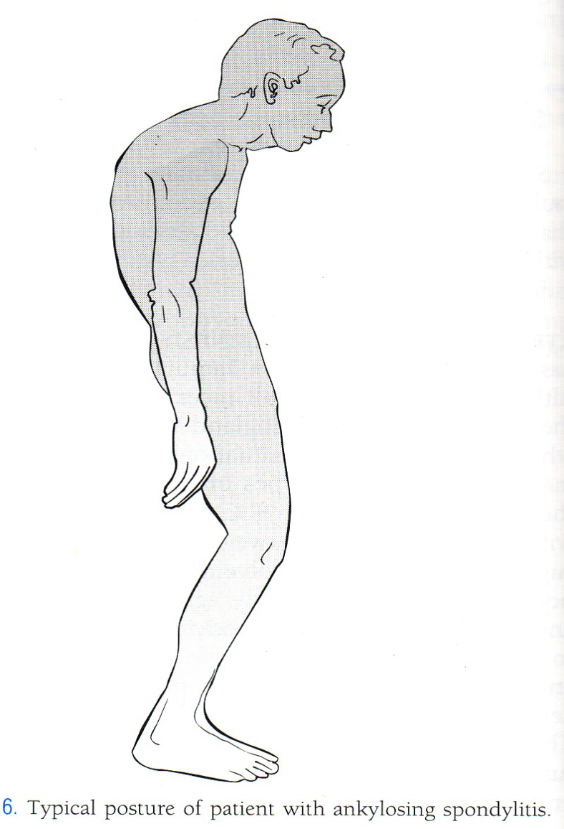
GENERAL CLINICAL USES
Short-term use in postoperative patients
Acute gouty arthritis
Acute musculoskeletal pain
Ankylosing spondylitis
Notes:
Ankylosing spondylitis is a type of arthritis that affects the spine. symptoms include pain & stiffness from the neck down to the lower back. The spine's bones (vertebrae) fuse together, resulting in a rigid spine.

Slide 26
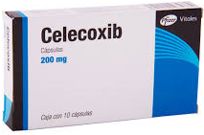
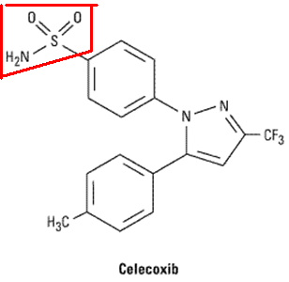
Selective COX-2 inhibitors
Half-life 11 hours
Food decrease its absorption
Highly bound to plasma proteins
Contraindicated in patients allergic to sulphonamides.
Notes:
Celecoxib is a selective COX-2 inhibitor—about 10–20 times more selective for COX-2 than for COX-1.
Probably because it is a sulfonamide, celecoxib may cause rashes.

Slide 27
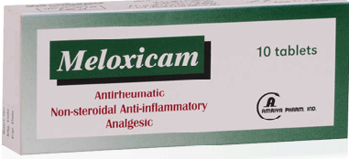
preferential COX-2 inhibitors
Meloxicam, nimesulide, nambumetone
Preferentially inhibits COX-2 over COX-1, particularly at low dose
Associated with lower GIT symptoms & complains, compared to non –selective COX inhibitors
t½=20 hours
Used for osteoarthritis & rheumatoid arthritis.
Notes:
It is not as selective as celecoxib & may be considered “preferentially” selective rather than “highly” selective.

Slide 28
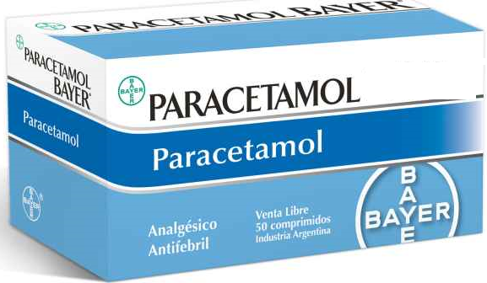
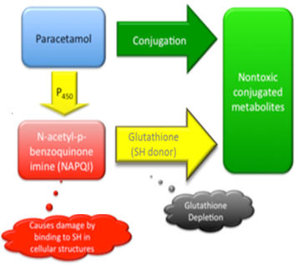
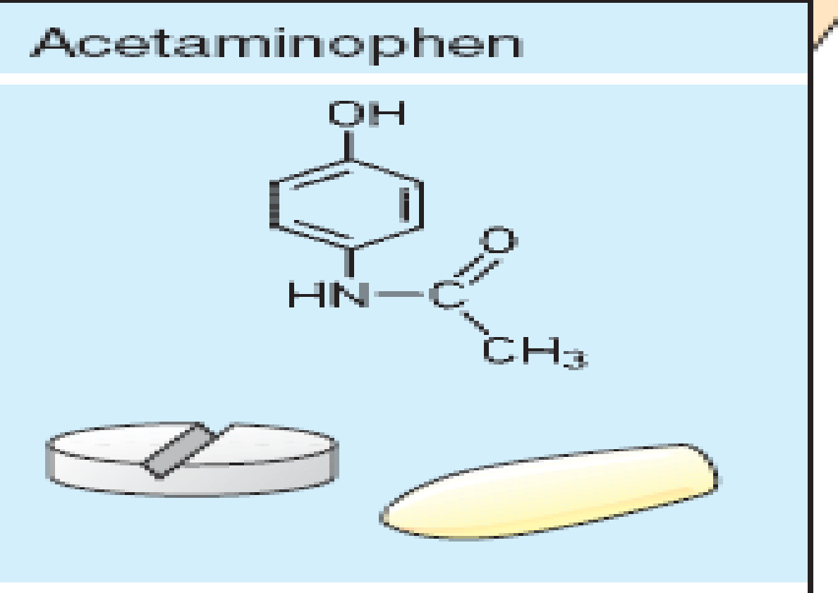
cox-3 inhibitors
Given orally, well absorbed.
t½=2-4h
Metabolized by conjugation at therapeutic doses
Notes:
Acetaminophen is 1 of the most important drugs used in the treatment of mild to moderate pain when an anti-inflammatory effect is not necessary.
Although said to be equivalent to aspirin as an analgesic & antipyretic agent, acetaminophen lacks anti-inflammatory properties. It does not affect uric acid levels & lacks platelet-inhibiting effects. The drug is useful in mild to moderate pain such as headache, myalgia, postpartum pain, & other circumstances in w aspirin is an effective analgesic.

Slide 29
cox-3 inhibitors
Binding of paracetamol to COX is inhibited by peroxides produced in inflammatory sites.
There is no evidence that COX3 exists in humans.
Weak anti inflammatory effect
Notes:
Acetaminophen is 1 of the most important drugs used in the treatment of mild to moderate pain when an anti-inflammatory effect is not necessary.
Although said to be equivalent to aspirin as an analgesic & antipyretic agent, acetaminophen lacks anti-inflammatory properties. It does not affect uric acid levels & lacks platelet-inhibiting effects. The drug is useful in mild to moderate pain such as headache, myalgia, postpartum pain, & other circumstances in w aspirin is an effective analgesic.

Slide 30
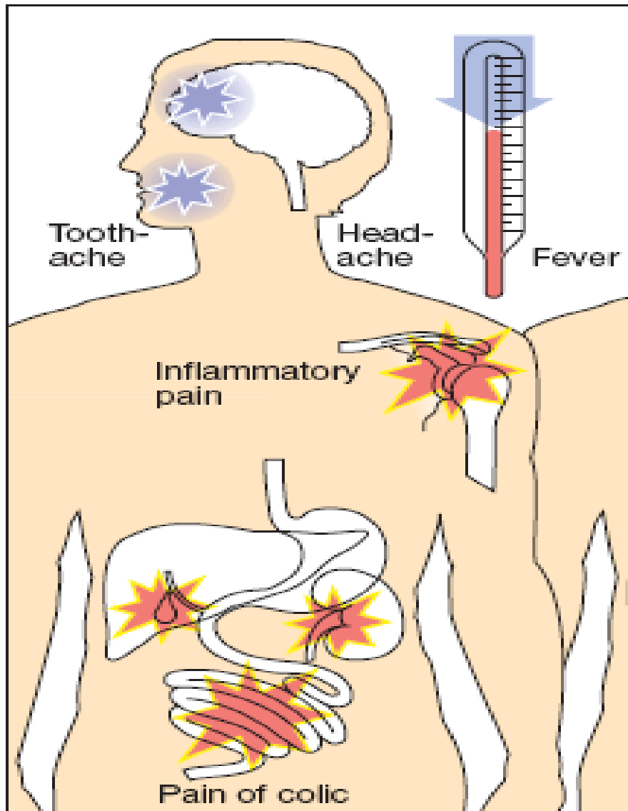
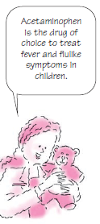
Clinical uses
Commonly used analgesic antipyretic
instead of aspirin in cases of:-
Peptic or gastric ulcers
Bleeding tendency
Allergy to aspirin
Viral infections in children
Pregnancy

Slide 31
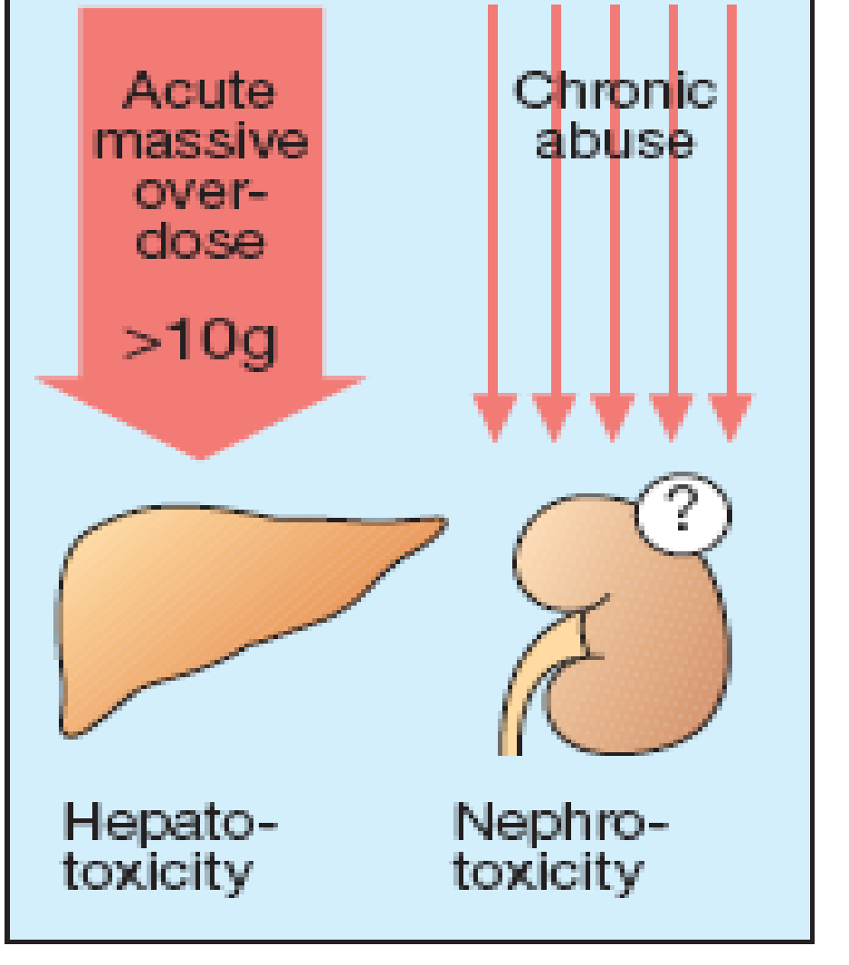
ADRS
Mainly on liver due to
its active metabolite
Therapeutic doses
elevate liver enzymes
In large doses it is metabolized into N- acetyl-p-benzoquinone imine, which causes liver damage
Treatment of toxicity of paracetamol is by N- acetylcysteine to neutralize the toxic metabolite.

