Slide 1
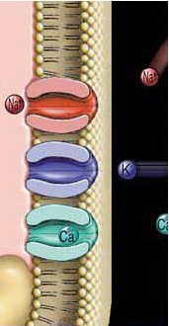
Resting membrane potential & action potential
TEXTBOOK OF MEDICAL PHYSIOLOGY
GUYTON & HALL 13TH EDITION
UNIT II CHAPTER 5
Pages 61-73
TEXTBOOK OF MEDICAL PHYSIOLOGY
GUYTON & HALL 13TH EDITION
UNIT II CHAPTER 5
Pages 61-64
Dr. Mohammed Alotaibi

Slide 2
Objectives
At the end of these lectures the student should be able to
Explain why some membranes are excitable.
Describe the electrochemical basis of RMP.
Describe the mechanism of generation and propagation of AP.
Describe conduction along nerve fibers, role of myelination and how nerve fibers are classified.

Slide 3
Excitable Tissues
Tissues which are capable of generation and transmission of electrochemical impulses along the membrane
Nerve
Muscles

Slide 4
Excitable tissues
excitable
Non-excitable
neuron
Red cell
GIT
muscle
•RBC
•Intestinal cells
•Fibroblasts
•Adipocytes
•Nerve
•Muscle
•Skeletal
•Cardiac
•Smooth

Slide 5
Membrane potential
A potential difference exists across all cell membranes
This is called
– Resting Membrane Potential (RMP)

Slide 6
Membrane potential
Inside is negative with respect to the outside
This is measured using microelectrodes and oscilloscope (VOLTMETER)
This is about -70 to -90 mV

Slide 7
Excitable tissues
excitable
Non-excitable
neuron
Red cell
GIT
muscle
Excitable tissues have more negative RMP
( - 70 mV to - 90 mV)
Non-excitable tissues have less negative RMP
-53 mV epithelial cells
-8.4 mV RBC
-20 to -30 mV fibroblasts
-58 mV adipocytes

Slide 8
Resting Membrane Potential
This depends on the following factors
Ionic distribution across the membrane
Membrane permeability
Other factors
Na⁺/K⁺ pump

Slide 9
Ionic distribution
Na⁺ Cl⁻
_{K}+
Pr ⁻
Major ions
Extracellular ions
Na⁺, Cl⁻
Intracellular ions
K⁺, Proteins

Slide 10
Ionic channels
Na⁺
Out
In
_{K}+
Leaky channels (K+/Na+ leak channels)
More permeable to K
Allows free flow of ions
In the resting state
K+ permeability is 100 times more than that of Na+

Slide 11
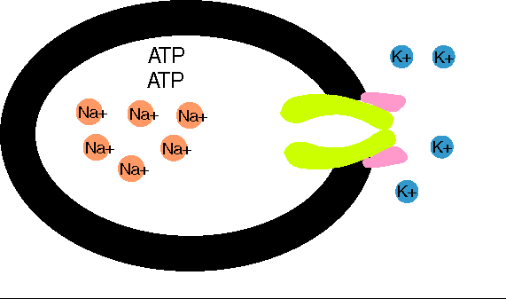
Na+/K+ pump
2 K⁺
ATP
3 Na⁺
ADP
Active transport system for Na+-K+ exchange using energy
It is an electrogenic pump since 3 Na+ efflux coupled with 2 K+ influx
Net effect of causing negative charge inside the membrane

Slide 12
Factors contributing to RMP
One of the main factors is K+ efflux (Nernst Potential: -94mV)
Contribution of Na+ influx is little (Nernst Potential:+61mV)
Na+/K+ pump creates additional degree of negativity inside the membrane (-4mV)
Negatively charged protein ions remaining inside the membrane contributes to the negativity
Net result: -70 to -90 mV inside

Slide 13
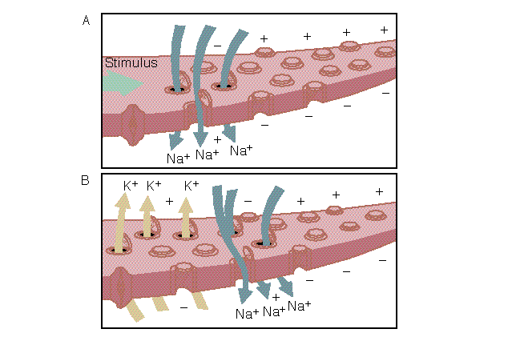
Neuron Action Potentials

Slide 14
The action potential
Nerve signals are transmitted by action potentials, which are rapid changes in the membrane potential that spread rapidly along the nerve fiber membrane to produce physiological effects such as:
Transmission of impulse along nerve fibres
Release of neurotransmitters
Muscle contraction
Activation or inhibition of glandular secretion

Slide 15
Each action potential begins with a sudden change from the normal resting negative membrane potential to a positive potential and ends with an almost equally rapid change back to the negative potential.
Stages of the action potential:
Resting Stage. It is the resting membrane potential before the action potential begins. The membrane is “polarized”.
Depolarization Stage.
Repolarization Stage.

Slide 16
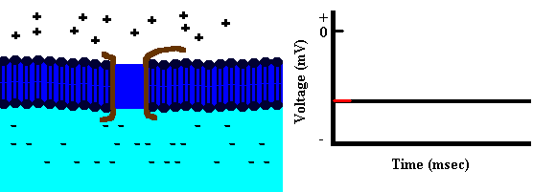
Depolarization
Na+
Depolarization: The membrane suddenly becomes permeable to Na⁺ ions, allowing tremendous numbers of positively charged Na⁺ to diffuse to the interior of the axon (Upstroke).

Slide 17
Repolarization
Na+
K+
Repolarization: Na⁺ channels begin to close and the K⁺ channels open. Rapid diffusion of K⁺ ions to the exterior re-establishes the normal negative resting membrane potential.

Slide 18
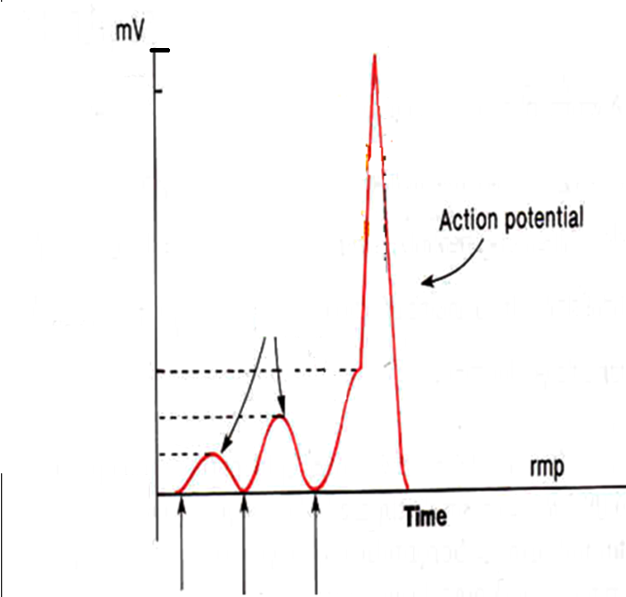
Reversal Potential
= + 35 mV
Local Responses
Threhold
Potential ( Firing Level )
= -50 to -65 mV
RMP= -90 mV
Q : What opens the voltage-gated channels ? Opened by a stimulus strong enough to depolarize them to threshold
Increasing Stimulation

Slide 19
Threshold stimulus:
The membrane potential at which occurrence of the action potential is inevitable.
Acute subthreshold potential:
Stimulus that results only in local depolarisation (acute local potentials) when stimulus is below the threshold.
Local Responses
All-or-nothing principle:
Once threshold value for excitation is reached a full AP is produced, its intensity can not be increased by increasing stimulus intensity.

Slide 20
Types of transport channels through the nerve membrane:
Voltage gated Na⁺ channels
Voltage gated K⁺ channels

Slide 21
Voltage gated Na⁺ channels
At rest, the activation gate is closed and the inactivation gate is open.
During the upstroke of the action potential, both gates are open and Na⁺ flows into the cell down its electrochemical potential gradient.
During repolarization, the activation gate remains open but the inactivation gate is closed.
local anesthetic lidocaine blocks this channel
Cannot elicit new AP

Slide 22
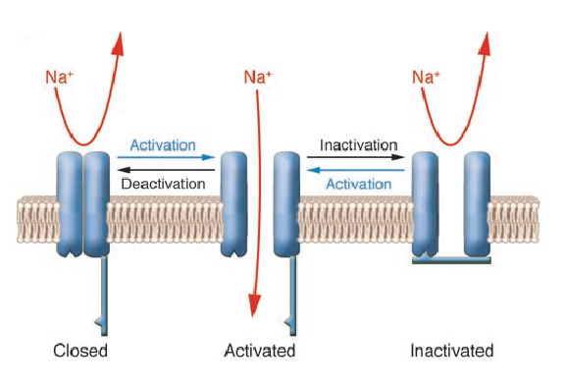
Activation-Inactivation-Deactivation

Slide 23
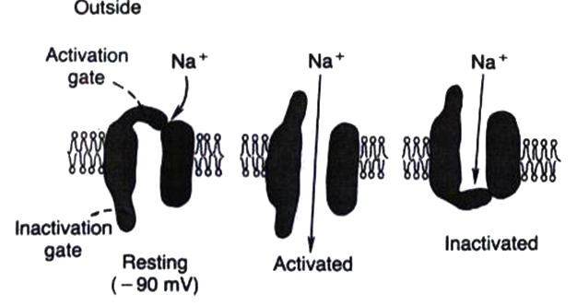
The Na+ Voltage-Gated Channel (1)
Has 2 gates : one on the outer side of the membrane and is called the activation gate ,
and another one on the inner side of membrane called the inactivation gate .
And this channel has 3 states :
(1) Resting state : in the resting cell , when the MP = RMP = -70 to -90 mV , 🡪
the activation gate is closed
this prevents entry of Na+ to the interior of the cell through this gate.

Slide 24
Activated State of Sodium Channel
(2) Activated state : when a Threshold Depolarizing Stimulus moves the MP from its resting value (-90 mV ) to its Threshold value (-65 to -55mV)
🡪 this opens the activation gate , and now the Na+ channel is said to be in the Activated State
( NB in this case BOTH the activation gate & inactivation gate are open ) 🡪
permeability to Na+ becomes increased 500 to 5000 times 🡪 Na+ influx
Na+ flows into the cell in large amounts ,

Slide 25
Inactivated State of Sodium Channel
(3) Inactivated state : A few milliseconds after the activation gate opens , the channel becomes inactivated :
At the peak of AP the inactivation gate will close
the inactivation gate will
not open by a second stimulus 🡪 & the cell
becomes Refractory ممانعة ) to another
stimulation .
This goes on until the MP has gone back to its resting ( RMP) level ( -70 to -90mV).
🡪 in this case , while the activation gate is still open ,
the inactivation gate is closed .

Slide 26
Voltage gated K⁺ channels
Has one gate only .
During the resting state, the gate of the potassium channel is closed and potassium ions are prevented from passing through this channel to the exterior.
Shortly after depolarization, when the sodium channel begins to be inactivated, the potassium channel opens.
K⁺ exits (Efflux) 🡪 Repolarization

Slide 27
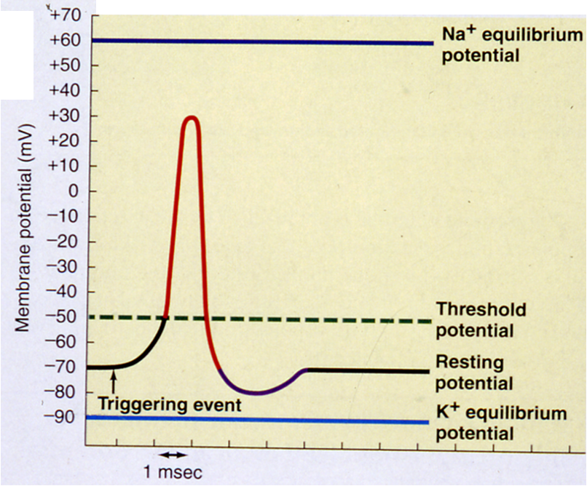
Hyperpolarization: Why?
For a brief period following repolarization, the K⁺ conductance is higher than at rest.
Na ⁺-K ⁺ ATPase pump now starts to move Na⁺ out & K⁺ in against their concentration gradient.
Na/K Pump brings membrane potential back to its resting value
Hyperpolarization

Slide 28
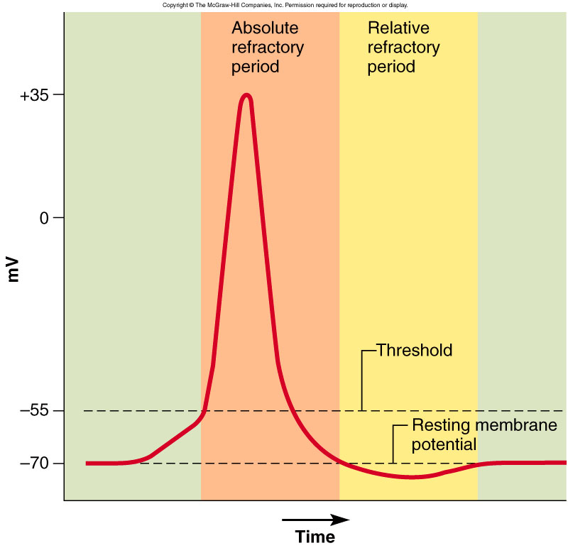
Refractory Periods
Two stages
Absolute refractory period
The period during which a second action potential
cannot be elicited, even with a strong stimulus.
Relative refractory period
Can trigger new action potential if stimulus is very strong.
Higher K+ conductance than is present at rest
Closure of the inactivation gates of the Na+ channel

Slide 29
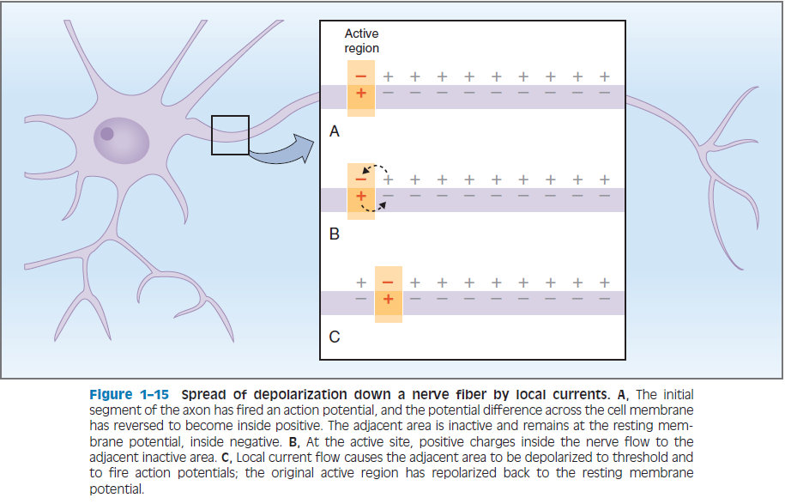
Propagation of the action potential

Slide 30
Conduction Velocity
It is the speed at which action potentials are conducted (propagated) along a nerve or muscle fiber.
Mechanisms that increase conduction velocity along a nerve:
1- Nerve diameter.
The larger the diameter, the faster the transmission, Because:
-Large fiber offers Less resistance to local current flow & more ions will flow.
Faster conduction
Slower conduction

Slide 31
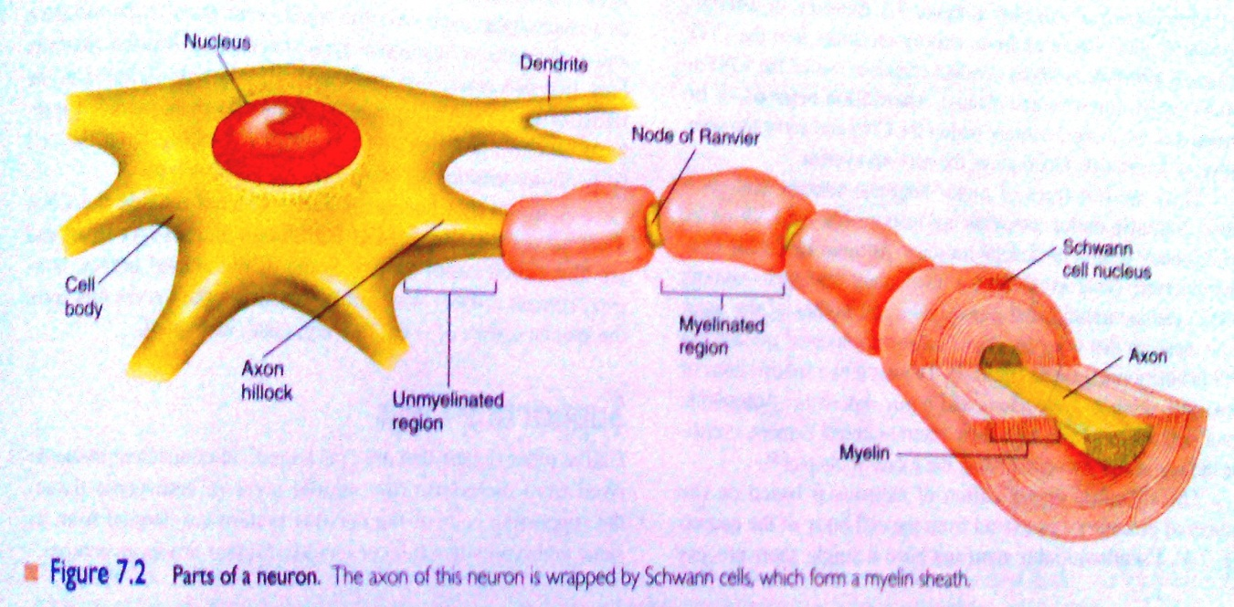

Slide 32
Conduction Velocity
Mechanisms that increase conduction velocity along a nerve:
2- Myelination.
Myelin is an insulator that makes it more difficult for charges to flow between intracellular and extracellular fluids.
The layers of Schwann cell membrane contain the lipid substance sphingomyelin which is excellent electrical insulator that decreases ion flow through the membrane.
- Node of Ranvier: small uninsulated area where ions can flow with ease.

Slide 33
Saltatory Conduction
It is the jumping of action potentials from one node of ranvier to the next as they propagate along a myelinated fiber.
Value:-
1- Increases conduction velocity.
2- Conserves energy for axon because only nodes depolarize.

Slide 34
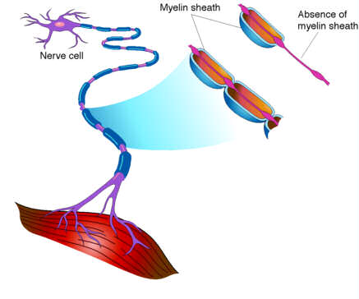
What happens if myelination is lost?
Multiple sclerosis
Autoimmune disease (Immune system attacks the myelin sheaths surrounding axons as well as the axons themselves).
Usually young adults
Blindness, problems controlling muscles
Ultimately paralysis
Scar tissues (scleroses) replaces some damaged cells.

Slide 35
The End

