Slide 1
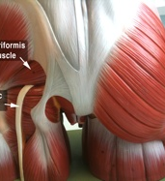
Applied Nerve & Muscle Physiology: Nerve Conduction Study ( NCS) and Electromyography ( EMG)
Dr. Fawzia ALRouq
Associated Professor and Consultant
Head of Clinical Physiology KAUH
هذه الصورة بواسطة كاتب غير معروف مرخصة بالاسم CC BY-SA-NC

Slide 2
At the end of the lecture student should be able to:
Define nerve conduction study (NCS) and electromyography ( EMG) .
Explain the procedure of NCS
Define the normal conduction velocity in upper limb and lower limb nerves .
Define the motor unit potentials ( MUPs) and how they are changed in muscle and nerve diseases .
هذه الصورة بواسطة كاتب غير معروف مرخصة بالاسم CC BY-SA

Slide 3
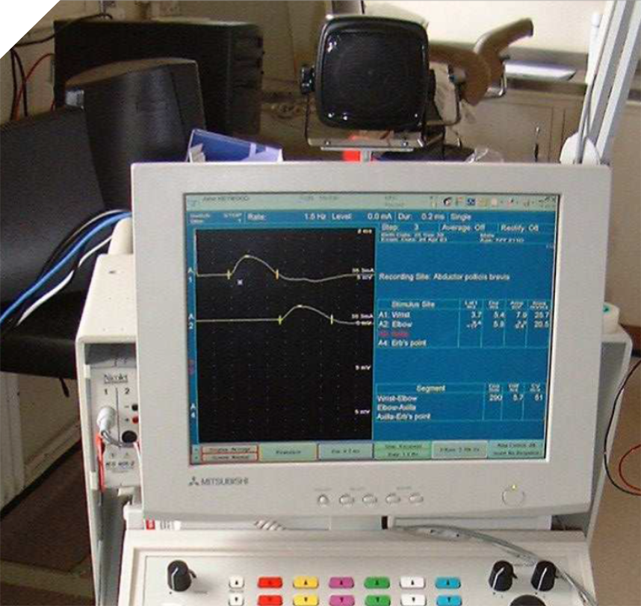
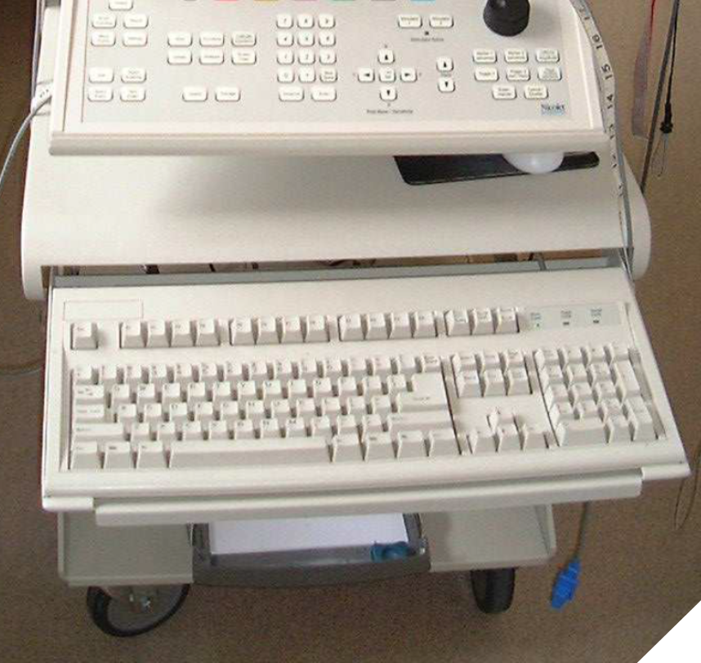
Nerve Conduction studies
A nerve conduction study (NCS) is a test commonly used to evaluate the function, especially the ability of electrical conduction, of the motor and sensory nerves of the human body.
Nerve conduction velocity (NCV) is a common measurement made during this test.
Notes:
Motor NCS are performed by electrical stimulation of a peripheral nerve and recording from a muscle supplied by this nerve. The time it takes for the electrical impulse to travel from the stimulation to the recording site is measured. This value is called the latency and is measured in milliseconds (ms). The size of the response - called the amplitude - is also measured. Motor amplitudes are measured in millivolts (mV). By stimulating in two or more different locations along the same nerve, the NCV across different segments can be determined. Calculations are performed using the distance between the different stimulating electrodes and the difference in latencies.

Slide 4
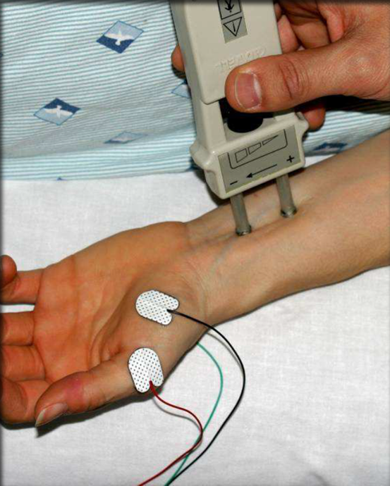
Nerve Conduction Studies
Standard nerve conduction studies typically include motor nerve conduction, sensory nerve conduction.
Sensory and motor nerve conduction studies involve analysis of specific parameters, including latency, conduction velocity, and amplitude.

Slide 5
Motor nerve conducin velocity
Motor nerve conduction velocity of peripheral nerves may be closely correlated to their functional integrity or to their structural abnormalities.
Based on the nature of conduction abnormalities two principal types of peripheral nerve lesions can be identified: Axonal degeneration and segmental demyelination.

Slide 6
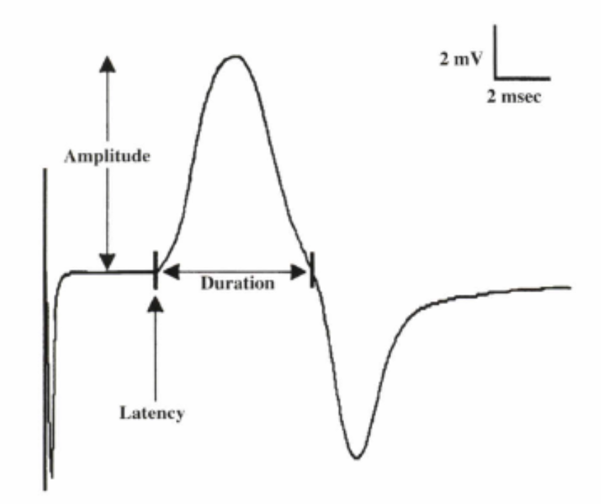
Motor Conduction Studies
The CMAP is a biphasic potential with an initial upward deflection from the baseline
For each stimulation site : the latency, amplitude, duration, of the CMAP are measured .
A motor conduction velocity can be calculated after two sites of stimulation, one distal and one proximal.

Slide 7
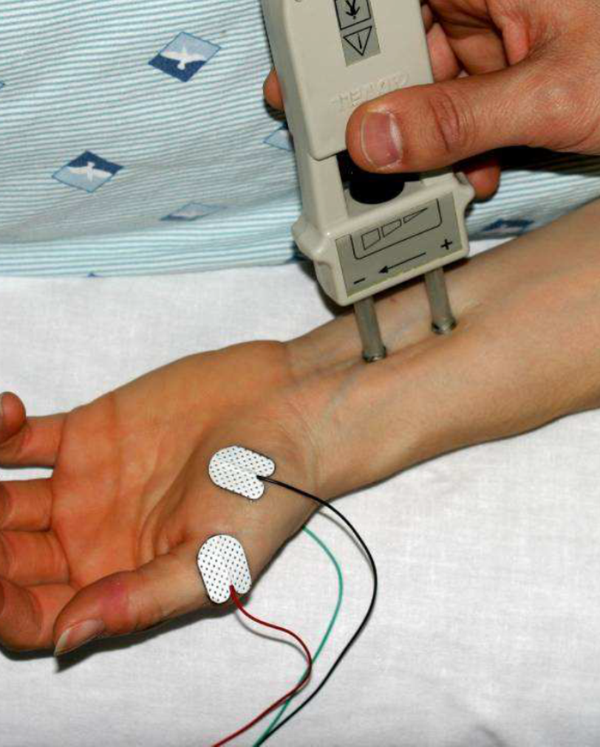
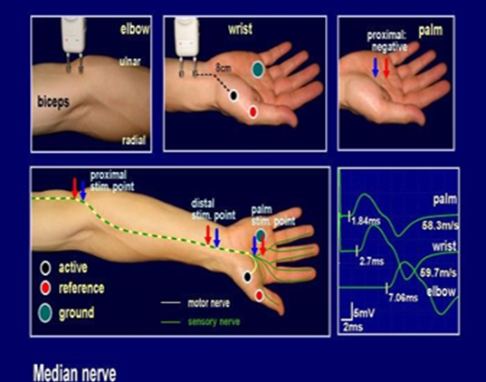
NCS Procedure
The active recording electrode is placed on the center of the muscle belly (over the motor endplate), and the reference electrode is placed distally about 3-4 cm
The stimulator then is placed over the nerve that supplies the muscle.
As current is slowly increased from a baseline: more of the underlying nerve fibers are brought to action potential, and subsequently more muscle fiber action potentials are generated.
most nerves require a current in the range from 20 to 50 mA to achieve supramaximal stimulation.

Slide 8
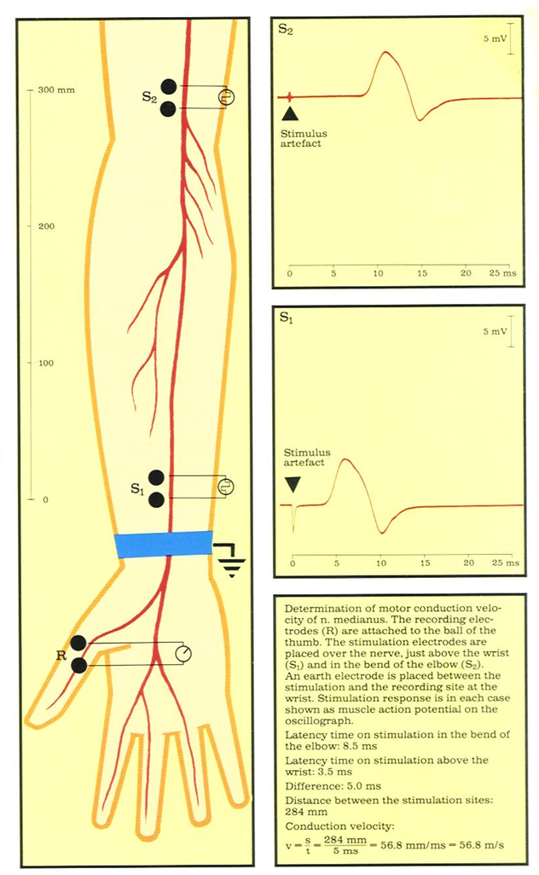
The recorded potential, known as the compound muscle action potential (CMAP), represents the summation of all underlying individual muscle fiber action potentials.
When the current is increased to the point that the CMAP no longer increases in size, one presumes that all nerve fibers have been excited and that supramaximal stimulation has been achieved. The current then is increased by another 20% to ensure supramaximal stimulation.

Slide 9
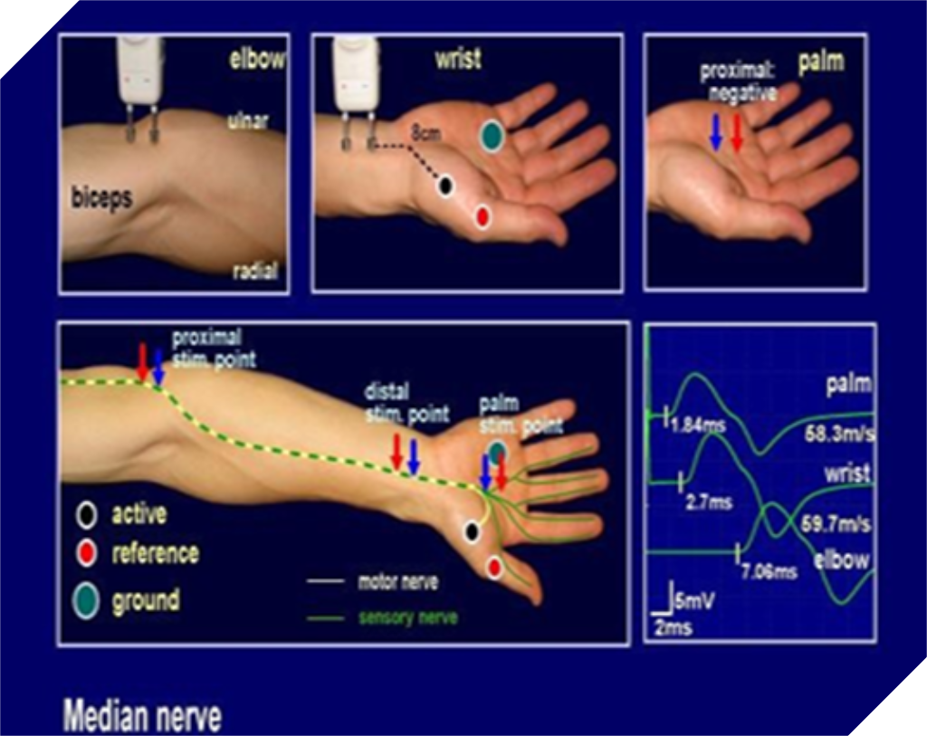
Conduction Velocity
It’s measurement of the speed of the conducting nerve axons
It is calculated by dividing the distance (between proximal stimulation site & distal stimulation site in mm) by the change in time (proximal latency in msec minus distal latency in ms)

Slide 10
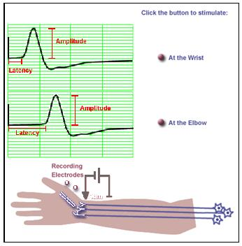
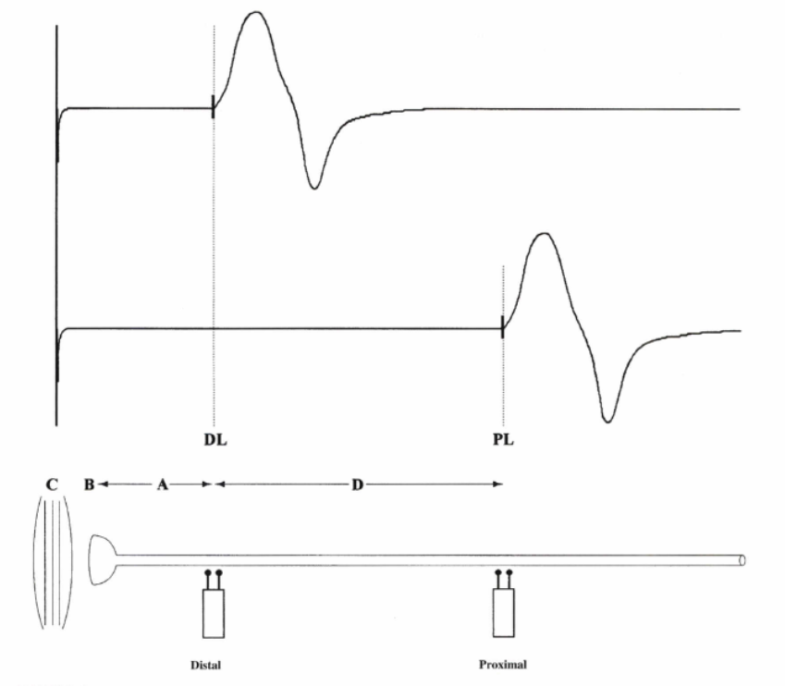
MOTOR NERVE CONDUCTION VELOCITY (MNCV)

Slide 11
LATENCY
Latency measurements usually are made in milliseconds (ms).
The latency is the time from the stimulus to the initial deflection from baseline

Slide 12
Duration
This is measured from the initial deflection from baseline to the final return
Duration characteristically increases in conditions that result in slowing of some motor fibers (e.g., in a demyelinating lesion).

Slide 13
MNCV
MNCV can also be calculated by formula
MNCV (m/sec)=
l₁ = latency at elbow.
l₂ = latency at wrist

Slide 14
Distance
d = 284 mm
Latency At elbow
L₁ = 8.5 ms
Latency At wrist
L₂ = 3.5 ms

Slide 15
Normal values for conduction velocity
In arm
50 – 70 m / sec.
In leg
40 – 60 m / sec.

Slide 16
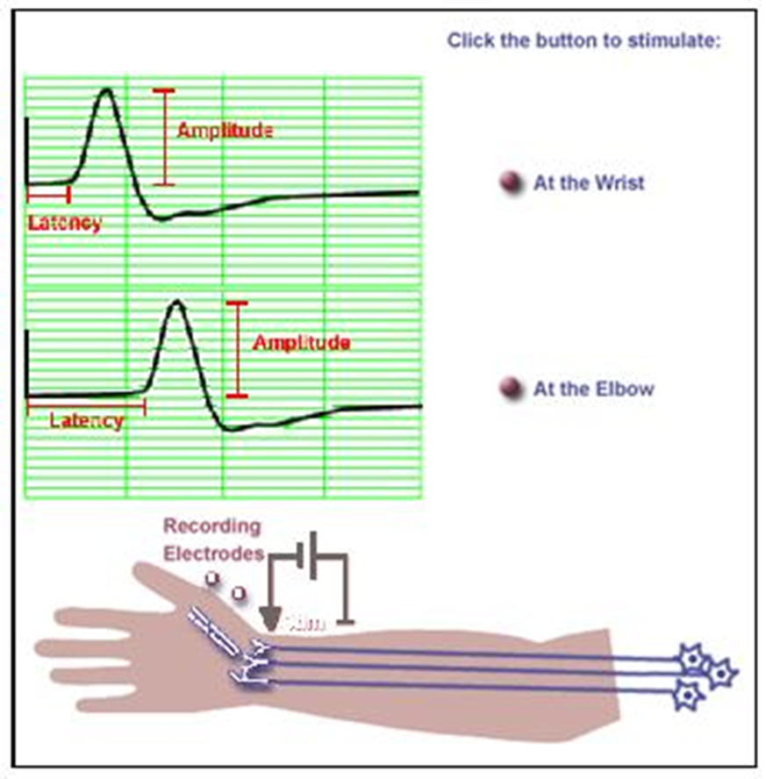
Amplitude
it is most commonly measured from baseline to the peak (baseline-to-peak) and less commonly from the first upward peak to the next downward peak (peak-to-peak).
CMAP amplitude reflects the number of muscle fibers that depolarize.
low CMAP amplitudes most often result from loss of axons (as in a typical axonal neuropathy)
average CMAP amplitude 3 mv

Slide 17
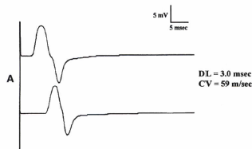
Patterns of Nerve Conduction
Normal study of Median Nerve:
Note the normal median distal latency (DL) 3 ms, amplitude >4 m V, and conduction velocity (CV) >49 mls.

Slide 18
Axonal loss
Amplitudes decrease
CV is normal or slightly slowed.
DL is normal or slightly prolonged.
The morphology of the potential does not change between proximal and distal sites.

Slide 19
Demyelination associated with inherited disorders
CV is markedly slowed < 75% lower limit of normal)
DL is markedly prolonged (>130% upper limit of normal).
However, there usually is no change in configuration between proximal and distal stimulation

Slide 20
Axonal degeneration neuropathy features | Demyelinating Neuropathy features
Low amplitudes | Normal amplitudes
Normal / slight delay in latency | Significant delay in latency
Normal / slightly low conduction velocity | Significantly low conduction velocity

Slide 21
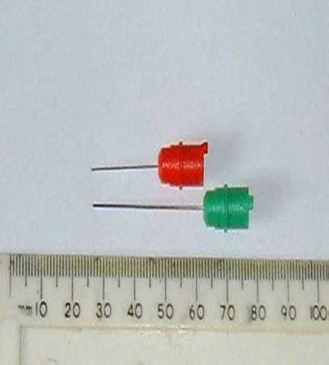
ELECTROMYOGRAPHY (EMG)
It’s a recording of electrical activity of the muscle by inserting needle electrode in the belly of the muscles or by applying the surface electrodes.
The potentials recorded on volitional effort are derived from motor units of the muscle, hence known as motor unit potentials (MUPs).

Slide 22
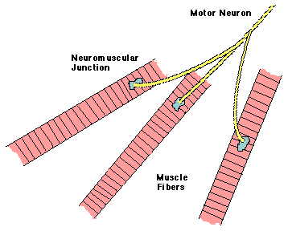
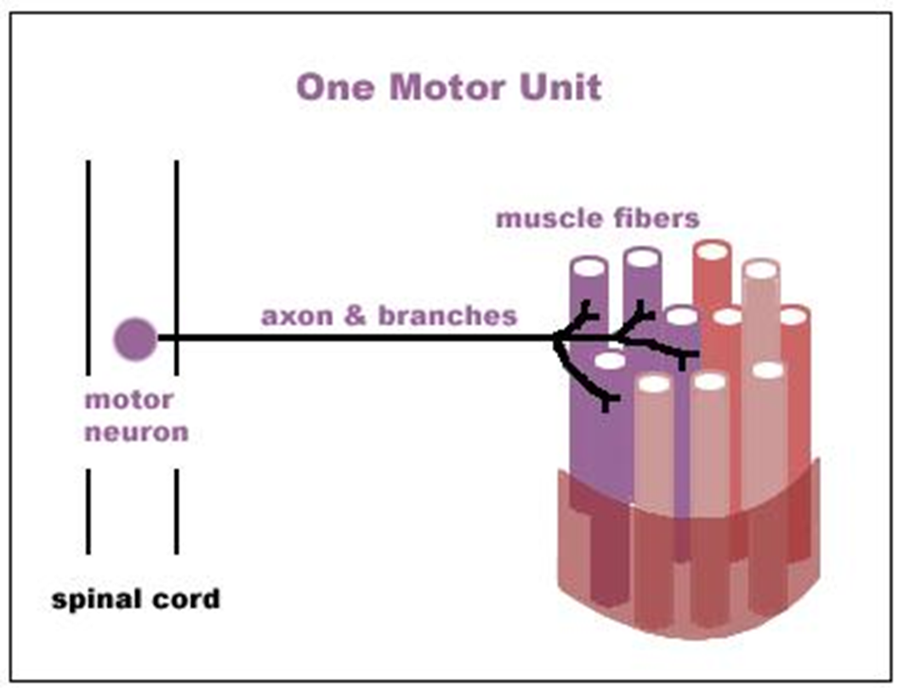
A motor unit is defined as one motor neuron and all of the muscle fibers it innervates.
Notes:
A motor unit is defined as one motor neuron and all of the muscle fibers it innervates. When a motor unit fires, the impulse (called an action potential) is carried down the motor neuron to the muscle. The area where the nerve contacts the muscle is called the neuromuscular junction, or the motor end plate. After the action potential is transmitted across the neuromuscular junction, an action potential is elicited in all of the innervated muscle fibres of that particular motor unit. The sum of all this electrical activity is known as a motor unit action potential (MUAP). This electrophysiologic activity from multiple motor units is typically evaluated during an EMG. The composition of the motor unit, the number of muscle fibres per motor unit, the metabolic type of muscle fibres and many other factors affect the shape of the motor unit potentials in the myogram.

Slide 23
Analysis
Insertional activity
The electrical activity present as the electrode is passed through muscle cells. These are discharge potentials provoked by the disruption of the cell membrane itself.
-decreased in atrophied muscle or fatty tissue.
- increased in many abnormal conditions that cause membrane instability, such as neuropathies, radiculopathies, and inflammatory myopathies.
Spontaneous activity
The skeletal muscle is silent at rest, hence spontaneous activity is absent.

Slide 24
Normal MUPs
Morphology: Bi – Triphasic
Duration – 3 – 15 mSec.
Amplitude – 300μV – 5 mV

Slide 25
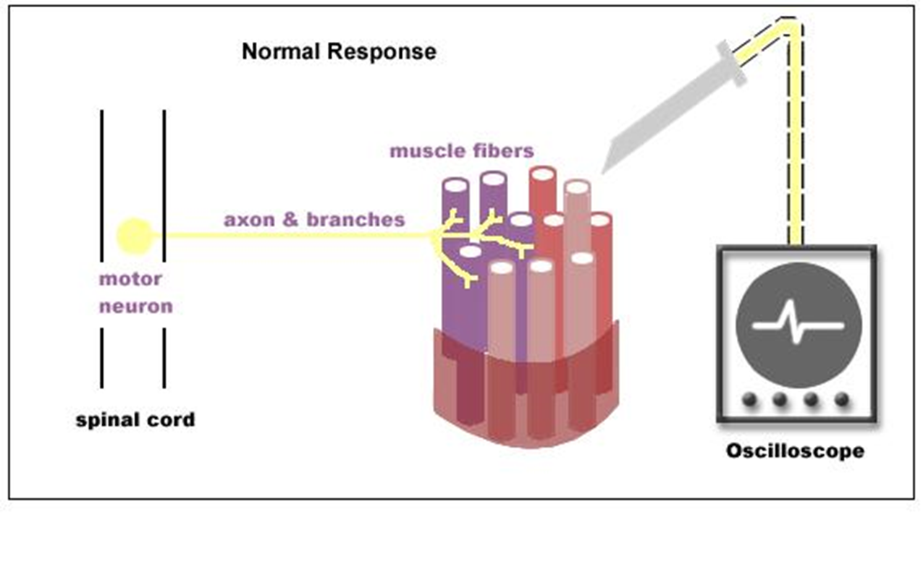
During Full Voluntary Effort .
There is full recruitment ( you
can not see the baseline )
During Moderate Effort → note recruitment of additional motoneurons

Slide 26
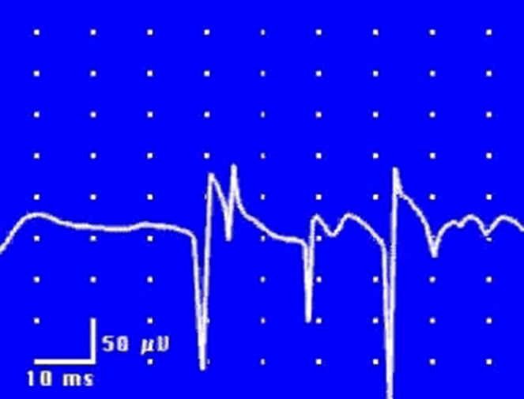
Abnormal MUPs
Presence of resting activity in form of:
1- Positive sharp wave:
A small potential of 50 to 100 µV, 5 to 10 msec duration with abrupt onset and slow outset. It is the earliest manifestation of axonal denervation .

Slide 27
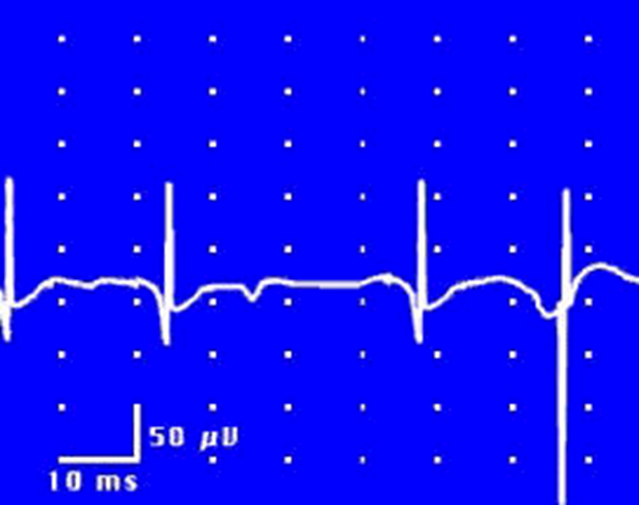
Cont…
2- Fibrillation potential:
These are randomly occurring small amplitude potentials or may appear in runs. The audioamplifier gives sounds, as if somebody listen sounds of rains in a tin shade house. These potentials are generated from the single muscle fiber of a denervated muscle, possibly due to denervation hypersensitivity to acetyl choline.
They are not visible through the skin
Fibrillations are not found exclusively in neurogenic disease, however; they also occur in inflammatory and dystrophic muscle disease.

Slide 28
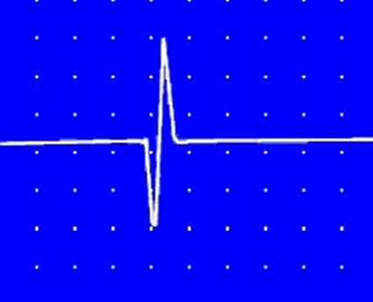
Cont…
3- Fasciculation potentials:
These are high voltage, polyphasic, long duration potentials appear spontaneously associated with visible contraction of the muscle.
May be benign and they occur in motor neuron disease, radiculopathy and neuropathy

Slide 29
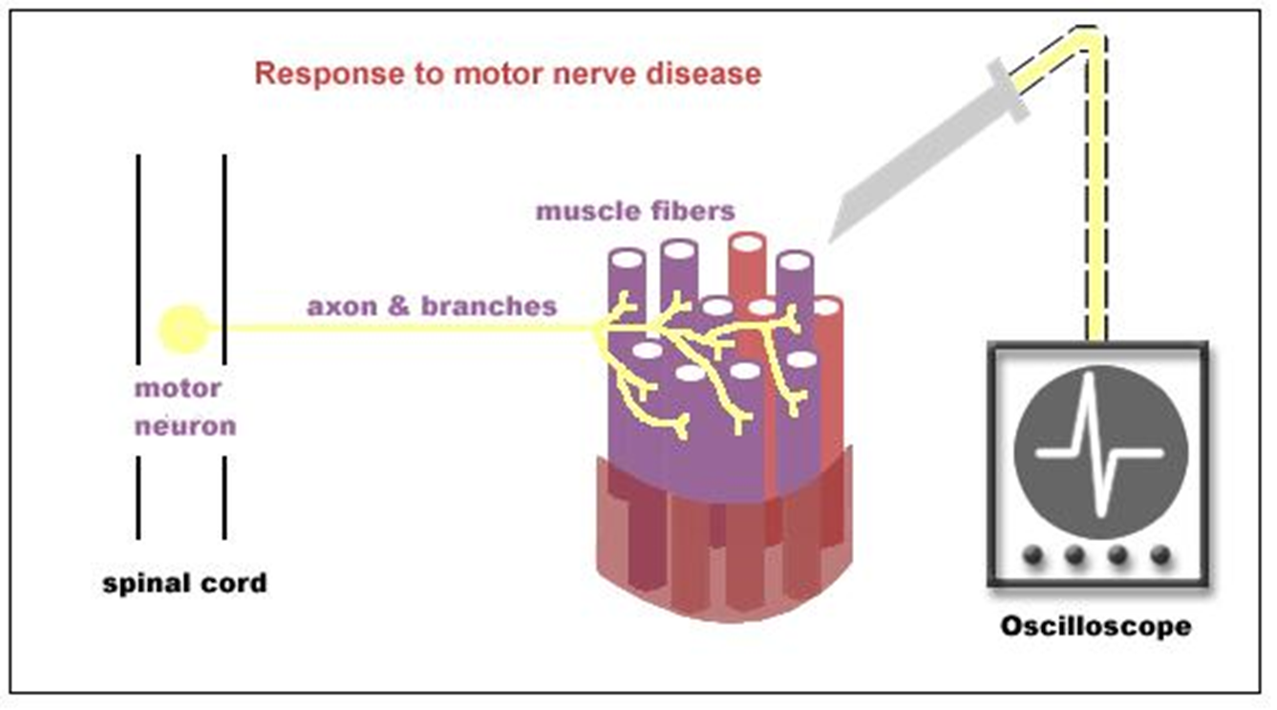
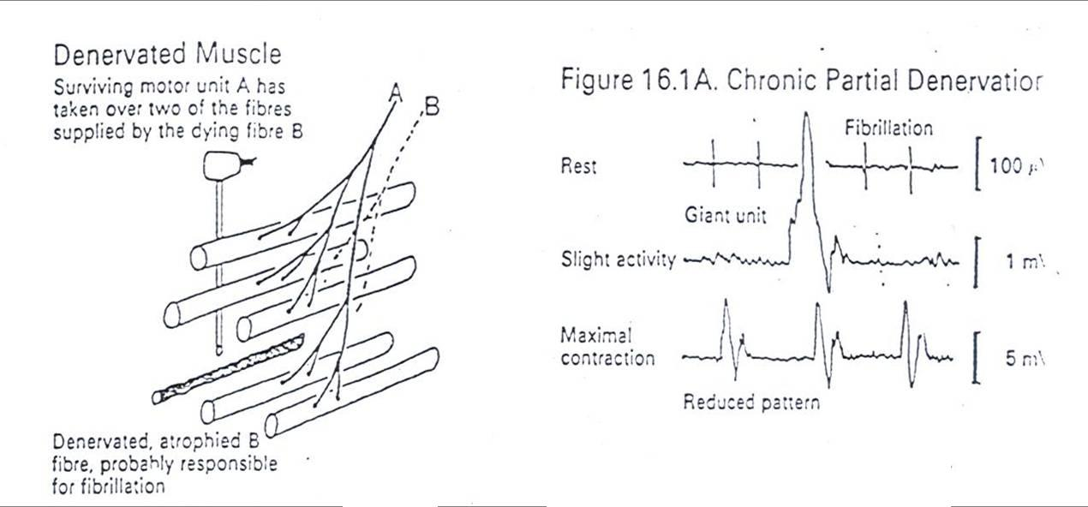
Neuropathic EMG changes

Slide 30
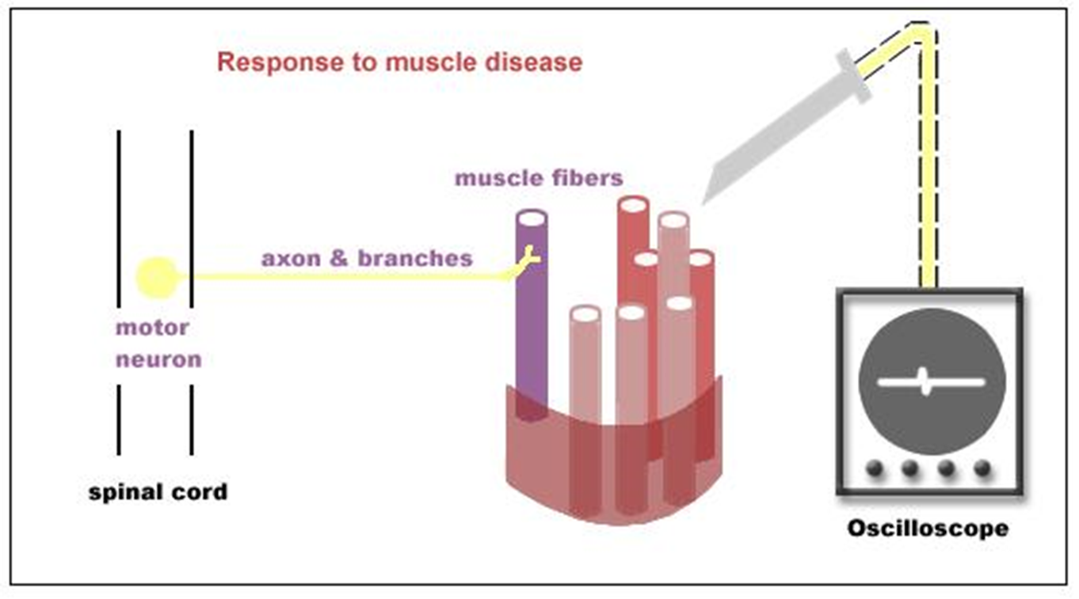
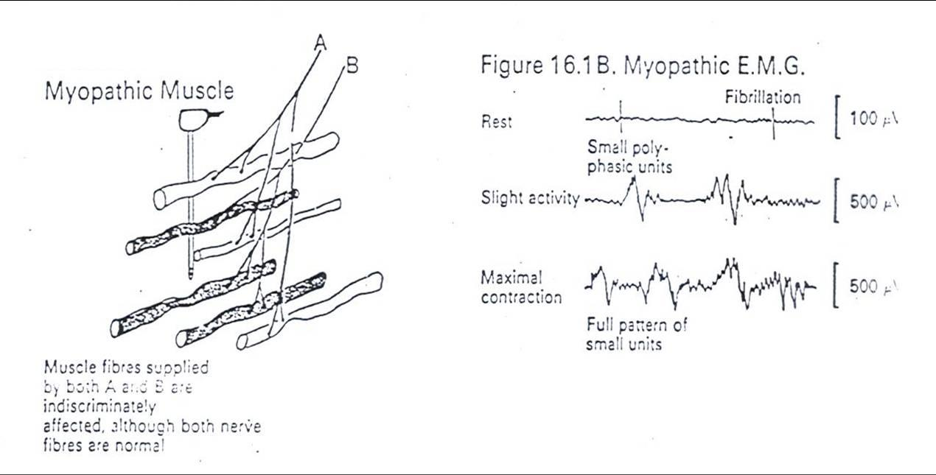
Myopathic EMG changes

Slide 31
Analysis of a motor unit potential (MUP)
MUP | NORMAL | NEUROGENIC | MYOPATHIC
Duration msec. | 3 – 15 msec | longer | Shorter
Amplitude | 300 – 5000 µV | Larger | Smaller
Phases | Biphasic / triphasic | Polyphasic | polyphasic
Resting Activity | Absent | Present | Present
Interference pattern | full | partial | Full

Slide 32
Typical MUAP characteristics in myopathic, neuropathic & normal muscle
MUP | Myopathy | Normal | Neuropathy
Duration | < 3 msec | 3 – 15 msec | > 15 msec
Amplitude | < 300 µV | 300-5000 µV | > 5 mV
configuration | polyphasic | triphasic | Polyphasic

Slide 33
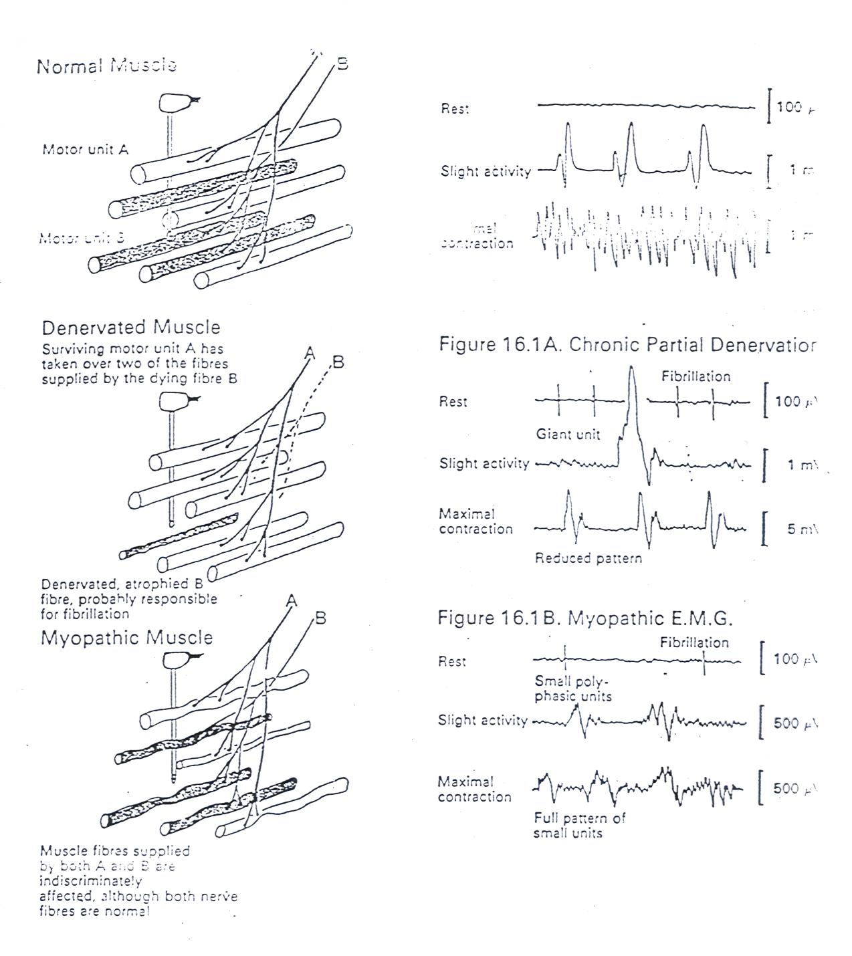

Slide 34
Thank you

