Slide 1
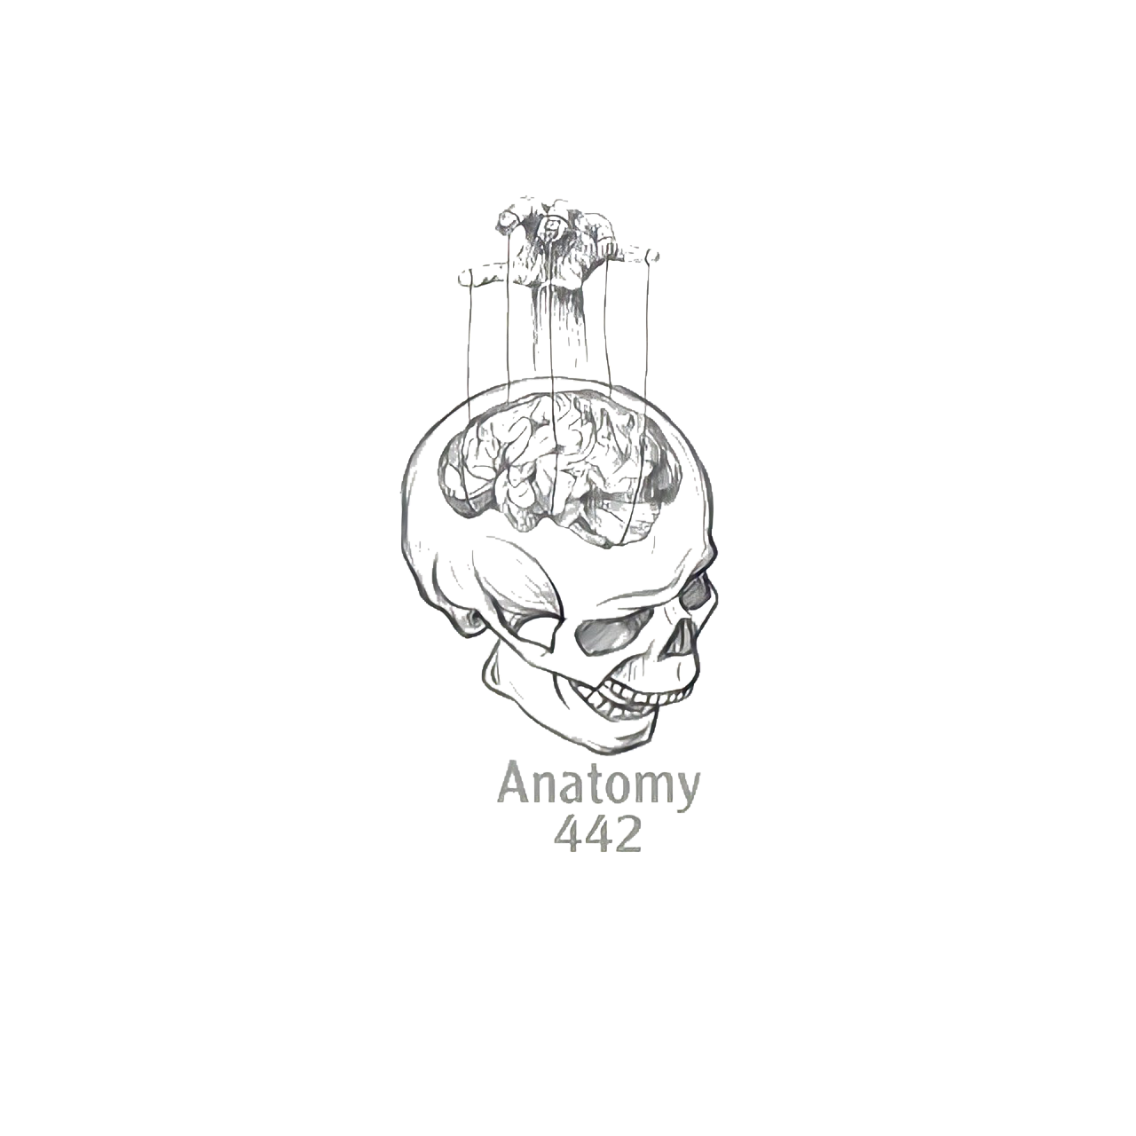
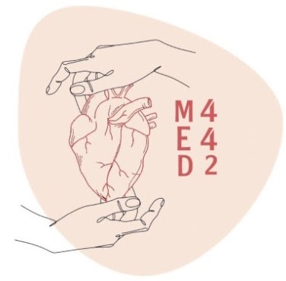
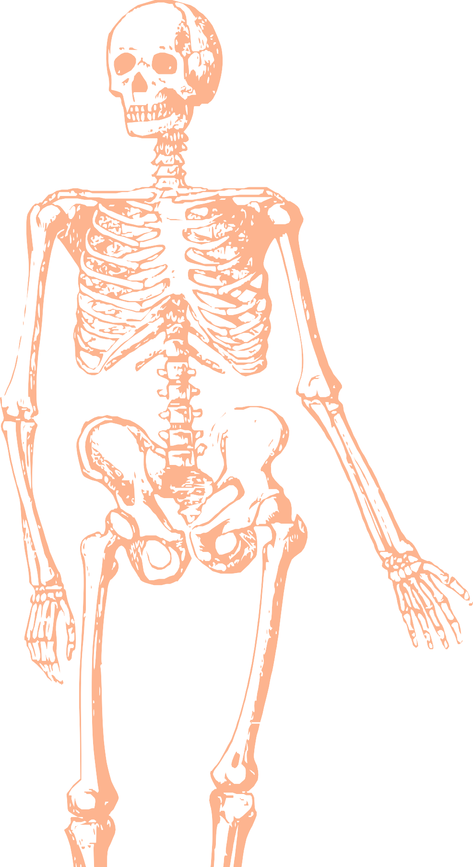
L1
Bones of upper and lower limbs
Editing file
Color index:
Mine text
Important
Doctors notes
Female slides only
Male slides only
Extra

Slide 2
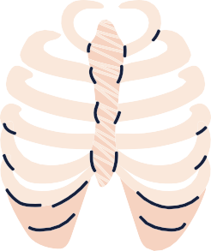
Objectives
By the end of this lecture you should be able to:
Classify the bones of the three regions of the upper and lower limb.
Memorize the main features of the
Bones of the arm (humerus), of the thigh (femur & patella)
Bones of the forearm (radius & ulna), of the leg (tibia & Fibula).
Bones of the hand ( carpal, metacarpal, phalanges), of the foot (tarsals, metatarsals and phalanges)
Recognize the side and position of each bone

Slide 3
Extra slide!! Just to be familiar with the terms, thanks for MED439
Terms | Meaning | Examples
Ridge | The long and narrow upper edge, angle, or crest of something | The supracondylar ridges (in the distal part of the humerus)
Notch | An indentation, (incision) on an edge or surface | The trochlear notch (in the proximal part of the ulna)
Tubercles | A nodule or a small rounded projection on the bone | (Dorsal tubercle in the distal part of the radius)
Fossa | A hollow place (The Notch is not complete but the fossa is complete and both of them act as the lock of the joint | Subscapular fossa (in the concave part of the scapula)
Tuberosity | A large prominence on a bone usually serving for the attachment of muscles or ligaments ( is a bigger projection than the Tubercle ) | Deltoid tuberosity (in the humorous) and it connects the deltoid muscle
Processes | A V-shaped indentation (act as the key of the joint) | Coracoid process ( in the scapula )
Groove | A channel, a long narrow depression sure | Spiral (Radial) groove (in the posterior aspect of the humerus)
Interosseous border | Between bones ( the place where the two parallel bones attach together by the interosseous membrane ) | Lateral interosseous sharp end of the ulna
Spine | Thick projecting ridge of bone | Spine of the scapula
Articulation | Meeting of two bones to make the joints | The articulation between the glenoid cavity and humerus

Slide 4
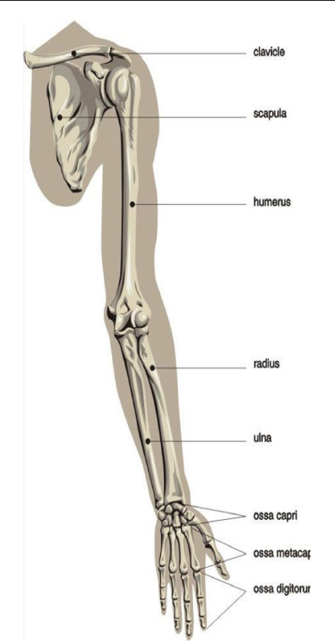
Bones Of The Upper Limb
1- Pectoral Girdle:
Clavicle
Scapula
2- Arm:
Humerus
3- Forearm:
Ulna
Radius
4- Wrist:
Carpal bones
5- Hand:
Metacarpals
Phalanges
DR’s note:
أكثر مفصل يعطي حرية بالحركة هو مفصل الكتف
Hip joint أكثر من ال

Slide 5
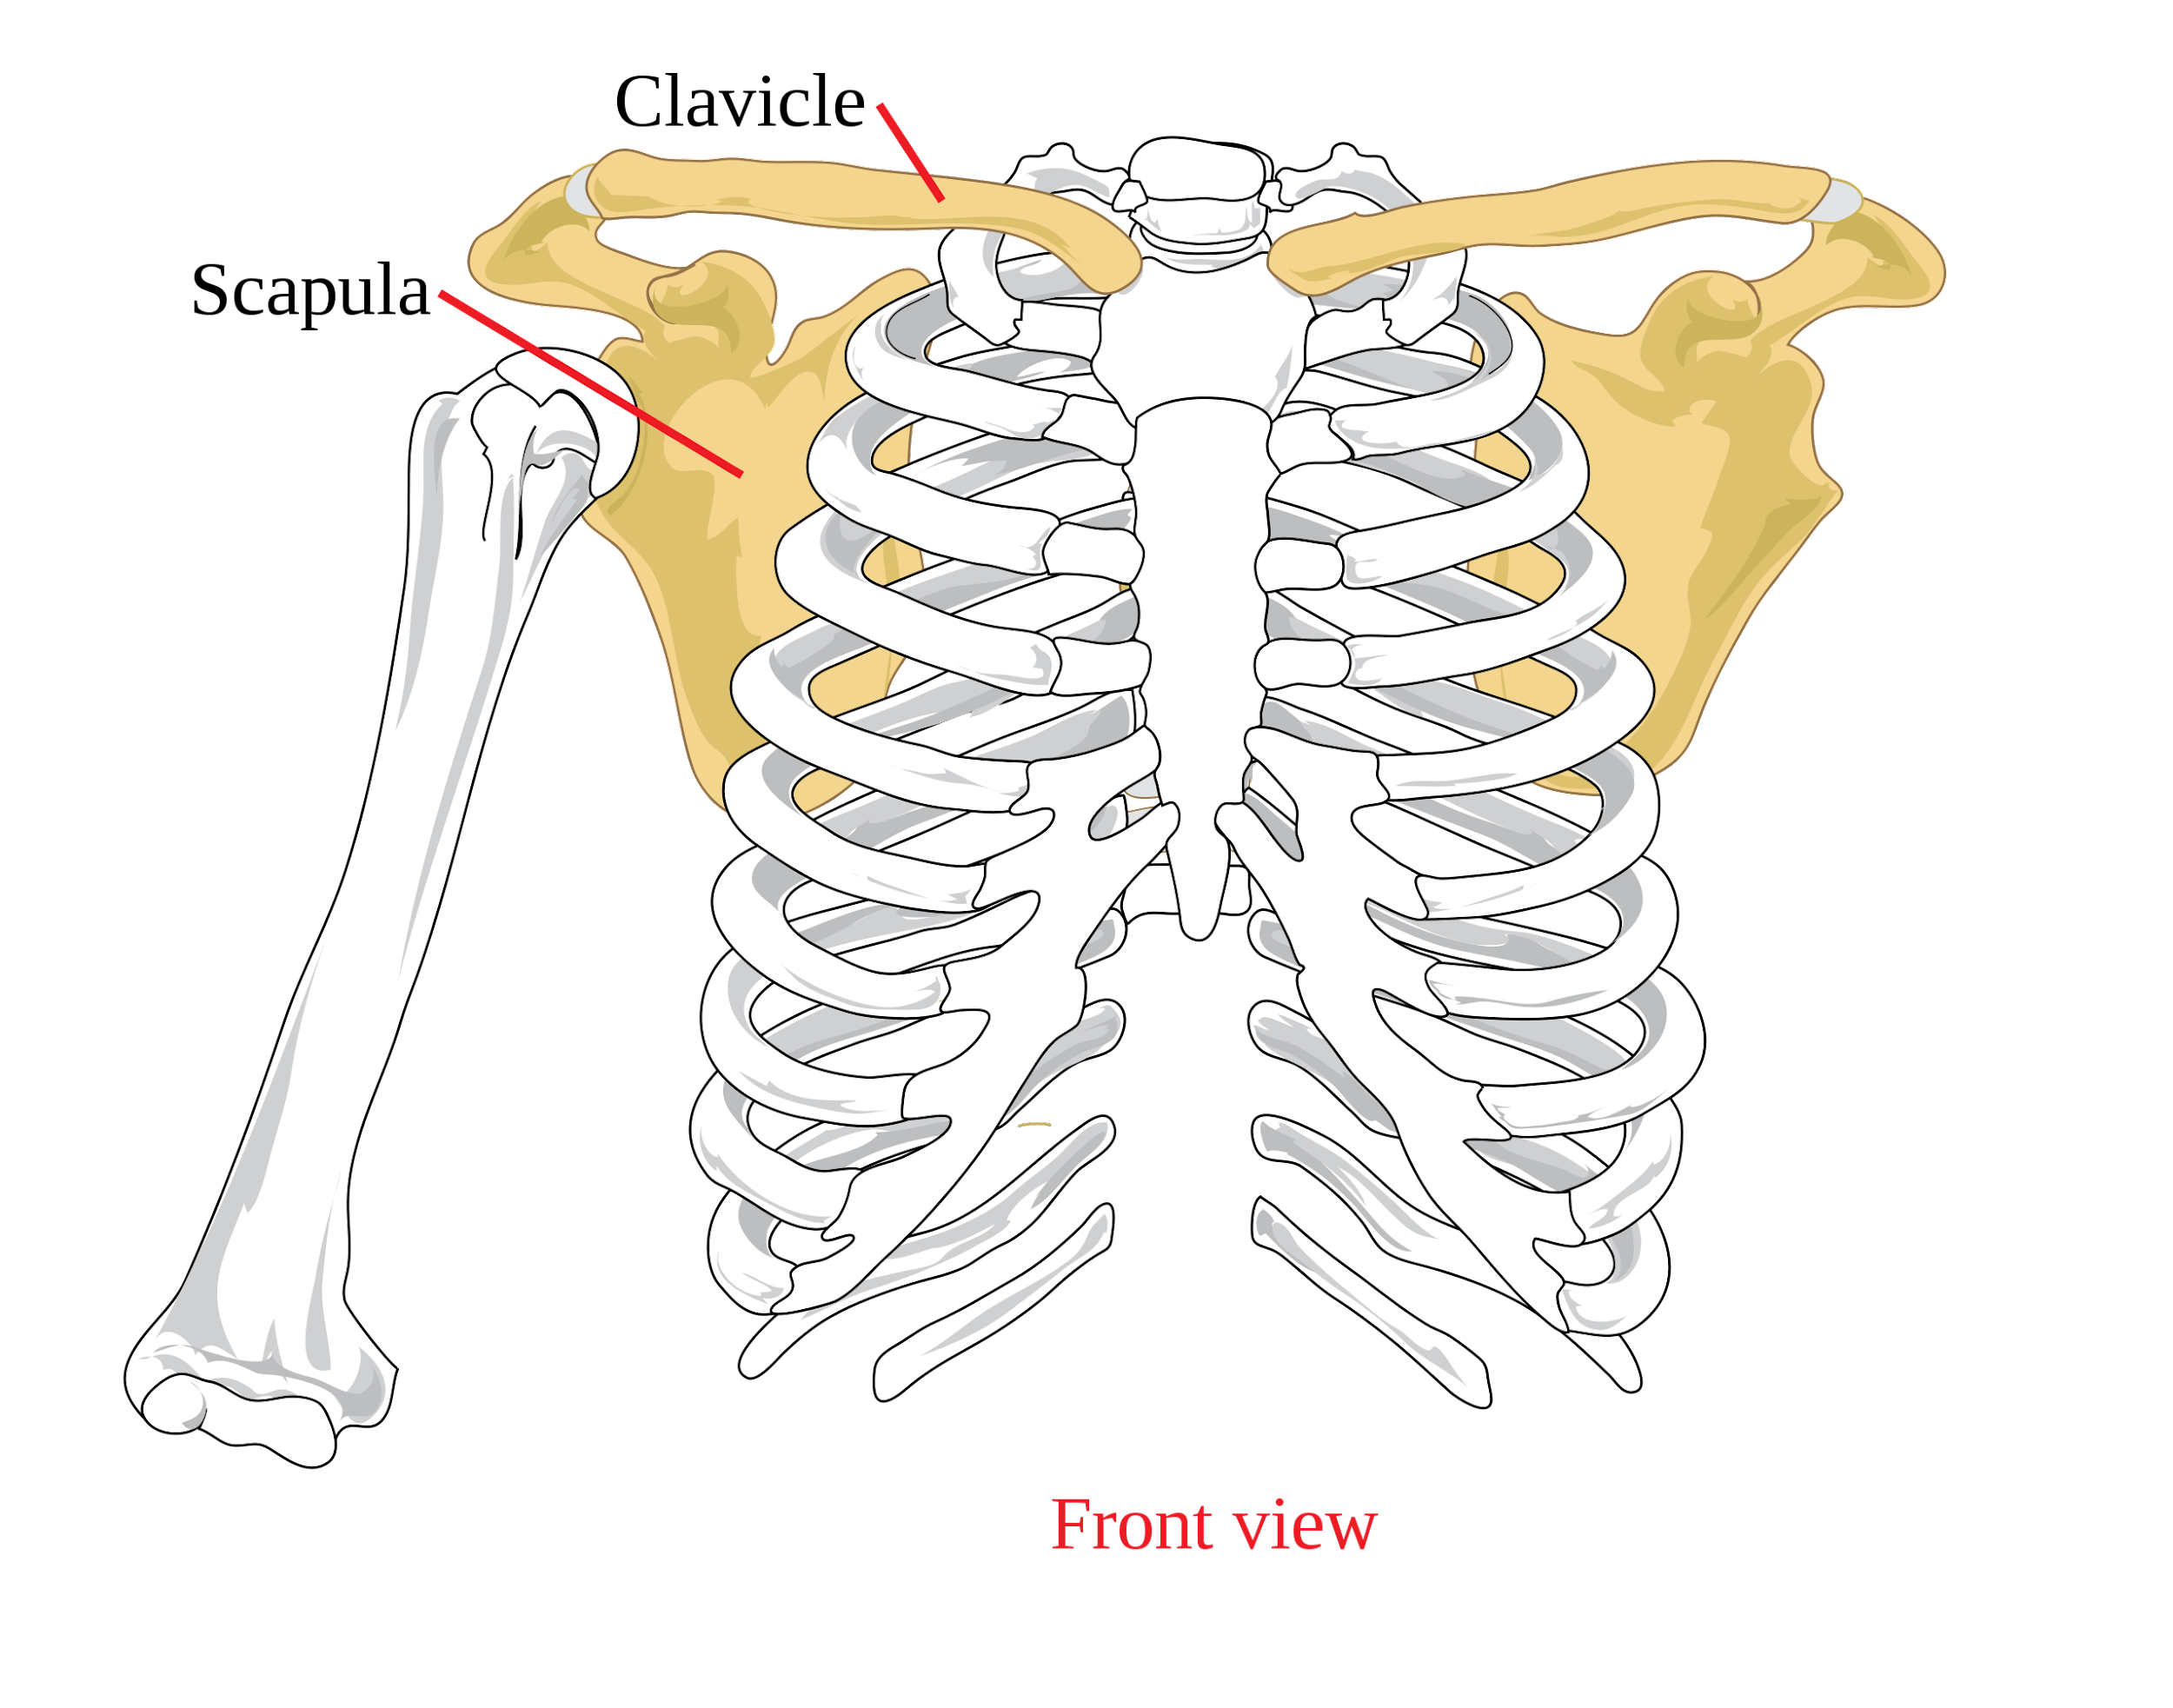
Pectoral Girdle: It is very light and allows the upper limb to have exceptionally free movement.
Scapula
Clavicle

Slide 6
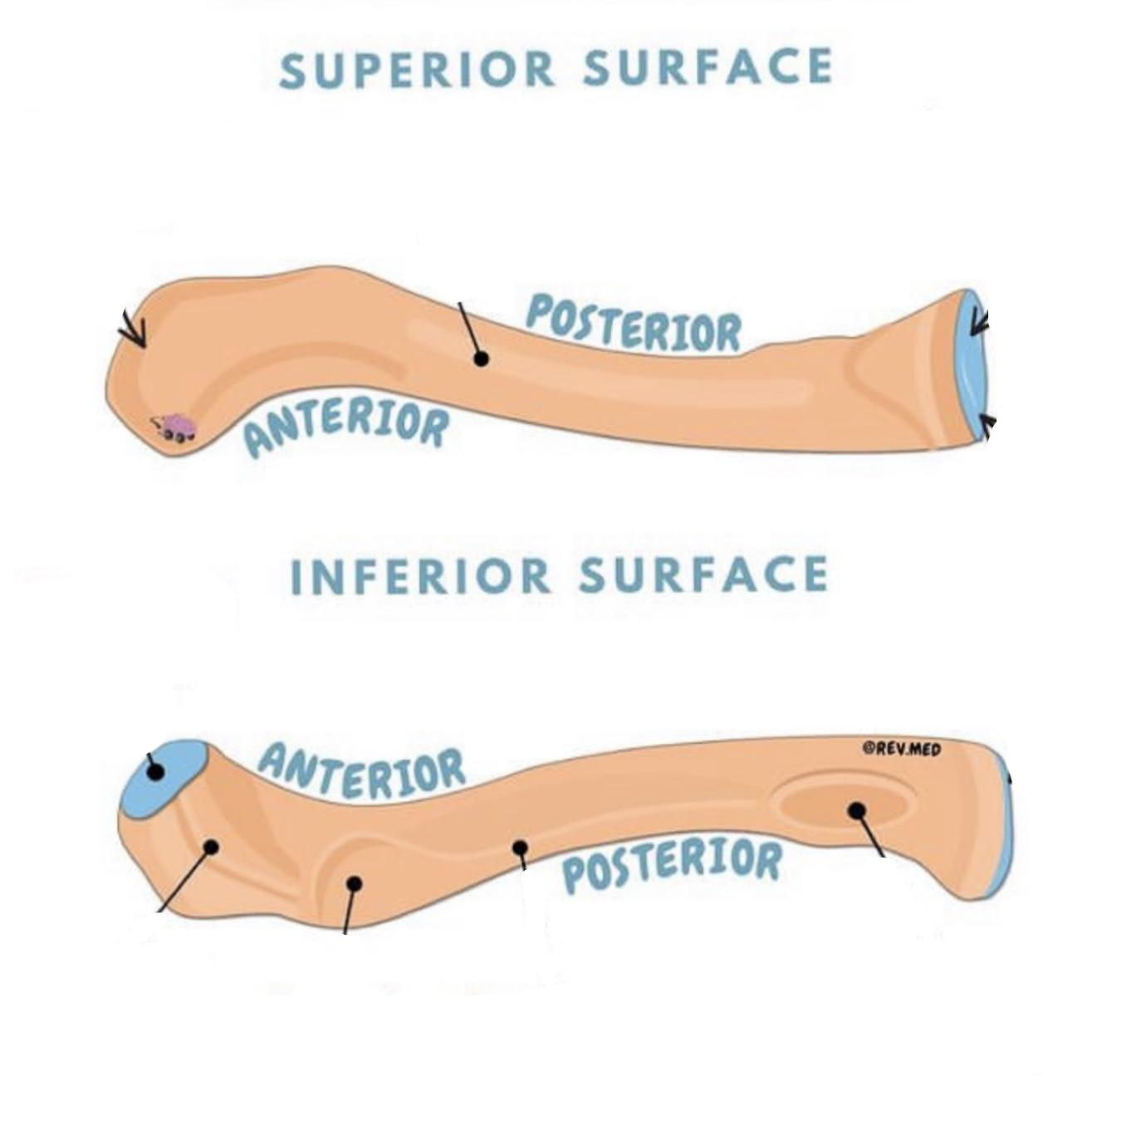
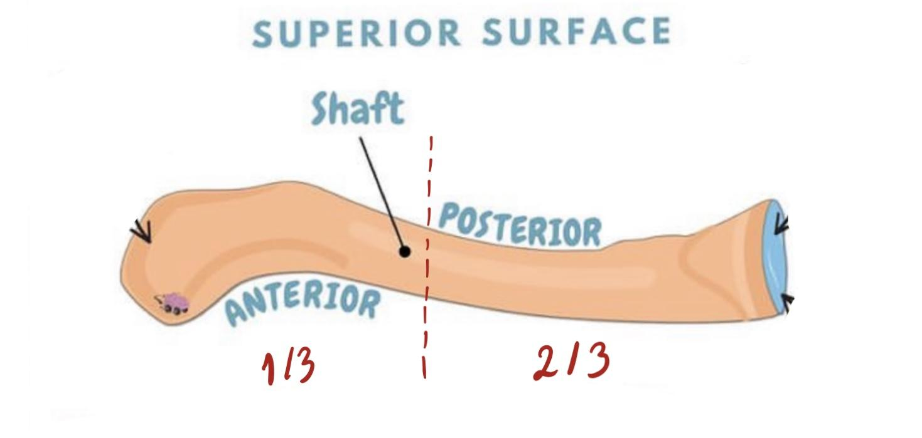
1) Clavicle: It’s a double curved long bone lying horizontally across the root of the neck,It is subcutaneous throughout its length.
Clavicle (anteriorly)
Two Surfaces | Superior: smooth as it lies just deep to the skin. Inferior: rough because strong ligaments bind it to the 1st rib.
Body (Shaft) | Its medial 2/3 is convex forward. Its lateral 1/3 is concave forward .
Two Ends | Medial (Sternal) articulates with the sternum: enlarged & triangular. Lateral (Acromial) articulates with acromion of the scapula: flattened.

Slide 7
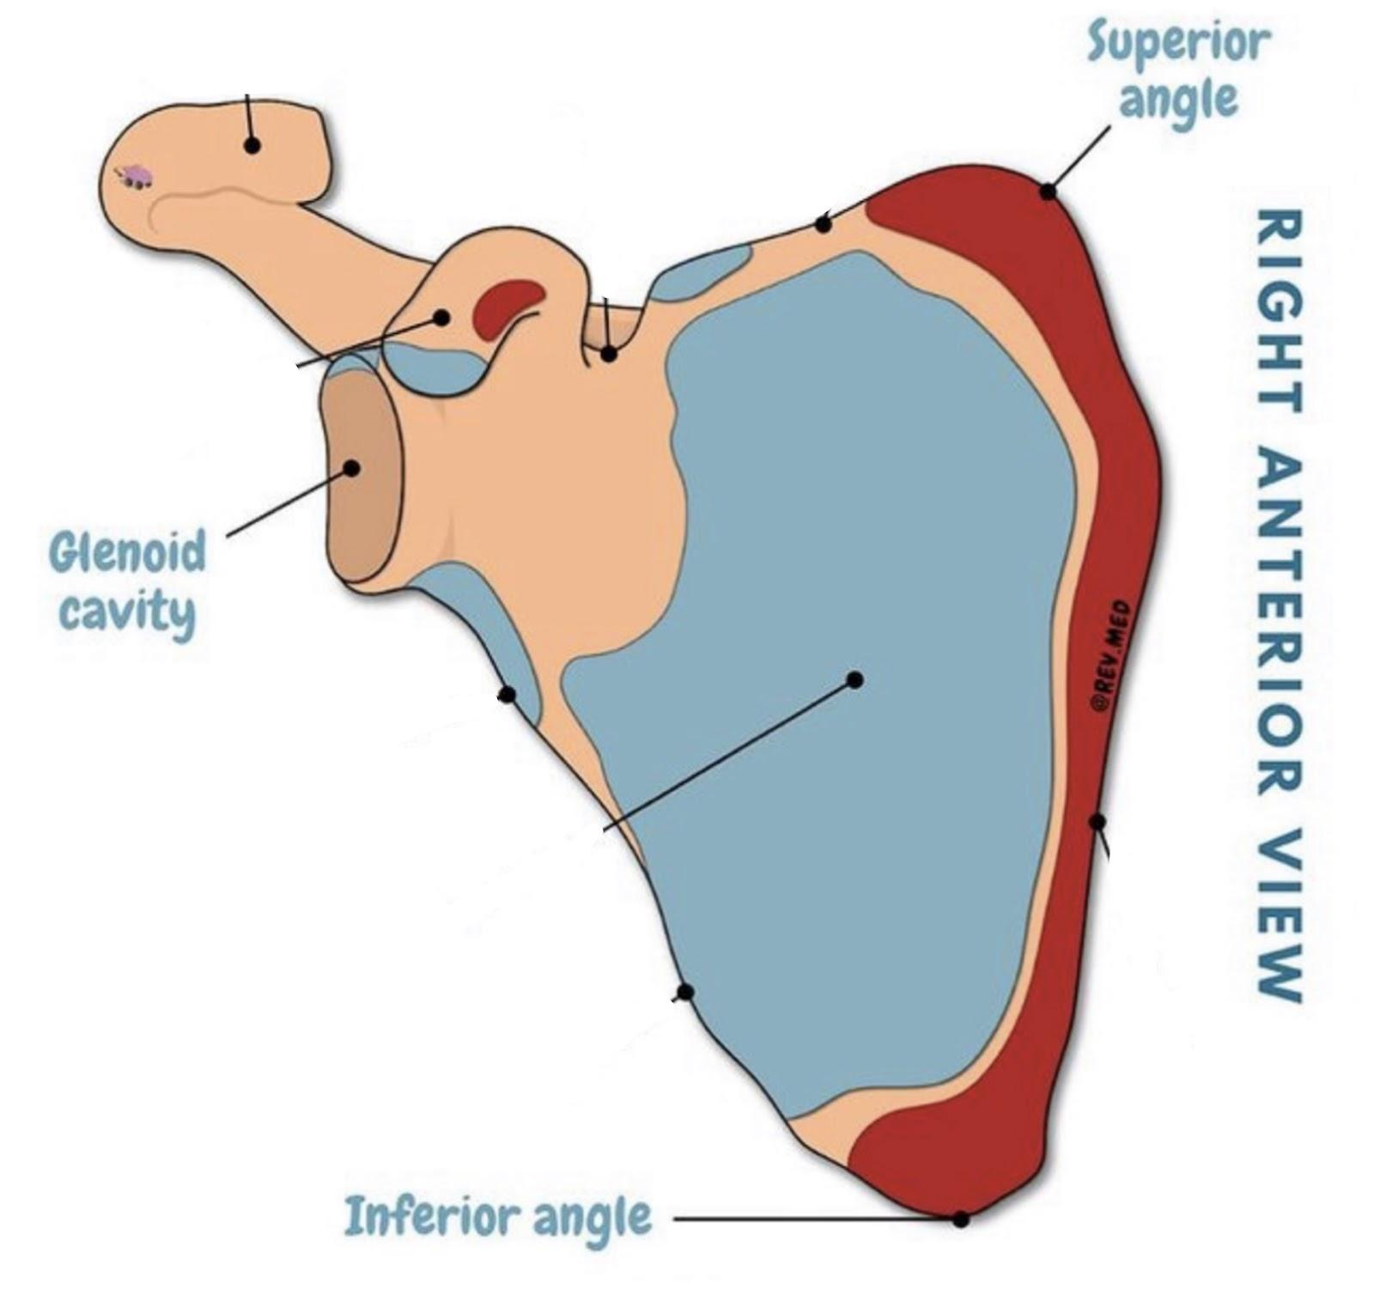
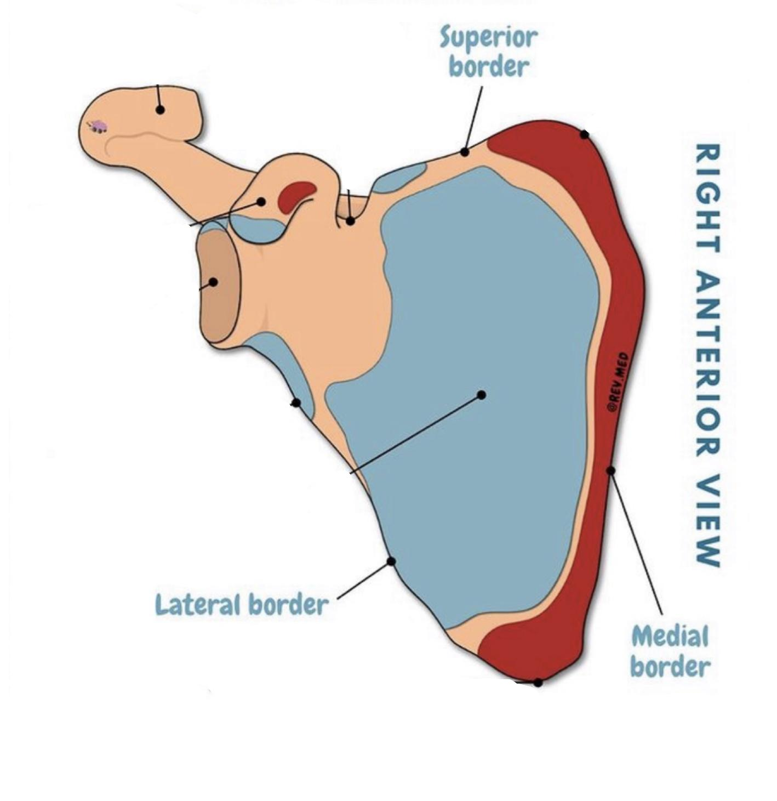
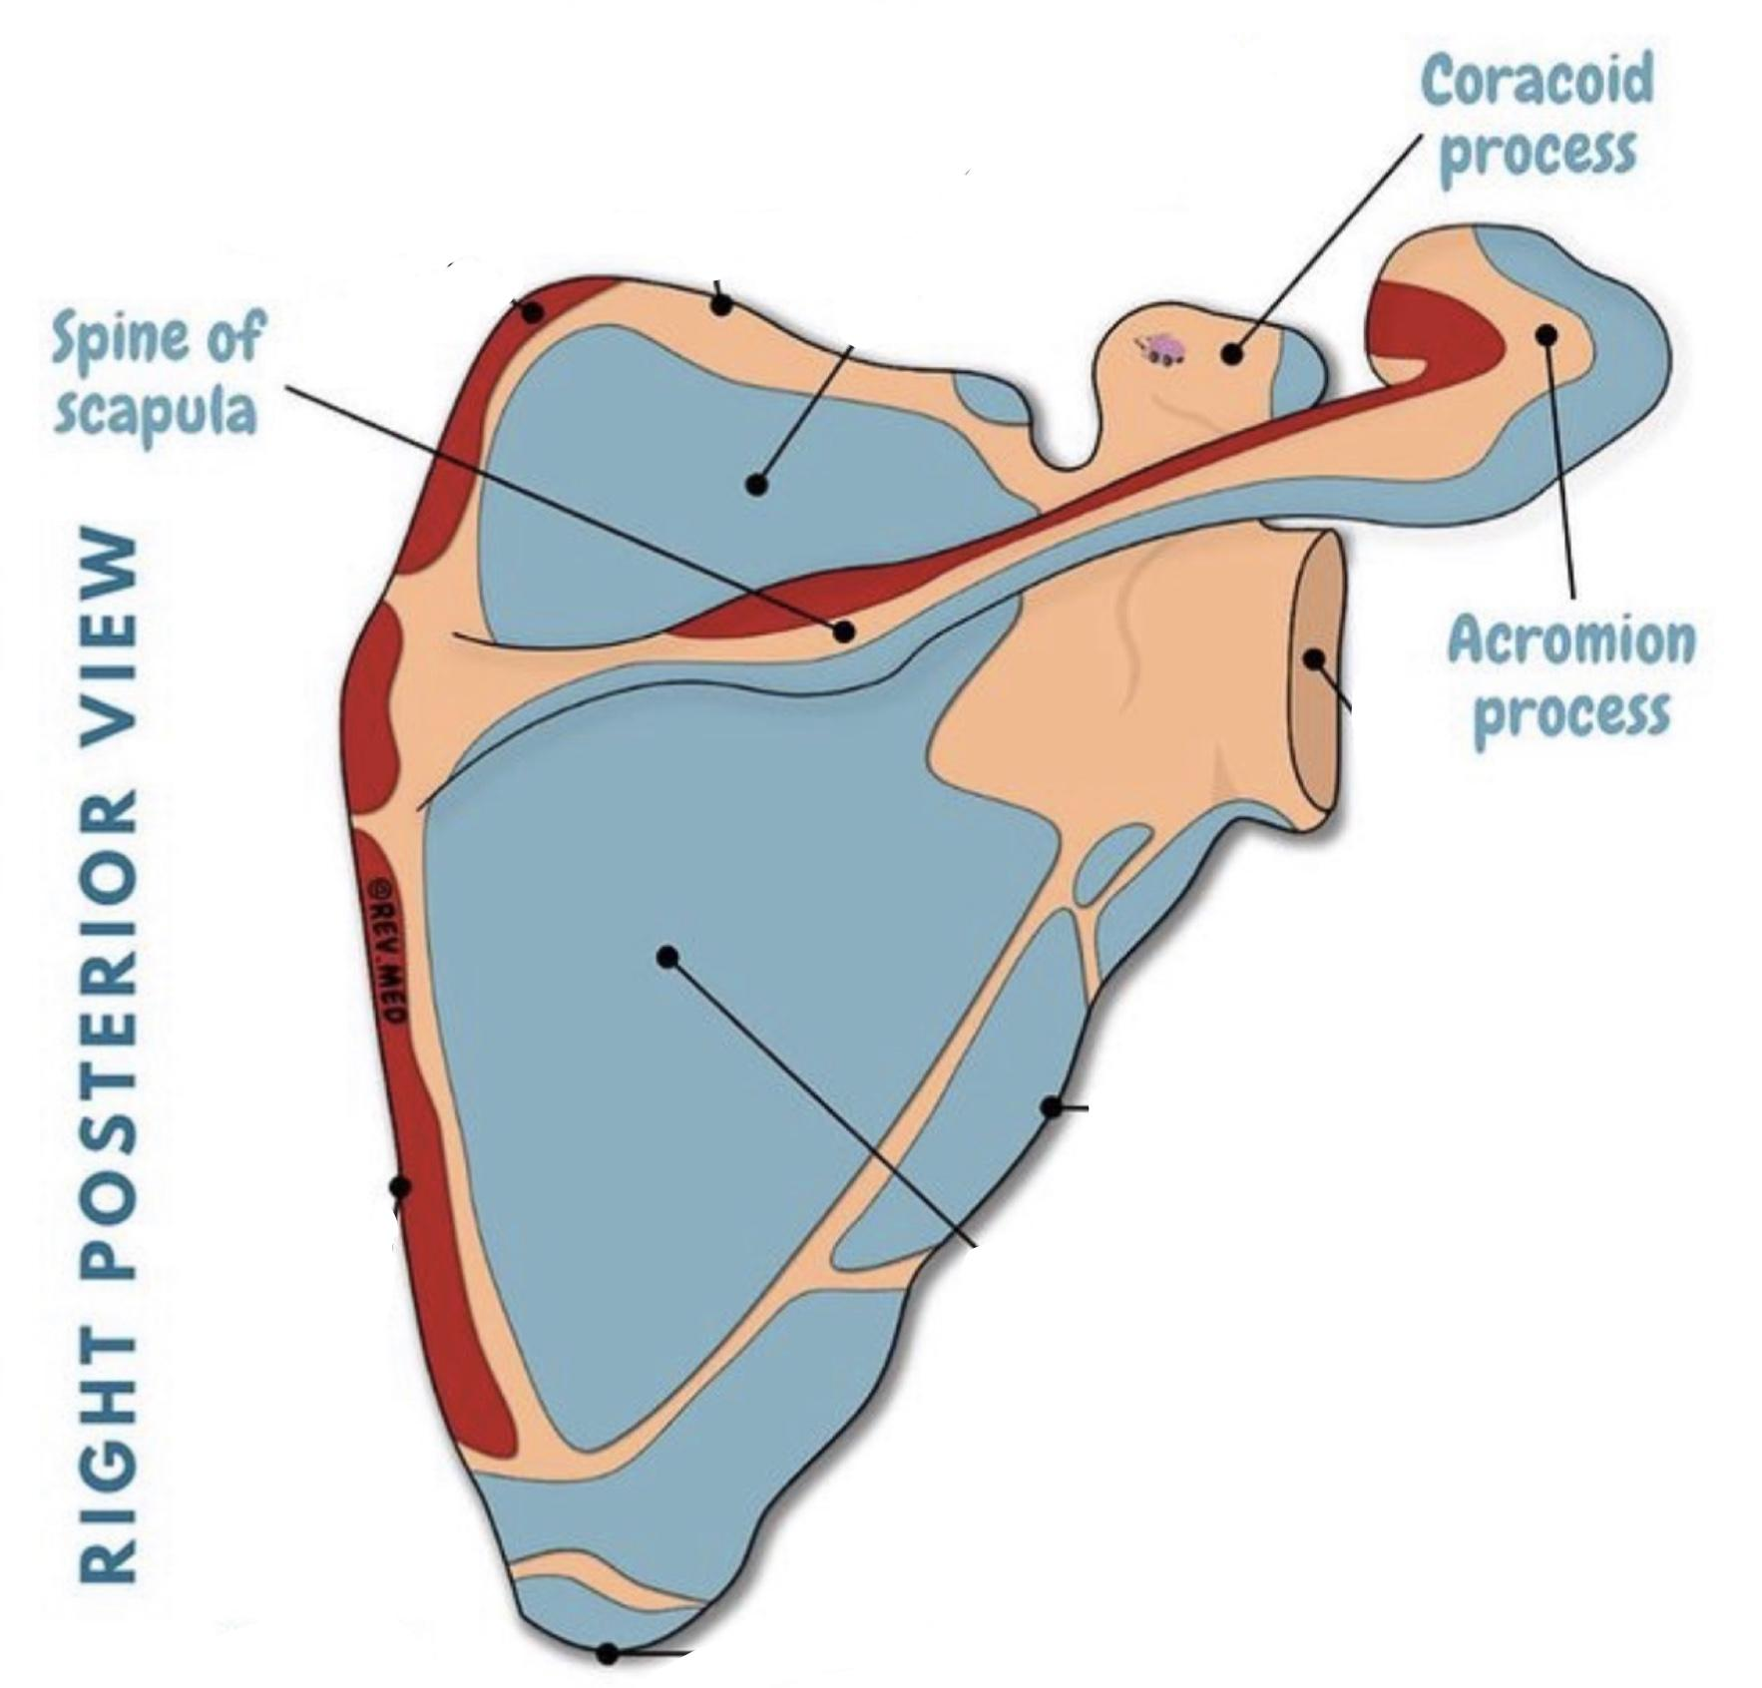
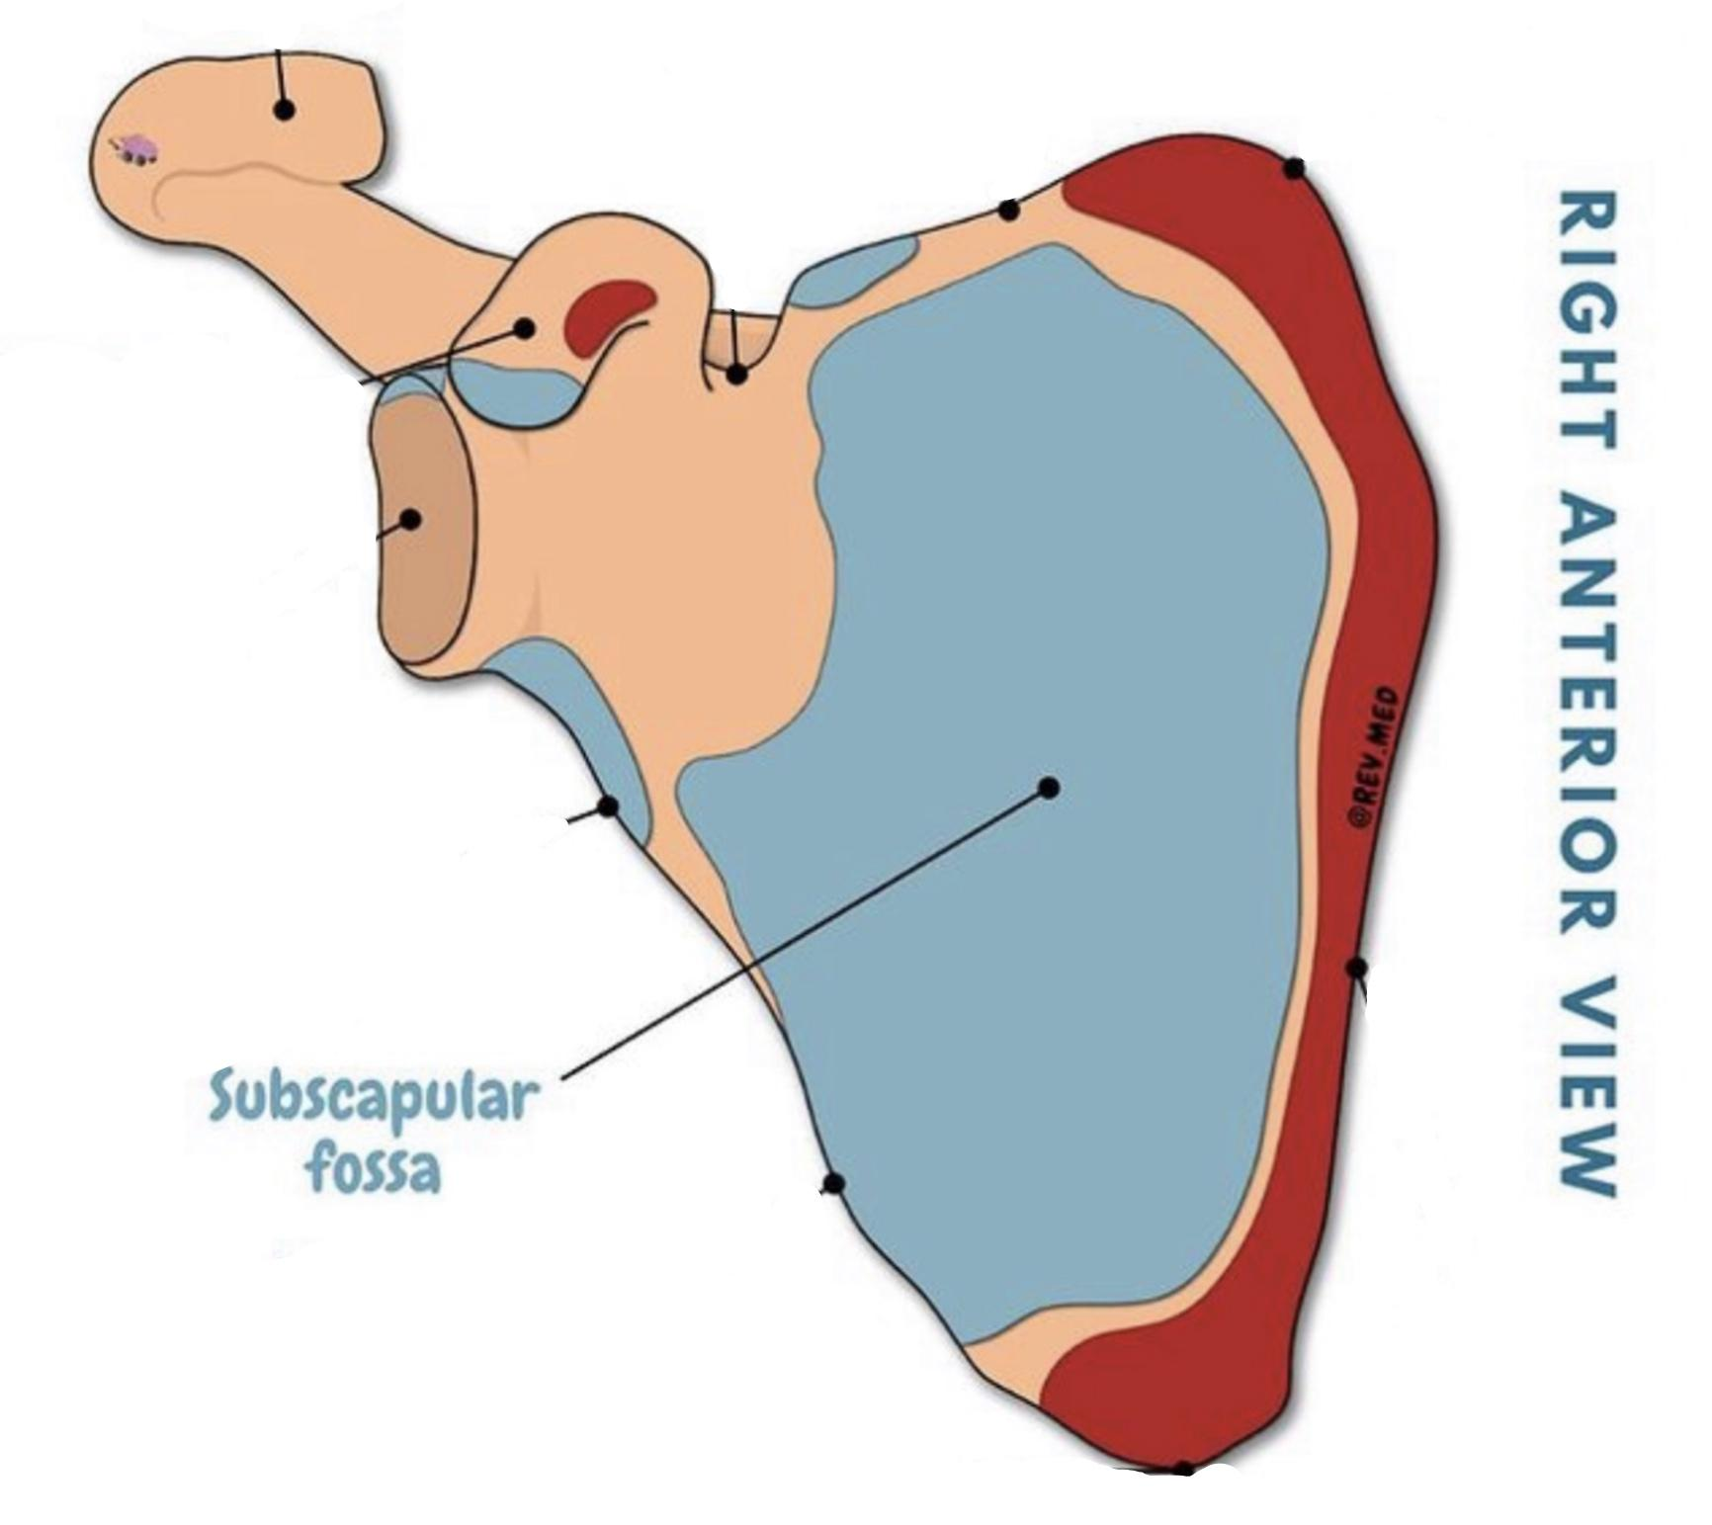
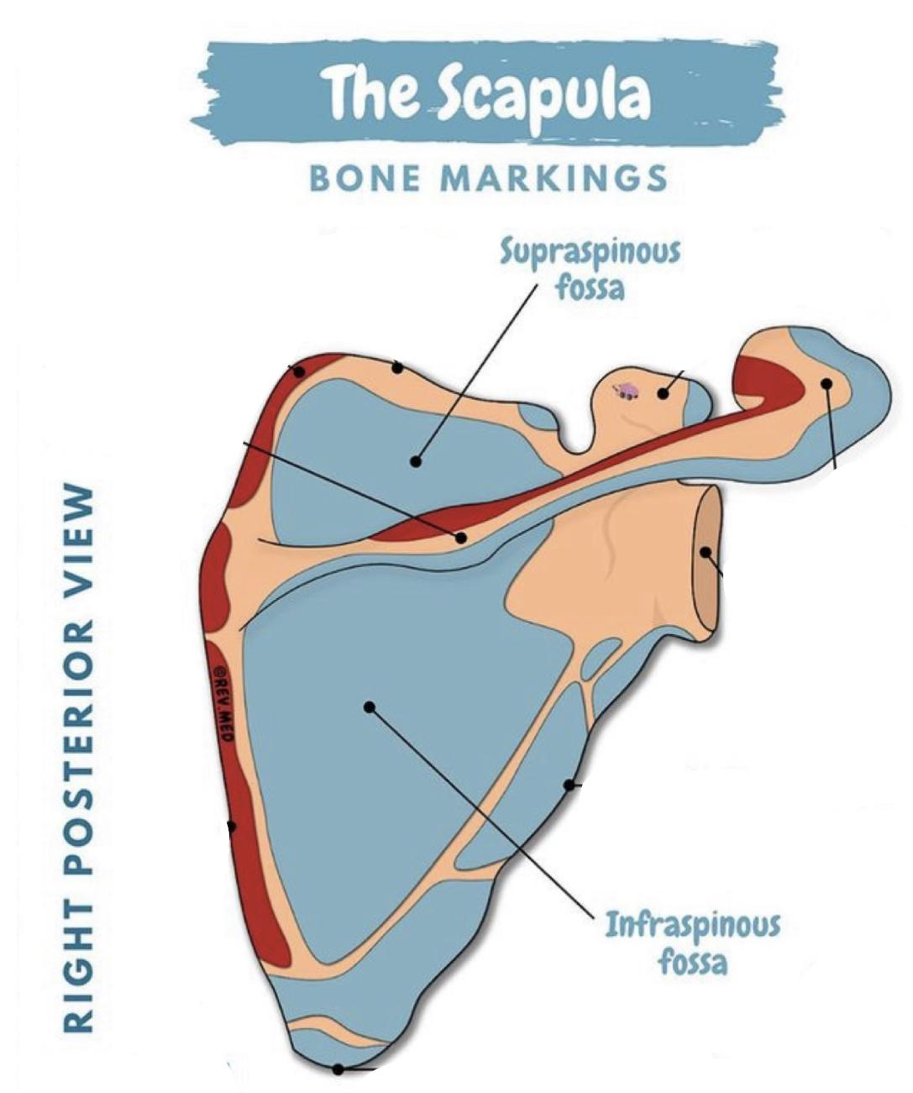
2) Scapula: It’s a triangular, flat bone that extends between the 2nd and 7th ribs
Two Surfaces | Three Angles (sharp edges) | Three Borders (sides) | Three Processes
1- Convex posterior divided into: -Supraspinous fossa: (smaller and above the spine) -Infraspinous fossa: (larger and below the spine) 2- Concave Anterior (costal): Subscapular fossa | 1-Superior 2-Lateral (Forms the Glenoid cavity) here is the articulation between humerus and scapula 3-Inferior | “Triangular” 1-Superior border 2-Medial border (vertebral) 3-Lateral border (Axillary) | 1-Spine 2-Acromion 3-Coracoid
1 2

Slide 8
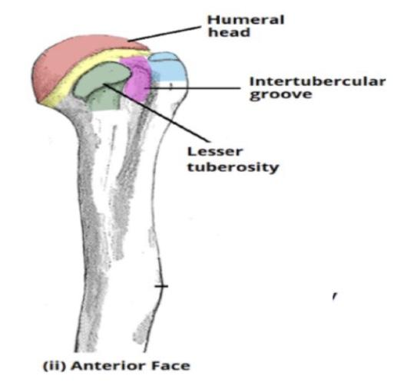
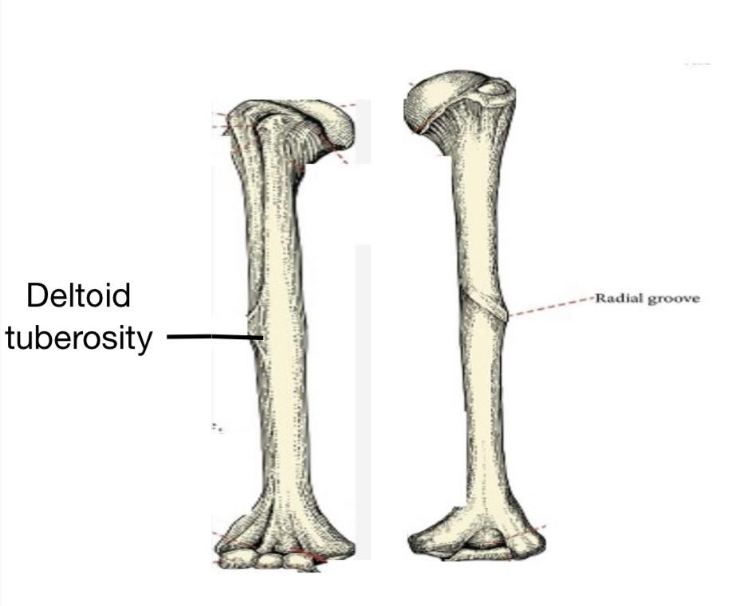
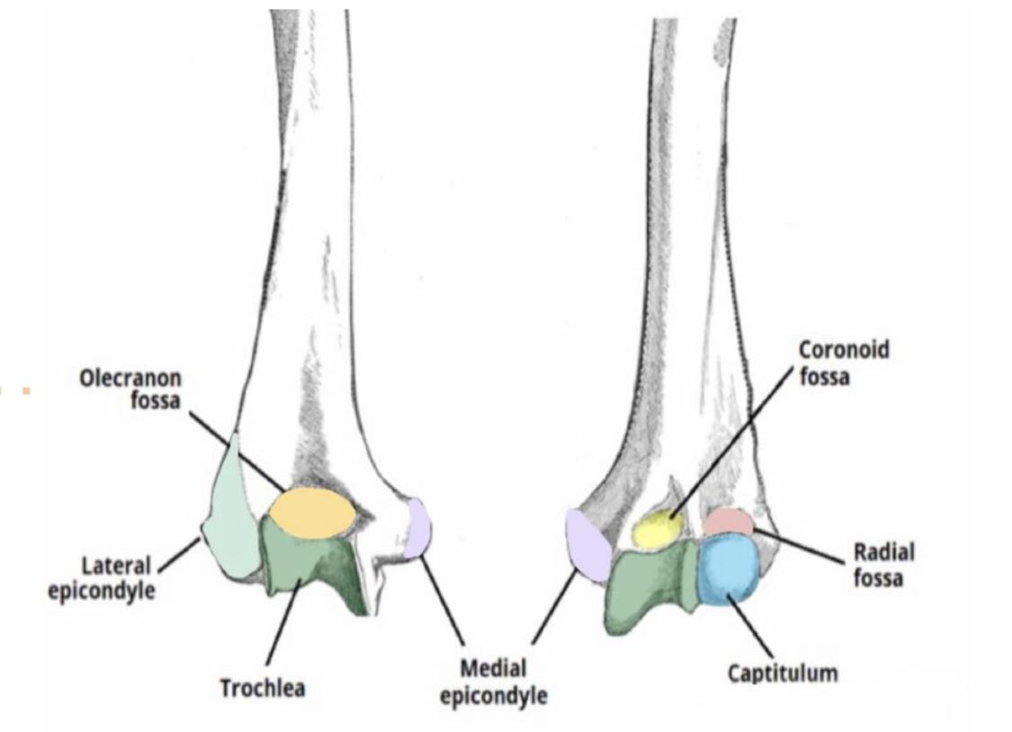
Bone of the arm + forearm
Humerus (Typical Long bone)
Proximal End |  | Shaft (Body) | Distal End
1.Head: Articulates with the Scapula at the glenohumeral joint (shoulder joint) 2.Anatomical Neck: Formed by a groove separating the head from the tubercles 3.Surgical neck: A narrow part distal to the tubercles 4.Greater Tubercles 5.Lesser Tubercles 6.Intertubercular Groove |  | It has two prominent features: 1. Deltoid tuberosity 2. Spiral (Radial) groove containing radial nerve | 1. Lateral epicondyle 2.Medial epicondyle(can be felt) Anteriorly: 1. Trochlea: (medial) for articulation with the ulna 2. Capitulum: (lateral) for articulation with the radius. 3. Coronoid fossa: above the trochlea. 4. Radial fossa: above the capitulum. Posteriorly: 1. Olecranon fossa: above the trochlea
 |  |  | Posterior
Posterior
Anterior

Slide 9
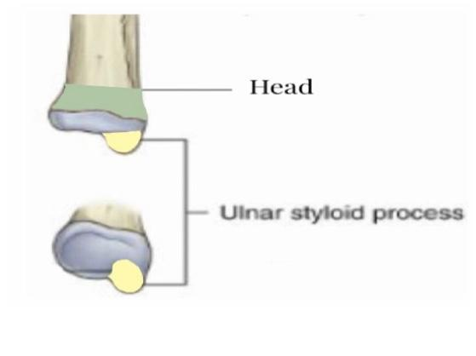
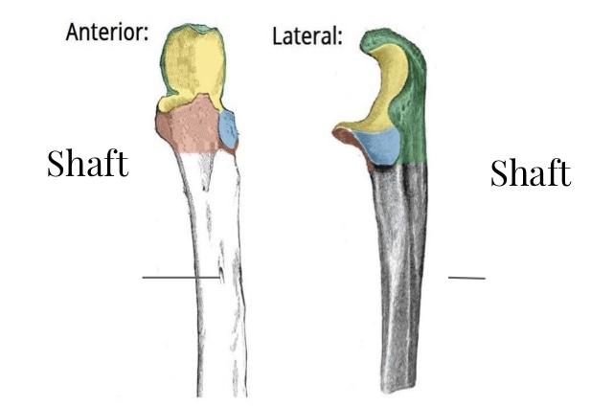
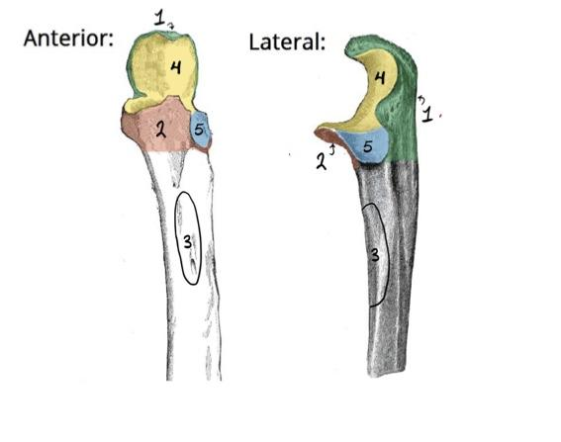
Ulna:It is the stabilizing bone of the forearm.It is the medial & longer of the two bones of the forearm.
Distal End |  | Shaft (Body) | Proximal End
Small rounded 1.Head: lies distally at the wrist 2.Styloid process: medial |  | Thick & cylindrical superiorly but diminishes in diameter inferiorly - it has three surfaces ● Anterior ● Medial ● Posterior Sharp Lateral Interosseous border | 1.olecranon process 2.Coronoid process 3.Tuberosity of ulna 4.Trochlear notch 5.Radial notch

Slide 10
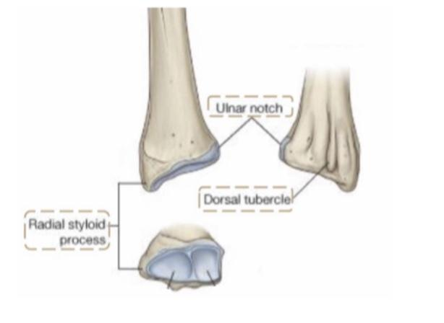
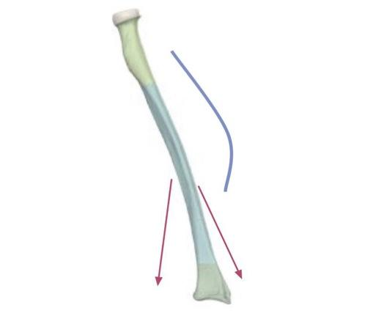
Radius: It is the shorter and lateral of the two forearm bones.
Distal End(lower) |  | Shaft (Body) | Proximal End
It is rectangular 1. Ulnar notch: a medial concavity to accommodate the head of the ulna 2. Radial Styloid Process: extends from the lateral aspects 3. Dorsal tubercle: projects dorsally |  | -It has lateral convexity. -It gradually enlarges as it passes distally. | 1. Head: small & circular. It’s upper surface is concave for articulation with the capitulum. 2.Neck 3.Radial (bicipital) tuberosity,medially directed and separates the proximal end from the body
الجزء المقصود من المحدب

Slide 11
Bones of the wrist and hand:
1) Carpal bones: (bones of the wrist)
A. Composed of eight short bones
B. Divided to:
-Proximal row ( from lateral to medial ) Scaphoid, Lunate, Triquetral & Pisiform bones.
-Distal row ( from lateral to medial ) Trapezium, Trapezoid, Capitate & Hamate
2) Metacarpal bones:
Five metacarpal bones, each has a base(Proximal), shaft, and head(Distal)
3) Phalanges bones:
Fourteen, each digit has three phalanges except the thumb which has only two
Mnemonics:
She Looks Too Pretty Try To Catch Her
سلوى لازم تلعب بوكر تكسب تخسر كله ھلس
نبدأ العد من الإبهام
Clavicle is the most commonly fractured bone in the body. Fractures commonly result from a fall onto the shoulder, or onto an outstretched hand. Most common fractures of humerus in the surgical neck especially in elderly people with osteoporosis. The fracture results from falling on the hand

Slide 12
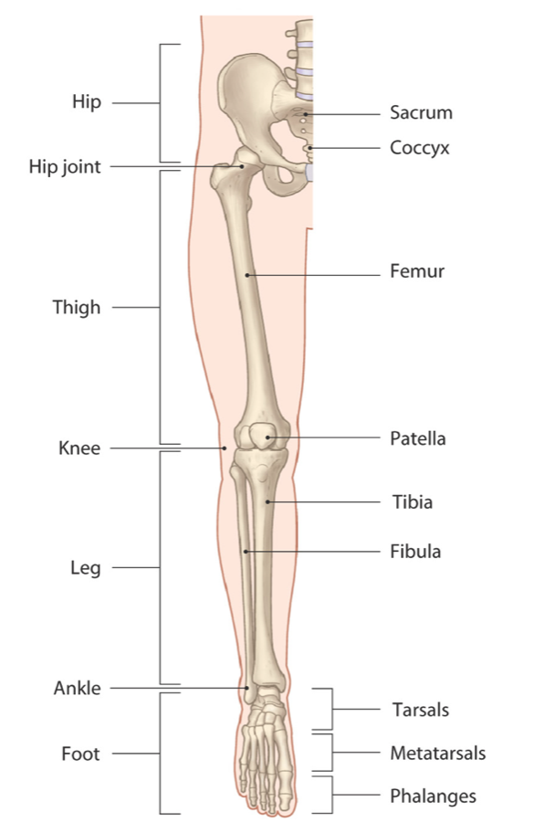
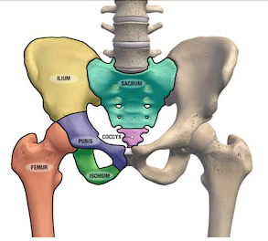
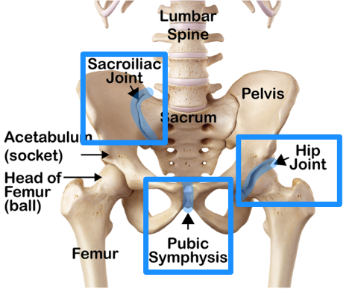
Bones of the Lower Limb
Pelvic Girdle
Note: this is not included in the slides but the Dr said it will be taught in the practical
1-Pelvic Girdle
Hip bone
Sacrum
The pelvis made of:
2 Hip (pelvic) bones
Ilium
Pubis
Ischium
Sacrum
Coccyx
2-Thigh
Femur
Patella
3-Leg
Tibia
Fibula
4-Ankle
Tarsal bones
Hip bone articulations:
Sacroiliac joint
(medial)
Pubic symphysis
(btw two pubic bones)
Hip joint
(with head of femur)
5-Foot
Metatarsals
Phalanges

Slide 13
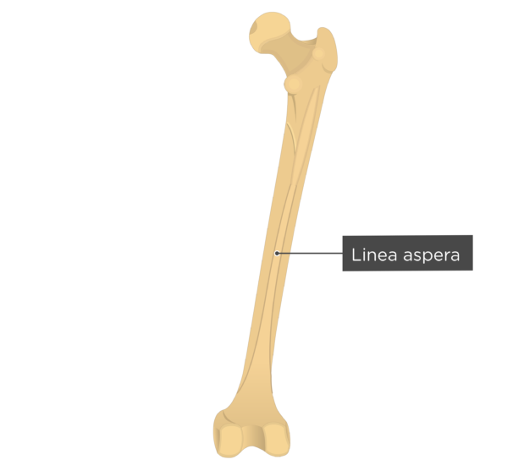
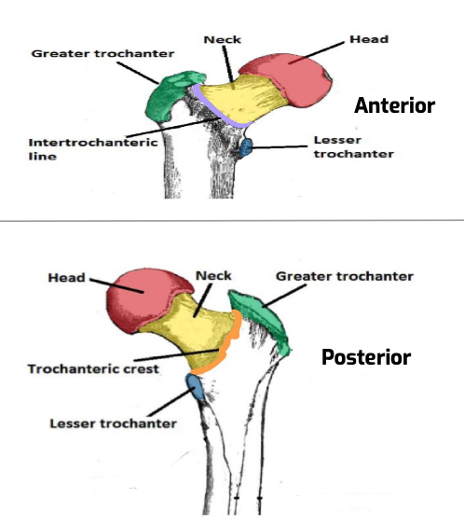
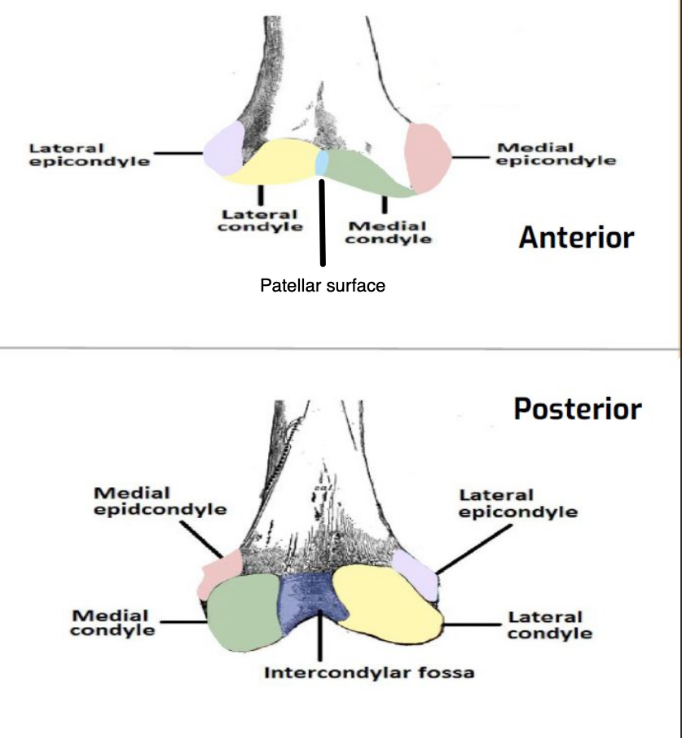
Femur
Articulates above with acetabulum of hip bone to form hip joint
Articulates below with Tibia & Patella to form knee joint
Upper end | Shaft (body) | Lower end
1. Head: articulates with acetabulum of hip bone to form hip joint. 2. Neck: connects head to the shaft. 3. greater trochanter 4. lesser trochanters 5. intertrochanteric line: connecting the 2 trochanters anteriorly, where the iliofemoral ligament attaches. 6. intertrochanteric crest: connecting the trochanters posteriorly. (on which is the quadrate tubercle / quadratus femoris muscle). | Has 3 surfaces Anterior Medial Lateral Has 3 borders 2 rounded: medial and lateral 1 thick posterior border with ridge called linea aspera | 1. lateral condyle 2. medial condyle separated anteriorly by articular 3. patellar surface, and posteriorly by 4. intercondylar notch or fossa. Above the condyles: 5. medial epicondyles 6.lateral epicondyles The two condyles take part in the knee joint and above them are the medial and lateral epicondyles DRs Note: deep fossa is dorsal

Slide 14
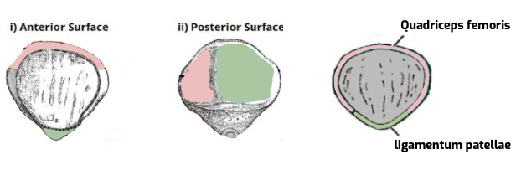
Patella
The largest sesamoid bone
Lies inside the quadriceps tendon in front of the knee joint
Anterior surfaces
rough & subcutaneous
Posterior surface
articulates with condyles of femur to form knee joint
Apex
lies inferiorly
Connected to tuberosity of tibia by ligamentum patellae
Upper, lateral, & medial margins
Gives attachments to quadriceps femoris muscle

Slide 15
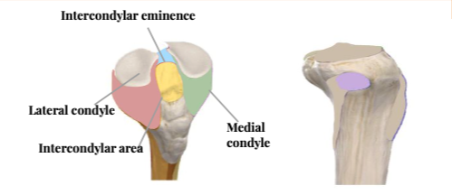
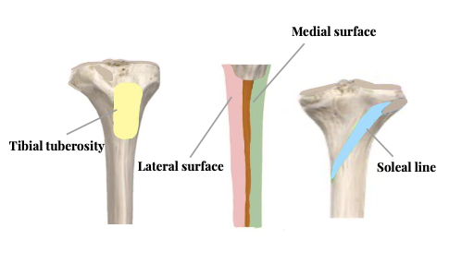
Tibia
The medial bone of the leg
Upper end | Shaft (body) | Lower end
1. Medial condyle: larger and articulate with medial condyle of femur. Has a groove on its posterior surface for semimembranosus muscle 2. Lateral condyle: is smaller and articulates with lateral condyle of femur. 3. Has facet on its lateral side for articulation with head of fibula to form proximal tibiofibular joint 4. Intercondylar area: is rough and has intercondylar eminence | 1. Tibial tuberosity: upper smooth part gives attachment to ligamentum patellae. Lower rough part is subcutaneous Has 3 borders: 1. Anterior border (sharp and subcutaneous) 2. Medial border 3. Lateral border (interosseous border) Has 3 surfaces 1. Medial (subcutaneous) 2. Lateral 3. Posterior (has oblique line, soleal line for attachment of soleus muscle) Drs Note: interosseous border lateral in medial bone and medial in lateral bone. It’s where the interosseous membrane attaches | Articulates with talus for formation of ankle joint 1. Medial malleolus: ● its medial surface is subcutaneous ● Its lateral surface articulate with talus 2. Fibular notch: lies on its lateral surface of lower end to form distal tibiofibular joint

Slide 16
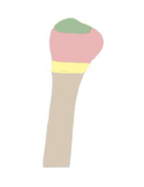
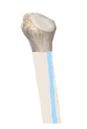
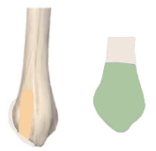
Fibula
The slender lateral bone of the leg
Takes no part in knee joint articulation
Proximal end | Shaft (body) | Distal end
1. Head: articulates with lateral condyle of tibia 2. Apex of the head: also known as styloid process 3. Neck | Has 4 borders: ● Its medial interosseous border gives attachment to interosseous membrane Has 4 surfaces | 1. Lateral malleolus: subcutaneous and has smooth medial surface for articulation with talus to form ankle joint. Sidenote: Malleolus groove
Fractures of the neck of the femur are common . Tibia fractures are normally caused by trauma,whether it was a sporting injury, a fall at home or a fall at work.

Slide 17
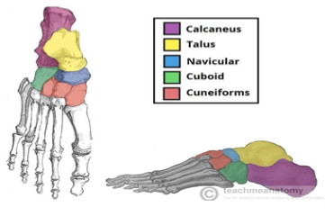
Ankle and Foot Bones: Tarsals
7 tarsal bones:
Calcaneum
Talus
Navicular
Cuboid
Medial Cuneiform
Intermediate Cuneiform
Lateral Cuneiform
● Calcaneum is the largest bone of the foot. Forms the heel
● Only the Talus articulates with tibia & fibula at ankle joint with no muscle attachment
Mnemonic: Cute Tigers Need MILC

Slide 18
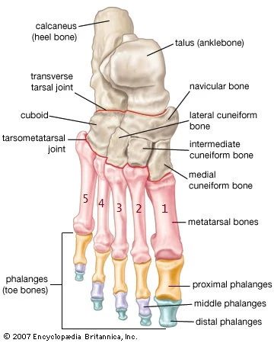
Ankle and Foot Bones: Metatarsals & Phalanges
5 metatarsal bones:
Numbered from medial (big toe) to lateral
1st metatarsal bone is large and is medial.
Each metatarsal bone has
Base (proximal)
Shaft
Head (distal)
14 phalanges:
2 phalanges for the big toe
(proximal & distal)
3 phalanges for each of the lateral 4 toes
(proximal, middle, distal).

Slide 19
Questions from the slides
Q1
Which bony landmark is located on the lateral side of the proximal humerus?
Greater tubercle
Trochlea
Lateral epicondyle
Lesser tubercle
A
B
C
D
Q2
Which region of the humerus articulates with the radius as part of the elbow joint?
Trochlea
Styloid process
Capitulum
Olecranon process
A
B
C
D
Q3
Which is the lateral-most carpal bone of the proximal row?
Q3
A
Trapezium
Hamate
Pisiform
D
Scaphoid
B
C
Answers:
1.A
2.C
3.D

Slide 20
Done by the amazing team
Team leaders:
Arwa Alghamdi
Deema Aljuribah
Razan Alnufaie
Team leaders:
Mishal Alsuwayegh
Mohammed Alghamdi
Members:
Members:
Aljazi Albabtain
Atheer Alkanhal
Arob Alasheikh
Ajwan Aljohani
Deema alqahtani
Dena Alsuhaibani
Farah alqazlan
Jana Alhazmi
Kadi aldosari
Mashael Alasmari
Noura Bin hammad
Najla aldhbiban
Nouf aldalaqan
Razan alasmari
Roaa alharbi
Raghad Mohammed
Shaden albassam
Waha Almathami
Walaa AlMutawa
Yara Ameer Alalwan
Othman Aldraihem
Faisal Alomar
Abdullah Alturki
Othman Alabdullah
Omar Alkadhi
Abdullah Ali
Meshari Alshathri
Yazeed Alsanad
Fahd Mobaireek
Emad Almutairi
Nasser Alghaith
Saad Almogren
Azzam Abdullah Alotaibi
Hassan Ali Alabdullatif
Rayan Alotaibi
Mohammed Nasser
Luay Almutair
Mohammed Fahad
Mohammed Majed
Abdulkarim Salman
Special thanks to mohammed alzer and Shatha Alshabani
anatomyteam442@gmail.com
Thanks to Faisal Alomar for his design of the team logo

