Slide 1
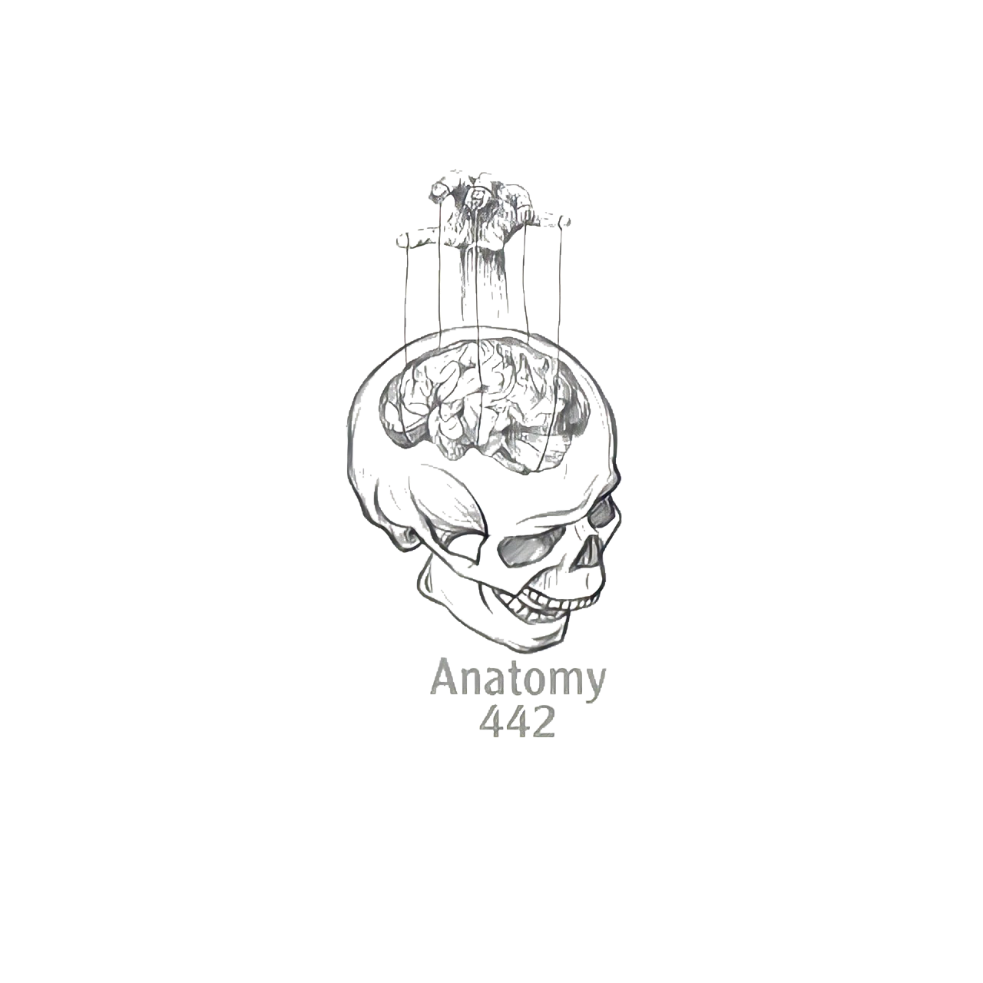
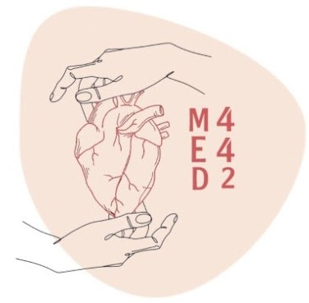
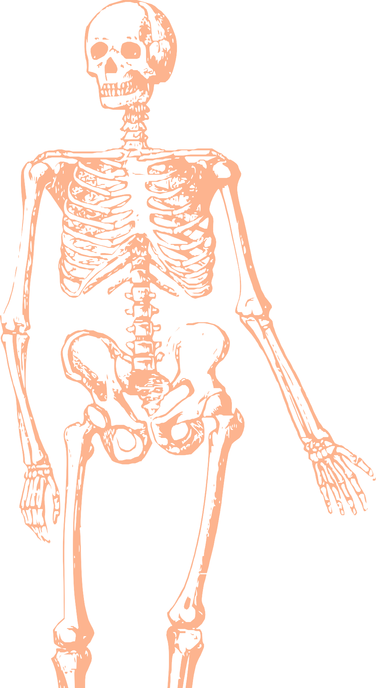
L10
Radial And Ulnar Nerves
Editing file
Color index:
Mine text
Important
Doctors notes
Female slides only
Male slides only
Extra

Slide 2
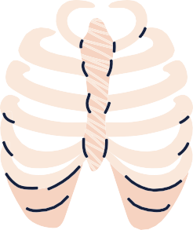
Objectives
Describe the anatomy of the radial and ulnar nerve regarding to origin, course, and distribution.
List the branches of the nerves.
Describe the causes and manifestations of nerve injury.

Slide 3
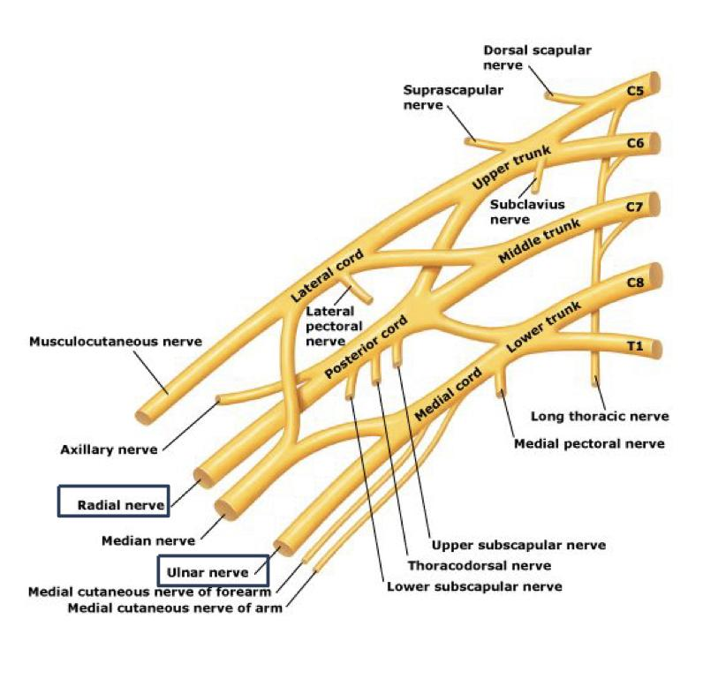
Introduction
There are five main nerves leaving the brachial plexus, which with their branches supply the muscles and skin of the arms and hand.
The ulnar nerve is the continuation of the medial cord and supplies the small muscles of the hand.
The radial nerve is one of the terminal branch of the posterior cord and supplies the extensor muscles and the skin of part of the arm and hand.
Boys Slide only

Slide 4
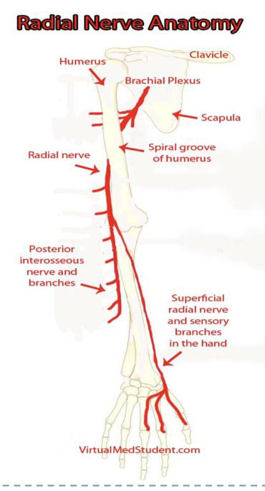
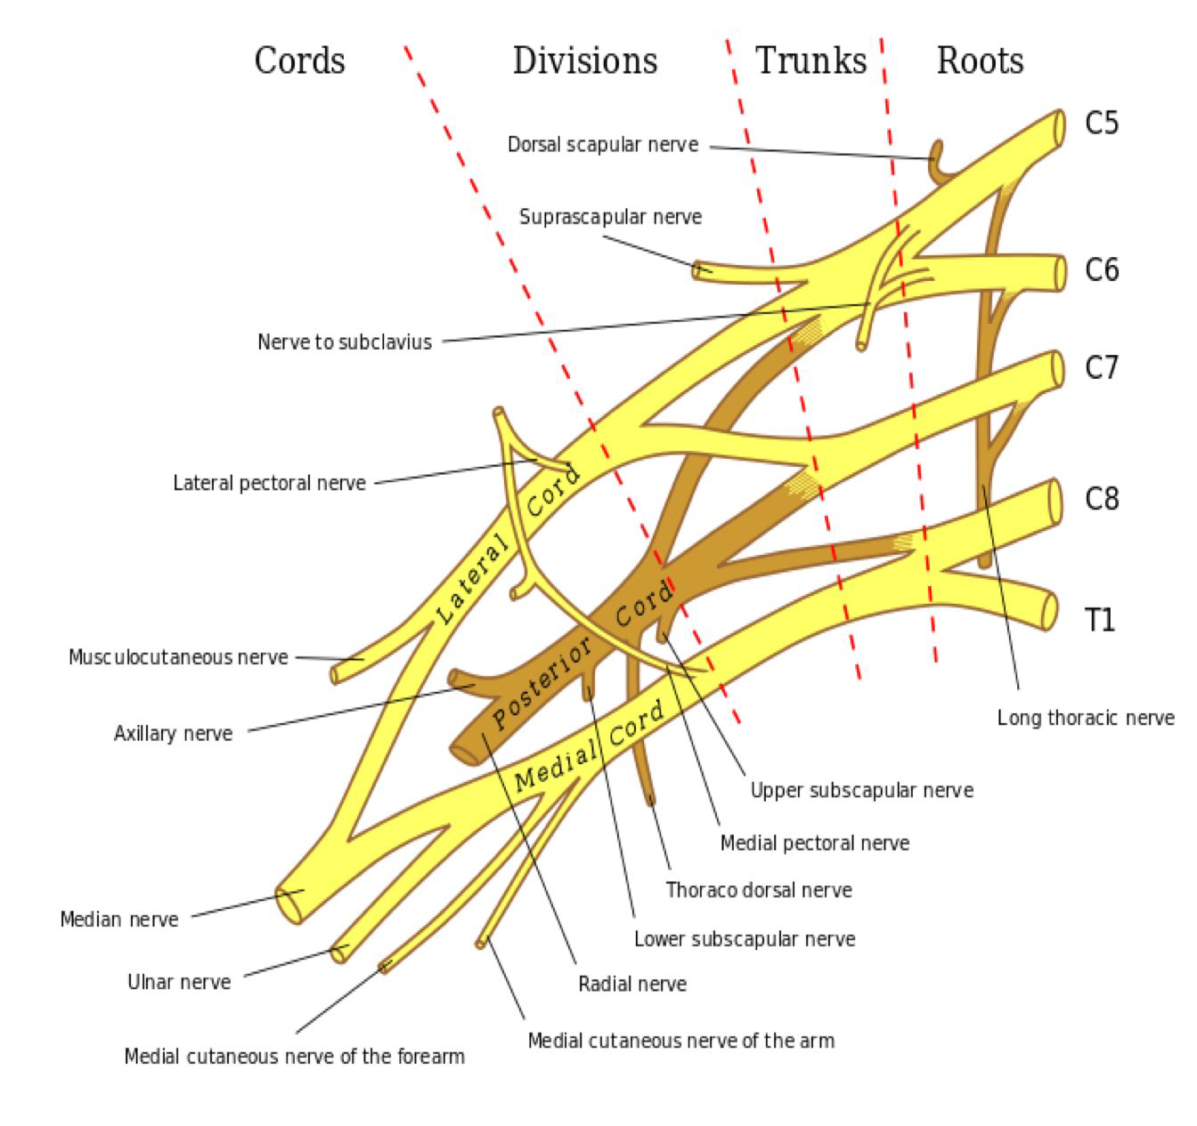
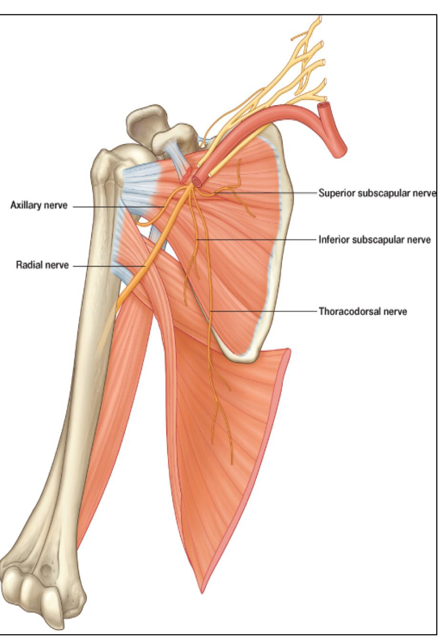
RADIAL NERVE (C5 C8, T1)
-The radial nerve arises from the posterior cord of the brachial plexus.
-The radial nerve receives branches from each nerve root from C5-T1.
• The largest branch.
• Begins in the axilla.
Origin: | Supplies:
-One of the five branches of the Posterior cord of the brachial plexus | -Extensor compartment -Muscles of the Posterior compartment of the arm & the forearm
Axillary Artery

Slide 5
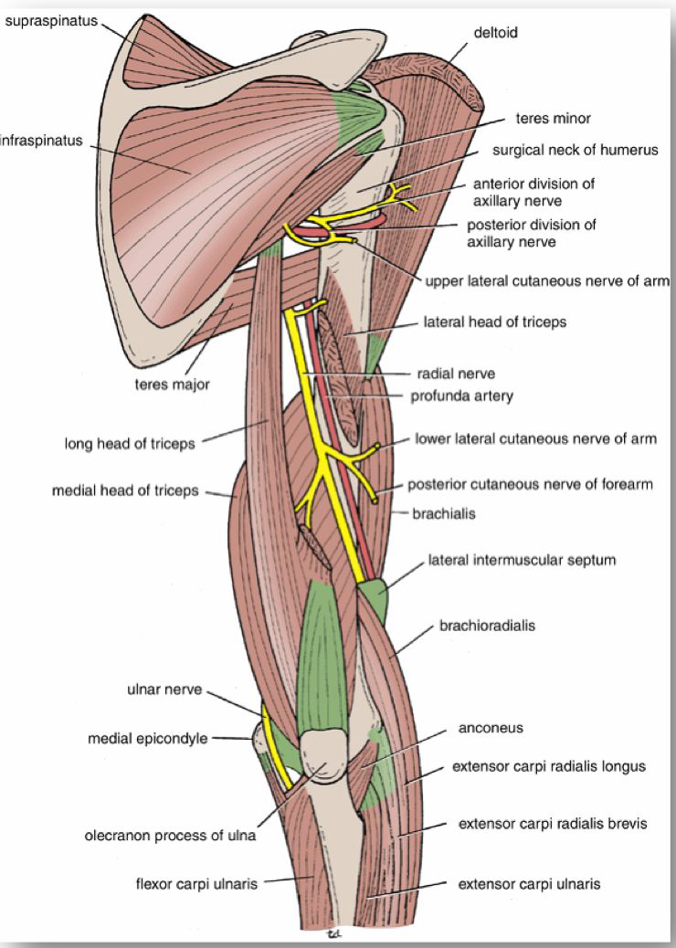
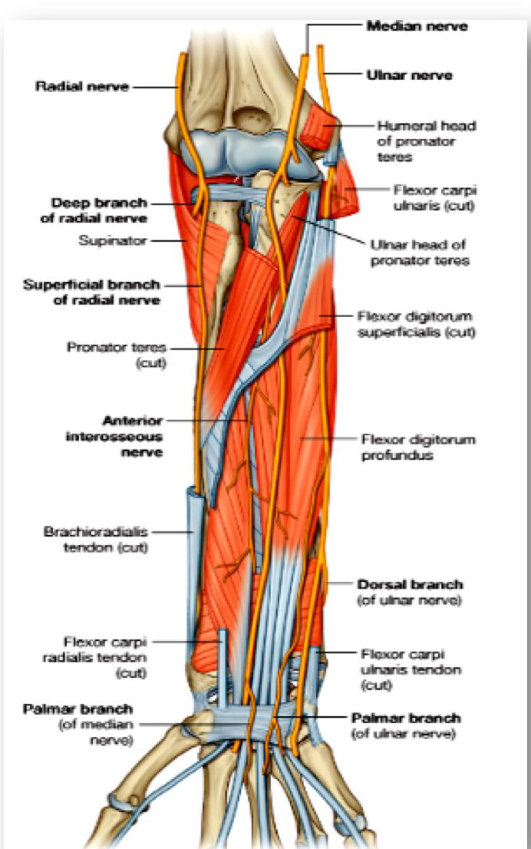
Radial Nerve
Axilla | Arm | Forearm
- The radial nerve lies posterior to the axillary artery (anterior compartment) and on top of the subscapularis, the teres major, and the latissimus dorsi muscles. -Passes through triangular space •Crosses the lower border of the posterior axillary wall -Lying on the glistening tendon f the LD - The radial nerve continuous into the posterior compartment of the arm. - The radial nerve next travels through the triangular interval with the profunda brachii artery posteriorly. The triangle intervals boundaries: • Teres major (proximal) • Long head triceps (medial) • Humeral shaft (lateral) | - Enters the upper arm between the long and medial heads of triceps. -The spiral groove is a thin, bare area of bone that lies in the upper 2/3 of the back of the humerus between the lateral and medial heads of triceps. - Winds around the back of the arm in the spiral groove on the back of the humerus. -In the spiral groove, the nerve is accompanied by the Profunda Vessel, and it lies directly in contact with the shaft of the humerus. (a Dangerous Position) | -It pierces the Lateral Intermuscular septum & enters the anterior compartment of the arm (7.5 cm) above elbow joint. “كذا رجع anterior” -Descends in front of the Lateral Epicondyle. -Passes forward into the Cubital Fossa. Anteriorly, it runs between the brachialis and brachioradialis muscles anterior to the Lateral Epicondyle.

Slide 6
Radial Nerve
AXILLA branches | ARM branches 4 branches arise from the radial nerve within the spiral groove. | FOREARM branches
Cutaneous: Posterior cutaneous nerve of arm. “gives sensory innervation” (and skin along the post. aspect of the arm ) | Cutaneous: 1. Lower lateral cutaneous nerve of arm. 2. Posterior cutaneous nerve of forearm. | Divides into: 1.Superficial branch: -Conti. of the radial nerve -Purely cutaneous 2. Deep branch (Post. interosseous) ”motor, no sensory “
Muscular: Long & Medial Heads of Triceps. | Muscular: 3. Lateral & Medial heads of triceps. 4. Anconeus.
BRANCHES Close to Lateral Epicondyle: In the flexor compartment of Arm
Muscular: 1. lateral Brachialis. 2. Brachioradialis. 3. Extensor carpi radialis longus. (ECRL) | Articular: -to the elbow joint

Slide 7
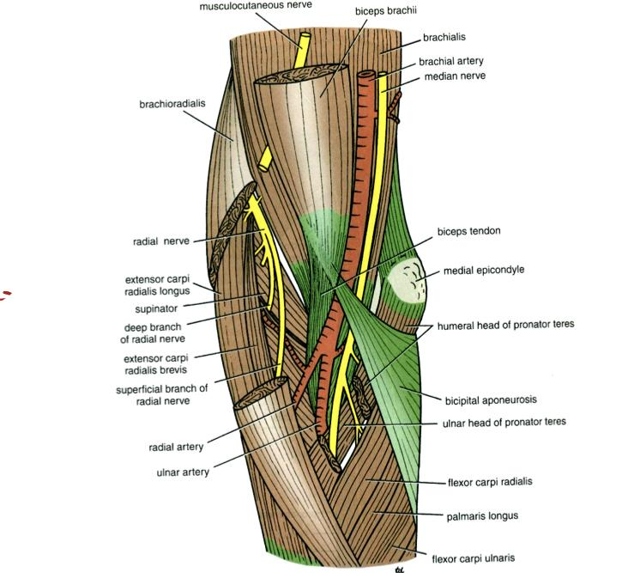
Radial Nerve
Pictures for The Previous Slide

Slide 8
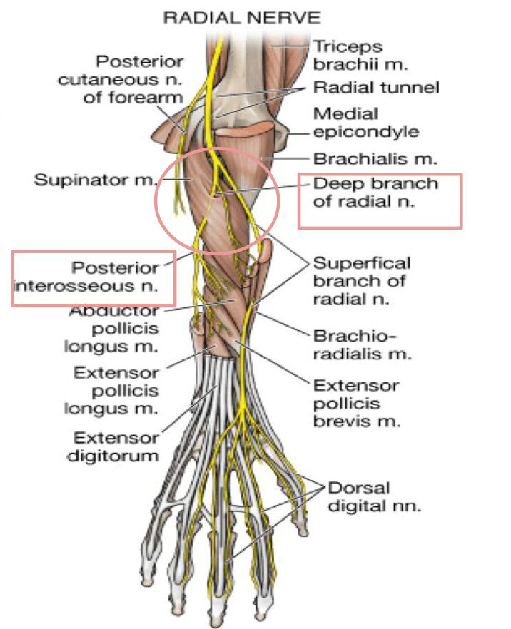
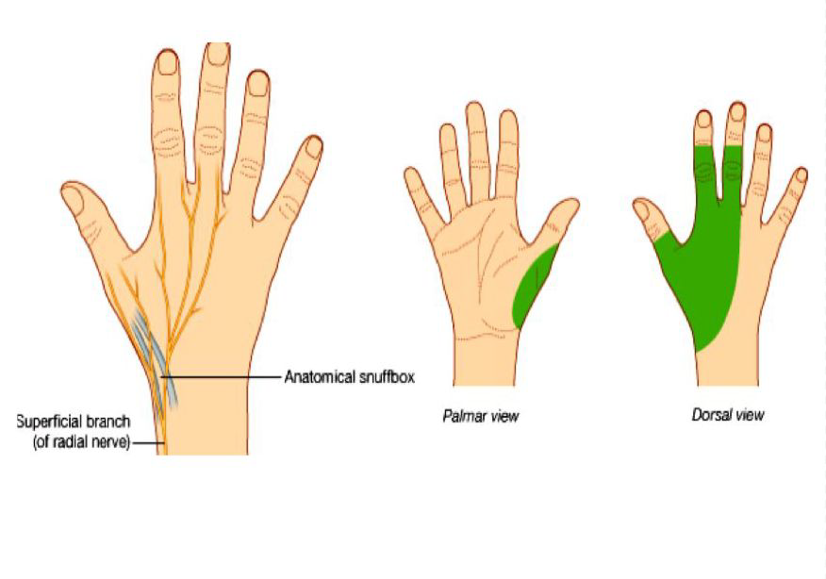
Radial Nerve
Terminal Branches At about the level of the lateral epicondyle, the radial nerve begins to divide into :
Deep Branch (Post. interosseous) (motor) supplies these muscles on the raa radial side and the dorsal surface of the forearm | Superficial Branch
Course: -It winds around the neck of the radius, and enters the extensor ( posterior compartment ) compartment of the forearm between the two heads of the supinator muscle (within the supinator muscle) -purely motor nerve | • Conti. of the radial nerve • Purely cutaneous • Runs down the flexor compartment of the forearm • Winds around the lower end of the radius deep to Brachioradialis. • Crosses the pollicis muscles (APL,EPL.EPB) to reach the back of the hand towards the anatomical snuff box.

Slide 9
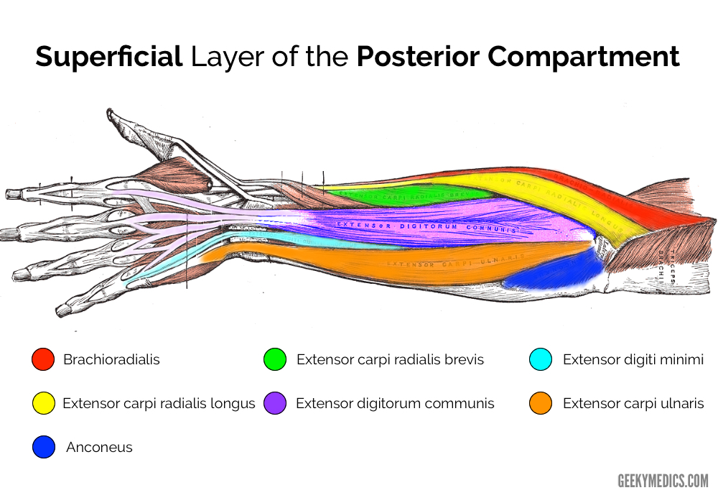
Radial Nerve
Terminal Branches Cont.
Muscular: Entire Extensor compartment of forearm. (Exc. FCU + Medial ½ FDP) 1. Extensor carpi radialis brevis. Cubital Fossa 2.Supinator 3. Extensor digitorum 4. Extensor digiti mini 5. Extensor carpi ulnaris 6. Abductor pollicis longus. 7. Extensor pollicis brevis. 8. Extensor pollicis longus. 9. Extensor indicis. From 3-9 Extensor compartment | Supplies: The superficial radial nerve is a sensory nerve supplying the majority of the dorsum of the hand. -Lateral two-thirds of dorsum of hand. - The skin on the lateral (radial) two and half digits (fingers) or three and a half of proximal phalanges.(fingers) - The skin of the corresponding half of the hand.

Slide 10
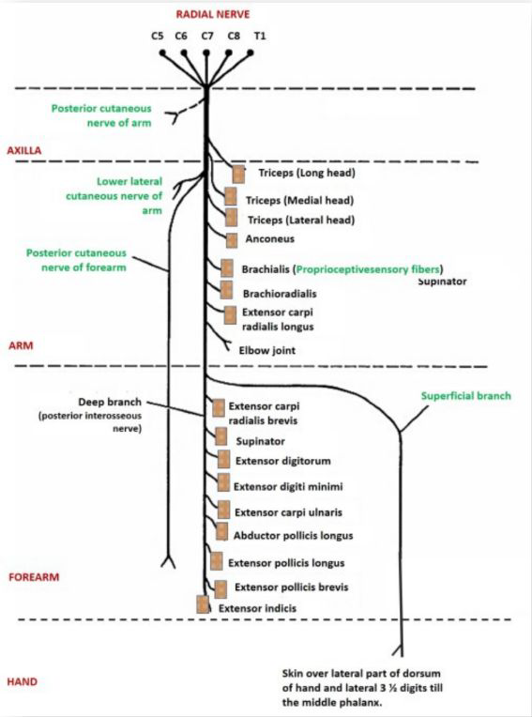
Summary of Radial Nerve
الأخضر
cutaneous

Slide 11
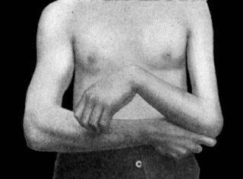
Girls Slides Only
Applied Anatomy: Injury of Radial Nerve
Radial nerve compression or injury may occur at any point along
the course of the nerve.
Very high radial nerve palsy (in the axilla):
A dislocation at the shoulder joint, or a fracture of the proximal
humerus and rarely excessive nerve compression at the axilla.
All motor and sensory function below the axilla will be affected.
Motor functions:
Loss of function of triceps and loss of elbow extension.
The patient is unable to extend at the forearm, wrist and
fingers.
Patient will experience wrist drop due to loss of function of
forearm extensors.
Sensory functions: “all four cutaneous branches of the radial nerve are affected”
Loss of sensation over the lateral and posterior arm.
Posterior forearm.
Dorsal surface of the lateral three and a half digits.
notes of girls doctor

Slide 12
Girls Slides Only
Applied Anatomy: Injury of Radial Nerve
another name spiral groove
B. High radial nerve palsy (In the Radial Groove) :
The radial nerve is tightly bound within the spiral groove of the humerus. Thus, it is most susceptible to damage with a fracture of the humeral shaft.
doc notes
Motor functions:
The triceps brachii may be weakened, but is not paralysed. ?
Muscles of the posterior forearm are affected. The patient is unable to extend at the wrist and fingers. Patient will experience wrist drop due to loss of function of forearm extensors.
doc notes
Sensory functions:
The superficial branch of the radial nerve will be damaged,
resulting in sensory loss to the dorsal surface of the lateral
three and half digits.

Slide 13
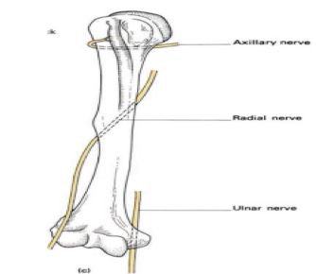
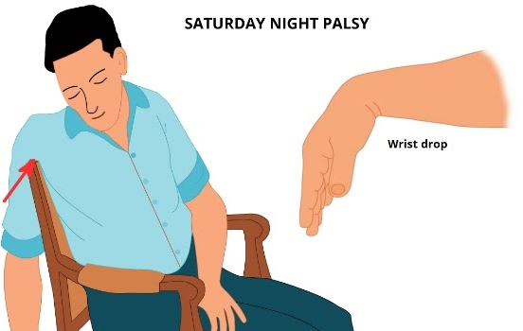
Applied Anatomy: Injury of Radial Nerve
- Transient paralysis: (Temporary)(Causes of compression or injury to the radial nerve at axilla)
1. Improper use of crutch (pressing the nerve in the axilla).
“CRUCH PALSY*
2. Saturday night palsy (draping the arm over the chair in a state of diminished consciousness).
Characteristic:
Wrist dropping:
Inability to extend WRIST and
metacarpophalangeal joint. All muscle
and skin supplied by radial nerve will be
affected
Sensory loss –MINIMAL – WHY??
Overlapping by the median and
ulnar nerves.
In The Spiral (Radial)
Groove (In The Arm):
-Most common-Fracture of the shaft of the humerus.
Characteristic:
-Wrist dropping
-can extend the elbow
-No extension of wrist and
metacarpophalangeal
joint (finger).

Slide 14
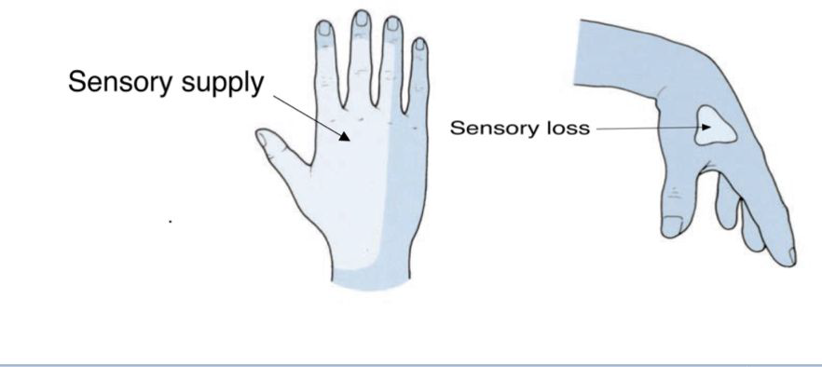
Applied Anatomy: Injury of Radial Nerve
Injuries of Deep Branch of the Radial Nerve in forearm (posterior interosseous):
-Deep radial nerve is motor.
Causes:
- Fractures of the proximal
end of the radius.
- During dislocation of
the radial head
(posterior dislocation of the radius)
Characteristic :
-Majority of the muscles in posterior forearm are affected The patient will experience weakness of finger extension.
-No wrist Drop, WHY?
The nerve supply to the supinator and the extensor carpi radialis longus will be undamaged, and because the latter muscle is powerful, it will keep the wrist joint extended.
No wrist drop
-Sensory loss
– Nothing Overlapping by the median and ulnar nerves
Injuries of Superficial Branch of the Radial Nerve in forearm: -Superficial radial nerve is sensory.
Team 438: Injury like a stab wound,
results in a variable small area of
anesthesia over the dorsum of the
hand and lateral three and half fingers
up to the base of their distal
phalanges. (or distal interphalangeal
joint).
- Sensory loss is minimal caused by Overlapping by the median and ulnar nerves.

Slide 15
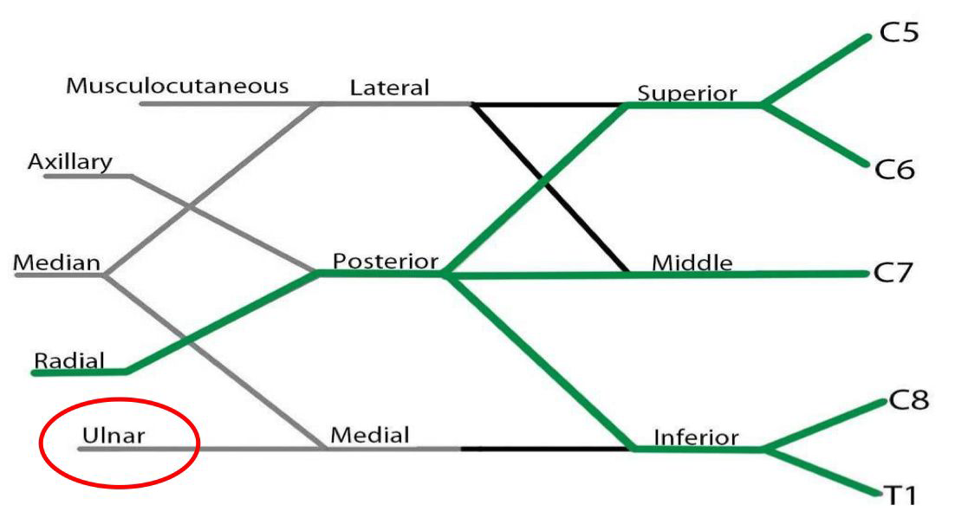
Ulnar Nerve
Originates from the C8-T1 nerve roots which form the medial cord of the brachial plexus.
- Begins in the axilla
- Continuation of the medial cord
Supplies:
- Some flexors muscles on ulnar side of the forearm (FCU + ½ FDP).
- Most of the intrinsic muscles of the hand. - Skin of the ulnar one a half digits
most important nerve in the upper limb because it supply a lot of muscles.
الدكتور عطانا معلومة بشكل عام عشان نعرف وش اللي ميديال ووش اللي لاتيرال سواء نيرف ولا ارتري
اللي ينقسم اول يكون لاتيرال

Slide 16
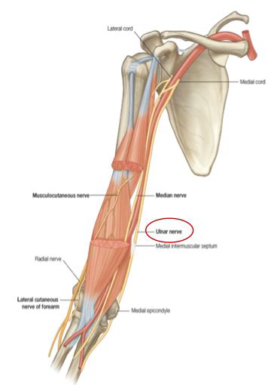
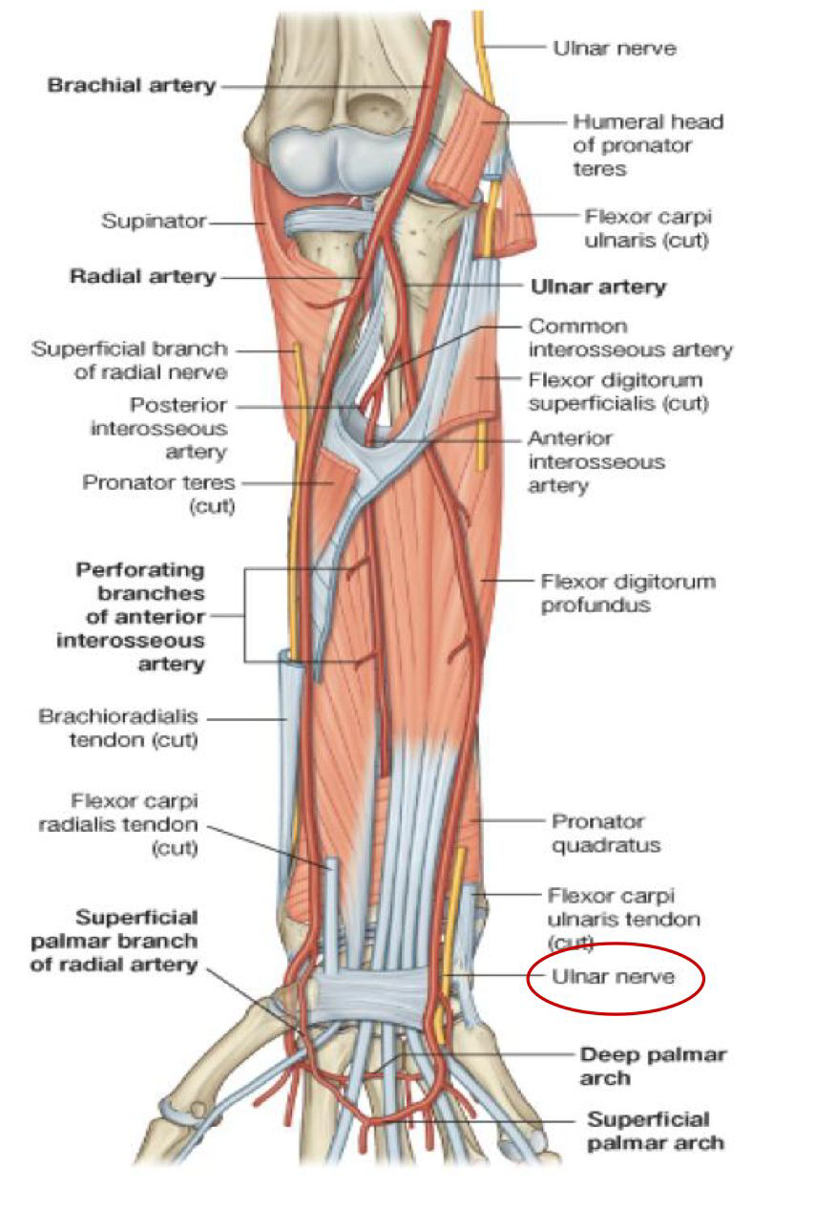
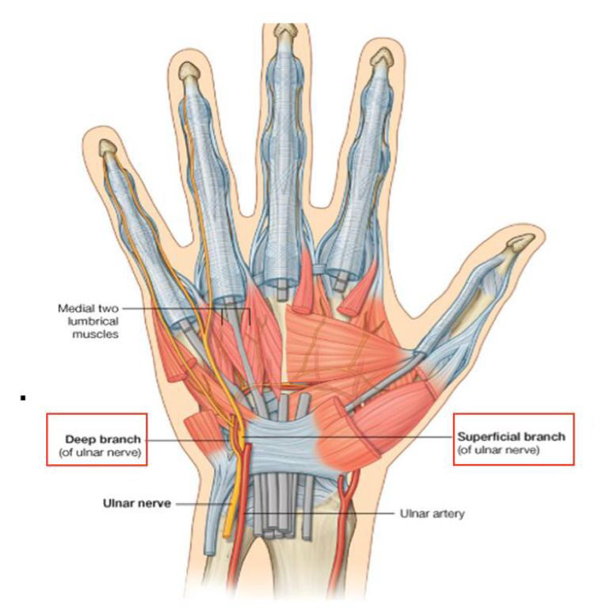
Ulnar Nerve
Arm | Forearm | Wrist
• Descends along the medial side of the following arteries: -Axillary -Brachial •Pierces the Medial Intermuscular Septum to the posterior compartment of arm. •Passes behind the Medial Epicondyle of the humerus at the elbow (funny bone). | Enters between the two heads of the Flexor Carpi Ulnaris muscle. • Lies deep to the Flexor Carpi Ulnaris. • It is medial to Ulnar Artery • Descend on flexor digitorum Profundus | • The ulnar nerve enters the palm of the hand. Course: At wrist Passes: • Anterior to Flexor Retinaculum. • Lateral to Pisiform bone & Hook of hamate. • Medial to Ulnar artery.

Slide 17
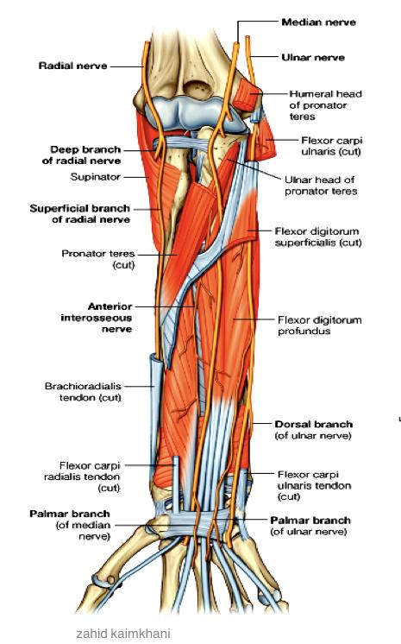
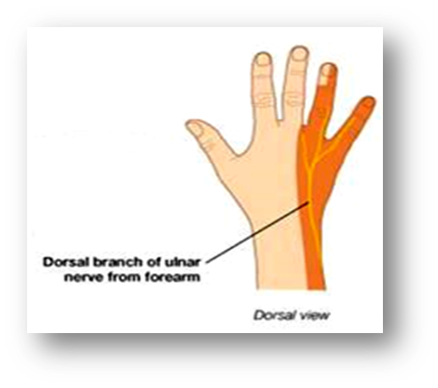
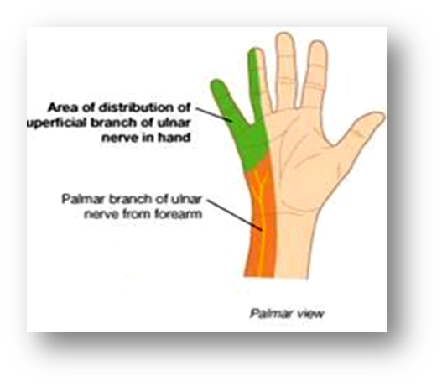
Ulnar Nerve Branches
Arm & axilla | no branches
forearm Supplies: Some flexors muscles on ulnar side of the forearm.
Muscular to: (1 & ½ muscles) 1. Flexor Carpi Ulnaris 2. Medial 1/2 of Flexor Digitorum Profundus | Articular to: Elbow joint. • The ulnar nerve then travels alongside the ulna bone of the forearm into the wrist • In the lower part of the forearm the ulnar nerve lies lateral to the FCU* & medial to ulnar Artery. (flexor carpi ulnaris muscle*) | Cutaneous to: 1. Dorsal (posterior) cutaneous: Supplies the skin over the back of Medial side of the hand & Medial 1+1/2 fingers 2. Palmar cutaneous: Supplies the skin over the Medial third of the palm.

Slide 18
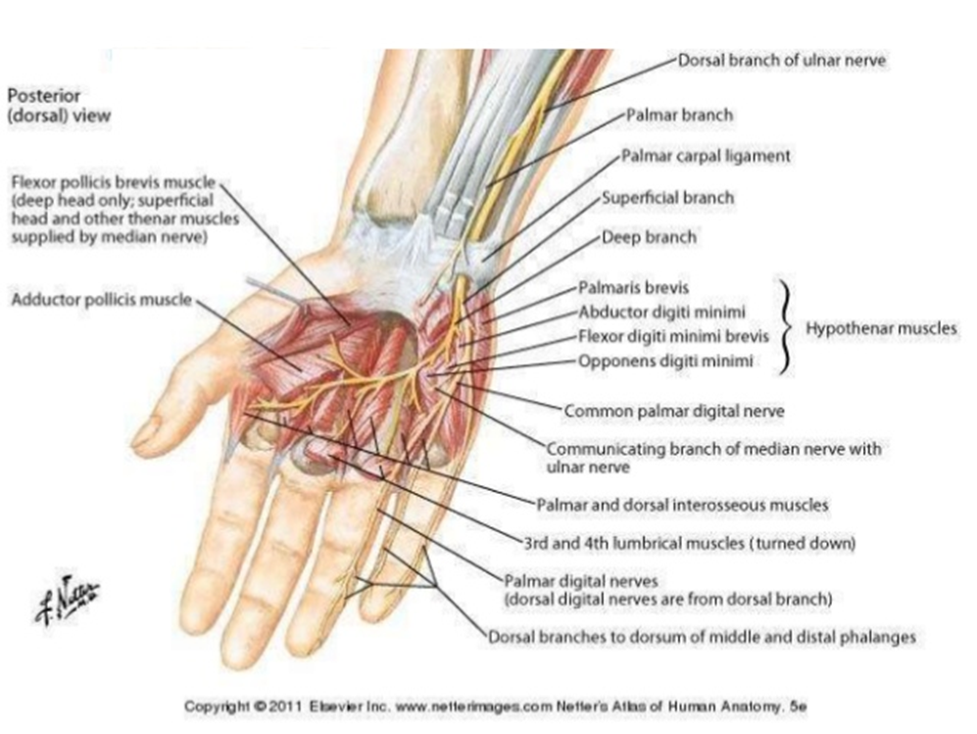
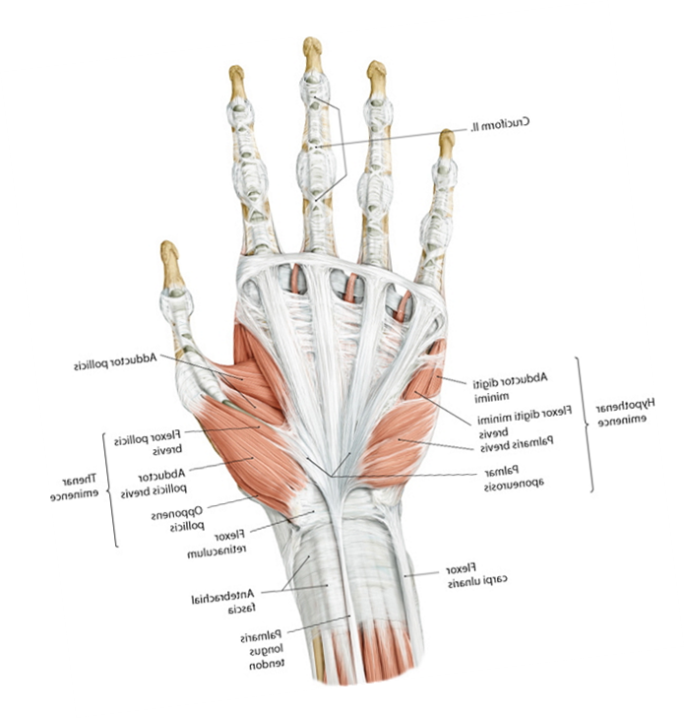
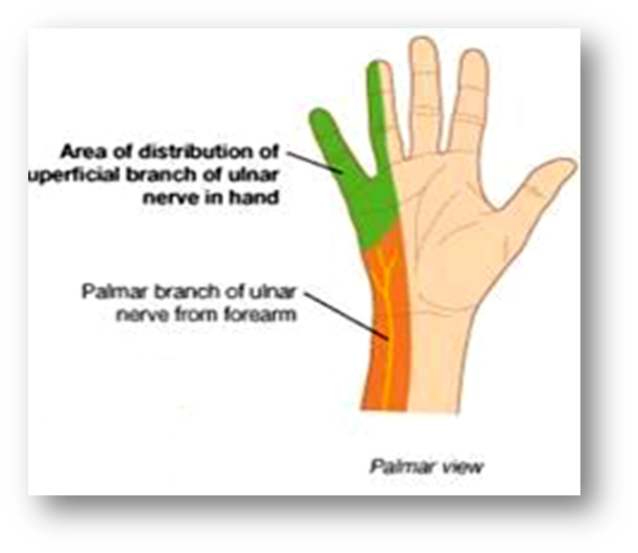
Ulnar Nerve Branches of Wrist
Terminal branches Supplies most of the intrinsic muscles of the hand.
Deep branches | Superficial Branches
- Muscular to: 1. Hypothenar Eminence. 2. All Interossei (Palmar & Dorsal). 3. 3rd & 4th ( Radial) Lumbricals. 4. Adductor pollicis (ends by supplying it) - Articular to: Carpal joints. | - Muscular to: Palmaris Brevis. - Cutaneous to: Supplies the skin over the Palmar aspect of the medial 1+ ½ fingers (including nail beds)

Slide 19
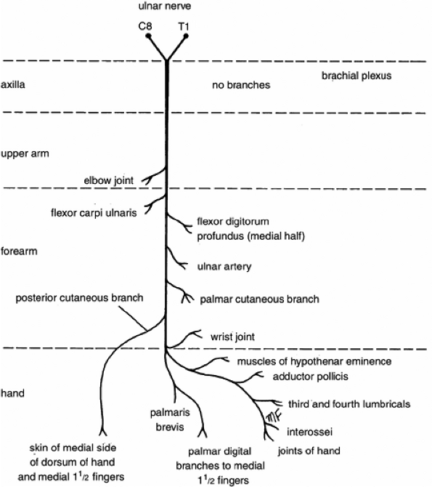
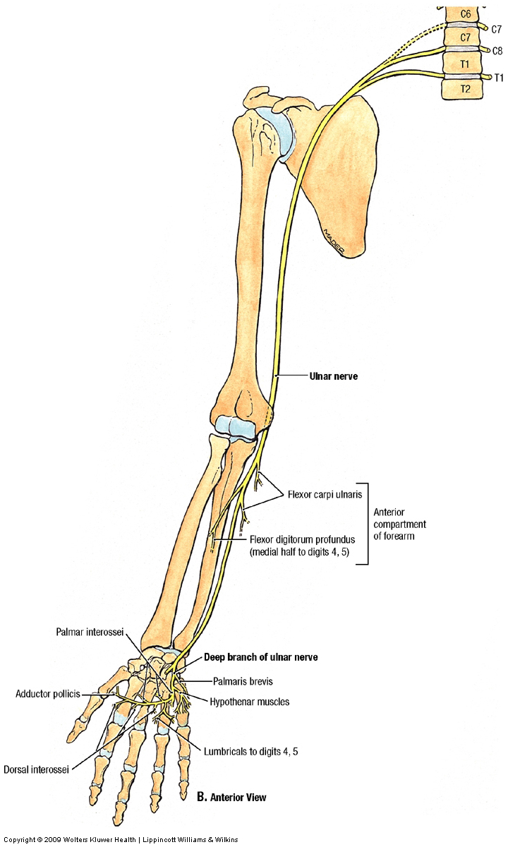
Summary of Ulnar Nerve

Slide 20
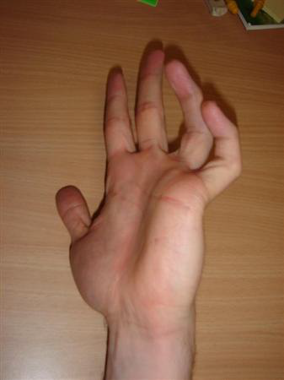
Applied Anatomy: Injury of Ulnar Nerve
● Most commonly injured:
1. Behind elbow
2. At wrist
● The classical sign of a low lesion “CLAW HAND”
➢ Hyperextension of the MCP (metacarpophalangeal) joints of ring and little fingers
➢ Flexion of the IP joints
Reason of Claw Hand:
➢ Paralysis of interossei & lumbricals (loss of function).
➢ Unopposed actions of extensors & FDP

Slide 21
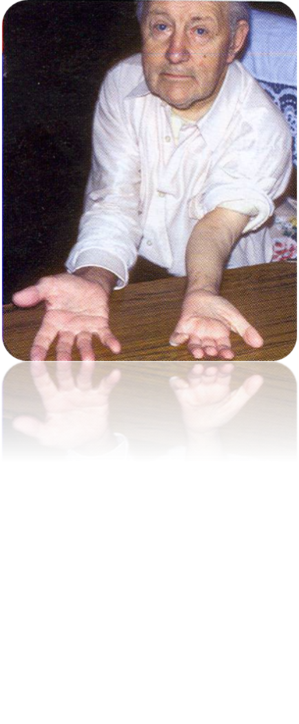
Applied Anatomy: Injury of Ulnar Nerve
behind the elbow
1- Atrophy of Ulnar side of forearm.
2- Flexion of the wrist With abduction.
3- Wasting of Hypothenar Eminence.
4- Claw hand.
At wrist Nerve
- Claw hand
- Wasting of hypothenar

Slide 22
Boys Slides Only
SUMMARY
The ulnar nerve is continuation of the medial cord which supplies some flexors muscles on ulnar side of the forearm, most of the intrinsic muscles of the hand and skin of the ulnar one and a half digits. It is most commonly injured behind the elbow followed by at the wrist. The classical sign of a low lesion “CLAW HAND”.
The radial nerve is one of the five branches of the Posterior cord and also the largest branch of the brachial plexus. It is the nerve of the extensor compartment the arm & the forearm. In the spiral groove, the nerve lies directly in contact with the shaft of the humerus (a Dangerous Position). Most commonly injured in fracture of the shaft of the humerus. The characteristic lesion is “WRIST DROP”.

Slide 23
MCQs:
The radial nerve enters the upper limb between ?
Q1
A
B
C
The long and medial heads of triceps
D
sd The long and lateral
heads of triceps
e Lateral and medial
heads of triceps
Heads of biceps
Q2
How many branches of the radial nerve are there in the ARM ?
A
B
C
D
1
9
4
2
Q3
The radial nerve begins in the ?
A
B
C
D
Axilla
Spiral groove
Posterior side of the
shoulder
Lateral Intermuscular
septum
Answer Key
Q1:C
Q2:C
Q3:A

Slide 24
MCQs:
Which nerve injury causes a claw hand?
Q4
A
B
C
D
Median nerve
Radial nerve
Ulnar nerve
Brachial nerve
Q5
Supplies the skin over the Palmar aspect of the medial 1+ 1⁄2 fingers :
A
B
C
D
Median nerve
Radial nerve
Ulnar nerve
Brachial nerve
Q6
Most commonly injured part of ulnar nerve :
A
B
C
D
behind the elbow
At wrist
shoulder
A+B
Answer Key
4.C
5.C
6.D

Slide 25
Done by the amazing team
Team leaders:
Arwa Alghamdi
Deema Aljuribah
Razan Alnufaie
Team leaders:
Mishal Alsuwayegh
Mohammed Alghamdi
Members:
Members:
Aljazi Albabtain
Atheer Alkanhal
Arob Alasheikh
Ajwan Aljohani
Deema alqahtani
Dena Alsuhaibani
Jana Alhazmi
Kadi aldosari
Mashael Alasmari
Noura Bin hammad
Najla aldhbiban
Razan alasmari
Roaa alharbi
Raghad Mohammed
Shaden albassam
Waha Almathami
Walaa AlMutawa
Yara Ameer Alalwan
Othman Aldraihem
Faisal Alomar
Abdullah Alturki
Othman Alabdullah
Omar Alkadhi
Abdullah Ali
Meshari Alshathri
Yazeed Alsanad
Fahd Mobaireek
Emad Almutairi
Nasser Alghaith
Saad Almogren
Azzam Abdullah Alotaibi
Hassan Ali Alabdullatif
Rayan Alotaibi
Mohammed Nasser
Mohammed Fahad
Mohammed Majed
Abdulkarim Salman
Saleh Aldeligan
Thanks to Faisal Alomar for his design of the team logo
anatomyteam442@gmail.com

