Slide 1
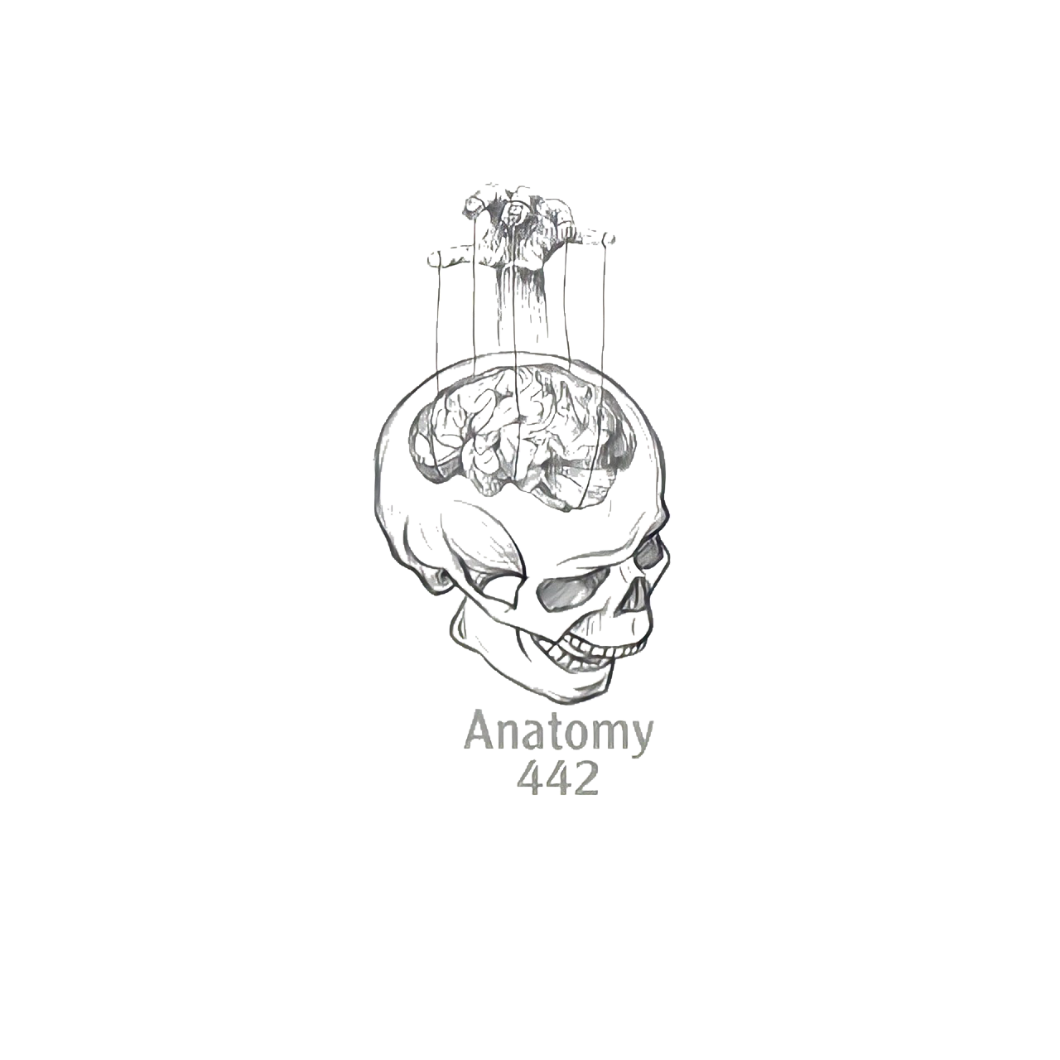
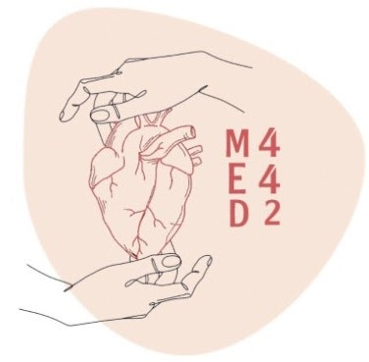
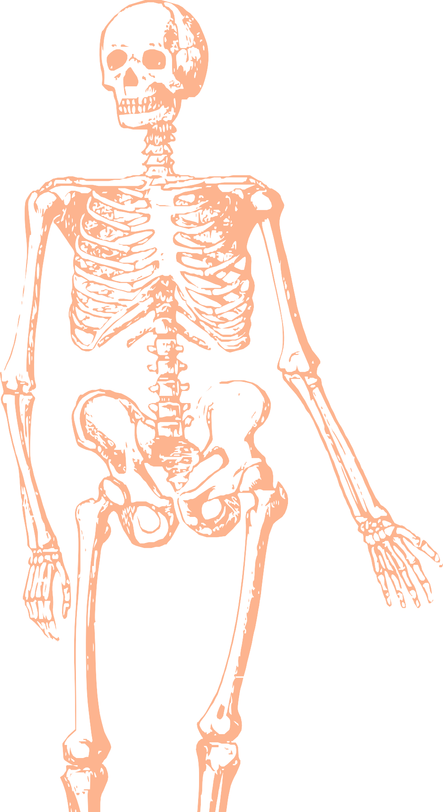
L11
joints
Editing file
Color index:
Mine text
Important
Doctors notes
Female slides only
Male slides only
Extra

Slide 2
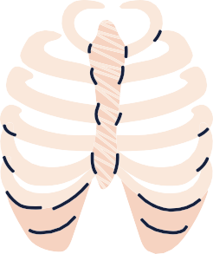
Objectives
Deﬁne the term “Joint” .
Describe the classiﬁcation of the 3 types of joints & give an example of each.
Describe the characteristics of synovial joints.
Describe the classiﬁcation of synovial joints & give an example of each.
List factors maintaining stability of joints.
Recite “Hilton’s law” for nerve supply of joints.

Slide 3
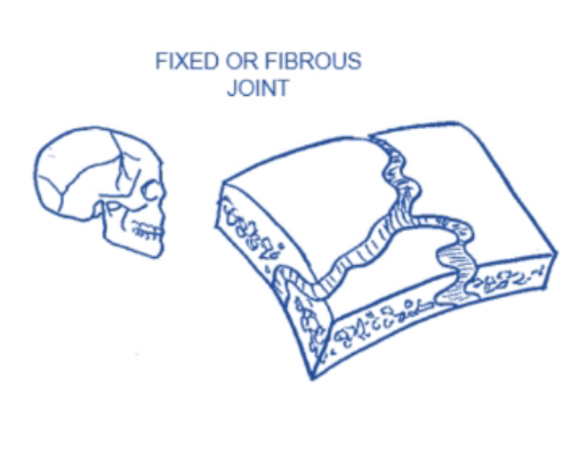
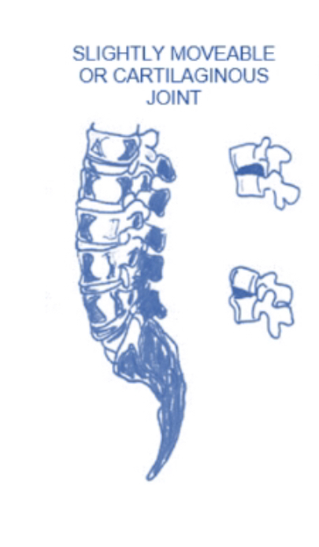
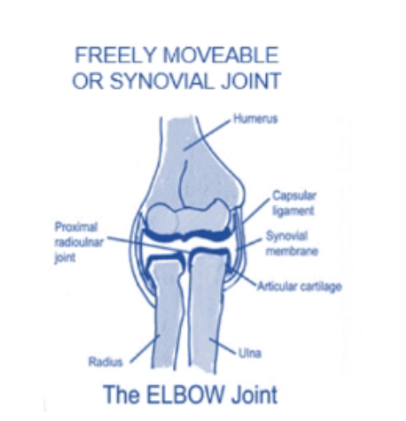
Definition
1-Fibrous
joint :It is the site where two or more bones meet together.
union of two or more bones of the body.
Classification
2-Cartilaginous
They are classified according to: tissues that lie between the articulating bones
3-Synovial

Slide 4
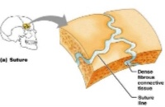
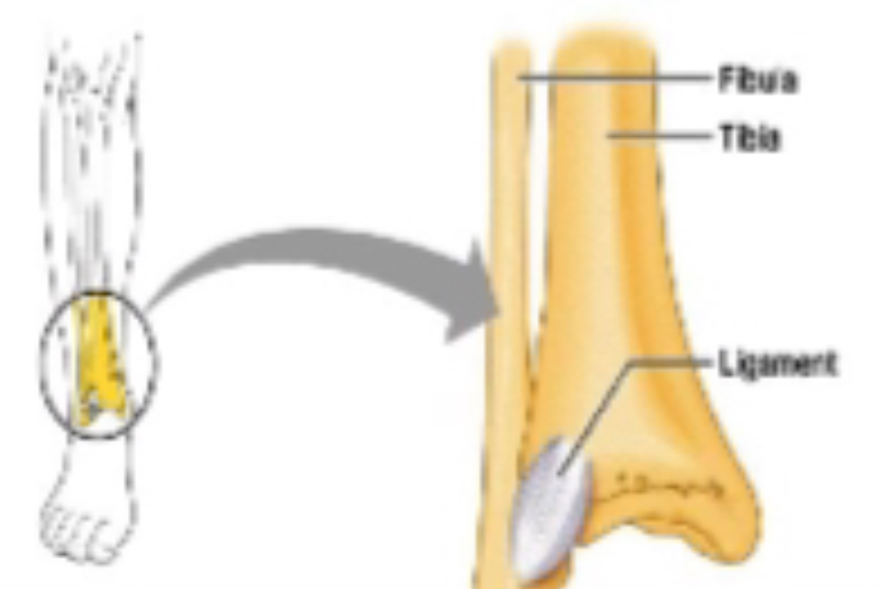
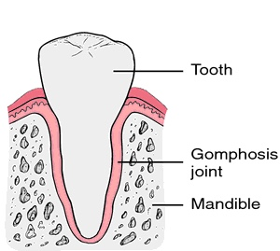
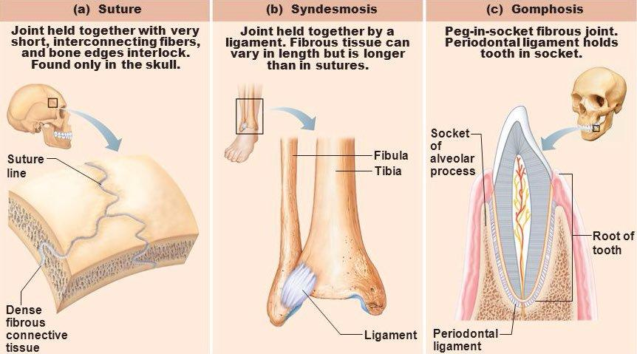
1) Fibrous joints :
The articulating surfaces are joined by fibrous connective tissue, where No or very mild movement( Negligible ) For example :
Skull sutures: | Inferior tibiofibular joints (syndesmosis): | Gomphosis:
●no movement. ●temporary (as it ossify later) They will become bones.They will become bones | ●minimal movement. ●permanent joints. | ●dental alveolar joints. Articulation between root of the tooth with the mandible (between the teeth & their socket)
in boys slides

Slide 5
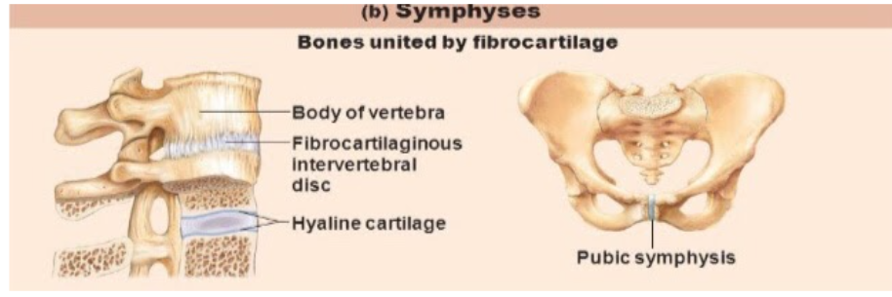
2) Cartilaginous Joints:
Happens when two bones are joined by cartilage. They are classified into 2 types:
Primary Cartilaginous (synchondrosis) | Secondary Cartilaginous (midline* or symphysis)
Structure | Structure
The bones are united by a plate or a bar of hyaline cartilage. & it's one where bone and cartilage meet. It's a very strong joint and immobile. | The bones are united by a plate of fibrocartilage. Their articulating surfaces are covered by a thin plate of hyaline cartilage.
Movement | Movement
No movement, temporary joints (ossify later). | Little movement, permanent joints.
-Between the Epiphysis and the Diaphysis of a growing bone. note: (epiphyseal plate). --Between the First Rib and the Sternum (1st sternocostal joint). → junctions of ribs with their costal cartilage. | Example: -Joints between the Vertebral Bodies (intervertebral discs). -Symphysis Pubis. between the two hip bones
*the rest of the sternocostal joints are synovial plane joints
*Syn- is a prefix with the meaning “with,” “together,”
thanks team 441!

Slide 6
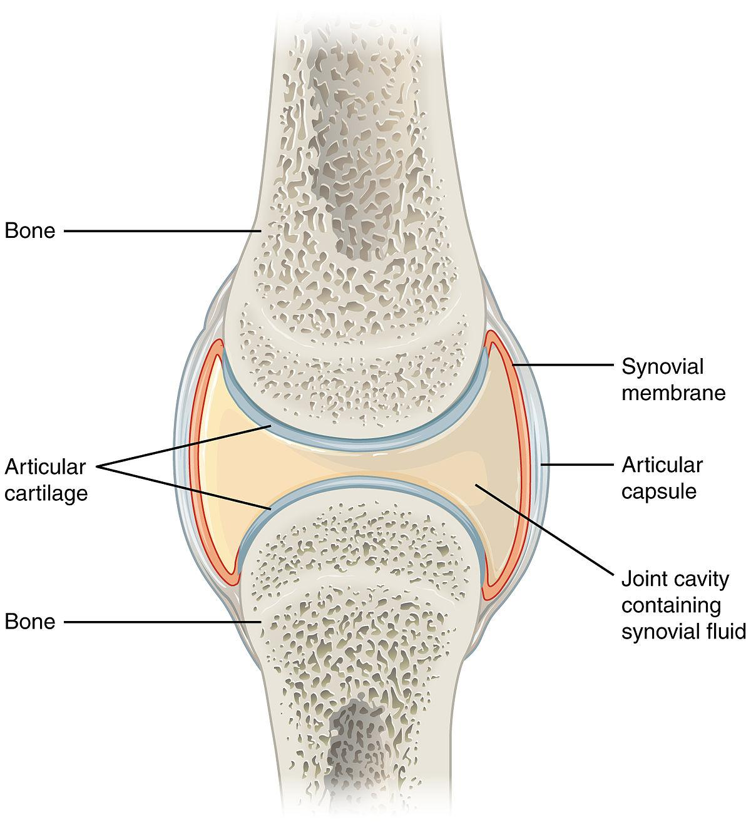
3) Synovial Joints:
All joints in appendicular skeleton are synovial joint
Freely movable joints.because of the synovial cavity and fluid
The articular surfaces are covered by a thin layer of hyaline cartilage (articular cartilage).
This can also decrease friction
along with the synovial fluid
A joint cavity enclosed within the capsule.
The 2 bones
(articulating bones)
are joined by a fibrous
capsule,
which is attached the margins of articular surfaces & enclosing the joint.
The capsule reinforced
ligaments both internally and externally.
synovial membrane :
a thin vascular membrane lining the inner surface of the capsule. It produces the synovial fluid.
synovial fluid:
a lubricating fluid produced by the synovial membrane in the joint cavity. The fluid minimizes the friction between the articular surfaces.
Note: The joint cavity | contain the synovial fluid which is secreted from the synovial membrane

Slide 7
Plane
synovial joints
Movement
Gliding Movement (minimal)
Arrangement
The articulating surfaces are flat and the bones slide on one another.
Examples
Intercarpal & intertarsal joints
Sternoclavicular joint
Acromioclavicular joint
Between the 2nd and 7th sternocostals (the 1st one is synchondrosis)
Classiﬁcation of Synovial joints:
Synovial joints can be classiﬁed according to:
1- The arrangement (shape) of the articular surfaces.
2- The range of movement that are possible
According to the range of movement
Axial
synovial joints
Movement
-Transverse (x-axis): flexion and extension.
-Longitudinal (y-axis): rotation.
-Antero-posterior (z-axis): abduction and adduction
Arrangement
The articulating surfaces occur along axis.
Examples
Elbow joint
Shoulder joint
Radio-ulnar joint
Axial joints are divided to:
uniaxial
biaxial
Multi-axial
(polyaxial)

Slide 8
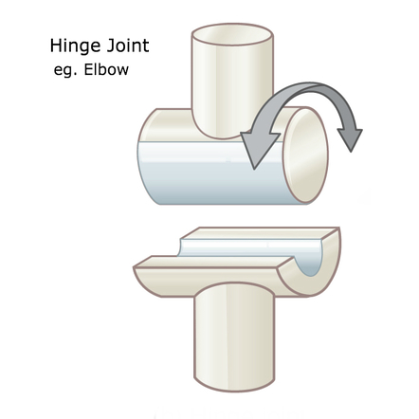
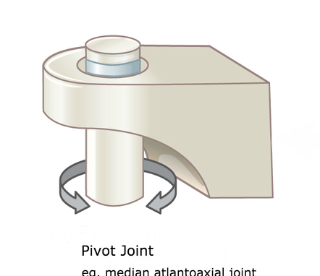
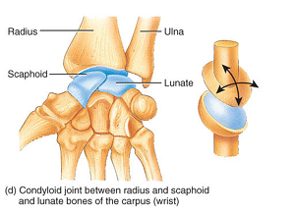
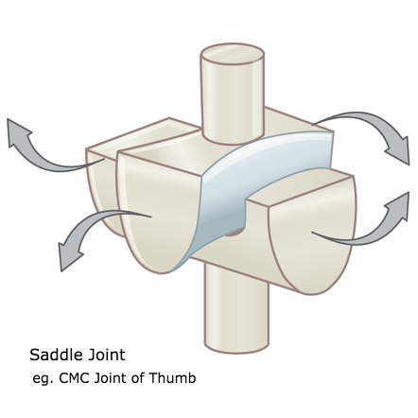
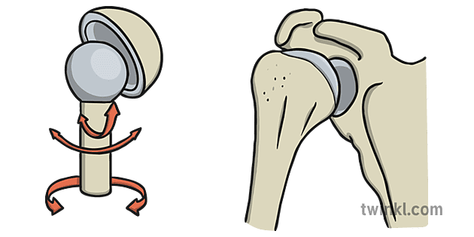
 | Uniaxial |  | Biaxial |  | Multiaxial
Type | Hinge | Pivot | Ellipsoid An elliptical convex fits into an elliptical concave articular surface. | Saddle The articular surfaces are reciprocally concavoconvex. | Ball & socket
Axis | Transverse | Longitudinal | Transverse & antero-posterior | They resemble a saddle on a horse’s back. | A ball–shaped head of a bone ﬁts into a socket-like concavity of another
Movement | Flexion & extension | Rotation | 1.Flexion & extension. 2.Abduction & adduction BUT rotation is impossible | 1.Flexion& extension. 2.Abduction& adduction Small range of rotation | 1.Flexion & extension. 2.Abduction &adduction. rotation along separate axis
Examples | 1.Elbow joint 2.Ankle joint. | 1.Radio-ulnar joint(supination & pronation) 2.Atlantoaxial joint | Wrist joint. | Carpometacarpal joint of the thumb | 1.Shoulder joint 2.Hip joint
Pictures
Helpful video

Slide 9
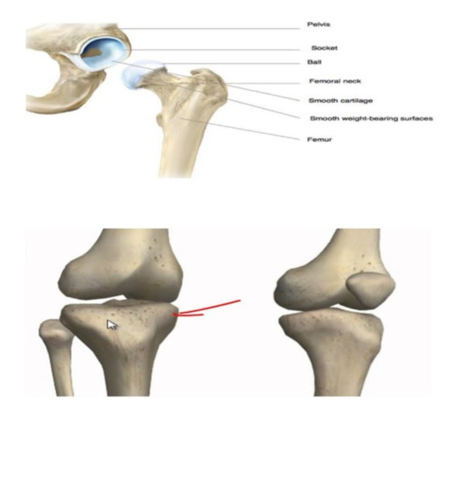
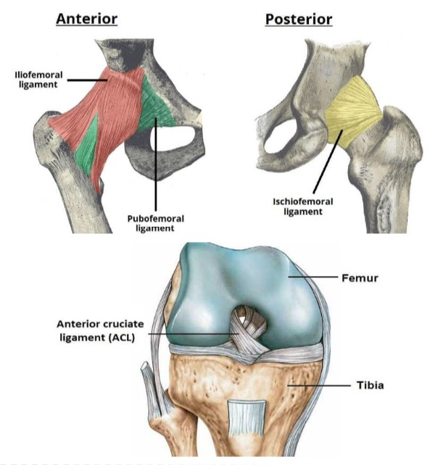
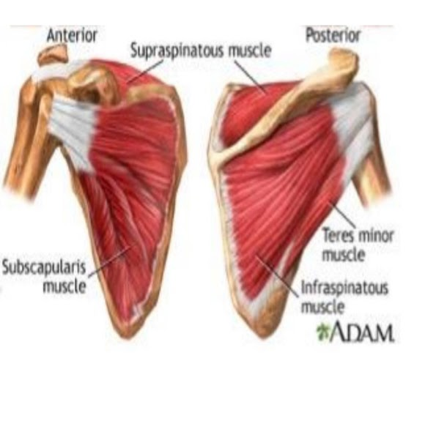
Factors Affecting Stability of Synovial Joints:
1. The shape of articular surfaces:
1. The shape of articular surfaces:
2. Strength of the ligaments:
• The ball and socket shape of the Hip joint is a good examples of the importance of the shape of the bone to maintain joint stability.
They prevent excessive movement in a joint
eg. Cruciate ligaments of the knee joint..
• The shape of the bones forming the Knee joint has nothing to do for stability.
2. Strength of the ligaments:
3. Tone of the surrounding muscles:
4. Atmospheric pressure
In most joints, it is the major factor controlling stability.
e.g. The short muscles around the shoulder joint (Rotator cuff muscles) keeps the head of the humerus in the shallow glenoid cavity.
3. Tone of the surrounding muscles:

Slide 10
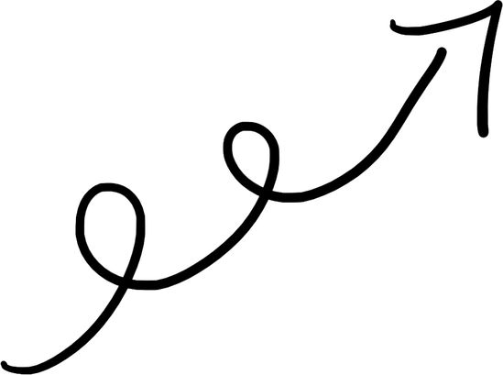
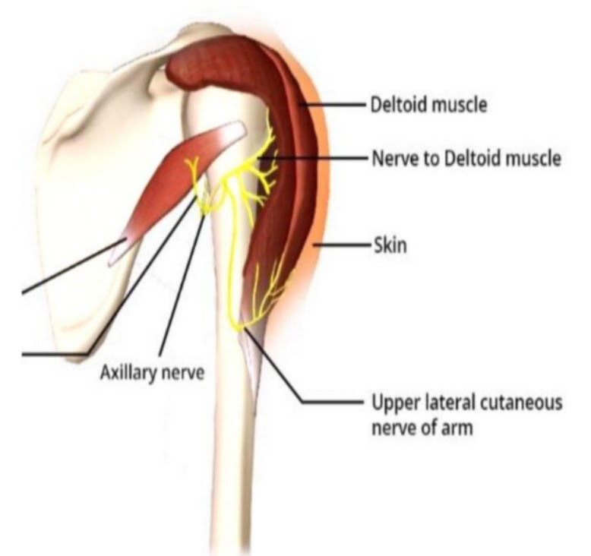
NERVE SUPPLY OF JOINTS
●The capsule and ligaments receive an abundant sensory nerve supply.
Hilton's Law:
"A sensory nerve supplying a joint also supplies the muscles moving that joint and the skin overlying the insertions of these muscles."

Slide 11
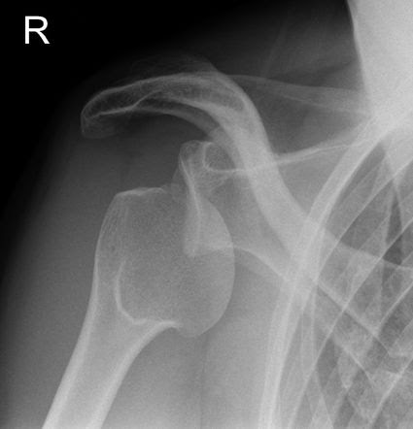
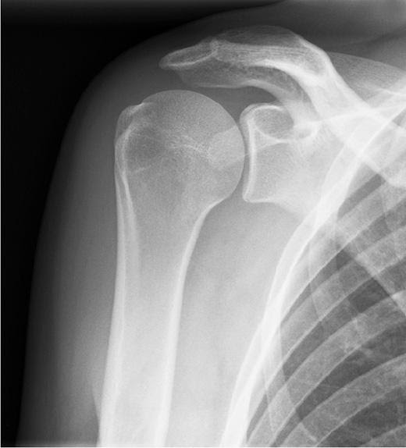
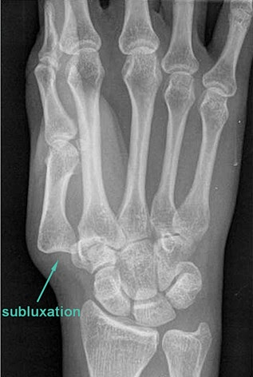
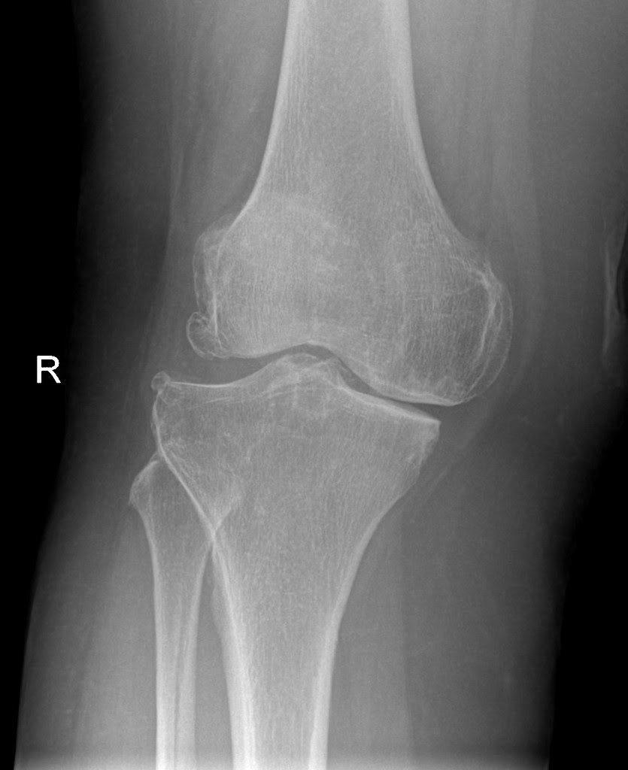
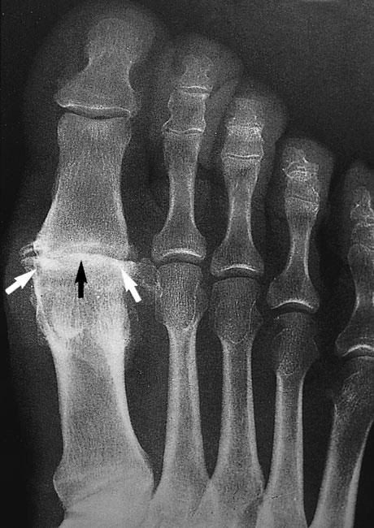
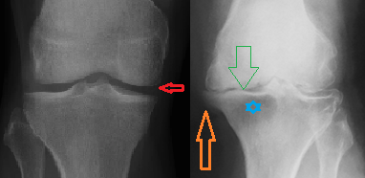
Applied anatomy
In males slide only
Many of these functional aspects of joints may be assessed by radiology.
Displacement of the articulating surfaces of a joint is known as dislocation.
Partial displacement of the articulating surfaces is known as subluxation.
Dislocation of a joint may follow severe injury and is always associated with damage to the capsular and accessory ligaments. There may also be fractures of the bony structures of the joint, and occasionally damage to closely related nerves and vessels.
Chronic inflammatory processes are prone to affect the bone ends (osteoarthritis) and synovial membrane (rheumatoid arthritis), and joints thus affected may be deformed and painful, with marked limitation of movement.

Slide 12
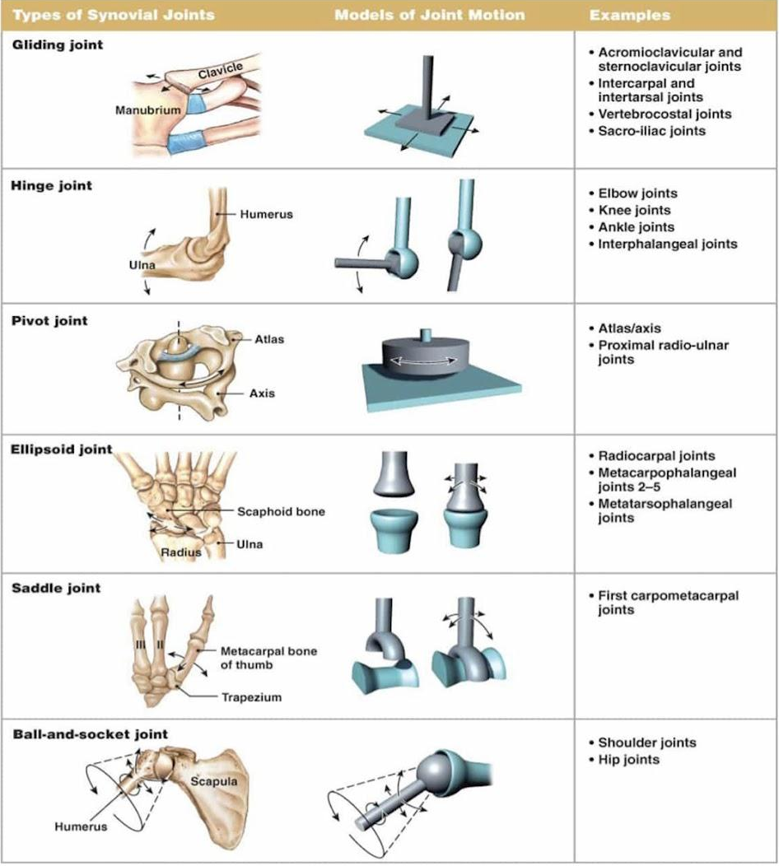
Summary form 346

Slide 13
Summary form the amazing razan alnufaie
أرهب وحده بالدنيا”
Click here to see in high quality

Slide 14
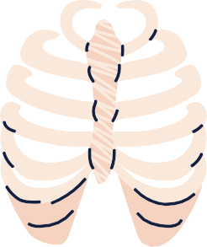
MCQs:
What of the following is an Uniaxial joint?
Q1
A
B
C
D
Wrist joint
Elbow joint
Hip joint
Shoulder joint
Q2
What of the following is incorrect about synovial joint
A
B
C
D
Synovial membrane is vascular
Synovial fluid is produced by synovial membrane
Not freely movable
articular surfaces are covered by a thin layer of hyaline cartilage
Q3
what type of joint that has No or very mild movement
A
Fibrous joints
B
Cartilaginous joints
C
Synovial Joints
D
Non of the above
Answers:
B
C
A

Slide 15
MCQs:
joints are classified according to?
Q4
A
B
C
D
type of bone
tissues that lie between the articulating bones
Number of bone
Size of bone
Q5
Secondary cartilaginous joints are united by
A
Hyaline cartilage
B
C
D
elastic cartilage
.fibrous tissue
fibrocartilage
Q6
what is the other name of Inferior tibiofibular joints
A
Gomphosis
B
syndesmosis joints
C
synchondrosis
D
symphysis
Answers:
B
D
B

Slide 16
MCQs:
Special thanks to 441QBank!
the innervation of joints follows?
Q7
A
Willi hennig’s rules
D
B
C
Hilton’s law
Temperature size rule
Bergmann’s rule
Q8
skull sutures is considered as?
A
B
C
D
Synovial joint
Secondary cartilaginous joints
.fibrous tissue
Pivot joints
Q 9
Which of the following have no joint cavity?
A
Fibrous joints
B
Cartilaginous joints
C
Synovial joints
D
Both A and B
Answers:
A
C
D

Slide 17
MCQs:
Special thanks to 441QBank!
found between flat bones and the skull??
Q10
A
Synovial joints
D
B
C
Cartilaginous joints
Both A and B
Fibrous joints
Q11
the joint between the epiphysis and the diaphysis of a grown bone is?
A
Synovial joint
B
C
D
Fibrous joints
.Synchondrosis
Midline joints
Q12
permit a great degree of movement?
A
Fibrous joints
B
Cartilaginous joints
C
Synovial joints
D
Both A and B
Answers:
D
C
C

Slide 18
Done by the amazing team
Team leaders:
Arwa Alghamdi
Deema Aljuribah
Razan Alnufaie
Team leaders:
Mishal Alsuwayegh
Mohammed Alghamdi
Members:
Members:
Aljazi Albabtain
Atheer Alkanhal
Arob Alasheikh
Ajwan Aljohani
Deema alqahtani
Dena Alsuhaibani
Jana Alhazmi
Kadi aldosari
Mashael Alasmari
Noura Bin hammad
Najla aldhbiban
Nouf aldalaqan
Razan alasmari
Roaa alharbi
Raghad Mohammed
Shaden albassam
Waha Almathami
Walaa AlMutawa
Yara Ameer Alalwan
Othman Aldraihem
Faisal Alomar
Abdullah Alturki
Othman Alabdullah
Omar Alkadhi
Abdullah Ali
Meshari Alshathri
Yazeed Alsanad
Fahd Mobaireek
Emad Almutairi
Nasser Alghaith
Saad Almogren
Azzam Abdullah Alotaibi
Hassan Ali Alabdullatif
Rayan Alotaibi
Mohammed Nasser
Luay Almutair
Mohammed Fahad
Mohammed Majed
Abdulkarim Salman
anatomyteam442@gmail.com
Thanks to Faisal Alomar for his design of the team logo

