Slide 1
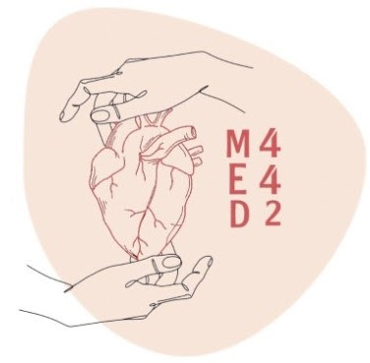
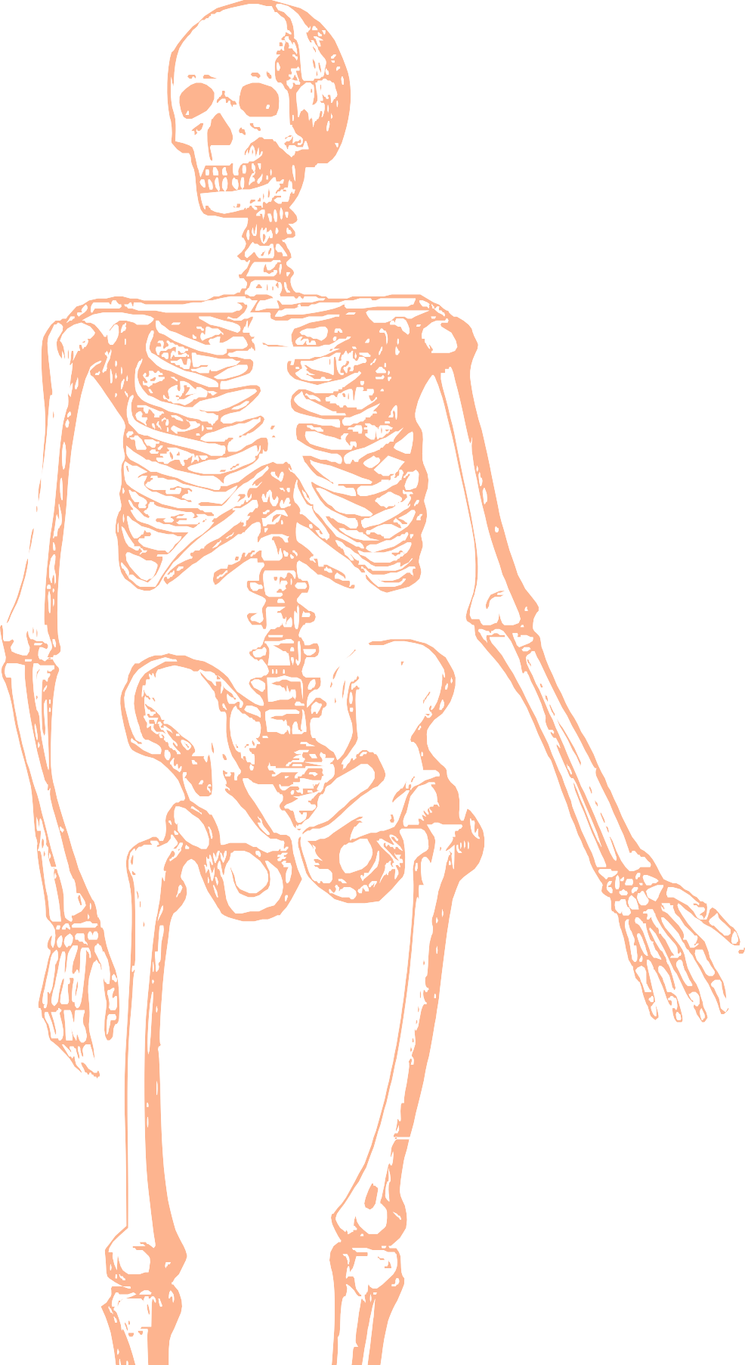
L2
Anterior & medial compartment of the thigh
Editing file
Color index:
Mine text
Important
Doctors notes
Female slides only
Male slides only
Extra

Slide 2
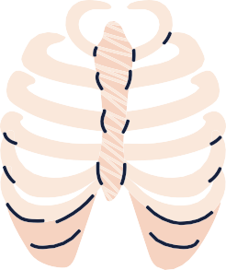
By the end of this lecture you should be able to:
List the name of muscles of anterior compartment of thigh
Describe the anatomy of muscles of anterior compartment of thigh regarding: origin, insertion, nerve supply and actions.
List the name of muscles of medial compartment of thigh.
Describe the anatomy of muscles of medial compartment of thigh regarding: origin, insertion, nerve supply and actions.
Describe the anatomy of femoral triangle & adductor canal regarding : site, boundaries and contents

Slide 3
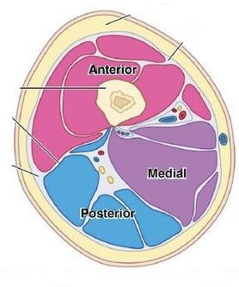
The thigh
The thigh is divided into 3 compartments by 3 intermuscular septa (extending from deep fascia into femur)
Thigh compartment
Anterior Compartment
Extensors of knee:
Quadriceps femoris
Flexors of hip:
1. Sartorius
2. Pectineus
3. psoas major
4. Iliacus
Nerve supply:
Femoral
nerve(L2,3,4)
Medial Compartment
Adductors of hip:
1. Adductor longus
2. Adductor brevis
3. Adductor magnus
(adductor part)
4. Gracilis
Nerve supply:
Obturator nerve(L2,3,4)
Posterior Compartment
Flexors of knee & extensors of hip: Hamstrings
Nerve supply:
Sciatic nerve(L4,5,S1,2,3)

Slide 4
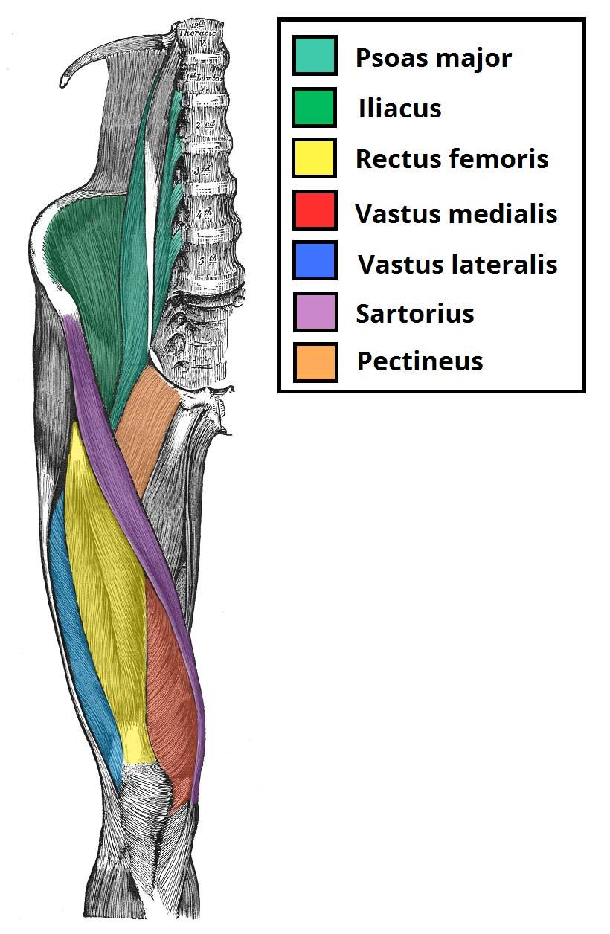
Anterior compartment of thigh
Click here
Min-7:15
Extensors of knee:
Quadriceps femoris
Muscle name | Rectus femoris | Vastus intermedius | Vastus Lateralis | Vastus medialis
origin | Anterior inferior iliac spine (hip bone) | front of shaft of femur (anterior & lateral ) | posterior border of femur (upper end and shaft of femur ) | posterior border of femur ( posterior border of femur ( upper end and shaft of femur)
insertion | into Patella (patella is a sesamoid bone) then form patella into Tuberosity of tibia through ligamentum patella ( patellar ligament )
action | Extension of knee joint
Nerve supply | Femoral nerve

Slide 5
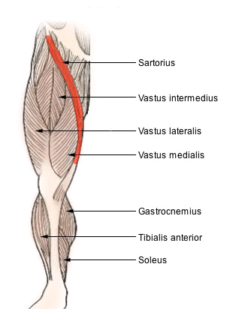
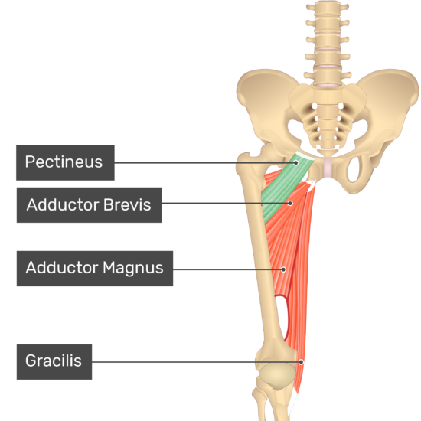
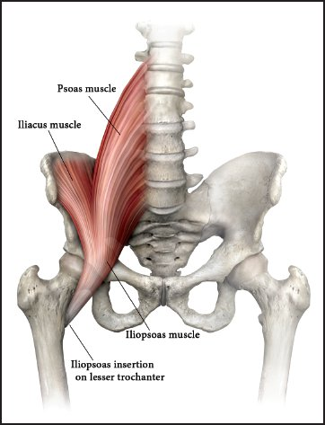
Anterior compartment of thigh
Flexors of hip:
Muscle name | Sartorius | Pectineus | Iliopsoas (Iliacus+psoas major)
Origin | Anterior superior iliac spine | superior pubic ramus | Iliacus :ilium of hip bone , psoas: transverse process of lumbar vertebrae
Insertion | upper part of medial surface of tibia | back of femur (below lesser trochanter) | lesser trochanter of femur
Action | (TAILOR’S POSITION) -flexion, abduction, lateral rotation of hip joint -flexion of knee joint | flexion,adduction of hip joint | flexion of hip joint (the main flexors)
Nerve supply | Femoral nerve
Mainly flexion of hip

Slide 6
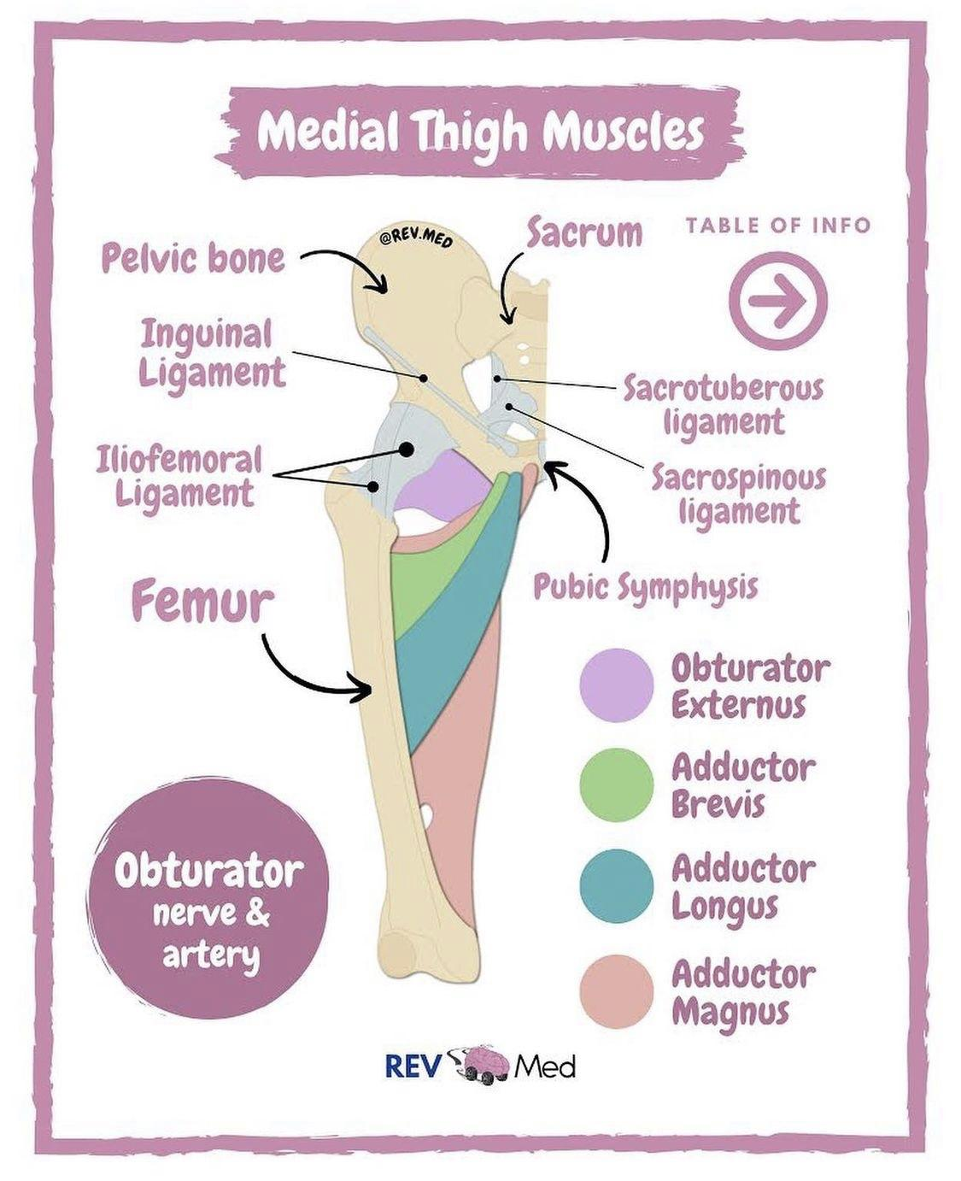
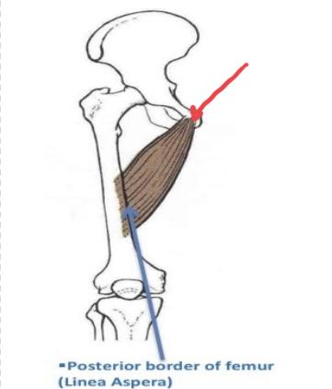
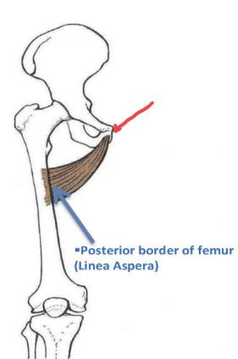
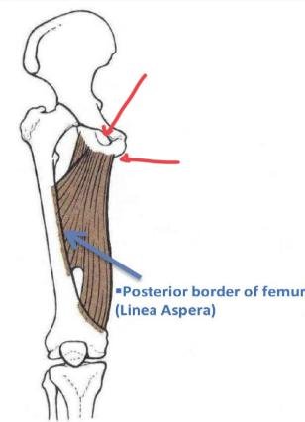
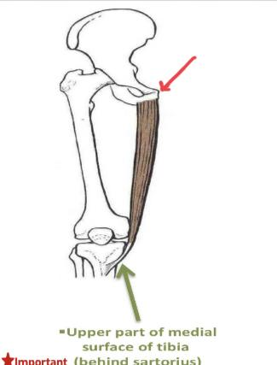
Medial compartment of the thigh
Click here
Muscle | Adductor longus | Adductor brevis | Adductor magnus (Adductor part) | Gracilis
Origin | Body of pubis | -Body of pubis -Inferior pubic ramus | -Inferior pubic ramus -Ischial ramus | -Inferior pubic ramus -Ischial ramus
Insertion | Posterior border of femur (Línea Aspera) |  |  | Upper part of medial surface of tibia (behind sartorius)
Action | Adduction of hip joint |  |  | -Adduction of hip joint -Flexes knee joint -Adduction og thigh
Nerve supply | Obturator nerve

Slide 7
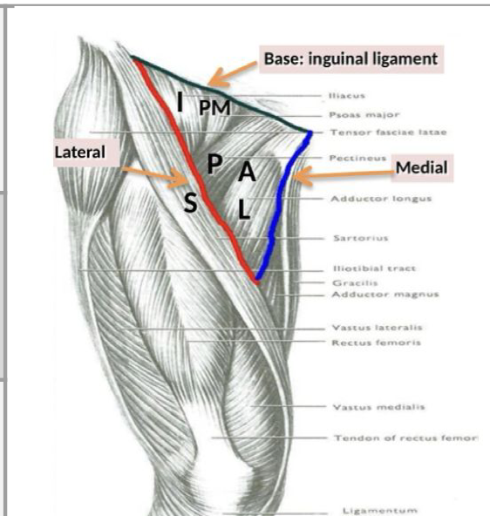
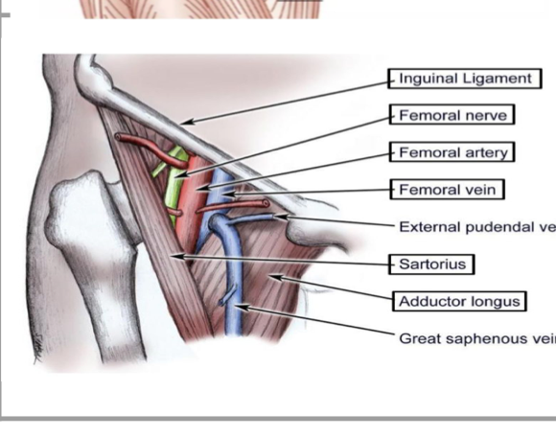
Femoral triangle
Click here
Site | Upper ⅓ of front of thigh
Boundaries | Base: inguinal ligament
 | Lateral: medial border of sartorius
 | Medial: medial border of adductor longus
Roof | •Skin •Fasciae (superficial & deep)
Floor (From medial to lateral) | •Adductor longus •Pectineus •Psoas major •iliacus
Contents | •Femoral vein •Femoral artery Both vein & artery are enclosed in a fascial envelope (femoral sheath) •Femoral nerve (No femoral sheath) Deep inguinal lymph nodes

Slide 8
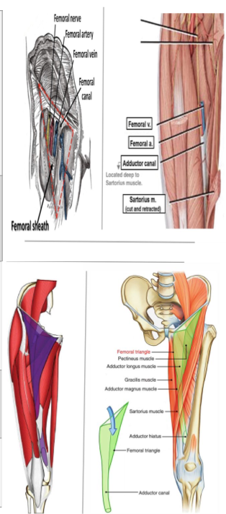
Adductor canal (Subsartorial canal)
Click here
Deﬁnition | Intramuscular passage of fascial envelope for femoral artery & vein to become the popliteal vessels in the popliteal fossa at the back of the knee
Site | In middle ⅓ of front of thigh
Extent | From apex of femoral triangle to adductor hiatus (in adductor magnus)
Boundaries | Roof: sartorius
 | Floor: adductor longus & magnus

Slide 9
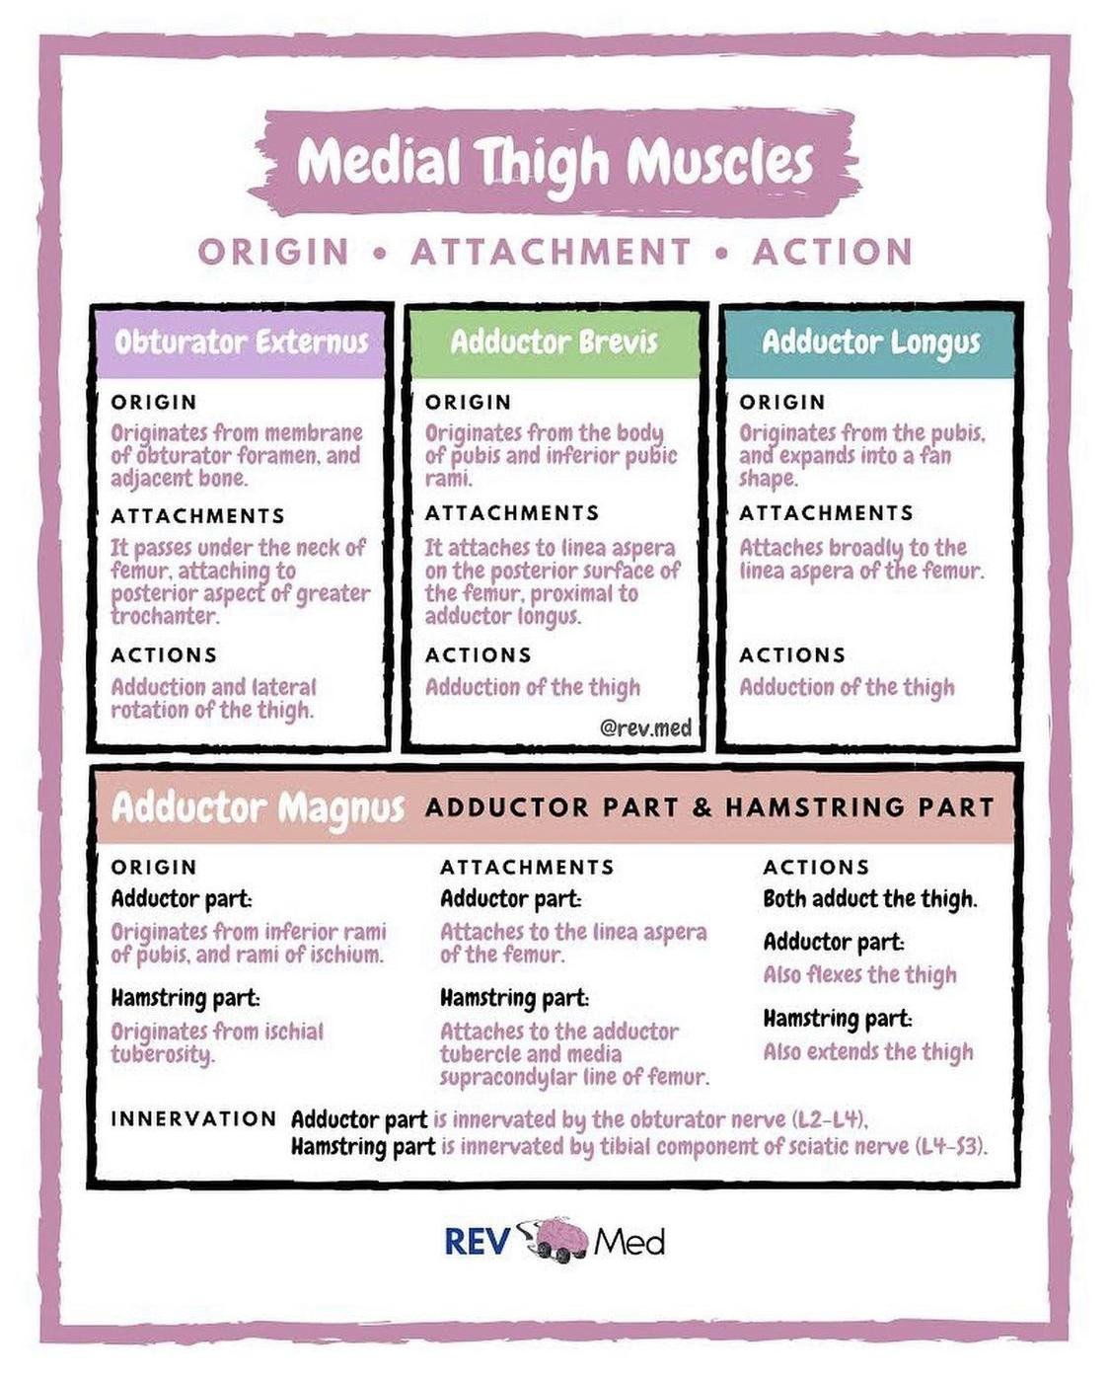
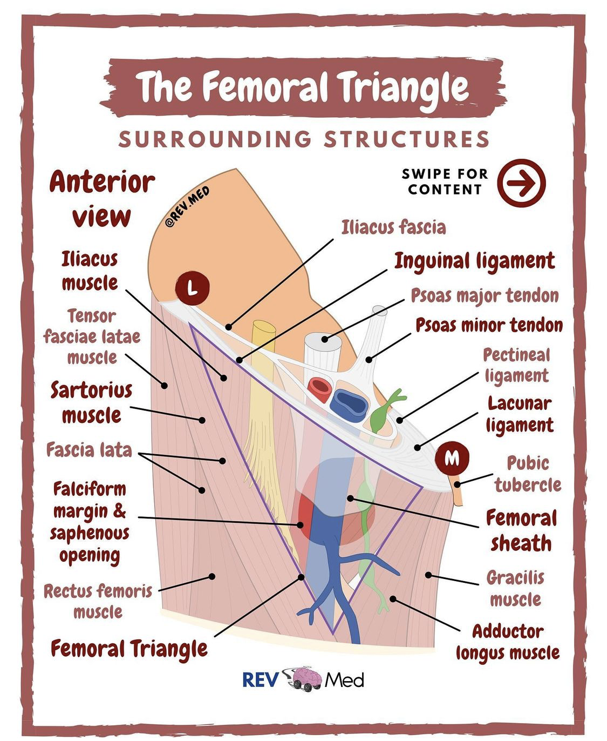
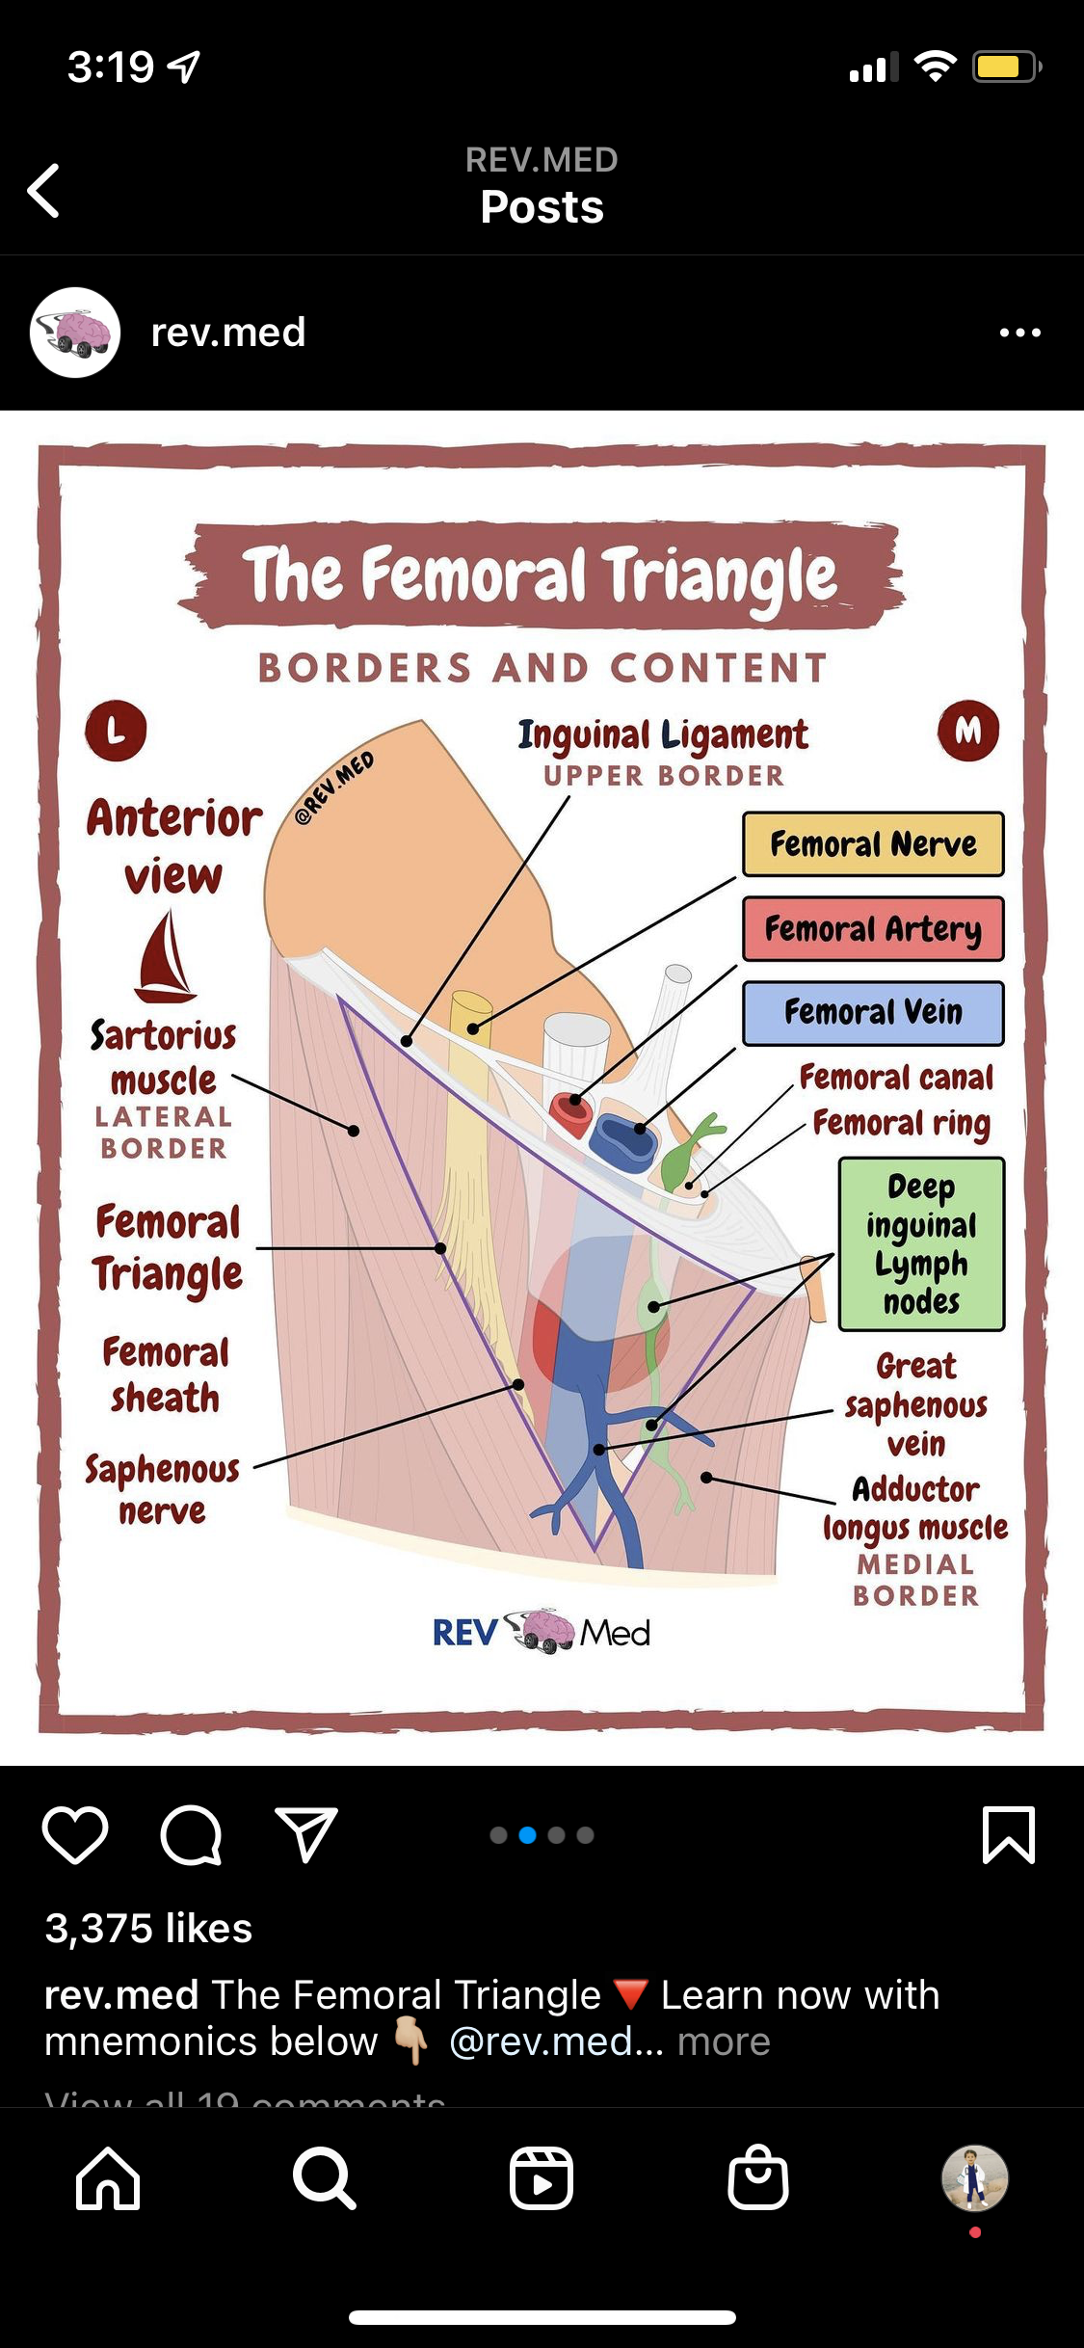
May help u!

Slide 10
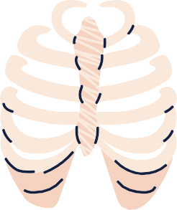
Here is a quizlet -flash cards- for revision
MCQs:
Click here
Which one of the following muscles is supplied by femoral nerve?
Q1
A
B
C
D
Sartorius
Gracilis
Adductor longus
Adductor brevis
Q2
Which of the following muscles is inserted into the tibia?
A
B
C
D
Sartorius
Pectineus
Iliacus
Adductor longus
Q3
Which one of the following is a roof of femoral triangle?
A
B
C
D
Iliacus
Skin
Inguinal ligament
Pectineus
Key answers:
1-A
2-A
3-B
Special thanks for 441 QBank!

Slide 11
MCQs:
The insertion of iliopsoas is?
Q4
A
B
C
D
Lesser trochanter of femur
Back of femur
Linea Aspera
Behind Sartorius
Q5
The Origin of the rectus femoris is?
A
B
C
D
Anterior superior iliac spine
Front of shaft of femur
Body of pubis
Anterior inferior iliac spine
Q6
The floor of subsartorial canal is?
A
B
C
D
Adductor longus
Adductor brevis
Adductor magnus
Both A&C
Key answers:
4-B
5-D
6-D
Special thanks for 441 QBank!

Slide 12
Done by the amazing team
Team leaders:
Arwa Alghamdi
Deema Aljuribah
Razan Alnufaie
Team leaders:
Mishal Alsuwayegh
Mohammed Alghamdi
Members:
Members:
Aljazi Albabtain
Atheer Alkanhal
Arob Alasheikh
Ajwan Aljohani
Deema alqahtani
Dena Alsuhaibani
Farah alqazlan
Jana Alhazmi
Kadi aldosari
Mashael Alasmari
Noura Bin hammad
Najla aldhbiban
Nouf aldalaqan
Razan alasmari
Roaa alharbi
Raghad Mohammed
Shaden albassam
Waha Almathami
Walaa AlMutawa
Yara Ameer Alalwan
Othman Aldraihem
Faisal Alomar
Abdullah Alturki
Othman Alabdullah
Omar Alkadhi
Abdullah Ali
Meshari Alshathri
Yazeed Alsanad
Fahd Mobaireek
Emad Almutairi
Nasser Alghaith
Saad Almogren
Azzam Abdullah Alotaibi
Hassan Ali Alabdullatif
Rayan Alotaibi
Mohammed Nasser
Luay Almutair
Mohammed Fahad
Mohammed Majed
Abdulkarim Salman
anatomyteam442@gmail.com
Thanks to Faisal Alomar for his design of the team logo

