Slide 1
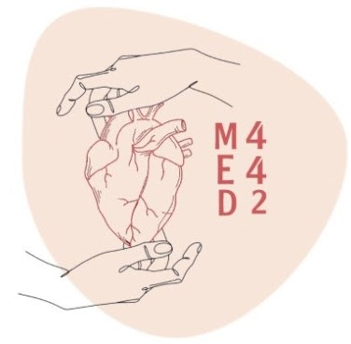
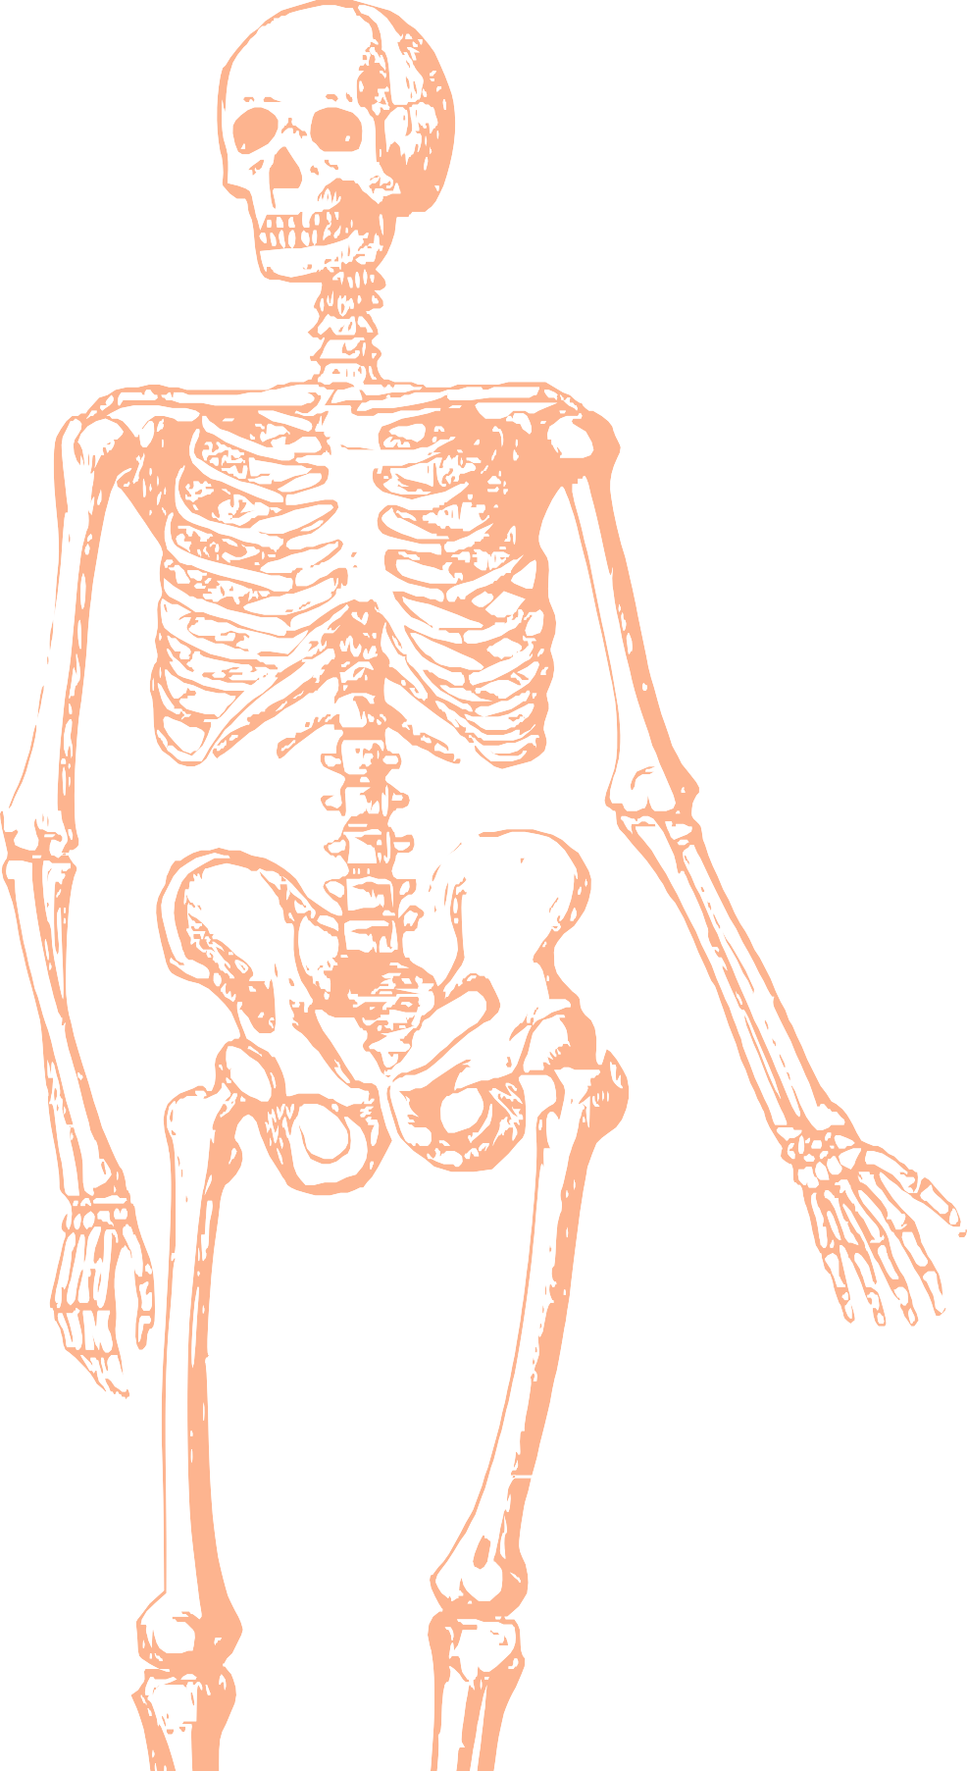
L13
Gluteal Region and Back of the Thigh
Editing file
Color index:
Mine text
Important
Doctors notes
Female slides only
Male slides only
Extra

Slide 2
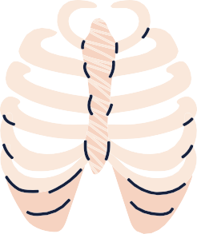
OBJECTIVES
identify Contents of the gluteal region:
3 Glutei muscles: Gluteus maximus, medius and minimus.
Other 5 Small muscles: Piriformis, Obturator internus, Superior gemellus, Inferior gemellus and Quadratus femoris.
Nerves & vessels.
Foramina: 1-Greater Sciatic Foramen. 2-Lesser Sciatic Foramen.
Back of the thigh: Hamstring muscles.

Slide 3
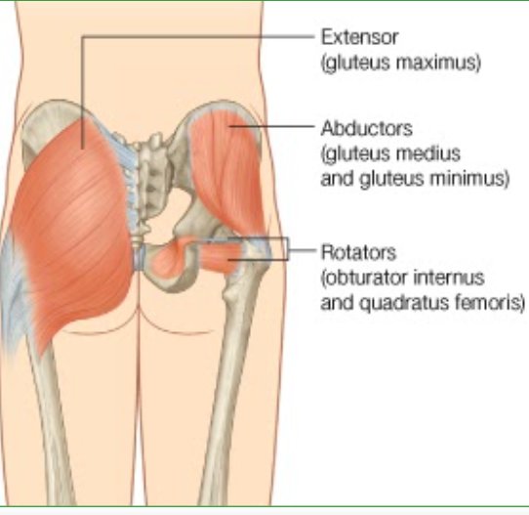
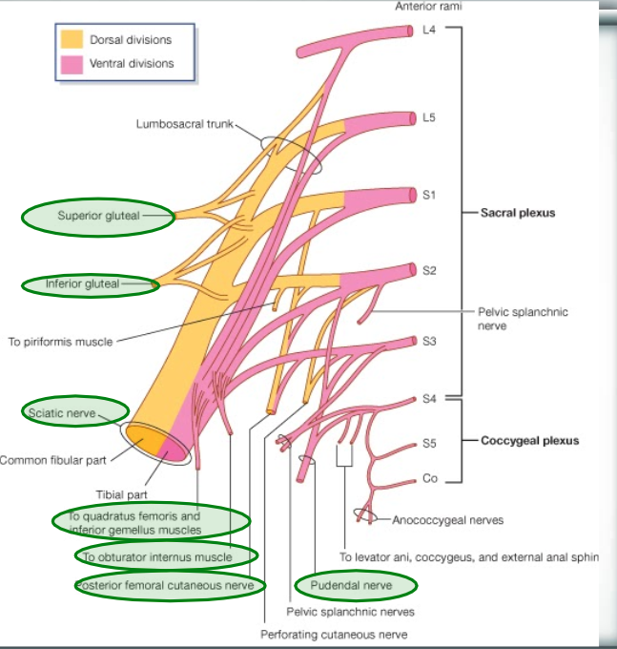
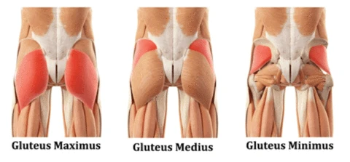
CONTENTS of gluteal region
2-NERVES
1-Muscles
(all from sacral plexus):
Sciatic nerve.
Superior gluteal n.
Inferior gluteal n.
Posterior cutaneous nerve of thigh.
Nerve to obturator internus.
Nerve to quadratus femoris.
Pudendal nerve. The Doctor said it not important “The Pundendal”
A- GLUTEI:
Gluteus maximus.
Gluteus medius.
Gluteus minimus.
B- GROUP OF SMALL MUSCLES:
Piriformis.
Obturator internus.
Superior gemellus.
Inferior gemellus.
Quadratus femoris
(all 5 muscles do lateral rotation).

Slide 4
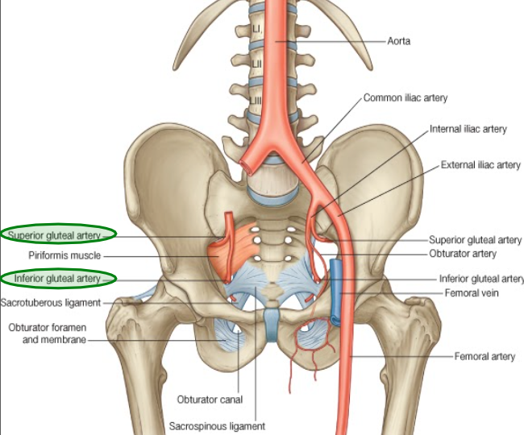
3-VESSELS
(all from internal iliac vessels):
Superior gluteal vessels.
Inferior gluteal vessels.
Internal pudendal vessels. The Doctor Said it is not important

Slide 5
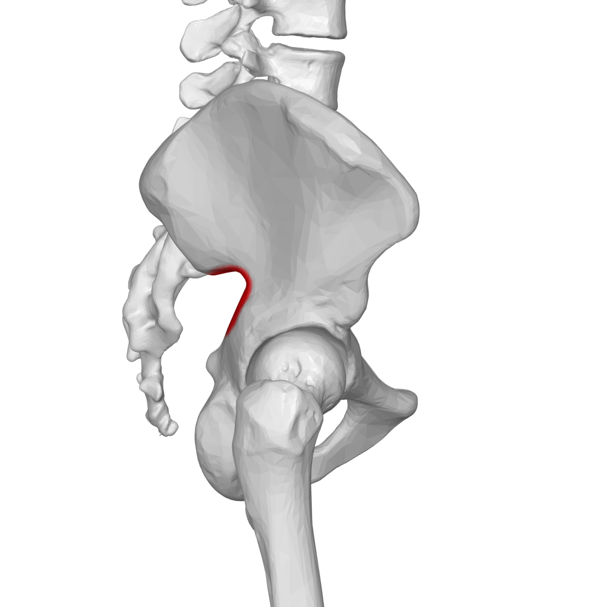
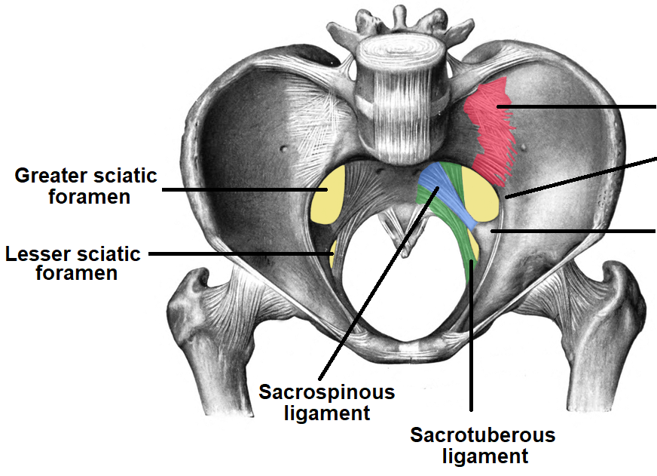
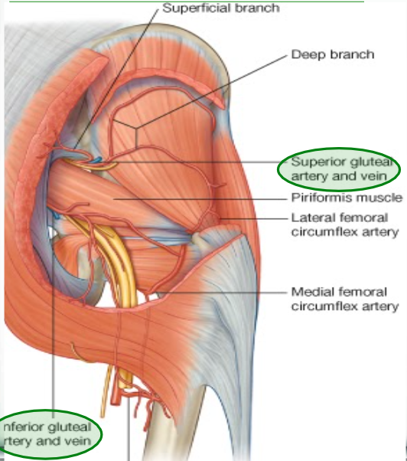
Greater & lesser sciatic foramen
Greater sciatic notch of hip bone is transformed into foramen
by sacrotuberous & sacrospinous ligaments.
Lesser sciatic notch of hip bone is transformed into foramen
by Sacrotuberous & sacrospinous ligaments.
Structures passing through Greater sciatic foramen :
Piriformis muscle.(landmark for greater sciatic foramen)
Above piriformis:
-Superior gluteal nerves & vessels.
Below piriformis:
-Inferior gluteal nerves & vessels.
-Sciatic nerve.
-Posterior cutaneous nerve of thigh.
-Nerve to quadratus femoris.
-Nerve to obturator internus.
-Pudendal Nerve.
-Internal pudendal vessels.
Structures passing through Lesser sciatic foramen :
-Tendon of obturator internus.
-Nerve to obturator internus.
-Pudendal nerve.
-Internal pudendal vessels.
(no sciatic nerve)
Important you should know what passes through and which below and above
Tendon of obturator internus only in lesser sciatic foramen while the rest of them can goes into Greater Sciatic foramen

Slide 6
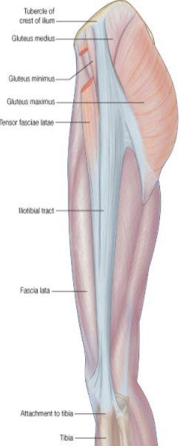
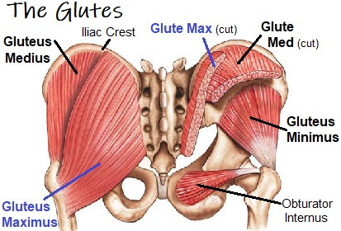
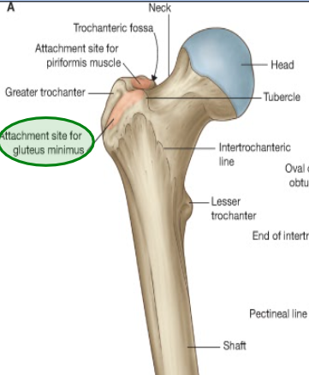
Glutei Muscles
ORIGINS:
Gluteus minimus:
Anterior part of the gluteal surface of ilium
Gluteus medius:
Middle part of the gluteal surface of ilium.
Gluteus maximus:
Posterior part of the gluteal surface of ilium.
Main origin of gluteus maximus:
Back of sacrum & coccyx & back of Sacrotuberous ligament
Insertion:
Gluteus minimus: anterior surface of the greater trochanter
Gluteus medius: lateral surface of the greater trochanter
Gluteus maximus:
Main insertion: iliotibial tract
Other insertion: gluteal tuberosity of the femur.

Slide 7
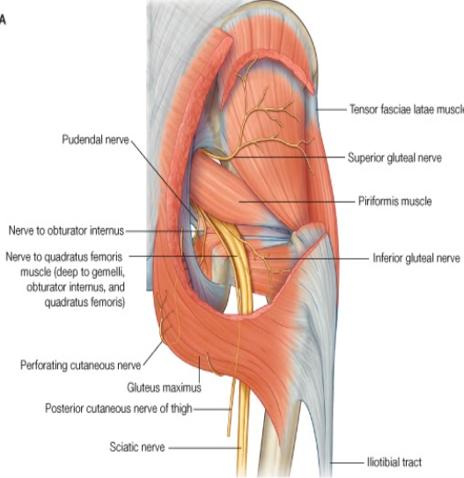
NERVE SUPPLY & ACTION of Gluteus Muscles
Gluteus medius & minimus:
Nerve supply:
Superior gluteal nerve.
Action:
Abduction & Medial rotation of hip joint.
Gluteus maximus:
Nerve supply:
Inferior gluteal nerve.
Action:
Extension & lateral rotation of the hip joint.
Through its attachment to iliotibial tract, it stabilizes the femur on the tibia during standing.

Slide 8
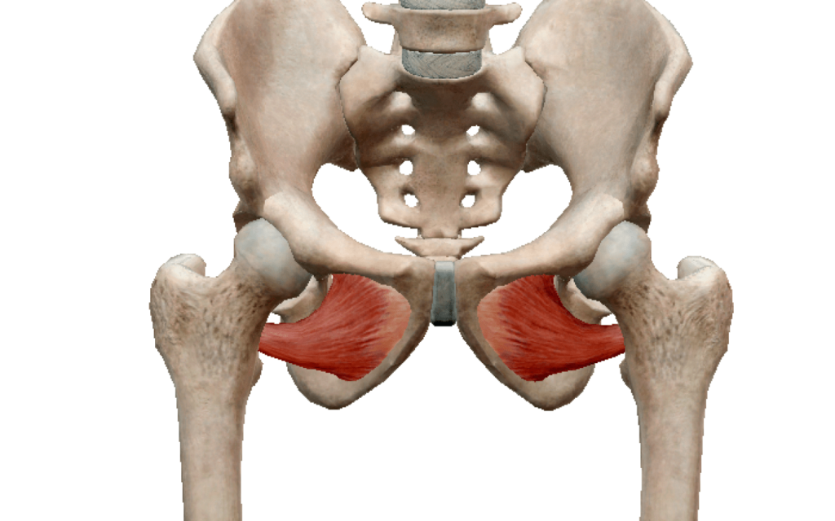
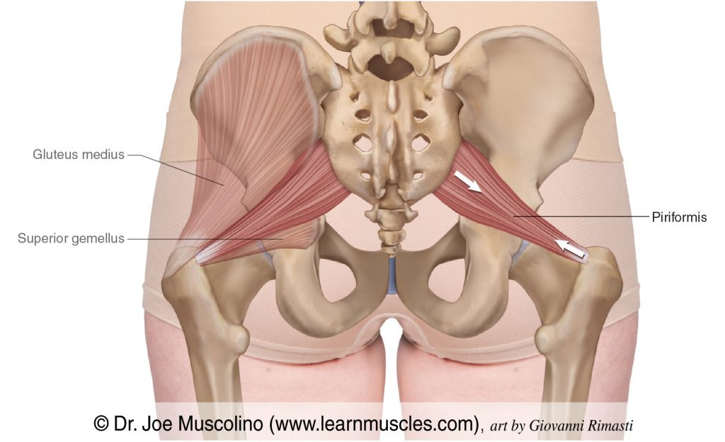
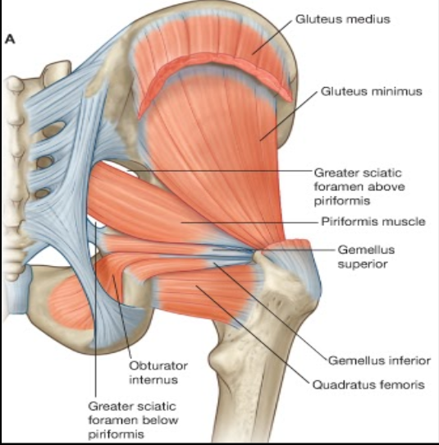
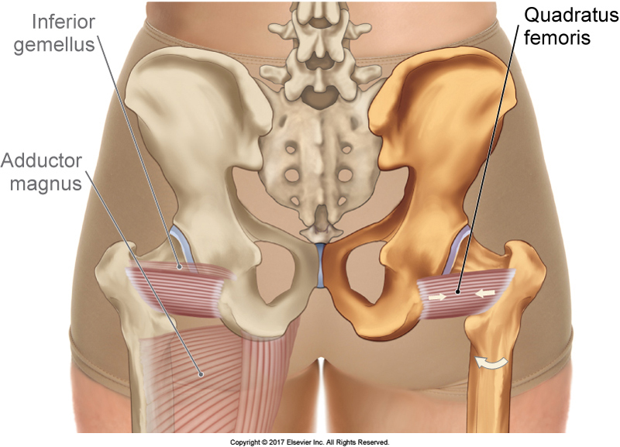
Small muscles
1-Obturator Internus:
Origin:
Side wall of the pelvis.
Insertion:
Greater trochanter.
Nerve supply:
Nerve to obturator internus.
2,3-Superior & Inferior Gemelli:
Origin:
Upper and lower part of lesser sciatic notch respectively.
Insertion:
Into tendon of obturator internus.
Nerve supply:
Superior gemellus: nerve to obturator internus.
Inferior gemellus: nerve to quadratus femoris.
4-Piriformis:
Origin:
Pelvic surface of middle 3 sacral vertebrae.
Insertion:
Greater trochanter.
Nerve supply:
Anterior rami of S1,2.
5-Quadratus femoris:
Origin:
Ischial tuberosity.
Insertion:
Quadrate tubercle.
Nerve supply:
Nerve to quadratus femoris.
Nerve Supply : ماله اسم محدد
Action: All have SIMILAR ACTION: Lateral rotation of the hip joint.
Control movement of the hip joint.

Slide 9
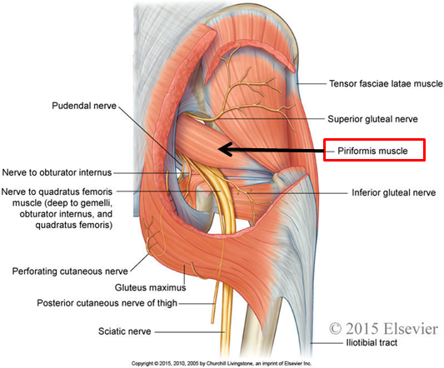
Nerves in Gluteal Region
Helpful video
Helpful Video
Superior gluteal Nerve
Inferior gluteal Nerve
Nerve to quadratus femoris Nerve
Posterior cutaneous nerve to thigh
Sciatic nerve
Nerve to obturator internus

Slide 10
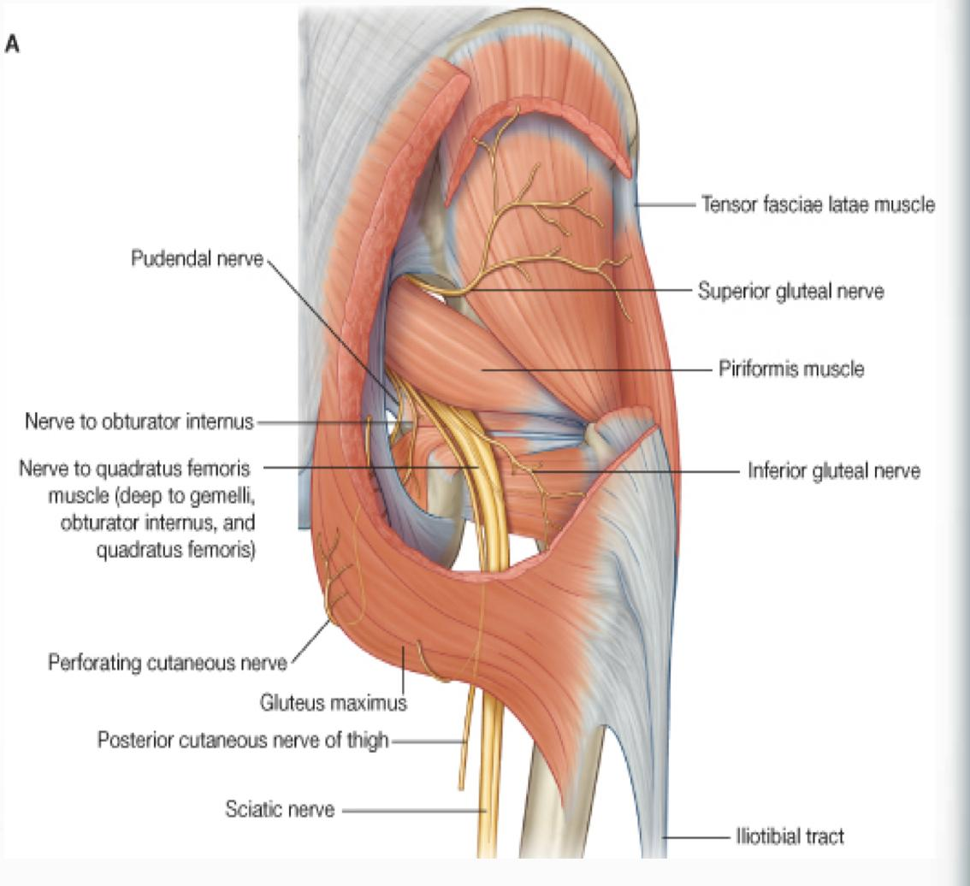
NERVES
SUPERIOR GLUTEAL NERVE:
INFERIOR GLUTEAL NERVE;
NERVE TO QUADRATUS FEMORIS
Course:
Passes through GSF , Below Piriformis
Branches:
Gluteus Maximus
Course :
Passes through GSF , Below Piriformis
Branches:
-Muscular to Quadratus Femoris & inferior gemellus
-Articular to Hip Joint
Course:
-Passes through GSF , Above Piriformis
Branches:
-Muscular to Gluteus Medius,Minimus & tensor fasciae lata muscle.
-Articular to Hip Bone
GSF= Greater Sciatic Foramen

Slide 11
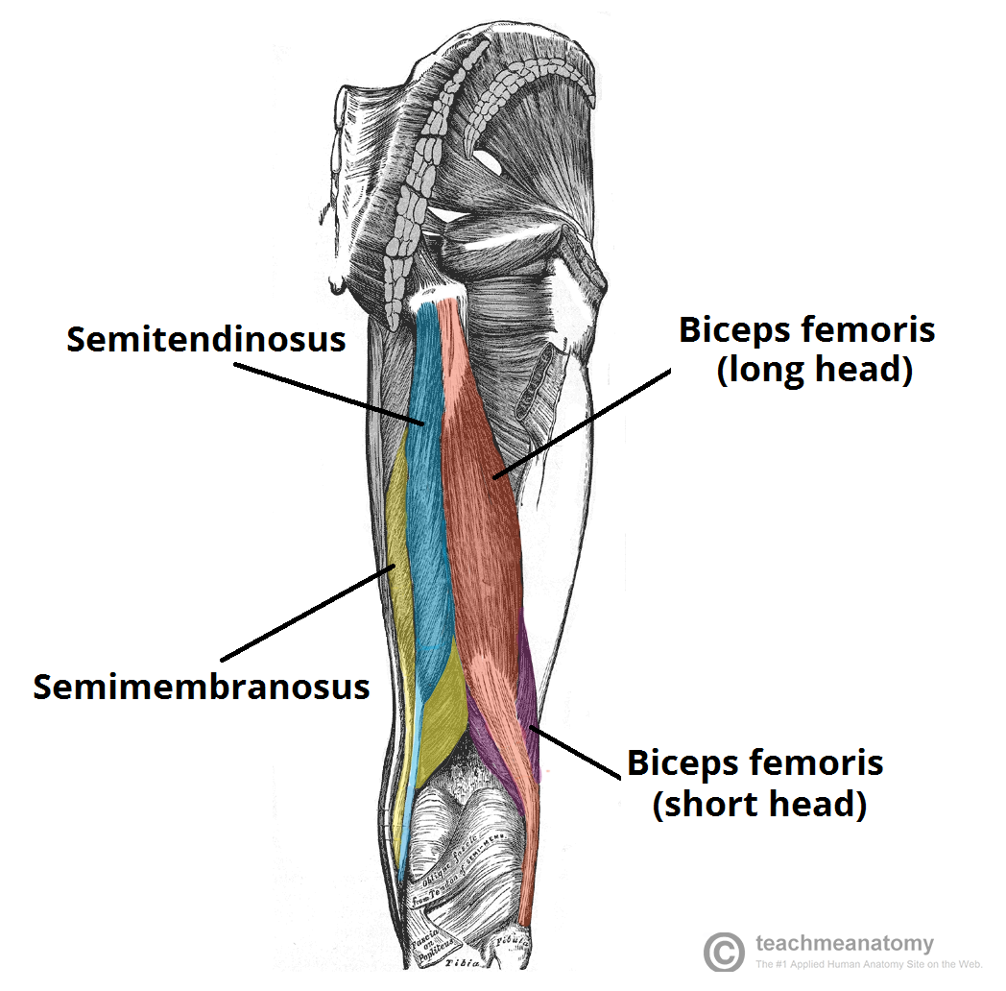
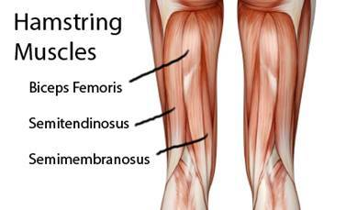
POSTERIOR COMPARTMENT OF THE THIGH
(HAMSTRINGS) :
Helpful video
Helpful Video
Biceps femoris
Semitendinosus
Semimembranosus
Ischial part of adductor magnus
Blood supply : branches of profunda femoris artery
nerve supply : sciatic nerve
Adductor Magnus have two parts:
1- Adductor part (Medial compartment of the
thigh)
2- Hamstring part ( Posterior compartment of
the thigh)
- Each have different action and different
nerve supply.
All the posterior compartment of the
thigh will be supplied by tibial part
of the sciatic EXCEPT the short head
of biceps femoris will be supplied by
the common peroneal part of the
sciatic

Slide 12
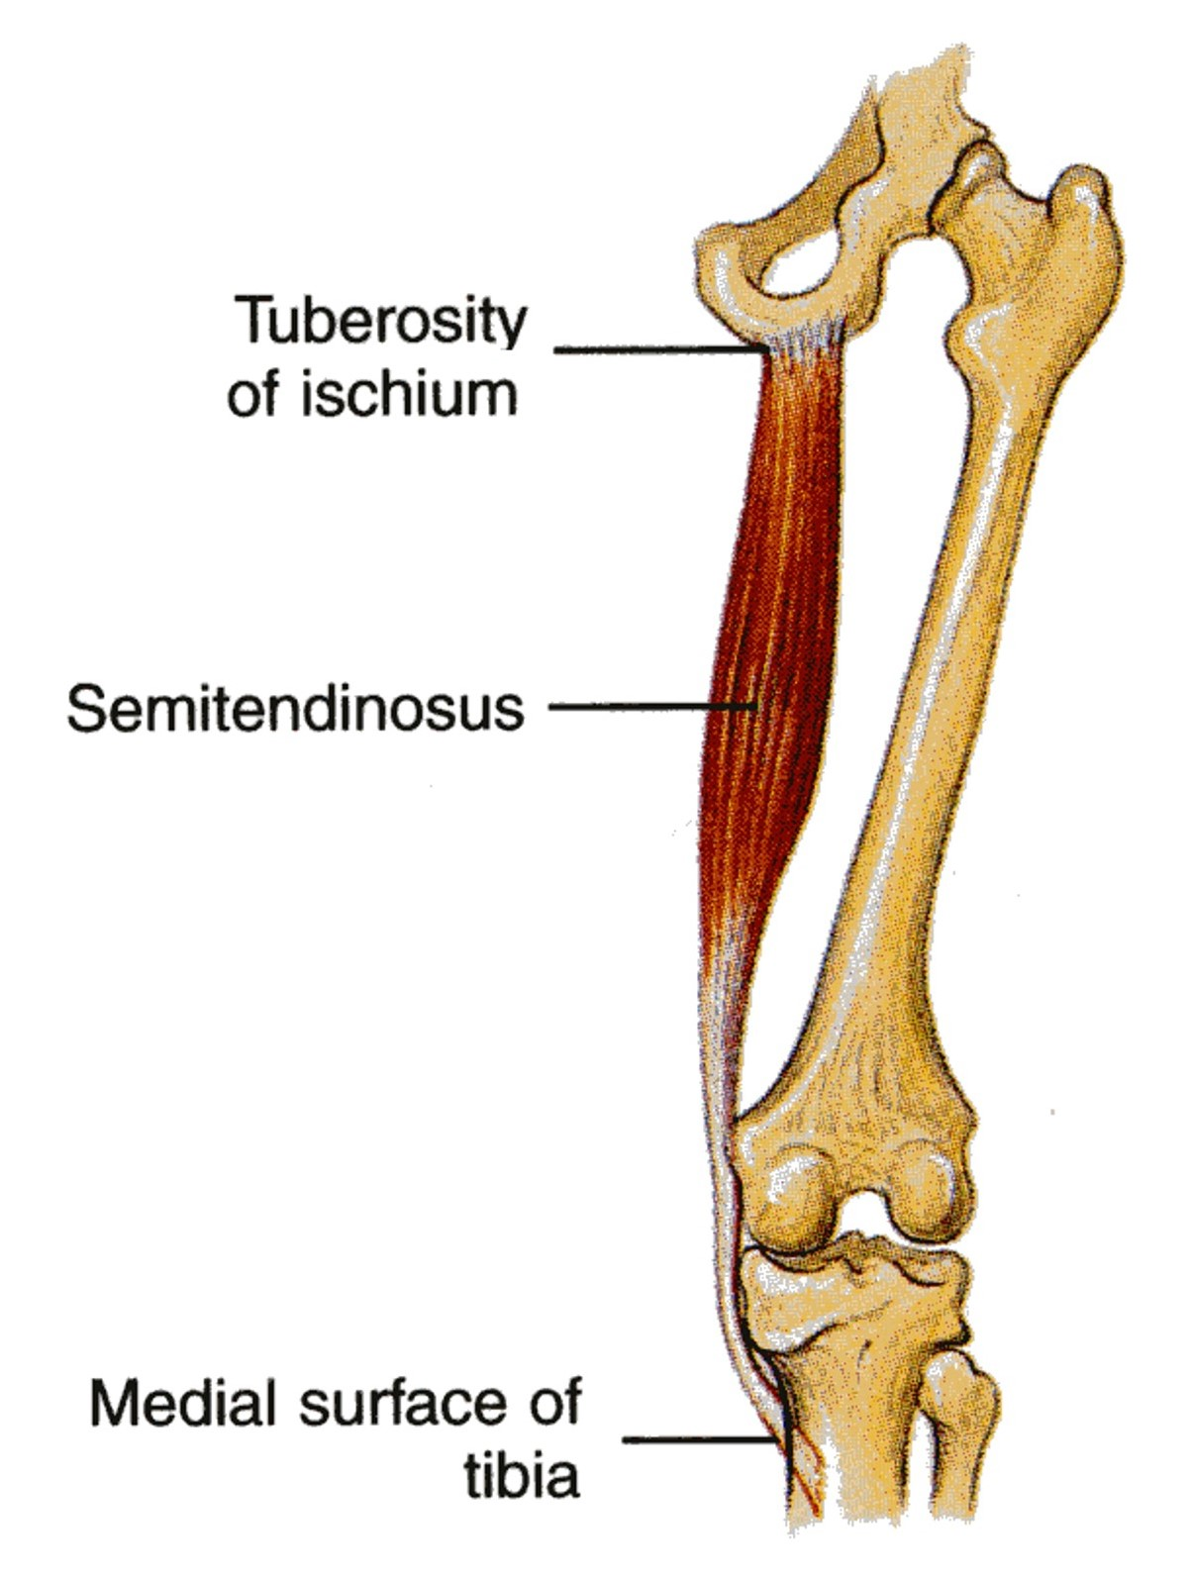
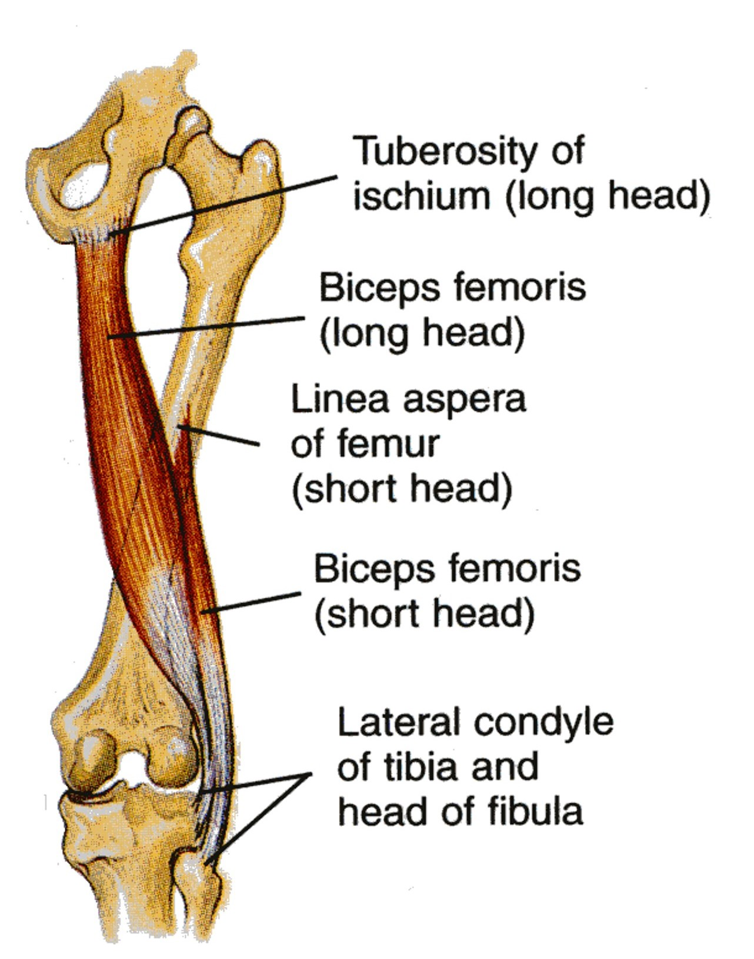
Muscles
Biceps Femoris
Semitendinosus
Origin :
long head : from the ischial tuberosity
short head : from the linea aspera
Origin :
Ischial tuberosity
Insertion :
Upper part of the medial surface of the shaft of the tibia (SGS)
Insertion : head of fibula
S= Sartorius - G=Gracilis - S=Semitendinosus
الدكتور يقول ان كل الانسيرشن حقهم في نفس المكان اللي هو ال
Tibia
Nerve supply :
long head : tibial part of the sciatic nerve
short head : common peroneal part of the sciatic nerve
Nerve supply :
Tibial sciatic nerve
Action :
Flexion of the knee joint
Medial rotation of the leg
Extends the thigh at the hip joint
Action :
1. flexion of knee.
2. Lateral rotation of flexed leg.
3.Long head extends the hip.

Slide 13
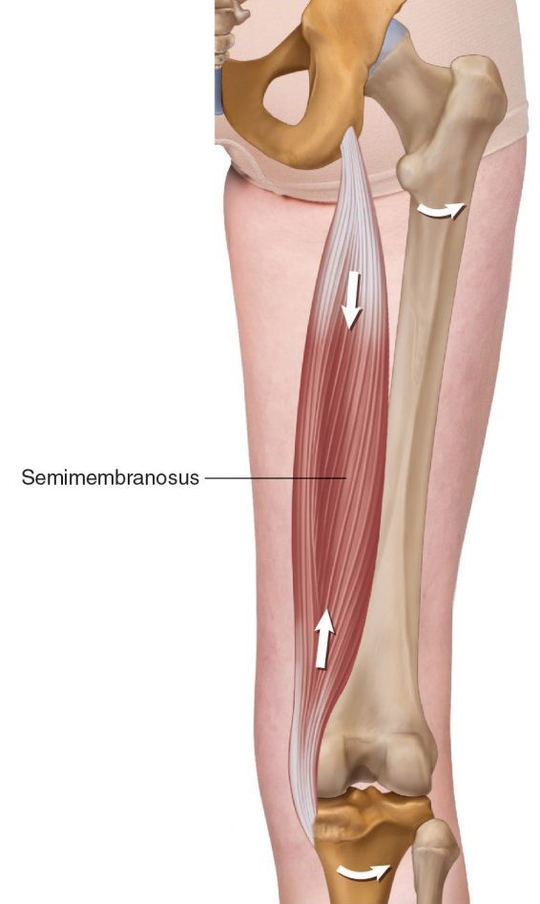
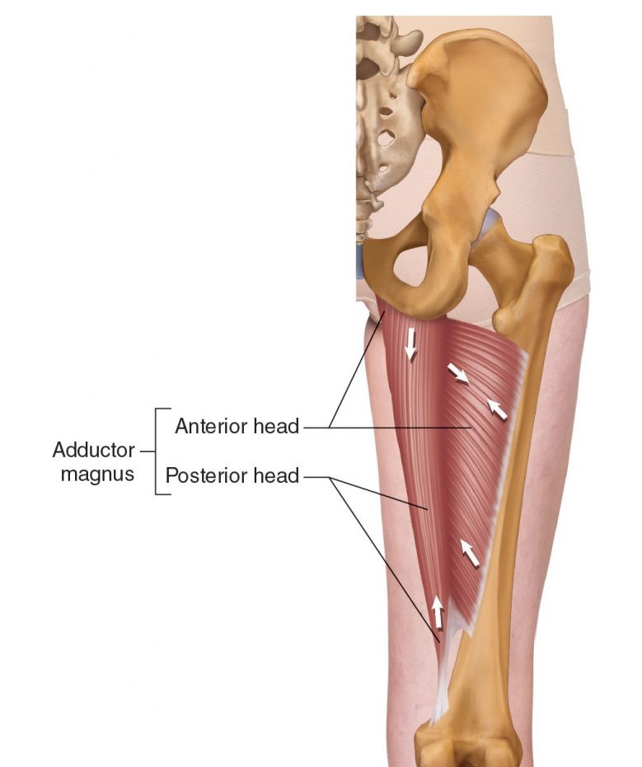
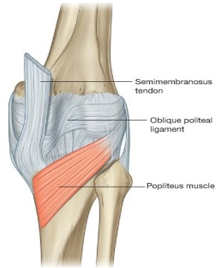
Muscles
Semimembranosus
Adductor magnus
Origin :
Ischial tuberosity
Origin :
Ischial ramus and ischial tuberosity
Insertion :
posterior surface of the medial condyle of the tibia
Insertion :
Adductor tubercle of the medial condyle of the femur
•It forms the oblique popliteal ligament, which reinforces the capsule on the back of the knee joint.
Nerve supply :
Tibial part of the sciatic nerve
Nerve supply :
Tibial part of the sciatic nerve
Action :
Extends the thigh at the hip joint
Action :
Flexion of the knee joint
Medial rotation of the leg
Extends the thigh at the hip joint

Slide 14
The Doctor said The Nerve Supply (sciatic nerve) it will be explained in details in Sciatic Nerve Lecture

Slide 15
MCQs:
Structures that pass through Greater sciatic foramen
Q1
A
B
C
D
Pudendal nerve
Piriformis muscle
Tendon of obturator internus
a A&B
Q2
Action of Gluteus maximus
A
B
C
D
Flexion
Extension
Medial rotation
none
Q3
Nerve supply of Inferior gemellus
A
B
C
D
nerve to quadratus femoris.
nerve to obturator internus.
Inferior gluteal nerve
Anterior rami of S1,2
Q1;D
Q2;B
Q3;A

Slide 16
MCQs:
The origin of the long head of biceps femoris
Q4
A
B
C
D
From the linea aspera
From the ischial tuberosity
From the ischial ramus
None of the above
Q5
Nerve that supply the short head of biceps femoris
A
B
C
D
common peroneal part of the s sciatic nerve
tibial part of the sciatic nerve
Inferior gluteal nerve
Posterior cutaneous nerve
Q6
Action of the semitendinosus
A
B
C
D
Flexion of the knee joint
Extends the thigh at the hip
Medial rotation of the leg
All of the above
Q4. B
Q5. A
Q6. D

Slide 17
Done by the amazing team
Team leaders:
Arwa Alghamdi
Deema Aljuribah
Razan Alnufaie
Team leaders:
Mishal Alsuwayegh
Mohammed Alghamdi
Members:
Members:
Aljazi Albabtain
Atheer Alkanhal
Arob Alasheikh
Ajwan Aljohani
Deema alqahtani
Dena Alsuhaibani
Jana Alhazmi
Kadi aldosari
Mashael Alasmari
Noura Bin hammad
Najla aldhbiban
Razan alasmari
Roaa alharbi
Raghad Mohammed
Shaden albassam
Waha Almathami
Walaa AlMutawa
Yara Ameer Alalwan
Othman Aldraihem
Faisal Alomar
Abdullah Alturki
Othman Alabdullah
Omar Alkadhi
Abdullah Ali
Meshari Alshathri
Yazeed Alsanad
Fahd Mobaireek
Emad Almutairi
Nasser Alghaith
Saad Almogren
Azzam Abdullah Alotaibi
Hassan Ali Alabdullatif
Rayan Alotaibi
Mohammed Nasser
Mohammed Fahad
Mohammed Majed
Abdulkarim Salman
Saleh Aldeligan
Thanks to Faisal Alomar for his design of the team logo
anatomyteam442@gmail.com

