Slide 1
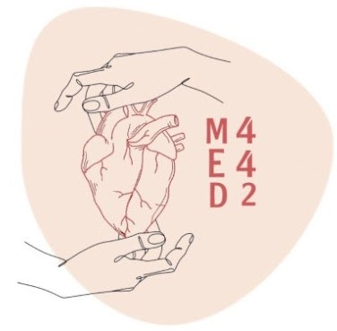
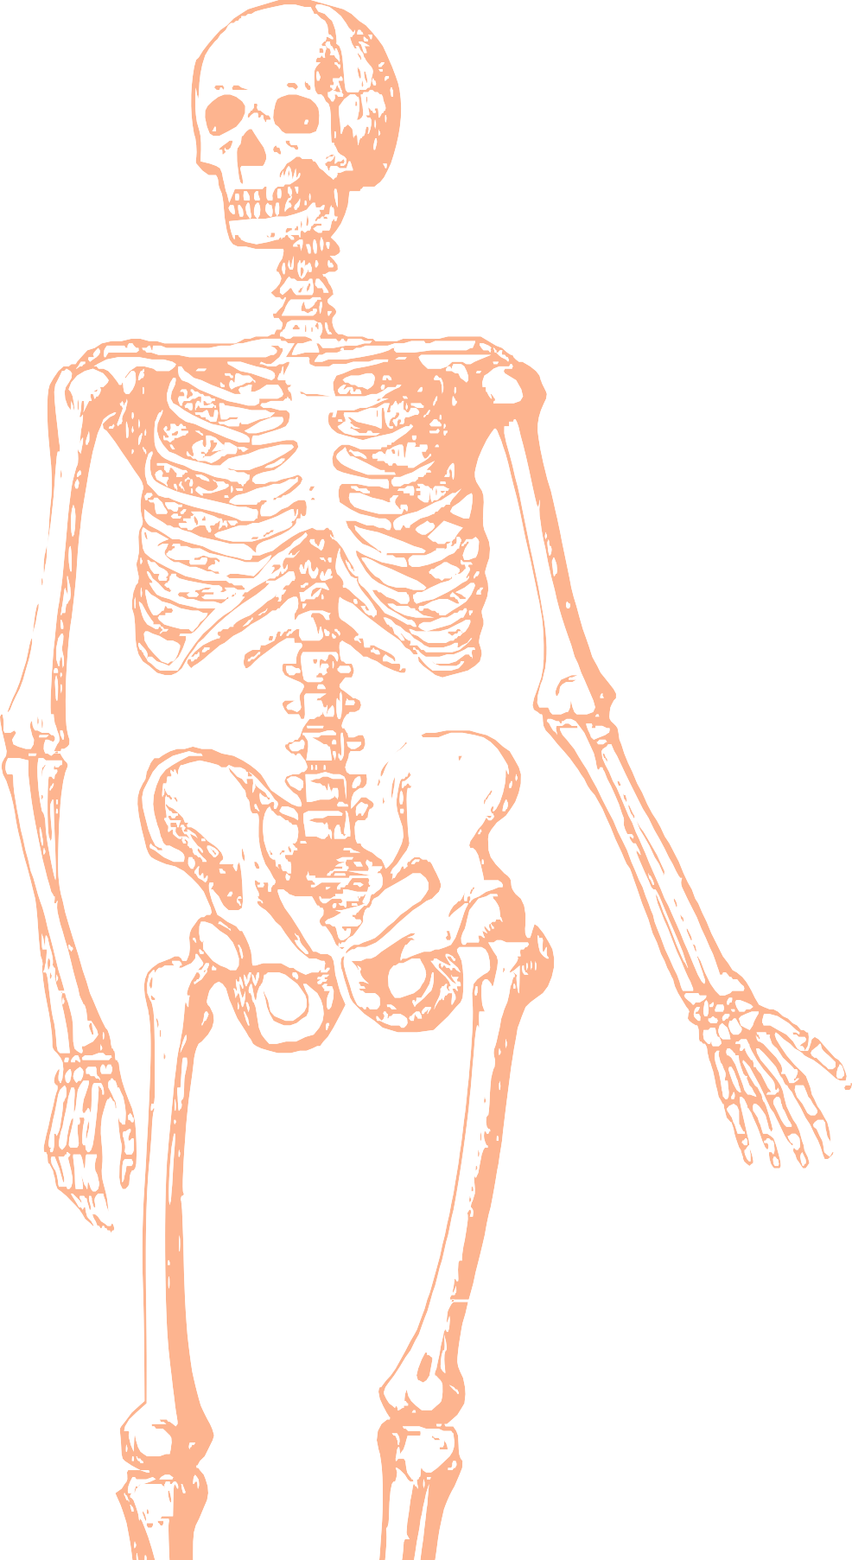
L14
Sciatic nerve
Editing file
Color index:
Main text
Important
Doctors notes
Female slides only
Male slides only
Extra

Slide 2
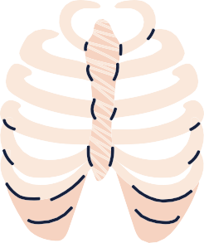
Objectives:
➔ Describe the anatomy (origin,
course and distribution) of the
sciatic nerve.
➔ List the branches of the sciatic
nerve.
➔ Describe briefly the main motor
and sensory manifestations in
case of injury of the sciatic
nerve or its main branches.

Slide 3
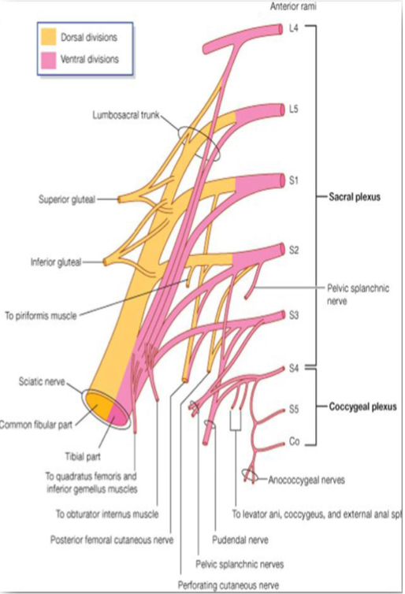
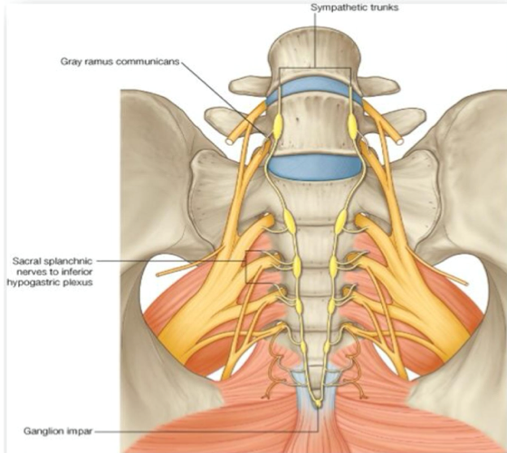
Sciatic Nerve
Sacral Plexus
★ From the Sacral Plexus
(L4,L5,S1,S2,S3)
★ It is the largest branch of the
plexus.
★ It is the largest nerve of the
body
Site:
Formation:
★ On the posterior pelvic wall.
★ In front of Piriformis
muscle.
Origin
★ Ventral (anterior) rami of a part of L4 & whole L5 vs (lumbosacral trunk) + S1,S2,S3 and most of S4.

Slide 4
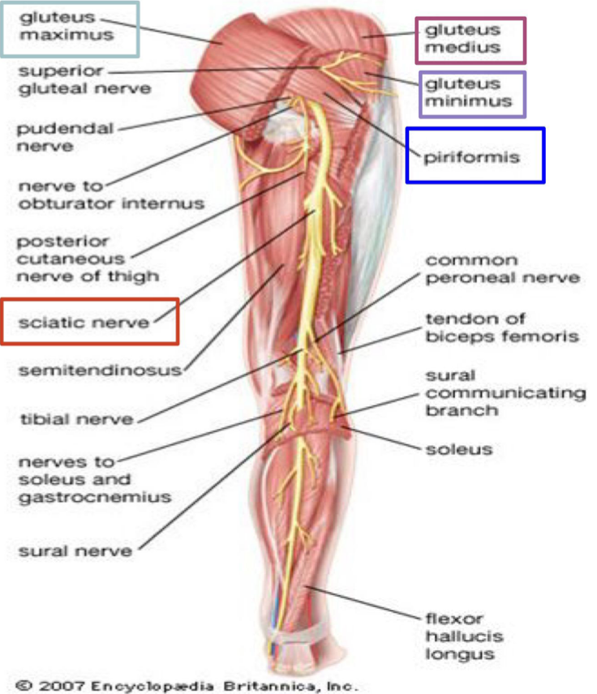
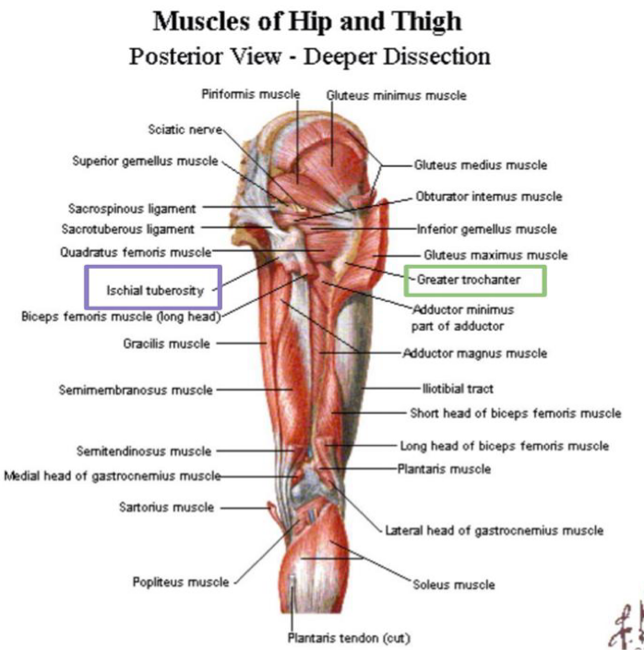
Sciatic Nerve contd..
★ The sciatic nerve leaves the pelvis through greater sciatic foramen, below the piriformis muscle.
★ It passes in the gluteal region midway (between ischial tuberosity & greater trochanter)
★ Then it enters the posterior compartment of the thigh.
Course &
Distribution
★ In the middle of the back of the thigh it divides into 2 terminal
branches:
1. Tibial (medial popliteal)
2. Common Peroneal, or lateral popliteal (Fibular)
Termination

Slide 5
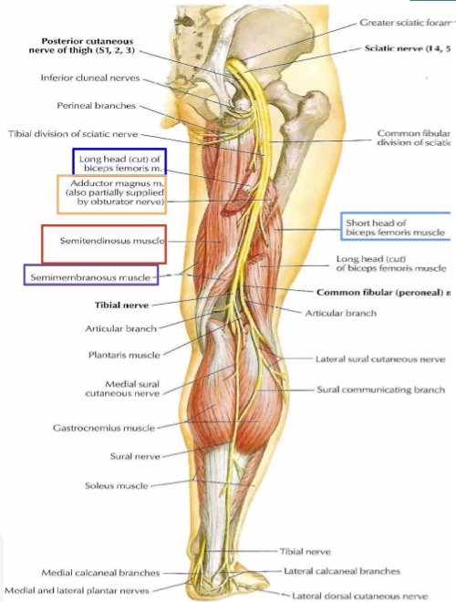
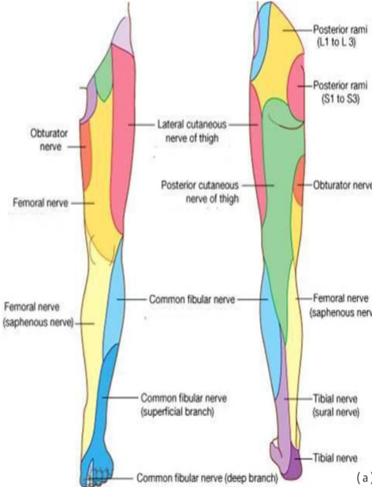
Cutaneous (a)
Branches of Sciatic
Nerve
Muscular (b)
(To Hamstring)

Slide 6
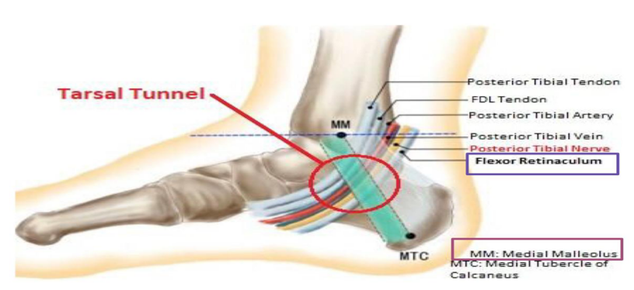
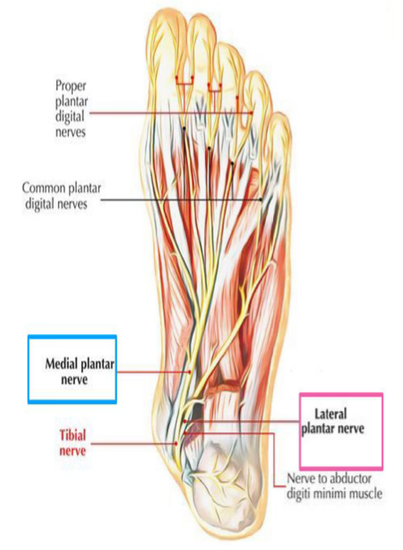
Tibial Nerve
Descends through
popliteal fossa to
posterior compartment
of leg.
In the sole it divides
into 2 terminal
branches:
1. Medial plantar
nerve.
2. Lateral plantar nerve.
Course:
Accompanied with
posterior tibial vessels.
Muscular Branches
ONE inventor
of
the foot
(tibialis
posterior)
Intrinsic
muscles of
sole.
Muscles of posterior compartment of leg (plantar flexors of the ankle, flexors of toes).
Note:
اثني اصابع رجلك
(Flexion of toes).
Passes deep to flexor retinaculum (through the tarsal tunnel, behind medial malleolus) to reach the sole of foot.
Note:
كيف يوقف على أطراف اصابعه والكعب لفوق ؟
( Plantar flexion).
Note: tibial nerve is superficial, however tibial artery is deep.
(فالنیرف أكثر عرضة للحوادث)

Slide 7
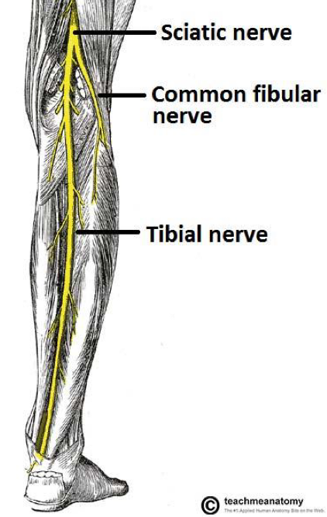
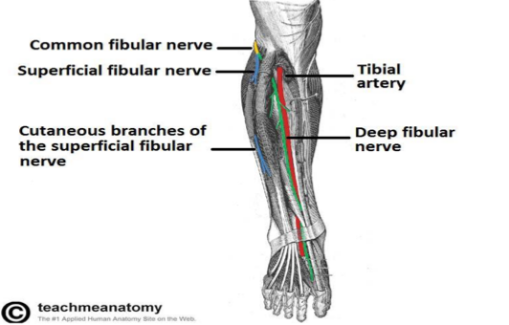
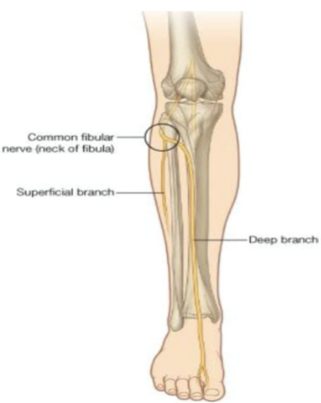
Common peroneal ( fibular) Nerve
Surgical neck of
the fibula.
Leaves popliteal fossa & turns around the lateral aspect of neck
of fibula (dangerous position) (uncovered by muscle)
It enters the upper part of the substance of peroneus
longus muscle where it divides into:
1 》Superficial peroneal or (musculocutaneous):
To supply lateral compartment of the leg.
2 》Deep peroneal or (anterior tibial)
To supply anterior compartment of the leg.
Muscular
branches
Muscles of anterior & lateral compartment of
the leg
Muscular Branches
Course:
Dorsiflexors of ankle.
Evertors of foot
Extensors
of toes

Slide 8
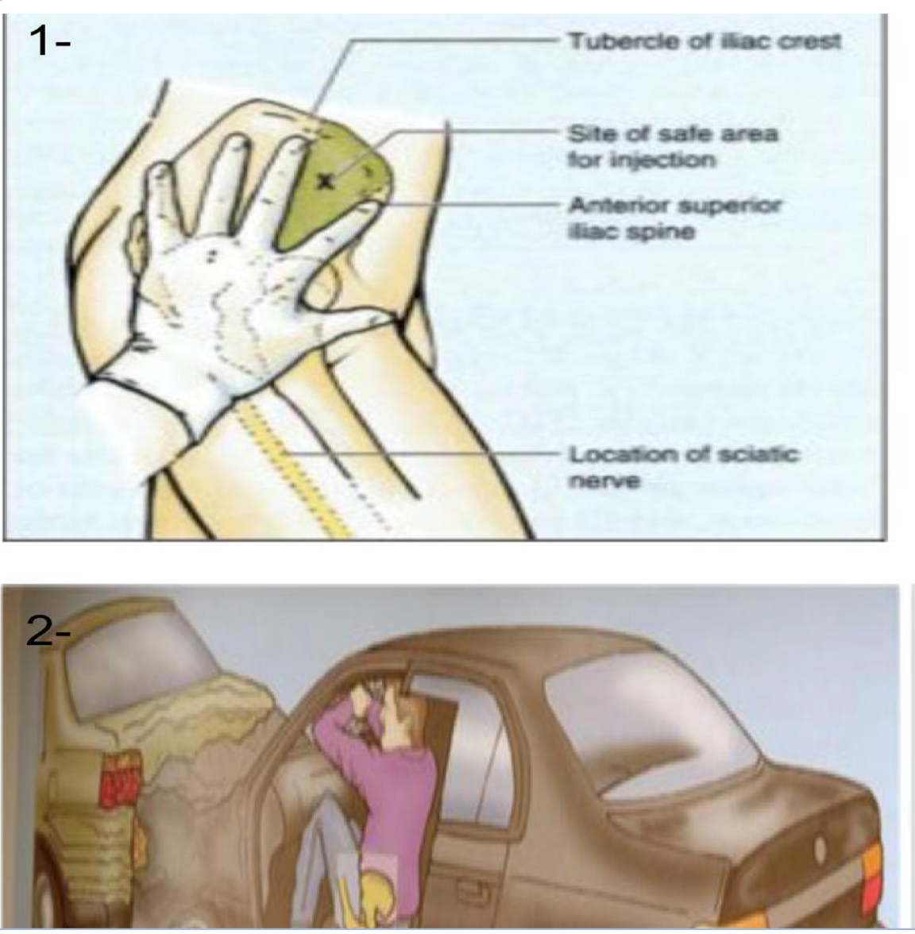
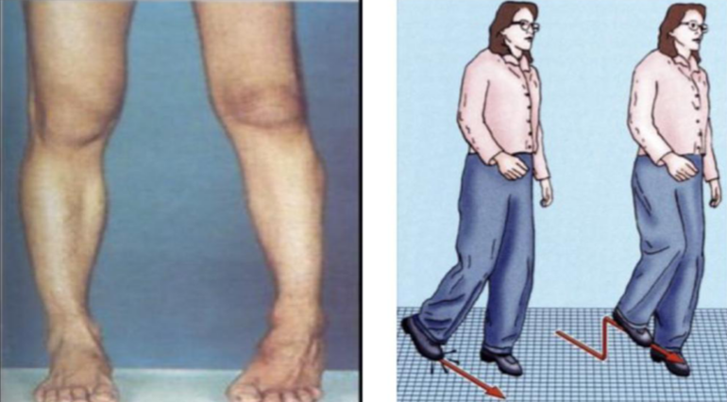
Sciatic Nerve Injury
Causes
The sciatic nerve is most frequently injured by?
1- Wrongly placed intramuscular injection in gluteal region
● To avoid this, injections should be
done into the gluteal maximus or
medius. (into the upper outer
quadrant of the buttock).
● Most nerve lesions are incomplete,
and in 90% of injuries, the common
peroneal (part of nerve) is most
affected. Why?
Because the common peroneal nerve
fibers lies superficial in the sciatic nerve.
2- posterior dislocation of hip joint.
Effects
Motor effect :
1- marked wasting of muscles below the knee
2- weak flexion of the knee (gracilis & sartorius are intact ) (they can do it , not rely on sciatic)
3- weak extension of hip (gluteus maximus is intact) (don’t rely on sciatic nerve)
4- All the muscles below the knee are paralyzed, and the weight of the foot causes it to assume the plantar flex position or Foot Drop.
5- Stamping Gait (High steppage gait).
Sensory effect : Sensation is lost below the knee, except for narrow area down the medial side of the lower part of the leg + along the medial border of foot as far as the ball of the big toe,, supplied by saphenous nerve ( femoral nerve)

Slide 9
Effects of sciatic nerve injury
 | Paralysis | Movement affected
Motor effect | Hamstrings + all muscles of leg & foot | Flexion of knee & extension of hip + all movements of leg & foot
Sensory effect | Loss of sensation of areas supplied by sciatic nerve (below knee) | All except area supplied by saphenous nerve

Slide 10
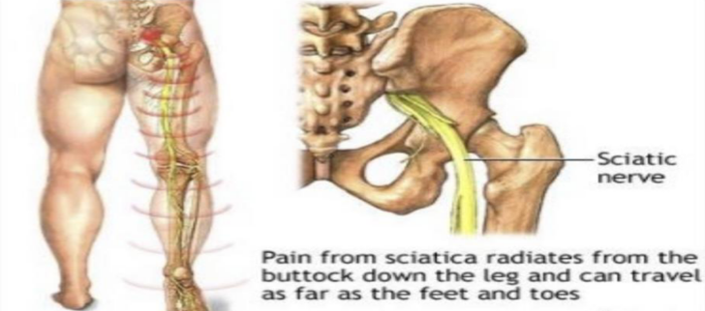
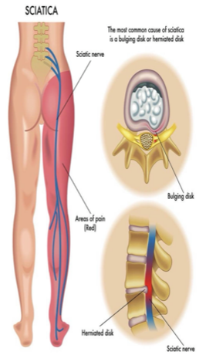
Sciatica
Its a condition in which patients have pain along the sensory distribution of sciatic nerve
Pain is experienced in posterior aspect of thigh , posterior & lateral sides of leg + the lateral part of the foot
Causes of Sciatica
Prolapse of intervertebral disc, with the pressure on one or
more roots of the lower lumbar & sacral spinal nerves.
Pressure on sciatic nerve by an intrapelvic tumor.
Inflammation of sciatic nerve or its terminal branch.

Slide 11
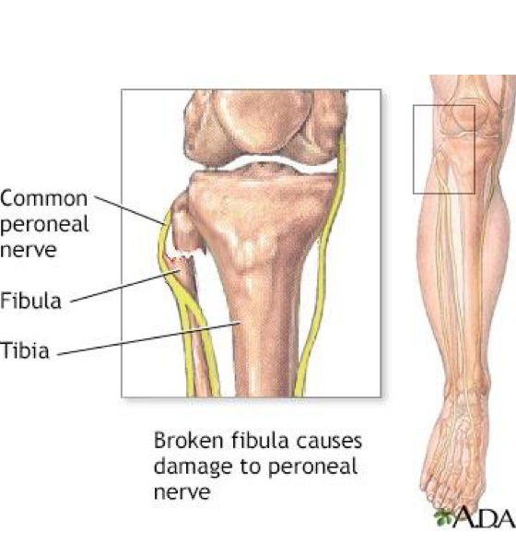
Common Peroneal Nerve Injury
The common peroneal nerve is an exposed position as it leaves popliteal fossa through it’s lateral angel, then it winds around neck of fibula to enter peroneus longus muscle which is a dangerous position (exposed to bone)
Common peroneal nerve is mostly injured by :
Fracture of the neck of fibula
Pressure from low casts or splints

Slide 12
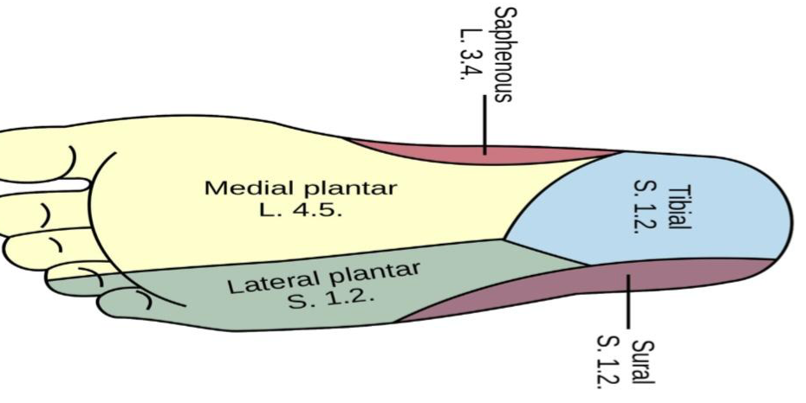
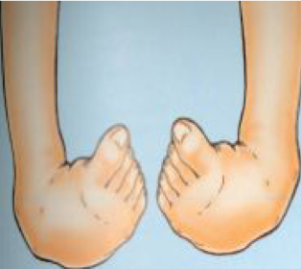
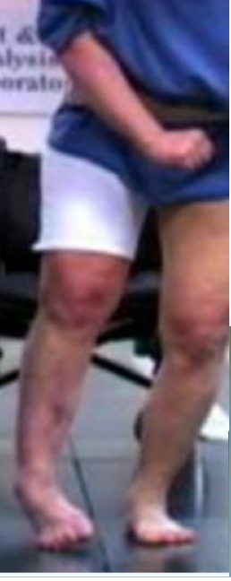
Manifestations of Common Peroneal Nerve injury
Motor
Muscles of anterior & lateral compartment of leg are paralyzed
As a result، the opposing muscles,(in the posterior compartment of leg) the plantar flexors of the ankle joint and thw invertors of the subtalar joints, cause the foot to be Plantar Flexed (Foot Drop) & Inverted, which is referred to as Talipes Equinovarus.
Sensory
Loss of sensation:
Between first & second toe
Dorsum of foot & toes
Medial side of big toe
Lateral side of leg

Slide 13
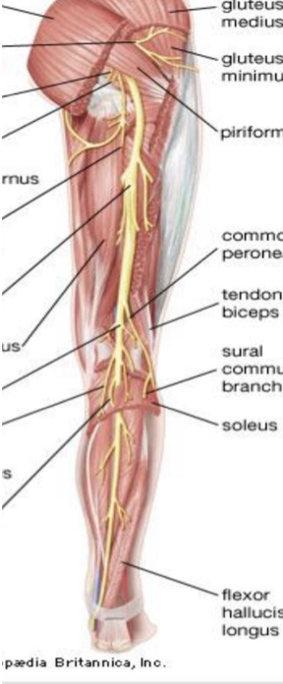
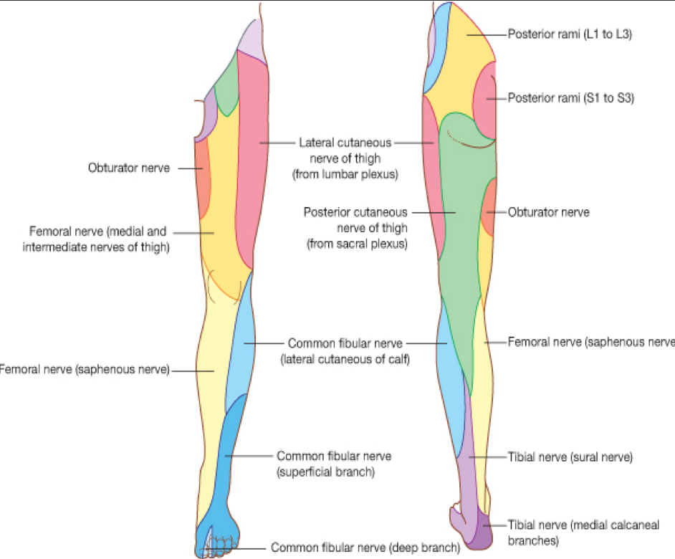
Tibial nerve injury
Because of the tibial nerve’s deep and protected position, it is
rarely injured
Complete division results in the following clinical features:
Motor
All muscles in back of leg & sole of foot are paralyzed
The opposing muscles dorsiflex the foot at the ankle joint and evert the foot at the subtalar joint , this is referred to as Taleps Calcaneovalgus
Sensory
Loss of sensation:
On lateral side of leg & foot
Trophic ulcers in the sole (also seen in case of sciatic nerve injury)
Note : it is the opposing of foot drop

Slide 14
MCQs:
Which of the following is considered as a site for sacral plexus ?
Q1
A
B
C
D
Posterior pelvic wall
Anterior pelvic wall
Lateral pelvic wall
Medial pelvic wall
which of the following is considered as the largest nerve of the body ?
Q2
A
C
D
Sciatic
Tibial
B
Radius
Fibula
The sciatic nerve terminate in the middle of the back of thigh and it’s divided into 2 branches one of them is ?
Q3
A
B
C
D
Tibial
Femoral
Popliteal
Saphenous
Q4
Tibial nerve is accompanied with ?
Posterior tibial vessels
Lateral tibial vessels
Anterior tibial vessels
Medial tibial vessels
A
B
C
D
Answers: 1.A - 2.A - 3.A - 4.A

Slide 15
MCQs:
Q5
Cutaneous branches of sciatic nerve found in all leg and foot EXCEPT areas supplied by ?
Saphenous
Obturator
Femoral
Sural
A
B
C
D
Q6
Which of the following is not considered as one of the muscular branches of the tibial nerve ?
Muscle of the posterior
compartment of leg
Intrinsic muscle
One inverter of the
foot
Extensors of toes
A
B
C
D
Q7
Which of the following is not a cause of Sciatica?
Prolapse of an intervertebral disc
Pressure on the sacral plexus
Inflammation of Sciatic Nerve
Pressure on Cervical Plexus
A
B
C
D
Q8
The sciatic nerve is most frequently injured by?
Irritation
Infection
Badly Placed intramuscular injection
Inflammation
A
B
C
D
Answers: 5.A - 6.D - 7.D - 8-C

Slide 16
Done by the amazing team
Team leaders:
Arwa Alghamdi
Deema Aljuribah
Razan Alnufaie
Team leaders:
Mishal Alsuwayegh
Mohammed Alghamdi
Members:
Members:
Aljazi Albabtain
Atheer Alkanhal
Arob Alasheikh
Ajwan Aljohani
Deema alqahtani
Dena Alsuhaibani
Jana Alhazmi
Kadi aldosari
Mashael Alasmari
Noura Bin hammad
Najla aldhbiban
Razan alasmari
Roaa alharbi
Raghad Mohammed
Shaden albassam
Waha Almathami
Walaa AlMutawa
Yara Ameer Alalwan
Othman Aldraihem
Faisal Alomar
Abdullah Alturki
Othman Alabdullah
Omar Alkadhi
Abdullah Ali
Meshari Alshathri
Yazeed Alsanad
Fahd Mobaireek
Emad Almutairi
Nasser Alghaith
Saad Almogren
Azzam Abdullah Alotaibi
Hassan Ali Alabdullatif
Rayan Alotaibi
Mohammed Nasser
Mohammed Fahad
Mohammed Majed
Abdulkarim Salman
Saleh Aldeligan
Thanks to Faisal Alomar for his design of the team logo
anatomyteam442@gmail.com
THANKS to Faisal Alomar for his design of the team logo

