Slide 1
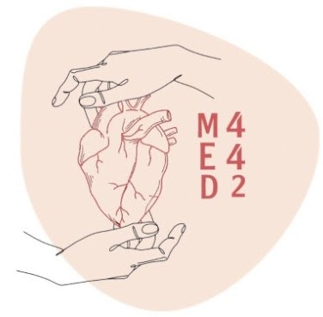
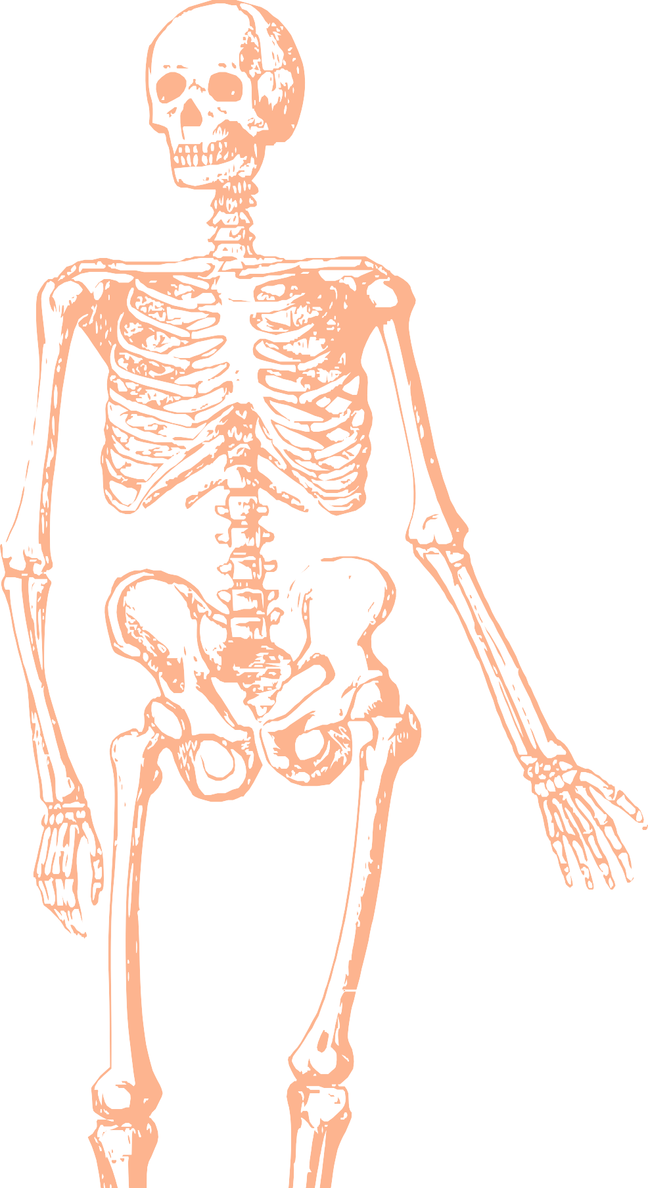
L15
ِAnterior & Lateral compartment The Leg and Dorsum Foot
Editing file
Color index:
Mine text
Important
Doctors notes
Female slides only
Male slides only
Extra

Slide 2
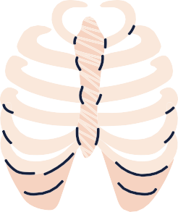
Objectives:
Identify the deep fascia of leg.
Identify the fascial compartments of the leg.
Describe the anatomy of the anterior & lateral compartments of the leg (muscles, vessels & nerves).
Describe the anatomy of the dorsum of the foot (retinacula, muscles, vessels & nerves).

Slide 3
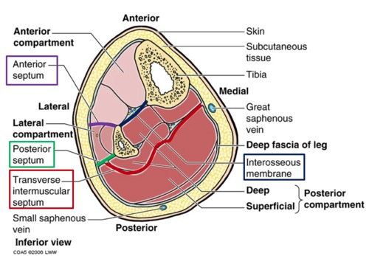
Fascia of the Leg
There is a deep fascia that surrounds the leg, attaching itself to the anterior and medial borders of the tibia.
Two Intermuscular Septa:
Pass from the deep aspect of this fascia to be attached to the corresponding margins of fibula:
1- Anterior intermuscular (fascial) septa (at anterior border of fibula)
2- Posterior intermuscular (fascial) septa (at posterior border of fibula)
There is also an interosseous membrane: A thin & strong membrane,
that binds the interosseous borders of the tibia & fibula.
It provides attachment for muscles.

Slide 4
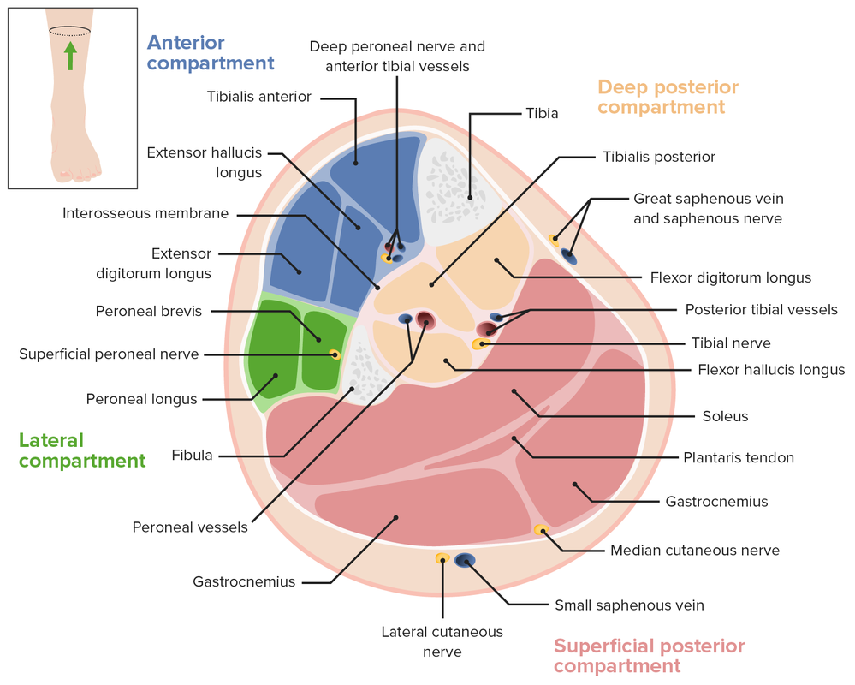
Fascia of the Leg
Together with the interosseous membrane,
the two septa divide the leg into
3 Compartments:
1-Anterior
2-Lateral (peroneal)
3-Posterior ( it’s divided into deep and superficial)
Each one has its own Muscles (with specific action), Blood vessels and Nerves.

Slide 5
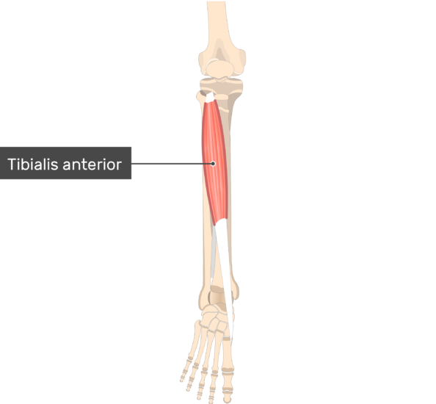
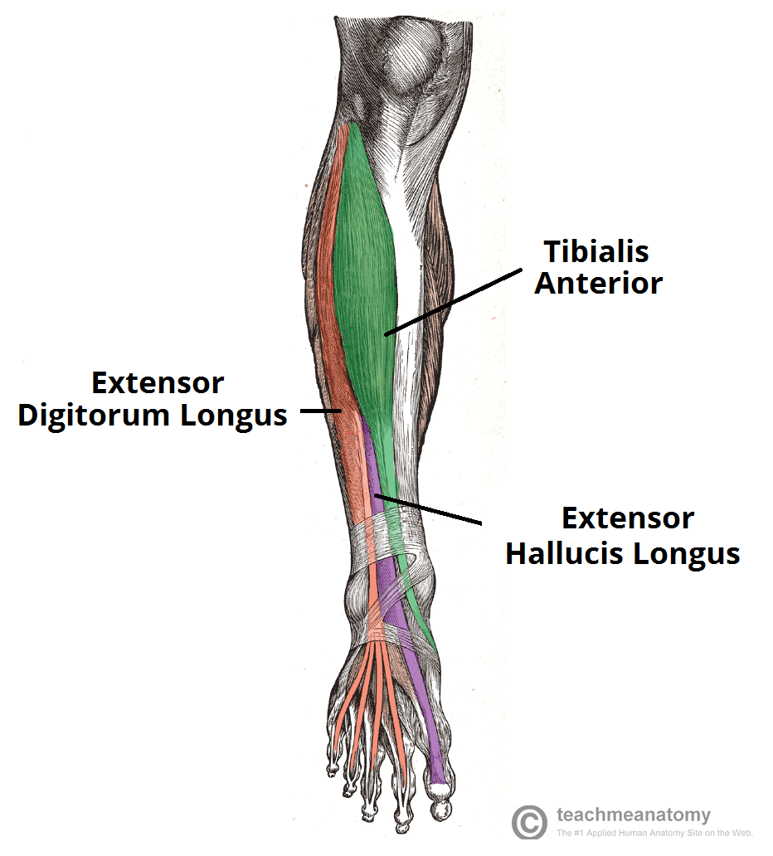
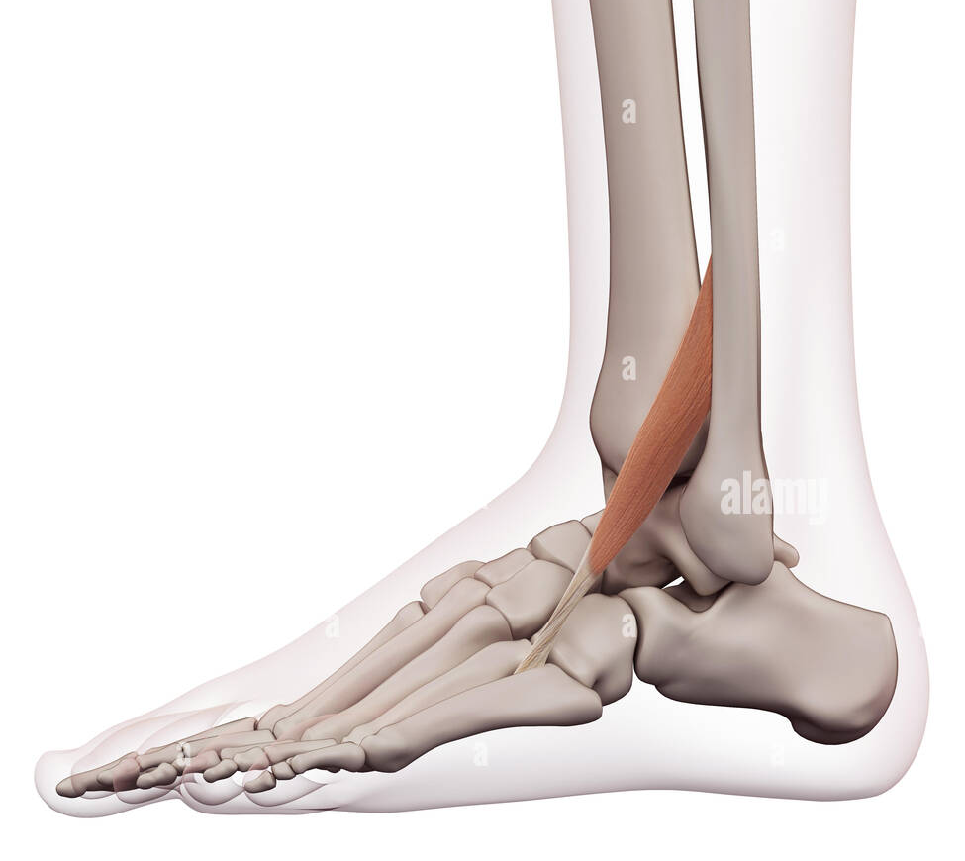
Anterior compartment of the leg:
 | Tibialis anterior | Extensor hallucis longus (EHL) | Extensor digitorum longus (EDL) | Peroneus tertius (may be absent)
Origin | Lateral surface of the shaft of the tibia.
Insertion | Medial cuneiform and base of first metatarsal bone | Base of distal phalanx of big toe | Extensor expansion of lateral 4 toes | Base of 5th metatarsal
Action | -Extends (dorsiflexion) of ankle. -Inversion of foot | -Extends (dorsiflexion) of ankle. - Extends all the joints of big toe | -Extends (dorsiflexion) of ankle. - Extends all joints of lateral 4 toes. | -Extends (dorsiflexion) of ankle. -Everts the foot
because its
attached to the Tibia
Hallucis = Big toe
Medial surface of the shaft of the fibula.
Blood supply for all anterior compartment
nerve supply for all anterior compartment
Anterior tibial artery
Anterior tibial (deep peroneal) nerve

Slide 6
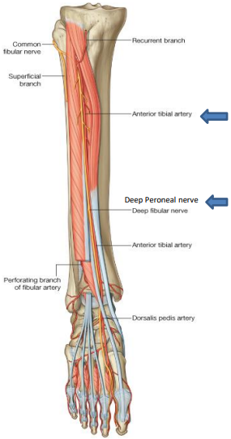
nerve and blood supply
 | Deep peroneal nerve | Anterior tibial artery
Origin | One of 2 terminal branches of common peroneal nerve at lateral aspect of neck of fibula | One of 2 terminal branches of popliteal artery at distal border of popliteus
Termination | Continues in dorsum of foot | Continues as dorsalis pedis in front of ankle joint
Course | Between tendons of EHL & EDL | Between tendons of EHL & EDL
Relations | Lateral to the artery | Medial to the nerve
Branches | 1-Muscular to anterior compartment & to Extensor Digitorum Brevis (EDB) in the dorsum of foot. 2- Articular to ankle joint. 3- Cutaneous to adjacent sides of big & 2nd toes. | 1- Muscular to anterior compartment. 2- Articular to both knee and ankle joints.

Slide 7
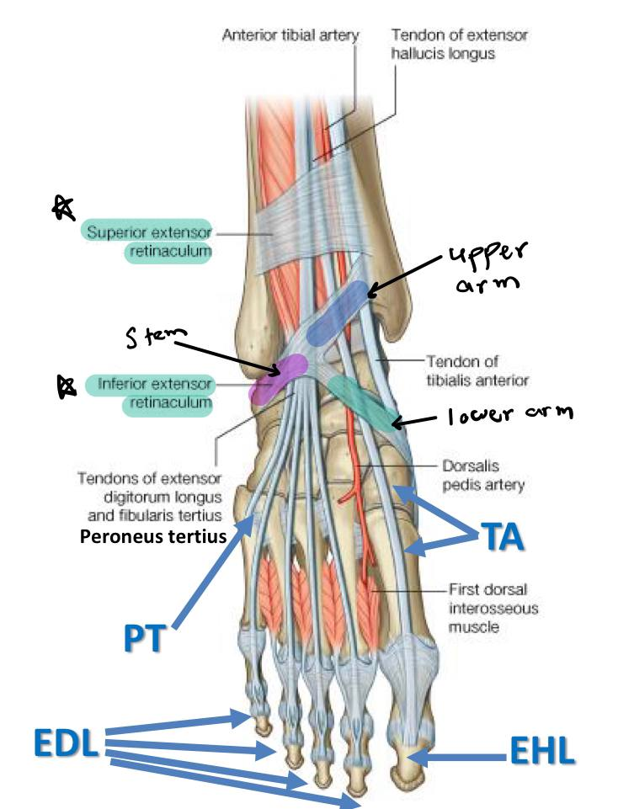
Extensor retinaculum
Extensor retinaculum:
Thickening of deep fascia in ankle region keeping
extensor tendons in position during action of ankle joint.
Superior extensor retinaculum: Attached to anterior borders of
tibia and fibula above ankle.
Inferior extensor retinaculum:
Y-shaped band located anterior to the ankle.
Stem: to upper surface of calcaneus, upper arm: to medial malleolus, lower arm: continuous with plantar aponeurosis.
Structures passing deep to extensor retinaculum
From medial to lateral
Tom Has a Very Nice Dog & Pig
1- Tibialis Anterior
2-Extensor hallucis longus
3- Anterior tibial artery (ATA)
4-Venae commitant of (ATA)
5-Anterior tibial nerve (deep peroneal nerve)
6-Extensor digitorum longus
7-Peroneus tertius
Notes:
team

Slide 8
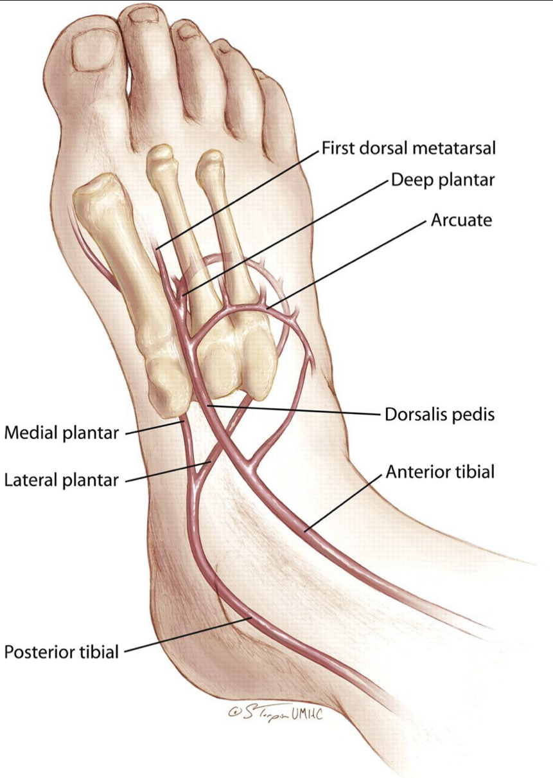
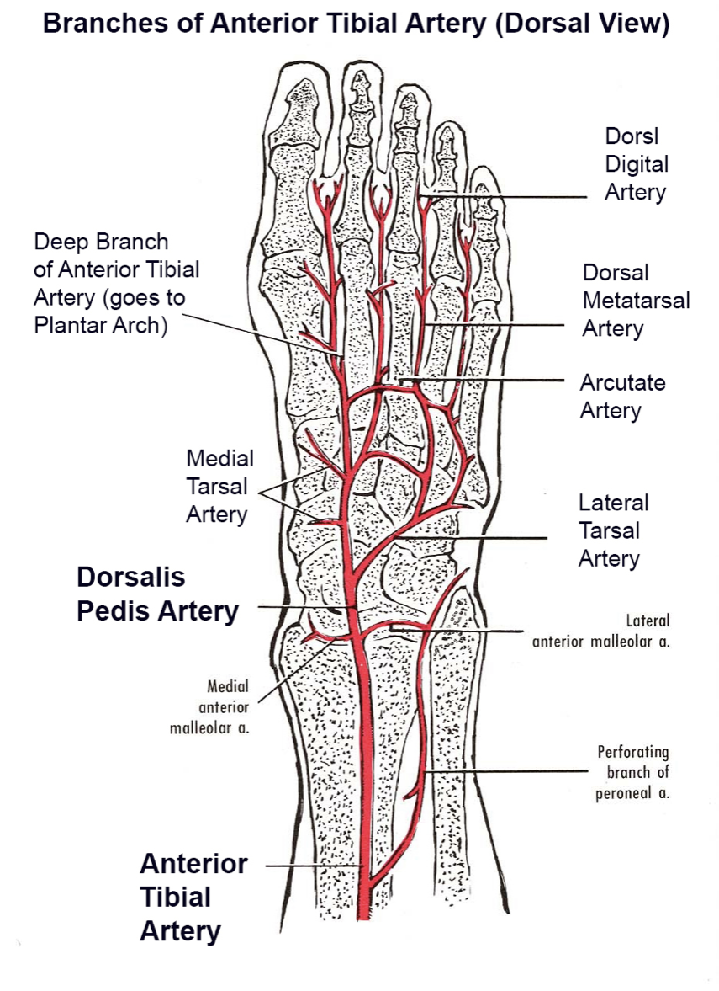
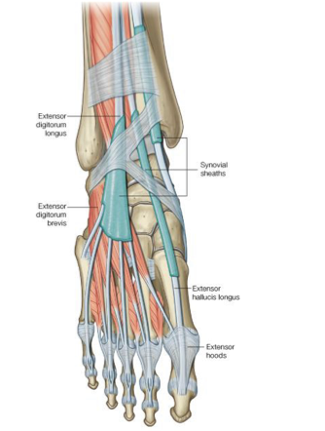
Dorsum of the foot
The pulse can be palpated by pressing the artery over the navicular bone between the tendons of EHL and EDL
Nerve supply is given by the deep and superficial peroneal nerves
Blood supply is given by the dorsalis pedis artery
 | Origin | Termination | Branches
Dorsalis Pedis Artery | Continuation of anterior tibial artery, in front of ankle joint (between superior & inferior extensor retinacula. | Pierces the 1st dorsal interosseous muscle & reaches the sole to join the plantar arch. | Muscular: to Extensor digitorum brevis Articular: to ankle joint
 | Origin | Insertion | Action | Nerve supply
Extensor digitorum brevis | Upper surface of calcaneus | Into the medial 4 toes. The first (Extensor hallucis brevis) into proximal phalanx of big toe. The other 3 join extensor expansions of 2nd, 3rd & 4th toes. | Extension of the medial 4 toes | Deep peroneal nerve

Slide 9
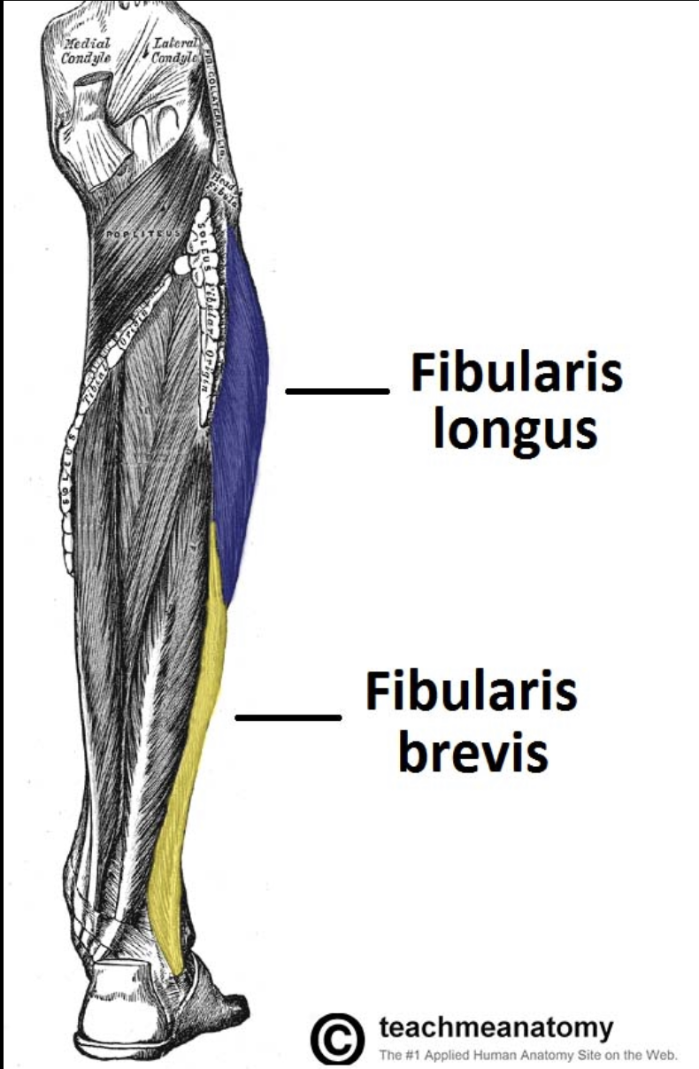
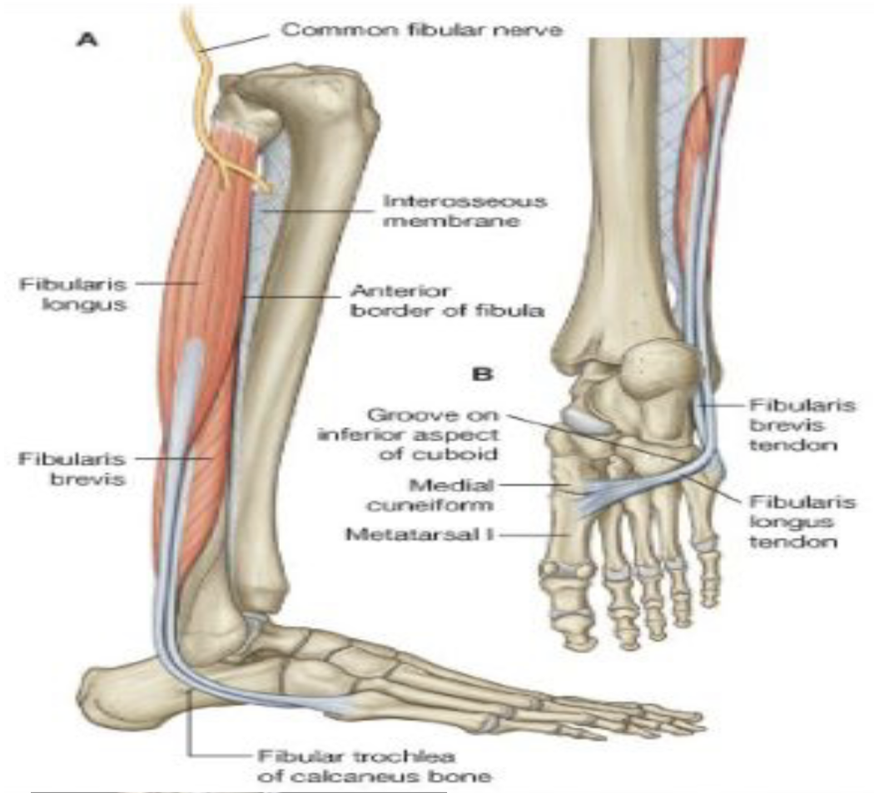
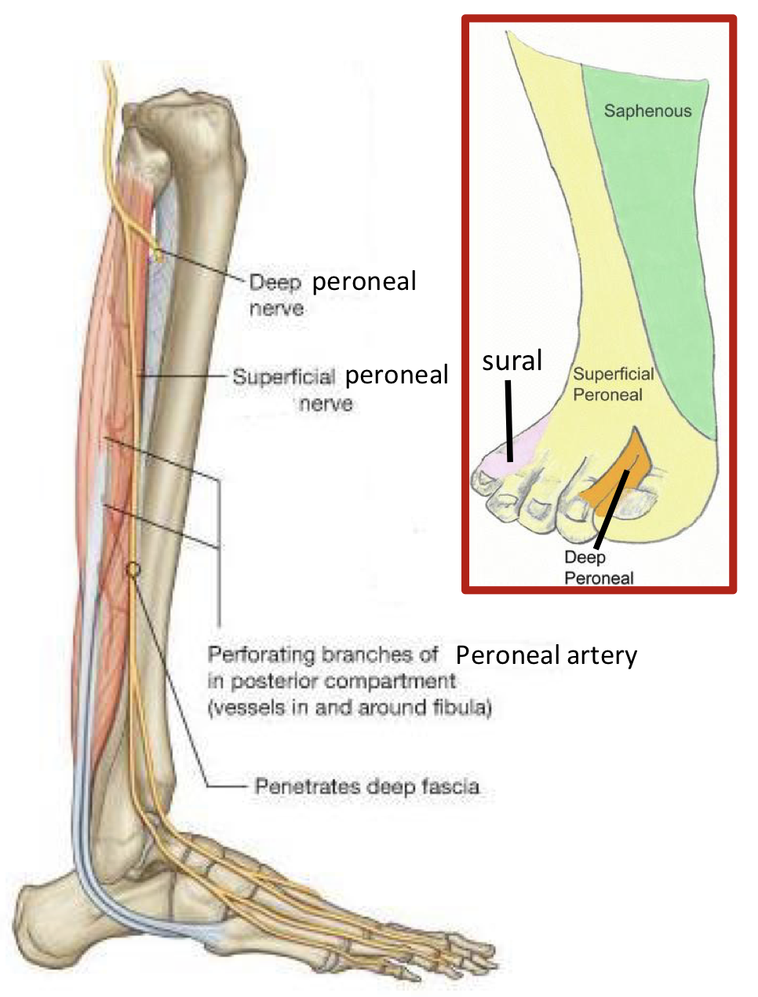
Lateral compartment of the leg
Both muscles pass behind then below lateral malleolus, reticula, then of calcaneus. deep to peroneal
on lateral surface
 | Origin | Insertion | Action
Peroneus longus (PL) | Lateral surface of the shaft of the fibula | First metatarsal & medial cuneiform bones (same as tibialis anterior) | Eversion + weak plantar flexion
Peroneus brevis (Pb) | Lateral surface of the shaft of the fibula | Tubercle fifth metatarsal bone (same bone as peroneus tertius). | Eversion + weak plantar flexion
Both receive blood supply from the peroneal branch of posterior tibial artery and nerve supply from the superficial peroneal nerve .
 | Origin | Course | Branches
Superficial peroneal nerve | One of 2 terminal branches of common peroneal nerve at lateral aspect of neck of fibula. | between Peroneus Longus and Peroneus Brevis then pierces deep fascia to become cutaneous. | Muscular: to Peroneus longus & brevis Cutaneous: i. To lower ⅓ of anterolateral aspect of the leg ii. To all dorsum except: foot (saphenous), lateral side of little toe (sural), adjacent sides of big & 2nd toes (deep peroneal).

Slide 10
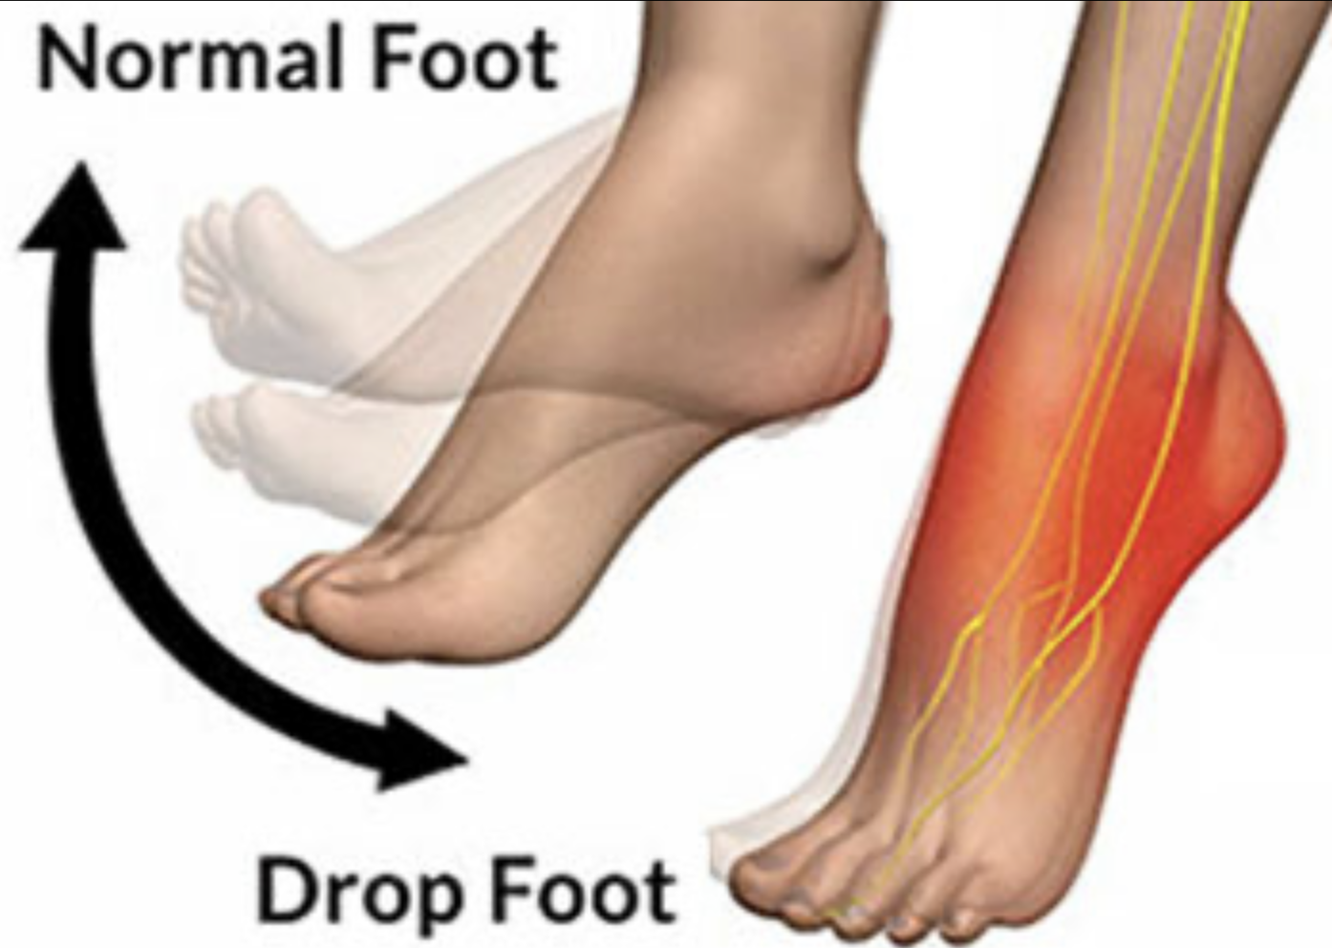
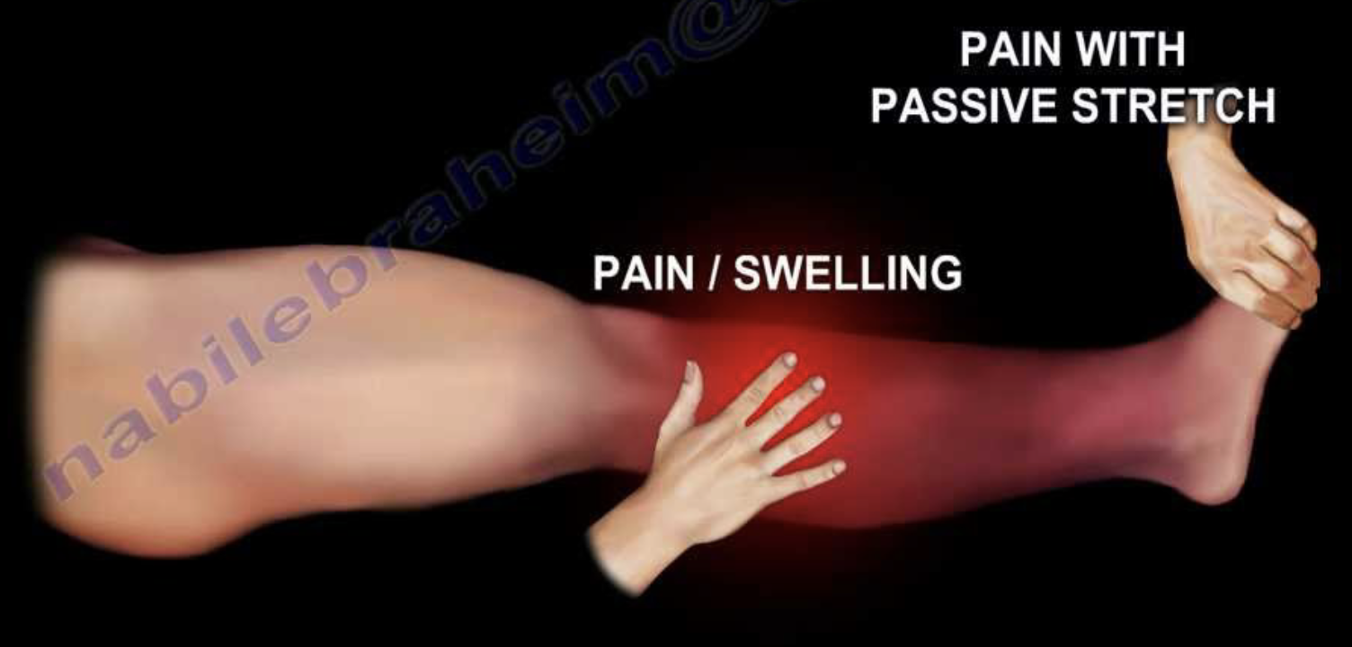
This is only in the female slides
Clinical anatomy
doctor said not important
just for your knowledge
Compartment syndrome:
The anterior compartment of the leg is the most common location for compartment syndrome.
These facial compartments are inextensible.
Any swelling within these compartments as a result of bleeding infection or venous obstruction produces a rise in the intra compartmental pressure that will hinder its blood supply and produce tender, swollen muscles.
Foot drop:
Is a clinical sign indicating paralysis of the muscles in the anterior compartment of the leg
A consequence of damage to the common peroneal nerve
Because the anterior muscles are paralyzed , the unopposed pull of the muscles in the posterior leg produce permanent plantar flextion.
This can interfere with walking (as affected limb is dragged along the ground). To circumvent this patients can flick their foot outwards (this is called the eversion flick)

Slide 11
MCQs:
Which of the following is a muscle in the lateral compartment of the leg?
Q1
A
B
C
D
Adductor magnus
Peroneus longus
Peroneus profundus
Semitendonosus
Q2
Which muscle is supplied by the deep peroneal nerve?
A
C
D
Peroneus longus
Flexor digitorum longus
Extensor digitorum brevis
All of the above
B
Q3
What artery supplies the dorsum of the foot?
A
B
C
D
Dorsalis pedis
Deep peroneal artery
Tibial artery
None of the above
Q4
how many intermuscular that go from the deep fascia to the fibula?
A
B
C
D
3
2
1
4
1-B
2- C
3- A
4- B
Thanks To Team 441 and 439 For questions!

Slide 12
MCQs:
how many muscles of the Anterior compartment of the leg is attached to the fibula?
Q5
A
B
C
D
1
2
3
4
Q6
Foot drop a clinical sign which of the following?
A
C
D
paralysis of the muscles in the anterior compartment of the leg
paralysis of the muscles
Dorsum of the foot
paralysis of the thigh muscles
None of the above
B
Q7
The anterior compartment is innervated by?
A
B
C
D
Common peroneal nerve
Deep peroneal nerve
Saphenous nerve
Sural Nerve
Q8
extensor digitorum brevis action is:
A
B
C
D
Flex the toes
Rotate the toes
Adduct the toes
Extend the toes
5-D
6-A
7-B
8-D
Thanks To Team 441 and 439 For questions!

Slide 13
Done by the amazing team
Team leaders:
Arwa Alghamdi
Deema Aljuribah
Razan Alnufaie
Team leaders:
Mishal Alsuwayegh
Mohammed Alghamdi
Members:
Members:
Aljazi Albabtain
Atheer Alkanhal
Arob Alasheikh
Ajwan Aljohani
Deema alqahtani
Dena Alsuhaibani
Farah alqazlan
Jana Alhazmi
Kadi aldosari
Mashael Alasmari
Noura Bin hammad
Najla aldhbiban
Nouf aldalaqan
Razan alasmari
Roaa alharbi
Raghad Mohammed
Shaden albassam
Waha Almathami
Walaa AlMutawa
Yara Ameer Alalwan
Othman Aldraihem
Faisal Alomar
Abdullah Alturki
Othman Alabdullah
Omar Alkadhi
Abdullah Ali
Meshari Alshathri
Yazeed Alsanad
Fahd Mobaireek
Emad Almutairi
Nasser Alghaith
Saad Almogren
Azzam Abdullah Alotaibi
Hassan Ali Alabdullatif
Rayan Alotaibi
Mohammed Nasser
Mohammed Fahad
Mohammed Majed
Abdulkarim Salman
Saleh Aldeligan
anatomyteam442@gmail.com
Thanks to Faisal Alomar for his design of the team logo

