Slide 1
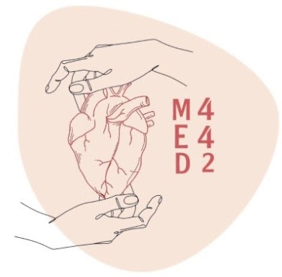
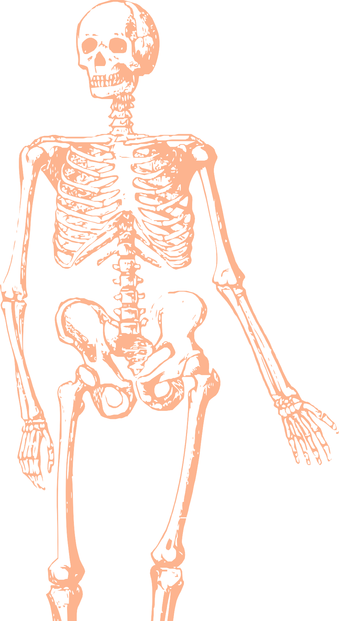
L16
LECTURE
Popliteal Fossa, Back of The Leg & Sole of The Foot
Editing file
Color index:
Mine text
Important
Doctors notes
Female slides only
Male slides only
Extra

Slide 2
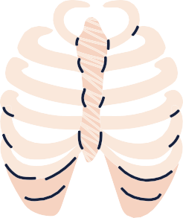
Objectives
The location, boundaries & contents of the popliteal fossa
The contents of posterior fascial compartment of Leg.
The structures hold by retinacula at ankle.
Layers forming in the sole of foot & bone forming the arches of the foot.

Slide 3
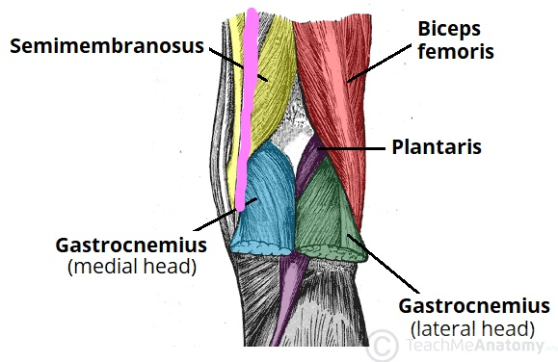
Popliteal Fossa
Video
Popliteal Fossa: ِA diamond-shaped intermuscular space at the back of the knee.
Boundaries
Dr.note: BOUNDARIES ARE VERY IMPORTANT
Laterally | Medially | Roof | Floor
1-Above: Biceps femoris. 2-Below: lateral head of gastrocnemius & plantaris | 1-Above: semimembranosus & semitendinosus. 2-Below: medial head of gastrocnemius | 1-Skin 2-superficial fascia and deep fascia of the thigh | 1-Popliteal surface of femur. 2-Posterior ligament of knee joint 3-Popliteus muscle.

Slide 4
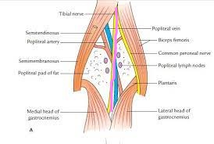
Popliteal Fossa
Dr.note: CONTENTS ARE VERY IMPORTANT
Contents:
From medial to lateral
1- Popliteal vessels 2- Small saphenous vein 3- Tibial nerve 4-Common peroneal nerve. 5- Posterior cut. nerve of thigh 6- Connective tissue & popliteal lymph nodes. The deepest structure is popliteal artery.
MOST SUPERFICIAL
MOST SUPERFICIAL
Dr.note : What’s the deepest structure in popliteal fossa? Popliteal artery

Slide 5
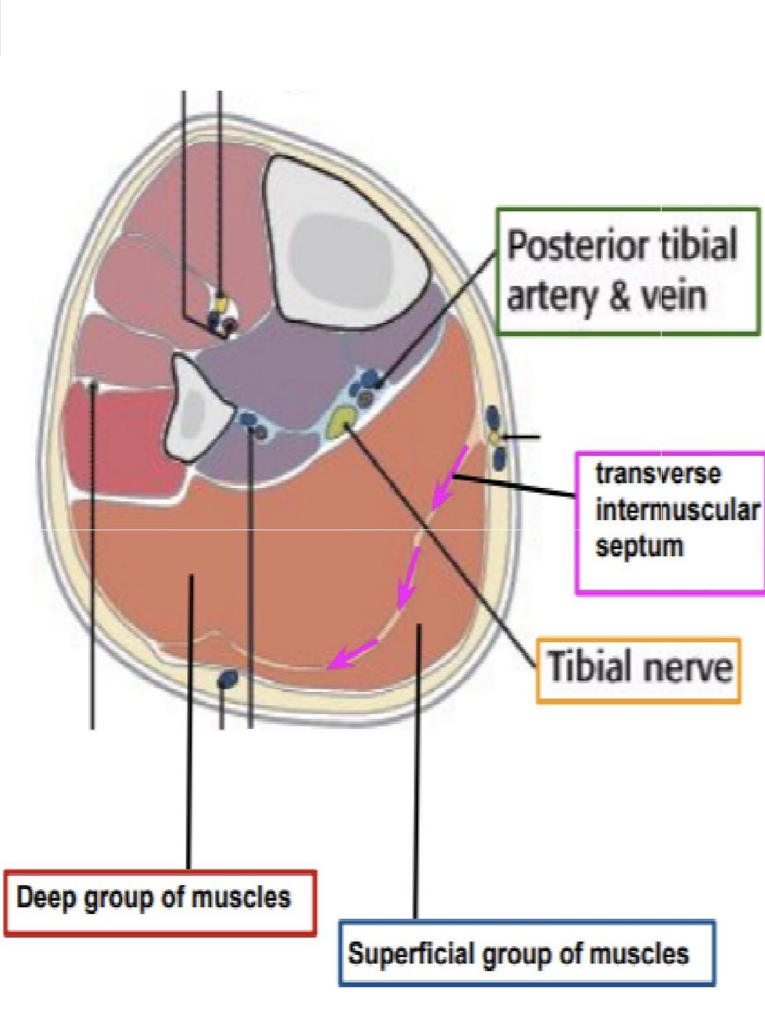
Popliteal Fossa
CONTENTS OF THE POSTERIOR FASCIAL COMPARTMENT OF THE LEG
The transverse intermuscular septum of the leg is a septum divides the muscles of the posterior compartment into superficial and deep groups
Superficial group of muscles | Deep group of muscles | Posterior Tibial Artery | Tibial Nerve
1. Gastrocnemius 2. Plantaris 3. Soleus | 1. Popliteus 2. Flexor digitorum longus 3. Tibialis posterior 4. Flexor hallucis longus | It is one of the terminal branches of the popliteal artery. | It is the larger terminal branch of the sciatic nerve in the lower ⅓ of the back of the thigh

Slide 6
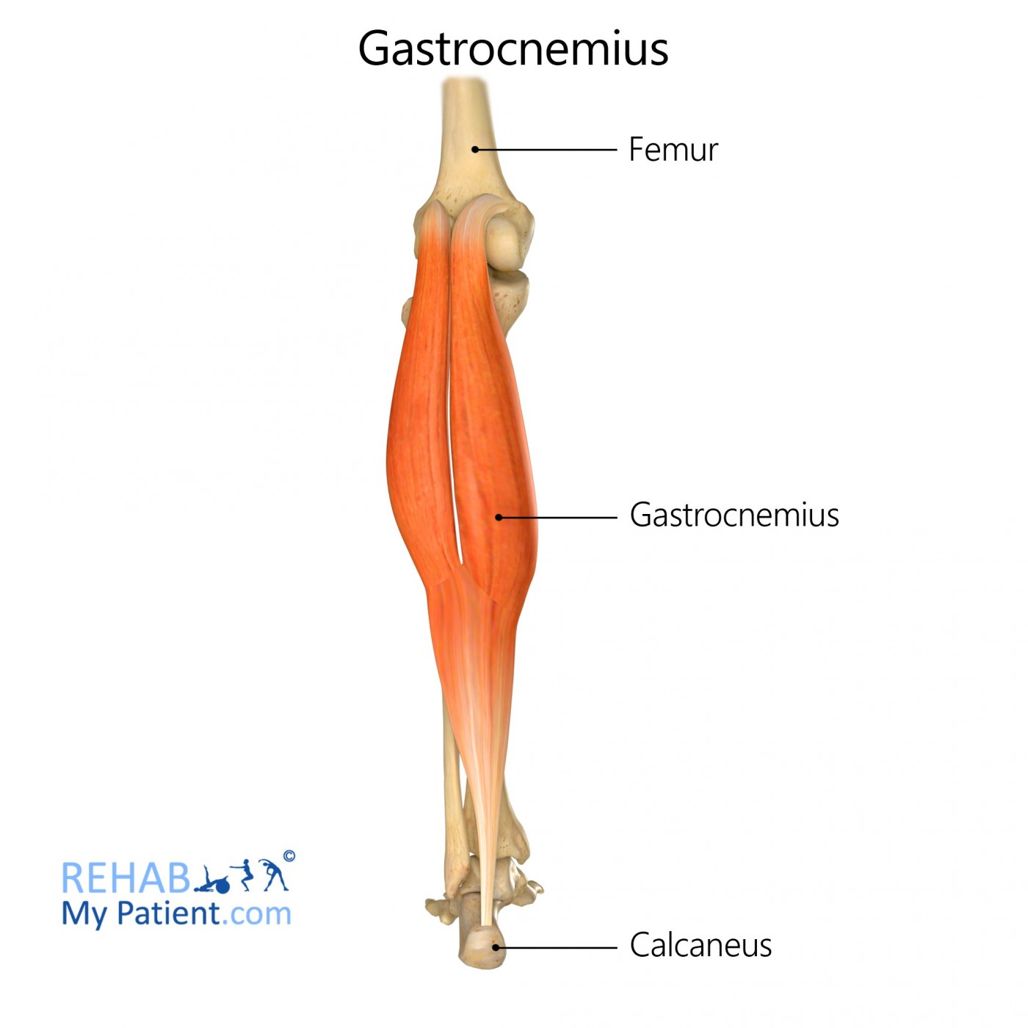
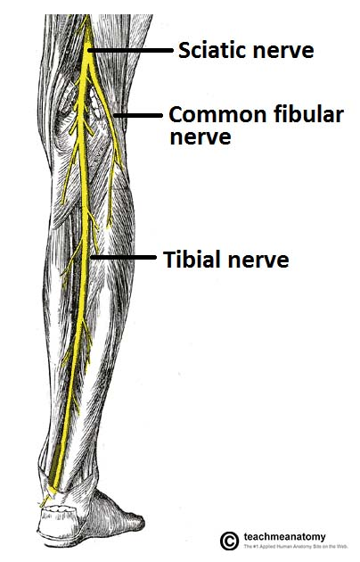
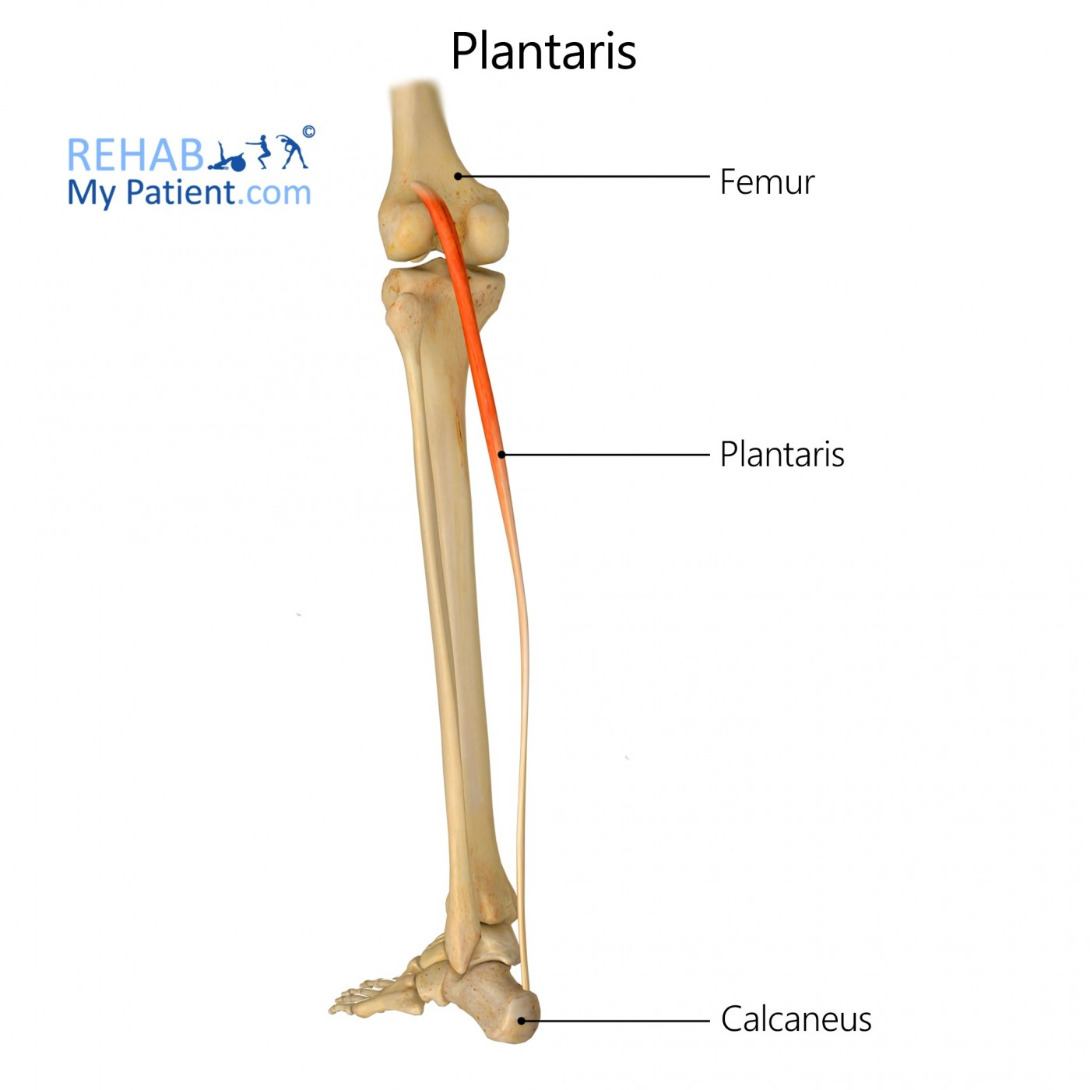
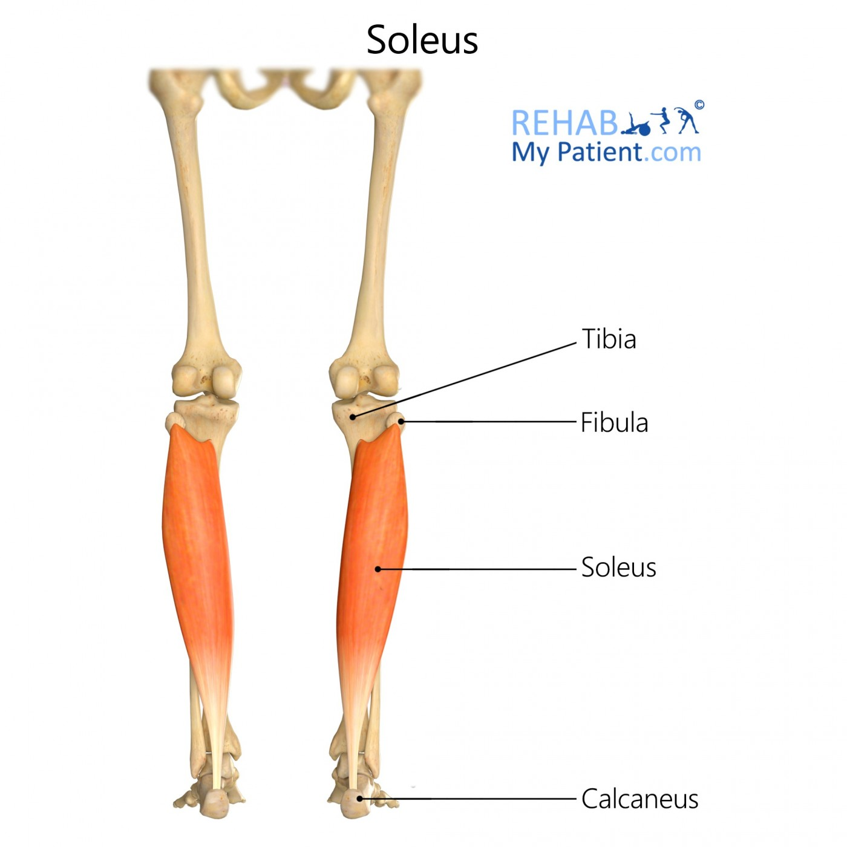
Superficial Group Muscles
Muscle | Origin | Insertion | Action | Muscle | Nerve
Gastrocnemius | -Lateral head from lateral condyle of femur -Medial head from above medial condyle | Posterior surface of calcaneus via tendo calcaneus | -Plantar flexes foot at ankle joint -flexes knee joint NOTE: We can't see the "Soleus muscle" until we remove the "Gastrocnemius muscle" which lays above it. (438) |  | All by Tibial Nerve
Plantaris | Lateral supracondylar ridge of femur | Posterior surface of calcaneum
Soleus | Shafts of tibia and fibula | Posterior surface of calcaneum via tendo calcaneus | Together with gastrocnemius and plantaris is powerful plantar flexor of ankle joint, provides main propulsive force in walking and running
Maybe absent
Dr note: Direct to the calcaneum without tendon

Slide 7
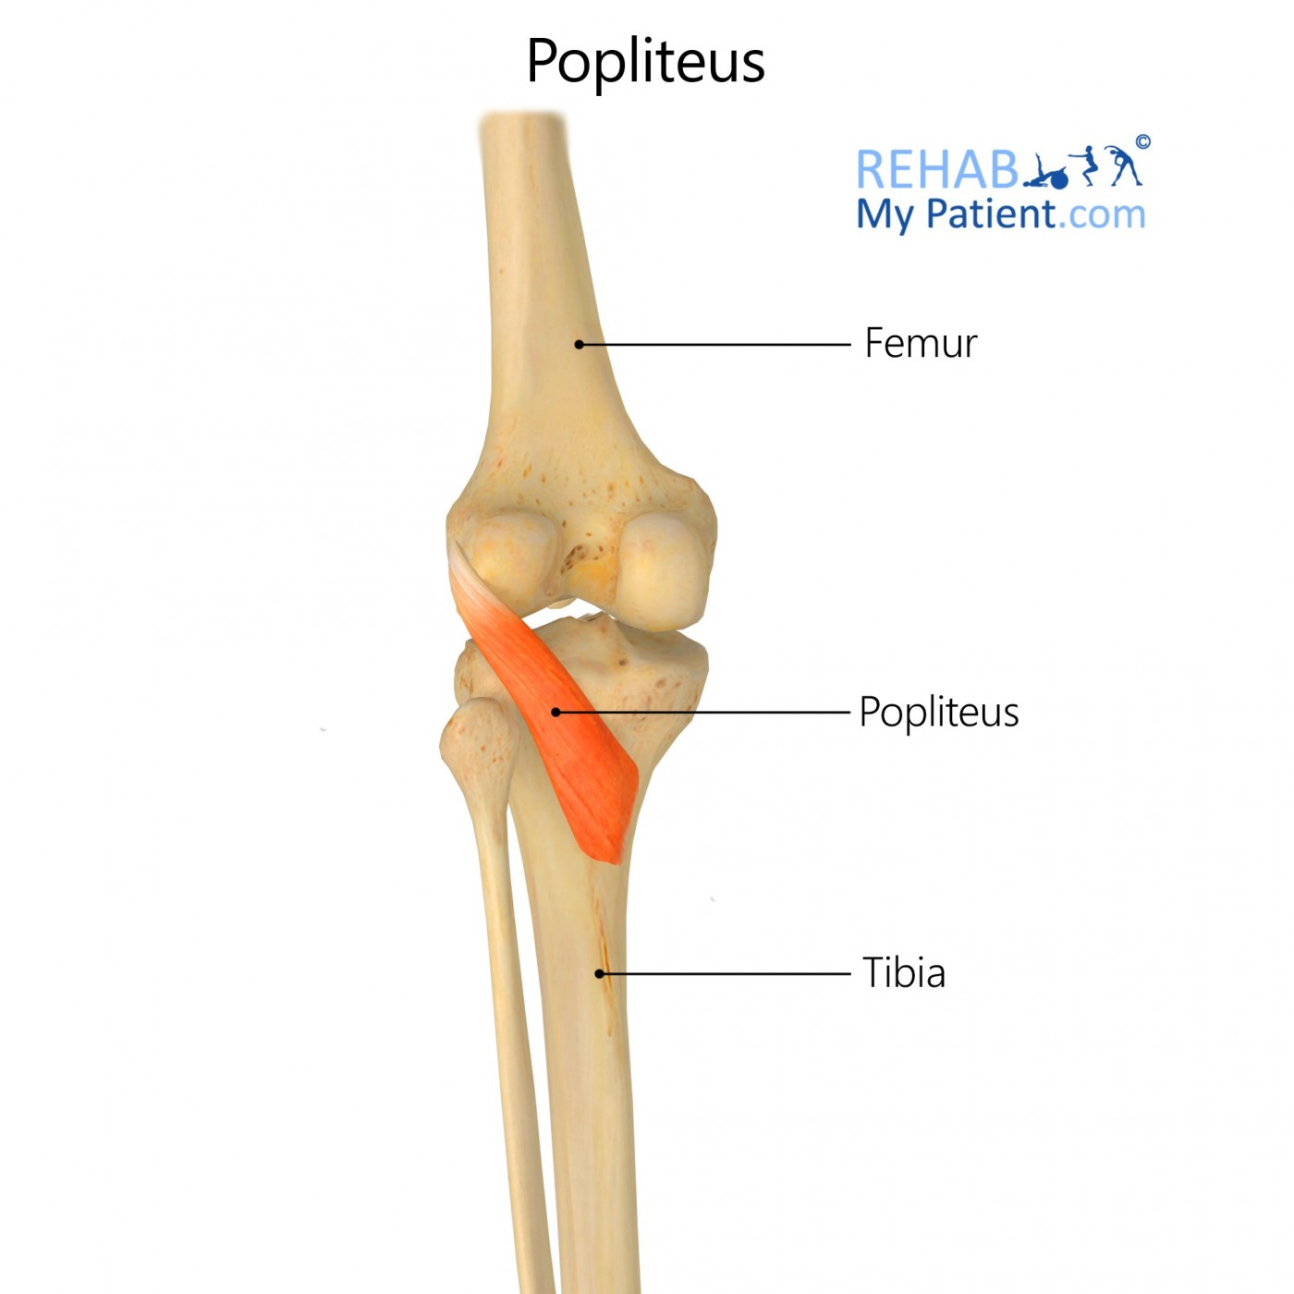
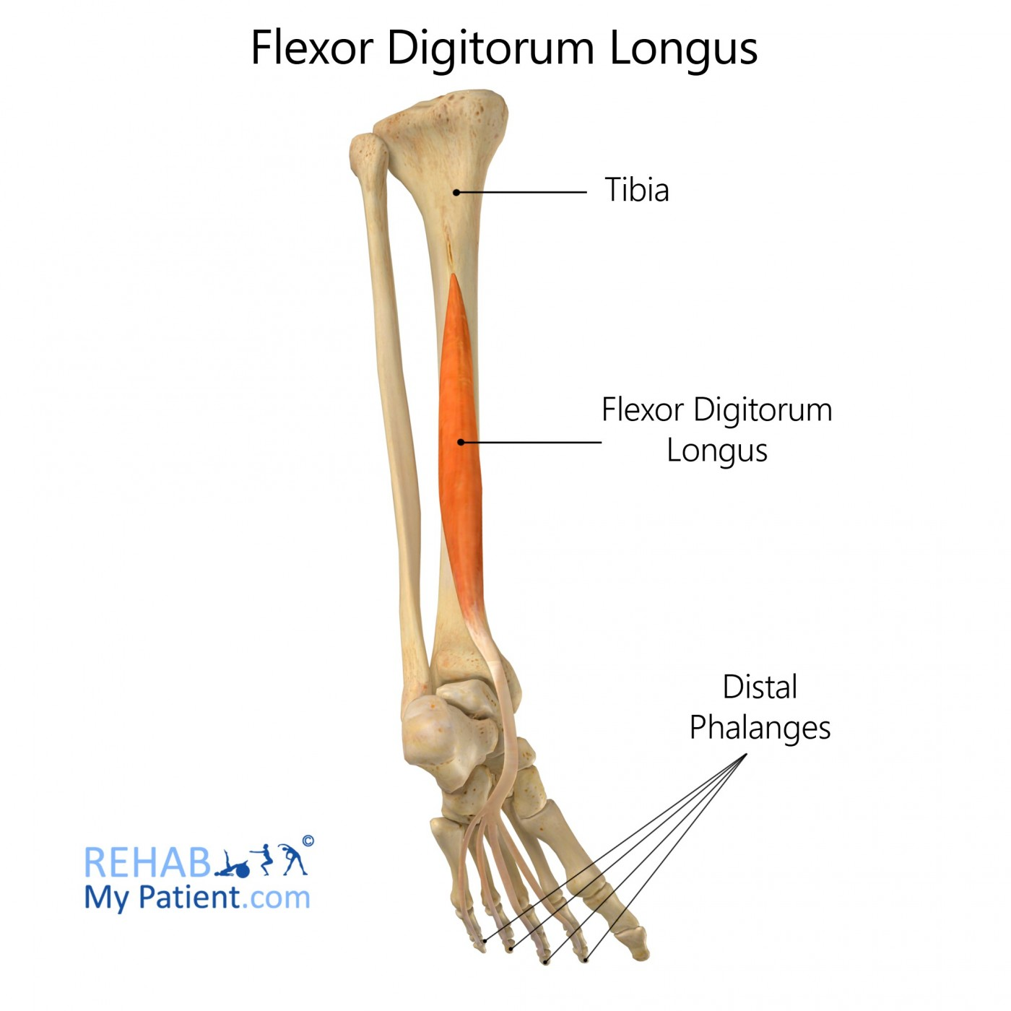
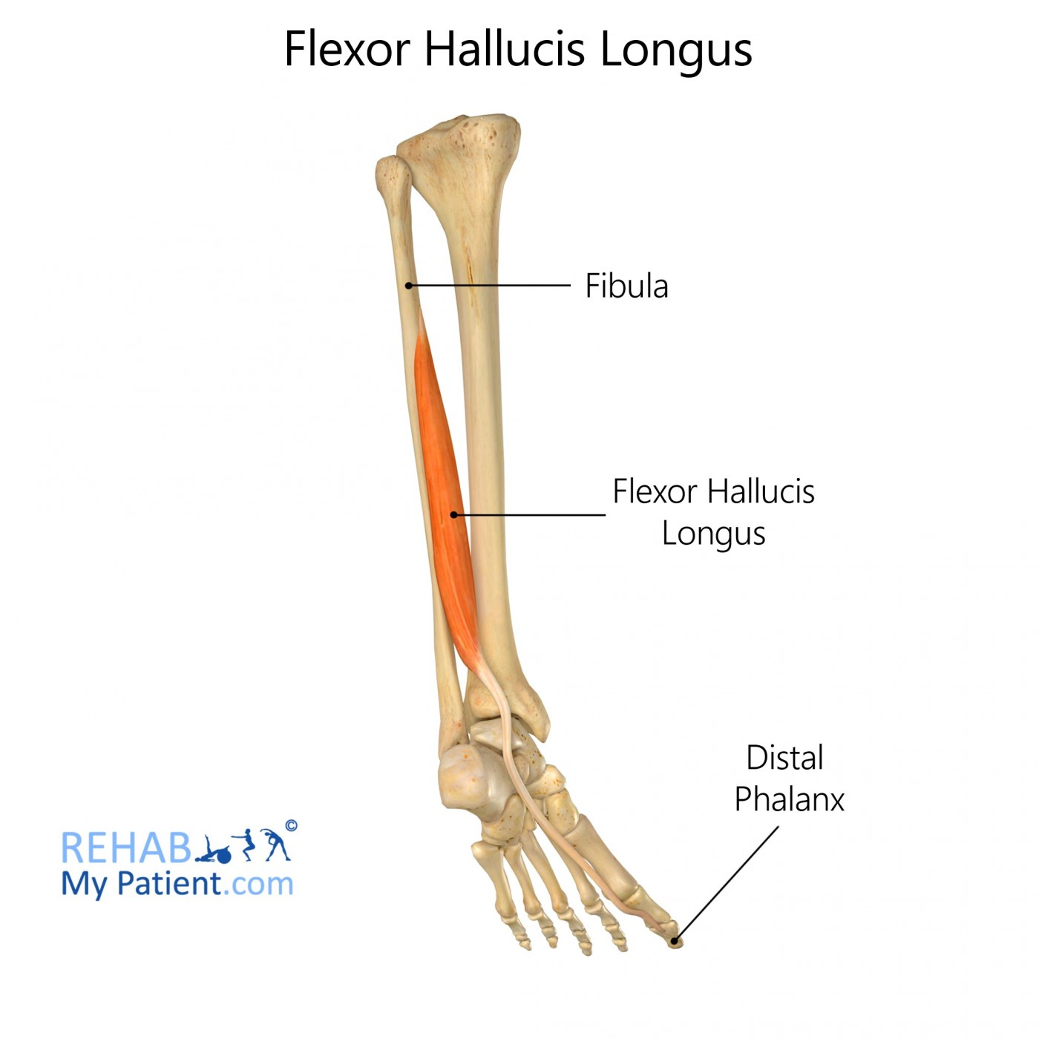
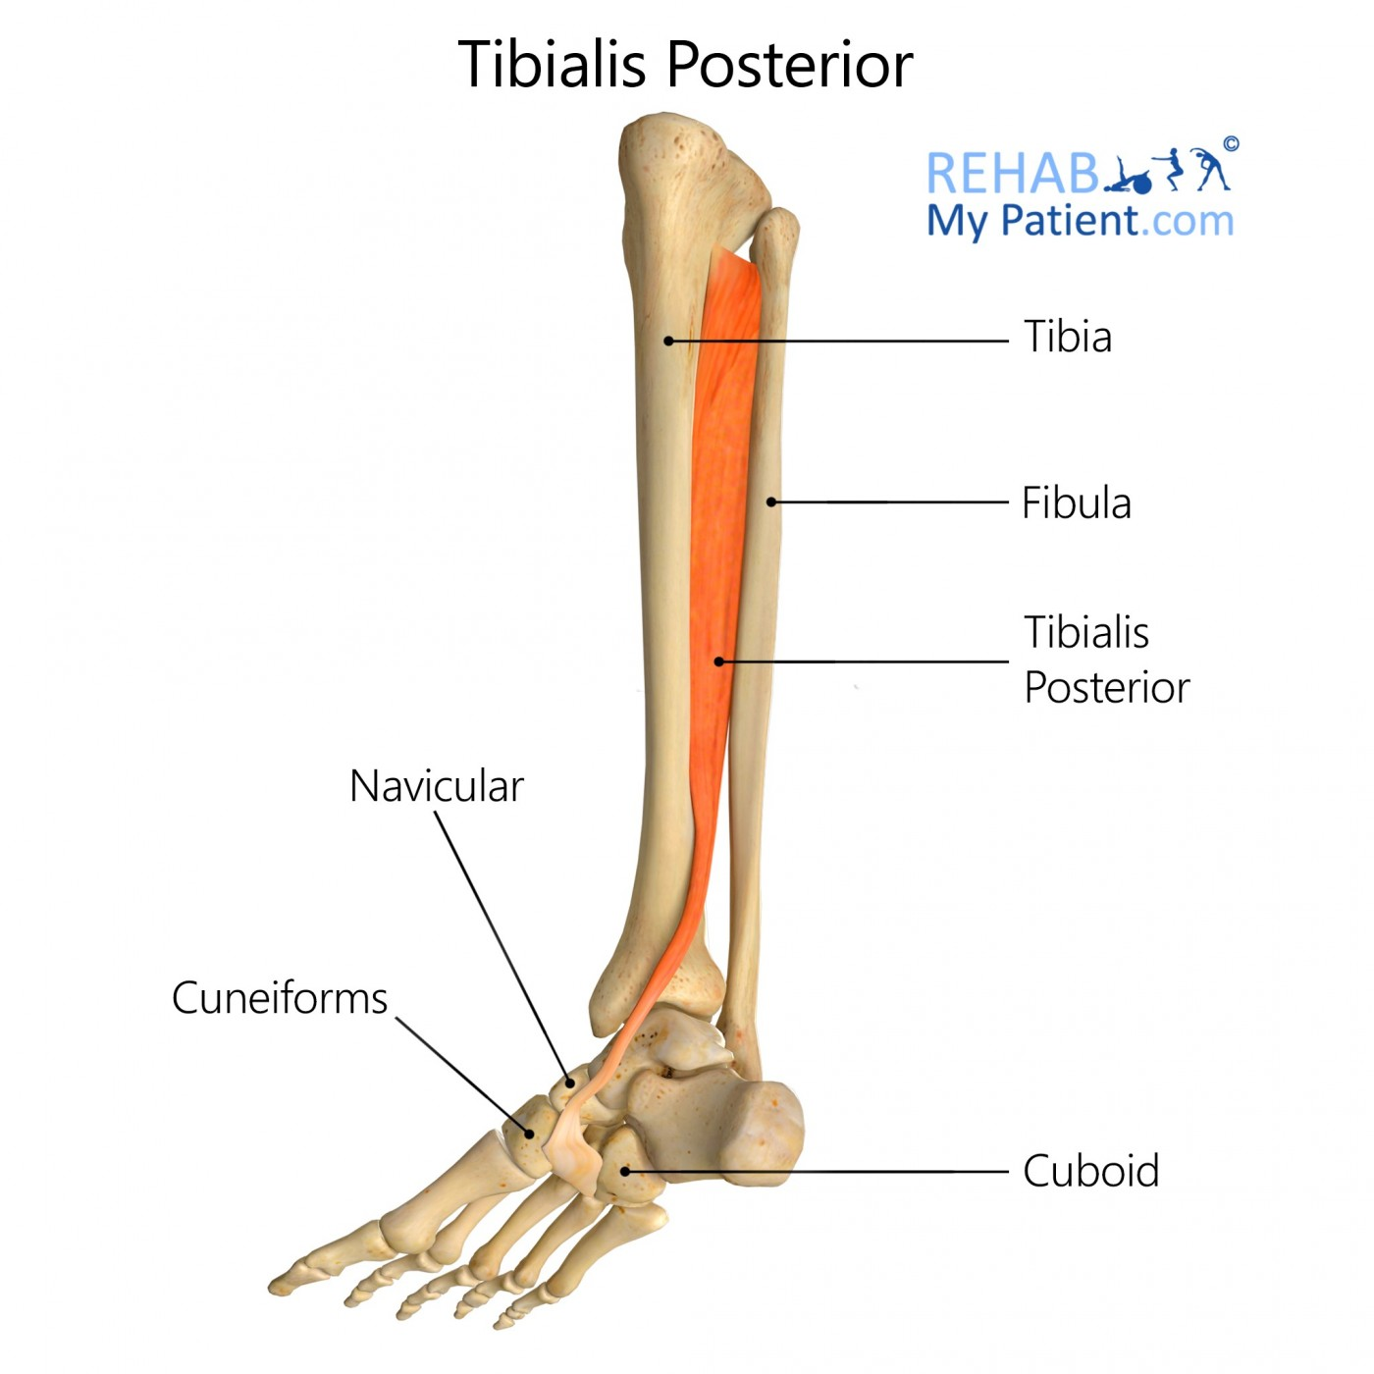
Deep Group Muscles
Muscle | Origin | Insertion | Action | Muscle | Nerve
Popliteus | Groove on Lateral surface of lateral condyle of femur (Intracapsular). | Post surface of shaft of tibia above soleal line. | Flexes knee joint: Unlocks knee joint by lateral rotation of femur on tibia (or slight medial rotation of leg which accompanies the flexion). |  | All by Tibial Nerve
Flexor digitorum longu | Posterior surface of shaft tibia | Bases of distal phalanges of lateral 4 toes. | Flexes distal phalanges of lateral four toes; plantar Flexes foot at ankle joint; Supports medial and lateral longitudinal arches.
Flexor hallucis longus | Posterior surface of shaft of fibula. | Base of distal phalanx of big toe. | Flexes distal phalanx of big toe; plantar flexes foot at ankle joint; supports medial longitudinal arch.
Tibialis posterior | Posterior surface of shafts of tibia and fibula and interosseous membrane. | Tuberosity of navicular bone (or in tarsal bone generally )and other neighboring tarsal bones. (except talus). | Plantar flexes foot at ankle joint; Flexes foot at ankle joint; inverts foot at subtalar and transverse tarsal joints; supports medial longitudinal arches.

Slide 8
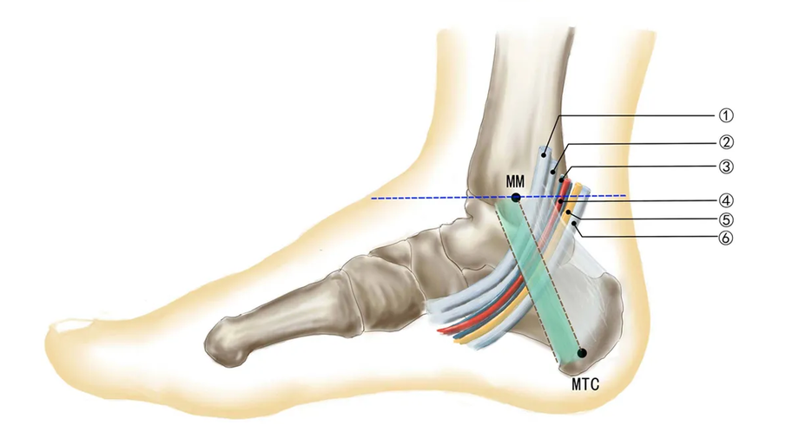
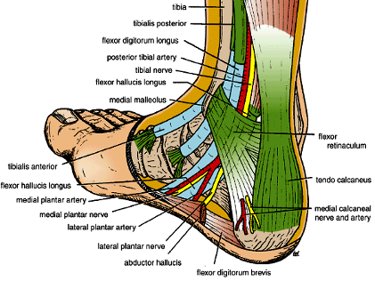
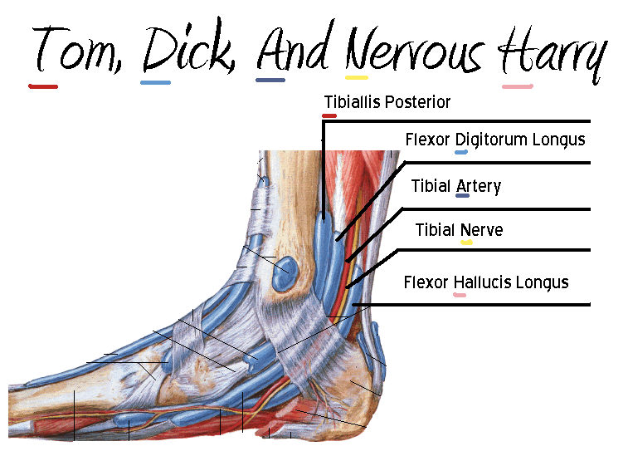
STRUCTURE IS VERY IMPORTANT
Flexor Retinaculum
Structures passing posterior to medial malleolus, deep to flexor retinaculum:
Extends from back of medial malleolus of tibia to medial side of calcaneum
1
2
3
4
5
Medial to lateral
3)Tibial vein مب معنا
1-Tibialis posterior tendon
2-Flexor digitorum longus tendon
3-Posterior tibial artery with venae comitantes (يفصل بينهم)
4-Tibial nerve
5-Flexor hallucis longus tendon
Team441: Tom Does A Very Nice Hat
Or : Tom Drives A Nice Honda
All the tendons are surrounded by synovial sheath

Slide 9
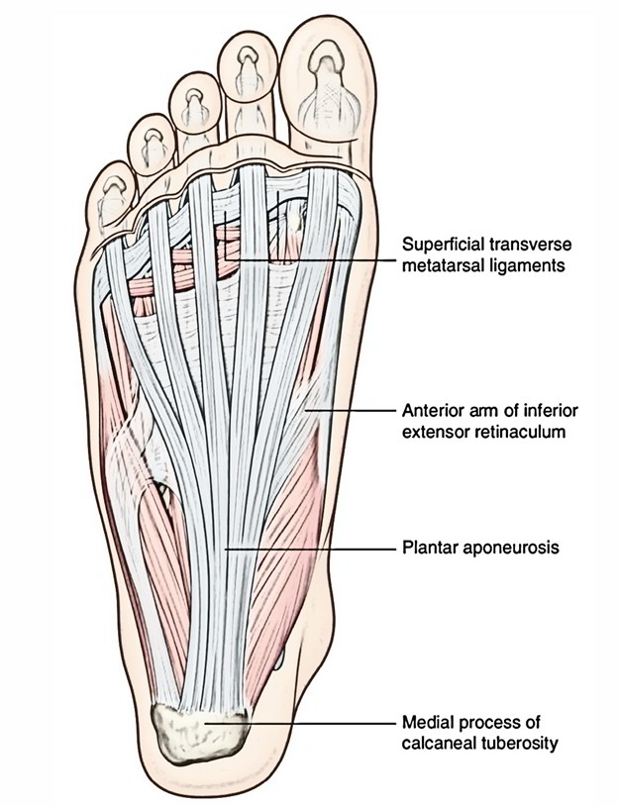
Sole of the foot
1- The skin of the sole of the foot is thick and hairless
2- it shows a few flexure creases at the site of the skin
تجاعيد باطن القدم اقل من تجاعيد باطن اليد لانها قليله الحركه
3- sweating glands are present in large numbers
Deep fascia of the sole of foot
1-The plantar aponeurosis is a triangular thickening of the deep fascia that protects the underlying nerves, blood vessels, and muscles
1
3
3-The base of the aponeurosis divides into five slips that pass into the toes
2
1
2- its apex is attached to the medial and lateral tubercles of the calcaneum
2

Slide 10
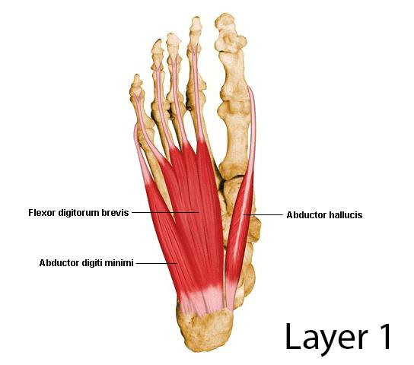
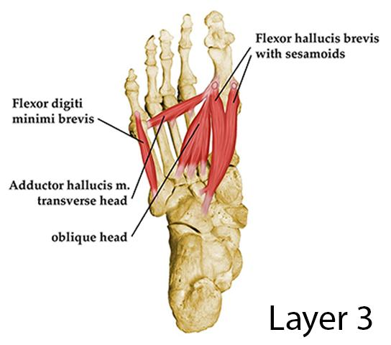
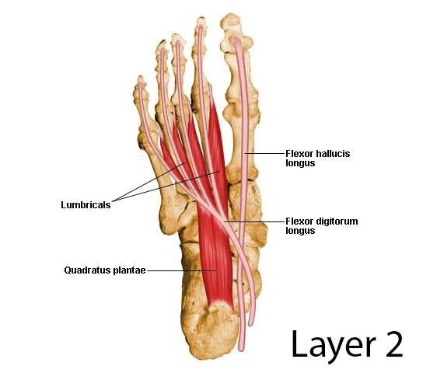
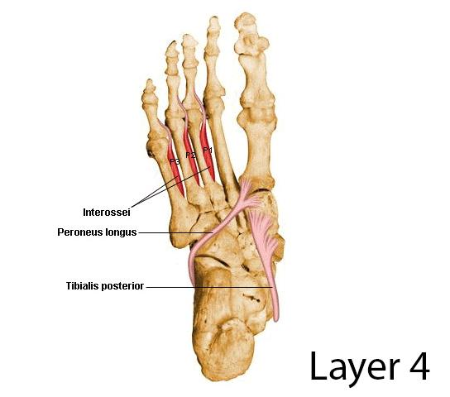
Muscles of the sole of the foot:
The muscles of the sole are conveniently described in four layers from superficial to deep
1st layer (more superficial layer)
1- abductor hallucis
2-flexor digitorum brevis
3- abductor digiti minimi
3rd layer
1-Flexor hallucis brevis
2-Adductor hallucis
3-Flexor digiti minimi brevis
Sole of the foot
2nd layer
1-Quadratus plantae
2-lumbricals
3-flexor digitorum longus tendon
4-flexor hallucis longus tendon
4th layer (deepest layer)
1-interossei(3 plantar &4 dorsal )
2- peroneus longus tendon
3- Tibialis posterior tendon
اهم شي TENDONS :Dr.note

Slide 11
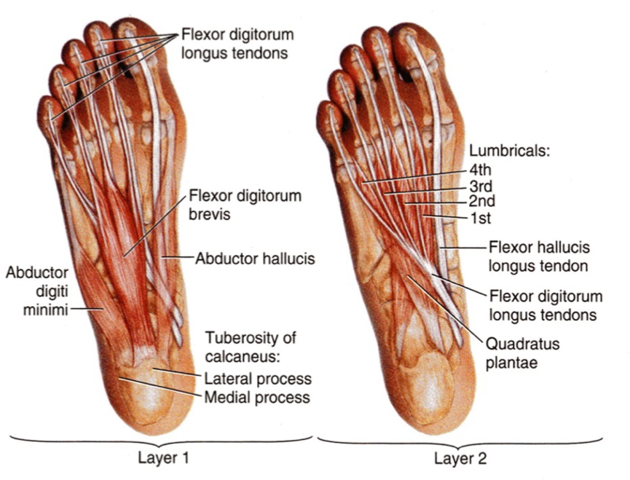
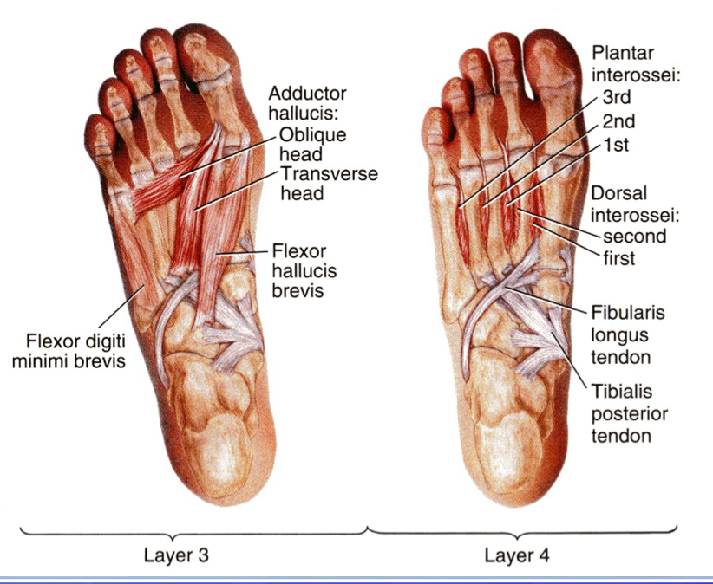
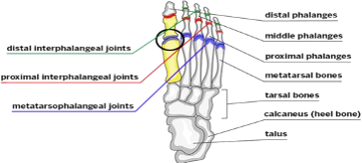
The function of small muscles of sole of foot
- Unlike the small muscles of the hand, the sole muscles have few delicate functions and are chieﬂy concerned with supporting the arches of the foot.
-They control movements of individual toes, this function is rarely used in most people.
(usually we don’t hold anything by our foot so no need for this function)
Metatarsophalangeal joints
Movement | Muscles*
Flexion | ●Flexor digitorum brevis ●Lumbricals. ●Interossei. ●Flexor hallucis brevis. ●Flexor hallucis longus. ●Flexor digiti minimi brevis. ●Flexor digitorum longus.
Extension | ●Extensor hallucis longus. ●Extensor digitorum longus. ●Extensor digitorum brevis.
Abduction | ●Abductor hallucis. ●Abductor digiti minimi. ●Dorsal interossei.
Adduction | ●Adductor hallucis. ●Plantar interossei.
Interphalangeal joints
Movement | Muscles*
 | ●Flexor hallucis longus ●Flexor digitorum longus ●Flexor digitorum brevis ●Quadratus plantae
Flexion
Extension | ●Extensor hallucis longus ●Extensor digitorum longus ●Extensor digitorum brevis
Team441;

Slide 12
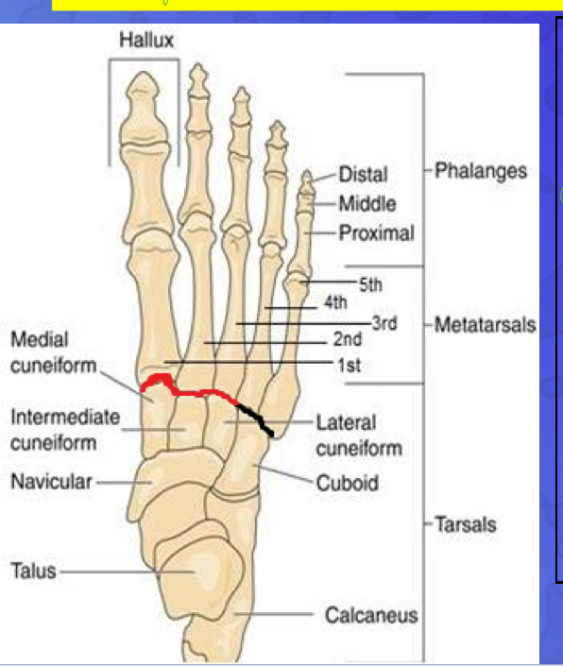
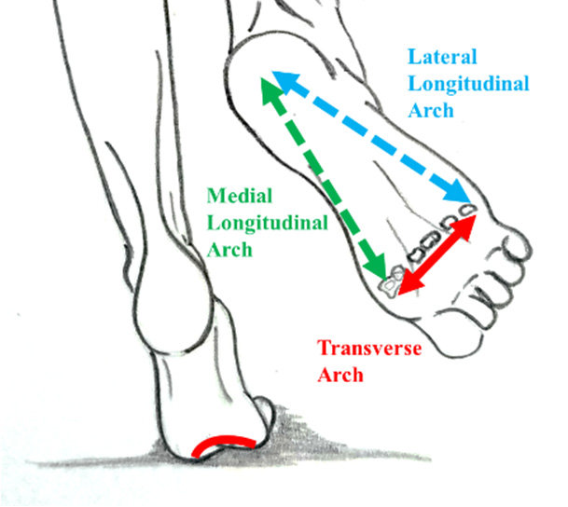
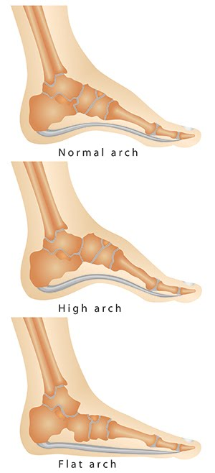
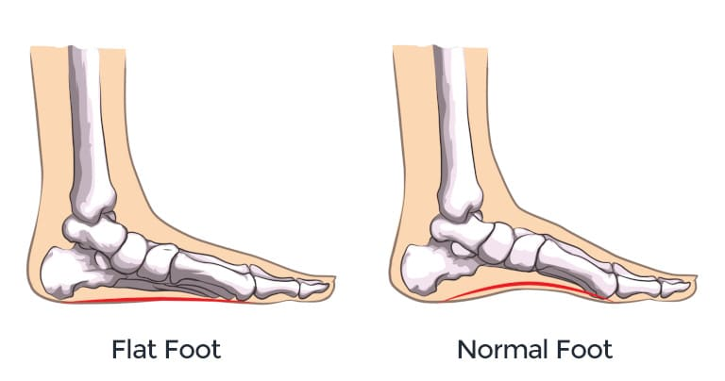
Arches of Foot
Medial longitudinal arches
Lateral longitudinal arches
Transverse arch
Is formed of calcaneum, talus, navicular, 3 cuneiform bones, and 3 medial metatarsal bones.
Is formed of calcaneum, cuboid & lateral 4th & 5th metatarsal bones
Lies at the level of tarso-metatarsal joints, formed of bases of metatarsal bones, cuboid & 3 cuneiform bones.
Function of Arches of the Foot
1-Weight bearing
2-Support walking & running
3- Act as shock absorber
4-Provide potential space for neurovascular bundle of the sole
In young child, the foot appears to be flat because of presence of a large amount of subcutaneous fat on the sole of foot
Team441: flat foot of adults is abnormal

Slide 13
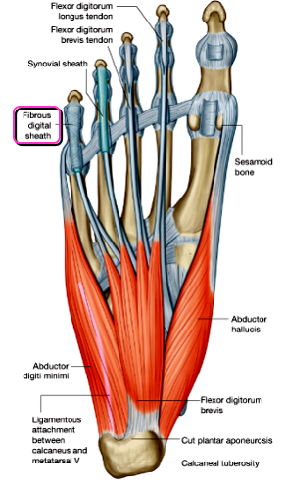
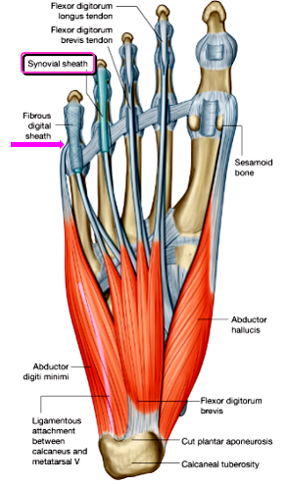
Fibrous Flexor sheaths
The inferior surface of each toe( sole of the foot), from the head of the metatarsal bone to the base of the distal phalanx, is provided with a strong fibrous sheath, which is attached to the sides of the phalanges.
The fibrous sheath, together with the inferior surfaces of the phalanges and the interphalangeal joints, forms a blind tunnel in which lie the flexor tendons of the toes.
Team441: (these tendons pass under the sheath)
(Fibrous flexor sheath protect synovial sheath)
Synovial Flexor sheaths
Surround the tendons of the flexor hallucis longus and the flexor digitorum longus

Slide 14
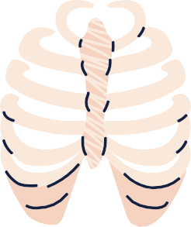
MCQs:
MCQs: SPECIAL THANKS TO 441
Answers: 1.C 2.B 3.C. 4D 5A
which of the following is a deep muscle of the posterior fascial compartment of the leg?
Q1
B
C
Gastrocnemius
Plantaris
Popliteus
D
A
Soleus
which of the following is the deepest structure in the popliteal fossa?
Q2
Tibial Nerve
Popliteal Artery
Common peroneal
Saphenous Vein
A
B
C
D
which of the following muscle damage causes inability to unlock the knee joint?
Q3
A
Semimembranosus
D
Rectus femoris
B
Popliteus
Gastrocnemius
C
Q4
All the following structures pass deep to flexor retinaculum EXCEPT?
D
B
Tibialis anterior
Tibialis Posterior
Tibial artery
A
C
Tibial nerve
Q5
Which of the following is a lateral boundary of popliteal fossa?
A
B
C
D
Biceps femoris
Semitendinosus
Popliteus muscle
Semimembranosus

Slide 15
MCQs:
MCQs: SPECIAL THANKS TO 441
Answers: 6.B 7C. 8 A. 9 A. 10 C
Which of the following nerves supply the Gastrocnemius muscle?
Q6
D
Fibular N
Tibial N
Femoral N
Popliteal N
A
B
C
Which muscle injury causes weakness in plantar flexors of ankle joint?
Q7
A
B
C
Popliteus
Tibialis anterior
Soleus
D
Flexor hallucis longus
Which part of foot has numerous sweat glands?
Q8
A
B
D
Sole of foot
Dorsum of foot
Medial
Lateral
C
Q9
Diamond shaped intermuscular space at the back of the knee?
B
C
D
Popliteal fossa
Cuboid fossa
Hypophyseal fossa
Soleus
A
Q10
Which of the following is the most medial structure in the popliteal fossa?
Small saphenous vein
D
Fibular N
Tibial N
C
Popliteal lymph nodes
A
B

Slide 16
Done by the amazing team
Team leaders:
Arwa Alghamdi
Deema Aljuribah
Razan Alnufaie
Team leaders:
Mishal Alsuwayegh
Mohammed Alghamdi
Members:
Members:
Aljazi Albabtain
Atheer Alkanhal
Arob Alasheikh
Ajwan Aljohani
Deema alqahtani
Dena Alsuhaibani
Farah alqazlan
Jana Alhazmi
Kadi aldosari
Mashael Alasmari
Noura Bin hammad
Najla aldhbiban
Nouf aldalaqan
Razan alasmari
Roaa alharbi
Raghad Mohammed
Shaden albassam
Waha Almathami
Walaa AlMutawa
Yara Ameer Alalwan
Othman Aldraihem
Faisal Alomar
Abdullah Alturki
Othman Alabdullah
Omar Alkadhi
Abdullah Ali
Meshari Alshathri
Yazeed Alsanad
Fahd Mobaireek
Emad Almutairi
Nasser Alghaith
Saad Almogren
Azzam Abdullah Alotaibi
Hassan Ali Alabdullatif
Rayan Alotaibi
Mohammed Nasser
Mohammed Fahad
Mohammed Majed
Abdulkarim Salman
Saleh Aldeligan
anatomyteam442@gmail.com
Thanks to Faisal Alomar for his design of the team logo

