Slide 1
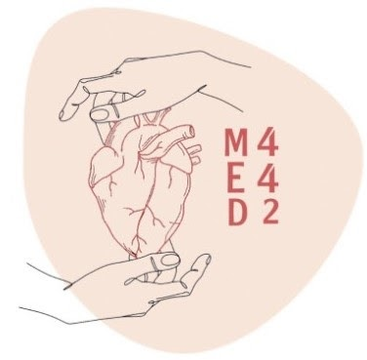
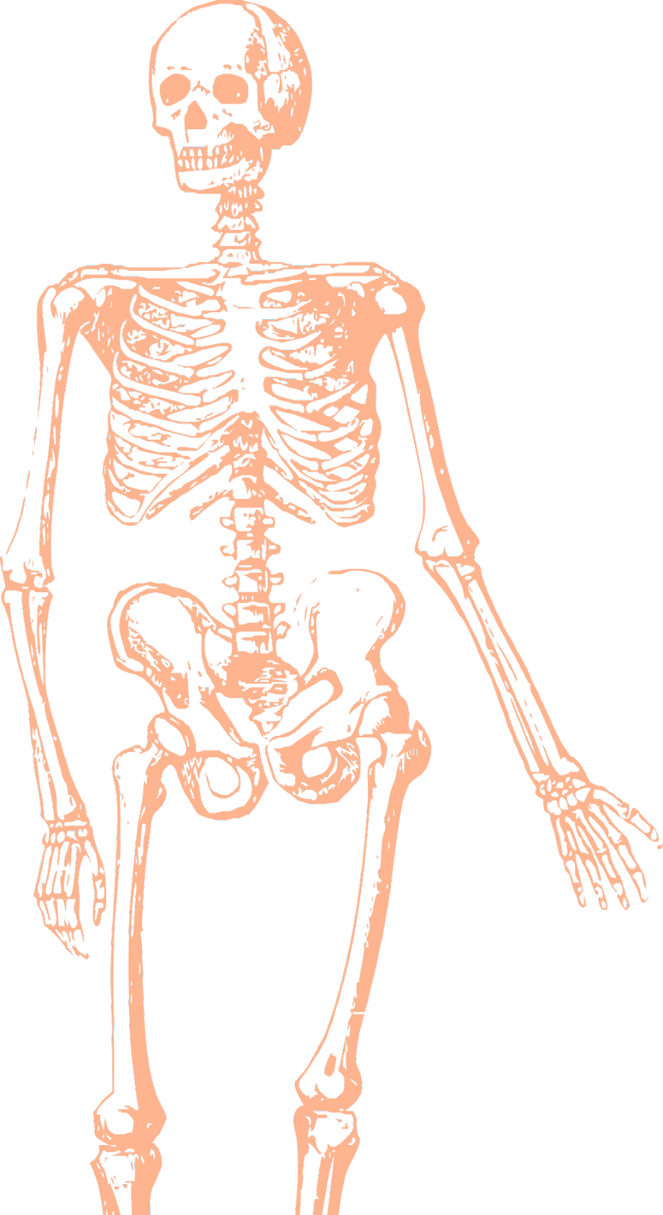
L17
Vascular anatomy of the lower limb
Editing file
Color index:
Mine text
Important
Doctors notes
Female slides only
Male slides only
Extra

Slide 2
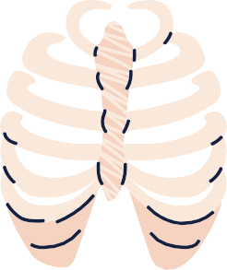
Objectives:
List the main arteries of the lower limb.
Describe their anatomy regarding: origin, course distribution branches.
List the main arterial anastomosis.
List the sites to feel the peripheral arterial pulse.
Describe the anatomy of the veins of the lower limb regarding:
differentiation into superficial & deep, origin, course & termination
Clinical point of superficial veins ( VARICOSE VEIN)

Slide 3
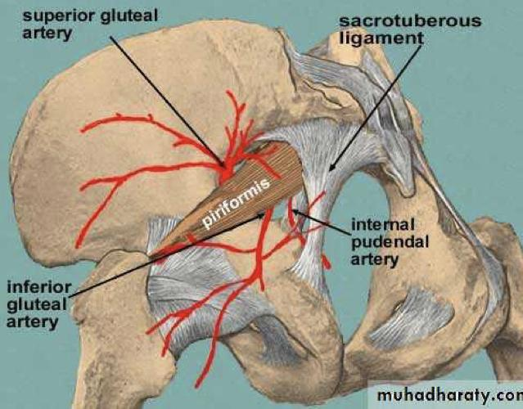
Arteries of the gluteal region
Click here!
SUPERIOR GLUTIAL ARETRY:
It is a branch of the internal iliac artery; it enters the gluteal region through the greater sciatic foramen above the piriformis to supply the gluteal region
INFERIOR GLUTIAL ARETRY:
It is a branch of the internal iliac artery; it enters the gluteal region through the greater sciatic foramen below the piriformis to supply the gluteal region

Slide 4
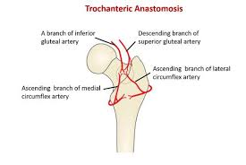
Trochanteric / Cruciate anastomosis
Trochanteric
Cruciate
It is formed by;
superior and inferior gluteal
medial and lateral femoral circumflex arteries.
-It is the main blood supply for the head of the femur.
It is formed by:
the inferior gluteal
medial circumflex femoral
lateral circumflex femoral
and 1st perforator
-With the trochanteric anastomosis it provides connection between the internal iliac and femoral arteries

Slide 5
Femoral Artery: It is the main arterial supply to the lower limb
Pictures at the next slide
Beginning | It is the continuation of the External iliac artery; it enters the thigh behind the inguinal ligament; midway between the anterior superior iliac spine and the symphysis pubis.
Termination | It descends vertically towards the adductor tubercle of the femur and ends by passing through the opening of the adductor magnus-hiatus-muscles and continue as popliteal artery.
Relation | Anterior: Upper part: Skin & fascia. Lower part: passes behind the Sartorius.
 | Posterior: Psoas (separates it from the hip joint),Pectineus & Adductor longus.
 | Medial: Femoral vein.
 | Lateral : Femoral nerve and its branches.
Relation of the Femoral vein to the Femoral artery | At the inguinal ligament: The vein lies medial to the artery.
 | At the apex of the femoral triangle: The vein lies posterior to the artery.
 | At the opening in the adductor magnus: The vein lies lateral to the artery.
Branches | Superficial branches: 1- Superficial Epigastric. 2- Superficial Circumflex iliac. 3-Superficial External Pudendal.
 | Deep branches: 1- Deep External Pudendal. 2- Profunda femoris.

Slide 6
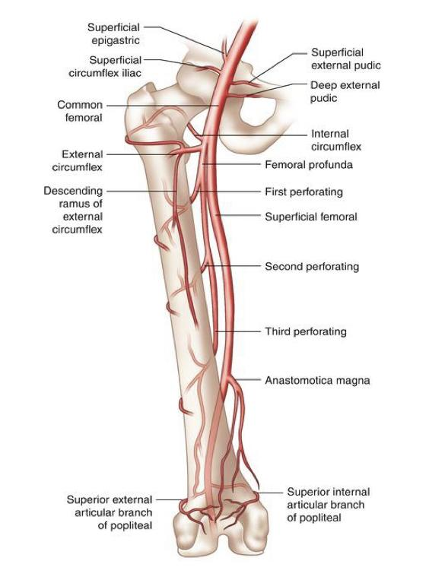
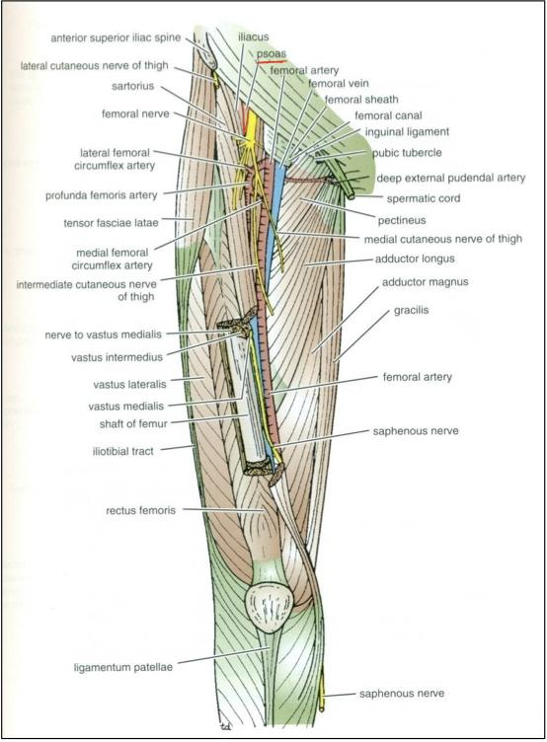
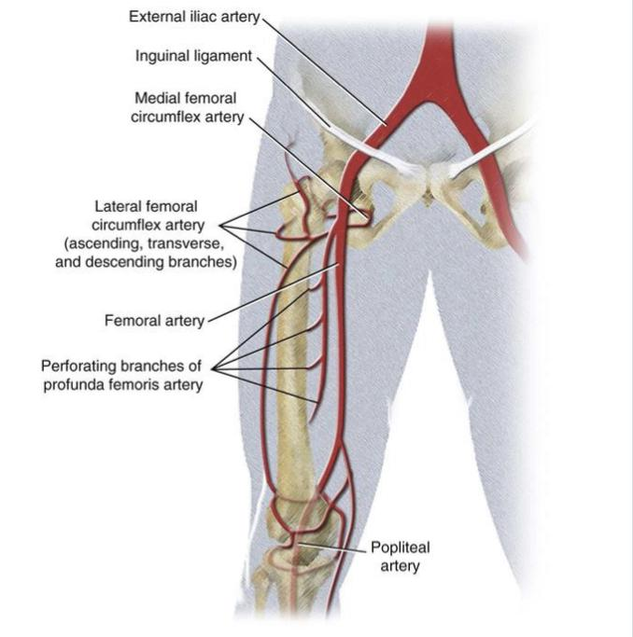
Femoral Artery:

Slide 7
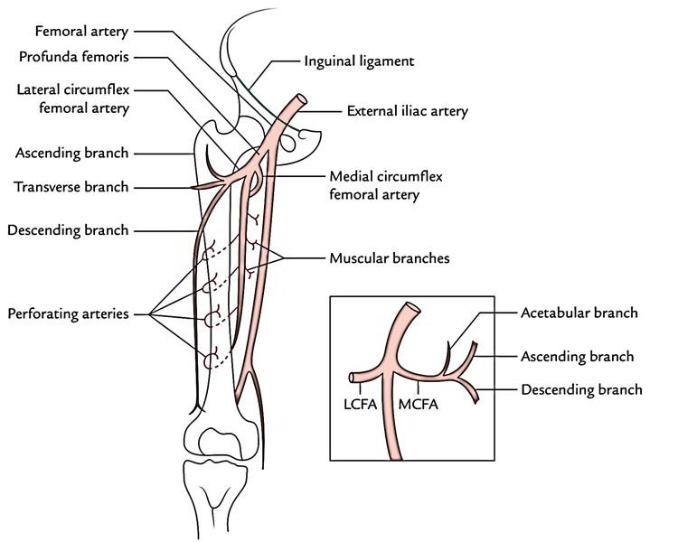
Profunda Femoris Artery: It is an important, large artery.
Arises from the Lateral side of the Femoral Artery
(4cm below the inguinal ligament).
It Passes medially behind the femoral vessels, lies above the adductor magnus muscle.
Where is it?
Where does it pass?
What are its Branches?
Where does it end?
Medial & Lateral Circumflex Femoral Arteries
Three Perforating Arteries
By becoming the 4th Perforating Artery

Slide 8
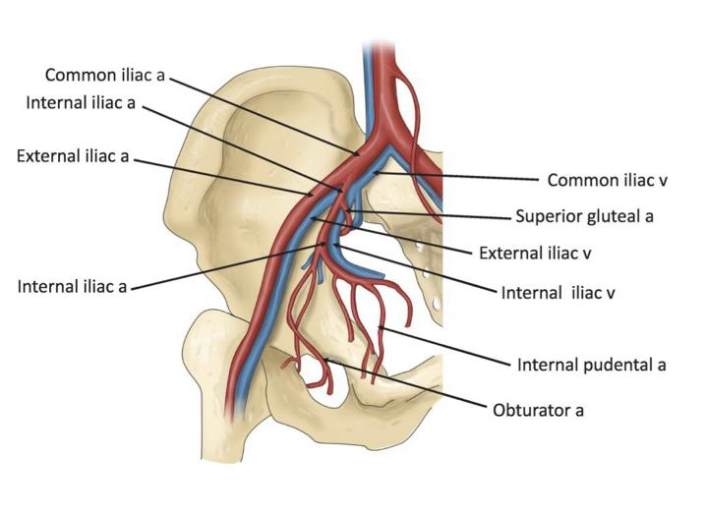
Obturator artery
Click here
It is a branch of the internal iliac artery, accompanies the nerve obturator through the obturator canal
What is it?
Where does it pass?
What are its Branches?
It enters the medial fascial compartment , dividing into medial and lateral branches
It gives muscular branches and articular to the hip joint

Slide 9
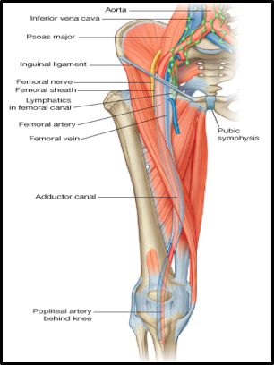
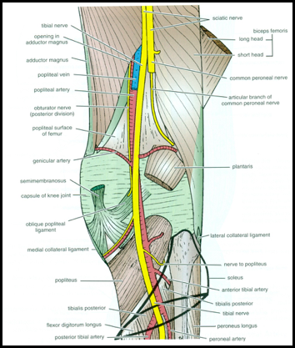
Popliteal Artery :
It is the continuation of Femoral artery, that enters the popliteal fossa through an opening in the Adductor magnus.
Anterior:
Popliteal surface of the femur.
Knee joint.
Popliteus muscle
Posterior:
Popliteal vein, Tibial nerve, skin and fascia.
What is it?
Relation
What are its Branches?
Where does it end?
Muscular and Articular to the knee.
Relations: Popliteal artery and its branches
At the lower border of Popliteus muscle by dividing into Anterior + Posterior tibial Arteries.

Slide 10
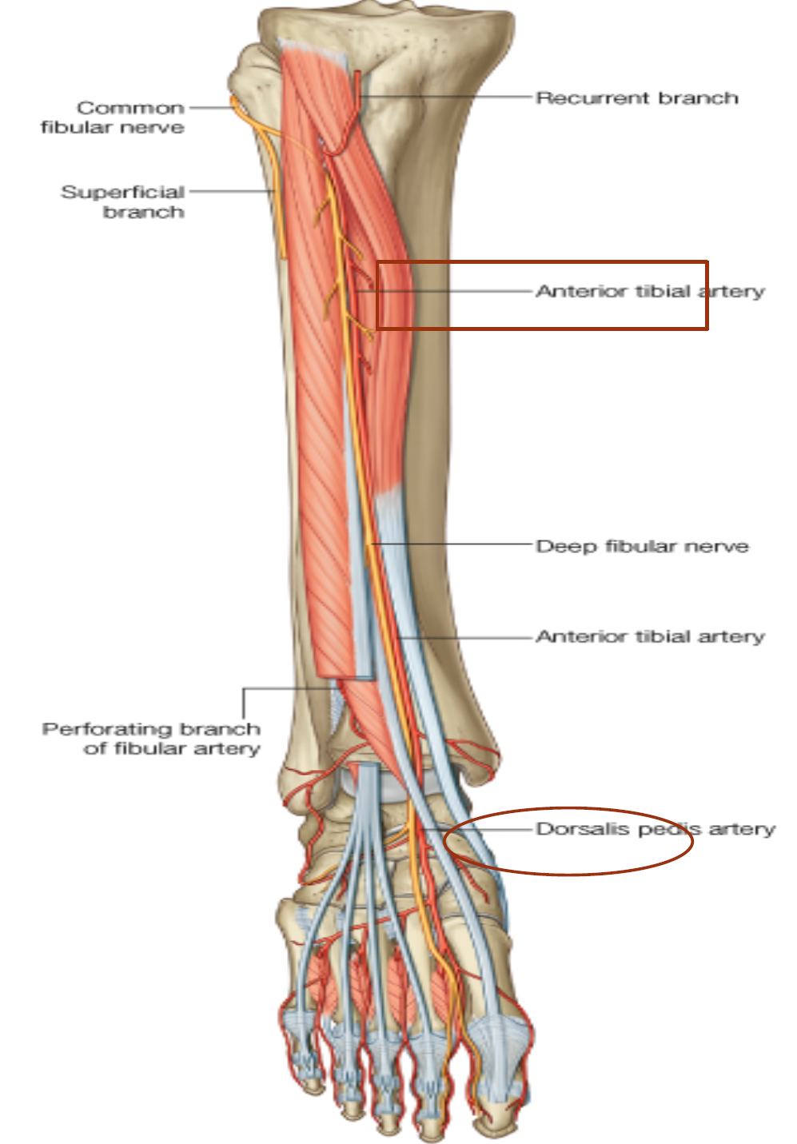
Anterior Tibial Artery : It is the smaller of the two terminal branches of the popliteal artery.
It enters the anterior compartment of the leg
It passes through an opening in the upper part of the interosseous membrane.
It descends with the deep peroneal nerve.
Where is it?
Where does it pass?
What are its Branches?
What about upper and lower part?
Muscular& Anastomotic to branches of other arteries around knee and ankle joints .
In the upper part of its course, it lies deep to the muscles of the anterior compartment.
In the lower part, it lies superficial in front of the lower end of the tibia.

Slide 11
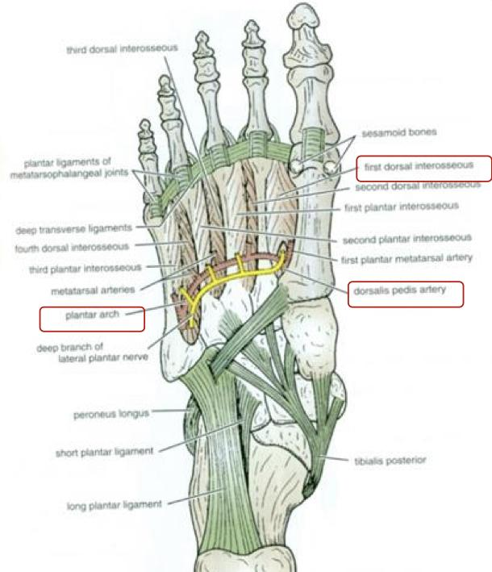
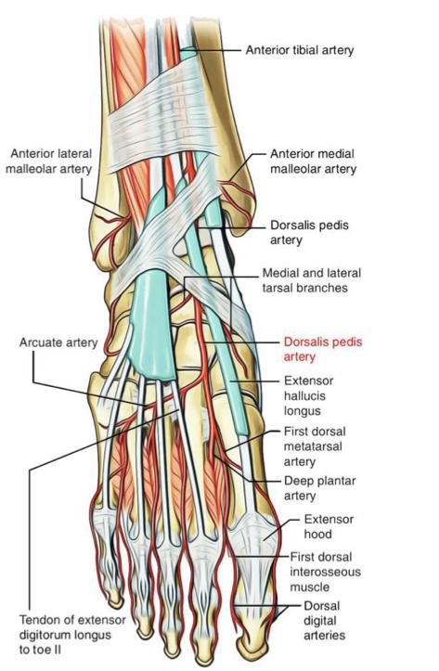
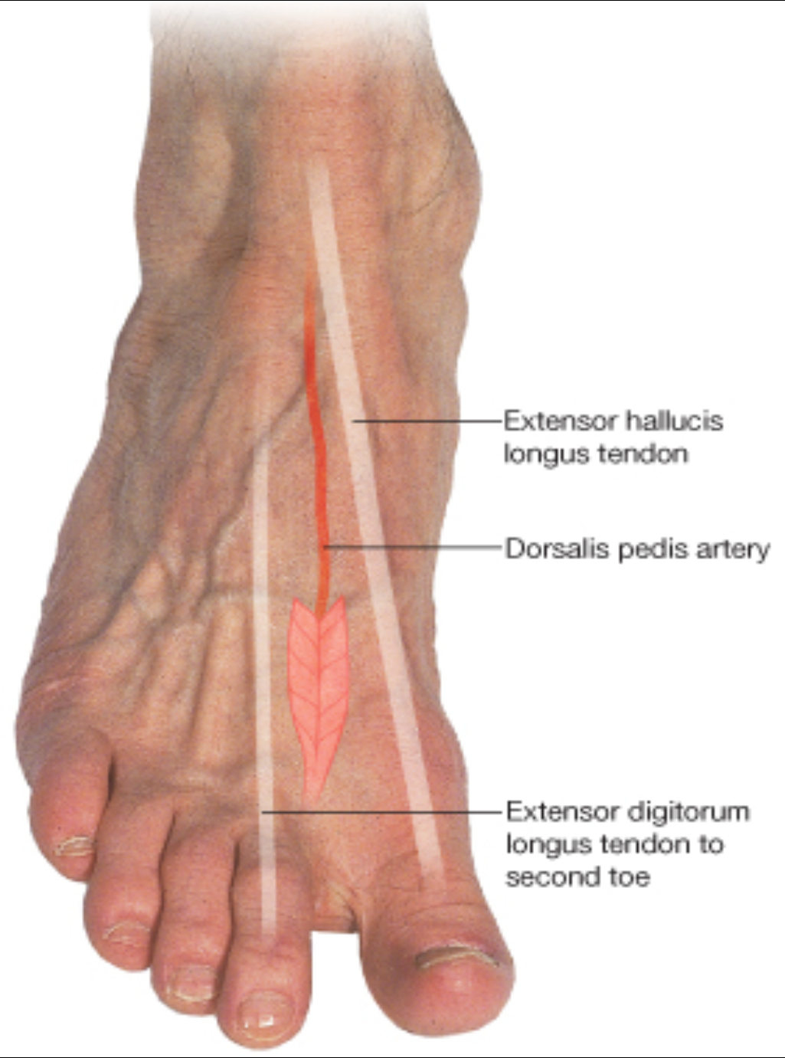
Dorsalis Pedis Artery :
Begins in front of ankle joint as a continuation of the Anterior Tibial artery, it is superficial in position.
Crossed by the inferior extensor retinaculum and the first tendon of extensor digitorum brevis.
Medially: Tendon of extensor hallucis longus.
Laterally: Deep peroneal nerve& extensor digitorum longus.
Where is it?
Where does it pass?
What are its Branches?
Where does it end?
Lateral tarsal artery.
Arcuate artery.
1st dorsal metatarsal artery.
It terminates by passing between the two heads of the 1st dorsal interosseous muscle. It joins the Lateral plantar artery to complete the Plantar Arch.

Slide 12
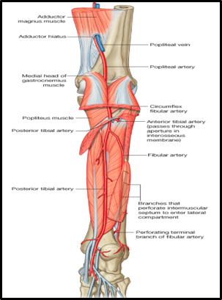
posterior tibial artery
It is one of the two terminal branches of the popliteal artery, at the level of the lower border of popliteus
it descends Deep to Soleus & Gastrocnemius, and deep transverse fascia of the leg.
it lies on the posterior surface of Tibialis Posterior muscle above, and on the posterior surface of tibia below, its lower part is covered by Skin & Fascia only.
It passes behind the medial malleolus, deep to flexor retinaculum.
What is it?
Where does it pass?
Where does it end?
What are its Branches?
It terminates by dividing into: Medial & Lateral plantar arteries.
Anastomotic branches to anastomosis around ankle joint.
Nutrient artery to the tibia.
Medial & Lateral plantar arteries.
4. Peroneal artery: a large artery, arises close to its origin, descends behind the fibula (the artery of the lateral compartment of the leg). Gives :
Nutrient artery to the fibula.
Muscular branches.
Perforating branch to lower part of front of leg.
Shares in the Anastomosis around the ankle joint

Slide 13
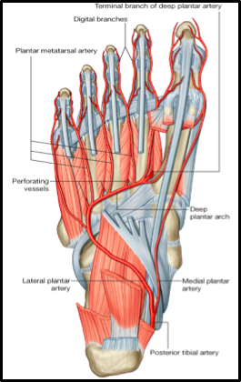
plantar arteries
The smaller of the two terminal branches of the posterior tibial artery.
Arises beneath the Flexor Retinaculum, passes forwards deep to abductor hallucis muscle, ends by supplying medial side of the big toe.
Gives: Muscular, Articular and Cutaneous branches.
medial plantar
The larger of the two terminal branches of the posterior tibial artery, arises beneath the Flexor Retinaculum, passes forwards deep to abductor hallucis muscle, and flexor digitorum brevis.
At the base of the 5th metatarsal bone, it curves medially to form the plantar arch.
Joins the Dorsalis pedis artery at the proximal end of the 1st intermetatarsal space.
Gives; muscular, articular & cutaneous branches. The plantar arch gives plantar digital arteries to the toes.
lateral plantar

Slide 14
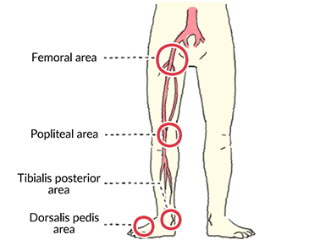
Where to feel peripheral arterial pulse?
Inferior to the lingual ligament and midway between the anterior superior iliac spine and symphysis pubis.
Deep in the popliteal fossa medial to the midline.
Femoral pulse
Popliteal pulse
Posterior tibial pulse
Dorsalis pedis pulse
Posteroinferior to the medial malleolus in the groove between the malleolus and the heel.
Over the tarsal bones between the tendons of extensor hallucis longus and extensor digitorum.

Slide 15
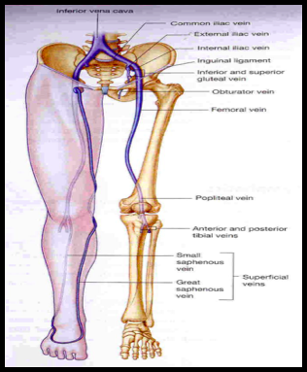
veins of the the lower limb
veins of the the lower limb
explained more in the next slide
superfisial set
deep set
They are immediately under the skin in the subcutaneous tissue.
Dorsal Venous arch (network): Drains most of the blood of the foot through Digital and Communicating veins.
It is Drained on:
Medial side by the Great Saphenous vein. Lateral side by the Small saphenous vein
Femoral vein
-It enters the thigh by passing through he opening in the adductor magnus .
-It leaves the thigh in the intermediate compartment of the femoral sheath
-Passes behind the inguinal ligament to become the External iliac vein
Popliteal vein
Formed by the union of venae comitantes around the anterior & posterior tibial arteries. lies posterior to popliteal artery.

Slide 16
superficial veins
every superficial vein must end in a deep vein | Origin | course
Great saphenous vein (It contains the largest number of valves) | -Begins from the medial end of the dorsal venous arch (as the medial marginal vein) -It is the longest superficial vein of the body. | ● Ascends: 1- in front of the Medial Malleolus accompanied by the Saphenous nerve. 2- posterior the Medial Condyle of the femur. 3- Passes through the Saphenous Opening (2.5-3.25)cm below and lateral to the pubic tubercle. ● Terminates in: Femoral Vein.
Small saphenous vein | From the lateral end of the dorsal venous arch. | ● Ascends: Behind the lateral Malleolus in company with the Sural nerve. Along the middle of the back leg. ● Terminates in: 1- May join Great Saphenous Vein 2- Or Bifurcates: one branch joins the Great Saphenous and the other joins the Popliteal vein.

Slide 17
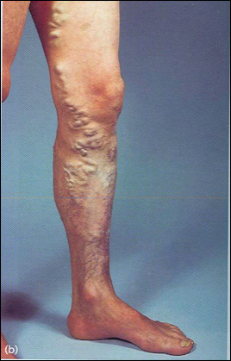
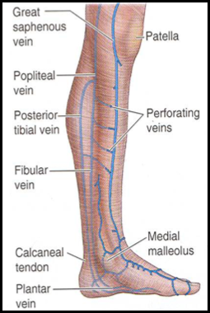
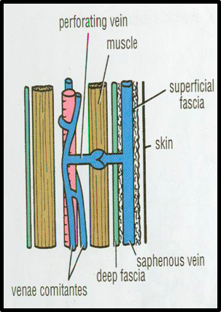
Varicose Veins
Click here!
it is a vein that has large dimeter, than normal, elongated and tortuous.
It is commonly occurred in the superficial veins of the lower limb.
It may result from incompetence of the valves in the perforating veins.
This allows the passage of high-pressure blood from the deep to the superficial veins.
perforating veins Connect the Great Saphenous vein with the deep veins along the medial side of the calf. Their valves only allow blood to flow from the superficial to the deep veins.
DEEP VEINS (VENAE COMITANTES)
Accompany all the major arteries and their branches. Usually paired. They are contained within the vascular sheath of the artery, whose pulsations help to compress and move blood in the veins.

Slide 18
MCQs:
Where is the site of varicose vein?
Q1
A
B
C
D
Posteromedial part of the lower limb
Lateral part of the lower limb
Anterior part of the lower limb
posterolateral part of the lower limb
Q2
Femoral artery has a medial relation with?
Femora vein
Femoral artery
Femoral nerve
None
A
B
C
D
Genicular anastomosis is an important anastomosis around which of the following?
Q3
A
B
C
D
Ankle
Knee
Both A&B
None
Q4
Calcaneal arteries supply the?
A
B
C
D
Heel
Knee
Elbow
Wrist
Special thanks for 441 QBank!
Key answers:
1-A 2-A
3-B 4- A

Slide 19
MCQs:
The anterior tibial artery supplies which of the following?
Q5
B
C
D
Posterior side of the leg
Anterior side of the thigh
Anterior side of the leg
A
posterior side of the thigh
Loss of the popliteal artery pulse is a sign of which of the following
Q6
Popliteal A obstruction
Vascular insufficiency
Femoral A obstruction
Tibial A obstruction
A
B
C
D
which of the following is not one of the main arteries of the lower limb ?
Q7
A
B
C
D
femoral
popliteal
planter
subclavian
Q8
where does the profunda femoris artery end ?
A
B
C
D
4th perforating artery
5th perforating artery
6th perforating artery
7th perforating artery
Special thanks for 441 QBank!
Key answers:
5-C 6-C
7-D 8-A

Slide 20
Done by the amazing team
Team leaders:
Arwa Alghamdi
Deema Aljuribah
Razan Alnufaie
Team leaders:
Mishal Alsuwayegh
Mohammed Alghamdi
Members:
Members:
Aljazi Albabtain
Atheer Alkanhal
Arob Alasheikh
Ajwan Aljohani
Deema alqahtani
Dena Alsuhaibani
Farah alqazlan
Jana Alhazmi
Kadi aldosari
Mashael Alasmari
Noura Bin hammad
Najla aldhbiban
Nouf aldalaqan
Razan alasmari
Roaa alharbi
Raghad Mohammed
Shaden albassam
Waha Almathami
Walaa AlMutawa
Yara Ameer Alalwan
Othman Aldraihem
Faisal Alomar
Abdullah Alturki
Othman Alabdullah
Omar Alkadhi
Abdullah Ali
Meshari Alshathri
Yazeed Alsanad
Fahd Mobaireek
Emad Almutairi
Nasser Alghaith
Saad Almogren
Azzam Abdullah Alotaibi
Hassan Ali Alabdullatif
Rayan Alotaibi
Mohammed Nasser
Luay Almutair
Mohammed Fahad
Mohammed Majed
Abdulkarim Salman
anatomyteam442@gmail.com
Thanks to Faisal Alomar for his design of the team logo

