Slide 1
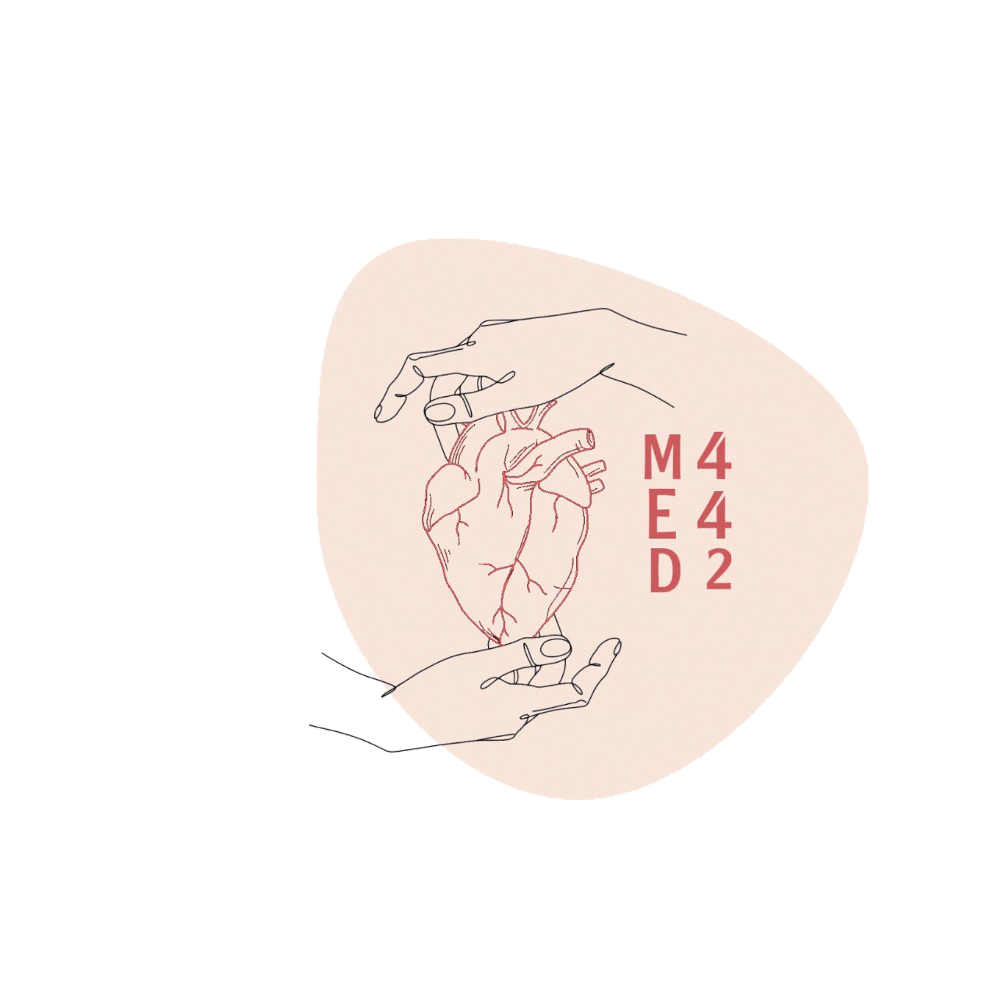
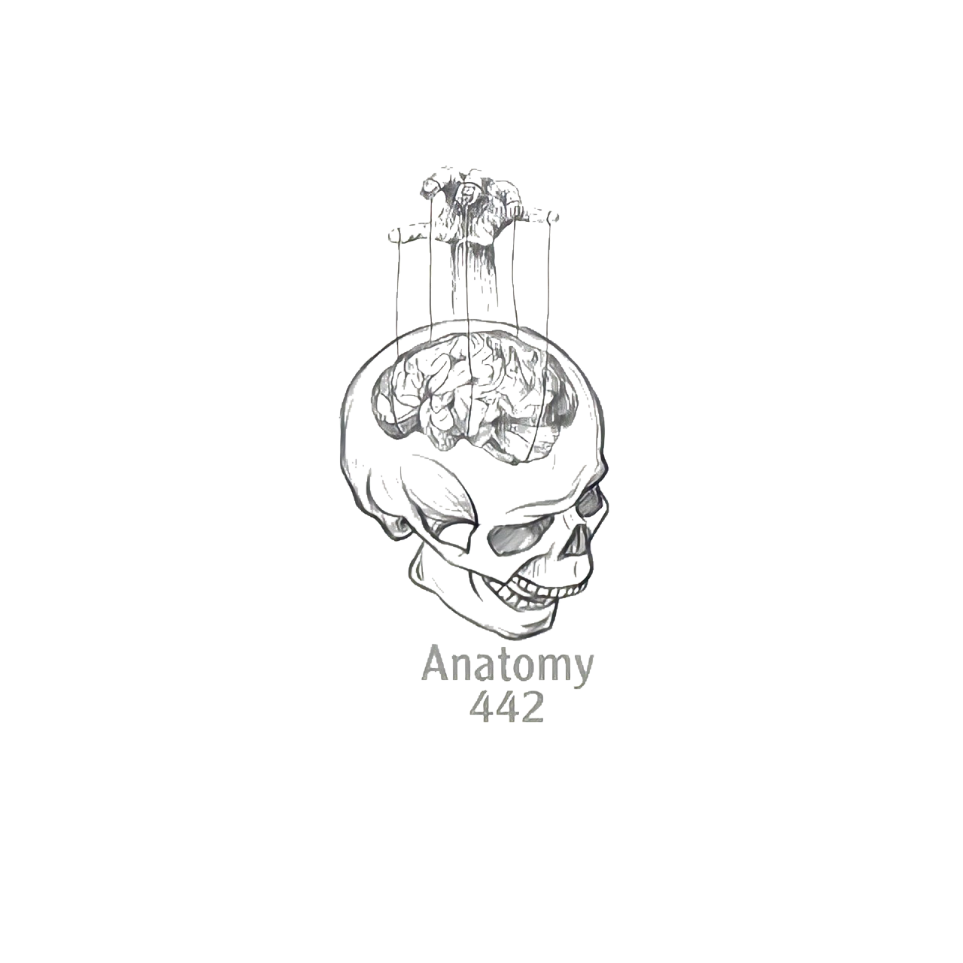
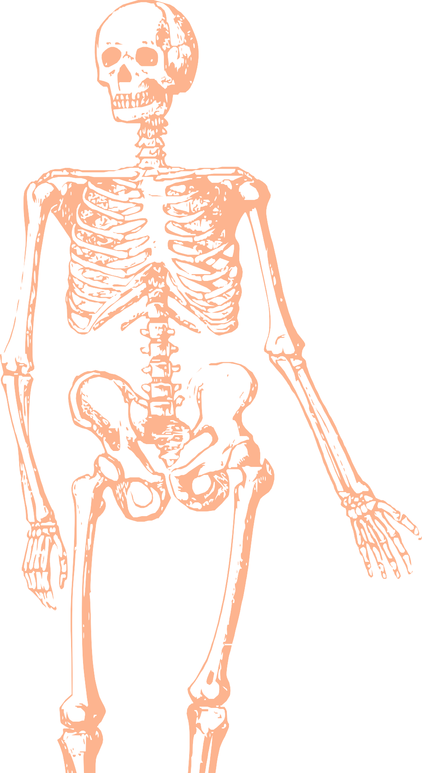
L18
Hip,Knee joint ,and Ankle Joint
Editing file
Color index:
Mine text
Important
Doctors notes
Female slides only
Male slides only
Extra

Slide 2
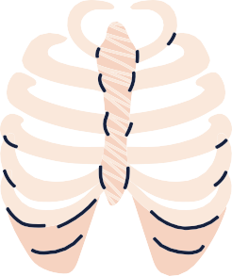
Objectives:
List the type & articular surfaces of hip joint.
Describe the ligaments of hip joints (extra & intra-capsular ligaments)
Describe movements of hip joint.
List the type & articular surfaces of knee joint.
Describe the capsule of knee joint, it’s extra & intra-capsular ligaments.
List important bursae in relation to knee joint.
Describe movements of knee joint.
Apply Hilton’s law about nerve supply of joints.
List the type & articular surfaces of ankle joint.
Describe the ligaments of ankle joints.
Describe movements of ankle joint.

Slide 3
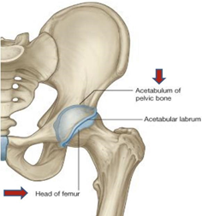
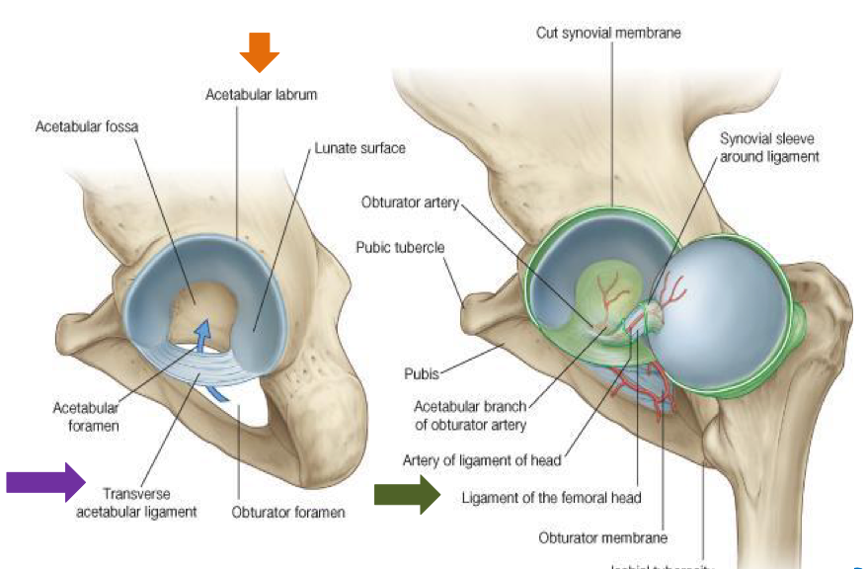
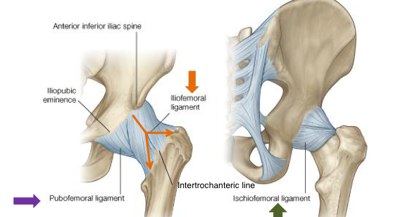
Hip joint
Helpful video
type
it is a synovial, ball & socket joint.
Articular Surface
-Acetabulum of hip (pelvic) bone.
-Head of femur
 |  | Acetabular labrum: fibro-cartilaginous collar attached to margins of acetabulum to increase it’s depth for better retaining of head of femur (it’s completed inferiorly by transverse ligament) | Transverse acetabular ligament: converts acetabular notch into foramen (acetabular foramen) through which pass acetabular vessels. Males dr :is for protection of the vessels not for stability of the joint | Ligament of femoral head: carries vessels to head of femur (branch of obturator artery).
 |  | Iliofemoral ligament: Y-shaped strong ligament, anterior to joint, limits extension. | Pubofemoral ligament: antero-inferior to joint, limits abduction & lateral rotation. | Ischiofemoral ligament: posterior to joint , limits medial rotation.
Intracapsular (3)
ligaments
Extracapsular (3)

Slide 4
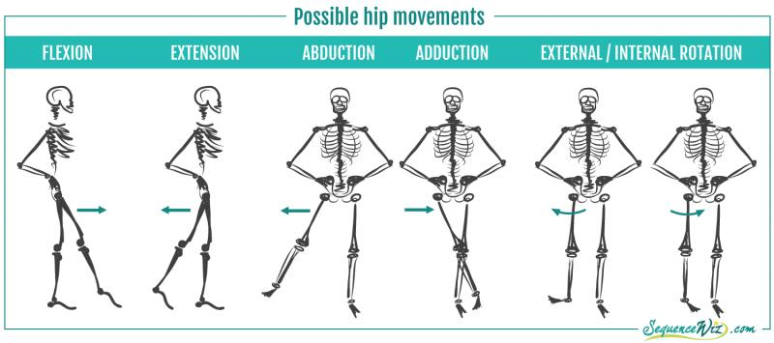
Movement of Hip Joint
1 - ADDUCTION:
-Adductors (all adductors muscles)
-Gracilis
3- MEDIAL ROTATION:
-Gluteus medius
-Gluteus minimus
5- FLEXION:
-Iliopsoas (mainly)
-Sartorius
-Pectineus
-Rectus femoris
2 -ABDUCTION:
-Gluteus medius and minimus
-Sartorius
4- LATERAL ROTATION:
-Gluteus maximus
-Piriformis
-Quadratus femoris
-Obturator externus and internus
6 -EXTENSION:
-Hamstrings(mainly)
-Gluteus maximus (powerful extensor)

Slide 5
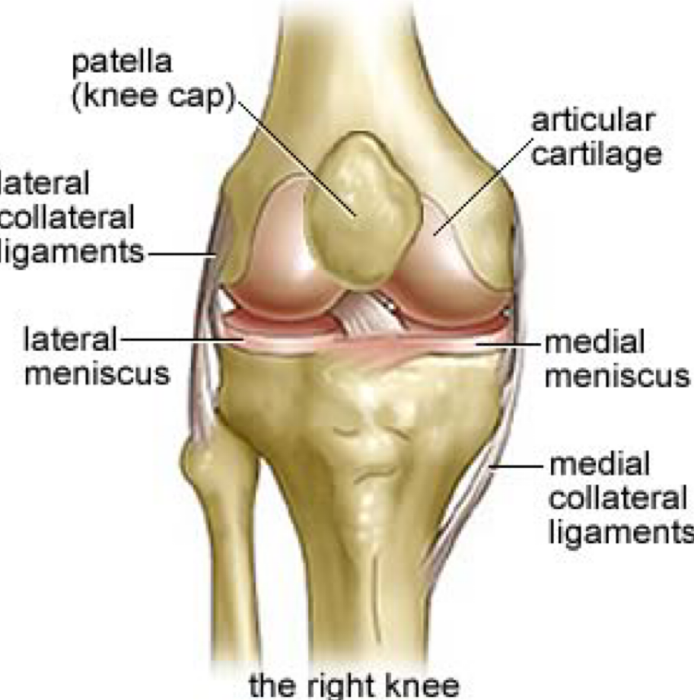
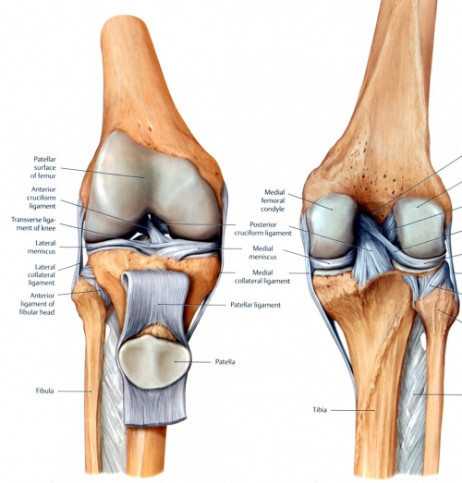
Knee joints
Helpful video
Is formed of :
Knee joints articulations
Three bones (tibia,femur,patella)
Three articulations
1-Femoro-patellar articulations:
Between the posterior surface of the Patella and patellar surface of femur
(Type: synovial, plane)
2-Femoro-tibial articulations:
Between the 2 femoral condyles and upper surfaces of the 2 tibial condyles
( Type: synovial,modified hinge)

Slide 6
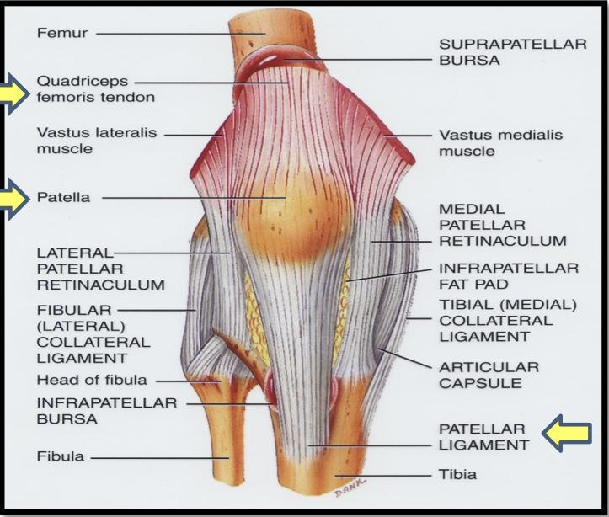
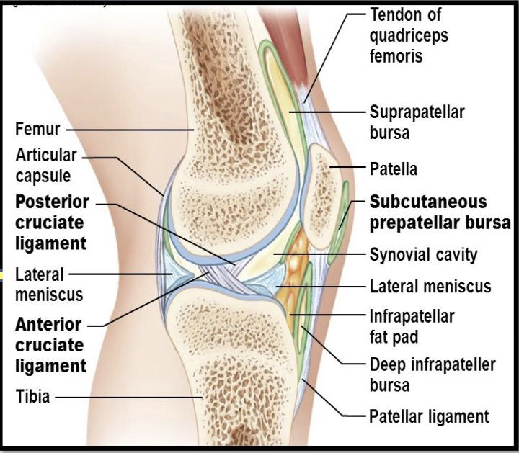
Knee joints
Capsule
The capsule in the knee is deficient anteriorly and replaced by :
-quadriceps femoris tendon
-Patella
-Ligamentum patella
It possesses two openings;
-One for popliteus tendon
-one for communication with suprapatellar bursa

Slide 7
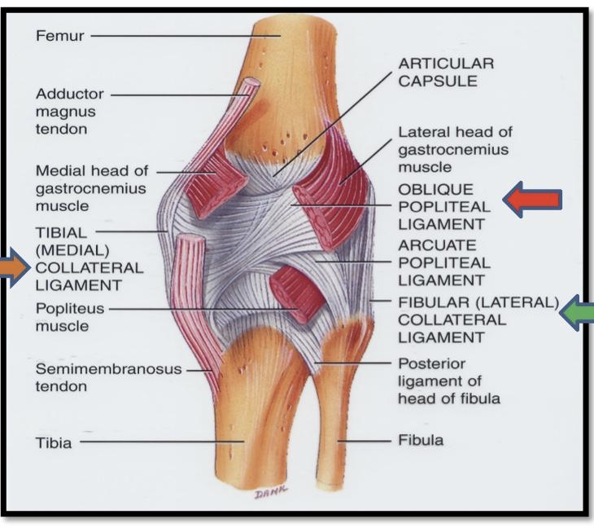
Extracapsular Ligament of The Knee
1
ligamentum patellae (patellar ligament) : from patella to tibial tuberosity.
Medial (tibial) collateral ligament: from medial epicondyle of femur to upper part of medial surface of tibia. (Firmly attached to medial meniscus). “Prevents unwanted movements” / صعب تتحرك ،الاصابه سهله
2
3
Lateral (ﬁbular) collateral ligament: from lateral epicondyle of femur to head of ﬁbula (separated from lateral meniscus by popliteus tendon). /سهلة الحركة ، الاصابه صعبة
4
Oblique popliteal ligament: extension of semimembranosus tendon.

Slide 8
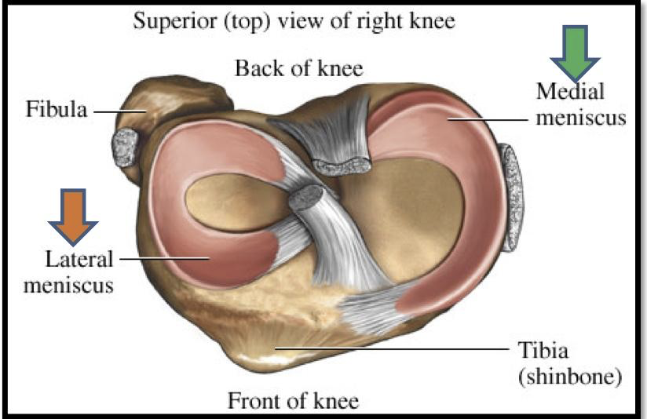
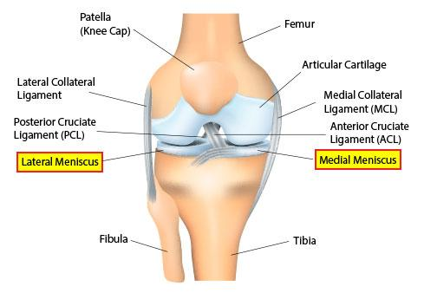
The menisci of the knees are semicircular fibrocartilaginous structures consisting of a hydrophilic extracellular matrix containing a network of collagen fibers, glycoproteins, and proteoglycans maintained by a cellular component.
Intracapsular Ligament of the knee
Menisci (it is a structure not a ligament)
ATTACHMENT | FUNCTION
- Each meniscus is attached by anterior & posterior horns into the upper surface of tibia. | 1) They Deepen articular surfaces of tibial condyles. 2) They Serve as cushions between tibia & femur
- The outer surface of medial meniscus is also attached to capsule & medial collateral ligament. - Medial meniscus is less mobile & more liable to be injured.
The lateral meniscus is small & circular.
Menisci shapes:
They are 2 C shaped plates of ﬁbro-cartilage
The medial meniscus is large & oval.
“It lies on the medial condyle of the femur “which is larger than the lateral”

Slide 9
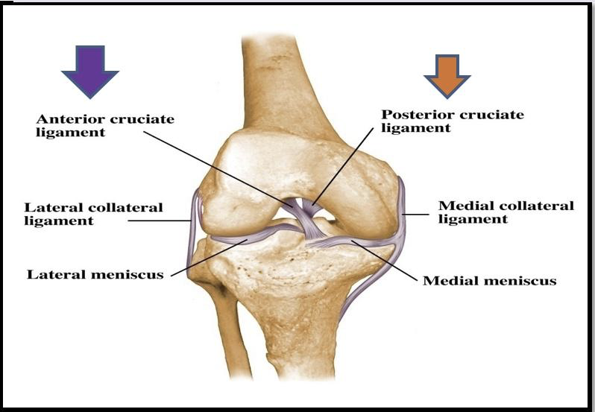
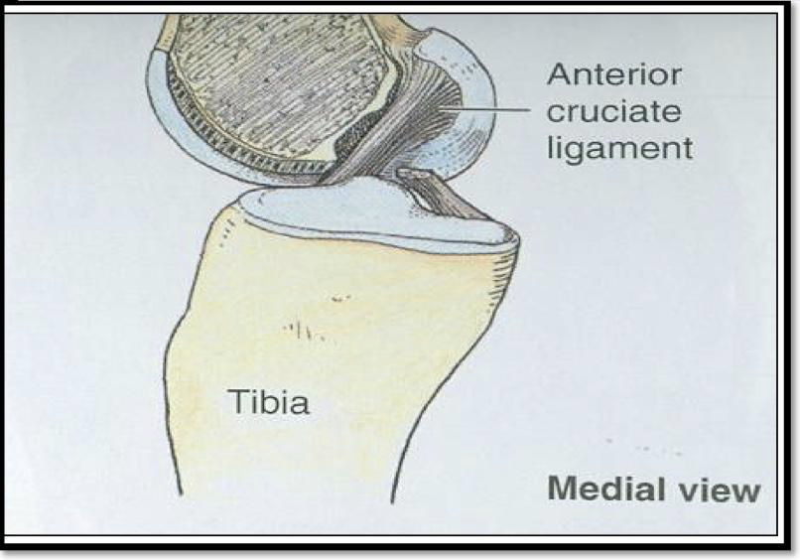
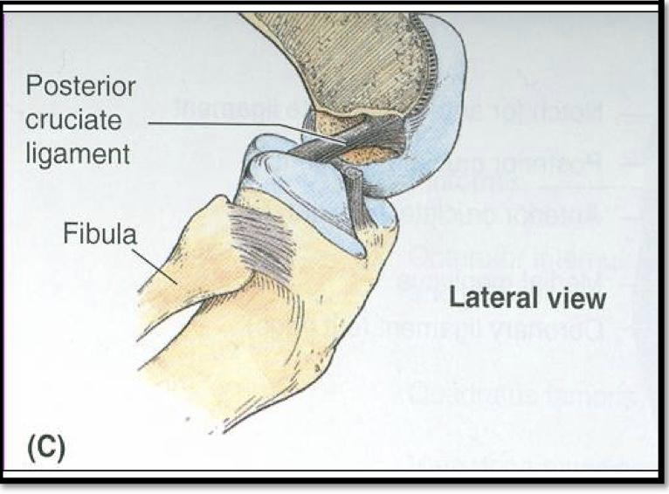
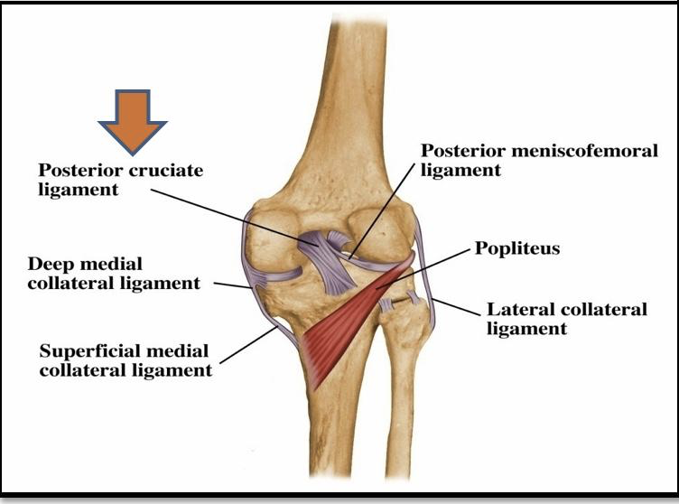
Intracapsular Ligament of the knee
ATTACHMENT | FUNCTION
Anterior cruciate (ACL): from anterior part of the intercondylar area of tibia to posterior part of lateral condyle of the femur. | Prevents the posterior displacement of femur on tibia.
Posterior cruciate (PCL): from posterior part of the intercondylar area of tibia to anterior part of medial condyle of the femur. | Prevents the anterior displacement of femur on tibia.

Slide 10
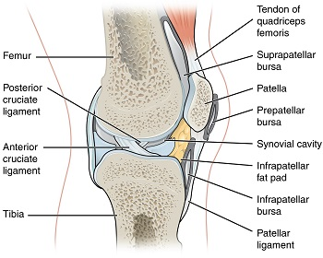
Bursae are small fluid-filled sacs that reduce friction between moving parts in your body's joints.
IMPORTANT BURSAE RELATED TO KNEE
suprapatellar bursa:
Deep infrapatellar bursa:
between tibia and ligamentum patella
popliteal bursa:
between femur & quadriceps tendon, communicates with synovial membrane of knee joint
between popliteus tendon & capsule,
communicates with synovial membrane of knee joint
prepatellar bursa:
subcutaneous infrapatellar bursa:
between patella & skin
between tibial tuberosity & skin
Suprapatellar bursa and popliteal bursa can communicate with synovial membrane of knee joint

Slide 11
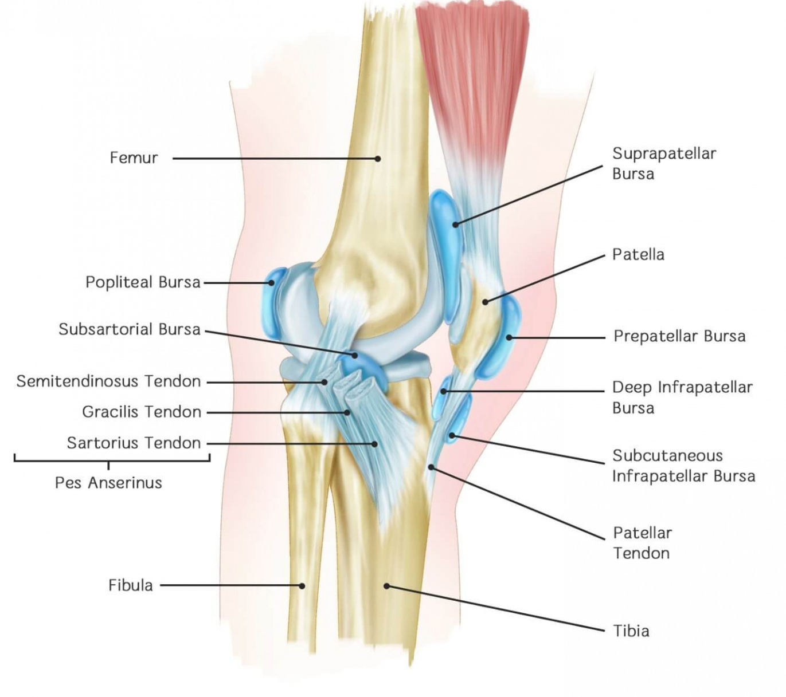
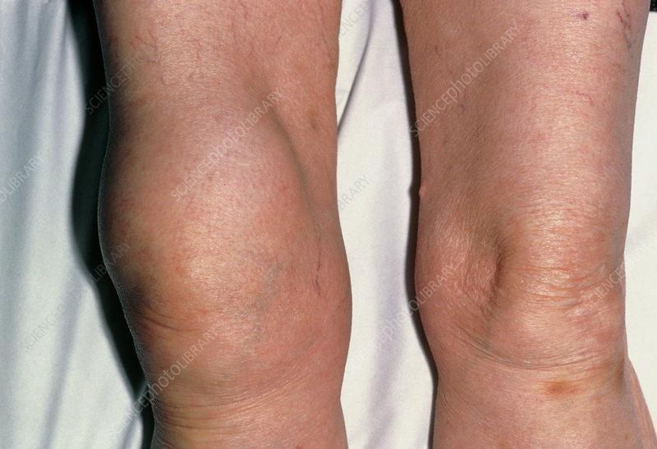
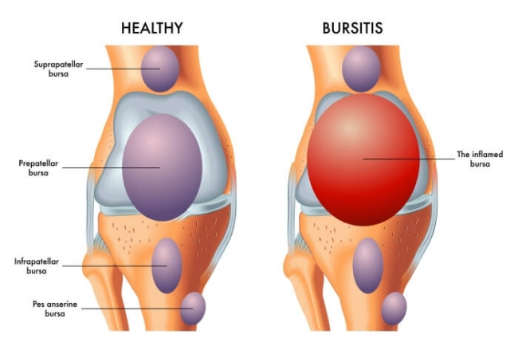
Only in females slides
IMPORTANT BURSAE RELATED TO KNEE
clinical importance (of the suprapatellar bursa) :
commonly inflamed bursa leads to bursitis.
note that: the colors of the boxes related to the previous slide.

Slide 12
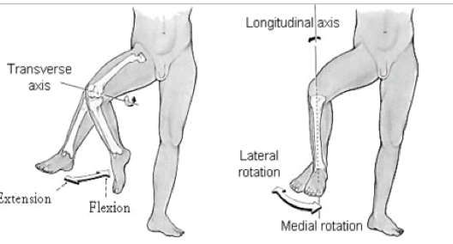
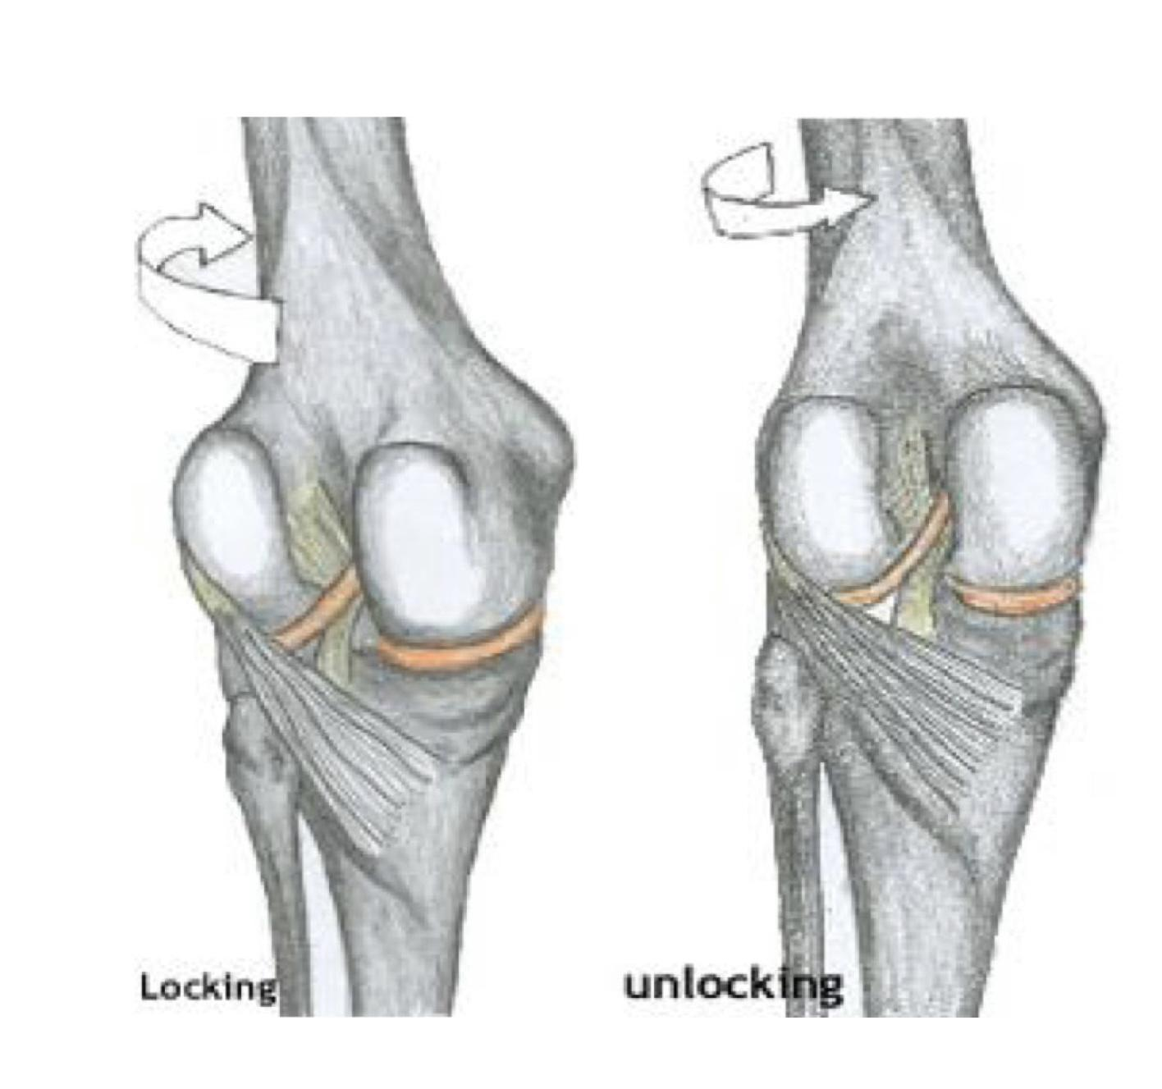
Movements of the knee joint
FLEXION | mainly by hamstring muscles: biceps femoris, semitendinosus & semimembranosus Assisted by sartorius, gracilis & popliteus.
EXTENSION | quadriceps femoris.
ACTIVE ROTATION (performed when the knee is flexed ) | Medial rotation: mainly by semitendinosus & semimembranosus. Assisted by sartorius & gracilis. B) Lateral rotation: biceps femoris.
INACTIVE (DEPENDANT) ROTATION: هي الحركات اللي تصير لمفصل الركبة لما الركبه ماتكون flexed وهذي الحركات ماراح نحس فيها Females dr : You can mention just one movement either the movements of tibia *OR* movements of femur Males dr : happens by itself when extension | Locking of knee: -slight lateral rotation of tibia (or medial rotation of femur ( due to the shape of condyle ), at the end of extension. - Results mainly by tension of anterior cruciate ligament. - In locked knee, all ligaments become tight. B) Unlocking of knee:واقف بس انه ريلاكس مو شاد على نفسه مرة Medial rotation of tibia (lateral rotation of femur), at the beginning of flexion. Performed by popliteus to relax ligaments & allow easy flexion.
هذا المقصود بال
Knee is must be flexed
( نفس وقفة العسكر )
لما الشخص يكون واقف وشاد على نفسه
This pic only in females slides
Females dr : this is an extra information just for your understanding

Slide 13
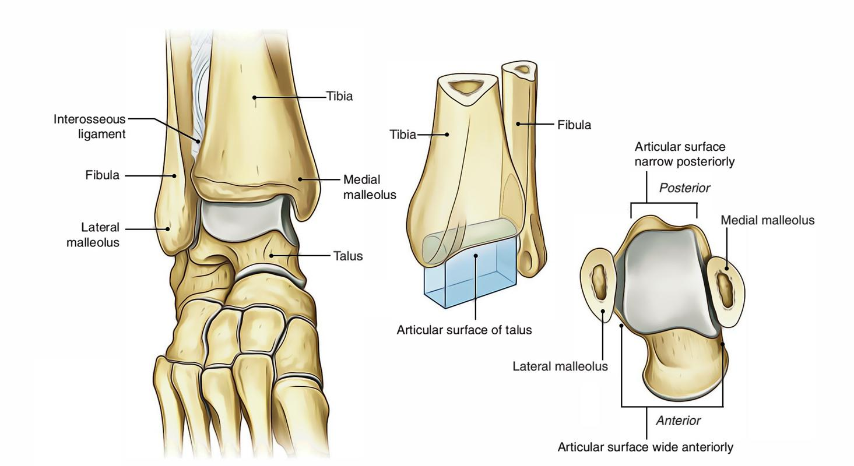
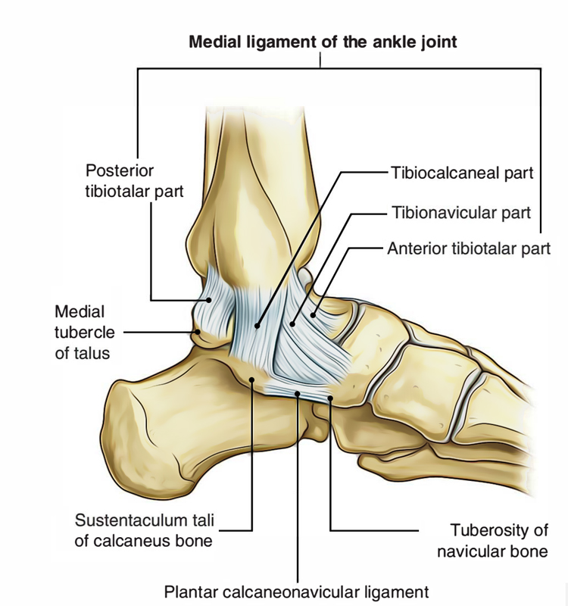
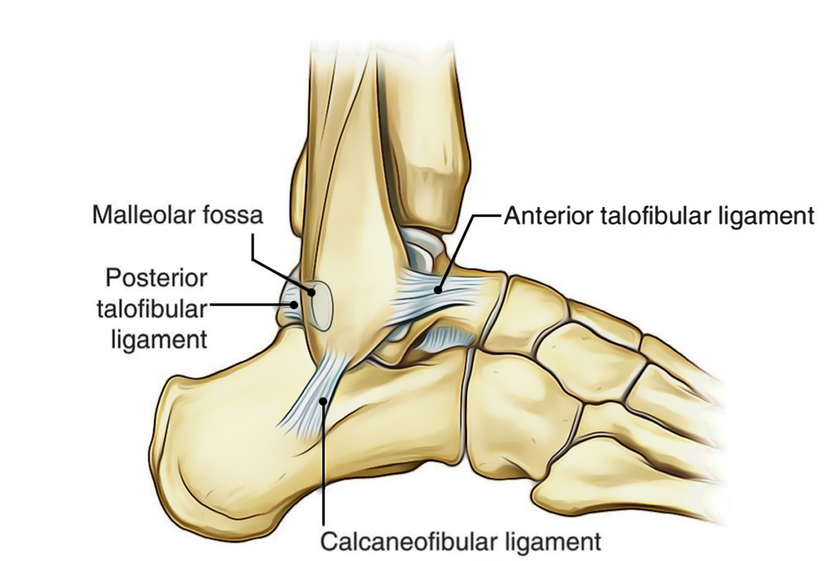
Ankle joint
Helpful video
Type
Articular surface
Upper: a socket formed by: the lower end of tibia, medial malleolus & lateral malleolus( fibula)
it is a synovial, hinge joint.
Lower: body of talus.
Ligaments:
Medial (deltoid) ligament: | A strong triangular ligament. Apex: attached to medial malleolus Base: subdivided into 4 parts: Anterior tibiotalar part Tibionavicular part Tibiocalcaneal part Posterior tibiotalar part
Lateral ligament: | composed of 3 separate ligaments: Anterior talofibular ligament calcaneofibular ligament posterior talofibular ligament
Upper articular surface
Lower articular surface

Slide 14
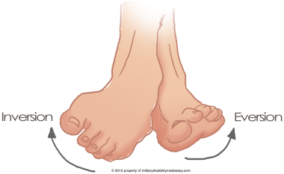
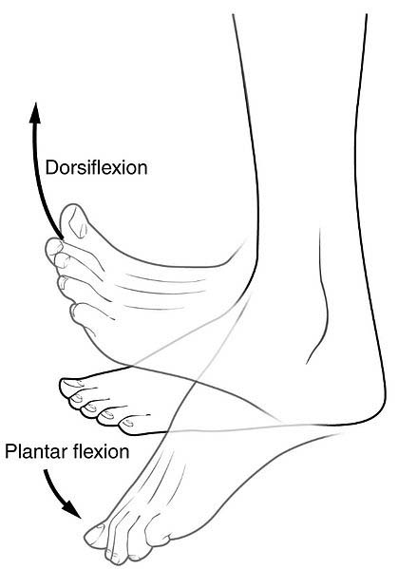
MOVEMENT OF ANKLE JOINT
very important
DORSIFLEXION:
Performed by muscles of anterior compartment of leg:
Tibialis Anterior
Extensor Hallucis Longus
Extensor Digitorum Longus
Peroneus Tertius
2) PLANTAR FLEXION:
-Initiated by Soleus.
-Maintained by Gastrocnemius.
-Assisted by other muscles in posterior compartment of leg:
Tibialis Posterior
Flexor Digitorum Longus
Flexor Hallucis Longus
+muscles of lateral compartment of leg (Peroneus Longus & Peroneus Brevis).
3) INVERSION:
muscles perform inversion:
Tibialis Anterior
Tibialis Posterior
4) EVERSION:
Performed by:
Peroneus Longus .
Peroneus Brevis.
Peroneus Tertius. (This muscle can be absent)
INVERSION & EVERSION MOVEMENT occur at the talo-calcaneo-navicular joint, the talocalcaneonavicular joint is a synovial ball and socket joint formed between three tarsal bones (talus, calcaneus and navicular) and the adjacent ligamentous structures.

Slide 15
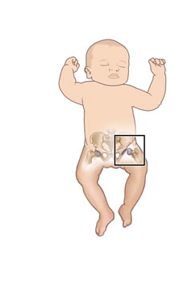
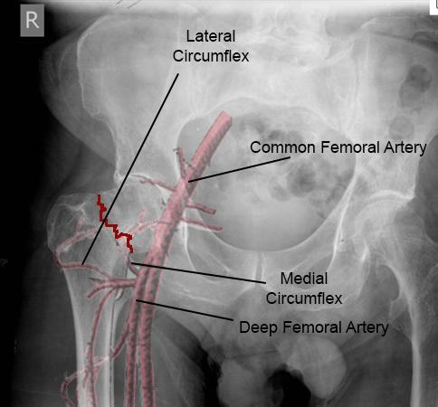
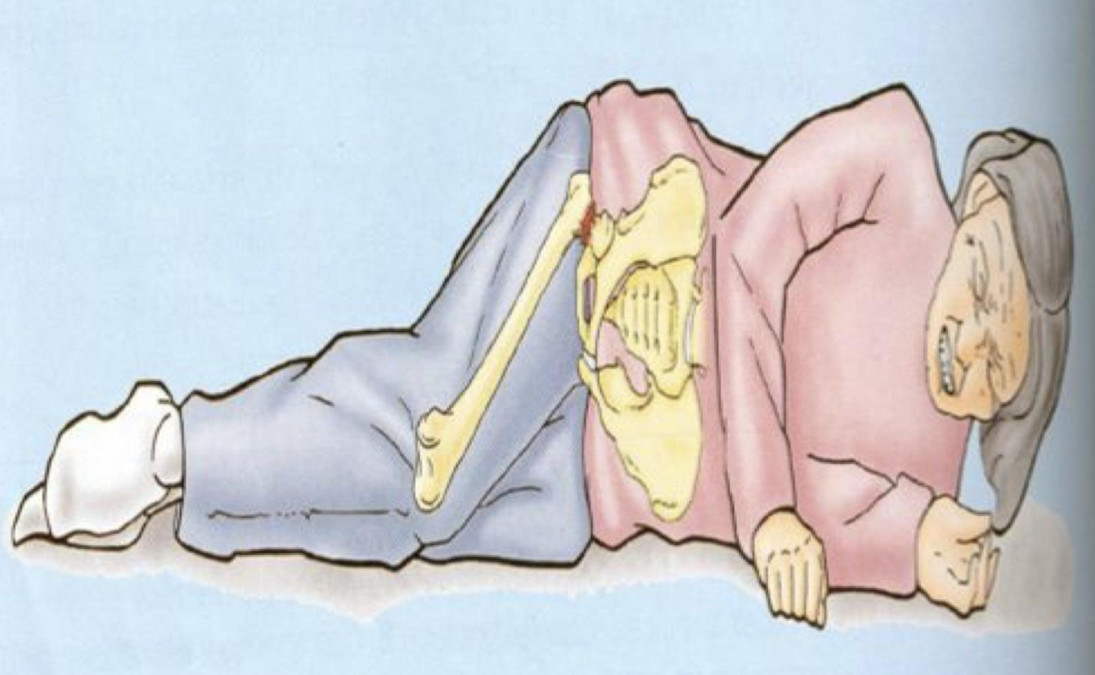
Nerve supply
Remember Hilton law:
-the joint capsule is supplied by branches from nerves supplying muscles acting on it
هذي ثاني مره يتكرر معنا هذا القانون (اول مره بمحاضرة ال
(Joint
والدكتوره دايم تركز عليه وتقول ان مهم تعرفون انه يكون
Nerves supply the joint capsule not the cavity
لان قد جاء عنه سؤال
FRACTURE OF NECK OF FEMUR (important)
It is common after 60 years of age especially in women because of Osteoporosis.
It results in a vascular necrosis of the head of femur.
Blood supply to femoral head; Mainly is medial femoral circumflex.
Displacement of femoral neck fracture will disrupt the blood supply and cause an Intracapsular Hematoma.
DISLOCATION OF HIP JOINT
Congenital
More common in girls and associated with inability to adduct the thigh.
The upper lip of the acetabulum fails to develop adequately.
The head of the femur rides up out of the acetabulum onto the gluteal surface of the ileum.

Slide 16
Only in females slides
knee joint injury (very important)
Meniscal tears | these pieces of cartilage can tear suddenly during sporting activities; With a sudden meniscus tear, a pop may be heard or felt in the knee. they may also tear slowly due to aging (degenerative meniscus tear) بسبب الكبر في السن ممكن يصير Degeneration for the meniscus
2) Anterior cruciate ligament injuries | Injuries to the ACL can be serious and require surgery A grade 1 sprain is a mild injury to the ACL, while a grade 3 refers to a complete tear. causes: sports as in football; improperly landing from a jump or quickly changing the direction.
3) Posterior cruciate ligament injuries | An injury to the posterior cruciate requires powerful force while the knee is in a bent position. this happens when someone falls hard onto a bent knee or is in an accident.
هذي الاصابه غالبا تصير في وضعية ان الشخص كأنه راح يجلس بس يطيح والطيحه تكون على وزنه ومره خطيره

Slide 17
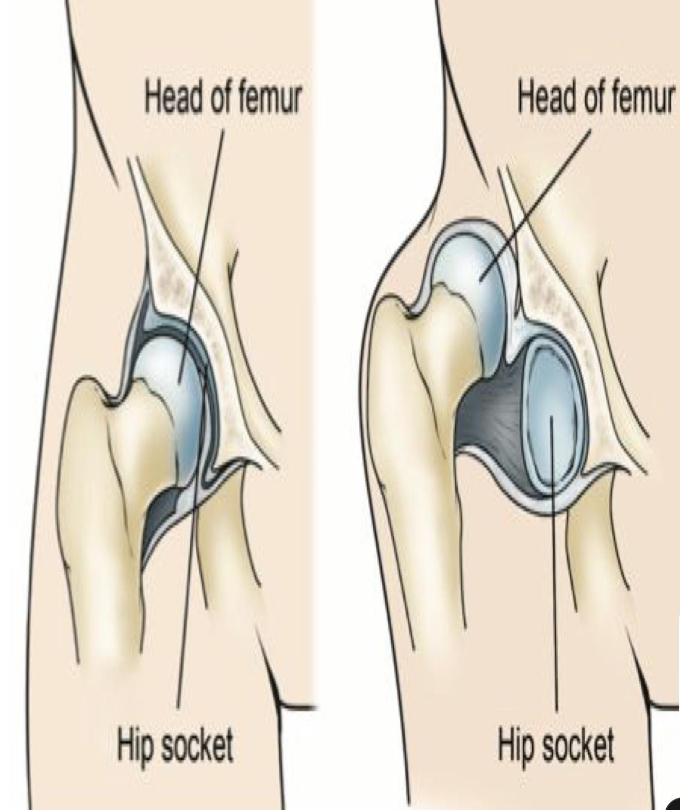
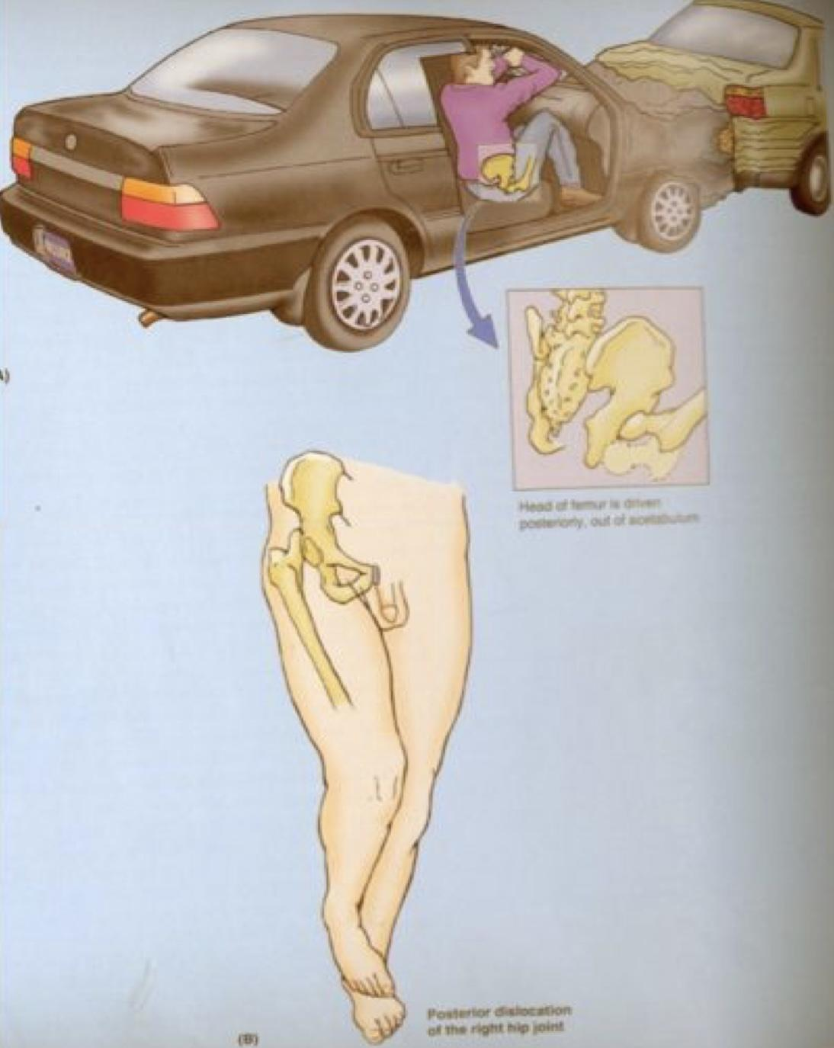
Traumatic Hip Dislocation
It is common in motor vehicle accidents when the thigh is flexed and adducted.
The dislocated head is displaced posteriorly to lie on the posterior surface of the ileum.
In posterior dislocation the sciatic nerve is liable to be injured
Only in females slides
what are the kind of ankle injuries? Females doctor didn’t focus on this and she said just for your knowledge Ankle injuries are: Sprains, Strains, and Fracture; That affect bones, ligaments, or tendons.
Sprain | Strain | Fracture
Is a common sports injury, but can also happen any time a sudden twist displaces the ankle joint. Is the term that describes damage to ligaments when they are stretched beyond their normal range of motion. it ranged from mild to a complete tear or rupture. | Refers to damage to muscles and tendons as a result of being pulled or stretched too far. | Describes a break in one or more of the bones in the ankle joint.
Only in females slides

Slide 18
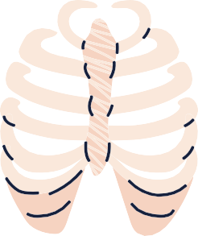
Questions from the slides
Q1
The muscle that extends the hip & flexes the knee joint is:
A
Gluteus maximus.
B
Quadriceps femoris.
C
Sartorius.
D
Semitendinosus.
Q2
The bursa that communicates with the synovial membrane of knee joint is:
A
Suprapatellar
Prepatellar
C
Subcutaneous infrapatellar
D
Deep infrapatellar
B
Q3
The muscle that dorsiflexes the ankle is:
A
Flexor digitorum longus
B
C
Peroneus brevis
D
Gastrocnemius
Tibialis anterior
1)D 2)A 3)B

Slide 19
MCQs from QBank:
A strain refers to damage to which of the following?
Q4
A
B
C
D
Tendons
Ligaments
C
muscles
Both A and C
Q5
Which type of cartilage are the knee menisci comprised of?
A
B
C
D
Elastic
Fibroelastic
Hyaline
Fibrocartilage
Q6
Damage to which artery is MOST likely to cause avascular necrosis of the femoral head?
A
B
C
D
Lateral femoral circumflex
Medial femoral circumflex
Artery to head of femur
Popliteal
Which of the following bones does NOT articulate at the ankle joint ?
Q7
Tibia
C
Talus
A
B
D
Fibula
Calcaneus
(special thanks for Qbank team441 )
Q4) D Q5) D Q6) B Q7) B

Slide 20
Done by the amazing team
Team leaders:
Arwa Alghamdi
Deema Aljuribah
Razan Alnufaie
Team leaders:
Mishal Alsuwayegh
Mohammed Alghamdi
Members:
Members:
Aljazi Albabtain
Atheer Alkanhal
Arob Alasheikh
Ajwan Aljohani
Deema alqahtani
Dena Alsuhaibani
Farah alqazlan
Jana Alhazmi
Kadi aldosari
Mashael Alasmari
Noura Bin hammad
Najla aldhbiban
Nouf aldalaqan
Razan alasmari
Roaa alharbi
Raghad Mohammed
Shaden albassam
Waha Almathami
Walaa AlMutawa
Yara Ameer Alalwan
Othman Aldraihem
Faisal Alomar
Abdullah Alturki
Othman Alabdullah
Omar Alkadhi
Abdullah Ali
Meshari Alshathri
Yazeed Alsanad
Fahd Mobaireek
Emad Almutairi
Nasser Alghaith
Saad Almogren
Azzam Abdullah Alotaibi
Hassan Ali Alabdullatif
Rayan Alotaibi
Mohammed Nasser
Mohammed Fahad
Mohammed Majed
Abdulkarim Salman
Saleh Aldeligan
anatomyteam442@gmail.com
Thanks to Faisal Alomar for his design of the team logo

