Slide 1
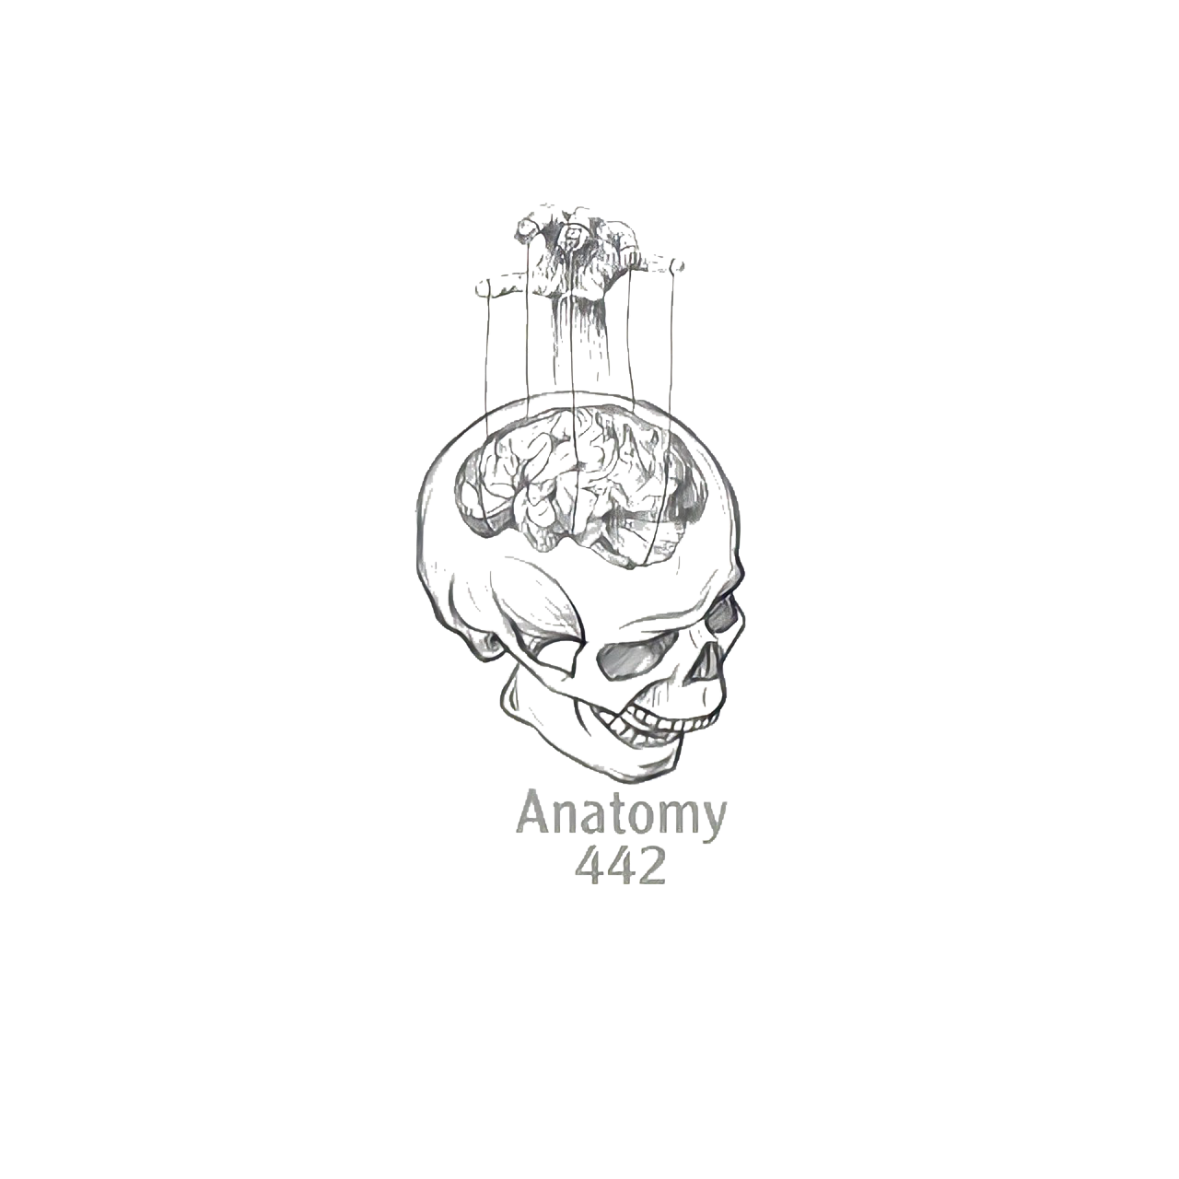
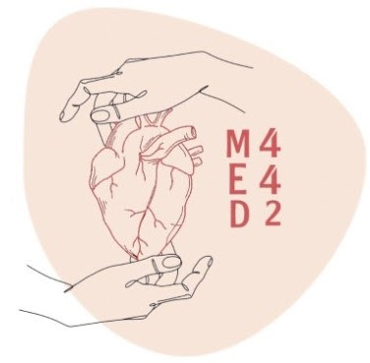
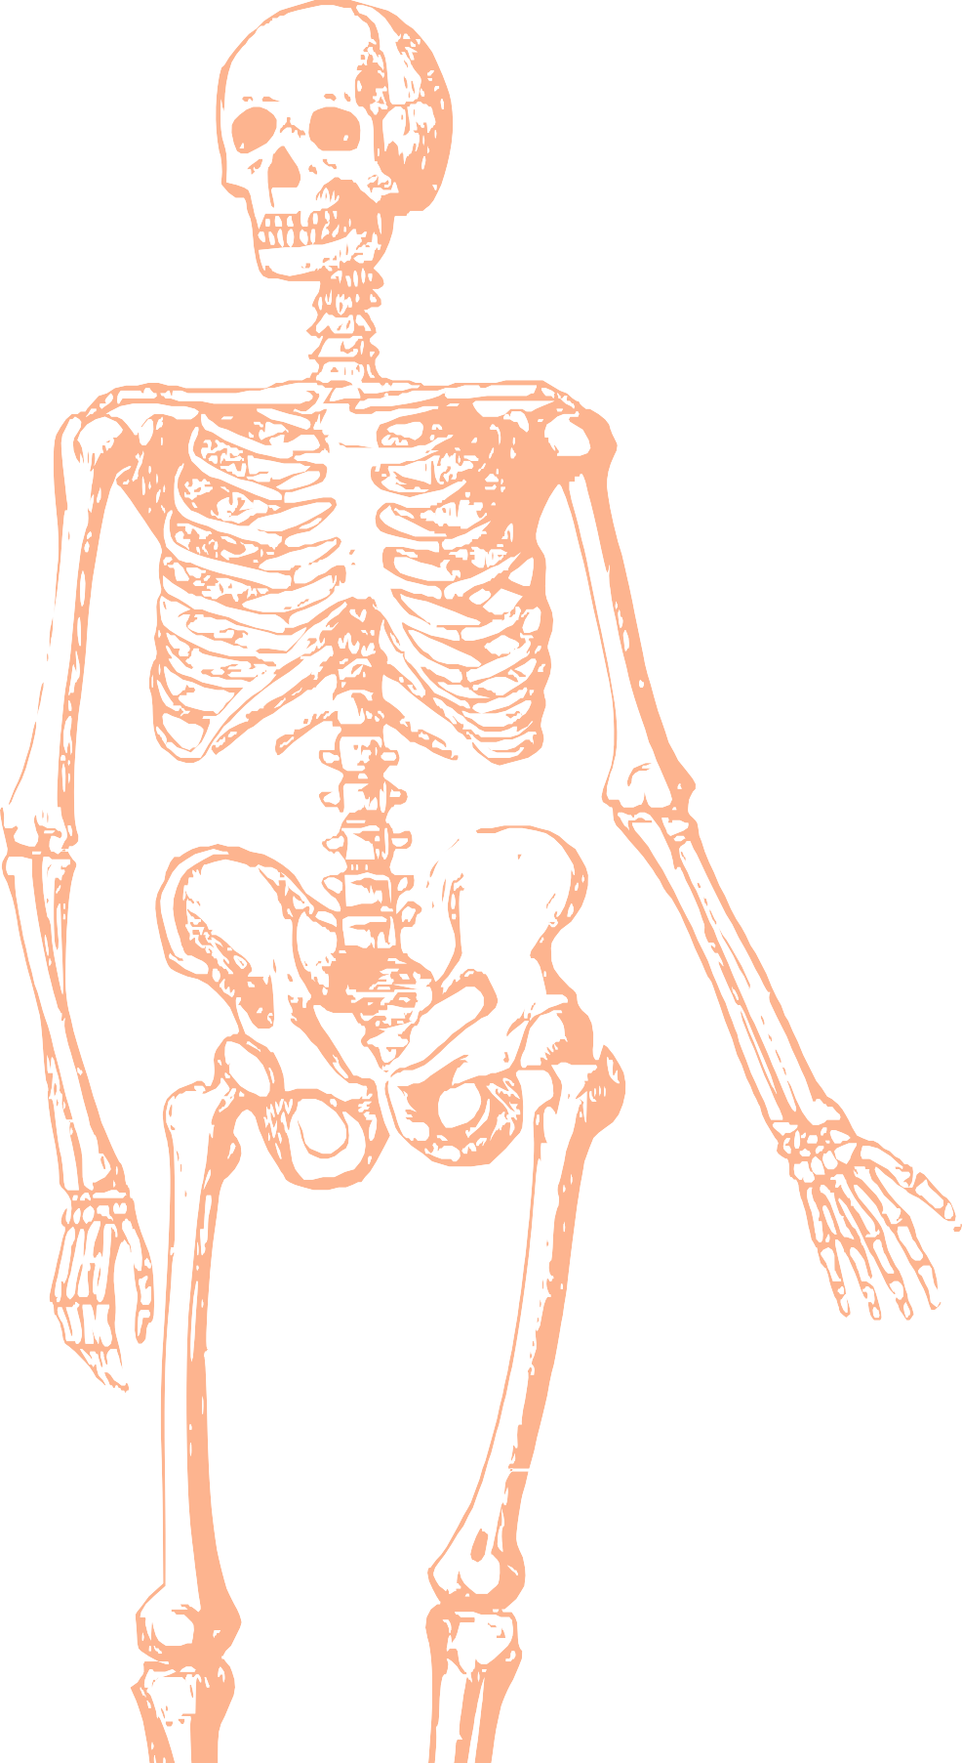
L19
Anatomy of the Shoulder
Editing file
Color index:
Mine text
Important
Doctors notes
Female slides only
Male slides only
Extra

Slide 2
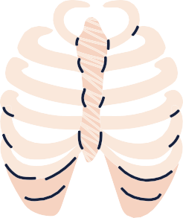
By the end of this lecture you should be able to:
List the name of muscles of the shoulder region
Describe the anatomy of muscles of shoulder region regarding: attachments of each of them to scapula & humerus, nerve supply and actions on shoulder joint
List the muscles forming the rotator cuff and describe the relation of each of them to the shoulder joint.
Describe the anatomy of shoulder joint regarding: type, articular surfaces, stability, relations & movements.

Slide 3
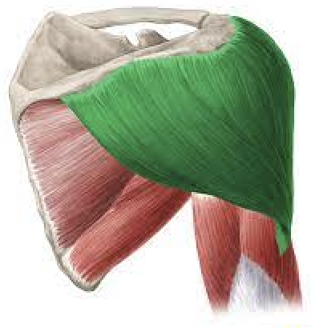
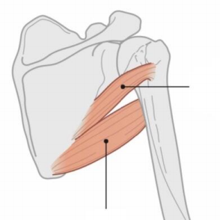
Deltoid mainly abduction, and do every movement except for adduction
Muscles of the shoulder region
These are muscles connecting the scapula to the humerus (move humerus through shoulder joint):
Muscle | Origin | Insertion | Nerve supply | Action | Picture
Deltoid triangular muscle that forms the rounded contour of the shoulder. | Lateral 1⁄3 of clavicle, acromion and spine of scapula = (insertion of trapezius) | Deltoid tuberosity humerus | Axillary nerve | -Anterior fibers: Flexion and medial rotation of humerus (arm, shoulder joint). -Middle fiber: Abduction of humerus 15°-90° -Posterior fibers: Extension & lateral rotation of humerus Note : if all fibers work at the same time only abduction happen
Teres minor Helping in stability of the shoulder | Lateral (axillary) Border of scapula | greater tuberosity of humerus |  | Lateral rotation of humerus *action is not important
Teres major |  | Medial lip of bicipital groove of humerus (With latissimus dorsi and pectoralis major) | lower subscapular nerve | Extension, adduction & medial rotation of humerus (as action of latissimus dorsi).

Slide 4
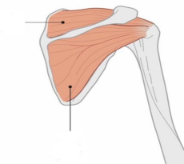
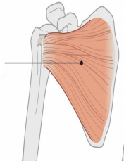
Supraspinatus & Infraspinatus:
Mainly maintain the stability of the shoulder
Muscles of the shoulder region
Muscle | Origin | Insertion | Nerve supply | Action | Picture
Supraspinatus | Supraspinous fossa | Greater tuberosity of humerus | Suprascapular nerve | Abduction of humerus from 0° - 15°
Infraspinatus | Infraspinous fossa |  |  | Lateral rotation of humerus
Subscapularis | subscapular fossa | Lesser tuberosity of humerus (the only muscle in the lesser tuberosity) | upper & lower subscapular nerves | medial rotation of humerus *The action not important

Slide 5
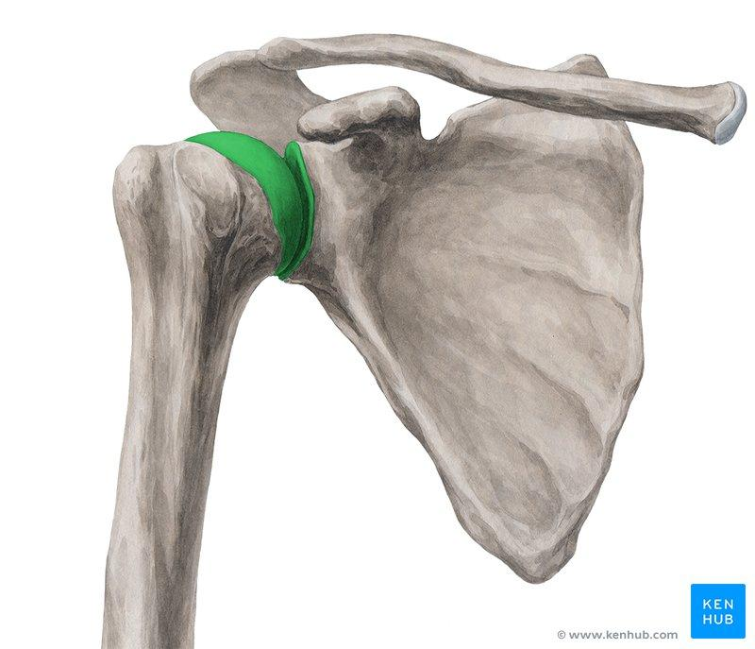
Shoulder Joint
Type: | Synovial, multiaxial (ball & socket)
Articular surface: | Head of humerus (ball) | Glenoid cavity of scapula (socket)
Stability: | NOT STABLE, why? 1- Head of humerus is 3 times larger than glenoid cavity. 2- Capsule is redundant. 3- Few ligamentous support glenoid labrum,coracohumeral 4- Main support: muscles around the joint (ROTATOR CUFF). 3- Wide range of movement.

Slide 6
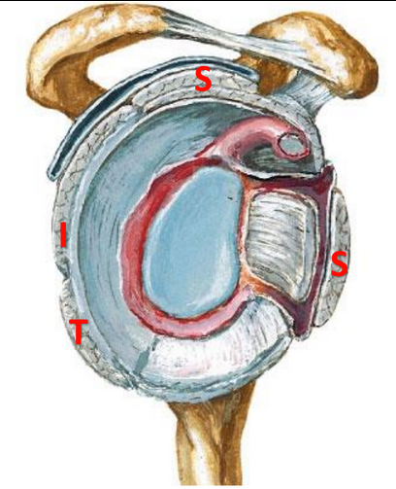
Rotator Cuff
A tendinous cuff around the shoulder joint covering its Anterior, Posterior & Superior aspects
The cuff is deficient inferiorly & this is the site of potential weakness.
It is formed of 4 muscles (SITS)
Supraspinatus, Infraspinatus, Teres minor, Subscapularis.
The tone of these muscles help in stabilizing the shoulder joint.
Rotator cuff can be damaged due to 1. trauma (during playing baseball) or 2. disease (in older individuals).
Supraspinatus tendon is the most common site of rotator cuff injury.
Trauma can tear or rupture one or more tendons forming the cuff. Patients with rotator injury will present with pain shoulder instability & limited range of motion.

Slide 7
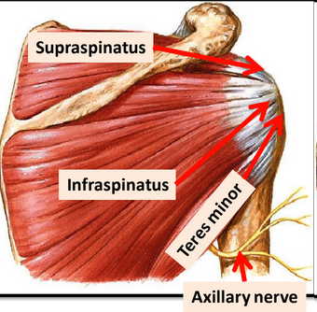
Bursae
They reduce friction between tendons, joints capsule & bone.
They are liable to be inflamed following injury of rotator cuff muscles.
1- Subscapularis bursa: between subscapularis tendon & capsule.
2- Infraspinatus bursa: between infraspinatus tendon & capsule.
3- Subacromial bursa: between deltoid, supraspinatus & capsule.
Relations of shoulder joint:
Anterior: Subscapularis
Posterior: Infraspinatus , Teres minor
Superior: Supraspinatus
Inferior: Axillary Nerve

Slide 8
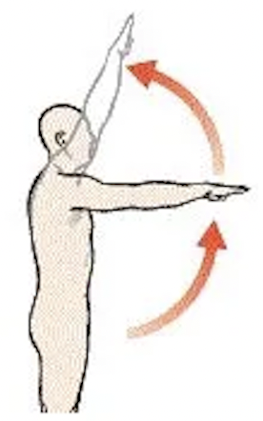
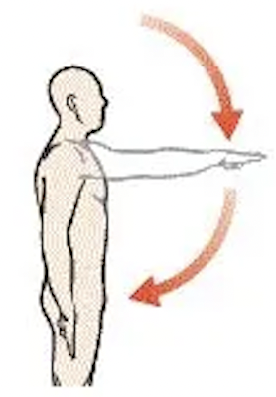
Movements of shoulder joint
Flexion
1- Anterior fibers of deltoid
2- Pectoralis major
3- Coracobrachialis (muscle of arm)
4- Short head of biceps (muscle of arm)
Flexion
Extension
1- Posterior fibers of deltoid
2- Latissimus dorsi
3- Teres major
Extension

Slide 9
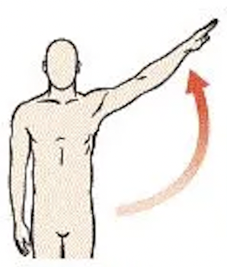
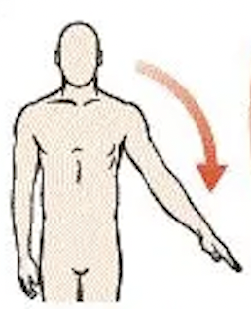
Movements of shoulder joint
Abduction:
1- From 0°-15° Supraspinatus
2- From 15°-90° Middle fibers of deltoid
Abduction
Adduction:
1- Pectoralis major
2- Latissimus dorsi
3- Teres major
all 3 inserted in bicipital groove
Adduction

Slide 10
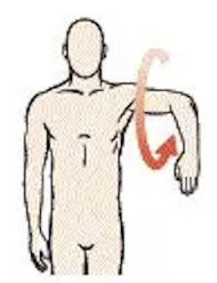
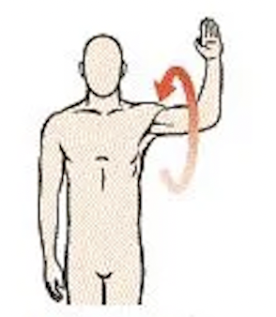
Movements of shoulder joint
Medial Rotation:
1- Pectoralis major
2- Latissimus dorsi
3- Teres major
all 3 inserted in bicipital groove
4- Anterior fibers of deltoid
5- Subscapularis
Medial rotation
Lateral Rotation:
1- Posterior fibers of deltoid
2- Infraspinatus
3- Teres minor
Lateral rotation

Slide 11
Summary
MUSCLES OF SHOULDER REGION:
Origin: scapula
Insertion: humerus:
Three in Greater tuberosity: teres minor, supraspinatus, infraspinatus.
One in Lesser tuberosity: subscapularis
One in Deltoid tuberosity: deltoid
One in Bicipital groove: teres major.
Nerve supply: anterior rami of spinal nerves through brachial plexus.
Two by axillary nerve: deltoid and teres minor.
Two by suprascapular nerve: infraspinatus and supraspinatus.
Two by lower subscapular nerve: subscapularis and teres major.
Action:
move humerus (SHOULDER JOINT)

Slide 12
Summary
Shoulder joint:
Type: synovial, ball & socket
Articular surfaces: head of humerus & glenoid cavity of scapula
Stability: depends on rotator cuff
Relations: rotator cuff and axillary nerve
Movement: flexion, extension, abduction, adduction, medial & lateral rotation
ROTATOR CUFF: 4 muscles in scapular region surrounds the shoulder joint (supraspinatus, infraspinatus, teres minor, subscapularis).
THEY ARE THE MAIN FACTOR FOR STABILITY OF THE SHOULDER JOINT.

Slide 13
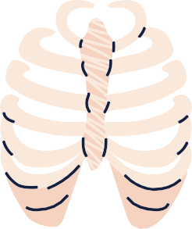
MCQs:
Special thanks to QBank441!
Which of the following factors does decrease the stability of the shoulder joint ?
Q1
A
Ball and socket mechanism
C
Rotator cuff muscle
B
Glenoid labrum
D
Glenohumeral ligaments
Which of the following is not a rotator cuff muscle ?
Q2
Subscapularis
Supraspinatus
Infraspinatus
Teres major
A
B
C
D
What muscle is the Prime mover of the shoulder?
Q3
A
Infraspinatus
D
Posterior deltoid
B
Teres minor
Trapezius
C
Q4
Which nerve innervates the teres minor muscle?
D
B
Accessory nerve
Radial nerve
Thoracodorsal nerve
A
C
Axillary nerve
Q5
Key answers:
1-B
2-D
3-A
4-A
5-A
Which nerve innervates the deltoid muscle?
A
B
C
D
Axillary nerve
Thoracodorsal nerve
Dorsal scapular nerve
Accessory nerve

Slide 14
MCQs:
Special thanks to QBank441!
The three bones that make up the shoulder complex are the clavicle, scapula, and ___.
Q6
A
B
C
D
Sternum
Rib
Humerus
Vertebra
Q7
a patient get damaged during playing basketball, he comes to hospital suffering from pain and shoulder instability. Further investigation believes a tear in one tendon forming the cuff, which muscle is the most common site for cuff injury?
A
C
Teres minor
subscapularis
infraspinatus
supraspinatus
B
D
Q8
Origin: Infraspinous fossa of scapula Insertion: Middle facet on greater tuberosity of humerus Action: Lateral rotation of the arm
A
B
C
D
Supraspinatus
Infraspinatus
Teres minor
Teres major
Q9
This muscle is NOT responsible for Lateral Rotation at the Shoulder
A
B
D
Key answer:
6-C
7-D
8-B
9-B
Infraspinatus
B
C
Supraspinatus
Teres Minor
Posterior deltoid

Slide 15
Done by the amazing team
Team leaders:
Arwa Alghamdi
Deema Aljuribah
Razan Alnufaie
Team leaders:
Mishal Alsuwayegh
Mohammed Alghamdi
Members:
Members:
Aljazi Albabtain
Atheer Alkanhal
Arob Alasheikh
Ajwan Aljohani
Deema alqahtani
Dena Alsuhaibani
Farah alqazlan
Jana Alhazmi
Kadi aldosari
Mashael Alasmari
Noura Bin hammad
Najla aldhbiban
Nouf aldalaqan
Razan alasmari
Roaa alharbi
Raghad Mohammed
Shaden albassam
Waha Almathami
Walaa AlMutawa
Yara Ameer Alalwan
Othman Aldraihem
Faisal Alomar
Abdullah Alturki
Othman Alabdullah
Omar Alkadhi
Abdullah Ali
Meshari Alshathri
Yazeed Alsanad
Fahd Mobaireek
Emad Almutairi
Nasser Alghaith
Saad Almogren
Azzam Abdullah Alotaibi
Hassan Ali Alabdullatif
Rayan Alotaibi
Mohammed Nasser
Luay Almutair
Mohammed Fahad
Mohammed Majed
Abdulkarim Salman
anatomyteam442@gmail.com
Thanks to Faisal Alomar for his design of the team logo

