Slide 1
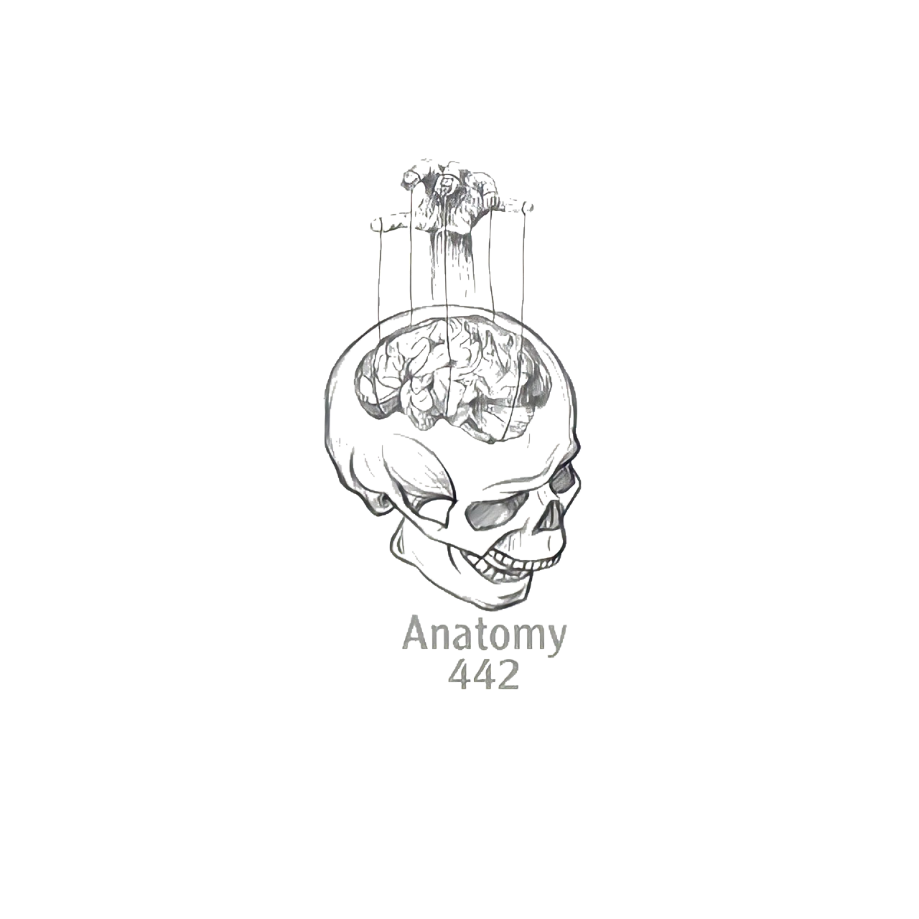
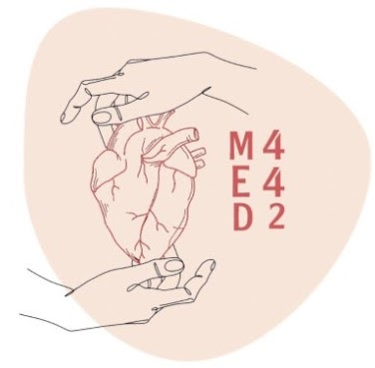
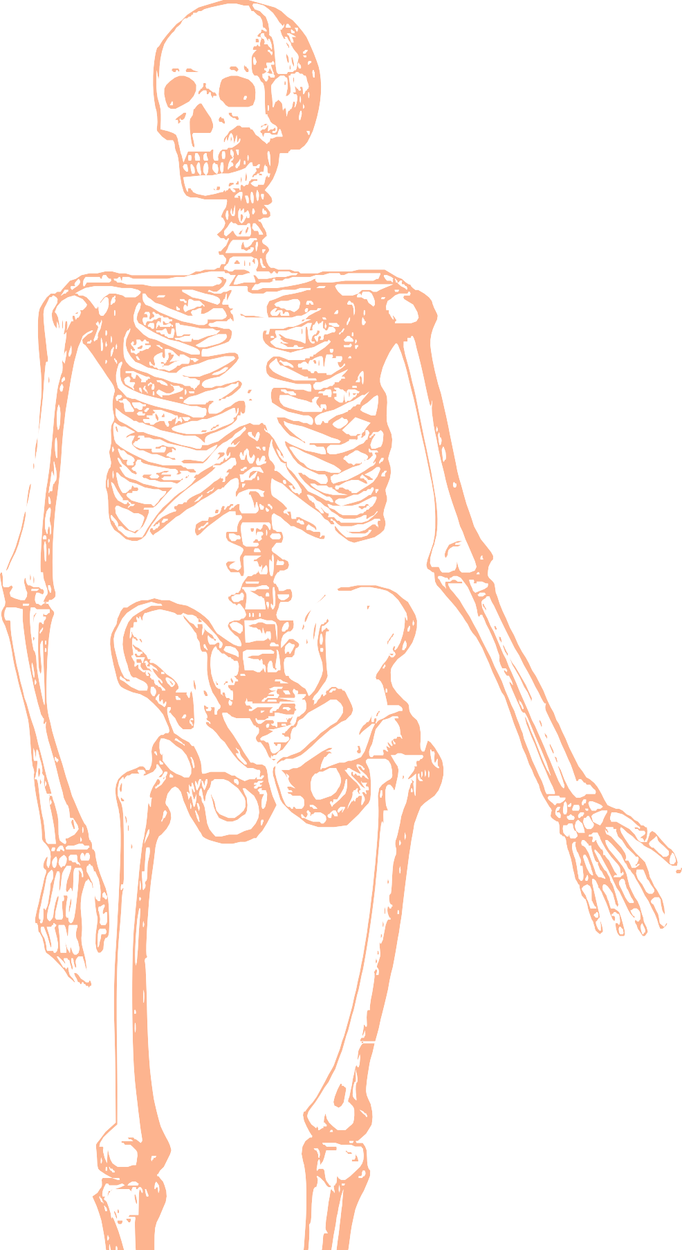
L2
Anatomy of the Spine
Editing file
When u finish studying it’s recommended to watch this videos!
Color index:
Mine text
Important
Doctors notes
Female slides only
Male slides only
Extra

Slide 2
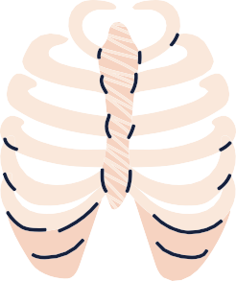
Objectives
By the end of this lecture you should be able to:
Distinguish, describe and identify the cervical, thoracic, lumbar, sacral and coccygeal vertebrae.
Describe the vertebral curvatures.
Describe the movement which occur in each region of the vertebral column.
List the structures which connect 2 adjacent vertebrae together.
List and identify the ligaments of the intervertebral joints.

Slide 3
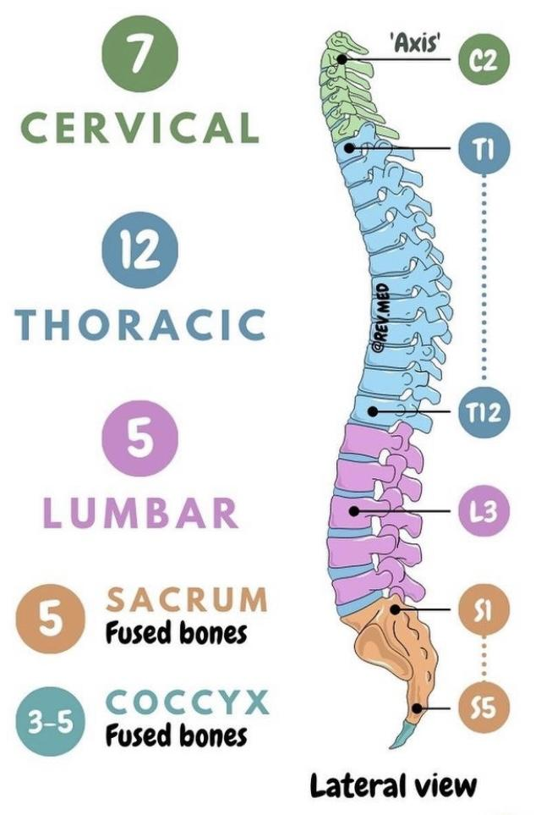
In Male Slides Only
Introduction
Vertebral
column
1- The vertebral column (Spine) is one of the most important parts of the body.
2- The most important function of the spine is to protect the spinal cord.
3- Along with this major function, others include supporting the mass of the body, withstanding external forces, and allowing for mobility and flexibility while dissipating energy and protecting against impact.
4- The spine is connected to the muscle and ligaments of the trunk for postural control and spinal stability.
5- It can be separated into FIVE distinct sections:
all of which are comprised of independent bony vertebrae and intervertebral discs.

Slide 4
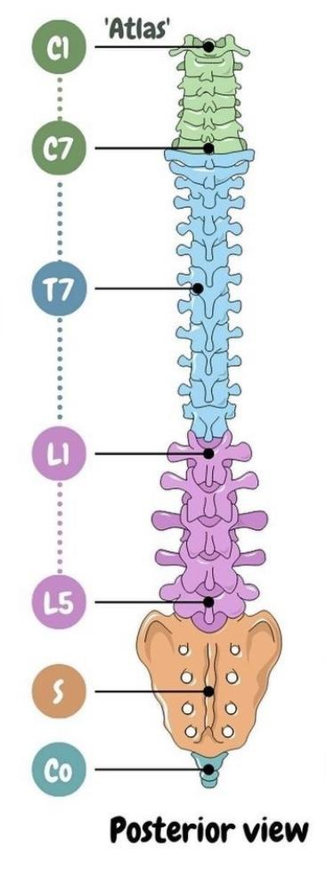
Extends from the skull to the pelvis
Surrounds and protects the spinal cord and supports the whole body
Formed from 33 irregular vertebrae
Spine or Vertebral Column
Consists of 24 single vertebrae and 2 bones
The 2 bones:
1- Sacrum (5 fused vertebrae)
2- Coccyx (4 fused vertebrae)
The 24 single vertebrae:
7 Cervical vertebrae
12 Thoracic vertebrae
5 Lumbar vertebrae
Mnemonic for the single vertebrae: Breakfast at 7 (Cervical) , Lunch at 12 ( Thoracic) , Dinner at 5 ( Lumbar)

Slide 5
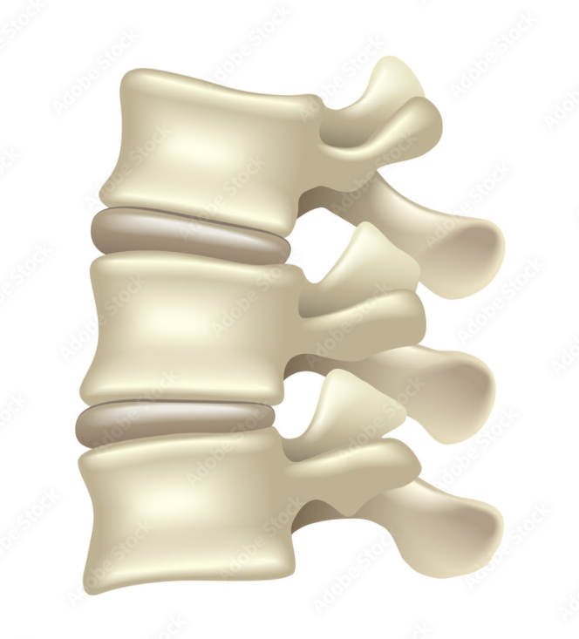
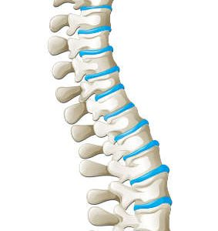
Vertebral Column
The single vertebrae are separated by pads of flexible fibrocartilage called the intervertebral disc (I/V disc) , which cushion the vertebrae and absorb shocks.
The intervertebral discs and S-shaped curvatures (Explained in the next slide) of the vertebral column work together to:
1- Prevent shock to the head when we walk or run
2- Make the body trunk flexible.
كأنه حشوة بين الفقرات
Intervertebral disc

Slide 6
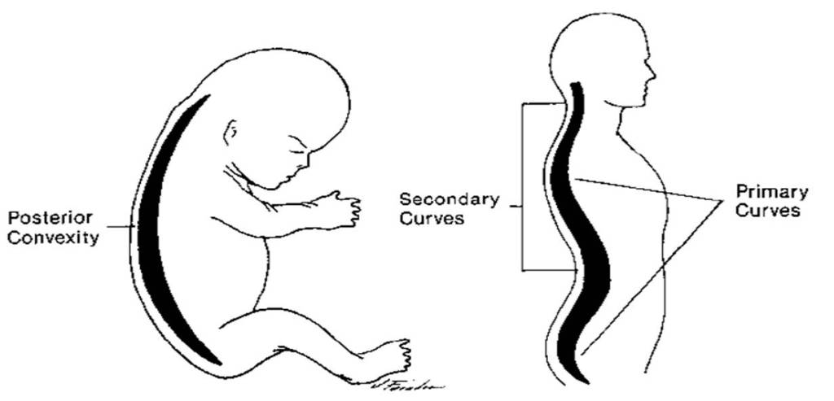
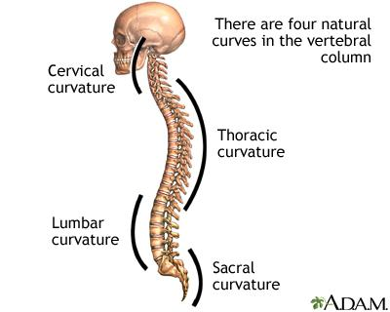
Spinal Curvatures
Primary curvatures
Secondary curvatures
Present in the Thoracic and Sacral regions.
Cervical curvature
Lumbar curvature
Referred to as primary, why? Because they are present when we are born
Appears when a baby begins to hold his head (6th month)
Develops when the baby begins to walk (around the end of the 1st year)

Slide 7
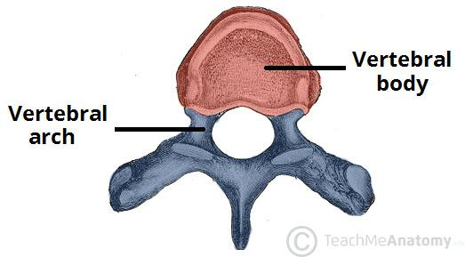
Typical Vertebrae
Disc like, weight-bearing part of the vertebra that lies anteriorly.
Body or Centrum
Fusion of 2 Pedicles and 2 Laminae
Formed from
Any vertebrae is formed from
Vertebral foramen
Vertebral arch (Neural arch)
2 transverse processes
Carries 7 processes
One spinous process
4 articular processes
2 superior
2 inferior
Looks complicated? Don’t worry, everything will be clear after studying the next slide

Slide 8
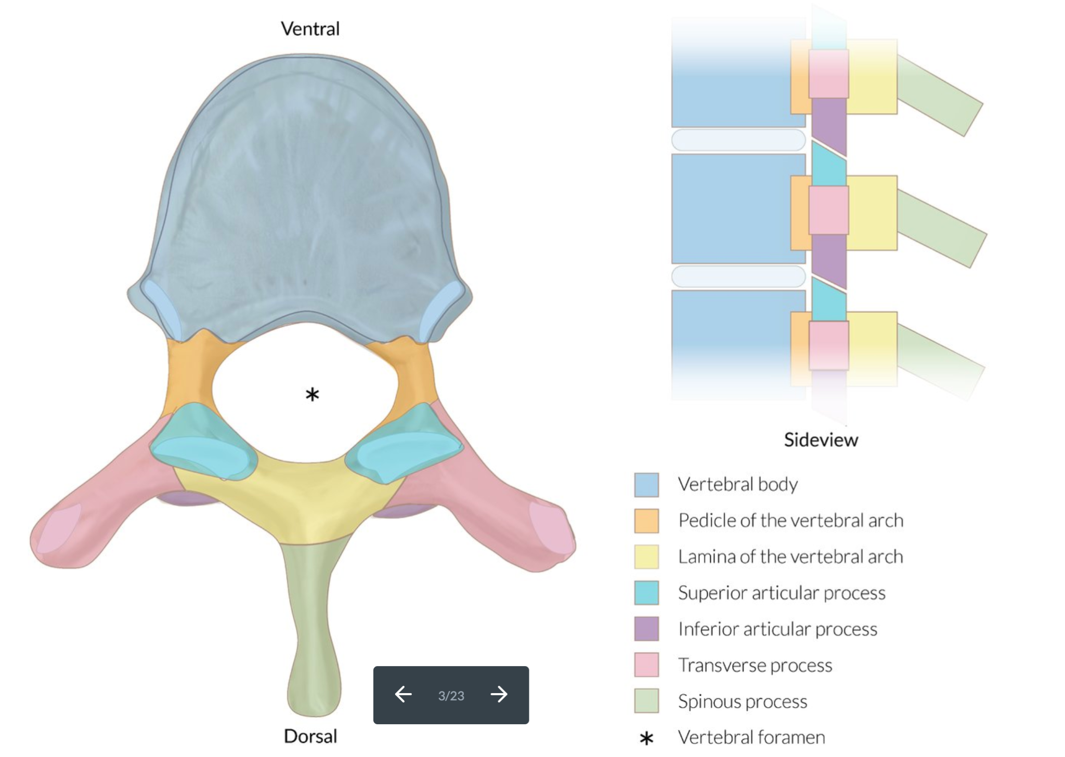
Typical Vertebrae
* Vertebral foramen:
Lies between the body and the arch, through which the spinal cord passes.
Transverse processes:
Lateral projections from the vertebral arch.
Spinous process:
Single projection arising from the posterior aspect of the vertebral arch.
هي العظمة البارزة الي تقدرون تلمسونها في ظهركم
Superior and inferior articular processes:
Paired projections lateral to the vertebral foramen, allowing a vertebra to form joints with adjacent vertebra.
(فائدتهم انهم يربطون كل فقرة مع الفقرة اللي تحتها و فوقها)

Slide 9
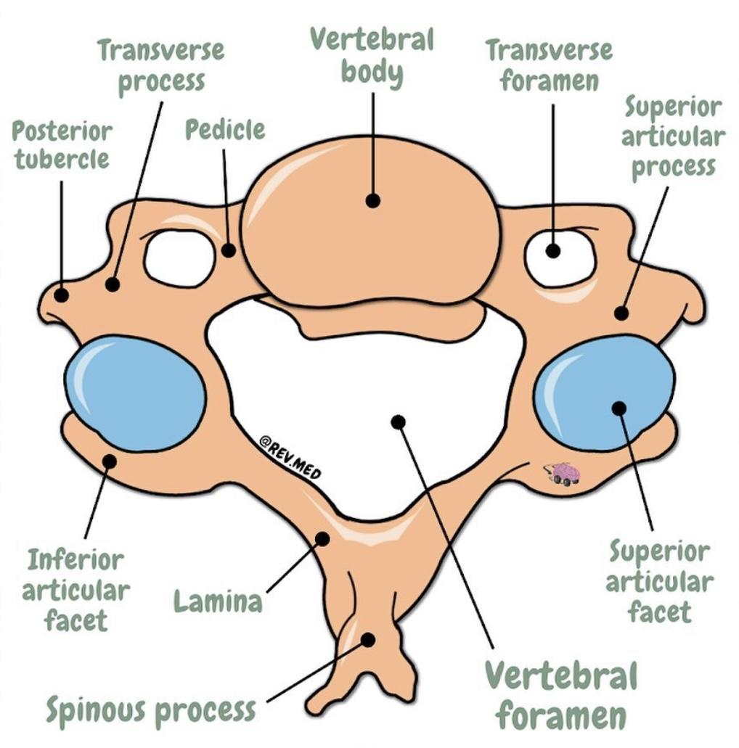
Typical Cervical Vertebrae
The typical cervical
vertebrae are
C3 to C6
They are the
smallest and the
lightest vertebrae
Their spinous
processes are
short and bifid.
The transverse
processes of the cervical
vertebrae contain foramina*
through which the
vertebral arteries and the sympathetic nerve fiber pass
on their way to
the brain above.
*Other name for the transverse process foramina: Foramen transversarium
Salient features of the cervical vertebrae:
Identified by
1- The foramen transversarium (FT)
2- Small and bifid spine ( Exception C1 and C7 )

Slide 10
Atlas and Axis are very important
Atypical Cervical Vertebrae
In general, there is 7 cervical vertebrae ( Identified as C1 to C7 ) from the neck region of the spine. The first two vertebrae ( Atlas and Axis ) are different because the perform functions not shared by the other cervical vertebrae.
Atlas (C1)
Axis (C2)
Cervica Prominens (C7)
Acts as a pivot for the rotation of the atlas (and the skull) above. It has a large upright process, the odontoid process, or dens, which acts as a pivot . The joint between C1 & C2** allows to rotate the head from side to side to say "No"
(Or 7th cervical vertebrae).
It has the longest spinous process which is not bifid.
It is the first spine felt subcutaneously in the root of the back of the neck.
The foramen transversarium does not transmit artery, but vein if double.
Has no body, formed of 2 lateral masses.
The superior surfaces of each lateral mass contain kidney shaped facet that receive the occipital condyles of the skull. This joint* allows you to nod "yes"
*The atlanto-occipital joint
**The atlanto-axial joint
Mnemonic: The Dens is like the tooth and who treats our tooth? The dentist
Let’s see the photos!

Slide 11
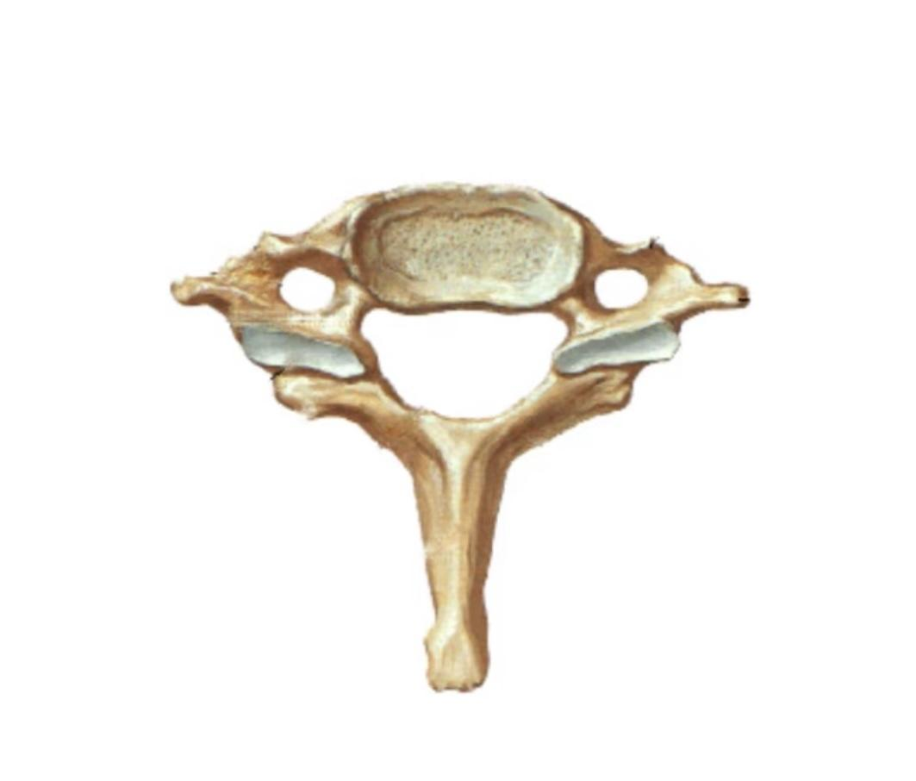
Atypical Cervical Vertebrae
Helpful video
Atlas (C1)
Axis (C2)
Cervica Prominens (C7)
7th cervical vertebra

Slide 12
Movements
Movements in the Atlanto-oocipital joint | Movements in the Atlanto-axial joint
The joints are capable of: 1- Flexion 2- Extension 3- Lateral flexion Allow us to nod i.e “YES” They don’t rotate | Extensive rotation of the atlas and the skull (and thus of the head on the axis). That is to say “NO”

Slide 13
In Male Slides Only
The Cervical Spine
Applied anatomy
The cervical vertebrae (particularly C7), may be fractured or, more commonly, dislocated by a fall on the head with acute flexion of the neck e.g: diving into shallow water.
Dislocation may even result from the sudden forward jerk (during car or airplane crash).
Why not fracture?
The relatively horizontal intervertebral facets of the cervical vertebrae allow dislocation to take place without their being fractured.
Cervical disc prolapse:
This may sometimes occur at the lower cervical intervertebral discs C5/6 and C6/7.

Slide 14
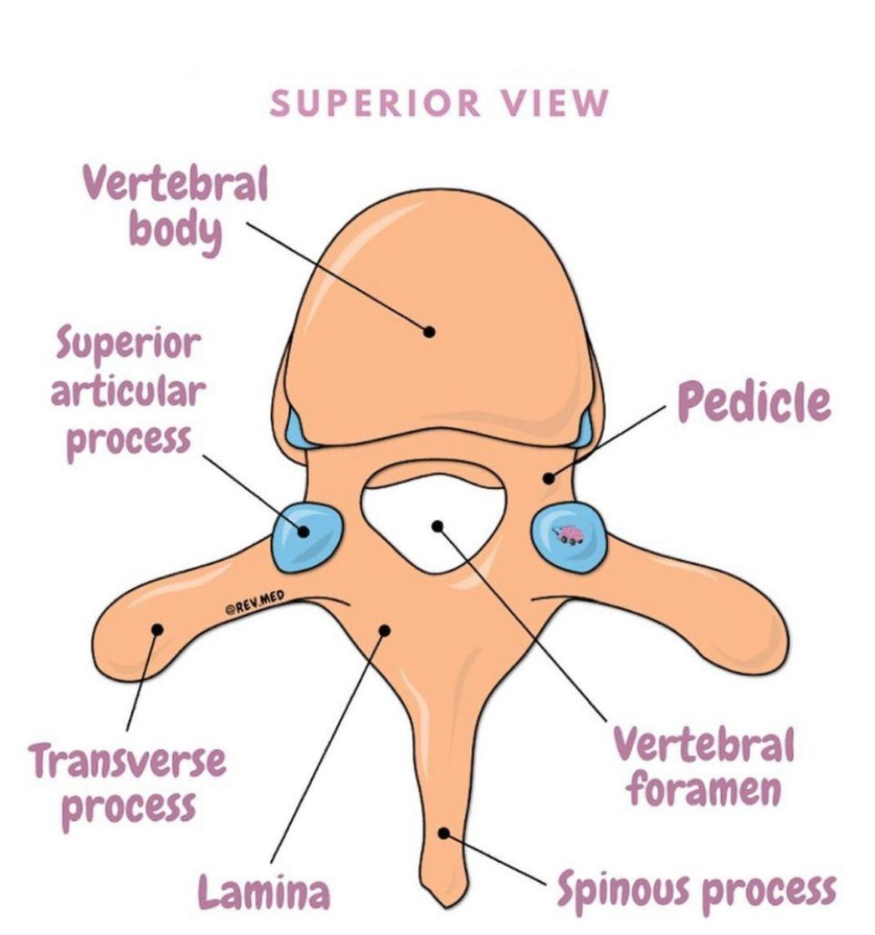
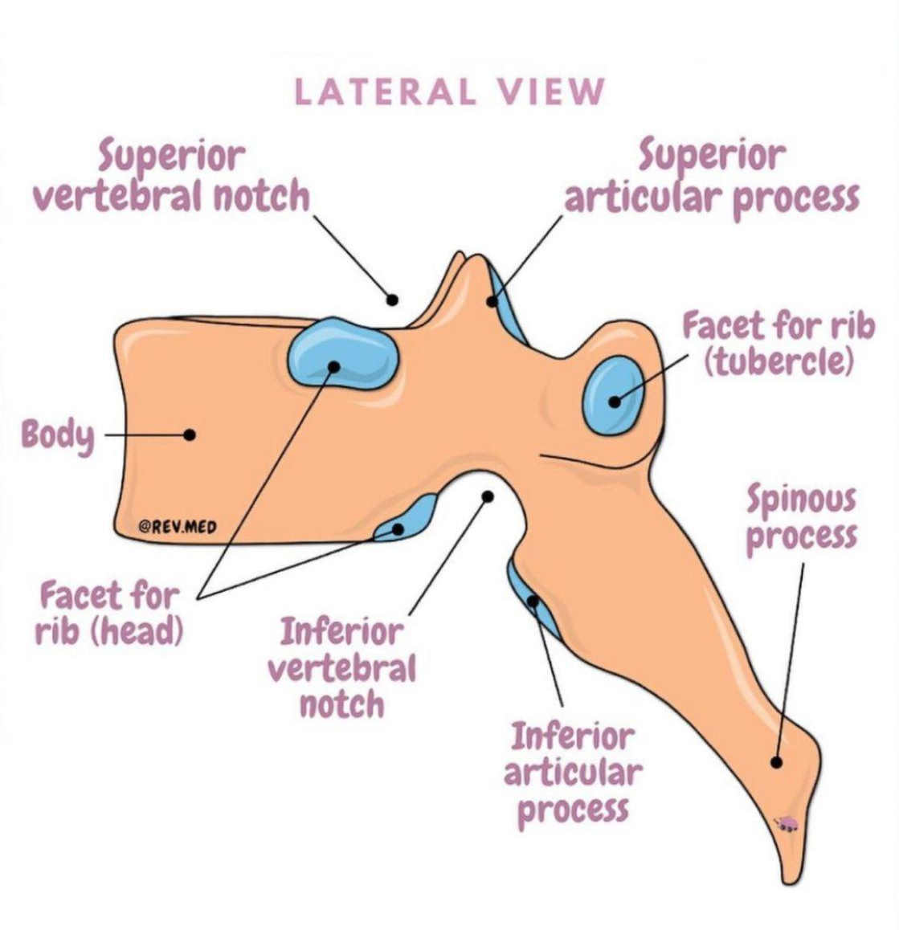
The 12 thoracic vertebrae (T1-T12) are almost typical.
They are larger than the cervical vertebrae.
Thoracic Vertebrae
The body : is somewhat heart-shaped and has 2 costal demifacets (articulating surfaces) on each side; superior and inferior (for articulation with heads of the ribs of same & next number).
Transverse process: No foramen. It has 2 costal facets (articulating surfaces) which receive the articulation of the tubercle of ribs of same number.
Spinous process : is long and hooks sharply downward.

Slide 15
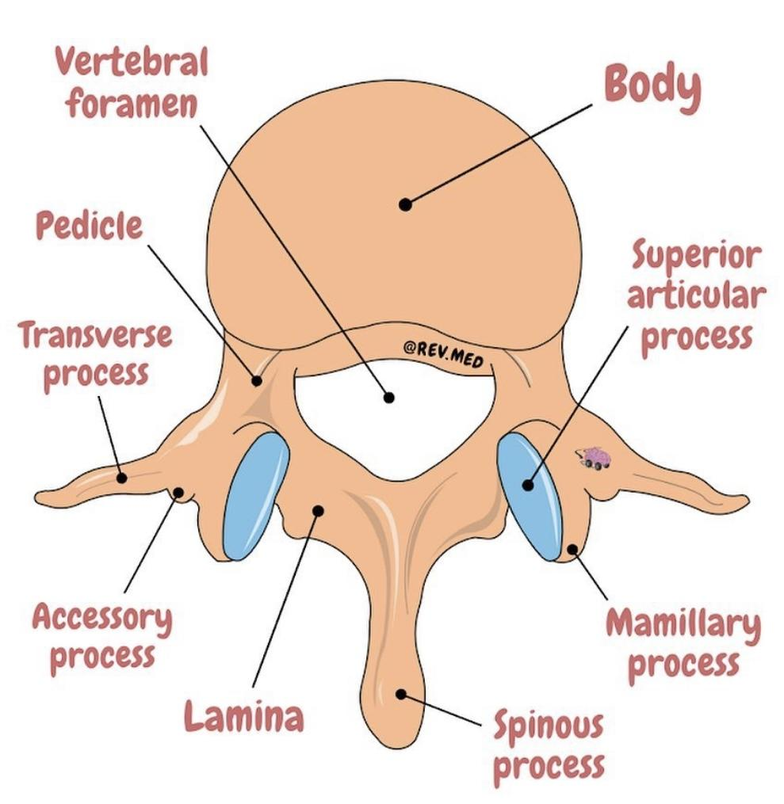
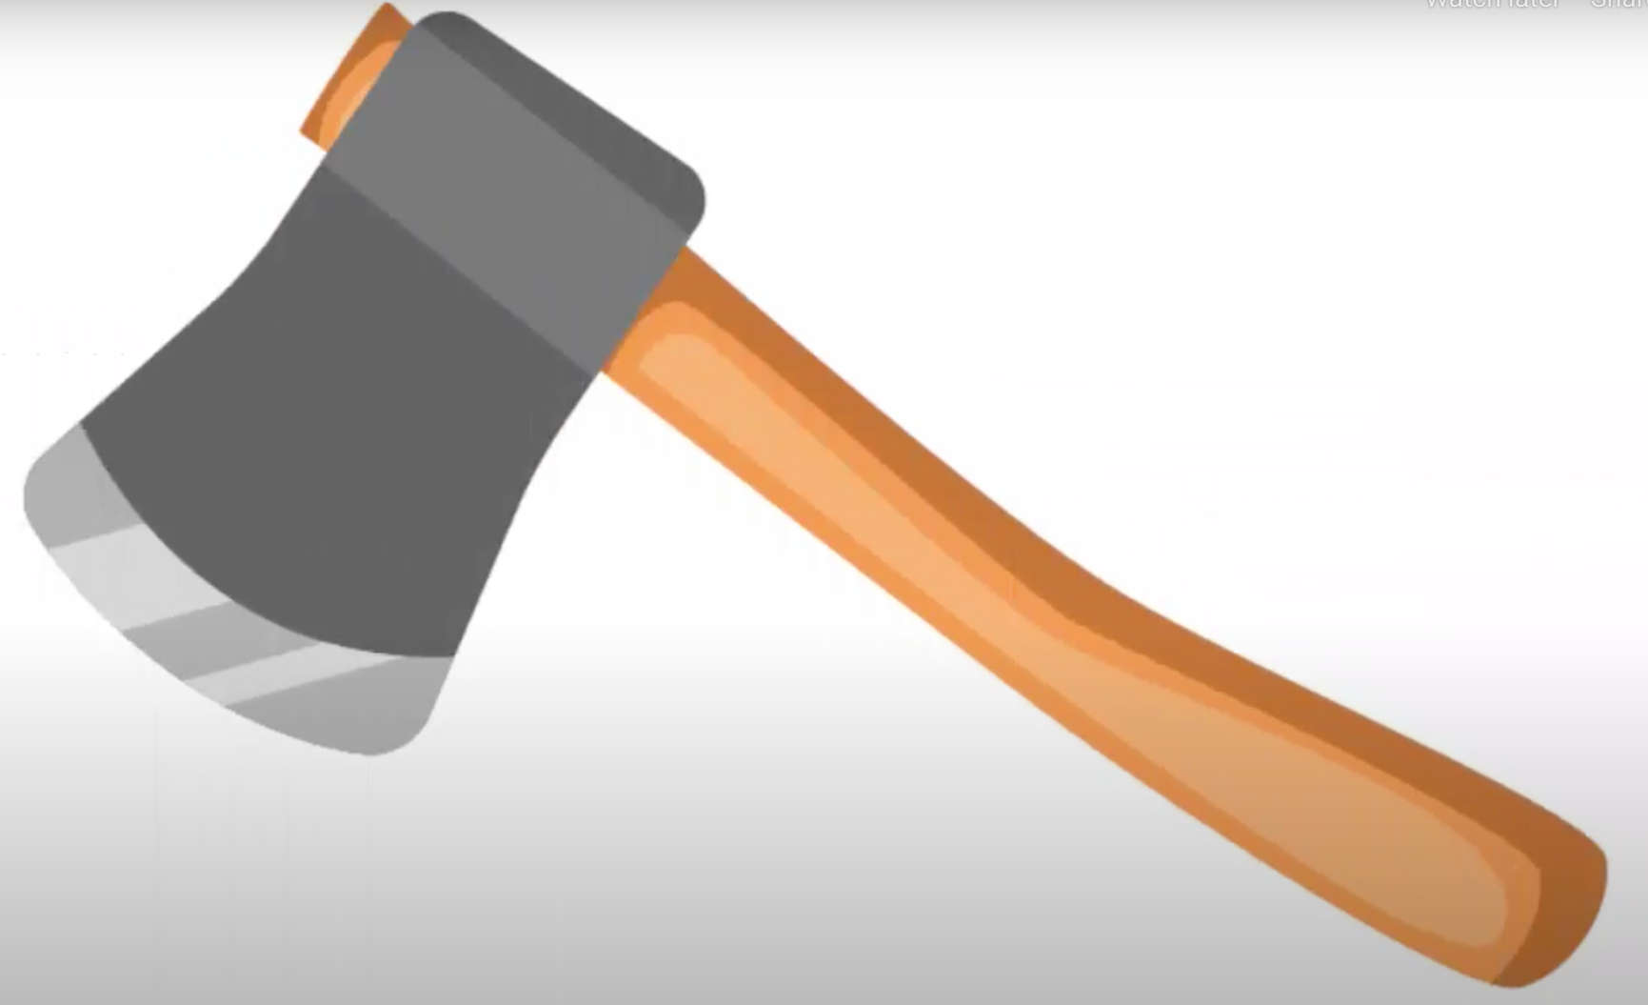
Lumbar Vertebrae
1
2
There is 5 lumbar vertebrae
(L1-L5)
They have massive, block like bodies.
They have short, broad and flat or hatchet-shaped* spinous processes.
They are the most
solid of all vertebrae.
3
4
*Hatchet-shaped :
شكلها يشبه الفأس

Slide 16
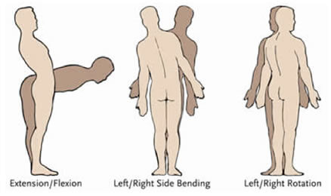
Movements of the Thoracolumbar Spine
The following movements are possible on the spine: flexion, extension, lateral flexion and rotation.
In the thoracic region, the ribs, the costal cartilages, and the sternum severely restrict the range of movement.
Extension, flexion and lateral flexion are:
Extensive in lumbar spine
Restricted in thoracic spine.
Rotation is:
Extensive in thoracic spine
Least extensive in the lumbar region.

Slide 17
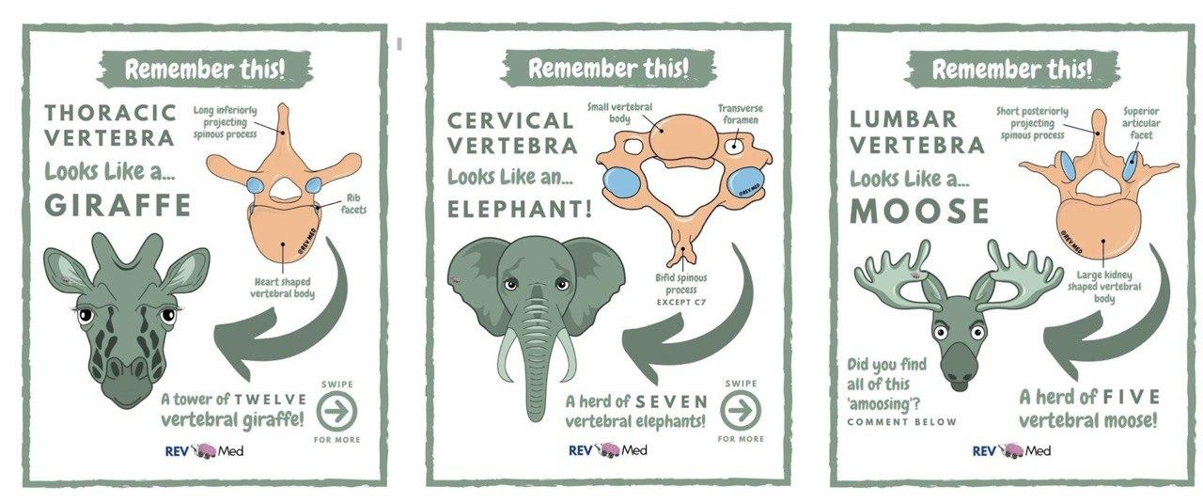
Helpful Pictures
Remember 3 points to differentiate between cervical, thoracic and lumbar vertebra:
1- Foramen in transverse process = Cervical
2- Facet on the body = Thoracic
3- No foramen in transverse process and no facet on the body = Lumbar

Slide 18
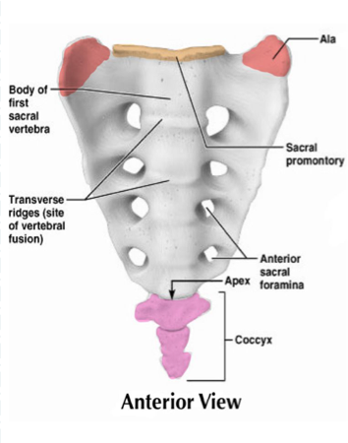
Sacrum & Coccyx
The sacrum is formed by fusion of 5 vertebrae.
Superiorly: it articulates with L5.
Inferiorly: it connects with the coccyx.
Pelvic Surface:
Sacral promontory: anterior and
upper margin of the 1st sacral vertebra.
The wing like ala articulate laterally with
the hip bones, forming the sacroiliac joints.
The sacrum forms the posterior wall of
the pelvic cavity.

Slide 19
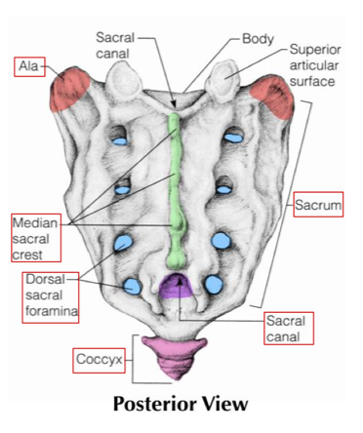
Sacrum & Coccyx
Revision video
Dorsal Surface:
The dorsal midline surface is roughened
by the median sacral crest (the fused
spinous processes of the sacral vertebrae).
This is flanked laterally by the dorsal
sacral foramina.
The vertebral canal continues inside the
sacrum as the sacral canal.
& Hiatus
The canal opens inferiorly in what is
called sacral hiatus (End of the sacral)
The coccyx: is formed from the fusion of 4 tiny,
irregularly shaped vertebrae.
Dr’s note: you just have to know it’s formed of 4 vertebrae

Slide 20
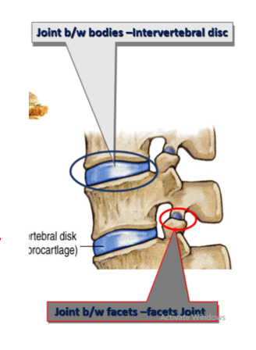
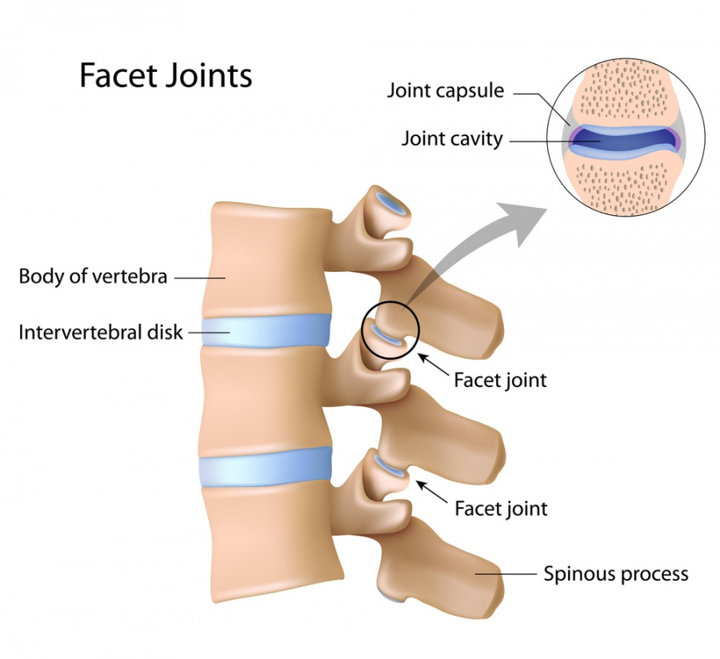
In Male Slides Only
Vertebral Joints
Adjacent vertebrae are held together by:
Joints between
1
Strong ligaments
2
Small joints
Neural arches
Bodies
Note: joints between neural arches (vertebral arches) allows greater range of movements than joints between bodies

Slide 21
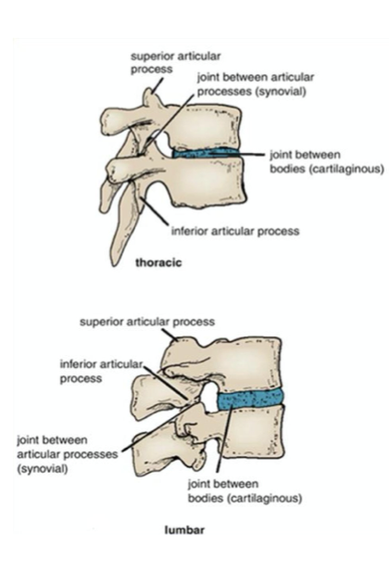
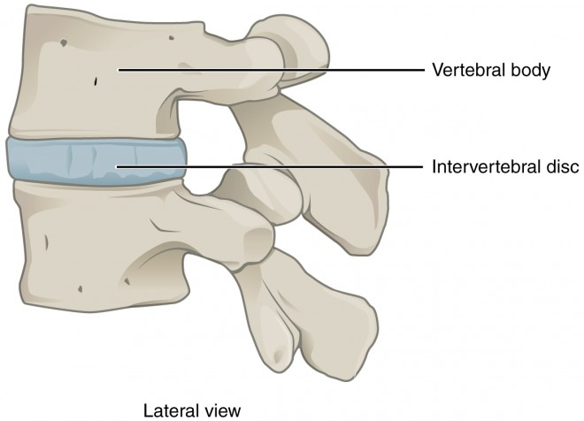
Joints Between Two Vertebral Bodies
It is a secondary cartilaginous joint. (Symphasis) (there are 2 types: primary and secondary)
The upper and lower surfaces of the bodies of 2 adjacent vertebrae are covered by thin plates of hyaline cartilage.
Sandwiched between the plates of hyaline cartilage is an intervertebral disc of fibrocartilage.
hyaline cartilage.
intervertebral disc
Vertebral

Slide 22
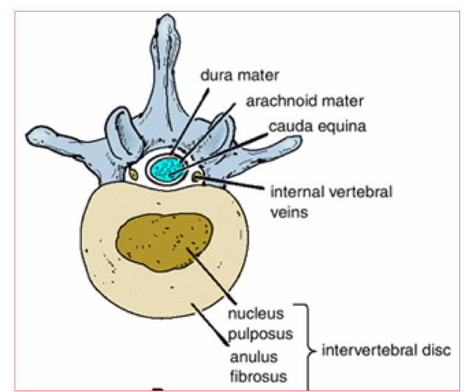
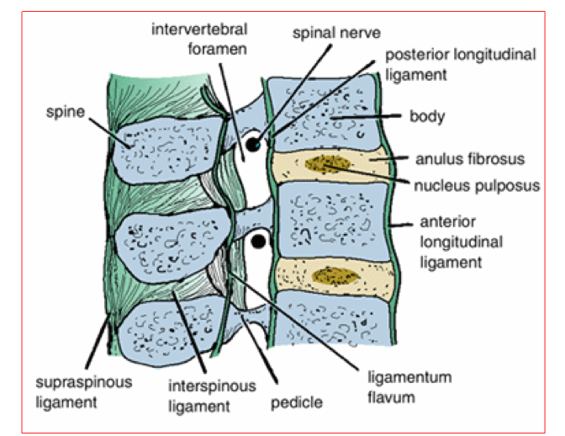
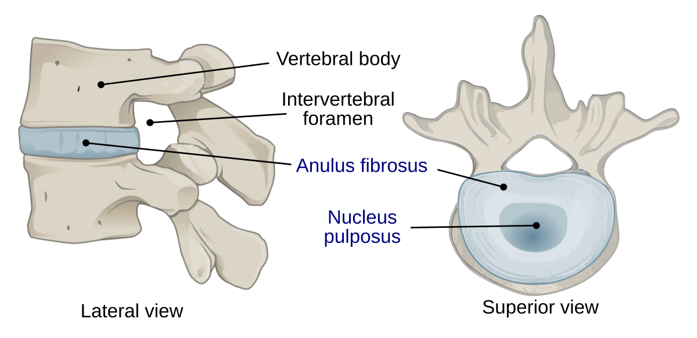
Intervertebral Discs
The intervertebral discs form about one fourth of the whole length of the vertebral column.
They are thickest in the cervical and lumbar regions, where the movements of the vertebral column are greatest.
Each disc is formed of:
1
Peripheral part, called the annulus
fibrosus, composed of fibrocartilage.
The nucleus pulposus:
15% of the whole disk, formed of:
Large amount of water (90% at birth and 70% at old age).
Small number of collagen fibers.
Few cartilage cells.
2
Central part, the nucleus pulposus, a mass of gelatinous material which is made up of mostly water (large amount of water), Small number of collagen fiber & few cartilage cells.
No discs are found between C1 & C2 or in the sacrum or coccyx. (or C1 & occipital condyles)

Slide 23
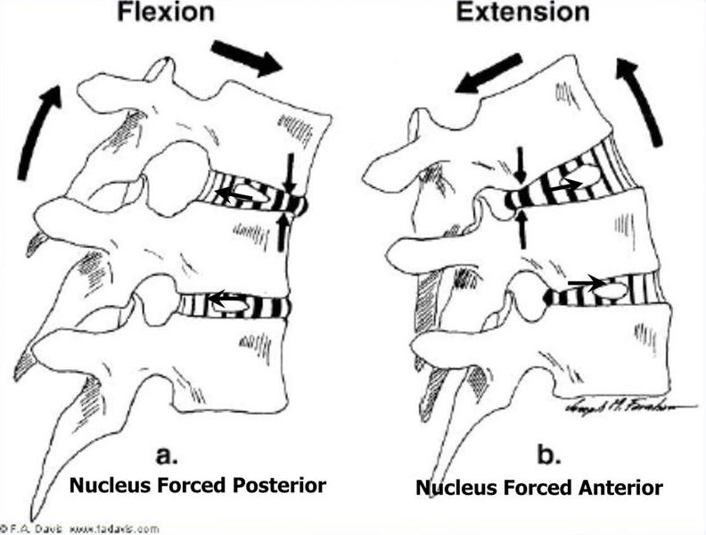
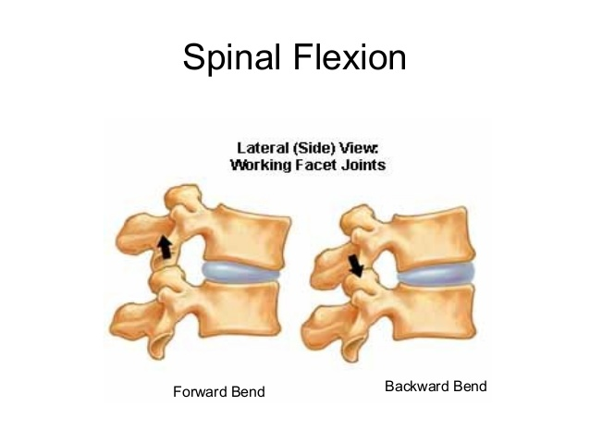
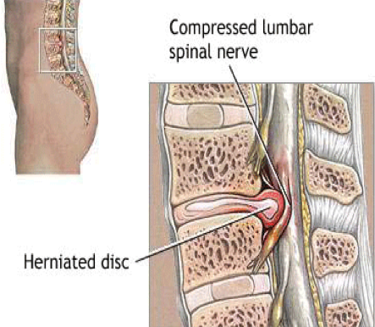
Intervertebral Discs Function
1
Allow one vertebra to move forward and backward on another (flexion and extension of vertebral column)
2
Serve as shock (trauma) absorbers when the load on the vertebral column suddenly increases (when one jumps from a height)
Disk prolapse / Herniated/Slipped disk:
Sometimes, the annulus fibrosus ruptures, allowing the nucleus pulposus to herniate and protrude into the vertebral canal, where it may press on the spinal nerve roots, or the spinal nerve, or even the spinal cord itself.
Helpful video

Slide 24
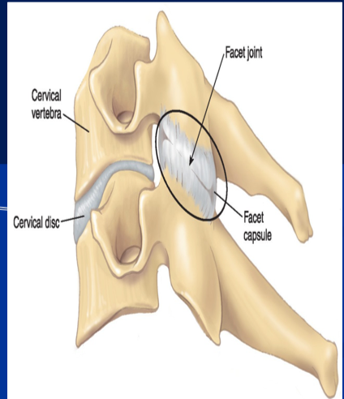
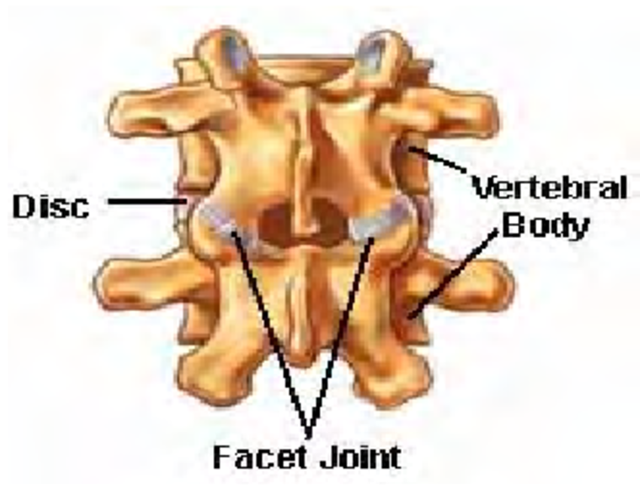
Vertebral Joints
The joints between two vertebral arches consist of synovial joints between the superior and inferior articular processes of 2 adjacent vertebrae.
The articular facets are covered with hyaline cartilage, and the joints are surrounded by a fibrous capsule.

Slide 25
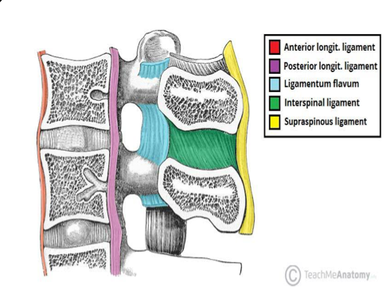
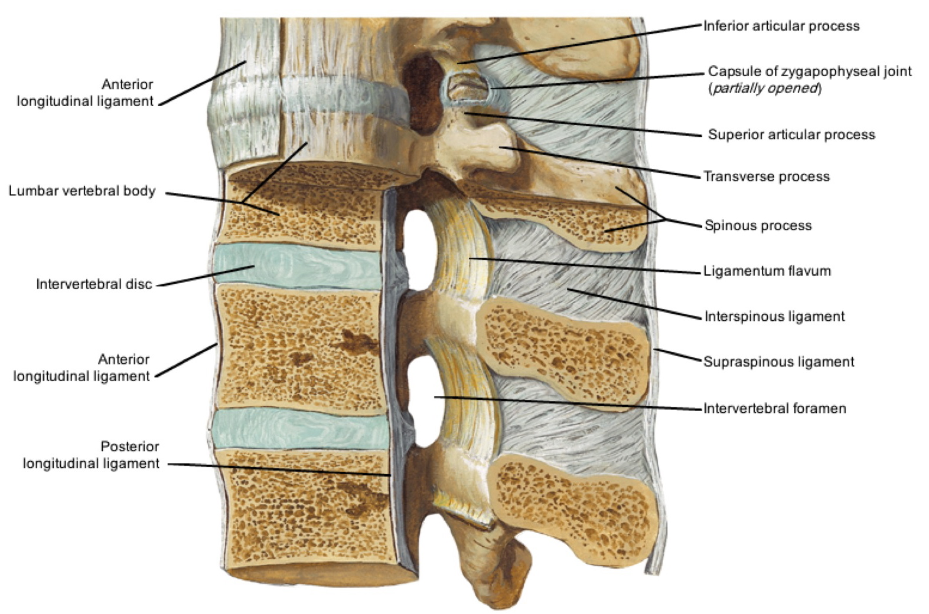
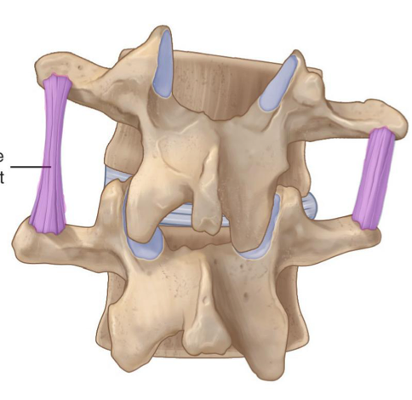
Ligaments
Click here!
And here
Joints between Bodies
1
The anterior and posterior longitudinal ligaments run as continuous bands along the anterior & posterior surfaces of the vertebral bodies.
2
These ligaments hold the vertebrae firmly together but at the same time permit a small amount of movement to take place.
Joints between Arches
1
Interspinous ligament | Connects two adjacent spinous processes.
2
Ligamentum flavum | Connects the laminae of adjacent vertebrae.
3
Supraspinous ligament | Connect the tips of adjacent spinous processes.
Intertransverse ligament
4
Intertransverse ligament | Connects 2 adjacent transverse processes.

Slide 26
In Male Slides Only
Vertebral Joints
Joints between the neural arches:
Between pedicles - intervertebral foramen
Adjacent articular process Synovial joint (Facet joints or Zygapophyseal joints).
Other arch by ligaments:
Ligamentum Flava*: yellow, high elastic fibers, join the adjacent lamina ,stretch by the flexion of spine (in leaning forward -ANTI-GRAVITY support).
Supraspinous ligament*: strong, white, join the tips of spinous process, lax in extended spine, taut by full flexion & support spine (touching the toes).
Interspinous & Intertransverse ligaments: weak ligaments
1
2
3
*most important

Slide 27
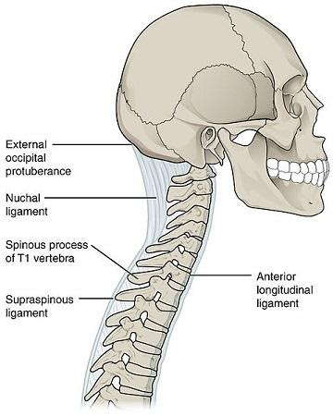
Important slide
Ligamentum Nuchae
In the cervical region, the Supraspinous and Interspinous ligaments are thickened to form the strong ligamentum nuchae
It extends from the external occipital protuberance of the skull to the spine of the 7th cervical vertebra.
7 C
Its anterior border is strongly attached to the cervical spines in between.

Slide 28
In Male Slides Only
Blood Supply of The Vertebrae
Segmentally (according
to region) by::
● The vertebral Artery.
● Ascending and deep cervical arteries.
● Intercostal artery.
● Lumber and lateral sacral
arteries.
Drains by:
● Basivertebral veins.
● Internal vertebral venous plexus.
● External vertebral venous plexus into
● Regional segmental veins [vertebral, post intercostal, lumber and lateral sacral veins]
reflux blood
along valveless
vein
from prostate, kidney, breast, bronchus، thyroid
can spread to spine
Venous communication
malignant disease

Slide 29
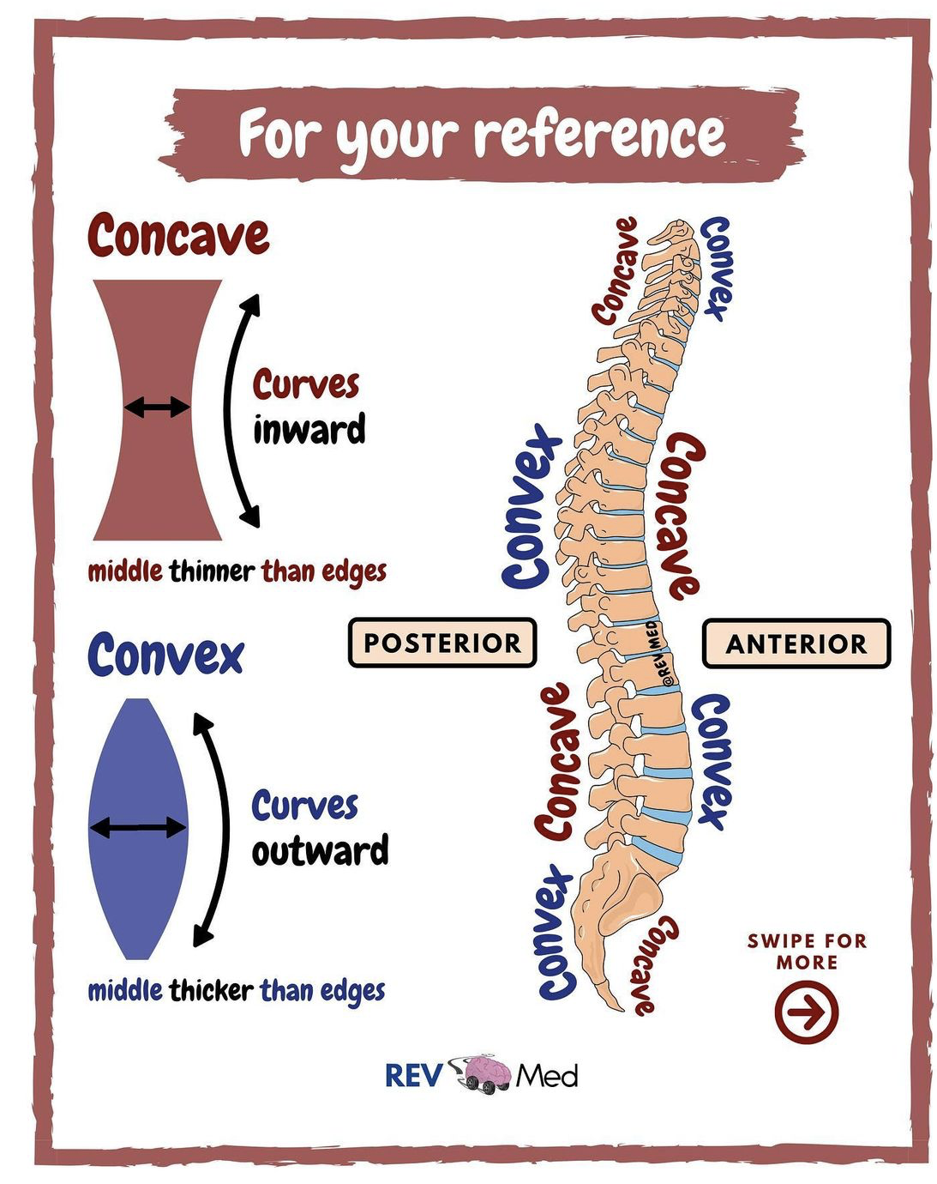
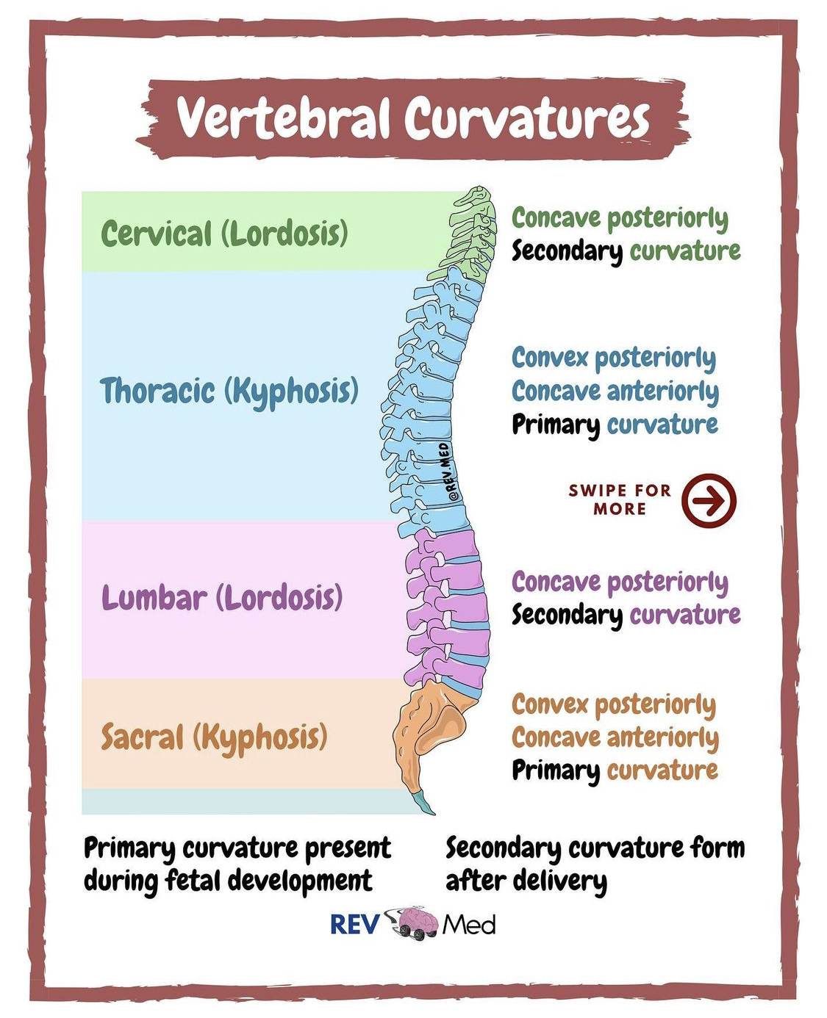
Helpful Pictures

Slide 30
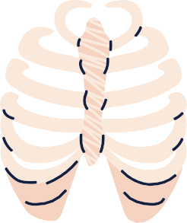
MCQs:
Here is a quizlet -flash cards- for revision
Click here
Which one of the following head movements contributes in the atlanto-axial joint ?
Q1
A
B
C
D
Flexion
Extension
Lateral flexion
Lateral rotation
Q2
which one of the following ligaments contributes in ligamentum nuchae?
A
B
C
D
Ligamentum flavum
Intertransverse ligament
Supraspinous ligament
Anterior longitudinal ligament
Q3
In which vertebral region the extensive rotation of the spine ?
A
B
C
D
Cervical
Thoracic
Lumbar
Sacral
Key answers:
1-D
2-C
3-B

Slide 31
MCQs:
Special thanks to 441QBank!
To which spine of the ligamentum nuchae is attached (extended) ?
Q4
A
B
C
D
T12
C5
C7
S1
Q5
The transverse arch is attached to the body of a typical vertebrae via?
A
B
C
D
Ligaments
Processes
Laminae
Pedicles
Q6
IVDs consist of ?
A
B
C
D
Annulus fibrosus
Nucleus pulposus
Nucleus pulposus
A&C
Key answers:
4-C
5-D
6-D

Slide 32
MCQs:
Special thanks to 441QBank!
The coccyx is typically made of ______ fused vertebrae?
Q7
A
B
C
D
5
4
7
6
Q8
The cervical vertebrae have ______, which the thoracic and lumbar vertebrae do not have?
A
B
C
D
Spinous processes
Transverse foramen
Transverse processes
Articular processes
Q9
What movement is extensive in thoracic spine and least extensive in lumbar spine?
A
B
C
D
Rotation
Extension
Flexion
B&C
Key answers:
7-B
8-B
9-A

Slide 33
MCQs:
Special thanks to 441QBank!
Which region of the vertebral column contains 5 vertebrae?
Q10
A
B
C
D
Cervical
Lumbar
Sacral
B & C
Q11
The intervertebral disc forms about ______ of the whole length of the vertebral column?
A
B
C
D
1/4
1/2
1/5
1/6
Q12
When does the secondary (cervical) curvature occur?
A
B
C
D
When the baby begins
to hold the head up
When the baby can sit without support
When the baby
begins to crawl
When the baby
starts to walk
Key answers:
10-D
11-A
12-A

Slide 34
MCQs:
Special thanks to 441QBank!
Through the foramina, the ____ pass on their way to the brain above
Q13
A
B
C
D
vertebral arteries
vertebral veins
vertebral nerves
spinal cord
Q14
The spinal cord exits the spine via
A
B
C
D
vertebral foramen
intervertebral foramen
Intravertebral foramen
IVD foramen
Q15
In which region(s) are the intervertebral discs the thickest?
A
B
C
D
cervical & thoracic
cervical & lumbar
thoracic & lumbar
cervical only
Key answers:
13-A
14-A
15-B

Slide 35
Done by the amazing team
Team leaders:
Arwa Alghamdi
Deema Aljuribah
Razan Alnufaie
Team leaders:
Mishal Alsuwayegh
Mohammed Alghamdi
Members:
Members:
Aljazi Albabtain
Atheer Alkanhal
Arob Alasheikh
Ajwan Aljohani
Deema alqahtani
Dena Alsuhaibani
Farah alqazlan
Jana Alhazmi
Kadi aldosari
Mashael Alasmari
Noura Bin hammad
Najla aldhbiban
Nouf aldalaqan
Razan alasmari
Roaa alharbi
Raghad Mohammed
Shaden albassam
Waha Almathami
Walaa AlMutawa
Yara Ameer Alalwan
Othman Aldraihem
Faisal Alomar
Abdullah Alturki
Othman Alabdullah
Omar Alkadhi
Abdullah Ali
Meshari Alshathri
Yazeed Alsanad
Fahd Mobaireek
Emad Almutairi
Nasser Alghaith
Saad Almogren
Azzam Abdullah Alotaibi
Hassan Ali Alabdullatif
Rayan Alotaibi
Mohammed Nasser
Luay Almutair
Mohammed Fahad
Mohammed Majed
Abdulkarim Salman
anatomyteam442@gmail.com
Thanks to Faisal Alomar for his design of the team logo

