Slide 1
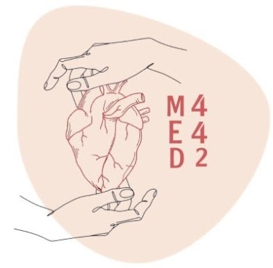
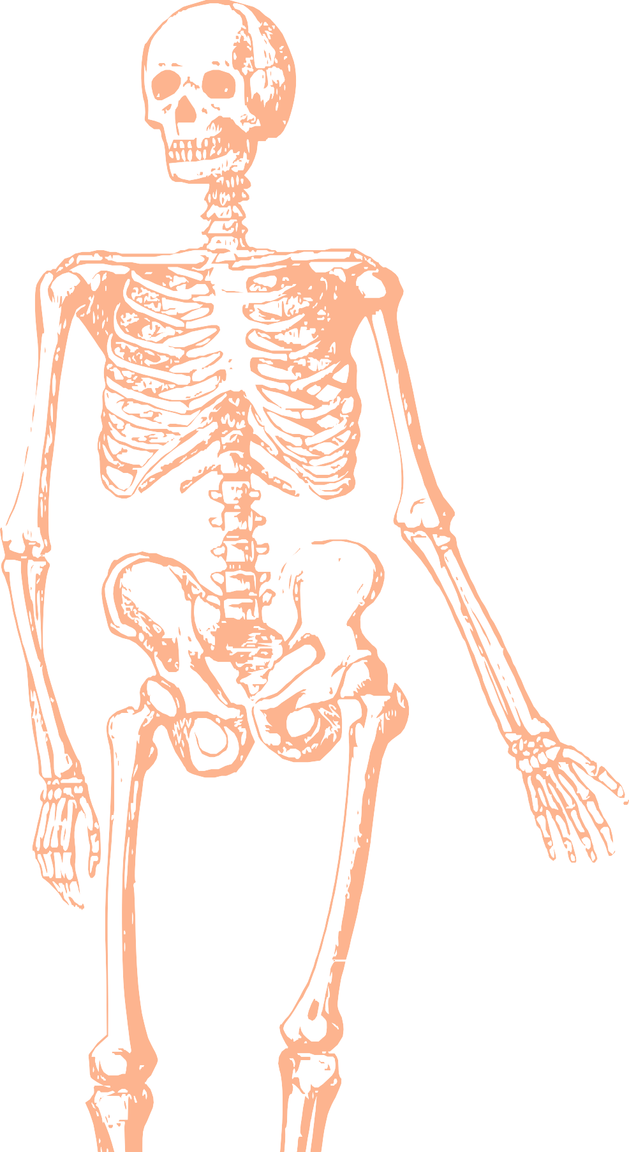
L20
Introduction to Surface anatomy of the upper & lower limbs
Editing file
Color index:
Mine text
Important
Doctors notes
Female slides only
Male slides only
Extra

Slide 2
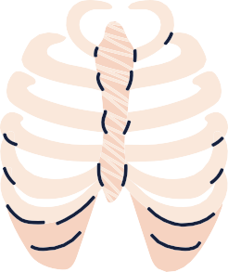
OBJECTIVES:
Define the surface anatomy and its clinical relevance.
Palpate and feel the important bony prominences in upper and lower limbs.
Palpate and feel the different muscles and muscular groups and tendons.
Perform some movements to see the action of individual muscle or muscular groups in the upper and lower limbs.
Feel the pulsations of most of the arteries of the upper and lower limbs
Locate the site of most of the superficial veins in the upper and lower limbs.

Slide 3
WHAT is surface Anatomy ?
It is a branch of gross anatomy that examines shapes and markings on the surface of the body as they are related to deeper structures. or
Surface anatomy is the configuration /shape/outline of the surface of the body, especially in relation to deeper parts.
It is essential in locating and identifying anatomic structures prior to studying the internal gross anatomy.
It helps to locate the affected organ / structure /region in disease process.
It helps the student to acquire knowledge of structures and movements palpable below the surface and to develop their tactile skills
Physical examination is the clinical application of Surface Anatomy.

Slide 4
BOYS SLIDE ONLY
How ,When and WHY?
Surface landmarks that are used today were established by cadaveric dissection and measurement decades ago, many of them during the nineteenth century
Surface anatomy was born out of the clinical need to visualize the internal landscape of the body from the outside by looking, listening, and palpating.
Why Surface Anatomy?
Essential part of anatomy, in clinical setting internal structures often need to be located accurately even when they can’t be visualize directly.
Provides knowledge of what lies under the skin , requires a thorough understanding of the anat. of the structure beneath the surface.
To distinguish any unusual /abnormal finding.
For example:
In a stab wound, physician must be able to visualize the deeper structures that may be injured.

Slide 5
BOYS SLIDE ONLY , cont..
Why Surface Anatomy?
•Physical examination is the clinical application of SA
Palpation is clinical technique used with observation (inspection) and listening (auscultation) for examine the body.
Palpation (taking) of arterial pulse.
Auscultation of heart and bowel sounds and lungs.
It is impossible to do any surgical procedure effectively and safely without any good working knowledge of anat. of the relevant part of the body.

Slide 6
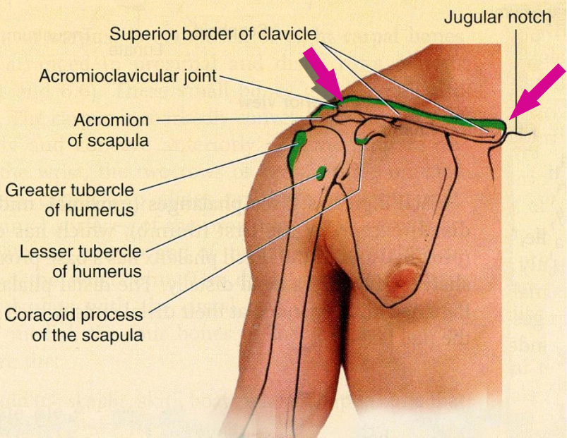
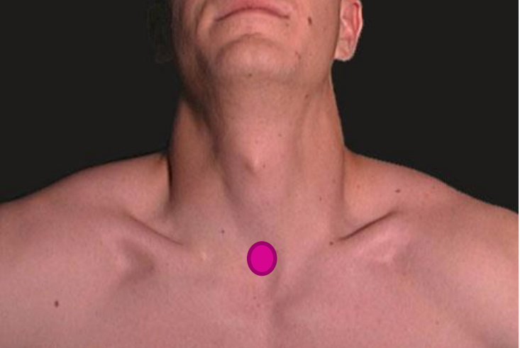
Surface anatomy of upper limb :
1
Clavicle :
● is subcutaneous and can be palpated throughout its length.
●Its sternal end projects little above the manubrium.
● Between the 2 sternal ends of the 2 clavicle lies the jugular notch (suprasternal notch).
● The acromial end of the clavicle :
palpated medial to the lateral border of the acromion of the scapula. (particularly when the shoulder is alternately raised and depressed.)
The large vessels and nerves to the upper limb pass posterior to the middle (convexity) of the clavicle.

Slide 7
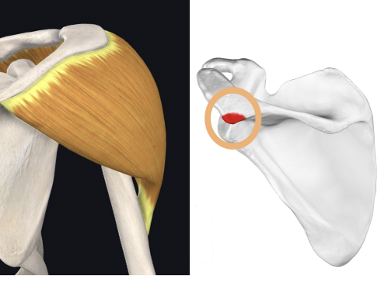
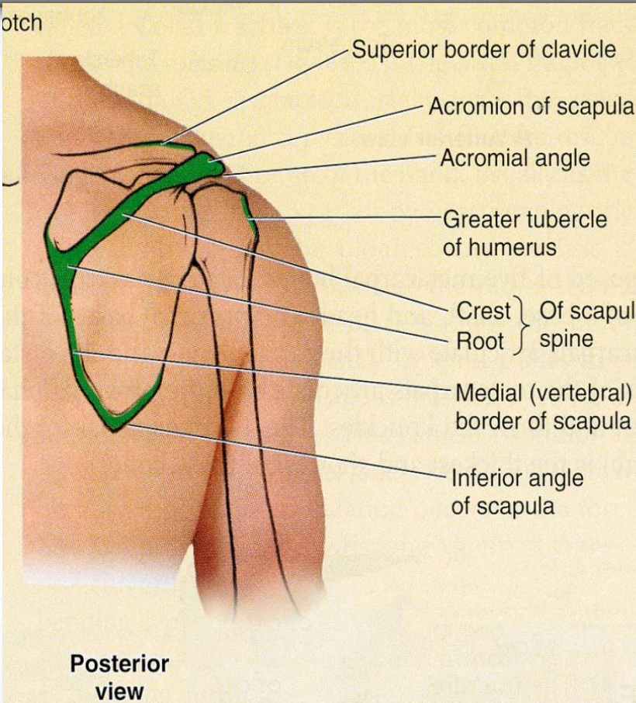
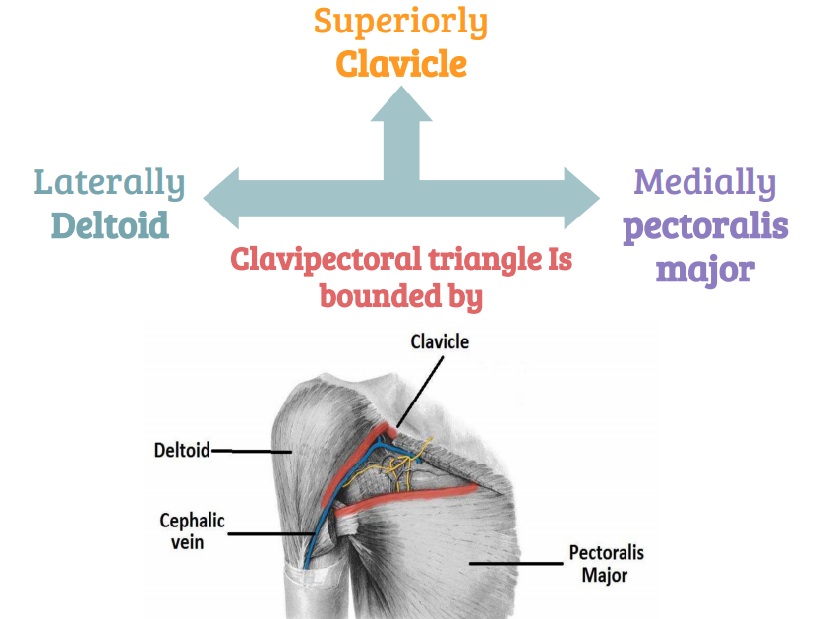
2
Scapula :
3
Deltopectoral groove :
The coracoid process of scapula can be felt deeply below the lateral one third of the clavicle in the Deltopectoral GROOVE or clavipectoral triangle.
The clavipectoral or the (Deltopectoral) triangle is the slightly depressed area just inferior to the lateral third of clavicle.
The lateral and posterior borders of the acromion meet to form the acromial angle. Supraspinatus tear change this angle
Inferior to the acromion, the deltoid muscle forms the rounded contour of the shoulder
The Clavipectoral triangle is bounded by the :
1.Superiorly:
clavicle
2.Laterally:
deltoid
3.Medially: pectoralis major

Slide 8
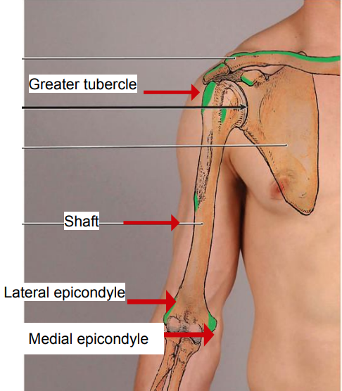
4
Humerus :
can be felt by deep palpation through the deltoid muscle,
inferior to the acromion when the arm is by the side.
In this position, the greater tubercle is the most lateral bony point of the shoulder.
greater tubercle
shaft
may be felt in different areas deep to muscles surrounding it.
medial and lateral epicondyles
palpated on the medial & lateral sides of the elbow.

Slide 9
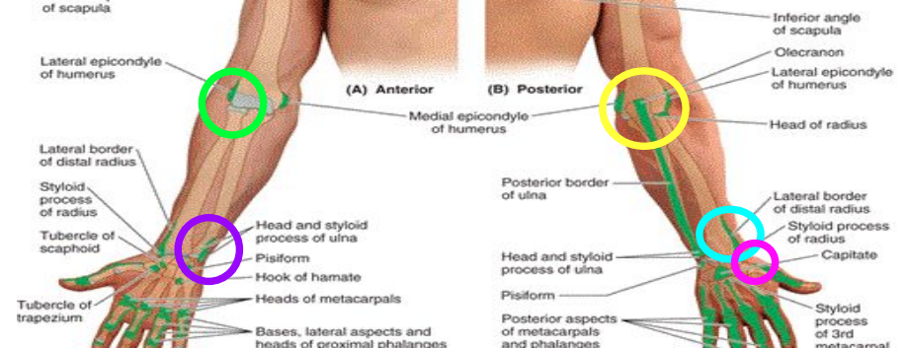
4
Ulna & Radius:
Ulna
Radius
The head of the ulna forms a rounded subcutaneous prominence that can be easily seen and palpated on the medial side of dorsal aspect of the wrist.
The pointed subcutaneous ulnar styloid process may be felt slightly distal to the head when the hand is supinated.
The olecranon and posterior border of the ulna lie subcutaneously and can be palpated easily
The head of radius can be palpated and felt to rotate in the depression on the posterolateral aspect of the extended elbow, just distal to the lateral epicondyle of the humerus with supination and pronation.
The radial styloid process can be palpated on the lateral side of the wrist in the anatomical snuff box.
It is approximately 1 cm distal to that of the ulna.

Slide 10
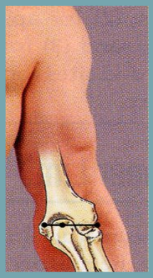
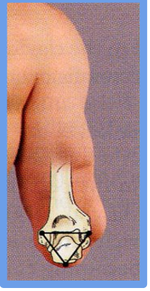
5
Elbow :
extended
flexed
the tip of the olecranon process, the medial and the lateral epicondyles lie
in a straight line.
the olecranon forms the apex of an equilateral triangle, where the epicondyles form the angles.
Fractures of any of these structures will disturbs this arrangement.

Slide 11
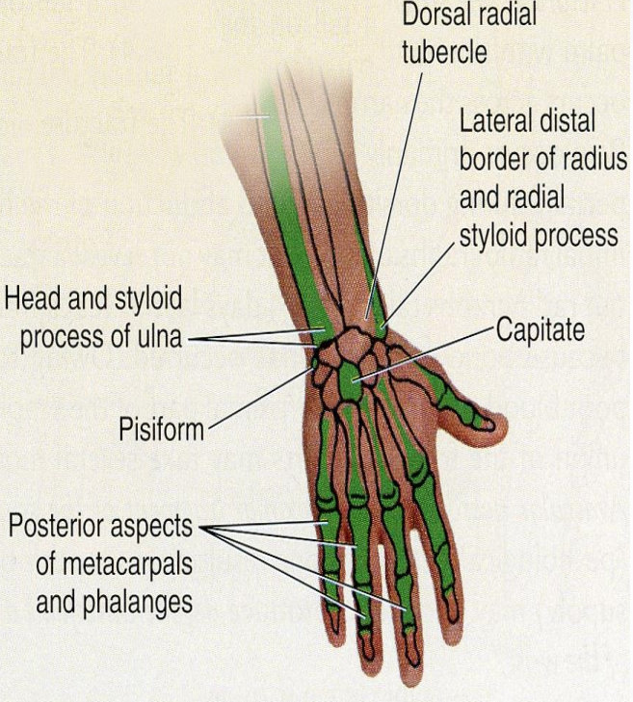
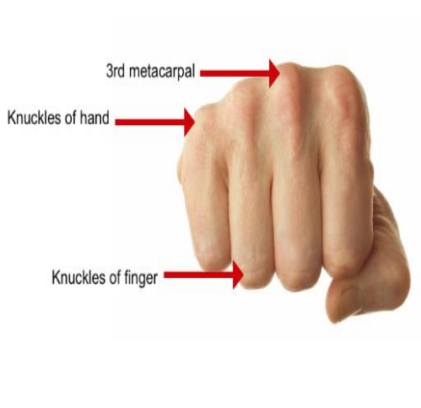
6
Hand :
The metacarpals, although they overlapped by the long extensor tendons of the fingers, they can be palpated on the dorsum of the hand.
The heads of the metacarpals form the knuckles of the hand.
Notice that the 3rd metacarpal head is the most projected.
The dorsal aspects of the phalanges can be easily palpated.
The knuckles of the fingers are formed by the heads of the proximal and middle phalanges.

Slide 12
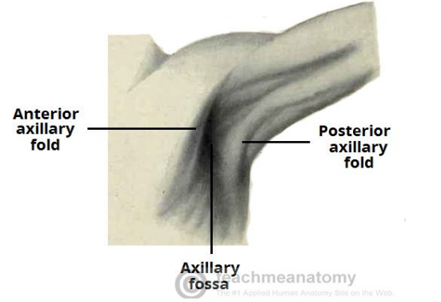
7
Axillary Folds:
Anterior
The anterior axillary folds is formed by the lower margin of the pectoralis major, and can be palpated by the finger.
This can be made by asking the patient to press the hand against the ipsilateral hip.
Posterior
The posterior axillary fold is formed by the tendon of latissimus dorsi & teres major.

Slide 13
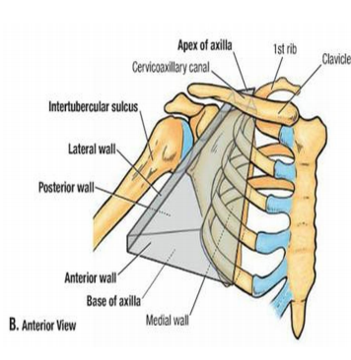
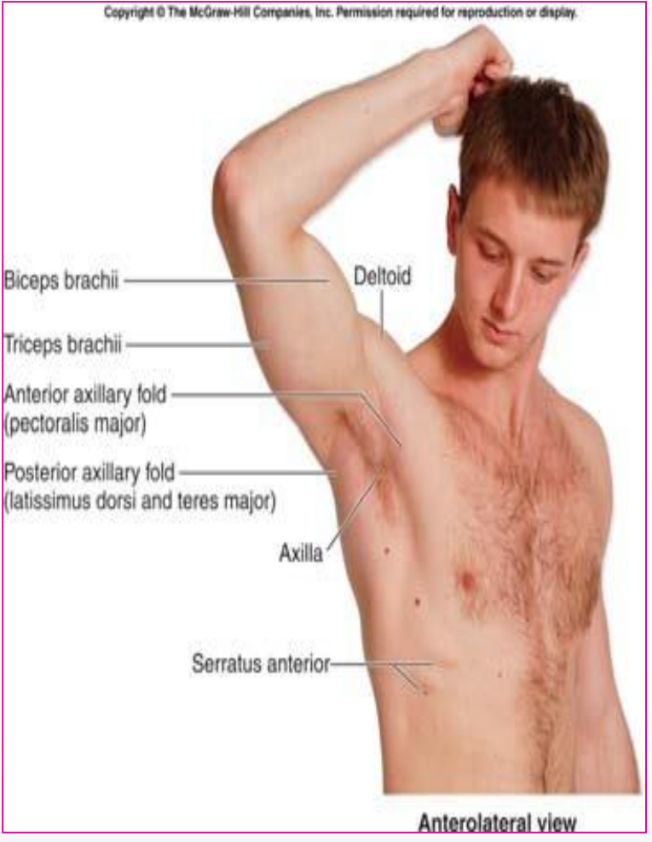
8
Axilla :
When the arm by the side, the inferior part of the head of the humerus can be easily palpated through the floor of the axilla.
Pulsations of the axillary artery can be felt high up in the axilla, and around the artery the cords of the brachial plexus.
The medial wall of the axilla is formed by the upper ribs covered by serratus anterior.
• The lateral wall is formed by biceps brachii, coracobrachialis and the bicipital groove.

Slide 14
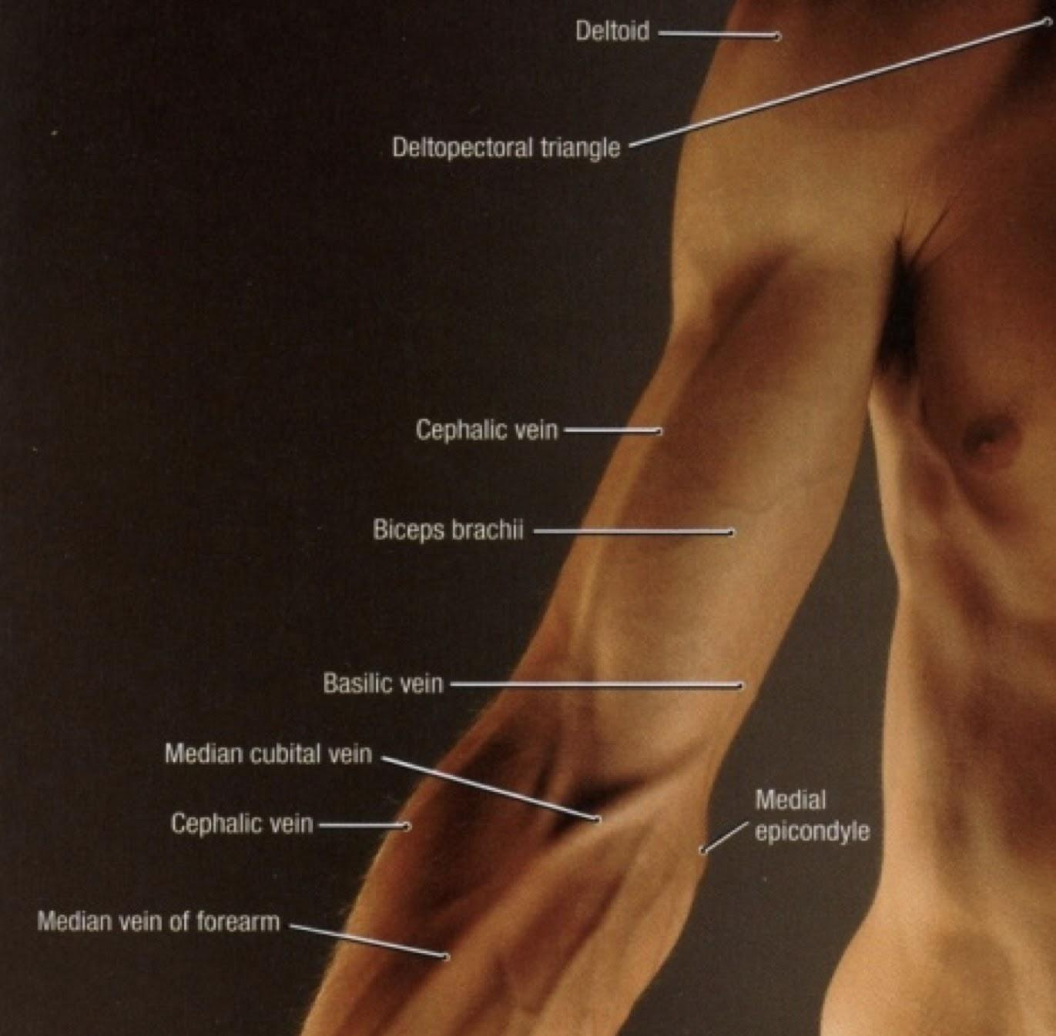
Muscles:
9
1.Deltoid: (shoulder): The borders are visible when the arm is abducted against resistance. • The distal attachment of the deltoid can be palpated on the lateral surface of the humerus. 2.Muscles of the arm: Biceps brachii & triceps brachii form bulge on the anterior and posterior surfaces of the arm: The triceps tendon can be palpated where it is attached to the olecranon process. “Posteriorly” The biceps tendon can be palpated in the cubital fossa, just lateral to the midline. “Anteriorly”

Slide 15
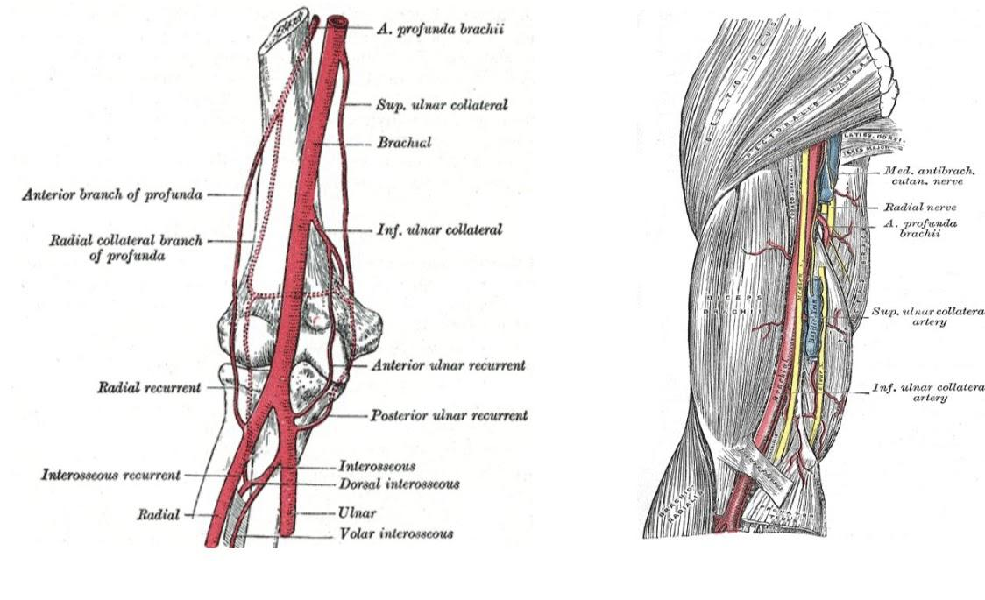
Veins :
11
10
Brachial artery :
There are 2 grooves that separate the bulges formed by the biceps and triceps:. (Medial and lateral grooves) 1-The cephalic vein ascends superiorly in the lateral groove. 2-The basilic vein ascends in the medial groove. | The brachial artery can be felt pulsating deep to the medial border of the biceps. To stop bleeding by pressure on the artery: - in the upper half of the arm it is pushed laterally against the humerus. -In the lower half it is pushed posteriorly. -In the cubital fossa, it lies beneath the bicipital aponeurosis.

Slide 16
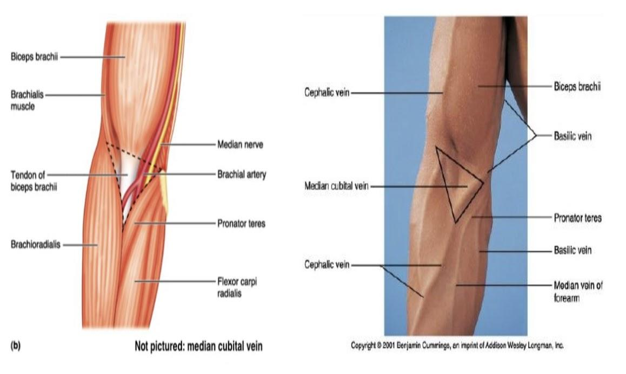
12
Cubital fossa :
Consists of : 1.Cephalic vein 2.Basilic vein 3.Median cubital vein are clearly visible. *The median cubital vein connects the cephalic and the basilic veins • It crosses over the bicipital aponeurosis. • It is the vein of choice for IV line, WHY? Venipuncture and Transfusion Because it has a wide lumen and is clearly visible in the cubital fossa. It is also more stationary and not surrounded by nerves.

Slide 17
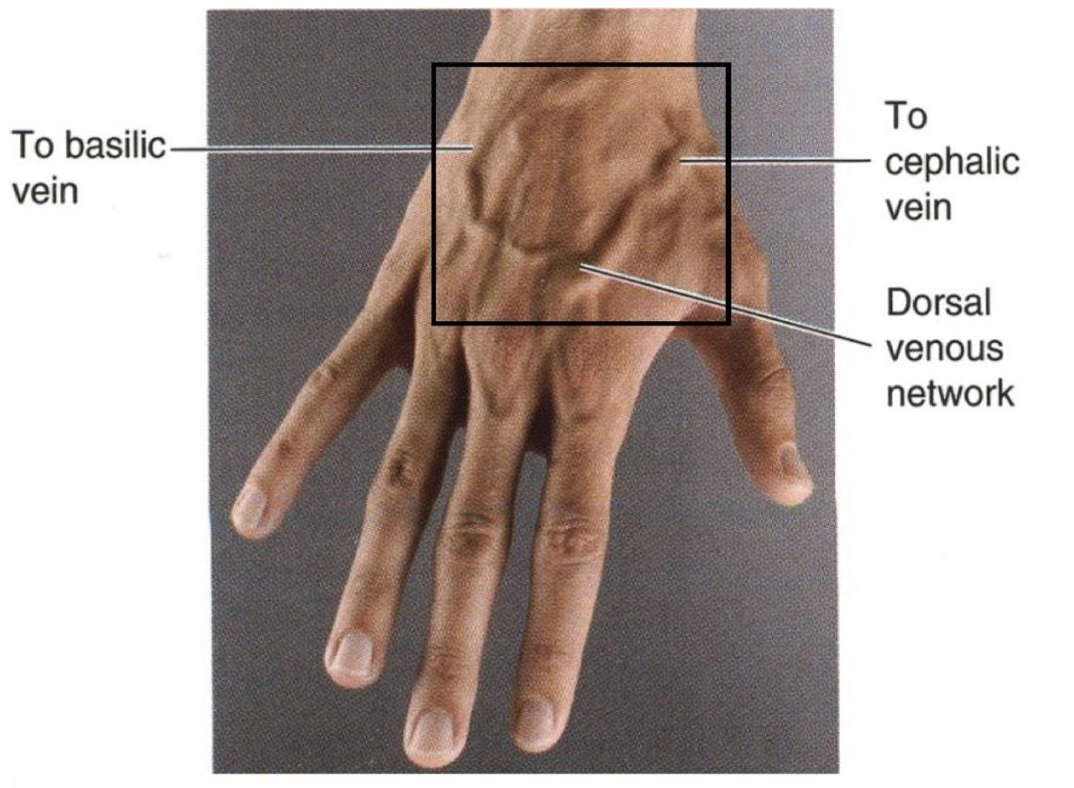
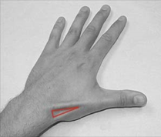
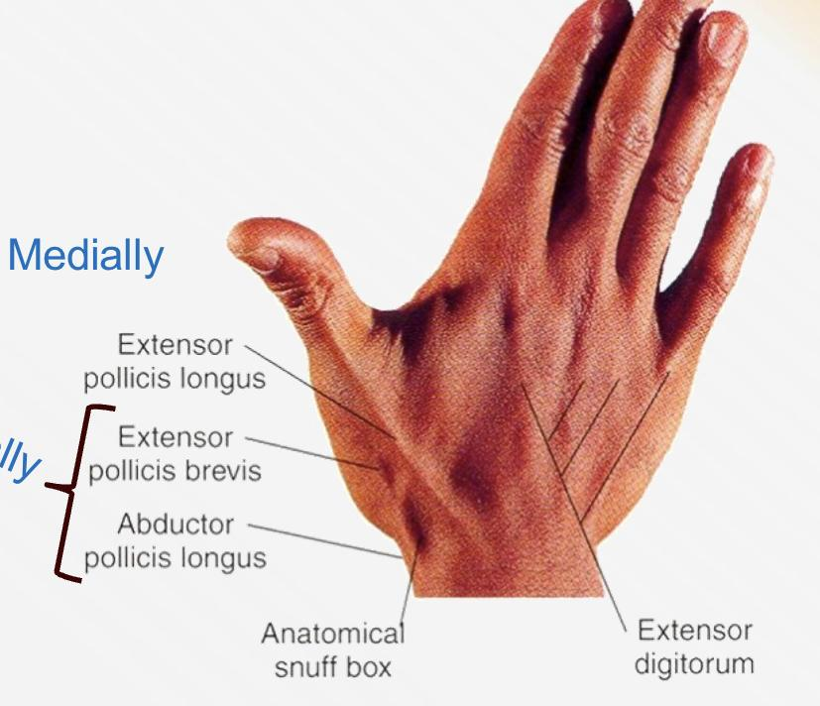
13
14
Hand dorsum :
Snuff box :
The dorsal venous network: The network of superficial veins can be seen on the dorsum of the hand. The network drains upward into the cephalic vein laterally, and the basilic vein medially. The tendons of extensor digitorum, extensor indicis, and extensor digiti minimi can be seen and felt as you extends your fingers. | It is a depression on the lateral aspect of the wrist joint which is accentuated when you extends your thumb. Boundaries: Laterally by 2 tendons: ● Abductor pollicis longus. ● Extensor pollicis brevis. Medially: ● Extensor pollicis longus. The Floor: In its proximal part the radial styloid process is palpable. The scaphoid bone is also palpable in the distal part of the anatomical snuff box.
Laterally

Slide 18
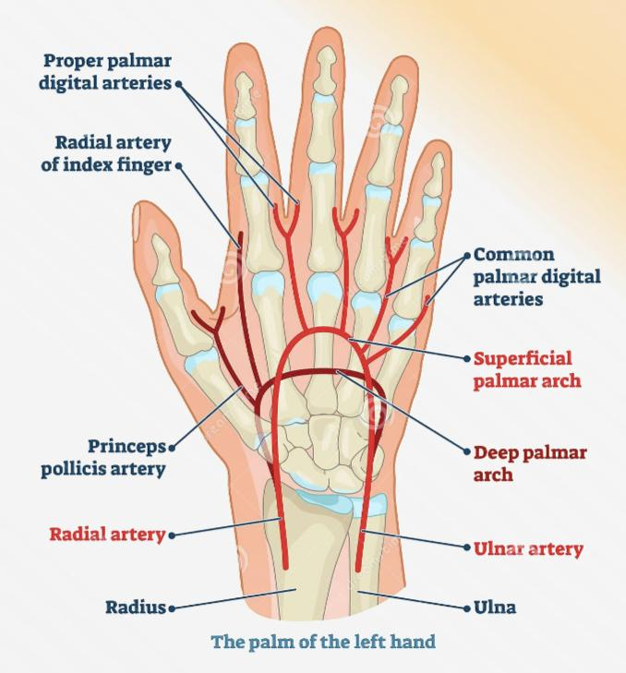
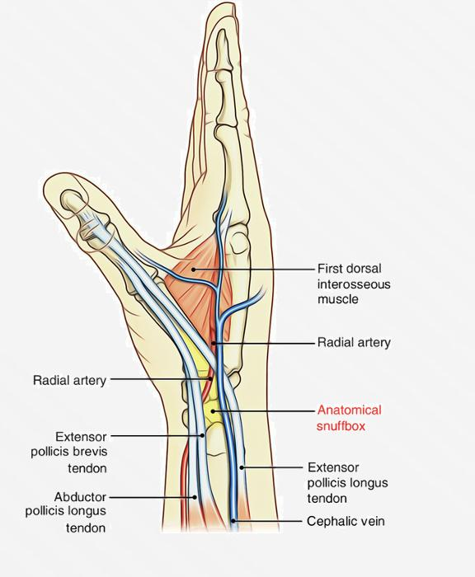
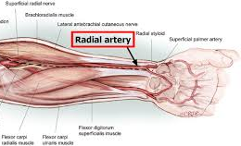
15 Radial artery:
16 Palmar A.arch:
The Radial artery can be drawn by a line extends from the midpoint of the cubital fossa to the base of the styloid process of radius. Radial Artery pulsation: Universally, its pulsations can easily be felt anterior to the distal third of radius. Here it lies just beneath the skin and fascia lateral to the tendon of flexor carpi radialis. Radial artery pulsation can be felt against the floor of the snuff box. More superficially, the anatomical snuff box is crossed by: The cephalic vein. The radial nerve. | Superficial Palmar Arterial arch: The superficial palmar arterial arch is located in the central part of the palm and lies on a line drawn across the palm at the level of the distal border of the fully extended thumb. Deep Palmar Arterial Arch: -The deep palmar arterial arch is also located in the central part of the palm (proximal to the superficial one), -lies on a line drawn across the palm at the level of the proximal border of the fully extended thumb.

Slide 19
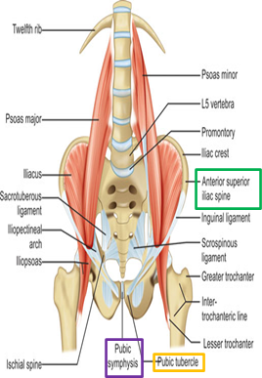
Surface anatomy of lower limb :
1 Inguinal region:
All of the following structures are palpable in the inguinal region: 1. Symphysis pubis. 2. Body of pubis. 3. Pubic tubercle. 4. ASIS. (Anterior Superior Iliac Spine) -The inguinal ligament extends between: The Pubic tubercle and The ASIS. -In the mid-inguinal point : -it is a point on the inguinal ligament midway between the symphysis pubis and ASIS -here you can feel the pulsations of the femoral artery. .The femoral artery is an important site for vascular access as a large number of arteriographic procedures are undertaken through its percutaneous puncture, (e.g. coronary angiography) . .The femoral vein lies on the medial side of the artery. While the femoral nerve lies lateral to the artery.

Slide 20
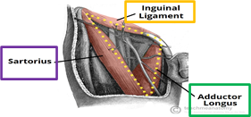
2 Femoral triangle:
3 Knee region:
The femoral triangle can be seen as a depression below the fold of the groin in the upper part of the thigh. In a thin, muscular subject: ●the boundaries of the triangle can be identified when the thigh is flexed, abducted, and laterally rotated. ● The base of the triangle is formed by the inguinal ligament, ● the lateral border by the sartorius and ● the medial border by the adductor longus ● The iliac crest is subcutaneous and can be palpated throughout its length, from the ASIS to the PSIS. ● The greater trochanter of the femur is also subcutaneous and can be palpated on the lateral aspect of the hip joint behind and below to the ASIS. | In the back of the knee and leg try to palpate: 1. The boundaries of the popliteal fossa 2. The pulsation of the popliteal artery which is deeply situated in the fossa. In front of the knee joint the patella and the ligamentum patellae can be easily palpated. 1. The ligamentum patellae can be traced downward as it is attached to the tibial tuberosity. 2. The condyles of the femur and tibia can be recognized on the sides of the knee and the joint line can be identified between them On the medial aspect of the knee Joint try to palpate: 1. Medial femoral condyle 2. Medial tibial condyle 3. The 3 tendons of: ● Sartorius ● Gracilis ● Semitendinosus. On the lateral aspect of the knee Joint try to palpate: 1. Lateral femoral condyle 2. Lateral tibial condyle 3. Head of the fibula 4. Neck of the fibula 5. Tendon of biceps femoris

Slide 21
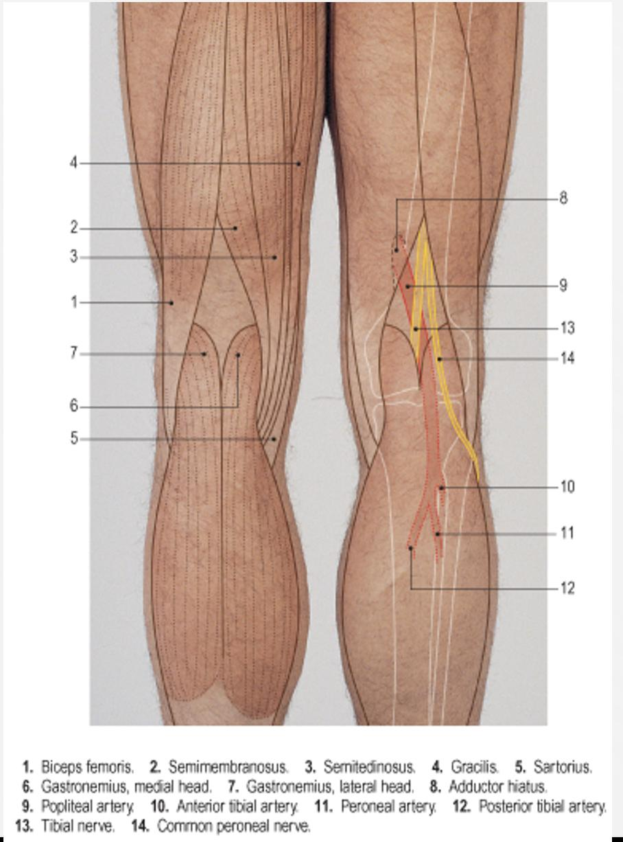
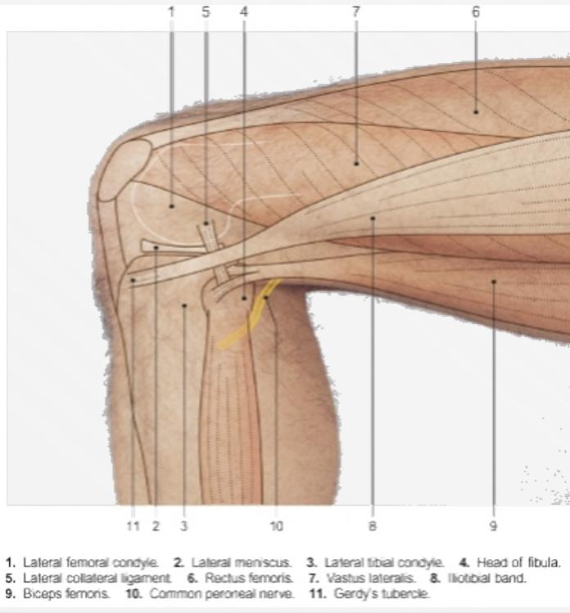
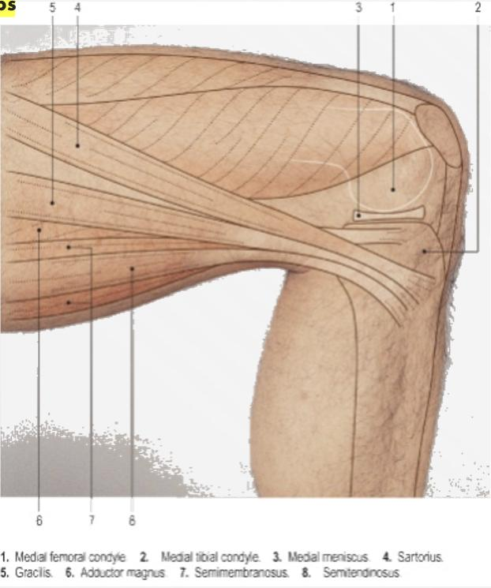
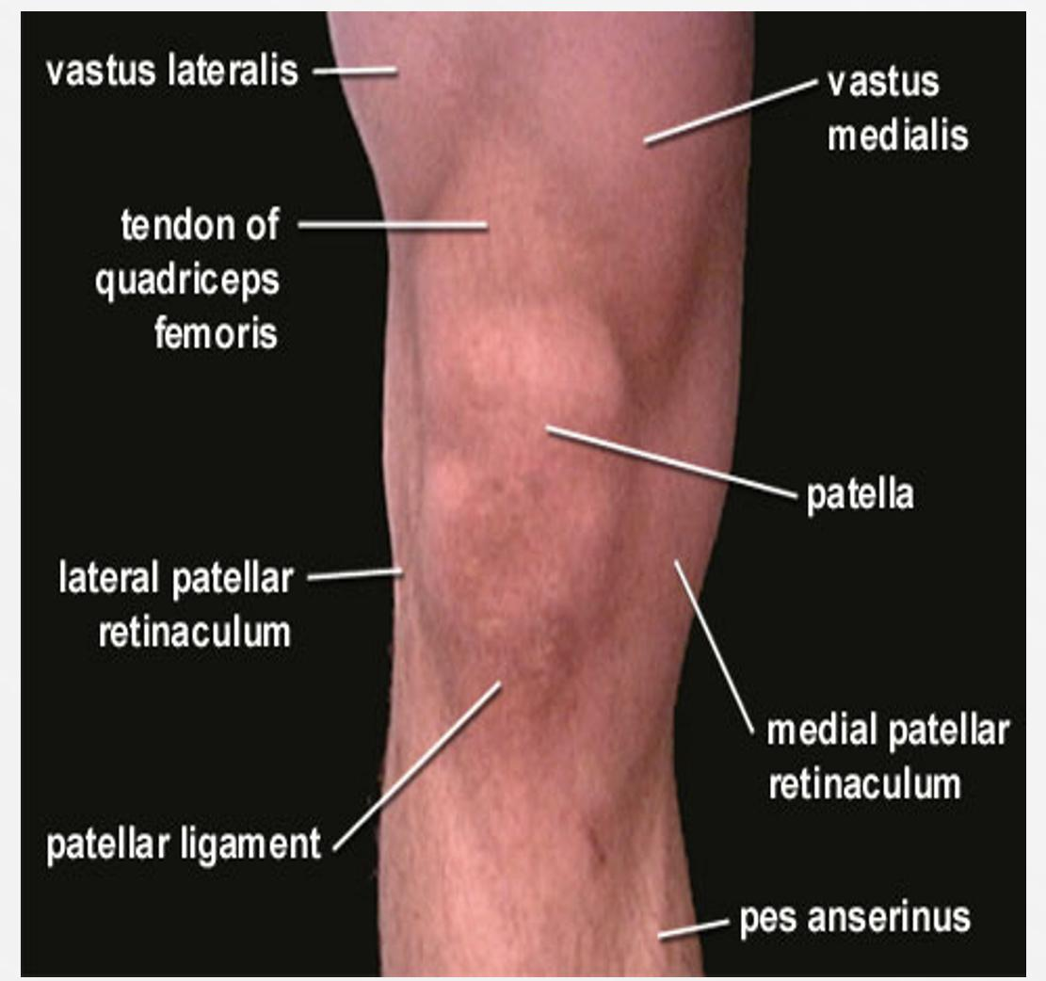
3 Knee region:
MEDIAL ASPECT
KNEE REGION
LATERAL ASPECT
BACK OK KNEE AND LEG

Slide 22
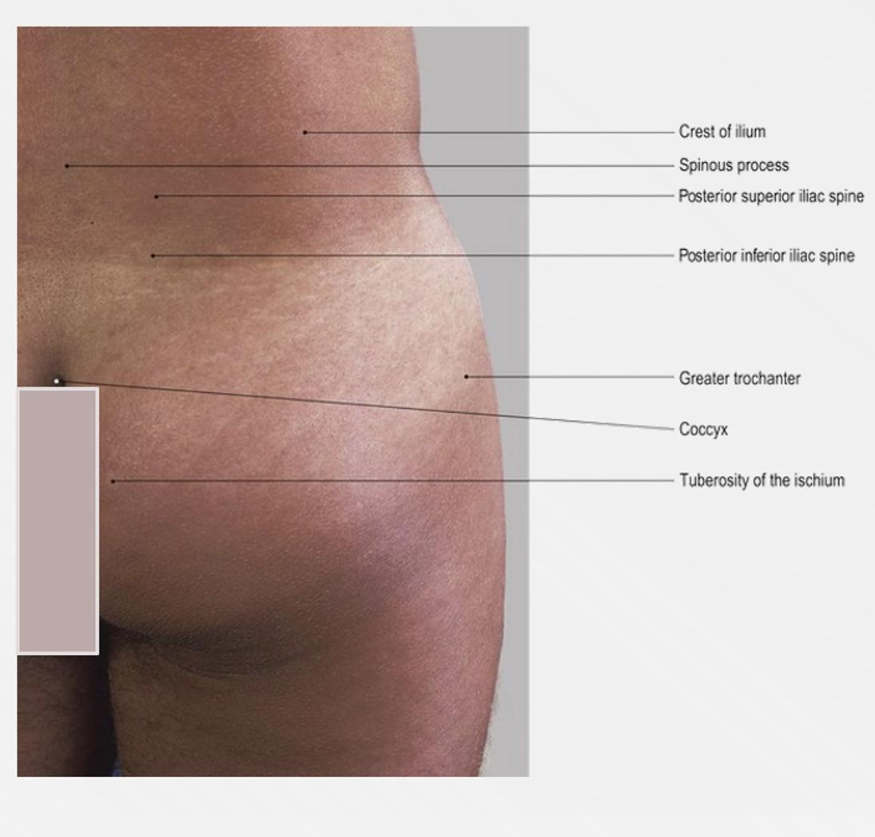
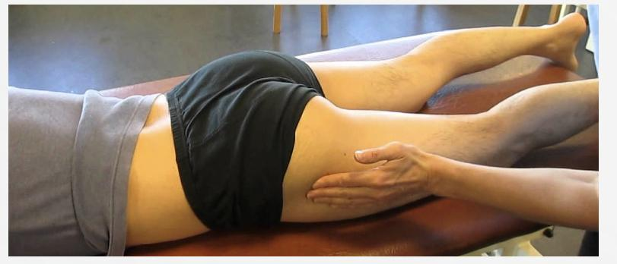
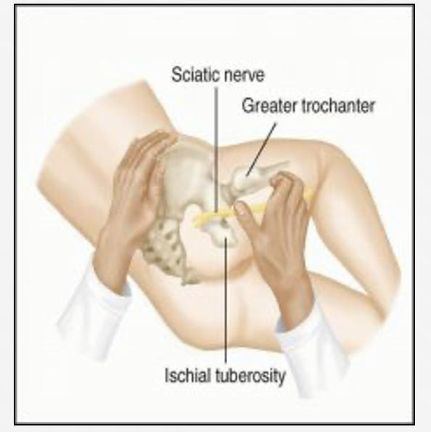
BOYS SLIDES ONLY
4 iliac crest
The iliac crest is subcutaneous and can be palpated throughout its length, from the ASIS to the PSIS.
The Greater trochanter of the femur is also subcutaneous and can be palpated on the lateral aspect of the hip joint behind and below to the ASIS
The greater trochanter of the femur lies a hand’s breadth below the iliac crest; it is best palpated with the hip abducted so that the overlying hip abductors (tensor fasciae latae and gluteus medius and minimus) are relaxed.
in the very thin, wasted patient the greater trochanter may be seen as a prominent bulge and its overlying skin is a common site for a pressure sore to form in such a case.
The ischial tuberosity is covered by gluteus maximus when oe strands, in sitting position, however , the muscle slips away laterally so that weight is taken directly on the bone, to palpate this bony point, therefore, feel for it uncovered by gluteus maximus in the flexed position of the hip.

Slide 23
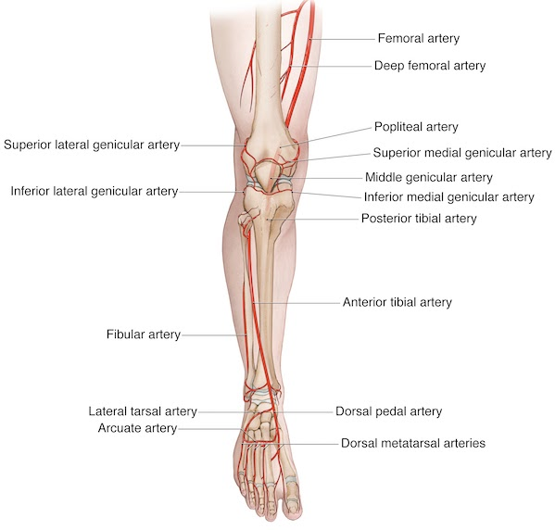
5 Leg & Foot:
On the anterior aspect of the leg and knee Joint and try to palpate: 1. The patella 2. The tibial tuberosity 3. The anterior border of the tibia, (shine) 4. The medial tibial condyle 5. The medial surface of the tibia 6. The medial malleolus 7. The lateral malleolus . On the dorsum of the foot try to palpate: 1. The tuberosity of the 5th metatarsal 2, The metatarsals

Slide 24
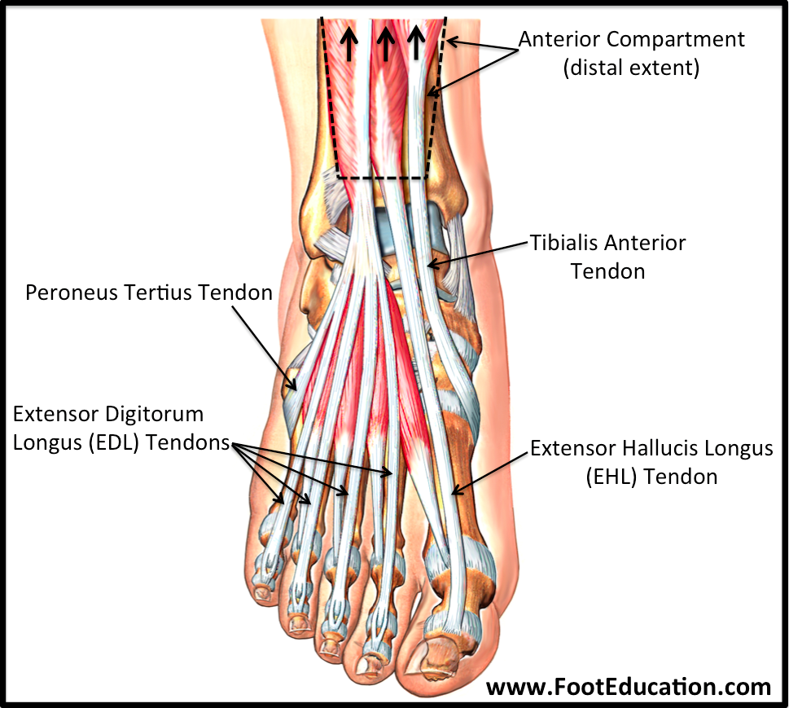
6 Leg and knee:
On the lateral aspect of the leg try to palpate: 1. The tendons of peroneus longus and brevis 2. The tendon Achilles 3. The lateral malleolus On the Medial aspect of the ankle try to palpate and feel: 1. The medial malleolus 2. The tendons of tibialis posterior 3. The tendon of flexor digitorum longus 4. The posterior tibial artery. 5. The calcaneus. On the dorsum of the foot try to palpate: The long extensor tendons: 1. Tibialis anterior 2. Extensor hallucis longus. 3. Extensor digitorum longus. 4. Peroneus tertius (Tom has a very nice dog pig) Also, try to feel the pulsation of the dorsalis pedis artery. Between the tendons of extensor hallucis longus & extensor digitorum longus.

Slide 25
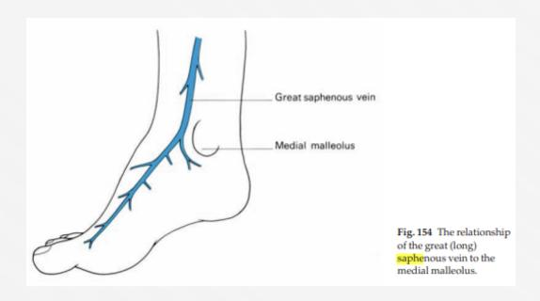
BOYS SLIDES ONLY
On the Medial Aspect of the ankle try to palpate and feel:
-The Great (Or Long) Saphenous Vein
arises from the medial side of the dorsal network of venus
passes upwards in front of the medial malleolus
enter the femoral vein in the groin, one inch below the inguinal ligament and immediately medial to the femoral pulse
From the practical point of view, The position of the long saphenous vein immediately in front of the medial malleolus is perhaps the most important single anatomical relationship; no matter how collapsed or obese , or how young and tiny the patient , the vein can be relied upon to be available at this site when urgently required for transfusion purposes

Slide 26
MCQs:
Q1
The clavipectoral triangle is medially bound by :
A
Clavicle
B
Deltoid
C
Pectoralis Major
D
Pectoralis Minor
Q2
Which of the following structures make up the knuckle of the hand?
A
Head of proximal phalanges
B
Head of distal phalanges
C
Head of metacarpals
D
Base of metacarpals
Q3
Which one of the following muscles makes the anterior axillary fold?
A
Teres major
B
Pectoralis major
C
Teres minor
D
Pectoralis minor
Q4
The pulsation of which of the following arteries can be felt in the snuff box?
A
Brachial artery
B
Femoral Artery
C
Radial Artery
D
Ulnar Artery
Q1:C Q2:C Q3:B Q4:C

Slide 27
MCQs:
Which vein ascend superiorly in the lateral groove ?
Q5
A
B
C
D
Cephalic vein
Basilic vein. Both None.
Which artery can be felt pulsating medial to biceps tendon ?
Q6
A
B
C
D
Radial artery Brachial artery. Axillary artery. Cephalic artery.
The cubital fossa consists of all the following except:
Q7
A
B
C
D
Lateral cubital vein. Median cubital vein Basilic vein. Cephalic vein.
Q5:B Q6:B Q7:A

Slide 28
Done by the amazing team
Team leaders:
Arwa Alghamdi
Deema Aljuribah
Razan Alnufaie
Team leaders:
Mishal Alsuwayegh
Mohammed Alghamdi
Members:
Members:
Aljazi Albabtain
Atheer Alkanhal
Arob Alasheikh
Ajwan Aljohani
Deema alqahtani
Dena Alsuhaibani
Jana Alhazmi
Kadi aldosari
Mashael Alasmari
Noura Bin hammad
Najla aldhbiban
Razan alasmari
Roaa alharbi
Raghad Mohammed
Shaden albassam
Waha Almathami
Walaa AlMutawa
Yara Ameer Alalwan
Othman Aldraihem
Faisal Alomar
Abdullah Alturki
Othman Alabdullah
Omar Alkadhi
Abdullah Ali
Meshari Alshathri
Yazeed Alsanad
Fahd Mobaireek
Emad Almutairi
Nasser Alghaith
Saad Almogren
Azzam Abdullah Alotaibi
Hassan Ali Alabdullatif
Rayan Alotaibi
Mohammed Aljarba
Mohammed Fahad
Mohammed Majed
Abdulkarim Salman
Saleh Aldeligan
Thanks to Faisal Alomar for his design of the team logo
anatomyteam442@gmail.com

